Slide 1
CLINICAL TRIAL OPERATIONS
TRIALGUARD
TEAM / WHO BUILT IT
ARCHITECT
Jason David Moses S.
Intelligent trial operations, built for the work between the events.
Overall system architecture, backend integration, technical decisions, and end-to-end engineering direction.
ENGINEERING SUPPORT
Rules decide. AI assists. Humans approve.
Muralidharan I.
Engineering a reliable bridge between clinical evidence, operational follow-up,
and human decision-making.
Implementation support, integration, debugging, and cross-component development.
ML ENGINEER
Nandhini M.
UNPROMPTABLES
AI/ML pipeline, model integration, investigation intelligence, and model evaluation.
PANIMALAR ENGINEERING COLLEGE · COMPUTER SCIENCE & ENGINEERING
JASON DAVID MOSES S · MONICA S
MURALIDHARAN I · NANDHINI M
UI/UX & PRODUCT DESIGN
Monica S.
Product design, user experience, visual system, and frontend presentation.
TG
Synthetic demonstration data · Research prototype
01

Slide 2
02 · SOLUTION
FROM MISSED EVIDENCE
TO CLOSED-LOOP ACTION.
Trial teams don't just need to know what is missing — they need to know what must
happen next, who must act, whether it was answered, and when it is actually resolved.
THE LOOP / WHAT ACTUALLY RUNS
01
RULES DECIDE
DETECT
The deterministic engine owns every clinical verdict. UNKNOWN is a finding, never a gap to fill.
Clinical & trial data · Evidence + screening · UNKNOWN found
obligation raised
02
AI ASSISTS
INVESTIGATE
Evidence pack assembled · AI investigation · Draft written
The model assembles evidence and drafts prose. It holds no field capable of a verdict.
proposed action
ACT
03
HUMANS APPROVE
Researcher approves · Gmail / WhatsApp / In-App · Sent + logged
Nothing external is sent without an approval record. There is no second path.
approved & sent
RESOLVE
Response tracked · New evidence re-screened · Obligation closed
Detection becomes work — owned, evidenced, approved, tracked, and closed by real evidence.
02

Slide 3
03 · ARCHITECTURE
THREE LAYERS. ONE CONTROLLED ACTION.
Deterministic core owns truth. | AI investigation drafts. | The researcher authorises.
DETERMINISTIC CORE
RESEARCHER APPROVAL
LAYER 1
Protocol rules & screening · Obligation lifecycle
Deduplication by natural key · Priority & routing
The only path to an
external action.
AI INVESTIGATION
Approve · Edit · Reject
LAYER 2
Local Ollama · Qwen3.5:9B · Hosted model
Template fallback — the floor · Schema-validated output
AI cannot mutate clinical state or send an external communication.
PERSISTENCE & DELIVERY
LAYER 3
PostgreSQL / Supabase · Follow-Up Ledger · Timeline
Gmail PRIMARY · WhatsApp SECONDARY · In-App
VERIFICATION
Gmail outbound
LIVE VERIFIED
Local Qwen / Ollama
LIVE VERIFIED
Hosted model
LIVE VERIFIED
WhatsApp
IMPLEMENTED
WhatsApp is implemented and tested; live delivery depends on Meta Cloud API account configuration.
Deterministic truth + AI reasoning + human approval = safe automation.
03
FastAPI · React/TypeScript · PostgreSQL · SQLAlchemy · Alembic · Ollama · Qwen3.5:9B · Gemini · Gmail API · WhatsApp Cloud API

Slide 4
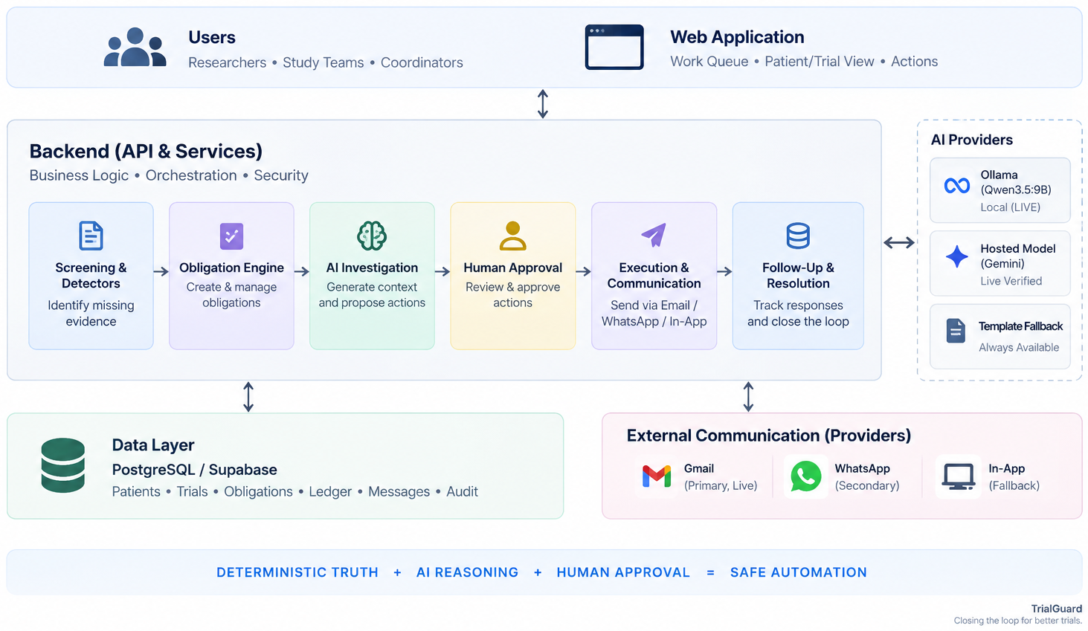
04 · SYSTEM ARCHITECTURE
THE SYSTEM, END TO END.
One workflow engine, one model abstraction, one delivery abstraction, one store.
04

Slide 5
05 · IMPACT
FROM MONITORING TO ACTION.
BEFORE
WITH TRIALGUARD
—
Data arrives
Evidence detected
—
Something is missing
Obligation created
—
Someone notices
Owner identified
AI-assisted investigation
—
Email / message
Human-approved action
—
Manual follow-up
Communication sent
—
Spreadsheet / memory
Response tracked
—
Unclear resolution
Evidence verified
Resolved
01
02
03
04
05
6/6
4/4
1
0
0 ms
investigation scenarios grounded & schema-valid
inbound responses classified deterministically
injection vulnerability found & fixed
leaks after remediation, regression-tested
template floor — loop runs with no AI
A persistent, auditable follow-up history — that closes itself only on real evidence.
05

Slide 6
06 · WHY IT MATTERS
BUSINESS VALUE → DEPLOYMENT → NEXT
01
02
03
BUSINESS VALUE
DEPLOYMENT-READY
ROADMAP — NOT BUILT
Less follow-up overhead
Provider-agnostic AI
—
Authentication + row-level security
Missing evidence becomes an owned obligation with a clear next action.
Local Qwen3.5:9B, hosted Gemini and a deterministic template floor — one abstraction.
—
Richer inbound response triage
Nothing disappears
Provider-agnostic comms
—
Expanded communication channels
One ledger records detection, investigation, approval, message, response, resolution.
Gmail primary, WhatsApp secondary, In-App — one delivery abstraction.
—
Stronger response intelligence
Faster coordinators
Persistent operational core
—
Protocol / amendment intelligence
AI investigates the evidence and drafts the action. Humans approve it.
PostgreSQL / Supabase. Indexed lifecycle, ledger, inbound, transactional execution.
—
Broader trial operations analytics
Real operational visibility
AI assists. Rules decide.
Humans approve.
A work queue and population view replace memory, inboxes and spreadsheets.
—
Improved model evaluation
TG
TRIALGUARD DOESN'T JUST DETECT WHAT IS MISSING.
IT CLOSES THE OPERATIONAL LOOP.
06

