Slide 1
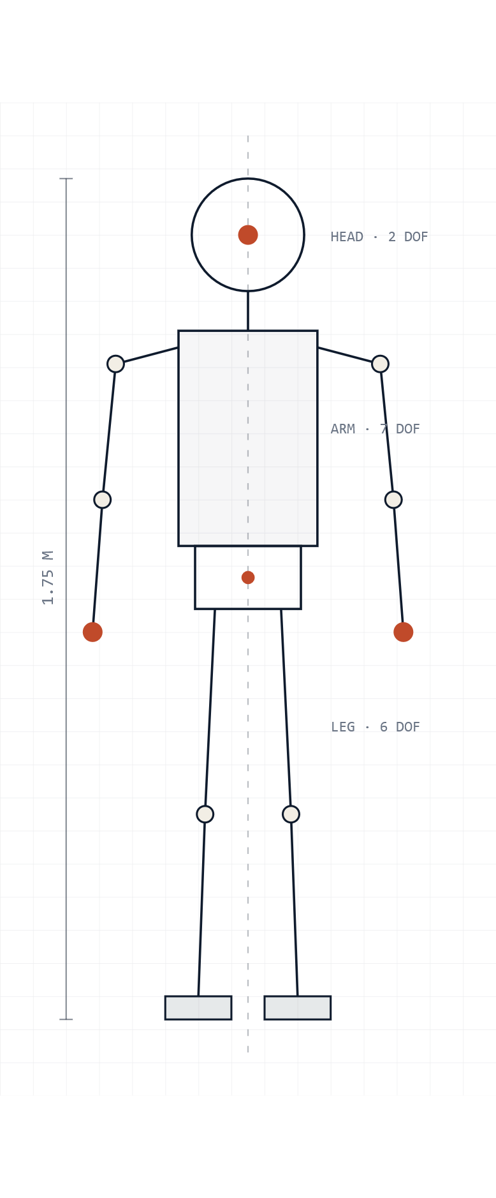
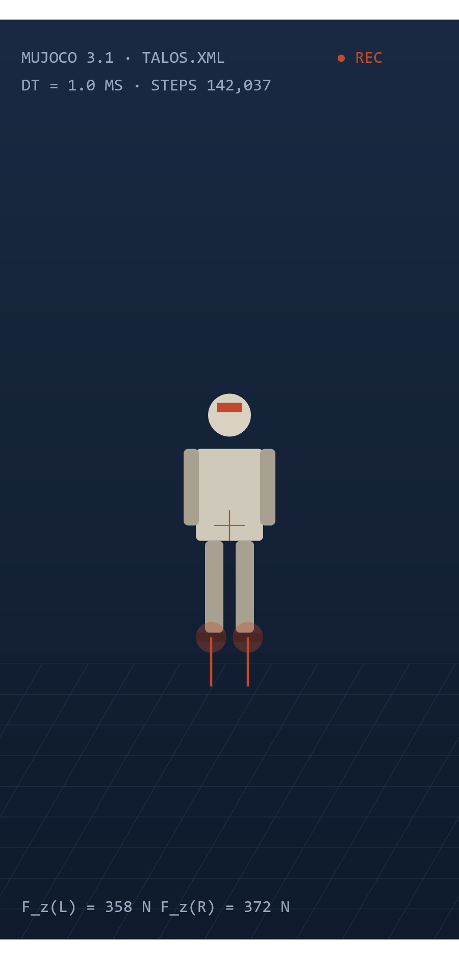
COVER
MASTER'S THESIS · PROGRESS MEETING · 05 MAY 2026
Whole-Body Control for Humanoid Robots.
A simulation-first foundation.
CANDIDATE
SUPERVISION
David Mazé
DR Gilbert Tang
Pr Phil Webb
DEPARTMENT
SUBMISSION
Cranfield University
26 August 2026
Robotics MSc
T − 16 weeks
FIG. 0 — TALOS · 32 DOF
MUJOCO · 1 KHZ
Original title — "Development & Simulation of a Whole-Body Control Framework for a Humanoid Robot"
05 · MAY · 2026
01/18

Slide 2
SECTION 1 · CONTEXT
01 · PROGRAMMATIC CONTEXT
·
5-YEAR STRATEGIC PLAN
The 5-year humanoid robotics program.
This thesis is thefirst academic output of a long-term institutional program — so generality and reproducibility are the primary design constraints.
▼ WE ARE HERE
2026
2027
2028
2029
2030
Year 1
Year 2
Year 3
Year 4
Year 5
Theoretical foundations
Simulation maturity
Hardware integration
First prototypes
Autonomous humanoid
Extended scenarios, sim-to-real preparation, second-generation control.
Acquisition of TALOS-class hardware, first physical experiments.
Closed-loop control on real hardware, on-board perception, manipulation.
Integrated whole-body autonomy in unstructured environments.
Literature, control formulation, simulation framework, evaluation protocol.
No physical hardware exists yet. Every decision made now must beforward-compatible — we are building the foundations the next researchers will inherit.
05 · MAY · 2026
02/18

Slide 3
SECTION 1 · CONTEXT
02 · POSITION IN THE PROGRAM
·
THE BRIDGE LAYER
Where this thesis fits.
L3 · YEAR 5
Autonomous humanoid system
MANDATORY FRAMEWORK PROPERTIES
01
Modular
Integrated cognition, perception, manipulation.
Components swap as the hardware program evolves — physics engine, dynamics library, even the planner itself.
L2 · YEAR 3–4
Hardware integration
02
Reproducible
Real TALOS · sim-to-real transfer · on-board perception.
Every result reruns from a single command. Seeds, configs and metrics are version-controlled alongside the code.
L1 · YEAR 1 · THIS THESIS
Simulation framework + evaluation protocol
03
Well-documented
Next researchers extend the framework — they do not restart it. README, tutorials, and inline derivations.
MPC + QP-WBC on TALOS in MuJoCo. Reproducible S1–S5 protocol. Open-source, modular, documented.
Without this floor, hardware work has nothing to build on.
05 · MAY · 2026
03/18

Slide 4
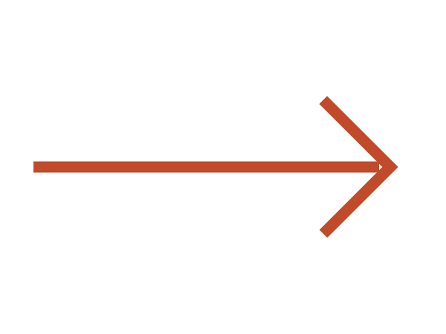
SECTION 2 · PROBLEM
03 · REFINING THE PROBLEM
·
FROM TOPIC TO QUESTION
From broad topic to a precise research question.
ORIGINAL TOPIC
REFINED RESEARCH QUESTION
"Development & simulation of a whole-body control model for a humanoid robot."
Can atwo-layer MPC + QP-WBC framework, implemented on TALOS in MuJoCo , be rigorously evaluated through a reproducible scenario-based protocol — and serve as a reusable simulation foundation for future hardware integration?
WHY THIS IS NOT ENOUGH
×
Which whole-body control approach? (dozens exist)
×
Which humanoid? Which simulator?
×
What does success look like? How is it measured?
ARCHITECTURE
PLATFORM
MPC + QP-WBC two-layer hierarchy
TALOS robot · MuJoCo simulator
×
No evaluation criterion → no way to know if we succeeded.
EVALUATION
LONG-TERM GOAL
Reproducible S1–S5 protocol
Reusable foundation for the program
05 · MAY · 2026
04/18

Slide 5
SECTION 2 · PROBLEM
04 · STRATEGY
·
A DESIGN CHOICE, NOT A LIMITATION
Why "simulation-first" is the right strategy.
SIMULATION ENVIRONMENT
REAL HARDWARE (YEAR 3+)
COST
Negligible
ITERATION
Minutes
COST
€ 500k+
ITERATION
Days
REPEATABILITY
1.000
DAMAGE RISK
None
REPEATABILITY
Drift
DAMAGE RISK
High
Rapid iteration, parameter sweeps, and reproducible experiments without physical risk.
Expensive, unforgiving, and unavailable during early-stage research.
SIM-TO-REAL TRANSFER
Domain randomization & contact-model tuning bridge the gap. By design, only the hardware-interface layer changes when physical TALOS arrives — the MPC + QP-WBC stack is identical in sim and on real hardware.
A solved research problem for locomotion.
05 · MAY · 2026
05/18

Slide 6
SECTION 3 · LITERATURE
05 · STATE OF THE ART
·
40 YEARS · 3 PARADIGMS
Forty years of whole-body control.
QP / Task-Priority
MPC-Based
Learning-Based
Escande
2014
Khatib
2026 ▼
1987
1987→
Sleiman
2021
Sentis & Khatib
Wensing & Orin
2005
2013
2013→
Del Prete
2016
PolySim
2025
Koolen
Radosavovic
2016
2024
Romualdi
2022→
2023
ASAP
2025
1985
1995
2005
2015
2025
Each generation solves part of the problem — none subsumes the others. Our framework deliberately sits in the most-validated branch (model-based) while staying compatible with the newest one (learning-based).
05 · MAY · 2026
06/18

Slide 7
SECTION 3 · LITERATURE
06 · WHAT THE FIELD AGREES ON
·
FOUR INVARIANTS
Four points of consensus.
Across three paradigms and four decades, the community has converged on these — they are the non-negotiables our framework must respect.
01· CONSENSUS
ORIN ET AL. 2013
02· CONSENSUS
ESCANDE 2014 · DEL PRETE 2016
Centroidal dynamics suffice for planning.
Hierarchical QP is the dominant execution paradigm.
A 32-DoF body abstracts to a 6-DoF centroidal model for trajectory planning. Every major framework does this; full-body planning adds compute with no empirical benefit at control rates.
Strict task priority — "don't fall" beats "track the arm" — plus inequality constraints (joint limits, friction cones) make QP-WBC the industry-standard execution layer.
03· CONSENSUS
RIGHETTI 2013 · SAAB 2013
04· CONSENSUS
ASAP 2025 · POLYSIM 2025
Contact stability requires QP wrench distribution.
The sim-to-real gap persists for contact-rich tasks.
Whether the contact model is rigid or compliant, all serious WBC systems solve a QP to distribute forces across contacts and enforce friction-cone constraints.
Domain randomization handles flat-ground walking. Stair climbing and sustained-contact manipulation remain unsolved in simulation-to-hardware transfer.
05 · MAY · 2026
07/18

Slide 8
SECTION 3 · LITERATURE
07 · THE METHODOLOGICAL GAP
·
THE REPRODUCIBILITY CRISIS
The reproducibility problem in WBC.
You cannot compare papers because everyone uses a different robot, simulator, scenario and metric. This is the field's biggest unsolved methodologicalproblem.
0
CURRENT STATE OF WBC EVALUATION
PAPER
ROBOT
SIMULATOR
SCENARIO
METRIC
papers using the same robot + sim + scenario + metric set
Koolen 2016
Atlas
custom
Balance
ZMP margin
5
Sleiman 2021
ANYmal
RaiSim
Walking
CoT
different simulators across these 5 papers
Romualdi 2023
iCub
Gazebo
Push recovery
Recovery time
∅
ASAP 2025
Unitree H1
IsaacGym
Locomotion
RL reward
cross-paper benchmarks · comparison is impossible
PolySim 2025
?
multi
?
?
?= not reported · units inconsistent · scenarios non-standardized
Researchers can't tell if controller A isbetter than B — or justtested on an easier scenario.
05 · MAY · 2026
08/18

Slide 9
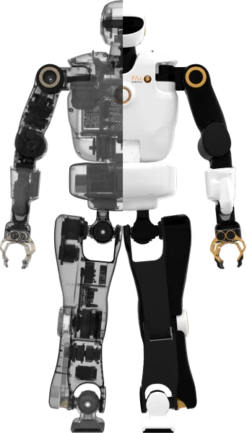
SECTION 4 · DECISIONS
DECISION 1 OF 4
·
THE ROBOT
TALOS — the only realistic, fully torque-controlled platform.
× REJECTED
× REJECTED
× REJECTED
✓ CHOSEN
Unitree H1/G1
Boston Dynamics Atlas
Custom simplified
TALOS · PAL Robotics
POSITION-CONTROLLED
CLOSED-SOURCE
TOY MODEL
32 DOF · TORQUE-CONTROLLED
+
Popular in RL
+
Industry benchmark
+
Quick to build
+
Open URDF
−
Not torque-controlled
−
No public URDF
−
Too abstract
+
Pinocchio-compatible
−
Limited dynamics access
−
Not reproducible
−
Not transferable
+
Used in WBC literature
+
Likely Year-3 platform
WHY TALOS
Full Pinocchio dynamic model · torque control compatible with QP-WBCand direct RL · community-validated in WBC papers · most likely starting point when university hardware arrives.
32 DOF
PAL ROBOTICS
05 · MAY · 2026
09/18

Slide 10
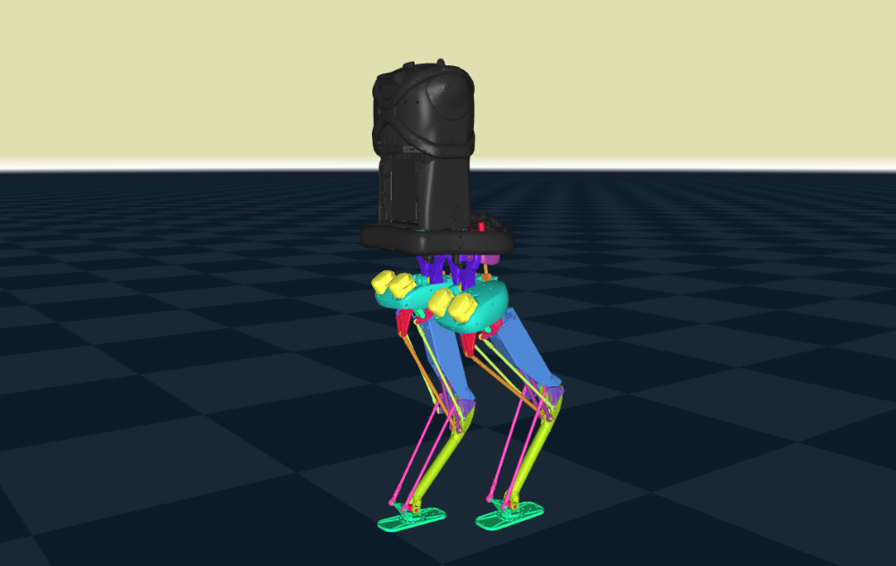
SECTION 4 · DECISIONS
DECISION 2 OF 4
·
THE SIMULATOR
MuJoCo — fastest, most accurate, most compatible.
BENCHMARK · NORMALIZED 0–100
MUJOCO VIEWPORT · 1 KHZ
Gazebo
35
60
75
Slower than real-time
PyBullet
70
30
80
Unreliable foot contacts
IsaacGym
95
75
60
NVIDIA license
MuJoCo ✓ CHOSEN
100
95
95
all green
SPEED
CONTACT ACCURACY
PYTHON API
WHY MUJOCO
< 1 ms
step time → enables 1 kHz control loop
2022
open-sourced by DeepMind · no license cost
3/3
Radosavovic · ASAP · HumanoidBench all use it
∂F/∂q
contact forces inspectable per timestep
05 · MAY · 2026
10/18

Slide 11
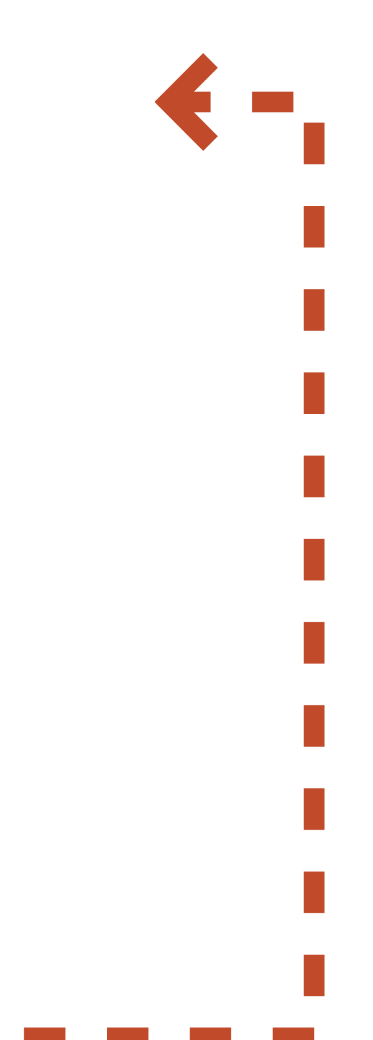

SECTION 4 · DECISIONS
DECISION 3 OF 4
·
THE CONTROL ARCHITECTURE
A two-layer hierarchy: theoretically grounded, real-time capable.
THREE OPTIONS · ONE VIABLE
TWO-LAYER CONTROL ARCHITECTURE
×
Pure QP-WBC
INPUT
Task references + state estimate
Reactive only · no predictive contact planning
GOALS · Q̂, Q̇̂
×
Pure MPC
Too slow at 1 kHz · joint limits hard
LAYER 1 · 100 HZ
Centroidal MPC
Crocoddyl
×
End-to-end RL
COM TRAJECTORY · CONTACT FORCE REFS
Data-hungry · black-box · not generalizable
LAYER 2 · 1 KHZ
QP-WBC
Pinocchio + TSID
STATE FEEDBACK
Τ — JOINT TORQUES (N·M)
WHY TWO LAYERS
MPC handles long-horizon contact prediction; QP-WBC enforces strict task hierarchy and joint limits in real time. Both are model-based — interpretable, debuggable, transferable to hardware.
PLANT
TALOS in MuJoCo
Validated on Atlas (Koolen ’16) · HRP-4 (Caron ’19) · ANYmal (Sleiman ’21).
05 · MAY · 2026
11/18

Slide 12


SECTION 4 · DECISIONS
DECISION 4 OF 4
·
THE CONTRIBUTION
Our novelty is not a new algorithm — it's a reproducible protocol.
STATUS QUO
S1–S5 EVALUATION PROTOCOL
S1
Static balance
Postural stability, joint limits
Every paper in its own bubble. No shared protocol. No comparison.
S2
Flat-ground walking
Gait, CoM-height regulation
S3
Push recovery
Force rejection (10–50 N impulse)
WITH THIS THESIS
S4
Stair climbing
Contact-rich locomotion
S5
Loco-manipulation
Walking + arm payload
All experiments share S1–S5. Direct, fair comparison becomes possible.
STANDARDIZED METRICS
CoM deviation · ZMP margin · Joint torque RMS · Recovery time · Energy per step
05 · MAY · 2026
12/18
Any future team adding a new algorithm runs S1–S5 and immediately knows whether they improved or regressed. This baseline does not exist today.

Slide 13
SECTION 5 · GAPS
08 · OPEN PROBLEMS
·
THREE GAPS · THREE ANSWERS
Three gaps we close.
GAP 1
PROBLEM
OUR ANSWER
Reproducibility crisis
No two WBC papers share scenario, metric or platform — cross-paper comparison is impossible. The field cannot tell whether controllers improve over time.
S1–S5 standardized protocol with fixed metrics. Future papers compare against our baseline.
GAP 2
PROBLEM
OUR ANSWER
Architecture fragmentation
Model-based (TSID, Crocoddyl) and learning-based (ASAP, Radosavovic) controllers are evaluated in isolation, with no common ground.
Two-layer MPC + QP-WBC on TALOS in MuJoCo — the same setup RL researchers use. Direct comparison becomes possible.
GAP 3
PROBLEM
OUR ANSWER
Contact-rich scenarios underexplored
90 % of WBC validation is flat-ground locomotion. Stair climbing and manipulation in simulation before hardware deployment are systematically avoided.
S4 and S5 explicitly force the controller into contact-rich regimes — with standardized metrics for them.
05 · MAY · 2026
13/18

Slide 14
SECTION 5 · GAPS
09 · BEYOND THIS THESIS
·
A ROADMAP FOR FUTURE RESEARCHERS
What we leave open — by design.
We are not trying to solve everything. We build the floor — here is what comes next.
DONE
L1
NEXT · YEAR 3
L2
LATER · YEAR 4–5
L3
Simulation framework + S1–S5 protocol
Hardware integration
Benchmark + autonomy extensions
—
Replace MuJoCo state estimator with IMU + encoder fusion
—
Two-layer MPC + QP-WBC on TALOS
—
S6 — dynamic obstacle avoidance
—
MuJoCo environment, reproducible
—
Tune contact model to physical TALOS foot compliance
—
S7 — collaborative human + humanoid task
—
Open-source, documented, modular
Run S1–S3 on real hardware, report sim-to-real gap
—
Dual-arm manipulation with external object models
—
—
Battery-life energy metrics on hardware
—
Extend Crocoddyl planner with learned residuals (test on S4–S5)
End-to-end autonomous task execution
—
—
Vision-based perception for unstructured terrain (S4 ext.)
Every component is open-source, documented and modular. Future researchersextend— they do notrestart.
05 · MAY · 2026
14/18

Slide 15
SECTION 6 · PLAN
10 · WHAT HAS SHIPPED
·
APR 13 → MAY 5
Three weeks · the theoretical foundation is complete.
TASK
START
END
✓
Literature review · Ch. 2 State of the Art, Bibliography
Apr 13
Apr 28
✓
Dedicated Github repository created
Apr 23
Apr 28
✓
Architecture decisions
Apr 28
Apr 30
✓
LaTeX+ thesis structure
Apr 28
Apr 30
05 · MAY · 2026
15/18

Slide 16
SECTION 6 · PLAN
11 · ROADMAP
·
16 WEEKS · 9 WORK PACKAGES · 4 MILESTONES
Roadmap to 26 August.
WRITING
SIMULATION
EXPERIMENTS
REVIEW
ADMIN
MAY 5
JUN 1
JUL 1
AUG 1
AUG 26
WRITING
Ch. 1 · Introduction
WRITING
Ch. 3 · Methodology (QP-WBC formulation)
ADMIN
GitHub management
SIMULATION
Environment setup · TALOS + MuJoCo + Pinocchio
EXPERIMENTS
S1–S3 · Balance, Walking, Push Recovery
EXPERIMENTS
S4–S5 · Stair Climbing, Manipulation
WRITING
Ch. 4–5 · Simulation & Results
WRITING
Ch. 6–7 · Discussion & Conclusion
REVIEW
Final review · proofreading · buffer
MILESTONES
JUN 15 · SIM ENV
JUL 10 · S1–S3 DONE
JUL 25 · ALL SCENARIOS
AUG 14 · FULL DRAFT
05 · MAY · 2026
16/18

Slide 17
CLOSING
12 · CLOSING
·
WHAT WE NEED FROM YOU
Three asks before implementation begins.
Implementation begins 20 May. Locking these three points now keeps the next 16 weeks on track.
01
02
03
FRAMING
SCOPE
OUTPUT
Research-question validation
S1–S5 scenario scope
Deliverable expectations
Are the five scenarios realistic for a single master's thesis? Should S5 (loco-manipulation) be de-risked to an optional extension?
Are the expected deliverables — framework + protocol + documented code + thesis — aligned with what the program needs for Year-3 hardware integration?
Is the refined RQ — "reproducible scenario-based evaluation protocol as a reusable foundation" — the right angle for the program's Year-1 output?
05 · MAY · 2026
17/18

Slide 18
SUMMARY
13 · RECAP
·
ONE SLIDE TO LEAVE ON SCREEN
Five takeaways.
01
CONTEXT
First thesis in a 5-year humanoid robotics program
Generality and reproducibility are the primary constraints — not optional refinements.
02
PROBLEM
Reproducible simulation-first WBC framework for TALOS
A foundation that future hardware teams can transplant without re-deriving the stack.
03
ARCHITECTURE
Two-layer MPC (Crocoddyl) + QP-WBC (TSID) on MuJoCo
Open-source, modular, theoretically grounded — and validated on Atlas, HRP-4, ANYmal.
04
NOVELTY
S1–S5 standardized evaluation protocol
The missing baseline in WBC research — fixed scenarios, fixed metrics, comparable results.
05
TIMELINE
Theory complete · implementation 20 May · submission 26 Aug
4/4 planned tasks delivered on schedule. 16 weeks remain. 4 milestones tracked.
Thank you.
SUBMISSION · 26 AUG 2026
05 · MAY · 2026
18/18

