Slide 1
Digital Circuit and System Lab10 FPGA
2025/05/22
TA: 潘柏宇 Bo-Yu(Glenn), Pan
Institute of Electronics,
National Yang Ming Chiao Tung University

Slide 2
Environmental preparation
Install Quartus II 13.1
https://hackmd.io/@pi-squareroot/rknIv7oD3?utm_source=preview-mode&utm_medium=rec

Slide 3
Lab10
Design a 3 layer Fully Connected
Input signals are selected by sw0 ~ sw8
Output signal are selected by key0 ~ key2

Slide 4
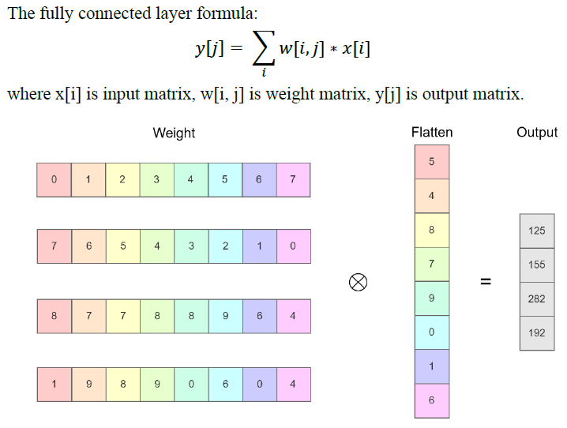
Lab10

Slide 5
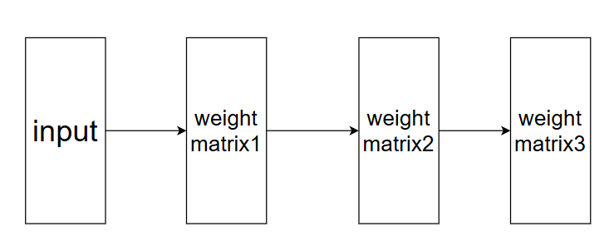
Lab10
Block diagram of Fully connected

Slide 6
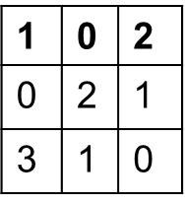
Lab10
Weight matrix1:
Weight matrix2:
Weight matrix3:
1 | 2 | 0
2 | 0 | 1
1 | 3 | 0
0 | 3 | 1
0 | 7 | 1
1 | 6 | 4

Slide 7
Lab10 – I/O
I/O Specification
Input | Bit Width | Definition and Description
In0 | 3 | Input signal, controlled by sw0 ~ sw2
In1 | 3 | Input signal, controlled by sw3 ~ sw5
in2 | 3 | Input signal, controlled by sw6 ~ sw8
Output | Bit Width | Definition and Description
out0 | 12 | output signal, controlled by key0
out1 | 12 | output signal, controlled by key1
out2 | 12 | output signal, controlled by key2

Slide 8
Lab10 – FPGA
In this lab, you need to verify your design in FPGA
The output are shown on the FPGA by SEG7 (7段顯示器)
You can refer the manual (My_First_FPGA.pdf) to implement it
https://drive.google.com/drive/folders/1ZFtIudKCY0BxJ6gFDUK5azXYzEfxCauK?usp=sharing

Slide 9
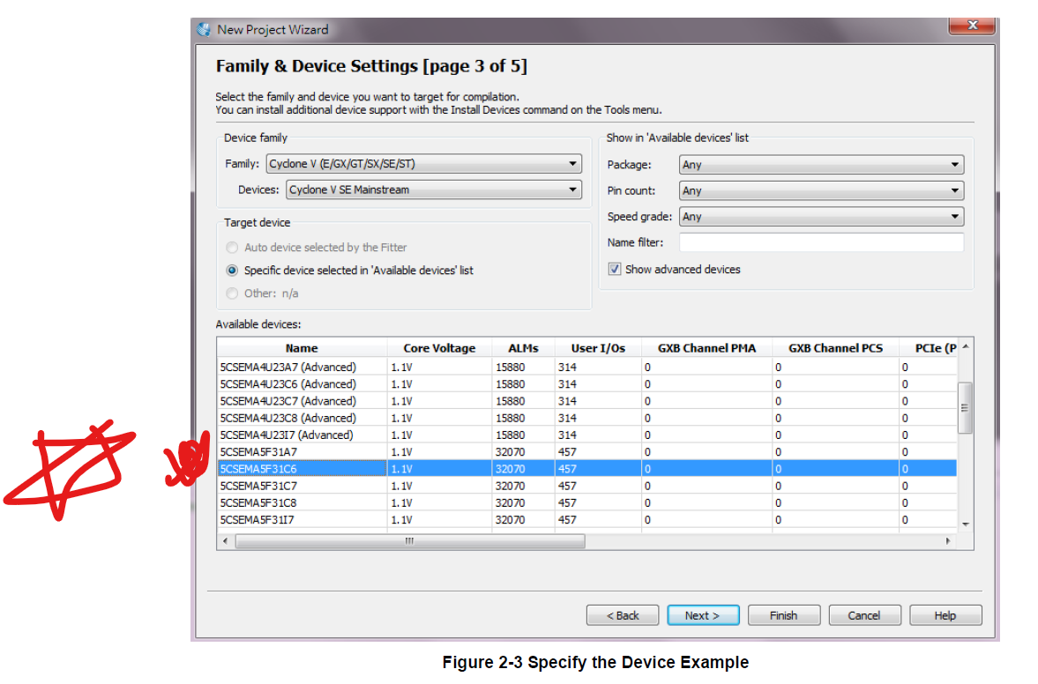
Lab10 – FPGA Device settings
You must select this device, or your demo would FAIL

Slide 10
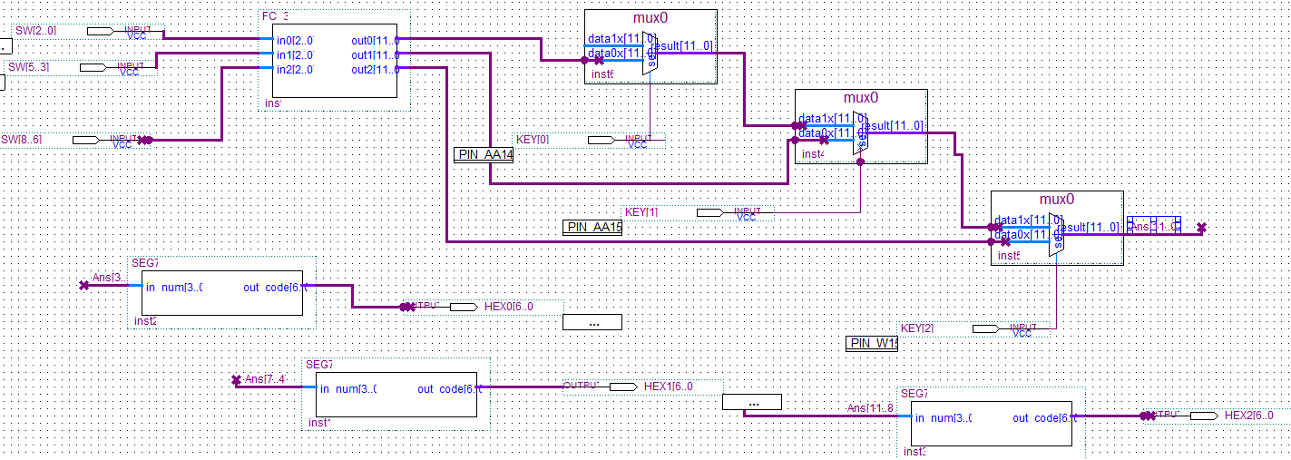
Lab10 – FPGA Block diagram

Slide 11
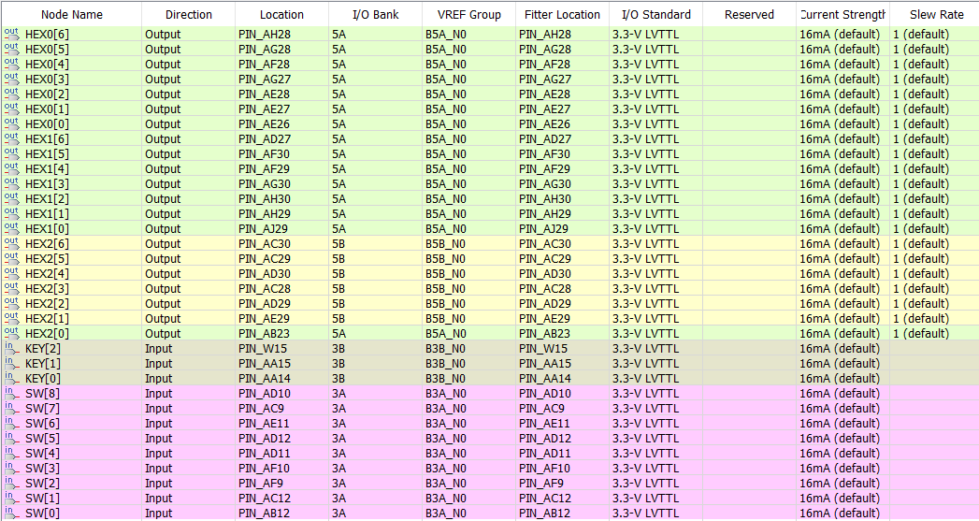
Lab10 – FPGA pin assignment

Slide 12
Lab10 – SPEC
This design is combinational circuit, you don’t need to use sequential circuit
You only need to implement FC_3.v, TA will provide SEG7.v
You need to convert your design to *.sof, TA will check your design on FPGA
The pin assignment must be the same to TA, or your demo would FAIL
The device must be the same to TA (important!!!)
In demo, TA will use random input to verify your design on FPGA

Slide 13
Score
Function Validity: 100%
Program to FPGA successfully: 70%
FPGA result correctness: 30%
Deadline :
1st_demo: 05/22 18:20
No 2nd_demo

Slide 14
Demo result
You can refer this video
https://drive.google.com/file/d/1E2i0-2vPcQjr_grPsAs8LDXgxHSt1ATb/view?usp=sharing

Slide 15
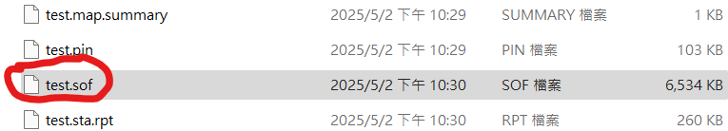
Lab Submission
You need to bring your design(AccountID.sof, e. DCS168.sof) in your USB, TA will verify your design in TA notebooks.
Each person will only have 1 demo opportunity unless there’s time remaining after everyone has finished their demos.
If you are worried that your demo may not pass, it is recommended that you bring your own laptop.

