Slide 1
Digital Circuit and System Lab04 Pipeline
20250327
TA: 陳祖喬 Tsu-Chiao, Chen
Institute of Electronics,
National Yang Ming Chiao Tung University

Slide 2
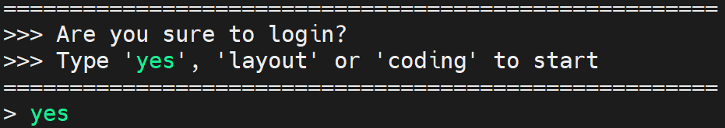
Environmental preparation
type ‘yes’ while you login the server
Extract files from TA’s directory (home directory)
tar -xvf ~DCSTA01/Lab04.tar

Slide 3
Lab04
Design a simple operation
𝑂𝑢𝑡=(𝑖𝑛_1+𝑖𝑛_2)×𝑖𝑛_3
in_1, in_2: 47 bits unsigned number
In_3: 48 bits unsigned number
Out: 96 bits unsigned number
Large bit width multiplier is costly.

Slide 4
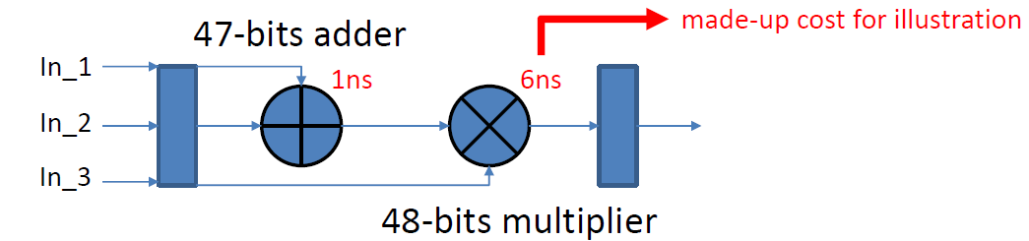
Lab04 - Naïve design
Assume we have a cycle time limit: 5ns
No pipeline -> long critical path
Critical path = 47 bits adder + 48 bits multiplier = 7 ns > 5ns
You will fail this lab!!

Slide 5
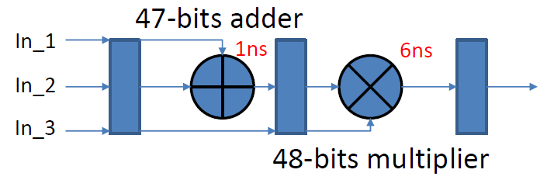
Lab04 - Simple pipeline design
Assume we have a cycle time limit: 5ns
Simply separate adder and multiplier
Critical path = 48 bits multiplier = 6 ns > 5ns
Better, but you still will fail this lab!!

Slide 6
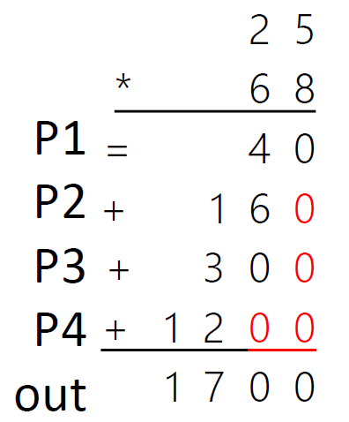
Lab04 - Optimization
You can try to separate the big multiplier to several small multipliers
Example:
25 * 68 = 1700
P1 -> 8 * 5 = 40
P2 -> 8 * 2 = 16
P3 -> 6 * 5 = 30
P4 -> 6 * 2 = 12
P1 + P2 * 10 + P3 * 10 + P4 * 100 = 1700
You can further integrate the pipeline.
Achieve lower critical path.

Slide 7
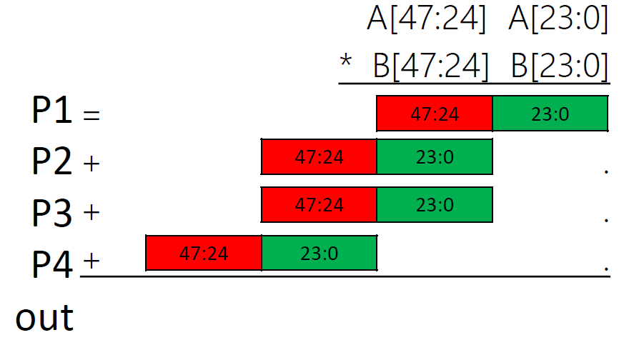
Lab04 - Optimization
In Binary cases : Partition operands A and B into two parts
A[47:0 ] * B[47:0]
=(A[47:24] * 2^24 + A[23:0]) * (B[47:24] * 2^24 + B[23:0])
= A[47:24] * B[47:24] * 2^48
+ A[47:24] * B[23:0] * 2^24
+ B[47:24] * A[23:0] * 2^24
+ A[23:0] * B[23:0]

Slide 8
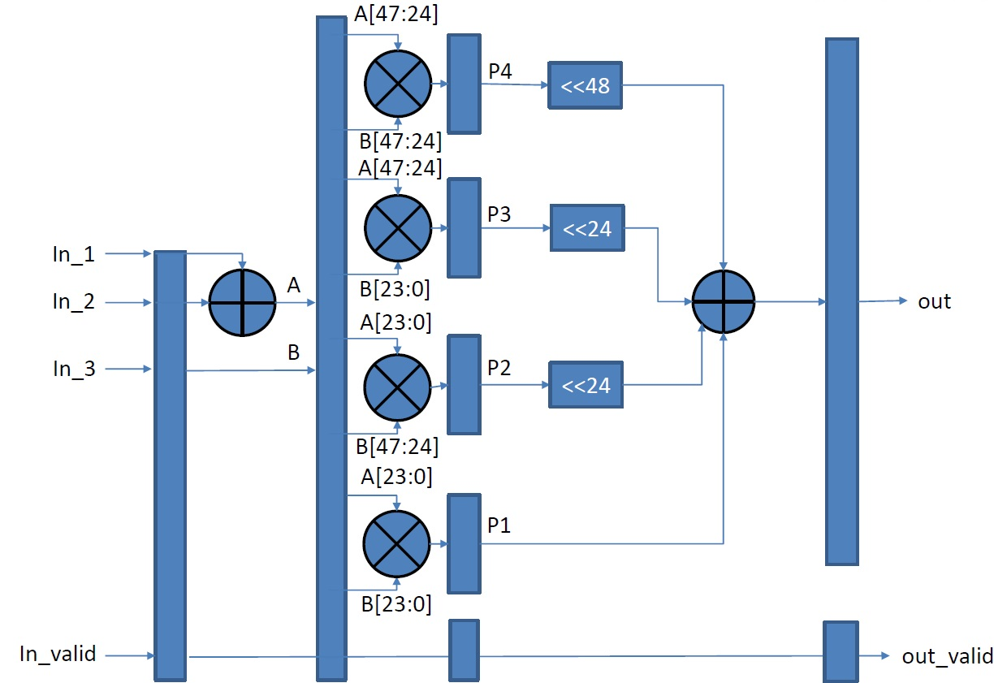
Lab04 – Block diagram
In theory, using the following design should pass the cycle time limit.
But if it still fails, it may be because the pipeline is not sliced finely enough.
Ex : There are multiplexers or any operations connected before or after the multiplication.

Slide 9
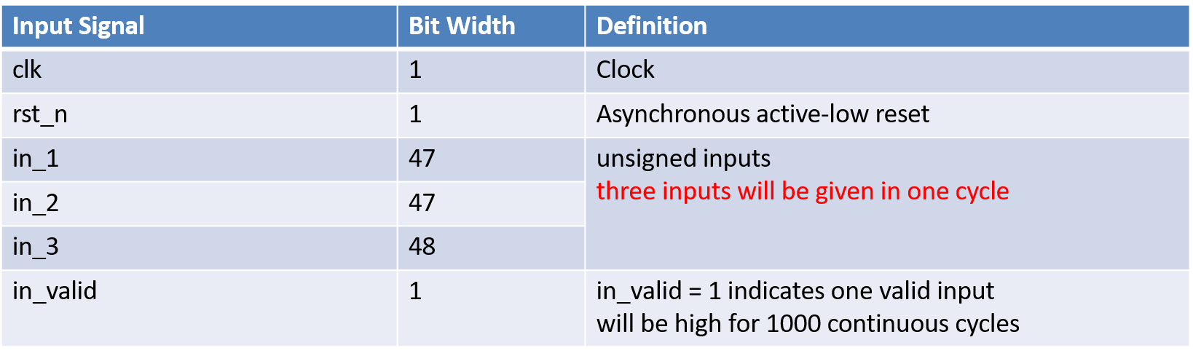
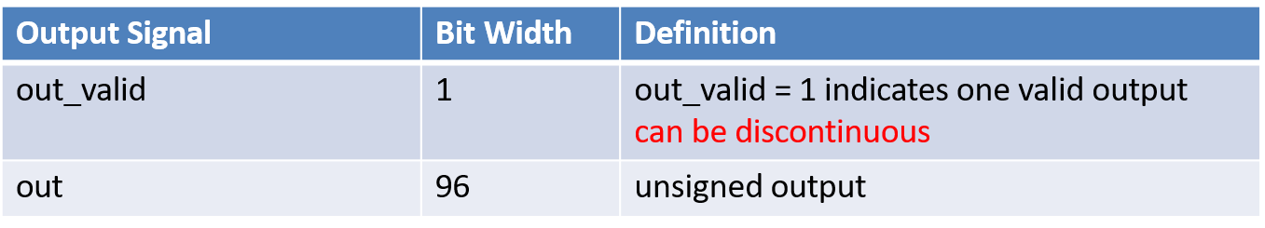
Signal

Slide 10
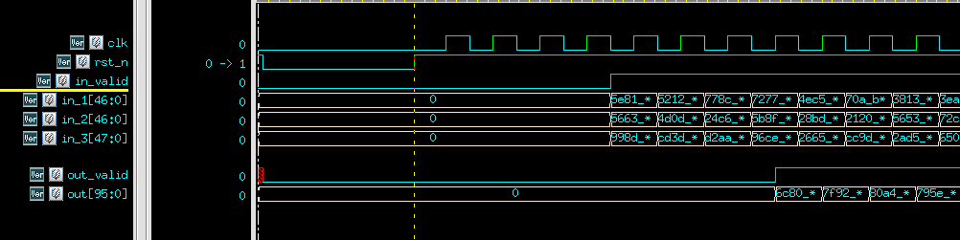
Waveform

Slide 11
SPEC
Cycle time is fixed to 5.0.
It is an asynchronous reset and active-low architecture.
The reset signal (rst_n) would be given only once at the beginning of simulation. All output signals should be reset to 0 after the reset signal is asserted.
All output signals should be synchronized at positive edge of clock.
Out_valid should be pulled high in 1000 cycle.
out_valid can overlap with in_valid at any time.
out_data should be zero when out_valid is low.
You are not allowed to modify syn.tcl.
After synthesis, the timing report should be non-negative (MET).
The synthesis result cannot include any latch and error.
Remember to check if a latch and error are synthesized (./08_check)
The gate-level simulation cannot include any timing violations.

Slide 12
Score
Function Validity: 100%
01_RTL PASS
02_SYN timing slack must be MET, no error and latch
03_GATE PASS, no error and timing violation
You can not adjust your clock period by yourself, the clock period is 5 ns.
09_SUBMIT
./00_tar 5
Don’t modify the number in this Lab.
./01_submit
./02_check
Deadline : 03/26 23:59
No 2nd_demo

Slide 13
Command List
Extract files from TA’s directory (home directory):
tar -xvf ~DCSTA01/Lab04.tar
Verilog RTL simulation (01_RTL/):
./01_run_vcs_rtl
Synthesis (02_SYN/):
./01_run_dc_shell
./08_check
Gate level simulation (03_GATE/):
./01_run_vcs_gate
Observe waveform to debug
nWave &
find *.fsdb
shift + L for reload fsdb file

