Slide 1
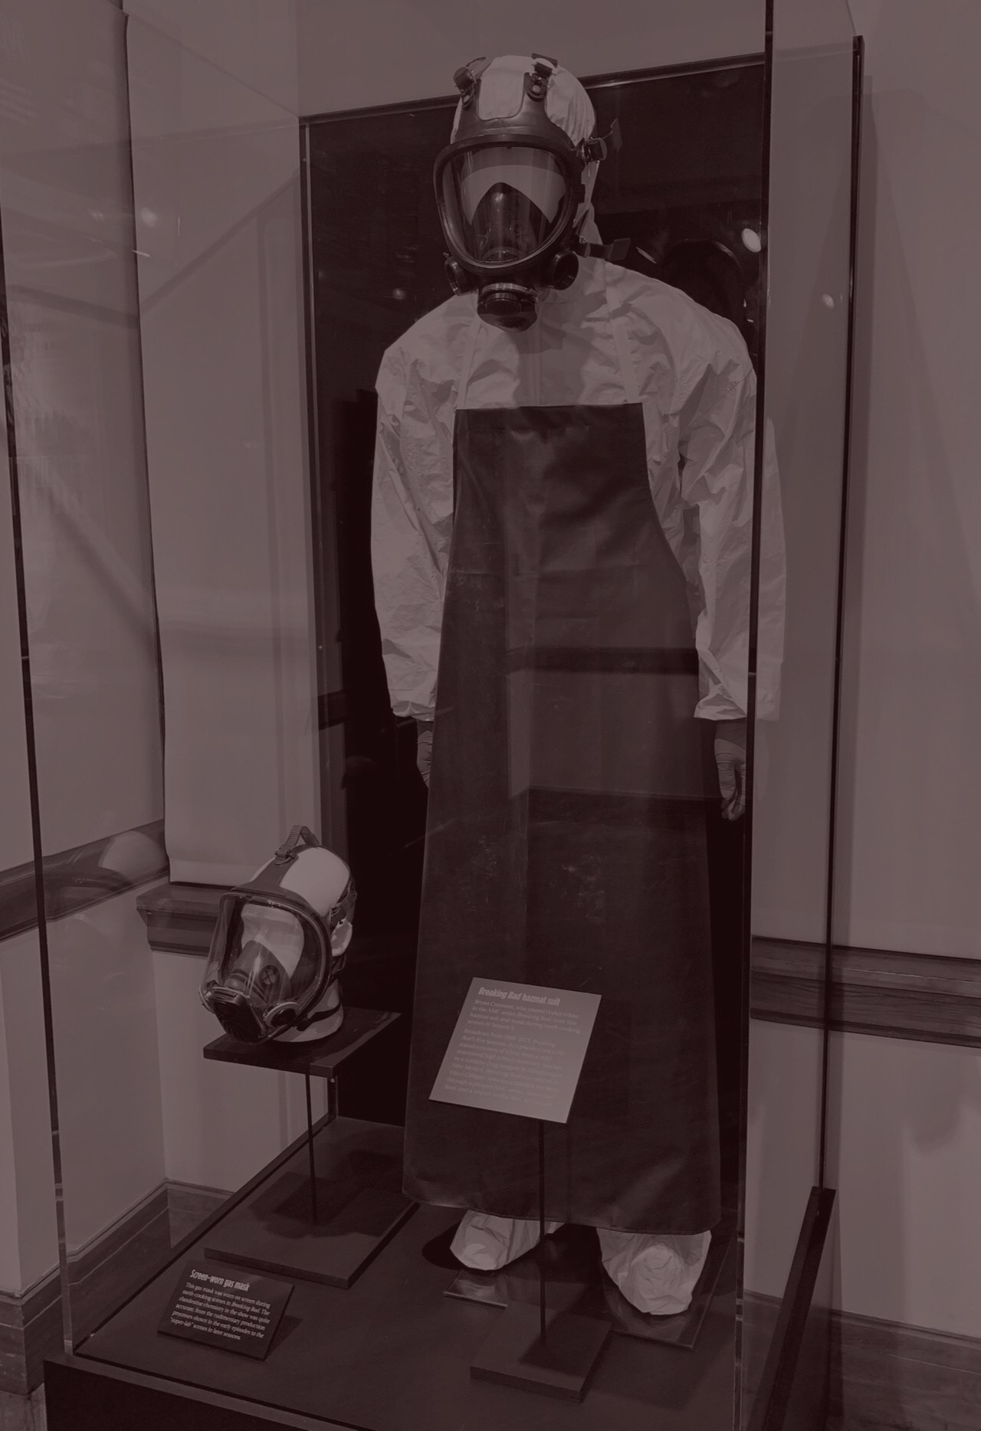
35
56
Br
Ba
BREAKING BAD
The chemistry of consequence
A vintage cinema presentation about the series that turned one desperate choice into an empire.
2008-2013
VINCE GILLIGAN
ALBUQUERQUE
01

Slide 2
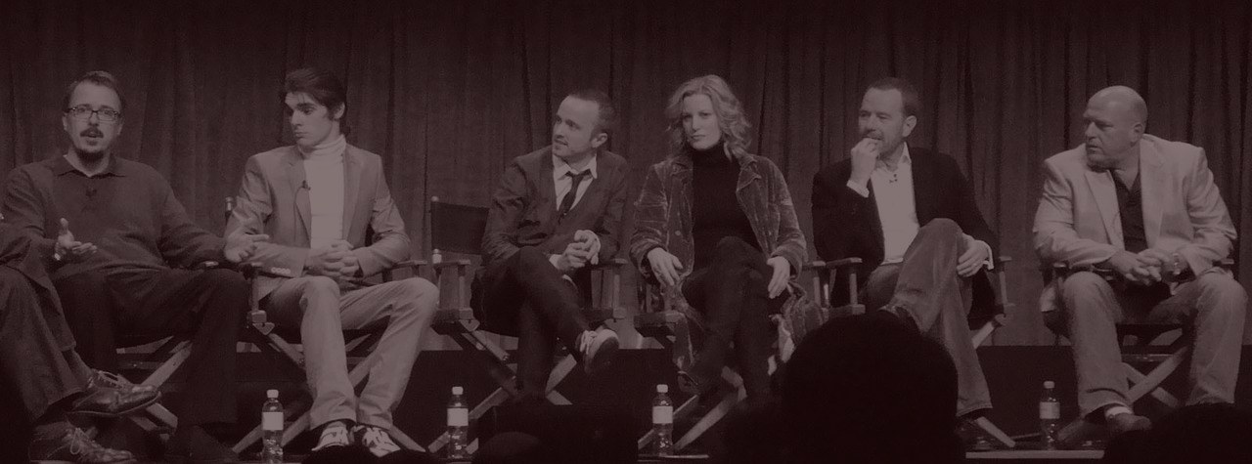
SERIES PROFILE
What It Is
American crime drama and contemporary western
Created by Vince Gilligan
Set in Albuquerque, New Mexico
Five seasons, originally aired from 2008 to 2013
A chemistry teacher turns survival panic into criminal identity
TV written like a tragedy: every clever solution raises the cost of the next scene.
02

Slide 3
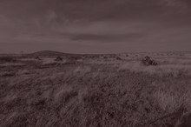
PLOT
Desperate Plan, Criminal Persona
Walter White, a brilliant but underpaid chemistry teacher, receives a terminal diagnosis and enters the drug trade with former student Jesse Pinkman. What begins as a way to leave money for his family turns into a story about pride, control, and moral collapse.
SURVIVAL
AMBITION
EMPIRE
Cancer, fear, and the promise of quick money
Skill becomes leverage, then appetite
Every victory isolates Walter further
03

Slide 4
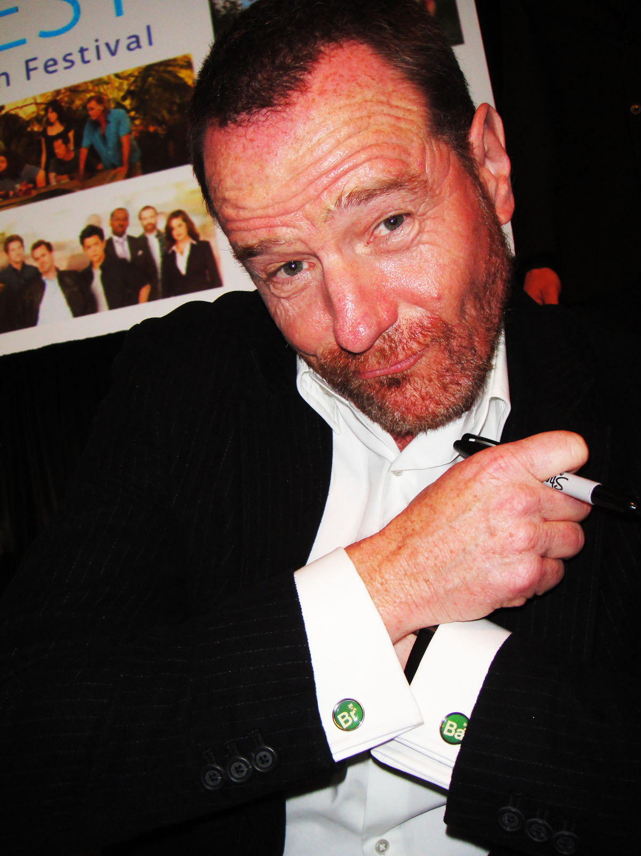
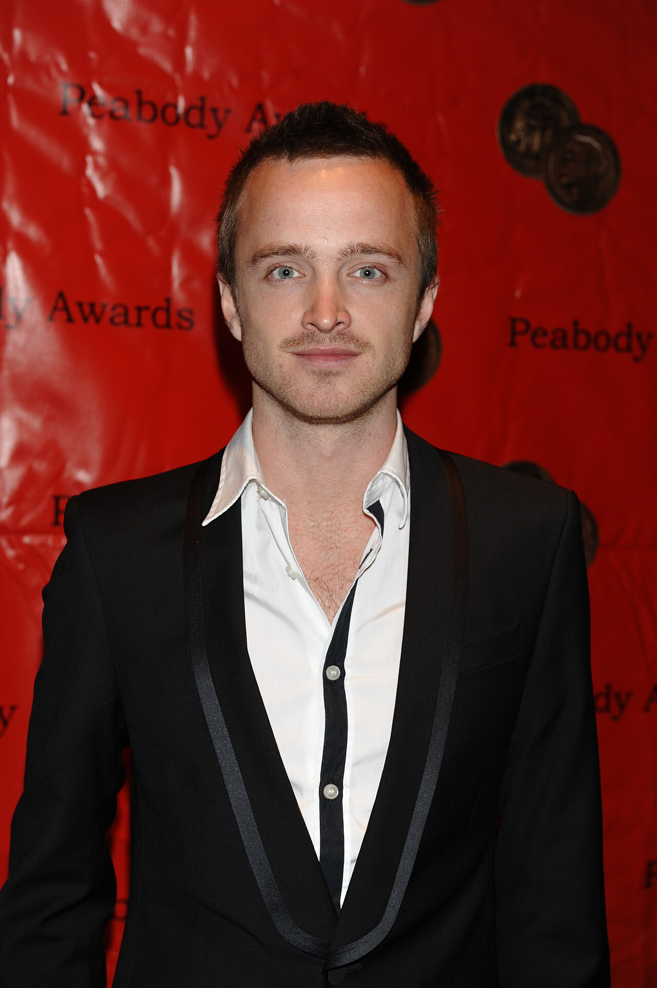
CHARACTERS
The People Inside the Machine
35
56
Br
Ba
Walter White
Jesse Pinkman
The Orbit
Pride disguised as responsibility
Conscience caught in the blast radius
Skyler, Hank, Gus, Saul, and Mike keep pressure on every lie
04

Slide 5
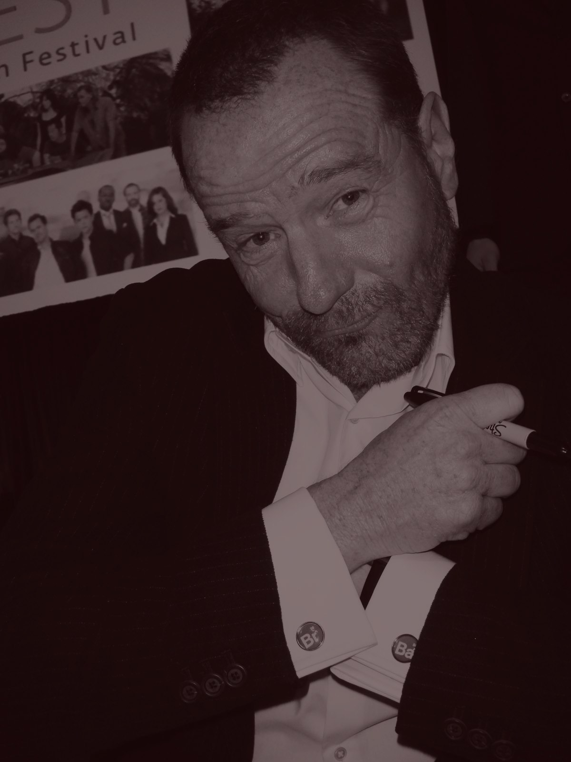
CHARACTER ARC
Walter Becomes Heisenberg
The shift is gradual: one compromise, one excuse, one reward. Heisenberg begins as armor and becomes the person Walter chooses.
Fear - mortality and money panic
Competence - chemistry creates leverage
Recognition - respect becomes addictive
Control - the mask becomes easier to wear
One name becomes a role; the role becomes the only room he can stand in.
05

Slide 6
VISUAL LANGUAGE
Heat, Chemicals, and Shadows
Breaking Bad looks like a sun-bleached western that wandered into a chemistry lab. The images keep returning to controlled surfaces, open desert, domestic spaces, and objects that turn ordinary life into evidence.
Desert
Green
Cinema Red
Black
Blue
Wide desert frames make small decisions feel exposed.
Close-ups turn props into moral evidence.
Color marks danger, contamination, and identity.
06

Slide 7
THEMES
What the Story Keeps Asking
Pride
Family
When does providing become performing power?
How often is love used as a shield for selfishness?
Consequence
Identity
Every clever escape creates a debt somewhere else.
A name can become a costume, then a prison.
The suspense is emotional as much as criminal: the question is not only whether Walter survives, but what survival reveals.
07

Slide 8
STRUCTURE
Five Seasons, One Trap
The series uses escalation like chemistry: add pressure, heat, and ego, then watch the reaction become irreversible.
01
02
03
04
05
Desperation
Partnership
Expansion
War
Collapse
A secret begins
The operation grows messier
Business replaces panic
Power meets a colder rival
The empire cashes its debts
08

Slide 9
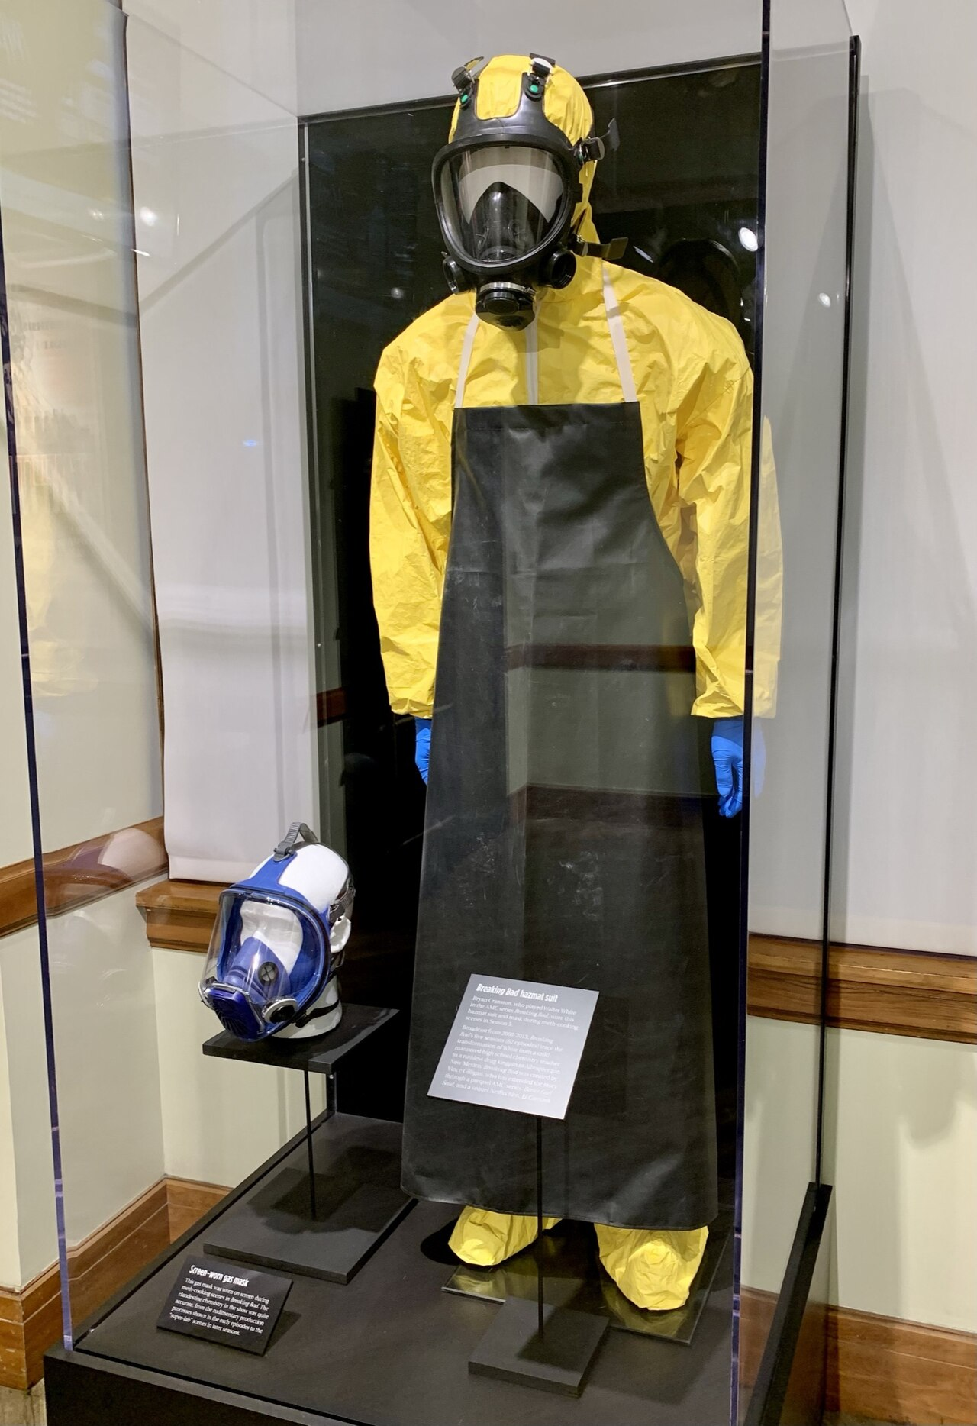
SYMBOLS
Objects That Carry the Story
RV Lab
Gas Mask
Pork Pie Hat
Blue Product
The first criminal stage
Science, danger, and disguise
A costume becomes an identity
Chemistry turned into reputation
09

Slide 10
IMPACT
Why It Stayed in the Culture
Helped define the modern TV antihero era
Attention Built Over Time
Turned Albuquerque into part of the show identity
Made the RV, gas mask, and hat instantly recognizable
Expanded into El Camino and Better Call Saul
1
2
3
4
5
Season
10

Slide 11
PRESENTATION OPTIONS
Presentation Angles
Character Study
Moral Tragedy
Focus on Walter transformation and Jesse conscience.
Track choices, excuses, and consequences.
Visual Style
Cultural Impact
Analyze color, props, desert framing, and chemistry motifs.
Explain how the show shaped prestige TV and spin-off storytelling.
Best choice for a short classroom talk: Moral Tragedy. It gives you plot, character, and theme in one clean argument.
11

Slide 12
CREDITS
Image Sources
Images were sourced from web pages with visible license or usage information. Check each source before public or commercial use.
Breaking Bad gas mask - Wikimedia Commons - CC BY-SA 4.0
PaleyFest 2010 Breaking Bad cast photo - Wikimedia Commons - CC BY 2.0
Bryan Cranston PaleyFest 2010 - Wikimedia Commons - CC BY 2.0
Aaron Paul at the 68th Annual Peabody Awards - Wikimedia Commons - CC BY 2.0
Albuquerque skyline - PerryPlanet, Wikimedia Commons - Public Domain
Desert grassland in southern New Mexico - Miguel Villarreal, USGS - Public Domain
Template note: direct Canva editing was unavailable, so this centered version is ready to import into Canva.
12

