Slide 1
MSc DISSERTATION, 2026
Breast Cancer Ultrasound
Classification Using Machine
Learning
Auditable evaluation and research dashboard
LOCAL COHORT EVIDENCE
Akerele David Damilola, Student ID 25908322
Supervisor: Professor Moi Hoon Yap, Manchester Metropolitan University
Notes:
Open with the evidence boundary. The repaired BrEaST and OASBUD cohort passes the subject-level split audit. The local BUSI derivative remains outside the validated experiment because its patient identifiers and transformation history cannot be reconstructed reliably.

Slide 2
WHY THIS STUDY MATTERS
02
Model scores and evidence strength are separate
The modelling problem
Engineering evidence
Ultrasound varies with operator, device, acquisition settings, anatomy, and speckle.
Rectangular images can be geometrically distorted by direct square resizing.
Small public datasets make leakage and undocumented preprocessing unusually consequential.
The code path executes consistently. Its artifacts are reproducible and auditable.
Generalisation evidence
The repaired local cohort has subject separation. External and clinical validation remain outside this study.
MSc dissertation research prototype
Notes:
Frame the dissertation around two evidence levels. The present result is patient separated within the local BrEaST and OASBUD cohort. It does not establish external or clinical performance.

Slide 3
SYSTEM DESIGN
03
One controlled path connects the data to every output
01
02
03
04
05
06
DATA
AUDIT
PREPROCESS
MODEL
EVALUATE
SURFACES
OASBUD and BrEaST
subjects and provenance
CLAHE, crop, pad
EfficientNet, ResNet, CNN
predictions and metrics
CLI, API, web
Shared contract
Training, evaluation, command-line prediction, and API inference call the same preprocessing implementation.
MSc dissertation research prototype
Notes:
Point out that the audit is a first-class stage. Every downstream surface shares the same preprocessing contract. BUSI is documented but cannot enter this path because the local derivative lacks recoverable patient provenance.

Slide 4
CURRENT COHORT
04
Validated datasets pass the subject-level split audit
Dataset | Train | Validation | Test | Audit finding
BUSI derivative | n/a | n/a | n/a | Excluded: provenance cannot be reconstructed
OASBUD | 138 | 30 | 30 | Pass: no subject crosses a partition
BrEaST | 164 | 33 | 32 | Pass: no subject crosses a partition
Validated | 302 | 63 | 62 | Pass: local cohort evidence
Release gate
The BUSI derivative cannot prove patient separation or reproduce published curation checks, so it remains outside the experiment.
Source: outputs/data_audit.json, generated from the supplied local folders
Notes:
Source: outputs/data_audit.json. BrEaST and OASBUD pass the subject-level audit. Exclusion concerns this local BUSI derivative, not the value of the original BUSI dataset published by Al-Dhabyani et al. The local copy was renamed and contains processed square derivatives, so its patient mapping, duplicate checks, overlays, and curation history cannot be reproduced.

Slide 5
EXPERIMENTAL METHOD
05
Preprocessing is configurable, shared, and testable
01
02
03
DIRECT RESIZE
CENTRE CROP
MASK / FALLBACK + PAD
Rectangular image is resized directly to 224×224.
A centred square is selected before resizing.
Mask box or central 80%, then margin and reflected square padding.
Comparator. Scaling differs across the two axes.
Comparator. Peripheral context may be removed.
Default research path. The crop retains its aspect ratio.
Controlled ablation rule
Hold the subject partition, architecture, training budget, and random seeds fixed. Change one preprocessing factor at a time.
Training augmentation uses horizontal flips and rotations up to 15°. Vertical flips are excluded because image depth has acquisition meaning.
MSc dissertation research prototype
Notes:
The current implementation supports all three strategies. The submitted experiment uses the default path. A comparative preprocessing claim would require a matched ablation with the same subject partition, seed policy, and training budget. That ablation was not run for this revision.

Slide 6
EXECUTABLE CHECKPOINT
06
Audited test performance
CONFUSION MATRIX
Actual / predicted | Benign | Malignant
Benign | 21 | 12
Malignant | 8 | 21
62 test images, EfficientNet-B0
Local cohort evidence only. Clinical validation is outside scope.
Source: outputs/metrics.json and outputs/predictions.csv
Notes:
Source: outputs/metrics.json and outputs/predictions.csv generated on the audited 62-image test folders. Accuracy 0.6774; macro F1 0.6774; macro recall 0.6803; ROC-AUC 0.7419. The confusion matrix contains 21 true negatives, 12 false positives, 8 false negatives, and 21 true positives. Audit status: passed for BrEaST and OASBUD.

Slide 7
WHAT CHANGED
07
The project now leaves a verifiable evidence trail
Subject-level audit is regenerated before training. Failed audits stop by default.
Python, NumPy, PyTorch, and CUDA seeds are set and checkpoint configuration is saved.
Evaluation writes one row per image plus metrics, figures, audit status, and checksums.
Mask discovery, crop dimensions, audit failure, and the non-clinical API boundary have regression tests.
The dissertation, notebook, slides, README, and web interface use the same current evidence status.
RELEASE ARTIFACTS
data_audit.json
predictions.csv
metrics.json
extended_evaluation.json
report figures
Generated, inspectable, and tied to one evaluation run.
MSc dissertation research prototype
Notes:
Emphasise reproducibility as the dissertation's present contribution. The extended evaluation was calculated from the preserved EfficientNet probabilities. No model was retrained and no threshold was selected from the test set.

Slide 8
INTERNAL BENCHMARK
08
Architecture comparison on the audited test split
Model | Accuracy 95% CI | ROC-AUC 95% CI
EfficientNet-B0 | 0.5645 to 0.7903 | 0.6217 to 0.8616
Custom CNN | 0.5323 to 0.7581 | 0.5330 to 0.7979
ResNet-50 | 0.4355 to 0.6935 | 0.5054 to 0.7701
Intervals overlap
The ranking is descriptive. The data do not support a superiority or breakthrough claim.
Source: outputs/model_benchmark.json, one training seed and 62 test images
Notes:
All models use the same audited test split. EfficientNet-B0 has the highest accuracy, macro F1, and ROC-AUC point estimates. The bootstrap intervals overlap, and the stored benchmark has summaries rather than paired per-image outputs, so a paired significance test cannot be reconstructed. The custom CNN exceeding ResNet-50 in this run is useful evidence, but it is not a scientific breakthrough.

Slide 9
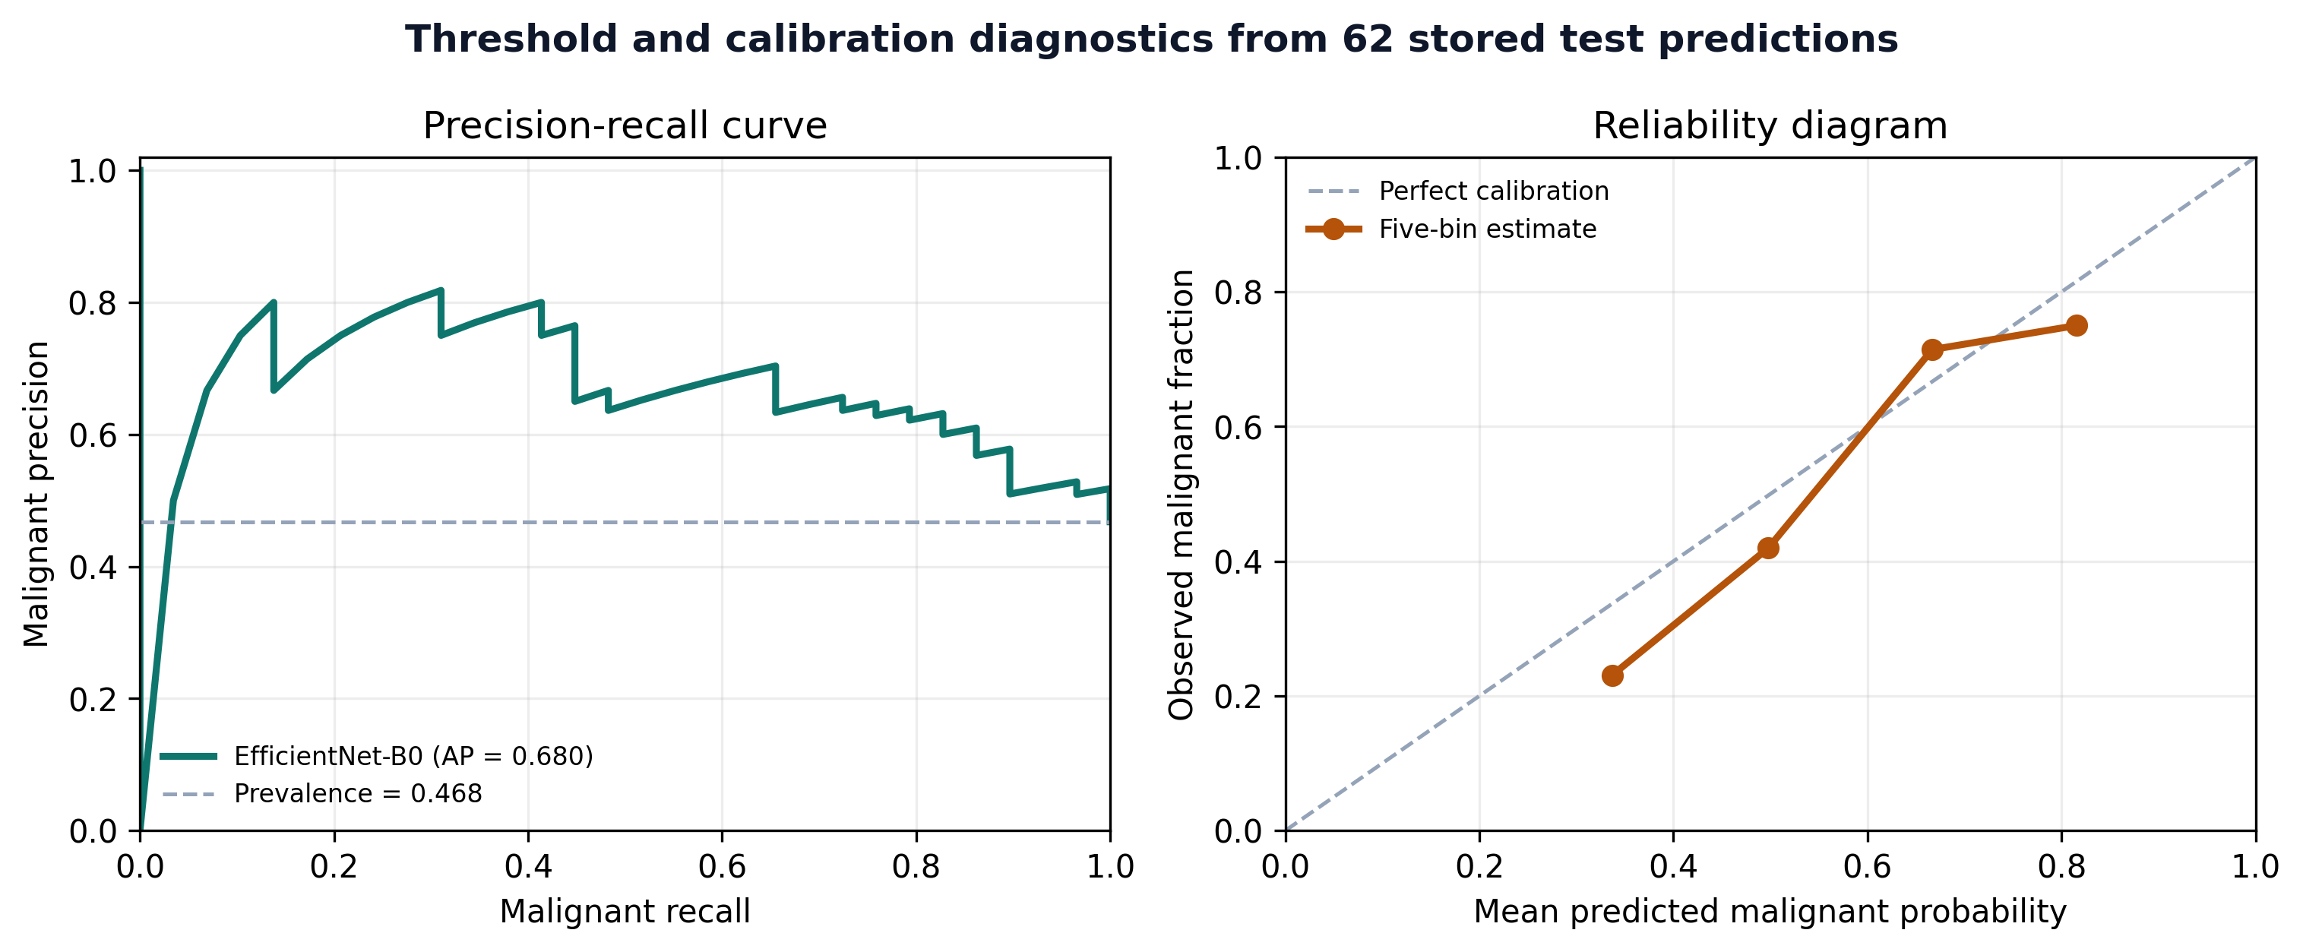
EXTENDED EVALUATION
09
Discrimination and calibration metrics
AVERAGE PRECISION
0.6803
BRIER SCORE
0.2144
EXPECTED CALIBRATION ERROR
0.0652
Five bins, descriptive test-set diagnostics
Source: outputs/extended_evaluation.json and outputs/predictions.csv
Notes:
Average precision summarises malignant-class ranking under class imbalance. The Brier score measures probability error. Expected calibration error compares confidence with observed frequency in five bins. These are descriptive diagnostics on 62 images. No calibration model or decision threshold was fitted on the test set.

Slide 10
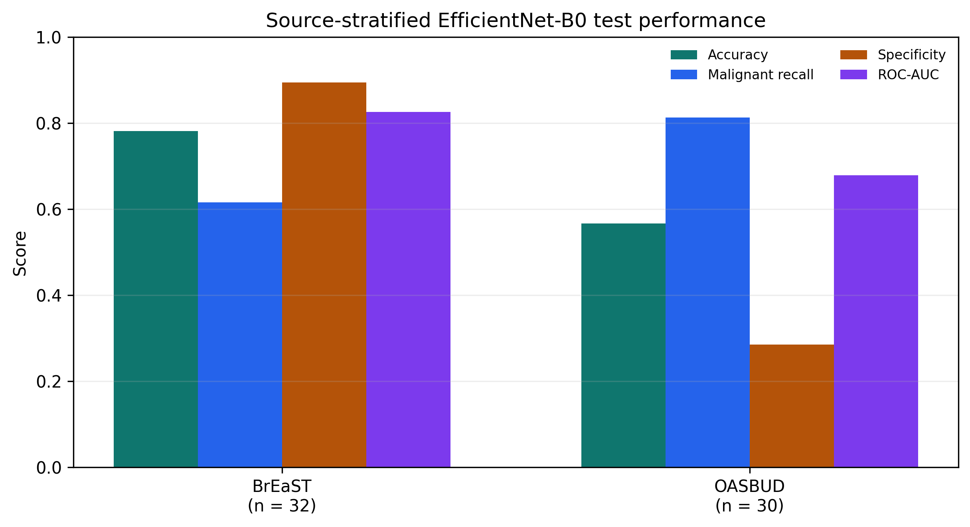
ERROR ANALYSIS
10
Errors differ between BrEaST and OASBUD
Source | n | Accuracy | FP | FN
BrEaST | 32 | 0.7813 | 2 | 5
OASBUD | 30 | 0.5667 | 10 | 3
Interpretation boundary
Source, case mix, acquisition, reconstruction, and sample size are confounded. The plot cannot rank dataset quality.
Fixed threshold 0.5 with no source-specific threshold tuning
Notes:
OASBUD contributes ten of the twelve false positives and three of the eight false negatives. BrEaST contributes two false positives and five false negatives. This shows why pooled accuracy is incomplete. It does not establish that one dataset is better because source and acquisition factors are confounded.

Slide 11
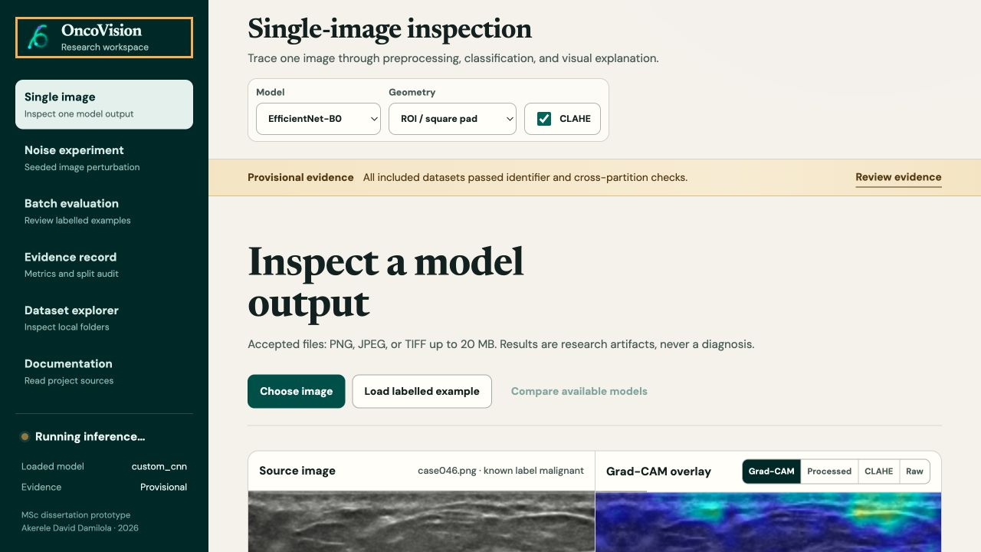
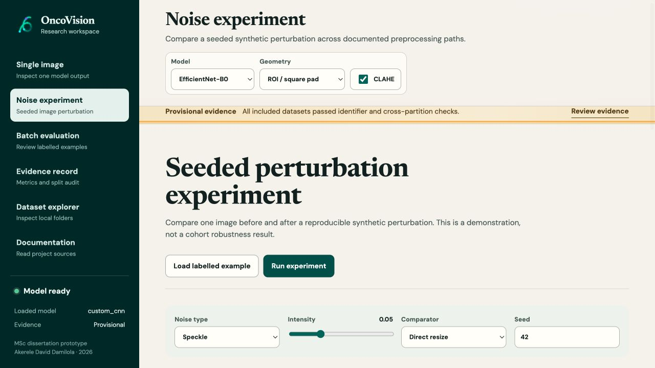
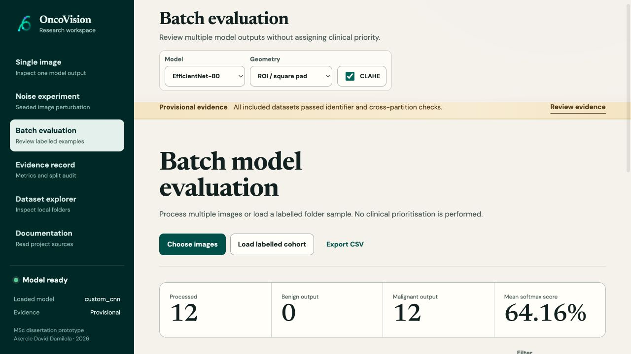
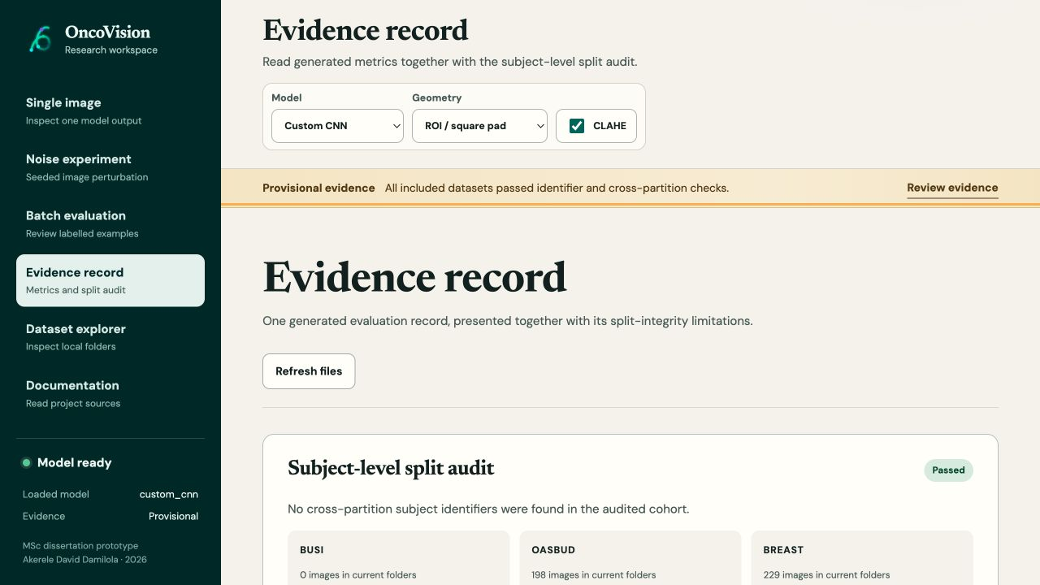
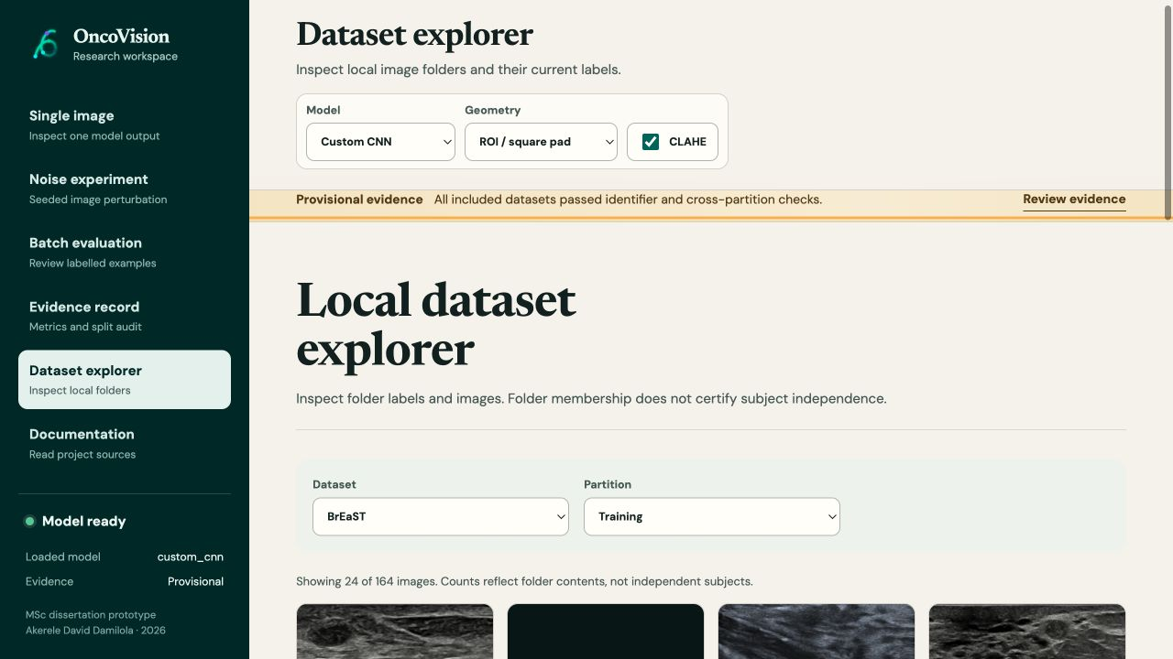
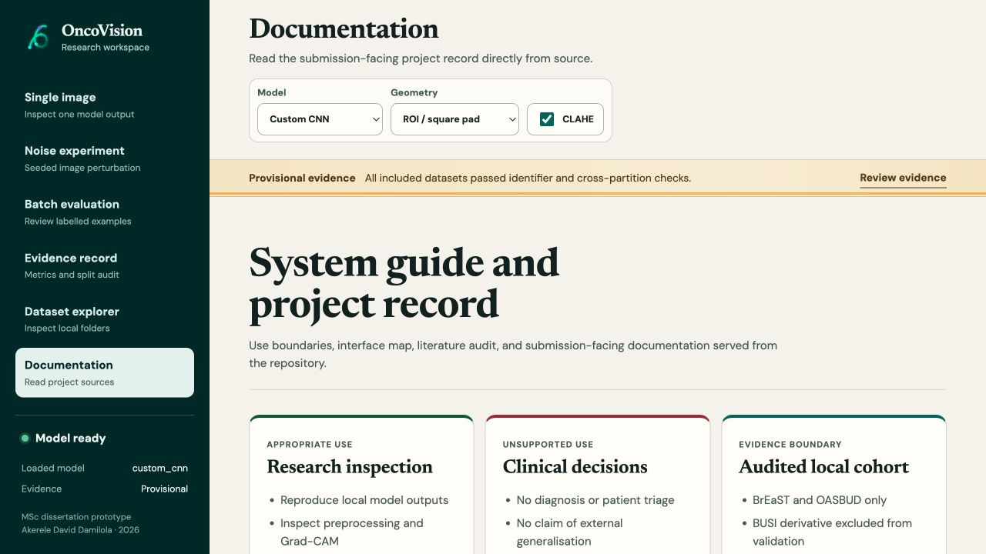
RESEARCH DASHBOARD
11
Six pages document the complete workflow
The dashboard documents research outputs. It does not provide a clinical service
Notes:
Walk through the six pages: single-image inference, noise robustness, batch explorer, evidence, dataset documentation, and project documentation. Explain that the same API and preprocessing code support every page. The interface includes appropriate-use and unsupported-use guidance. The screenshots document implementation only and do not add clinical evidence.

Slide 12
CONCLUSION
A complete research system
with an honest evidence boundary
Defensible now
Claim boundary
Shared preprocessing and inference implementation
Auditable evaluation artifacts and release checks
Patient-separated local checkpoint with uncertainty estimates
Clinical effectiveness or diagnostic safety
External validation beyond the local combined cohort
Statistically proven superiority over other architectures
Product repository: github.com/DavidAkerele/breast-cancer-ultrasound-classification-ml
Questions
No diagnostic, BI-RADS, or management inference is authorised by this prototype.
Notes:
Close with the central contribution: a reproducible, patient-separated local experiment linked to a transparent research interface. Point the examiners to the repository before the product demonstration. The report does not use the BUSI derivative, does not claim clinical readiness, and does not claim model superiority. Future work can add multi-seed training, expert error review, and external validation without changing the submitted evidence.

