Slide 1
Disinformation Channels

Slide 2
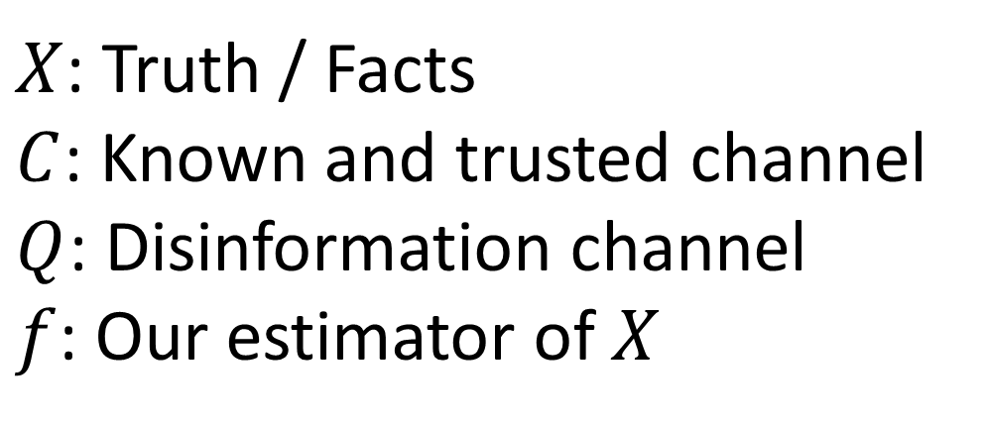






Problem Statement
$X$: Truth / Facts
$C$: Known and trusted channel
$Q$: Disinformation channel
$f$: Our estimator of $X$
$$C$$
$$Y$$
$$X$$
$$Q$$
$$Z$$
$$f\left(Y, Z\right)=\hat{X}$$

Slide 3
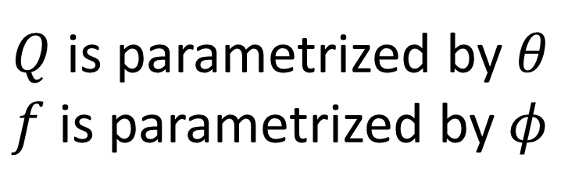
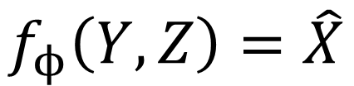
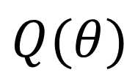
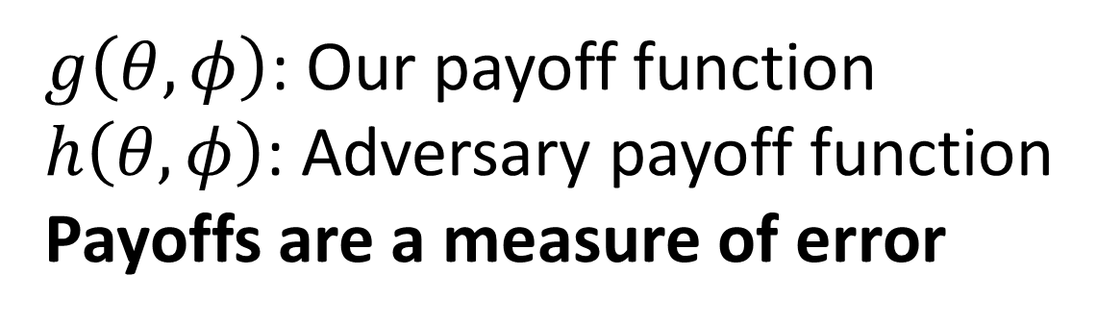
Problem Statement (ctd.)
$Q$ is parametrized by $θ$
$f$ is parametrized by $φ$
$$C$$
$$Y$$
$$X$$
$g\left(θ, φ\right)$: Our payoff function
$h\left(θ, φ\right)$: Adversary payoff function
Payoffs are a measure of error
$$Q(θ)$$
$$Z$$
$$f_{ϕ}\left(Y, Z\right)=\hat{X}$$

Slide 4
Goals and Motivation
Our strategy takes Z into consideration
Adversary strategy contains some degree of truth (i.e. not maximally random)
Interesting problem in the age of fake news
Understand the nature of fake news and why they work

Slide 5
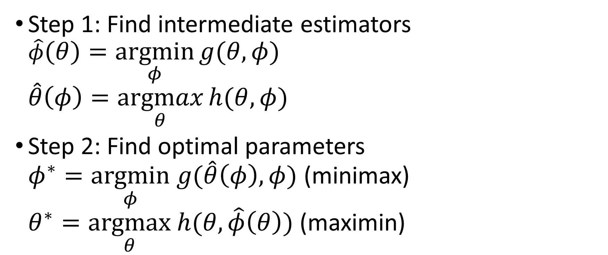
General Approach
Step 1: Find intermediate estimators $\hat{φ}\left(θ\right)=\underset{φ}{argmin}{g(θ, φ)}$ $\hat{θ}\left(φ\right)=\underset{θ}{argmax}{h(θ, φ)}$
Step 2: Find optimal parameters $φ^{∗}=\underset{φ}{argmin} g(\hat{θ}\left(φ\right), φ)$ (minimax) $θ^{∗}=\underset{θ}{argmax} h(θ, \hat{φ}\left(θ\right))$ (maximin)

Slide 6
Cases considered
Binary discrete random variables with BSC
Real random variables with additive Gaussian noise

Slide 7
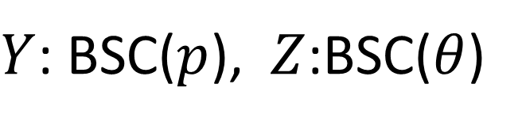
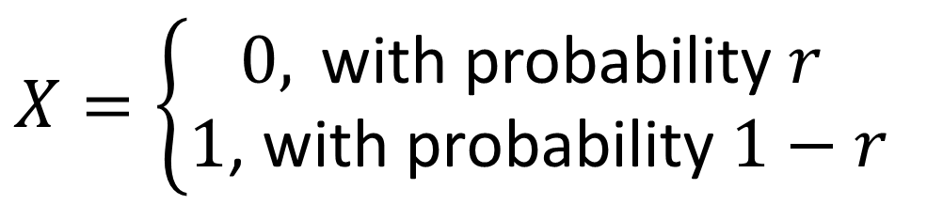
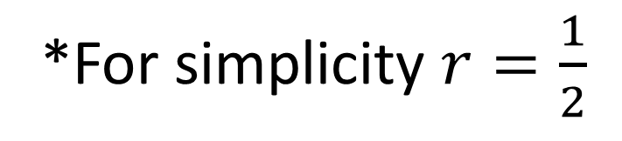
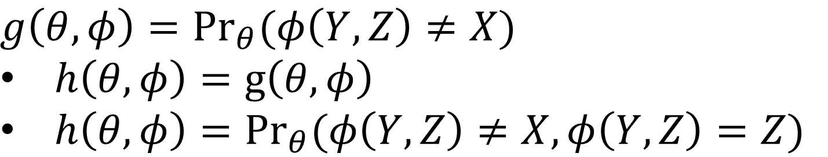
Discrete Case
$$X=\left\{\begin{aligned}0, \text{with} \text{probability} r \\ \text{1}\text{, }\text{with} \text{probability} 1−r\end{aligned}\right.$$
*For simplicity $r=\frac{1}{2}$
$Y$: BSC($p$), $Z$:BSC($θ$)
$$g\left(θ, φ\right)={Pr}_{θ}(φ\left(Y, Z\right)≠X)$$
$h\left(θ, φ\right)=g\left(θ, φ\right)$
$h\left(θ, φ\right)={Pr}_{θ}(φ\left(Y, Z\right)≠X, φ\left(Y,Z\right)=Z)$

Slide 8
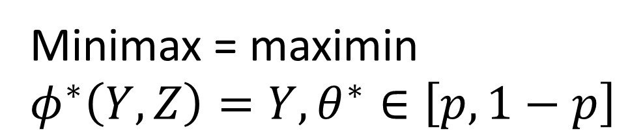
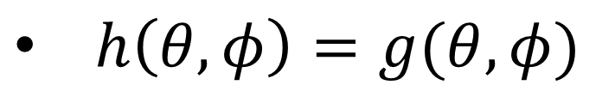
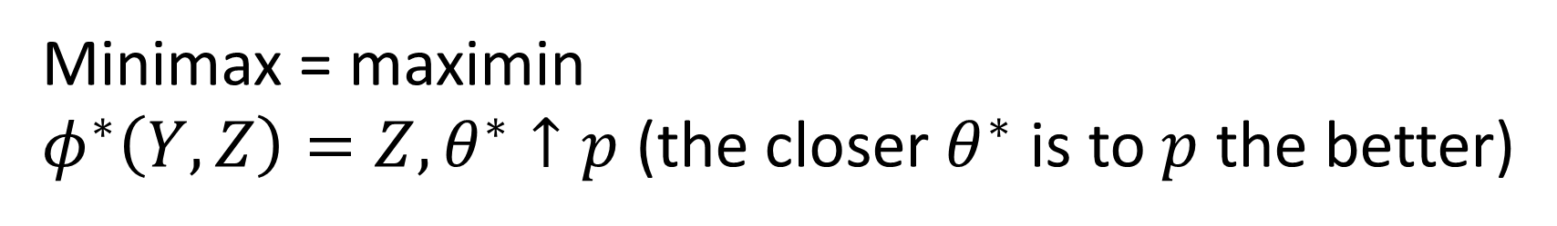
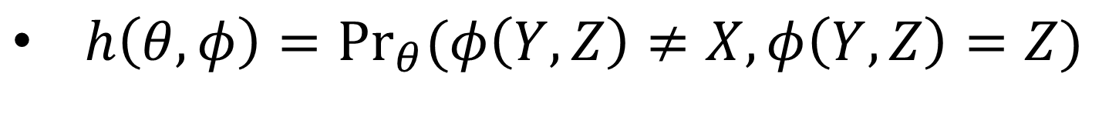
Discrete Case (ctd.)
$h\left(θ, φ\right)=g(θ, φ)$
Minimax = maximin
$$φ^{∗}\left(Y, Z\right)=Y, θ^{∗}∈\left[p, 1−p\right]$$
$h\left(θ, φ\right)={Pr}_{θ}(φ\left(Y, Z\right)≠X, φ\left(Y,Z\right)=Z)$
Minimax = maximin
$φ^{∗}\left(Y, Z\right)=Z, θ^{∗}↑p$ (the closer $θ^{∗}$ is to $p$ the better)

Slide 9
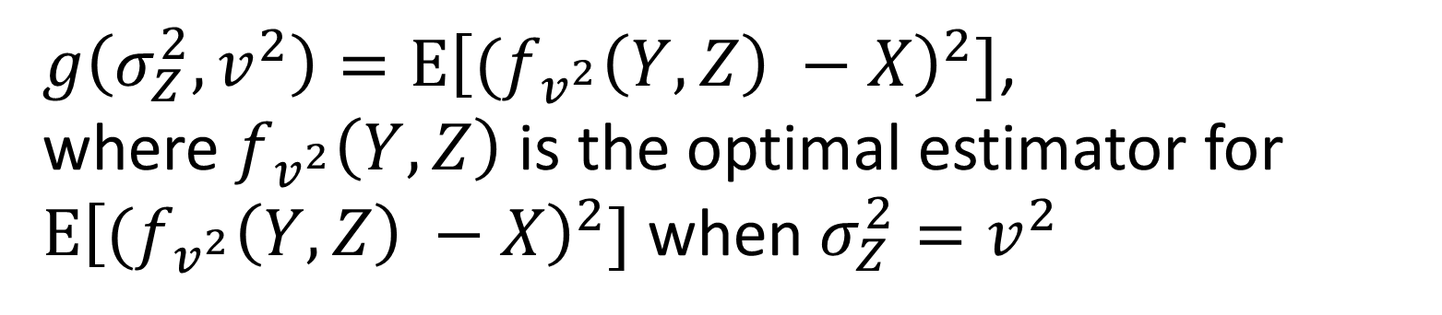
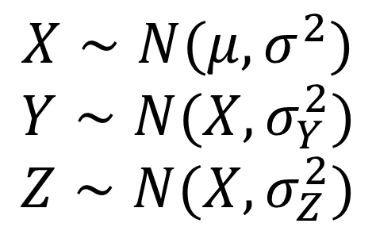
Gaussian Case
$$X∼N(μ, σ^{2})$$
$$Y∼N(X, σ_{Y}^{2})$$
$$Z∼N(X, σ_{Z}^{2})$$
$g\left(σ_{Z}^{2}, v^{2}\right)=E{\left[{(f}_{v^{2}}\left(Y, Z\right) −X\right)}^{2}]$,
where $f_{v^{2}}\left(Y, Z\right)$ is the optimal estimator for
$E{\left[{(f}_{v^{2}}\left(Y, Z\right) −X\right)}^{2}]$ when $σ_{Z}^{2}=v^{2}$

Slide 10
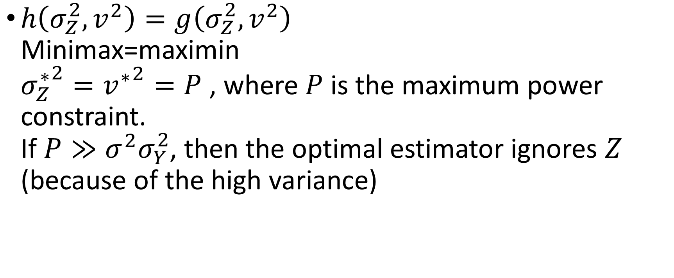
Gaussian Case (ctd.)
$h\left(σ_{Z}^{2}, v^{2}\right)=g\left(σ_{Z}^{2}, v^{2}\right)$ Minimax=maximin ${σ_{Z}^{∗}}^{2}={v^{∗}}^{2}=P$ , where $P$ is the maximum power constraint. If $P≫σ^{2}σ_{Y}^{2}$, then the optimal estimator ignores $Z$ (because of the high variance)

Slide 11
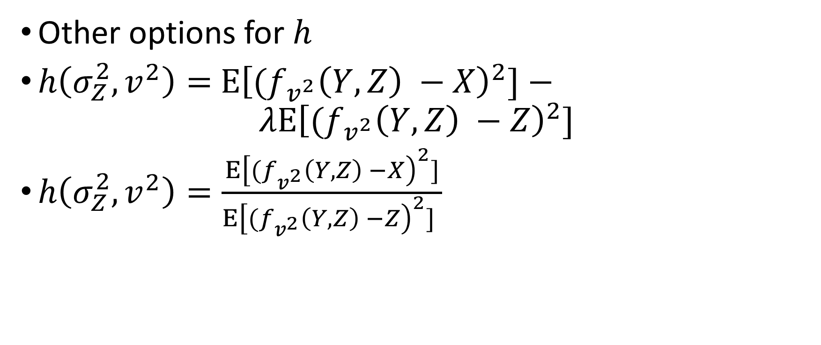
Gaussian Case (ctd.)
Other options for $h$
$h\left(σ_{Z}^{2}, v^{2}\right)=$ $E{\left[{(f}_{v^{2}}\left(Y, Z\right) −X\right)}^{2}]−$ $λE{\left[{(f}_{v^{2}}\left(Y, Z\right) −Z\right)}^{2}]$
$h\left(σ_{Z}^{2}, v^{2}\right)=\frac{E{\left[{(f}_{v^{2}}\left(Y, Z\right) −X\right)}^{2}]}{E{\left[{(f}_{v^{2}}\left(Y, Z\right) −Z\right)}^{2}] }$

Slide 12
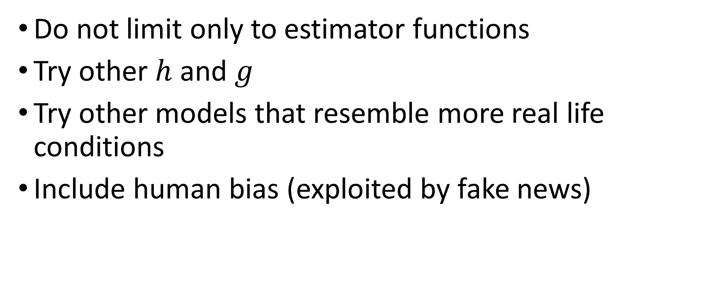
Future work
Do not limit only to estimator functions
Try other $h$ and $g$
Try other models that resemble more real life conditions
Include human bias (exploited by fake news)

