Slide 1
Deep learning for cell biology
Progress weeks 7-8

Slide 2
Main changes since project presentation
Started working with biological data (ish)
Fixed discriminator not updating bug
Train gen to discrim epochs = n:1
Additive noise in discrim
Label flipping

Slide 3
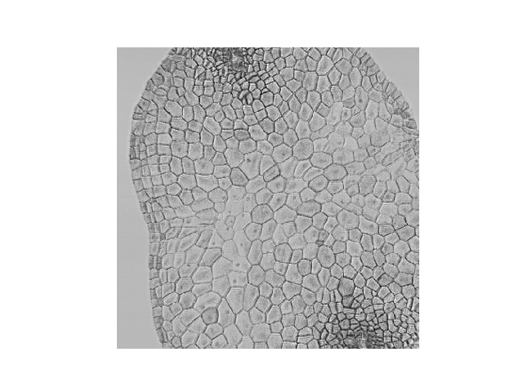

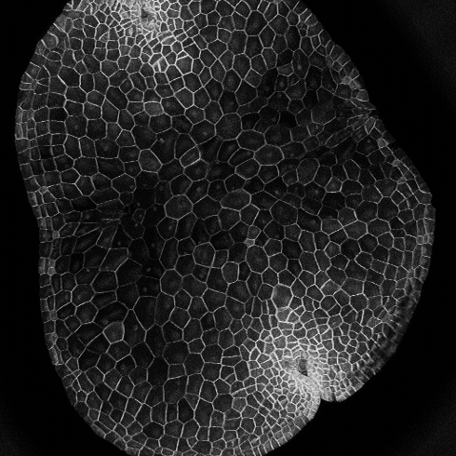
Without label flipping
Original 10 epochs 400 epochs

Slide 4
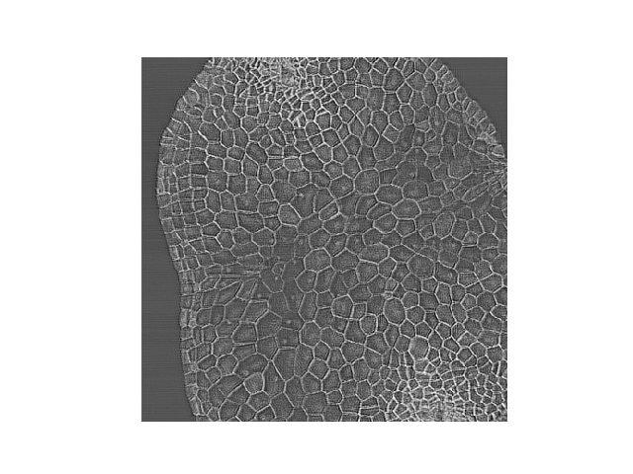
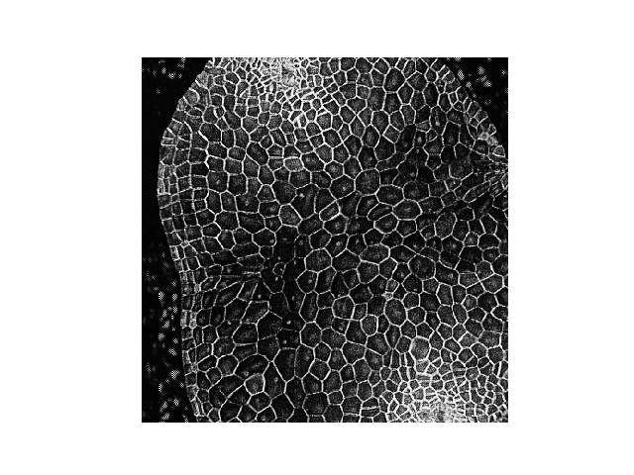
With label 20% change label flipping
Original 10 epochs 400 epochs

