Slide 1



JAH Program Shutdown Analysis & Insurance Claim Report
View in Power BI
David Lawrence

Slide 2
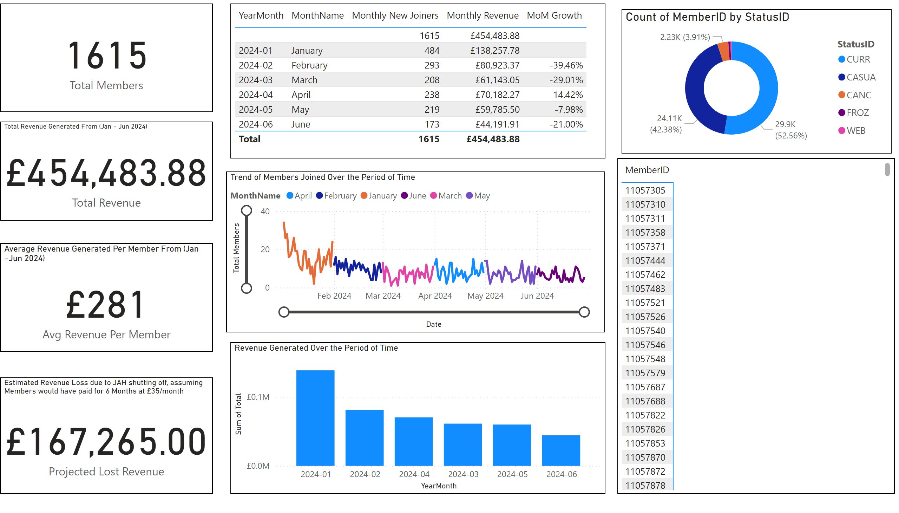
JAHClaimYTD 2024 To Date
Notes:
donutChart
No alt text provided
pivotTable
No alt text provided
Revenue Generated Over the Period of Time
No alt text provided
Total Revenue Generated From (Jan - Jun 2024)
No alt text provided
Estimated Revenue Loss due to JAH shutting off, assuming Members would have paid for 6 Months at £35/month
No alt text provided
Average Revenue Generated Per Member From (Jan -Jun 2024)
No alt text provided
Trend of Members Joined Over the Period of Time
No alt text provided
card
No alt text provided
tableEx
No alt text provided

Slide 3
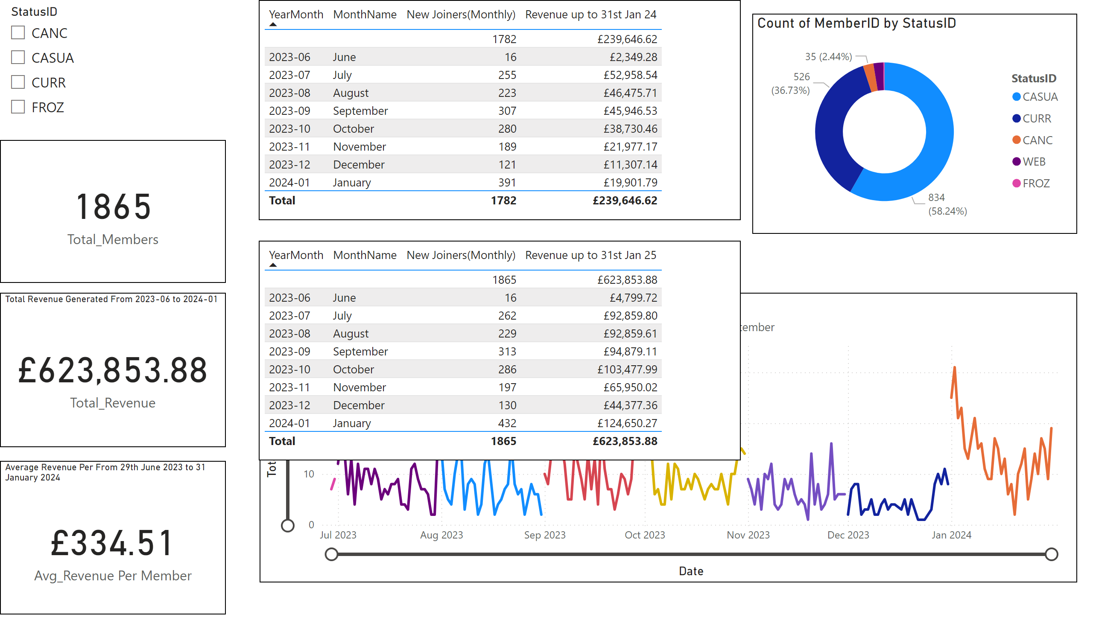
JAHLFL 29th June 23 - 31st Jan 2024
Notes:
Average Revenue Per From 29th June 2023 to 31 January 2024
No alt text provided
Total Revenue Generated From 2023-06 to 2024-01
No alt text provided
donutChart
No alt text provided
Trend of Members Joined Over the Period of Time
No alt text provided
card
No alt text provided
tableEx
No alt text provided
slicer
No alt text provided
tableEx
No alt text provided

Slide 4
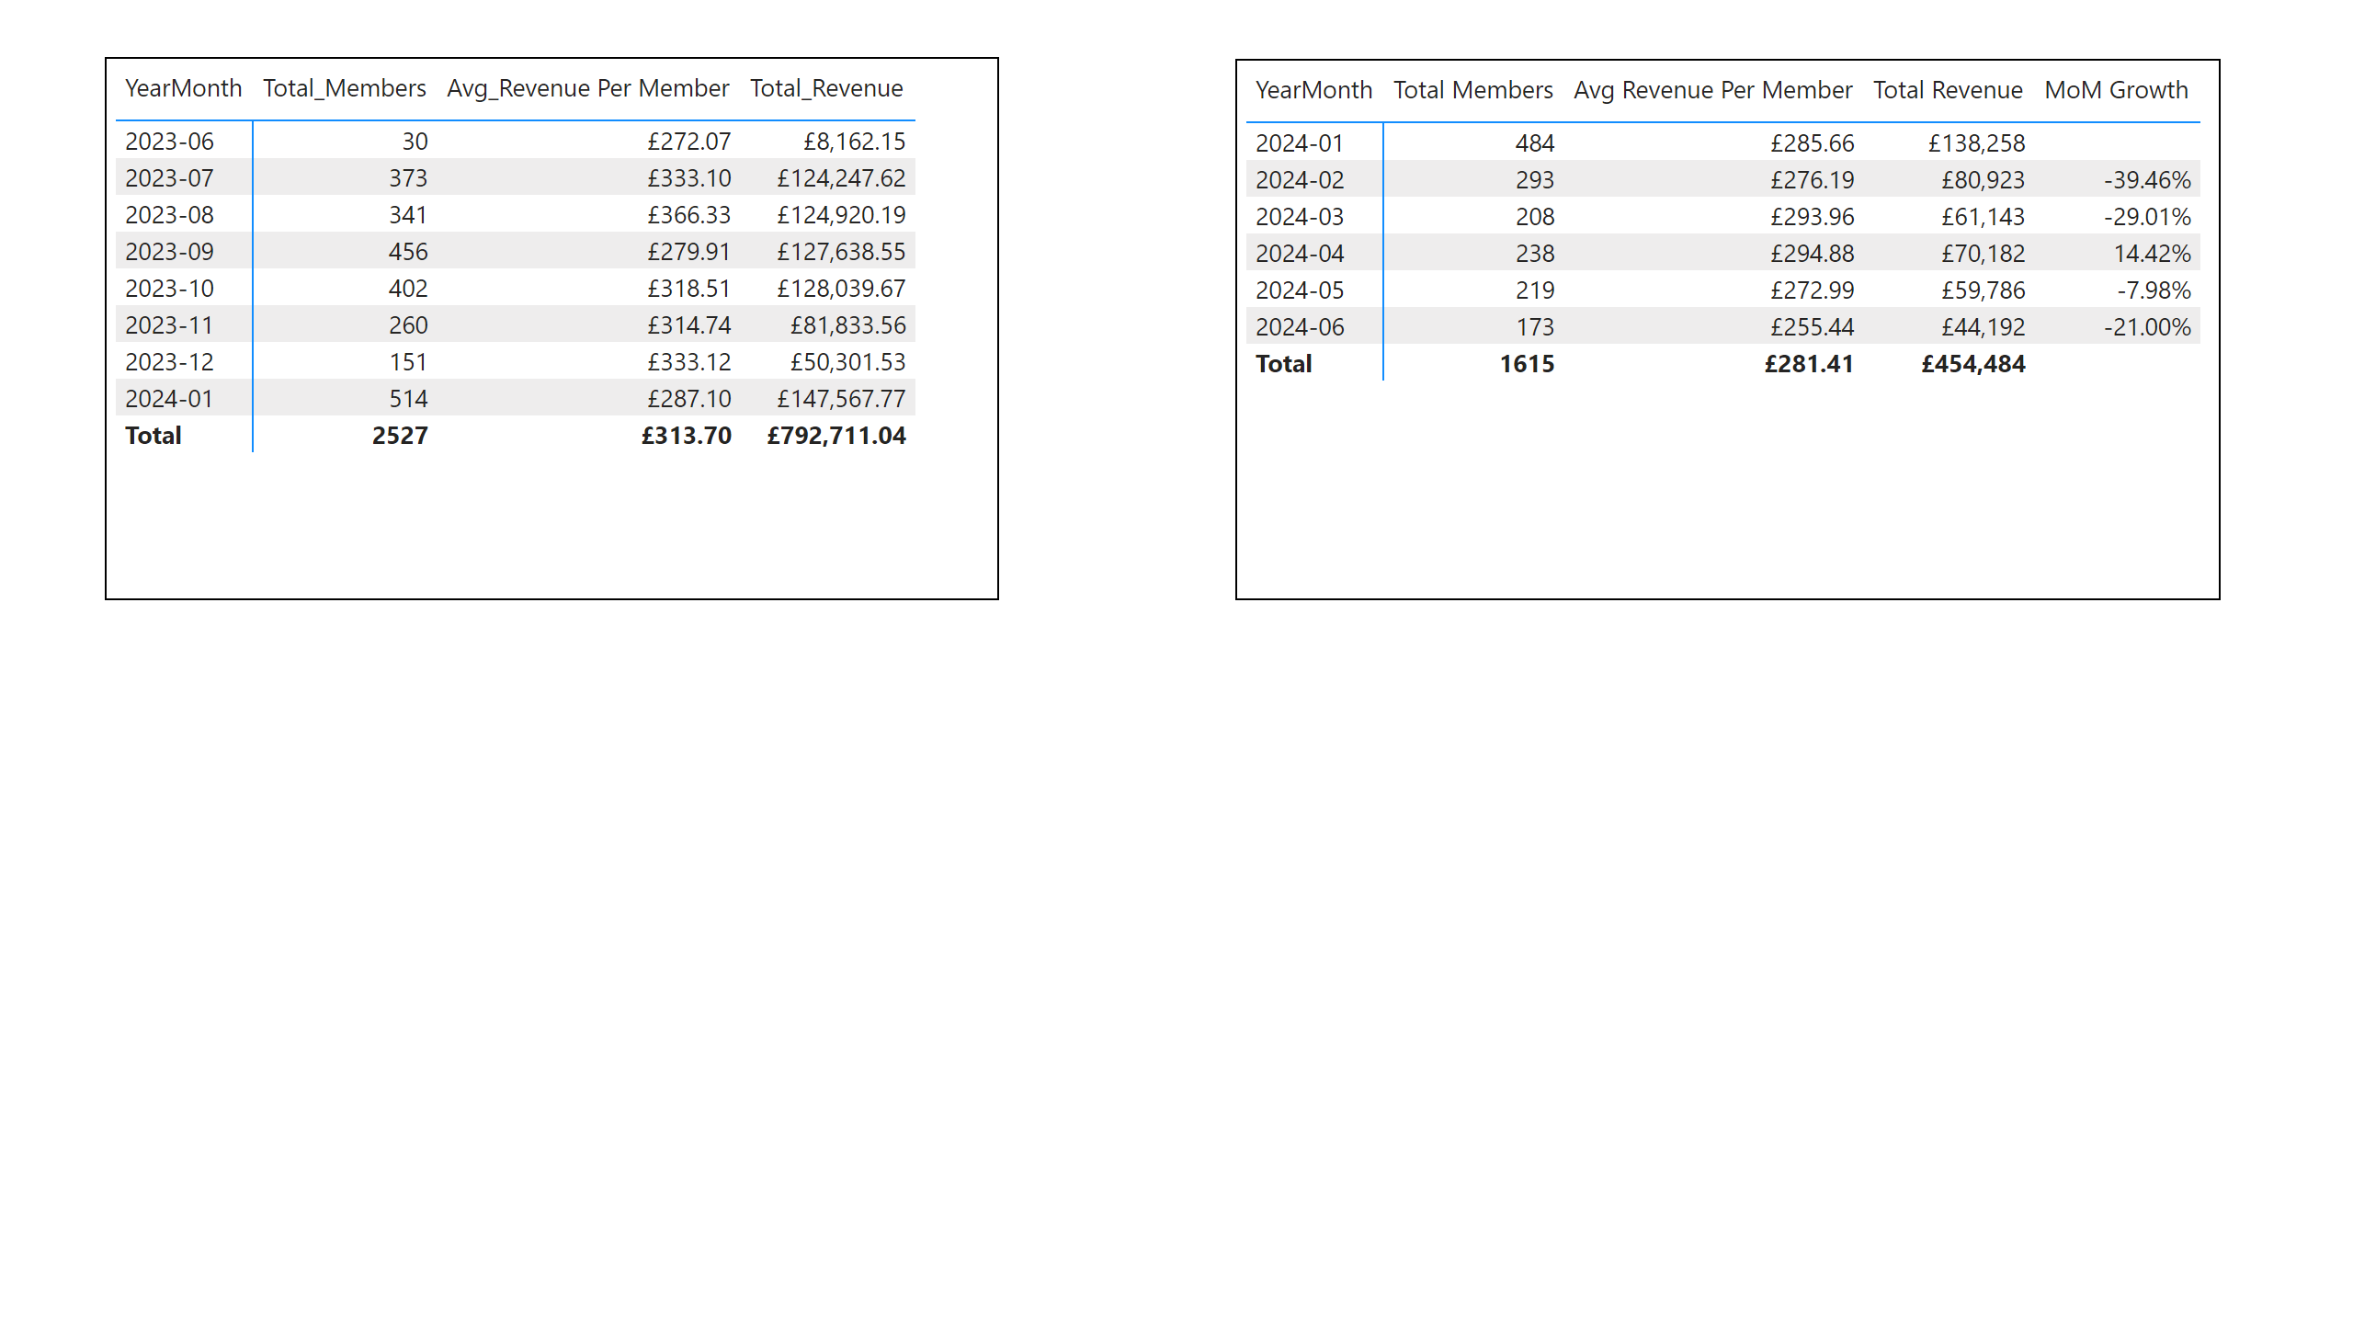
Side-by-Side Comparison Table
Notes:
pivotTable
No alt text provided
pivotTable
No alt text provided

