Slide 1

ElectRight
Final Presentation & Demo
Design and prototyping of an application using a human-centered approach
Group: David Araújo 93444, Gonçalo Sousa 98152, Catarina Oliveira 98292
Lab Class: P3
Deliverable: 5

Slide 2
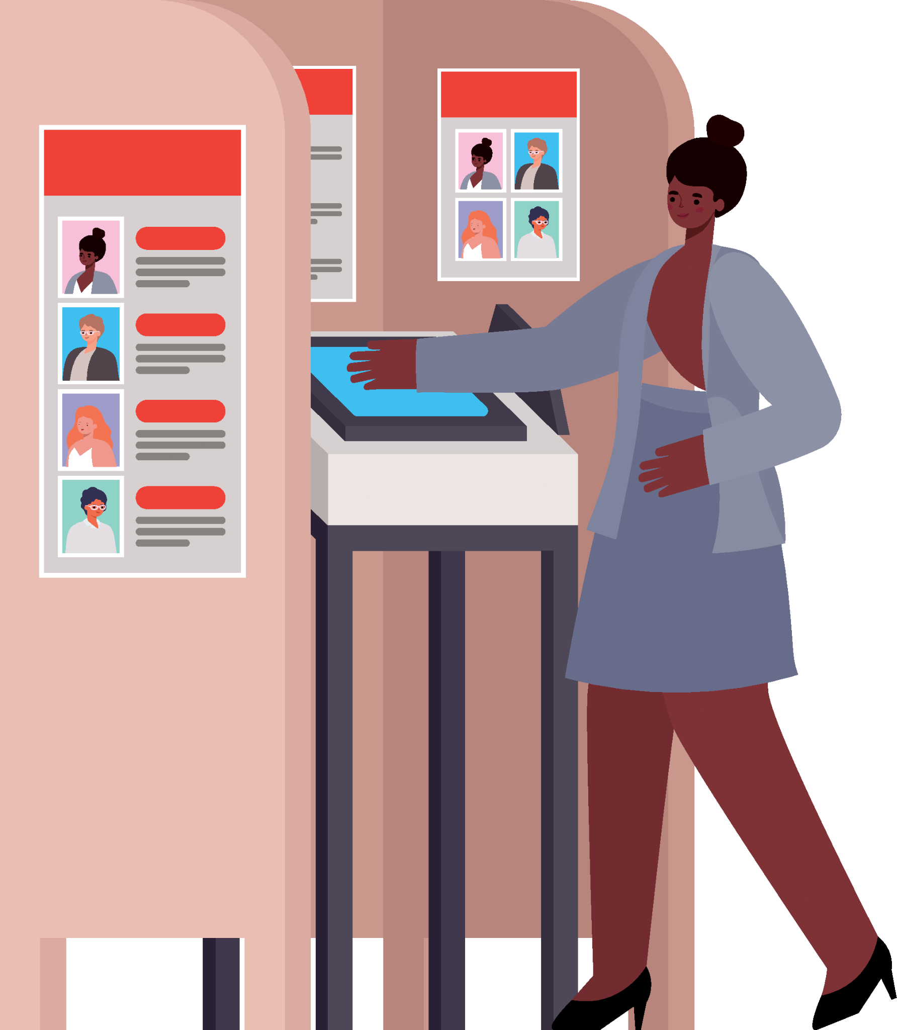
Introduction
Elections are a simple way of making decisions, the process not so.
Need for remote, authenticated and confidential elections.
How can one authenticate a user, know if a user voted, but still preserve the confidentiality of the vote ?

Slide 3
What is ElectRight ?
Online platform where a user can run open, authenticated and confidential polls and/or elections.
Create profiles and friend groups.
Run election only for selected users.
Inspired in the formal processes of town councils.

Slide 4
Objectives
High-level goals
Host multiple users.
Host election between users.
Organize users in groups to limit access to the elections.
Run different types of elections.
Benefits
Make possible to run the election with local and remote voters.
Faster access to election results.
Expected outcomes
More truth-worthy election processes.

Slide 5
Personas
Tomás Onofre
40 year old, happily Married Trucker with 3 children.
President of a trucker’s trade union.
Goals and Tasks
Host election for the members of the council.
Have access to answers while member who voted is anonymous.
Background
Being a trucker and a family man, Tomás has little time to dedicate to activities outside of his schedule.
Bárbara Isidora
21 year old, IT university student.
Member of university’s student council.
Goals and Tasks
Vote in elections made by the council.
Keep track of the council’s elections and results.
Background
Bárbara is studying IT and has a vast knowledge of applications.

Slide 6

Scenarios
Two main scenarios are voting and casting elections.

Slide 7
Tomás wants better work conditions
A big part of the trade union’s members are unsatisfied with work conditions.
Tomás decides to have an election to determine if they are going to go on strike and what demands they have.
What steps should he take ?
Tomás enters the platform and his account.
Create new election.
Give the election a name.
Add questions to the ballot.
For each question, choose a method of response.
Invite users individually or a group of users. // Provide members with the election code.
Check the number of votes cast and the final results.
Make results public.

Slide 8
Bárbara will cast her vote
The university’s student council made an election to determine what to spend their budget on.
Bárbara needs to enter the election in order to vote.
What steps should she take ?
Bárbara enters the platform.
She accesses the election with its respective code.
She reads the plans.
She selects if she agrees or not.
She submits the ballot.
She sees the results of the voting once finished if results are public.

Slide 9
Task Analysis
Election Creation
Option of type of election
Insert name.
Date of start and finish.
User will be transported to editing page where:
Add question.
Text,
Images,
Answer options.
Files.
Add user groups as voters.
Vote Casting
Access election with confirmed identity from any device.
Open ballot.
Read questions
Access files
Select answer options.
Submit ballot
Access result at a later time.

Slide 10
Functional Requirements - 1
Need | Feature | Priority | Expected Release
Cast elections | Create election See results | High | First Iteration
Save election | Associate each users with all pasts election | High | First Iteration
Profile view | Page for profile information Profile edition | High | First Iteration
Friends | Create profiles | High | First Iteration
 | Create groups | Medium | Second Iteration

Slide 11
Functional Requirements - 2
Need | Feature | Priority | Expected Release
Home feed | List of previous and current elections | Medium | Second iteration
File and image support in ballot | Add file to ballot Add image to ballot | Low | Not attainable due to time constraints

Slide 12
Non-Functional Requirements
Need | Feature | Priority | Expected Release
Privacy & Security | Users voting in election have their answers anonymous | High | Not implemented due to the aim of the class
Multiple Users | Allow a High amount of users at the same time | High | Not implemented due to the aim of the class
Load Speed | Take little time for the platform to be usable once accessed | Medium | Not implemented due to the aim of the class

Slide 13
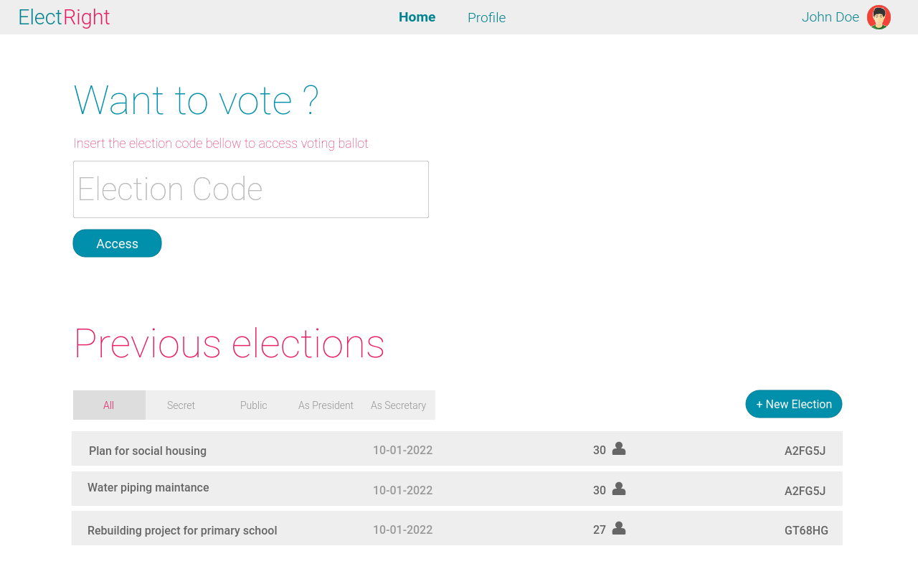
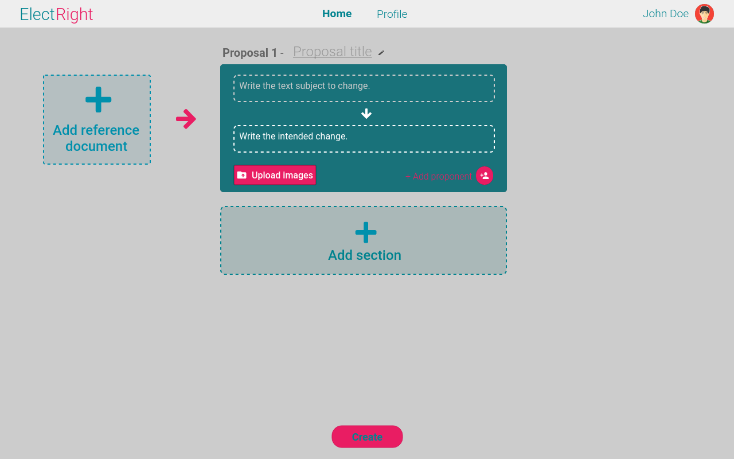
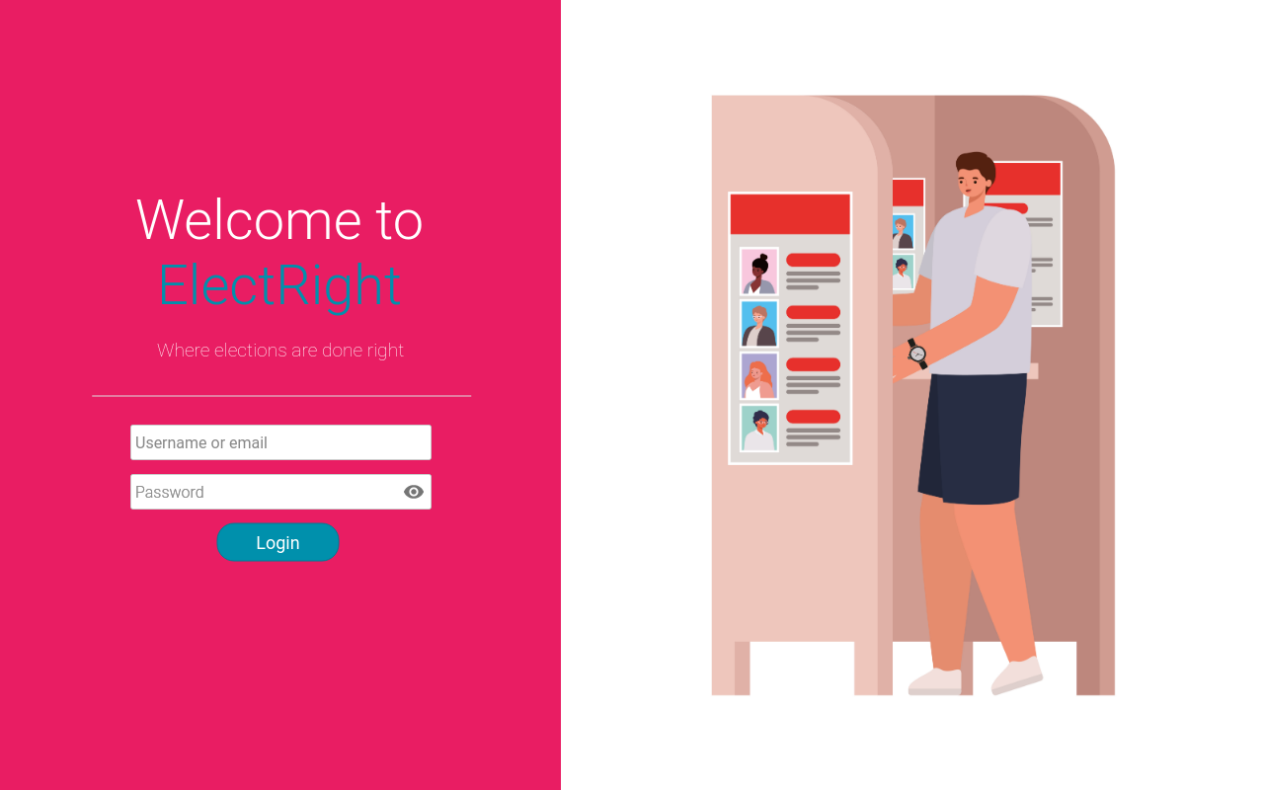
Low Fidelity Prototype (LFP) - 1
Digital prototype made using Pencil project.
Home Page
Login Screen

Slide 14
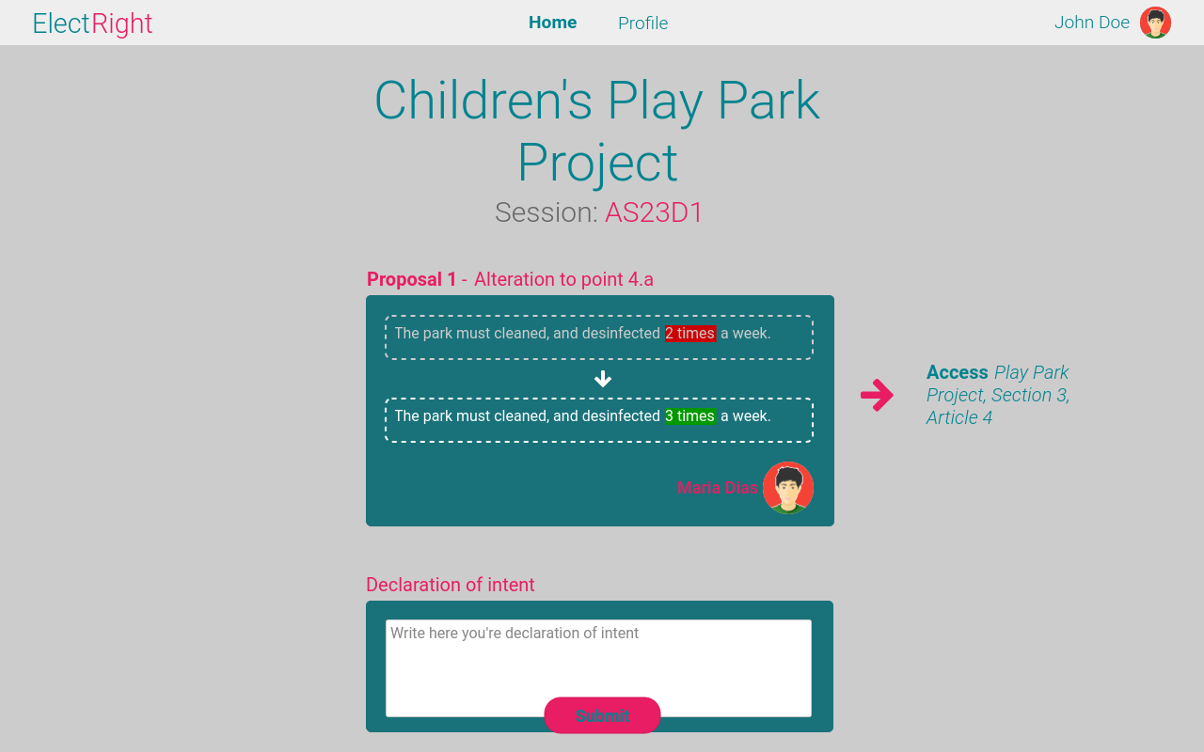
Low Fidelity Prototype (LFP) - 2
Digital prototype made using Pencil project.
Election Editor
Election Ballot

Slide 15
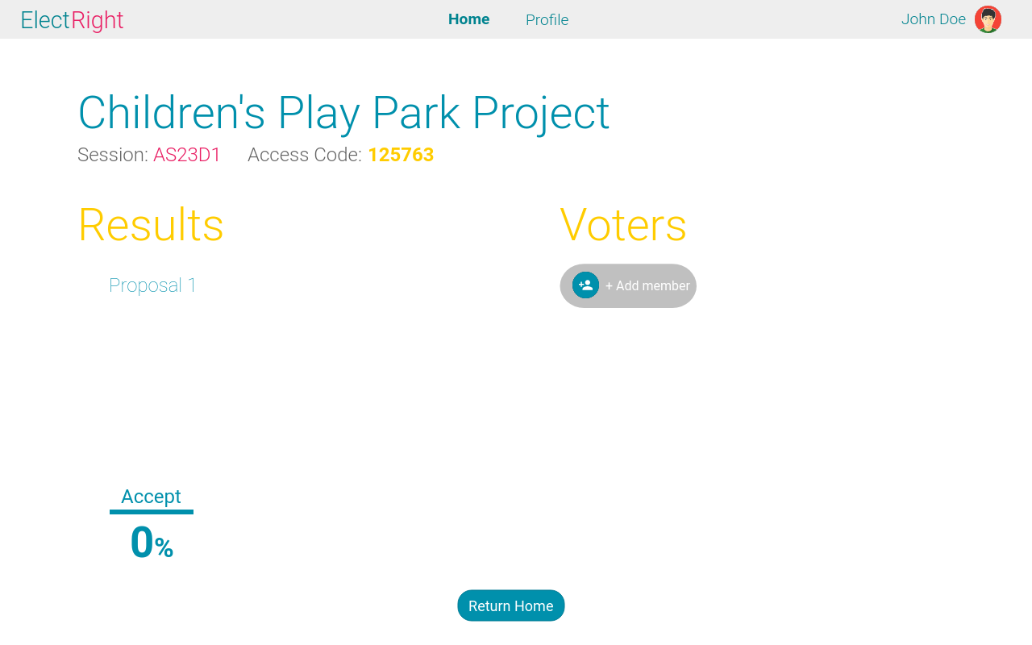
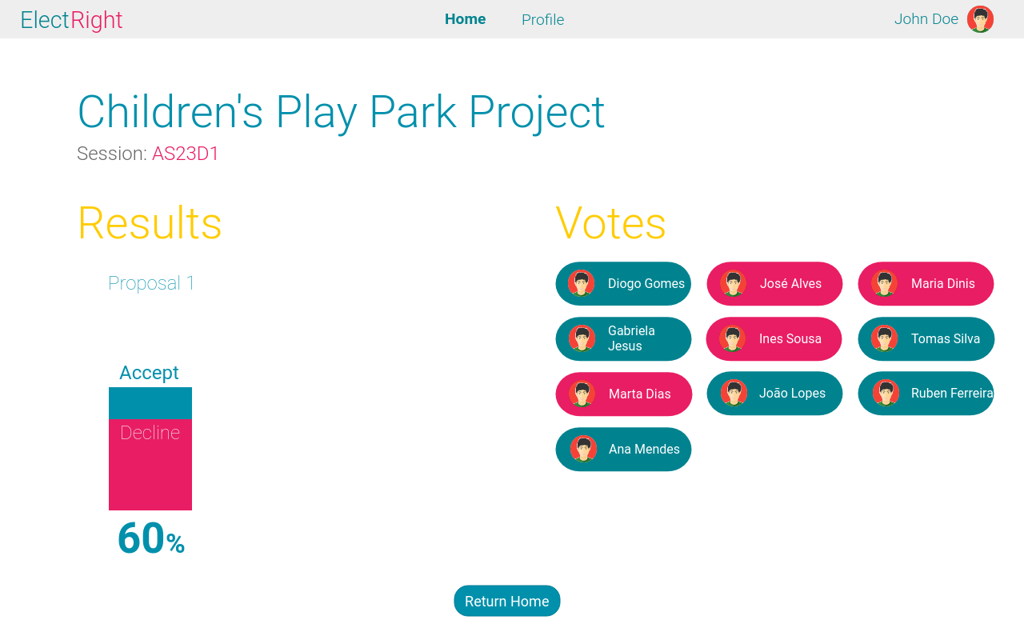
Low Fidelity Prototype (LFP) - 3
Digital prototype made using Pencil project.
Election Share
Election Results

Slide 16
LFP Usability Tests
User evaluation was conducted in the form of a usability test with volunteer participants.
Scenarios tested:
Election Creation
Vote Casting
View Results
User evaluation tasks:
Create an election.
Enter the election with the given code.
Cast your vote.
See the results of the election.

Slide 17
LFP Usability Tests - Results
This Low Fidelity Prototype showed promising results, with users finding the platform easy to use and intuitive in its design.
The sole flaw that became clear from the tests was that the platform’s background colour in the election editor and election ballot should be changed.

Slide 18
Functional Prototype (FP)
The platforms used in the making of ElectRight were React, Bootstrap 5 and Font Awesome.
It was designed for both computers and phones.
Created with the previous prototype as a baseline.

Slide 19
FP Usability Tests - 1
User evaluation was conducted in the form of the previous usability tests with the addition of a SUS questionnaire.
The scenarios tested were limited due to the amount of functionalities implemented at the time.

Slide 20
FP Usability Tests - 2
Scenarios tested:
Election Creation
User evaluation tasks:
Add a title to the proposal.
Write the text to be changed and the respective change.
Add a file.
Add a second proposal.
Delete the second proposal.
Submit the proposal.

Slide 21
FP Usability Tests Results - 1
Several flaws became apparent in the functional prototype:
Users did not realize you could input a title.
Due to a lack of visual explanation, users did not know what to do in some fields.
The proposal “window” was too big making the user scroll to find the submit button.
Homepage should only have the section to enter and election with the create election option becoming available to a signed in user.

Slide 22
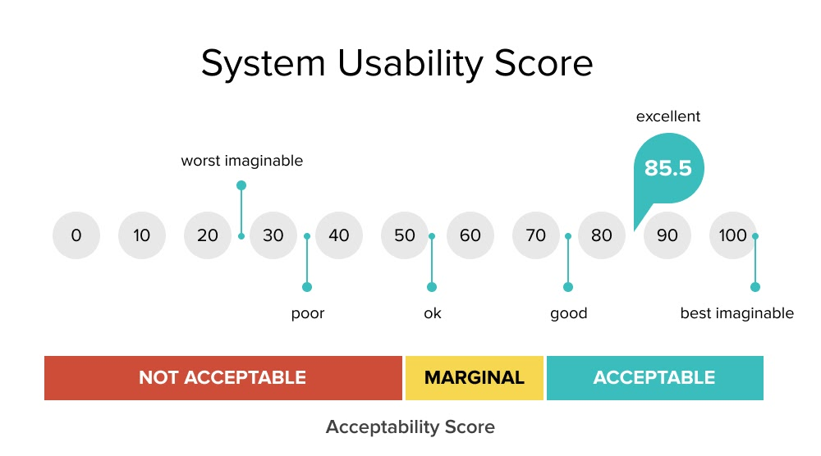
FP Usability Tests Results - 2
Mean SUS questionnaire score (6 participants): 72.92

Slide 23
FP Demo
We’ll now have a quick rundown of the functional prototype.

Slide 24
Future Work
Given more time to develop this project, we would perform more usability tests to the remaining features we did not test, to improve them accordingly.
We would also focus on achieving our non-functional requirements, especially the security and anonymity of our users and the functional requirements we did not implement (friend list).

Slide 25
Acknowledgments
Special thanks to:
Usability test participants – for giving us their feedback on our platform;
HCI teachers - for giving us suggestions along the development of the project.
Team effort:
David Araújo %;
Gonçalo Sousa %;
Catarina Oliveira %.

