Slide 1

ElectRight
Final Presentation & Demo
Design and prototyping of an application using a human-centered approach
Group: David Araújo 93444, Gonçalo Sousa 98152, Catarina Oliveira 98292
Lab Class: P3
Deliverable: 5

Slide 2
What is ElectRight ?
Online platform where a user can run open, authenticated and confidential polls and/or elections.
Create profiles and friend groups.
Run election only for selected users.
Inspired in the formal processes of town councils.

Slide 3


Some competitors
Slido – Has interactive presentations and meetings with live polling tools.
Electionrunner – Create a secure, cloud-based election in which user can vote easily from any device and location.

Slide 4
Our advantages
ElectRight is oriented towards voting in high complexity elections (councils).
Possibility of adding files to ballot.
Election leader has final vote if there is a tie.

Slide 5
Objectives
High-level goals
Host multiple users.
Host election between users.
Organize users in groups to limit access to the elections.
Run different types of elections.
Benefits
Make possible to run the election with local and remote voters.
Faster access to election results.
Expected outcomes
More truth-worthy election processes.

Slide 6
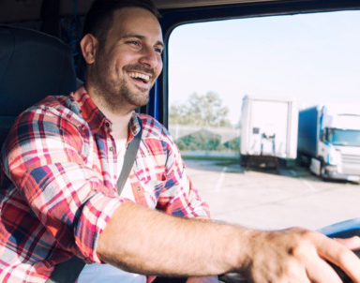
Personas
Tomás Onofre
40 year old, married trucker with 3 children.
President of a trucker’s trade union.
Goals and Tasks
Host election for the members of the council.
Have access to answers while votes from members are anonymous.
Background
Being a trucker and a family man, Tomás has little time to dedicate to activities outside of his schedule.

Slide 7

Personas
Bárbara Isidora
21 year old, IT university student.
Member of university’s student council.
Goals and Tasks
Vote in elections made by the council.
Keep track of the council’s elections and results.
Background
Bárbara is studying IT and has a vast knowledge of applications.

Slide 8

Scenarios
Two main scenarios are voting and casting elections.

Slide 9
Tomás wants better work conditions - 1
A big part of the trade union’s members are unsatisfied with work conditions.
Tomás decides to have an election to determine if they are going to go on strike and what demands they have.
What steps should he take ?

Slide 10
Tomás wants better work conditions - 2
Tomás enters the platform and his account.
Create new election.
Give the election a name.
Add questions to the ballot.
For each question, choose a method of response.
Invite users individually or a group of users.
Check the number of votes cast and the final results.
Make results public.

Slide 11
Bárbara will cast her vote - 1
The university’s student council made an election to determine what to spend their budget on.
Bárbara needs to enter the election in order to vote.
What steps should she take ?

Slide 12
Bárbara will cast her vote - 2
Bárbara enters the platform.
She accesses the election with its respective code.
She reads the plans.
She selects if she agrees or not.
She submits the ballot.
She sees the results of the voting once finished if results are public.

Slide 13
Task Analysis
Election Creation
Option of type of election
Insert name.
Date of start and finish.
User will be transported to editing page where:
Add question.
Text,
Images,
Answer options.
Files.
Add user groups as voters.
Vote Casting
Access election with confirmed identity from any device.
Open ballot.
Read questions
Access files
Select answer options.
Submit ballot
Access result at a later time.

Slide 14
Functional Requirements - 1
Need | Feature | Priority | Expected Release
Cast elections | Create election See results | High | First Iteration
Save election | Associate each users with all pasts election | High | First Iteration
Profile view | Page for profile information Profile edition | High | First Iteration
Friends | Create profiles | High | First Iteration
 | Create groups | Medium | Second Iteration

Slide 15
Functional Requirements - 2
Need | Feature | Priority | Expected Release
Home feed | List of previous and current elections | Medium | Second iteration
File and image support in ballot | Add file to ballot Add image to ballot | Low | Not attainable due to time constraints

Slide 16
Non-Functional Requirements
Need | Feature | Priority | Expected Release
Privacy & Security | Users voting in election have their answers anonymous | High | Not implemented due to the aim of the class
Multiple Users | Allow a High amount of users at the same time | High | Not implemented due to the aim of the class
Load Speed | Take little time for the platform to be usable once accessed | Medium | Not implemented due to the aim of the class

Slide 17
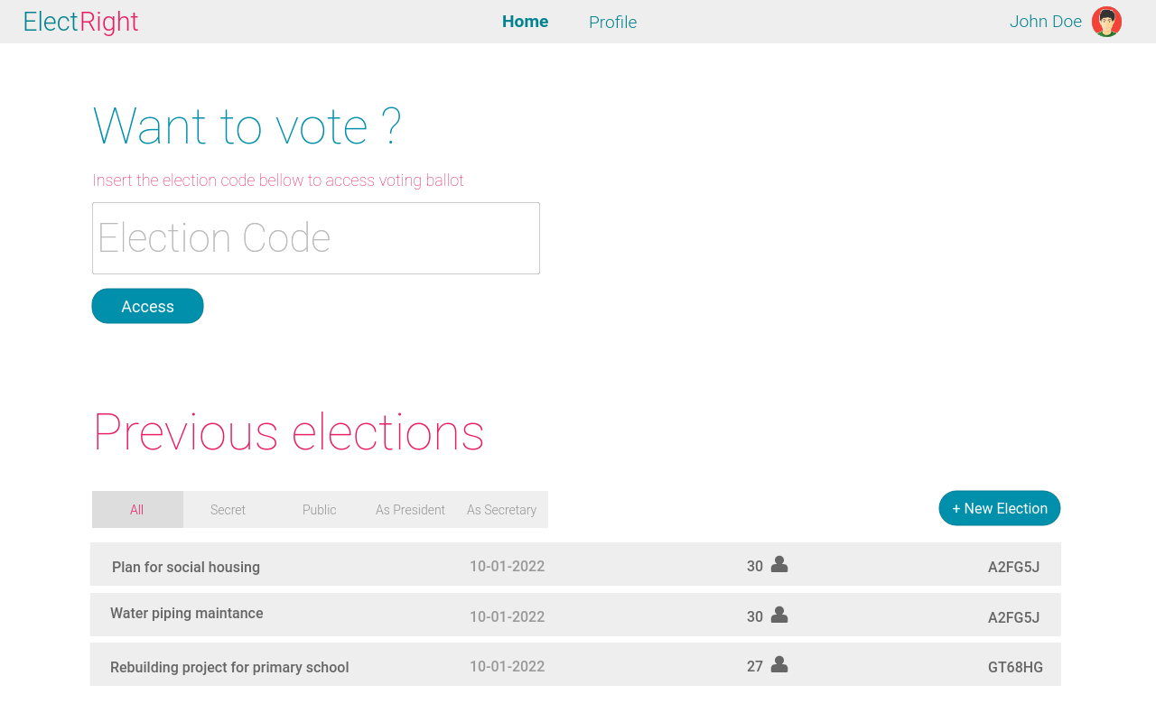
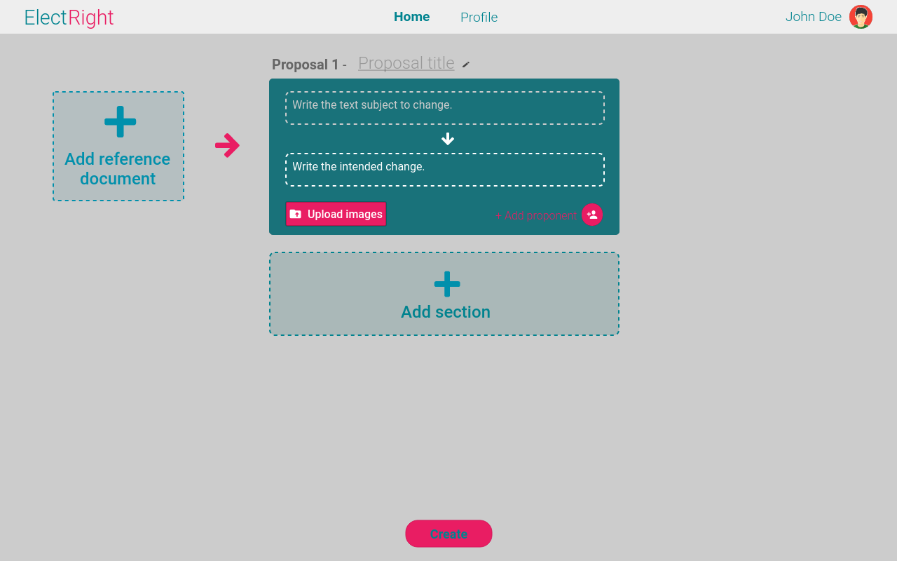
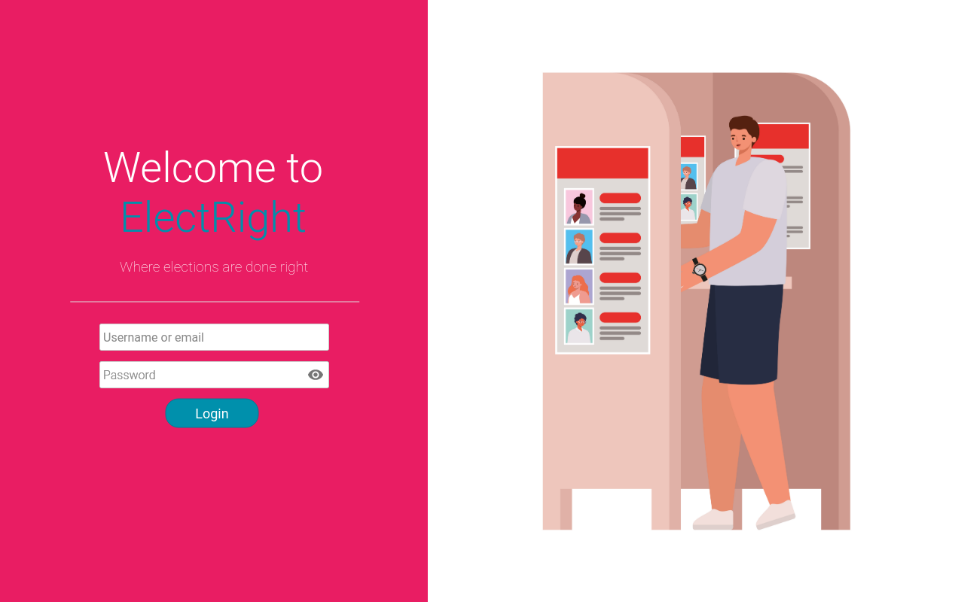
Low Fidelity Prototype (LFP) - 1
Digital prototype made using Pencil project.
Home Page
Login Screen

Slide 18
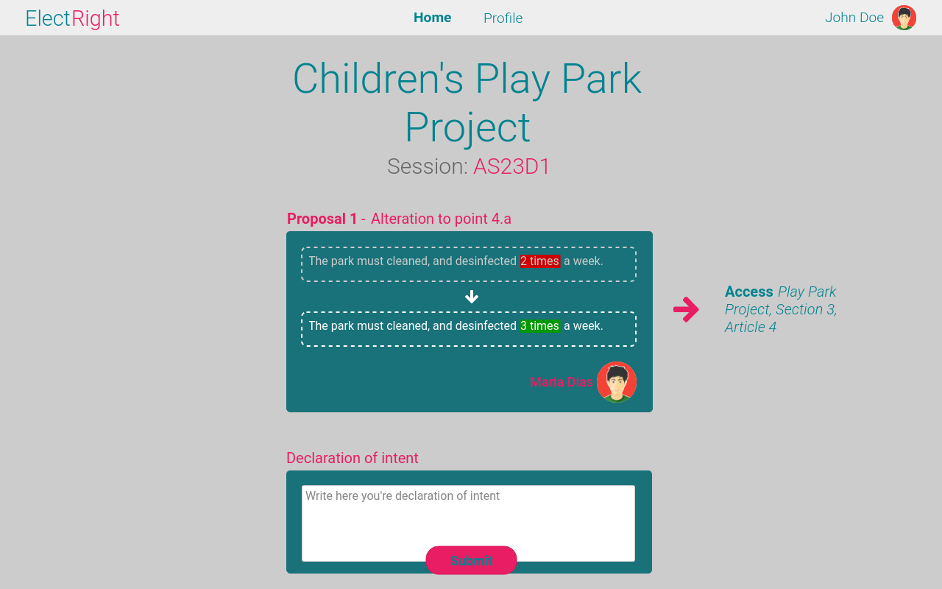
Low Fidelity Prototype (LFP) - 2
Digital prototype made using Pencil project.
Election Editor
Election Ballot

Slide 19
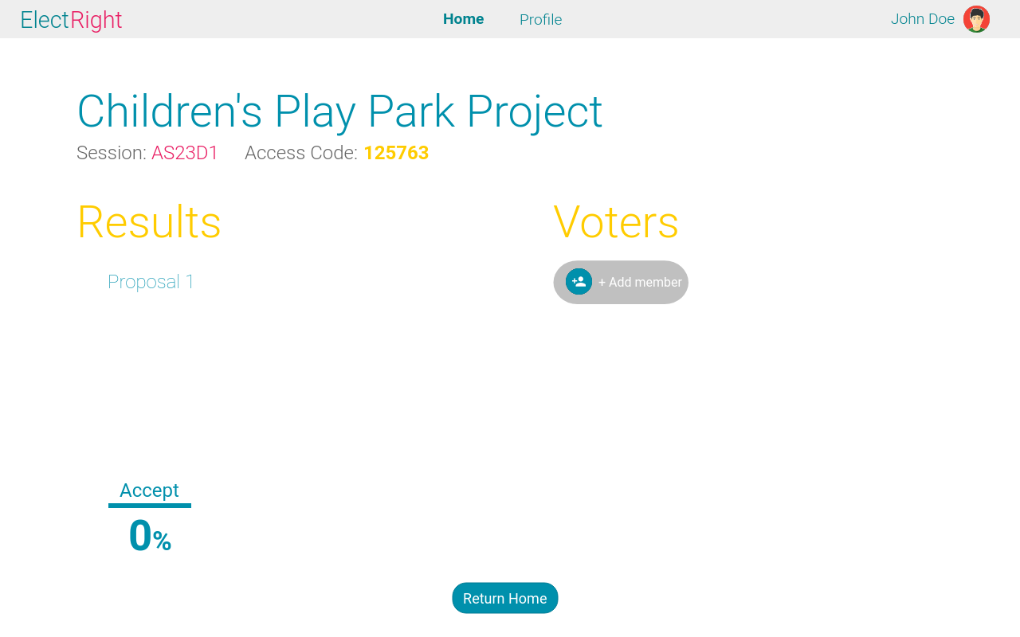
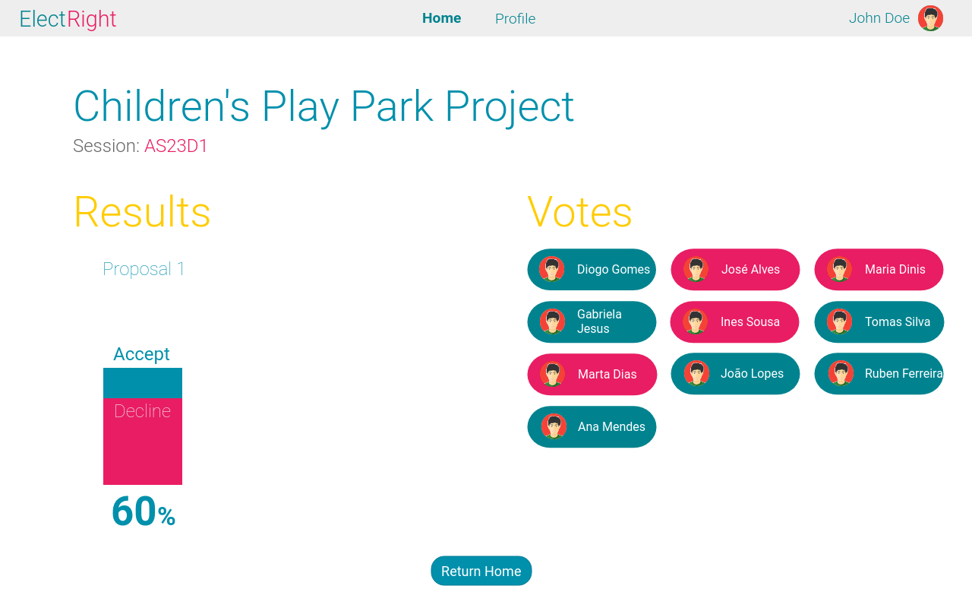
Low Fidelity Prototype (LFP) - 3
Digital prototype made using Pencil project.
Election Share
Election Results

Slide 20
LFP Usability Tests
User evaluation was conducted in the form of a usability test with volunteer participants.
Scenarios tested:
Election Creation
Vote Casting
View Results
User evaluation tasks:
Create an election.
Enter the election with the given code.
Cast your vote.
See the results of the election.

Slide 21
LFP Usability Tests - Results
The users found the Low Fidelity Prototype:
Easy to use;
Intuitive design.
The flaw that became clear from the tests was:
Background colour in the election editor and election ballot;

Slide 22
Functional Prototype (FP)
The platforms used in the making of ElectRight were React, Bootstrap 5 and Font Awesome.
It was designed for both computers and phones.
Created with the previous prototype as a baseline.

Slide 23
FP Main Issues
Given the deadline of the project, some aspects needed to be simplified or not implemented:
President’s vote –> Special vote to end a tie in the election;
Group Creation -> Elections must have every member assigned individually;
File and image support -> Not implemented.

Slide 24
FP Usability Tests - 1
User evaluation was conducted in the form of the previous usability tests with the addition of a SUS questionnaire.
The scenarios tested during classes were limited due to the amount of functionalities implemented at the time.

Slide 25
FP Usability Tests - 2
Scenarios tested:
Election Creation
User evaluation tasks:
Add a title to the proposal.
Write the text to be changed and the respective change.
Add a file.
Add a second proposal.
Delete the second proposal.
Submit the proposal.

Slide 26
FP Usability Tests (Creating Election) Results
Several flaws became apparent in the functional prototype, tested during classes:
User did not realize you could input a title.
Lack of visual explanation -> user did not know what to do in some ballot fields.
Proposal “window” too big -> user has to scroll to find the submit button.
Homepage’s focus on create election should be altered to a focus on casting a vote.

Slide 27
FP Usability Tests (Voting) Results
Similar to the Low Fidelity Prototype of this task, users found voting:
Easy to use;
Intuitive design.
There was also a small flaw pointed out:
Only 1 type of response possible(declaration of intent).

Slide 28
FP Usability Tests SUS Results - 1
Creating Election (6 participants):
SUS questionnaire results: 70, 75, 85, 72.5, 75, 60;
Mean SUS questionnaire score: 72.92.
Voting (4 participants):
SUS questionnaire results: 75, 82.5, 80, 80;
Mean SUS questionnaire score: 79.38.

Slide 29
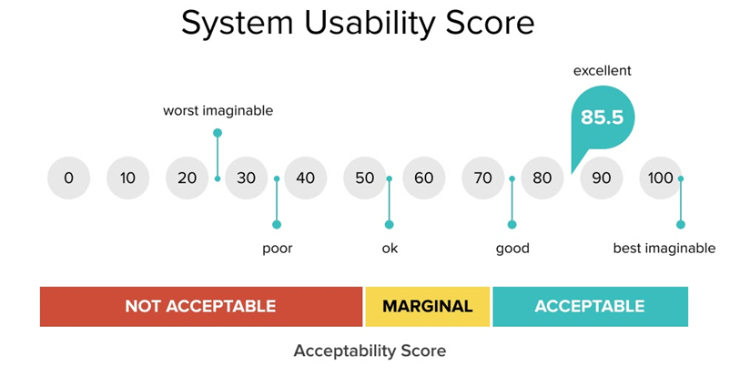
FP Usability Tests SUS Results - 2
Contextualising the previous results:
Average user will find it easy to use our application;
Even older people (1 participant had 66 years old) can easily interact with app.

Slide 30
FP Heuristic Evaluation
Description | Evaluation | Usability Heuristic
Can’t make groups | 3 | #7: Flexibility and efficiency of use
Lack of help in application | 2 | #10: Help and documentation

Slide 31
FP Demo
We’ll now have a quick rundown of the functional prototype.

Slide 32
Future Work
Implementing further requirements, such as:
File and image support;
Complexity in the voting process;
Create groups of people;

Slide 33
Acknowledgments
Special thanks to:
Usability test participants – for giving us their feedback on our platform;
HCI teachers - for giving us suggestions along the development of the project.
Team effort:
David Araújo 50%;
Gonçalo Sousa 25%;
Catarina Oliveira 25%.

