Slide 1
Advanced Section #2: Methods of Regularization and their justifications
Robbert Struyven and Pavlos Protopapas (viz. Camilo Fosco)

Slide 2
Outline
Motivation for regularization
Generalization
Instability
Ridge estimator
Lasso estimator
Elastic Net estimator
Visualizations
Bayesian approach

Slide 3
Regularization: introduce additional information to solve ill-posed problems or avoid overfitting.

Slide 4
Motivation
Why do we regularize?

Slide 5
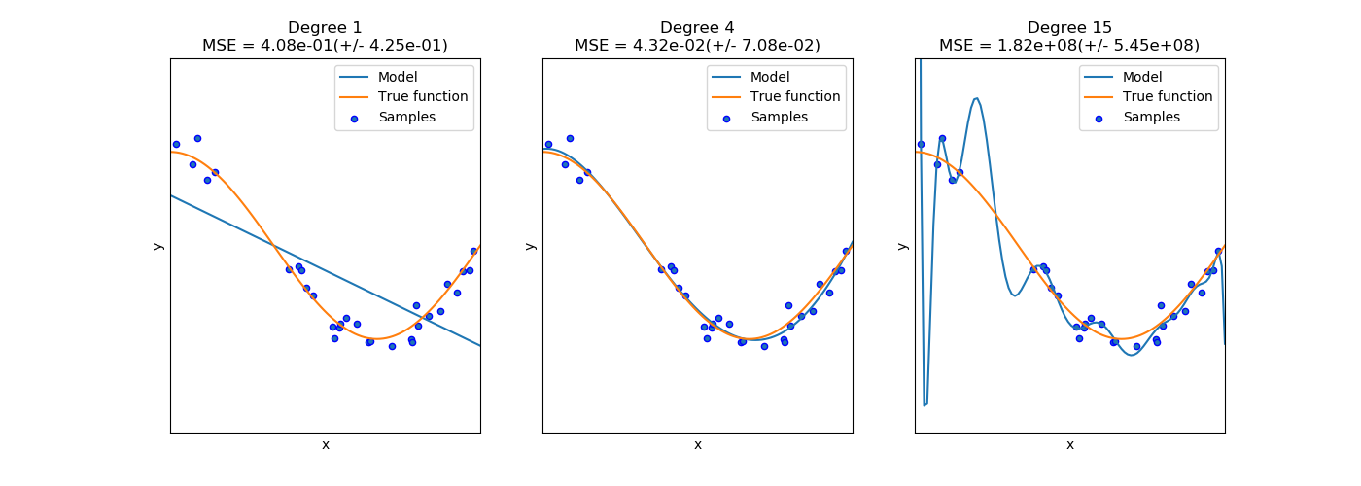
Generalization
Avoid overfitting. Reduce features that have weak predictive power.
Discourage the use of a model that is too complex.
Do not fit the noise!
Notes:
Regularization will, in most cases, add a bias to our coefficients such that they perform worse on train data, but hopefully they perform better on test data. Complex model hard to understand!

Slide 6
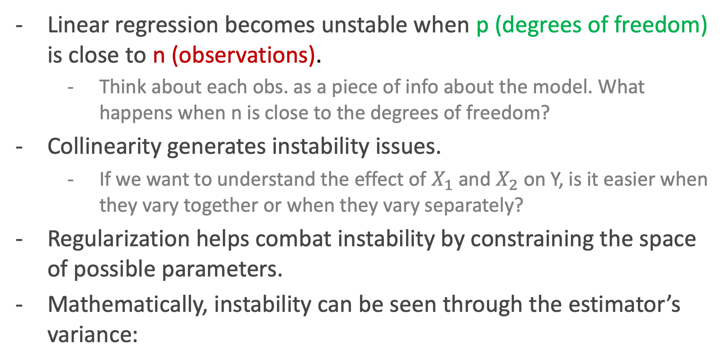
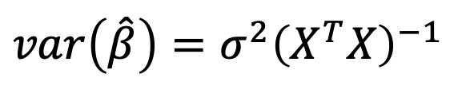
Instability issues
Notes:
Instability = (small change in input generates big change in output)
P the number of degrees of freedom of the model
N = number of data points
Smoking -> Lung cancer
Alcohol -> Lung cancer
Bar -> (Smoke) -> Lung cancer

Slide 7

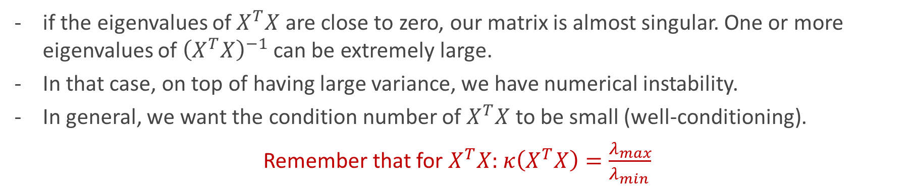
Instability issues
var(Y)
Inverse of Gram matrix
The variance of the estimator is affected by the irreducible noise of the model. We have no control over this.
But the variance also depends on the predictors themselves! This is the important part.
Notes:
Out loud: This is an important formula. The sigma corresponds to the variance of the response, and the second term is the inverse of the Gram matrix. It is clear from here that if XtX is ill-conditioned, the variance of my estimator will be large. Ill-conditioning = condition number large = you are working on scales that differ on complete orders of magnitude. Thinking of our matrix as a transformation, it is like squeezing something really thin in one direction, while stretching it very far in another direction.
In nearly collinear datasets, condition number is large, and small changes in our data can yield large changes in our estimations.
Singular = eigenvalues 0

Slide 8
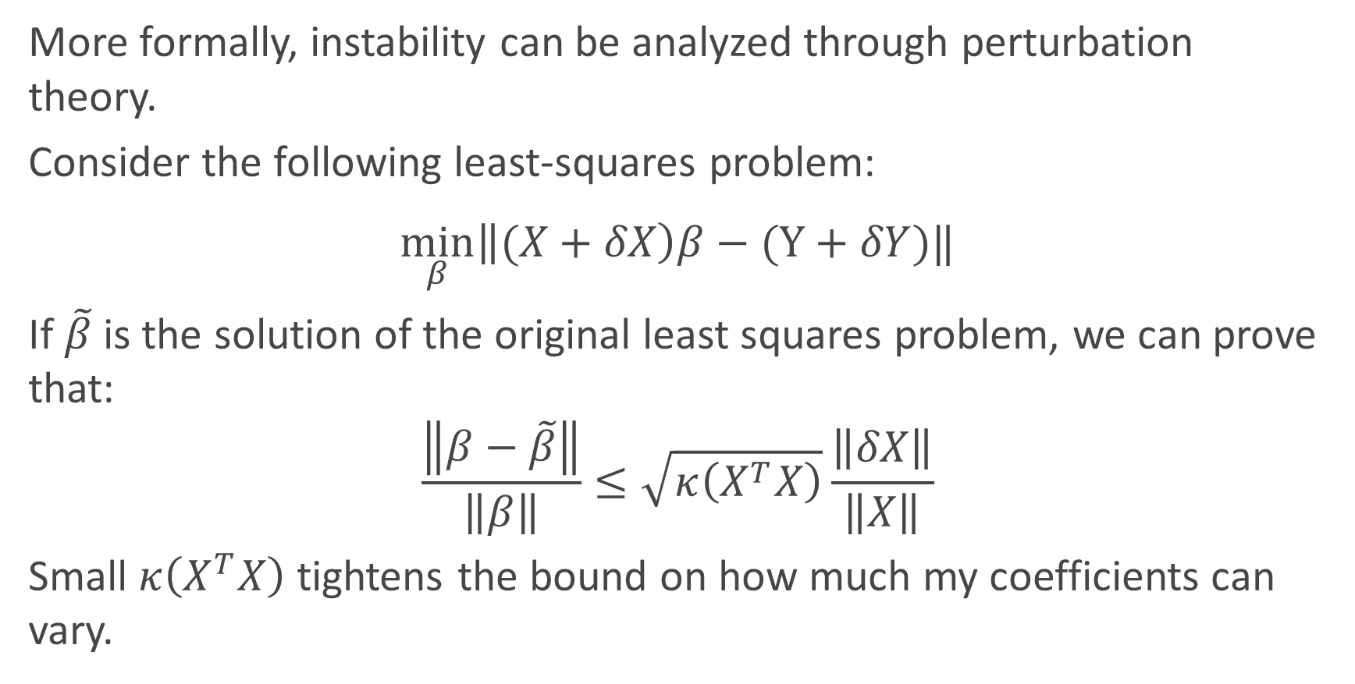

Instability and the condition number
Perturbations

Slide 9
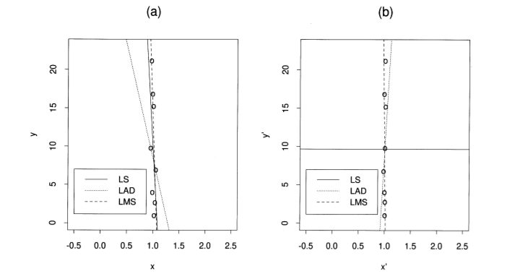
Instability visualized
Instability can be visualized by regressing on nearly colinear data, and observing the changes on the same data, slightly perturbed:
Image from “Instability of Least Squares, Least Absolute Deviation and Least Median of Squares Linear Regression”, Ellis et al. (1998)

Slide 10
Motivation in short
We want less complex models to avoid overfitting and increase interpretability.
We want to be able to solve problems where p = n or p > n, and still generalize reasonably well.
We want to reduce instability (increase min eigenvalue/reduce condition number) in our estimators. We need to be better at estimating betas with colinear predictors.
In a nutshell, we want to avoid ill-posed problems (no solutions / solutions not unique / unstable solutions)

Slide 11
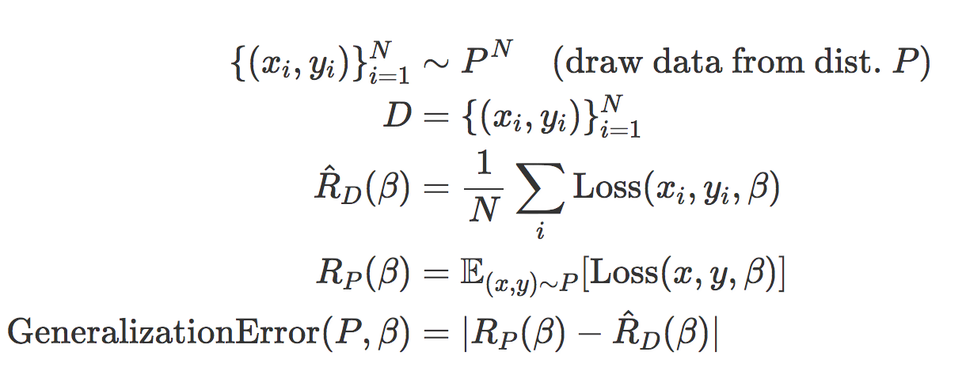
Generalization
Can define generalization: error on available dataset and all hypothetical datasets doesn’t differ too much!
Notes:
Regularization will, in most cases, add a bias to our coefficients such that they perform worse on train data, but hopefully they perform better on test data. Complex model hard to understand!

Slide 12
Ridge regression
Instability destroyer

Slide 13
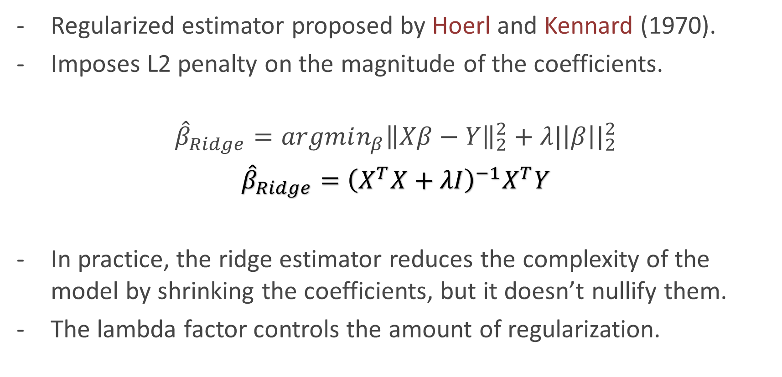
What is the Ridge estimator?
Regularization factor
Notes:
Although we learn from this formulation that Ridge helps because it shrinks the parameters (less model complexity translates to better out of sample error, provable with learning theory), This formulation is not the original one. In fact, originally, it was proposed as a way to solve instability in the Gram matrix by adding a constant to the eigenvalues.

Slide 14
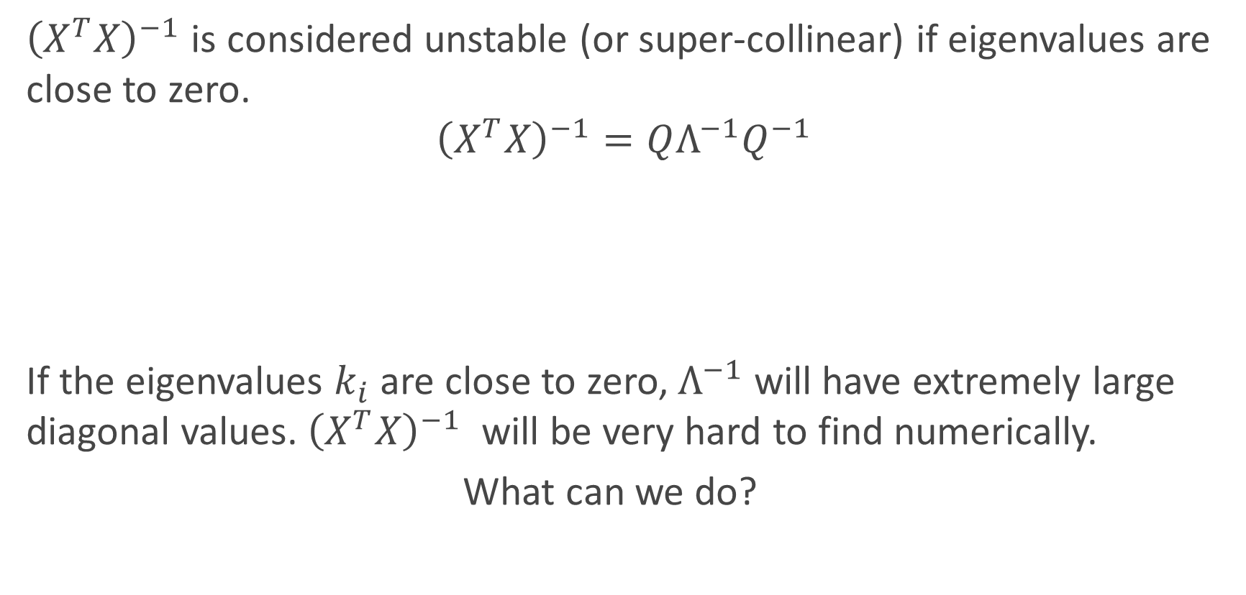
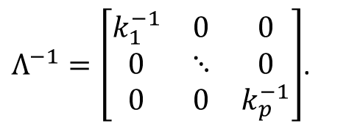
Deriving the Ridge estimator
Eigendecompostion

Slide 15
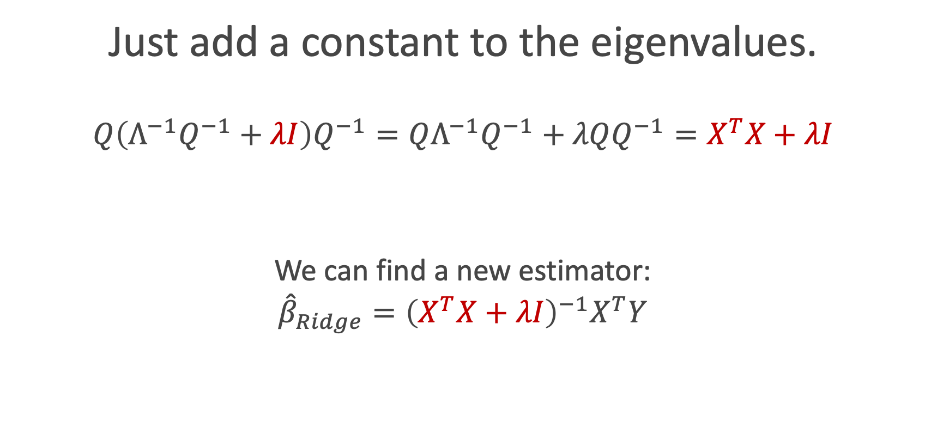

Deriving the Ridge estimator

Slide 16
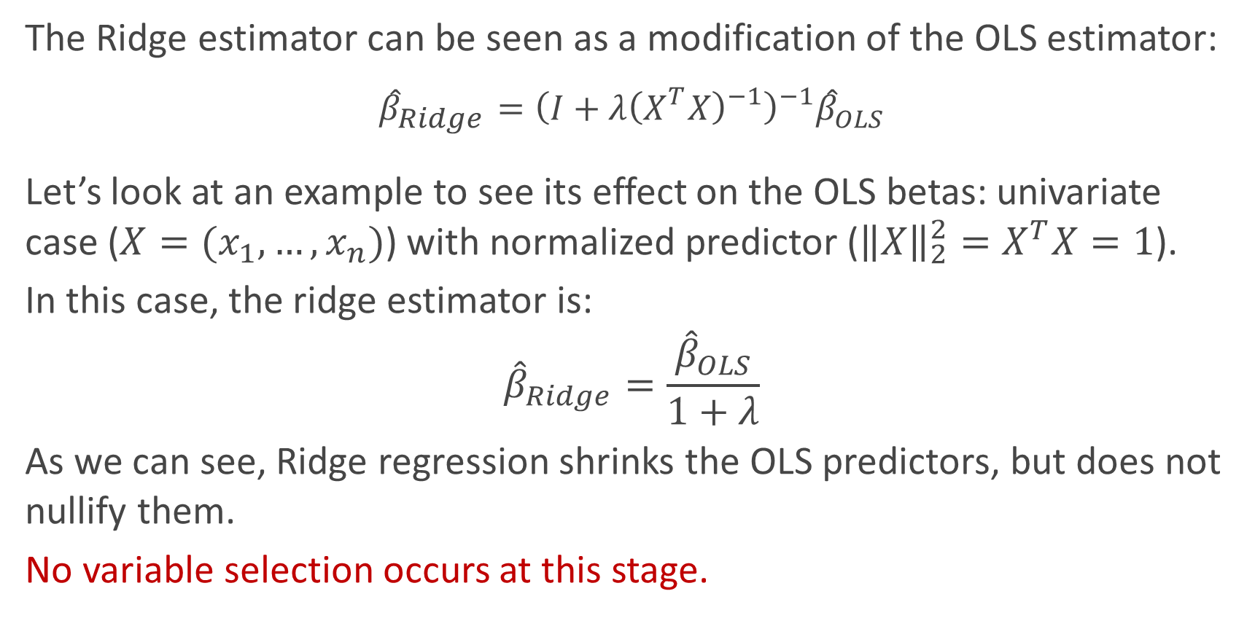
Properties: shrinks the coefficients

Slide 17
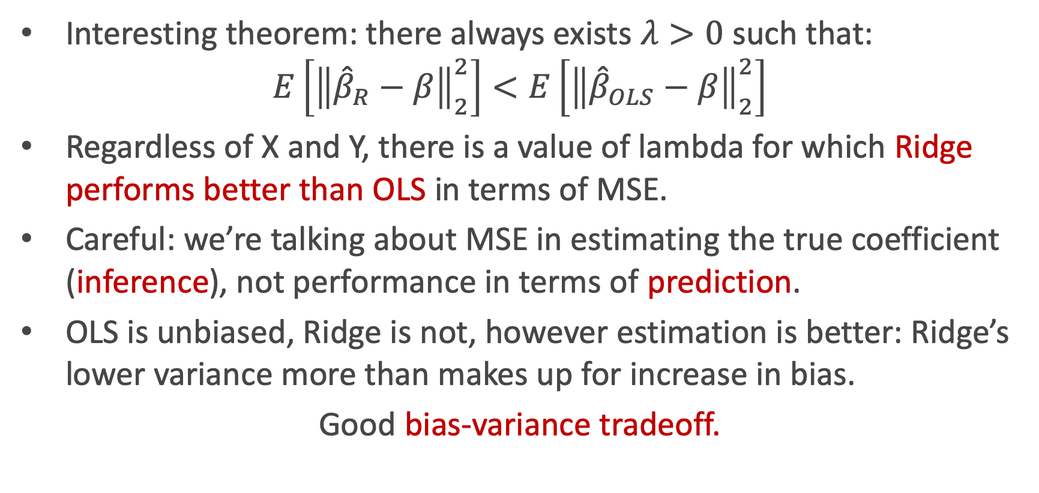
Properties: closer to the real beta

Slide 18
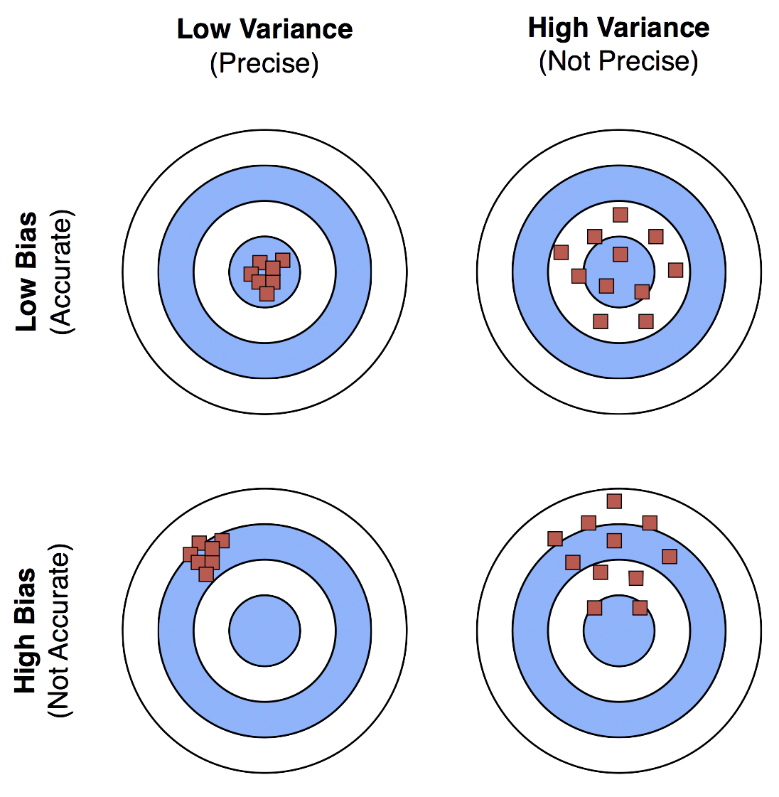
Good bias-variance tradeoff.
OLS
Higher Variance (instable Betas)
No Bias
Ridge
Lower Variance
Adding some Bias

Slide 19
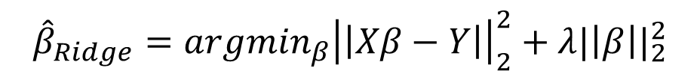
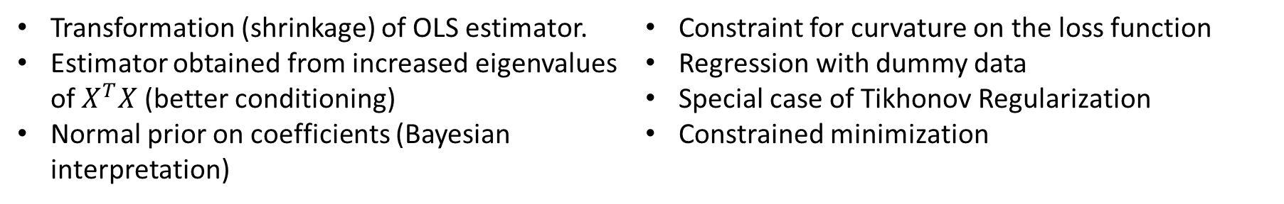
Different perspectives on Ridge
So far, we understand Ridge as a penalty on the optimization objective:
However, there are multiple ways to look at it:

Slide 20
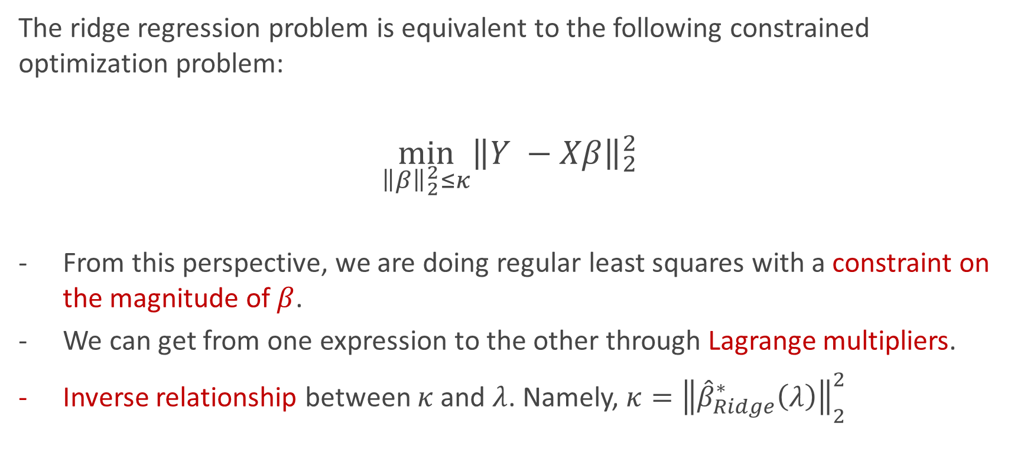
Optimization perspective

Slide 21
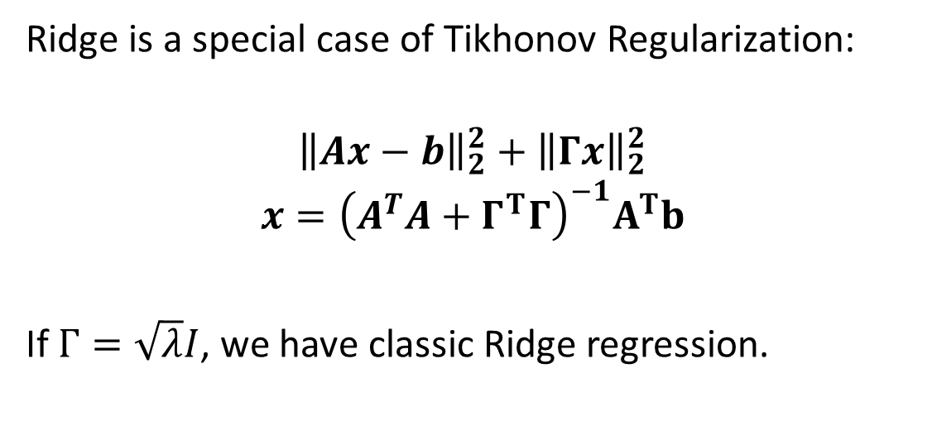
Ridge, formal perspective
Monsieur Ridge
Tikhonov Matrix

Slide 22
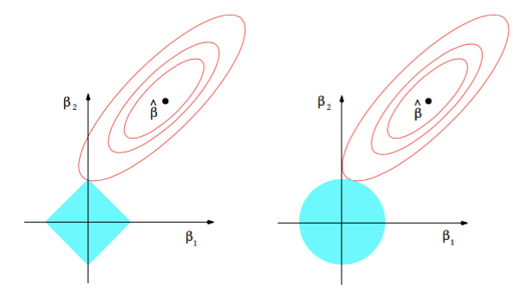
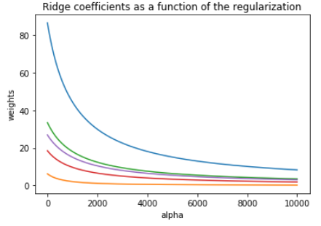
Ridge visualized
Ridge estimator
The ridge estimator is where the constraint and the loss intersect.
The values of the coefficients decrease as lambda increases, but they are not nullified.

Slide 23
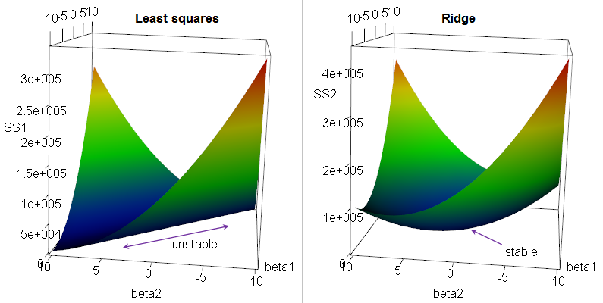
Ridge visualized
Ridge curves the loss function in colinear problems, avoiding instability.
Notes:
If there's multicollinearity, you get a "ridge" in the likelihood function (likelihood is a function of the β's). This in turn yields a long "valley" in the RSS (since RSS=−2logL−2log⁡L).
Ridge regression "fixes" the ridge - it adds a penalty that turns the ridge into a nice peak in likelihood space, equivalently a nice depression in the criterion we're minimizing.

Slide 24
LASSO regression
Yes, LASSO is an acronym

Slide 25
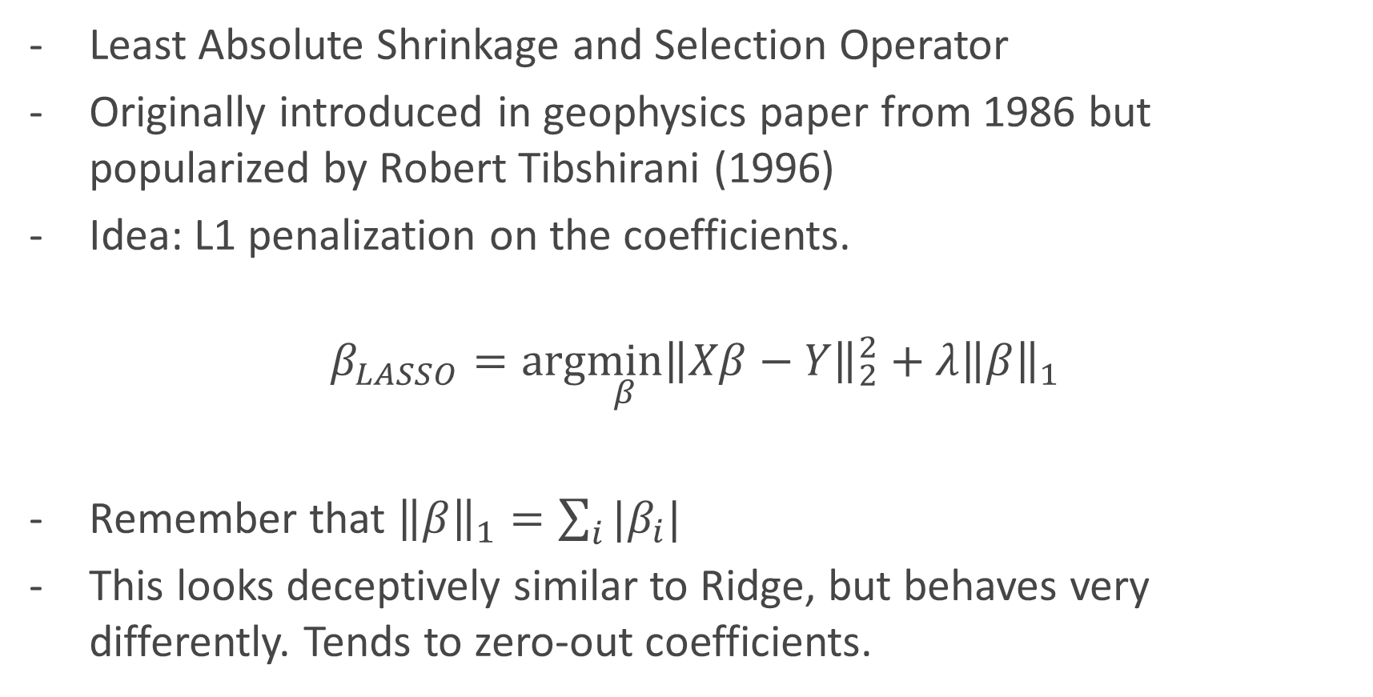
What is LASSO?

Slide 26
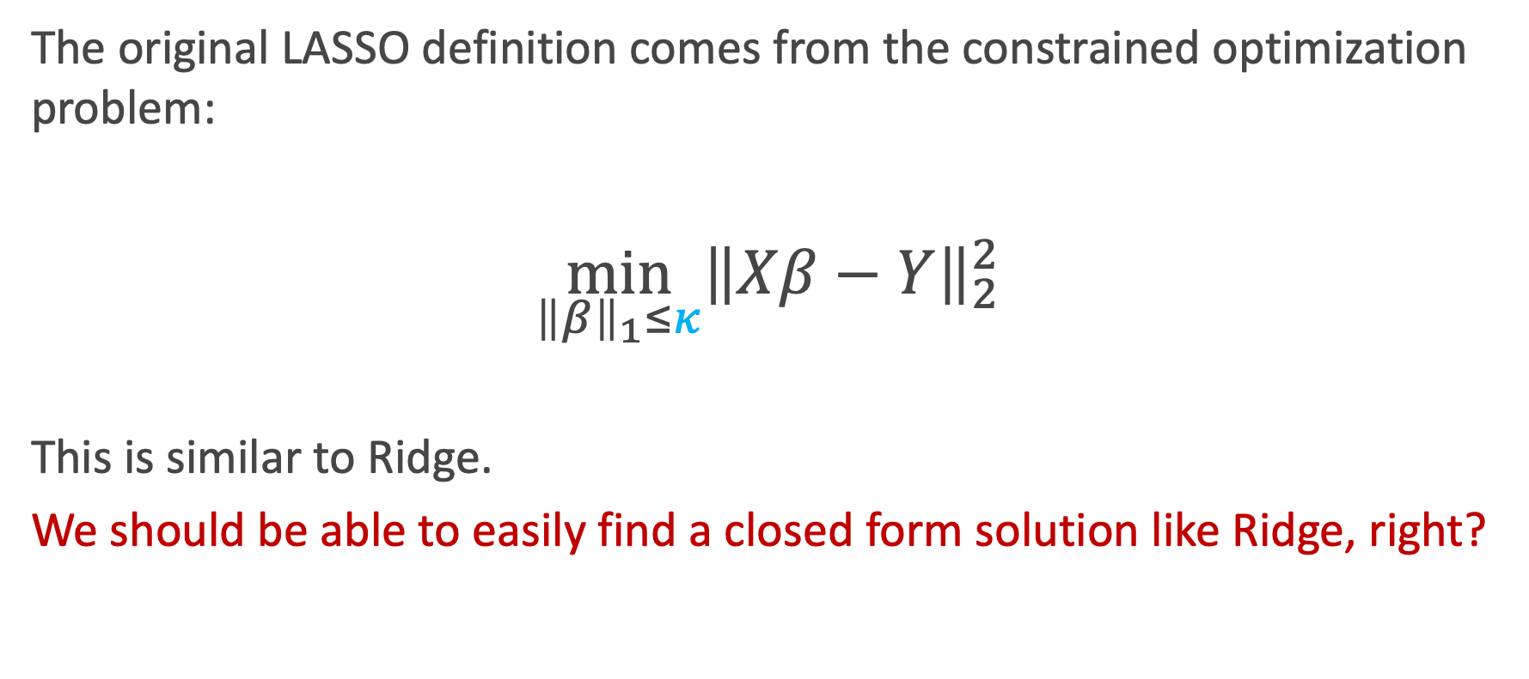
Deriving the LASSO estimator

Slide 27
No.

Slide 28
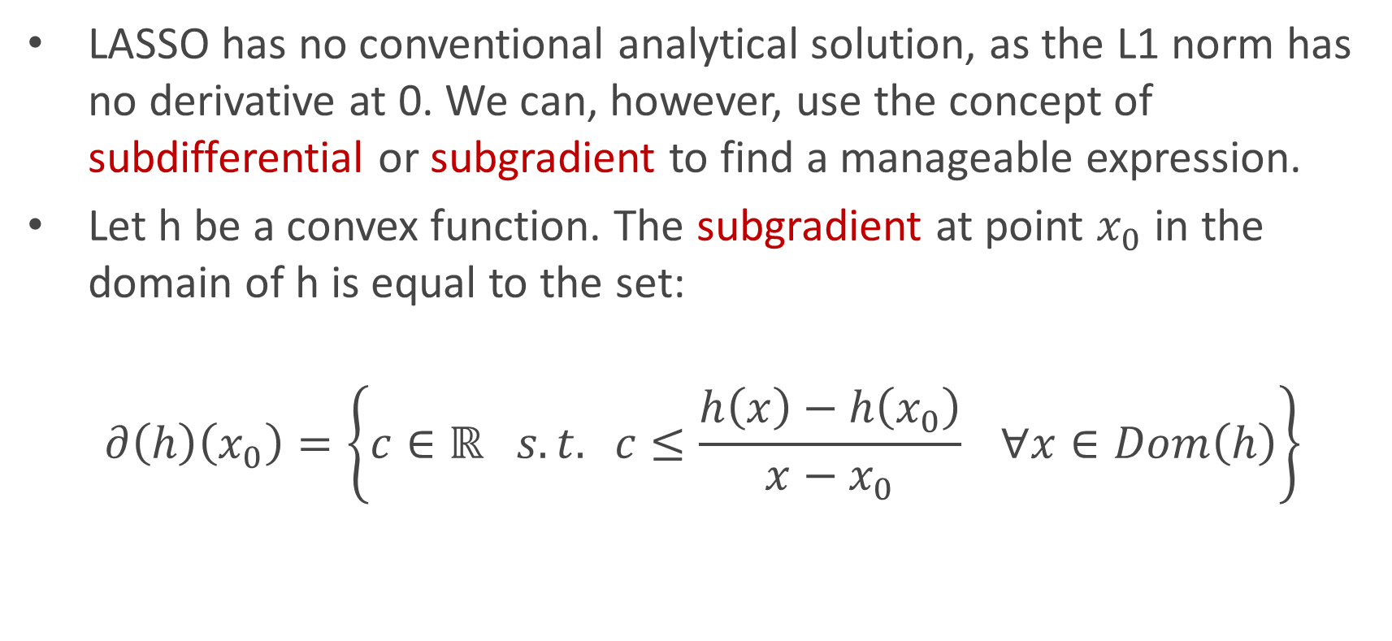
Subgradient to the rescue

Slide 29
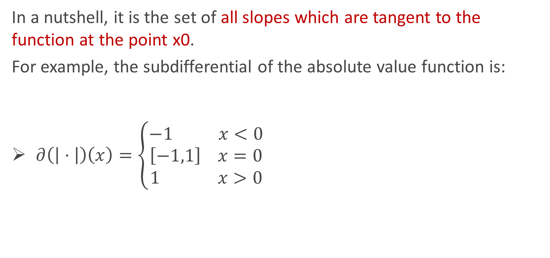
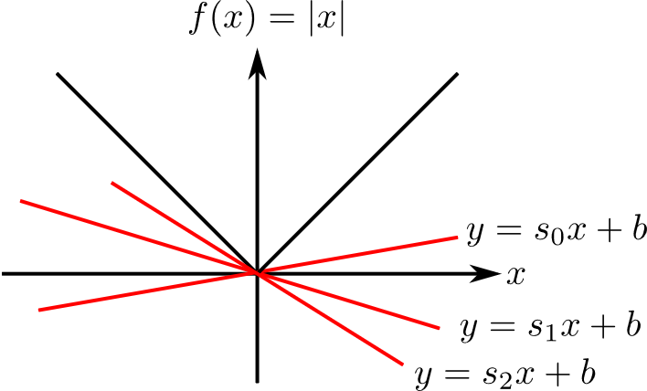
Subgradient to the rescue

Slide 30
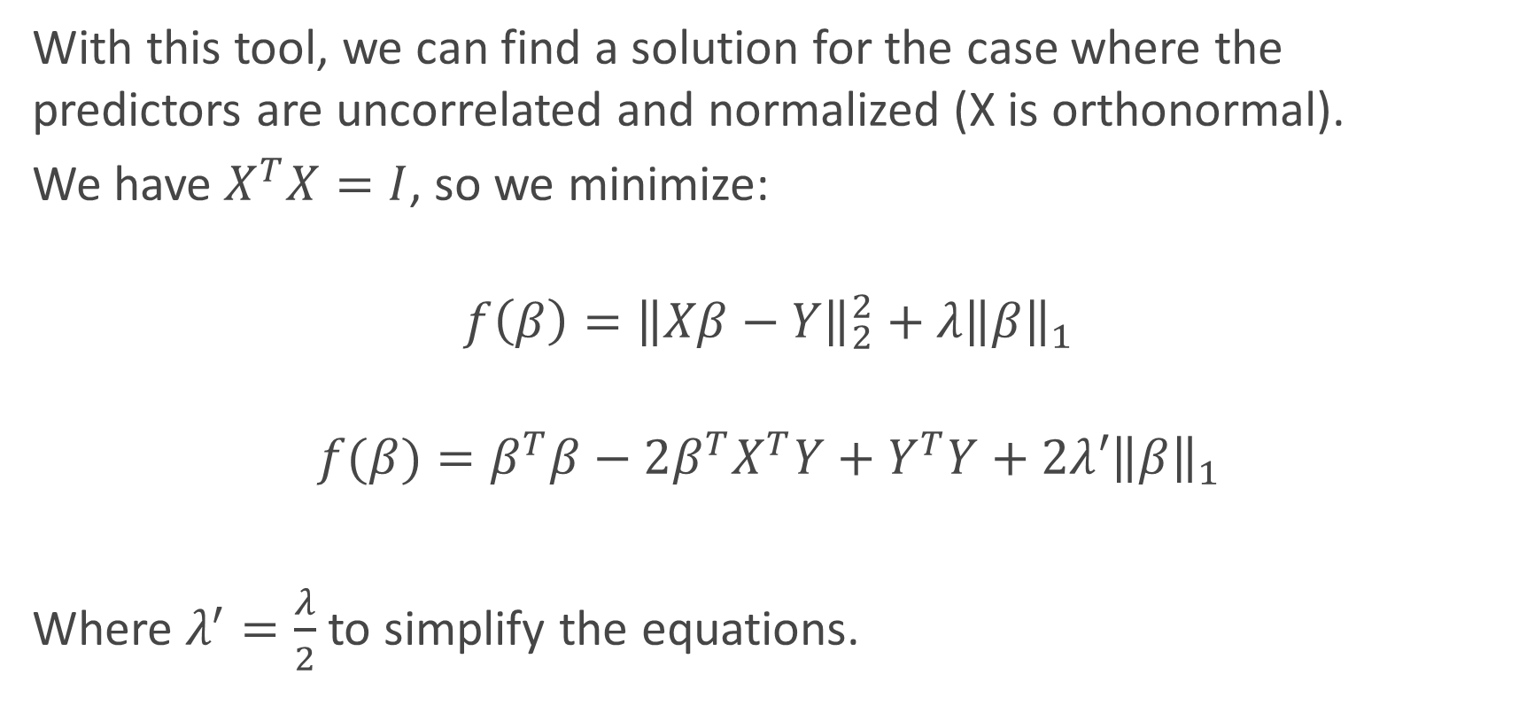
Deriving LASSO

Slide 31
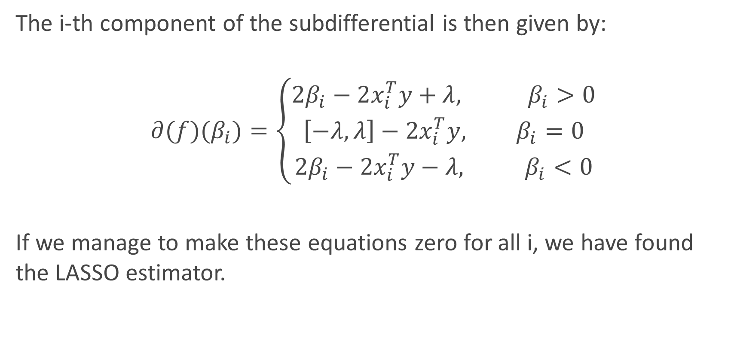
Deriving LASSO

Slide 32
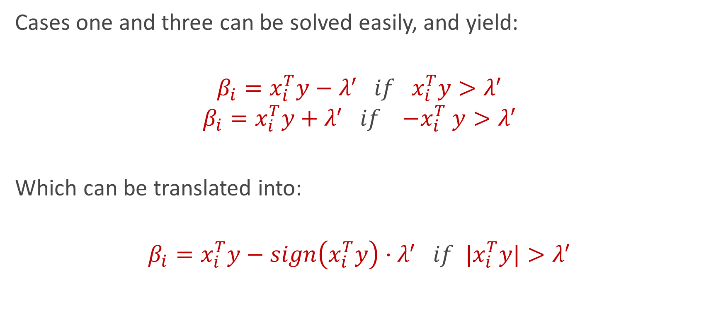
Deriving LASSO

Slide 33
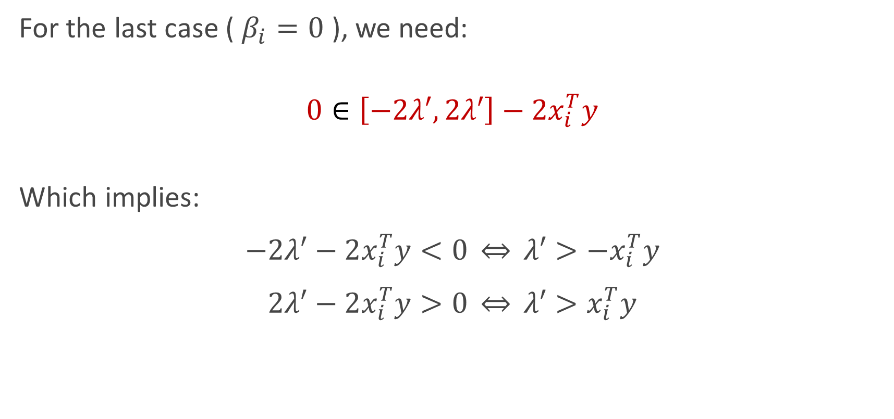
Deriving LASSO
Notes:
Im putting a cap on how little correlation with the output I want. If xty is smaller than lambda, eliminated!

Slide 34
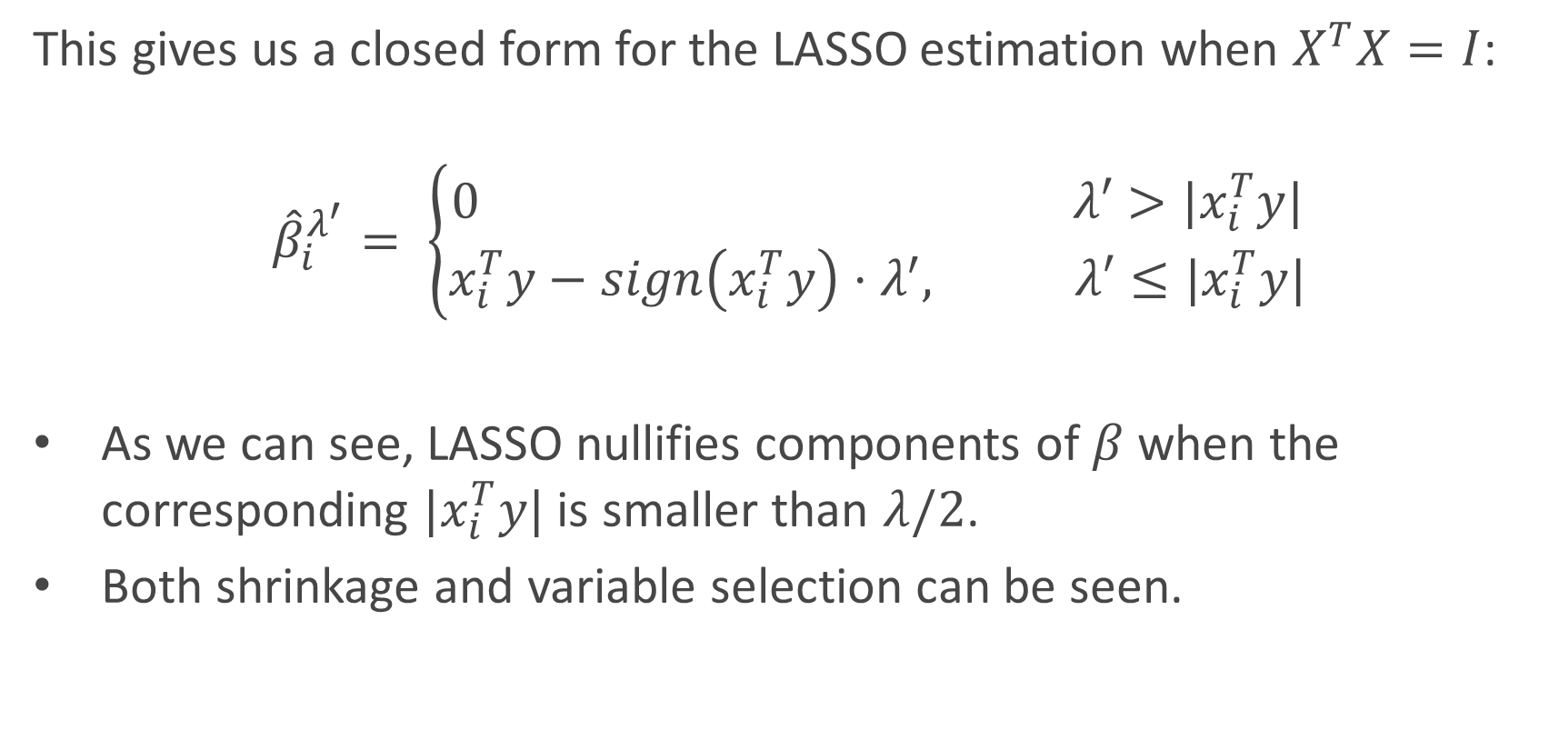
Deriving LASSO

Slide 35
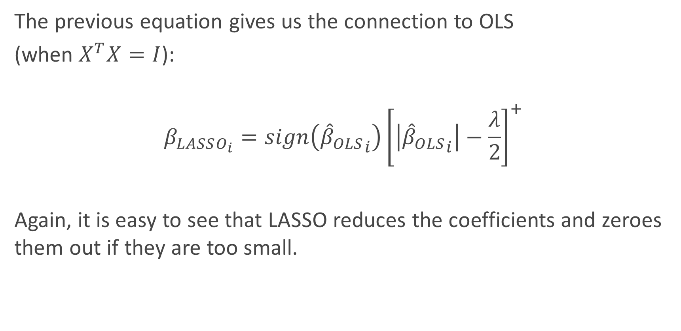
Connections of LASSO with OLS

Slide 36
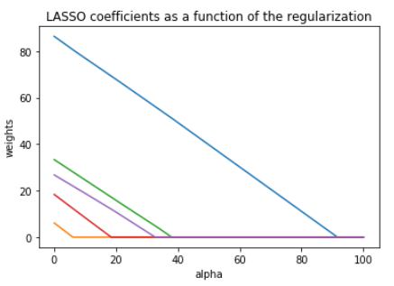
LASSO visualized
Lasso estimator
The Lasso estimator tends to zero out parameters as the OLS loss can easily intersect with the constraint on one of the axis.
The values of the coefficients decrease as lambda increases, and are nullified fast.

Slide 37
Elastic Net ESTIMATOR
Estimators, assemble

Slide 38
Problems with Ridge and LASSO
Ridge does not perform feature selection.
Ridge and Lasso are sensible to outliers.
When p > n, LASSO can choose at most n predictors to use. The rest are nullified.
When there are multiple correlated predictors, LASSO tends to indifferently choose one and discard the rest.
For example, if you run a problem with large number features multiple times, you might have a very different feature set each time.
Notes:
In addition, both empirical evidence and theoretical analysis (Efron et al., 2004) show
that when there are a number of highly-correlated predictors, then the LASSO estimator
indierently selects one among them and discards the rest. This can be highly problematic
in practice; for example, if a group of clustered genes jointly predict for a disease but are
correlated, it would be scientifically invalid to randomly select one of these genes and
ignore the rest.

Slide 39
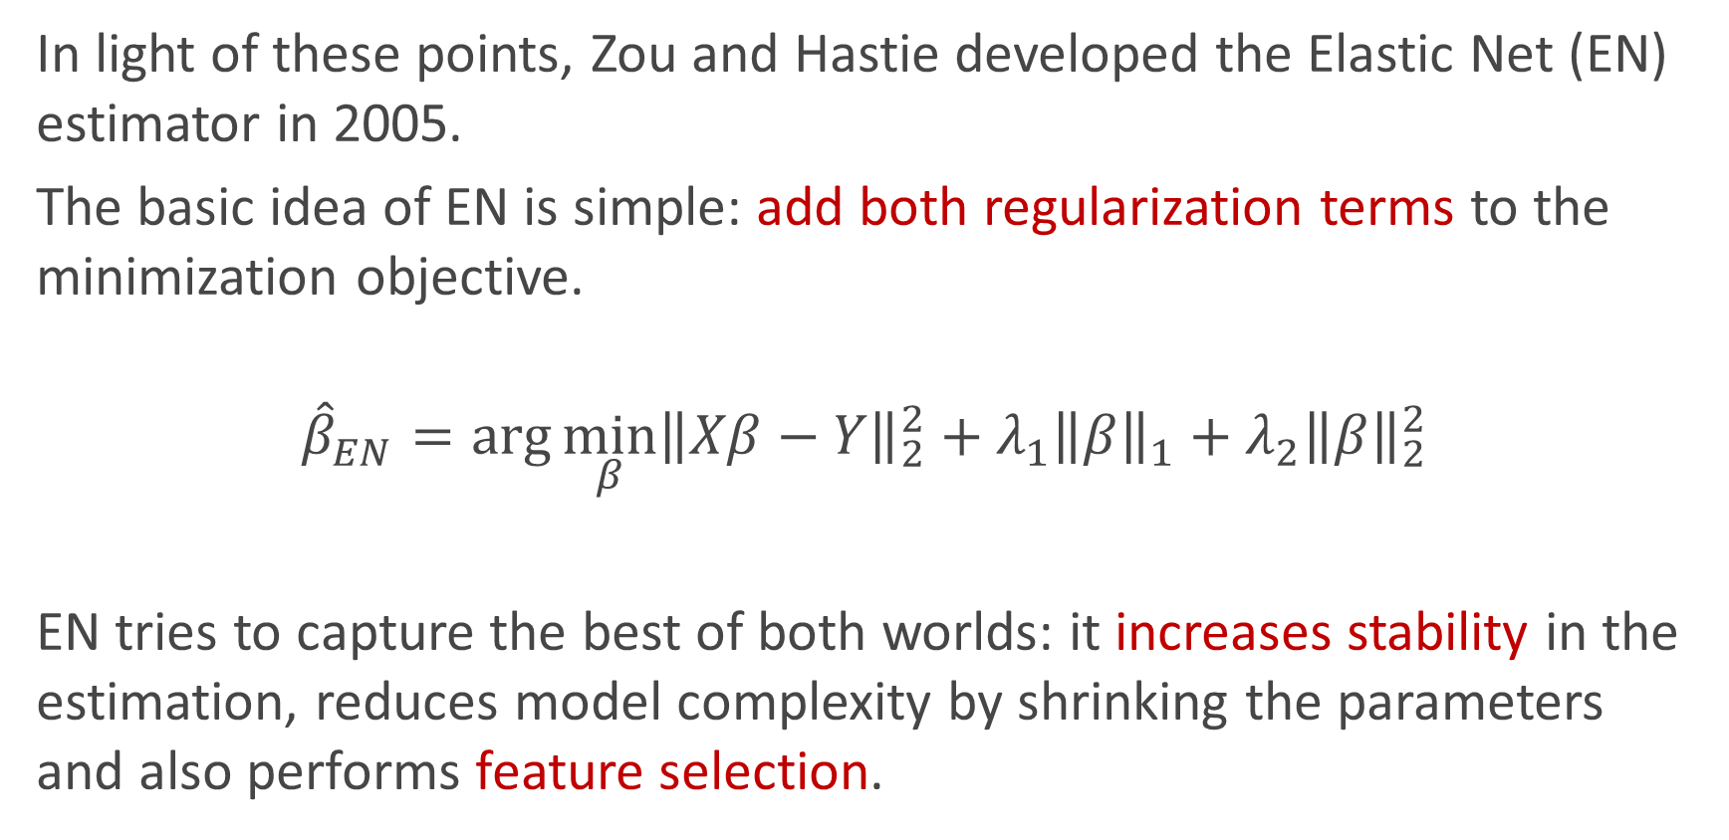
Combine Ridge and LASSO!
LASSO
Ridge

Slide 40
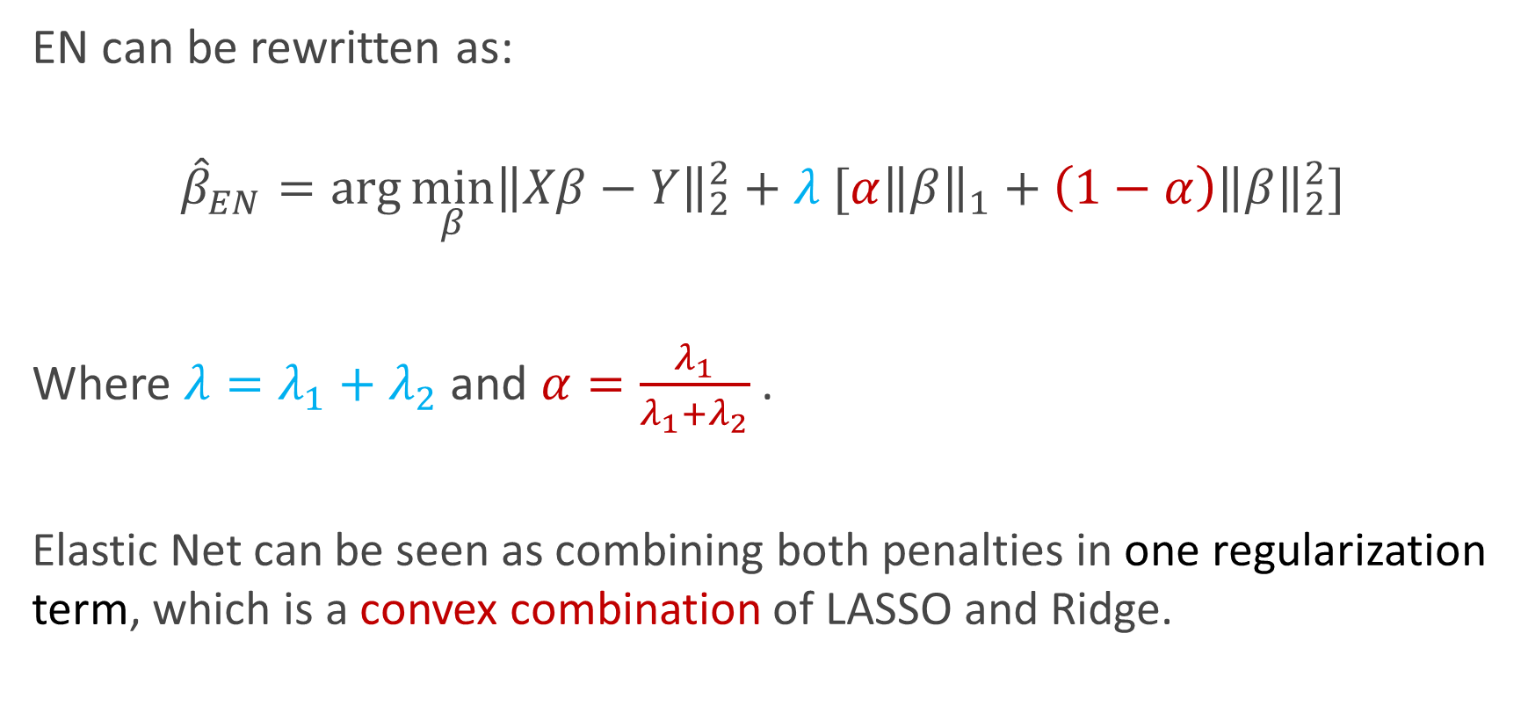
Combine Ridge and LASSO!

Slide 41
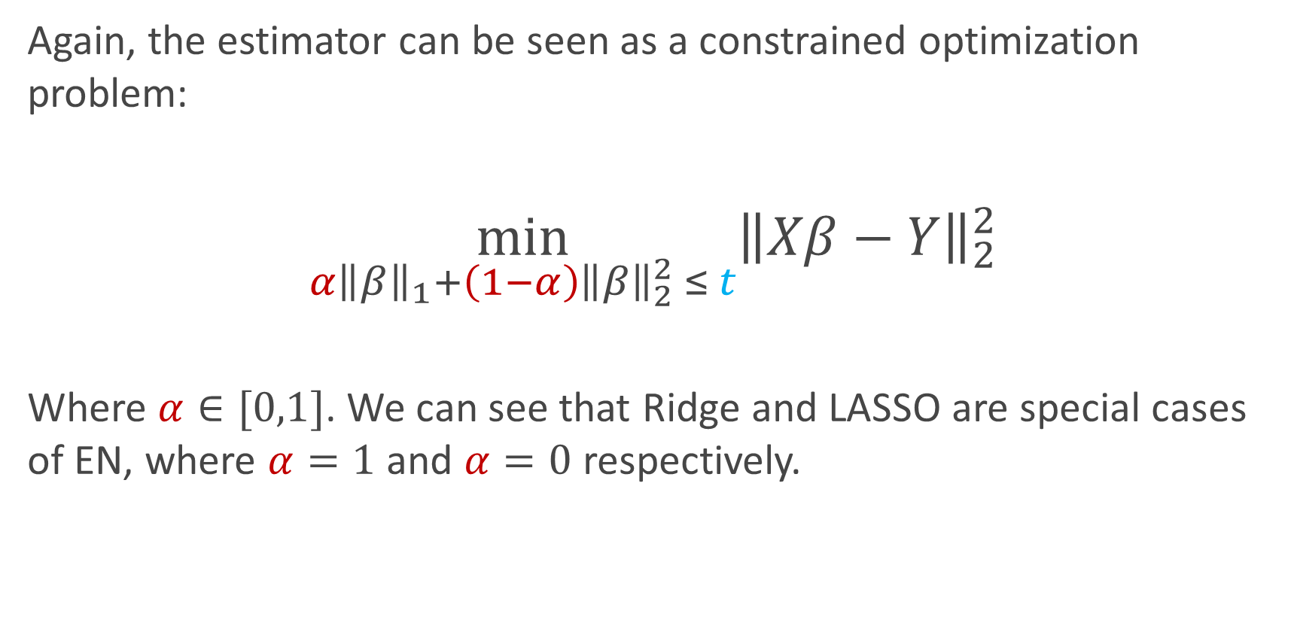
Combine Ridge and LASSO!

Slide 42
Geometry of estimators
Visualization is key

Slide 43
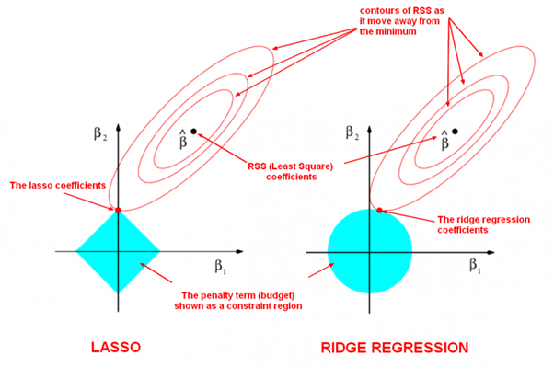

Slide 44
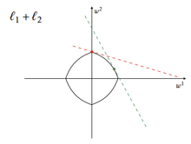
Elastic Net

Slide 45
Let’s see it live!
DEMO TIME

Slide 46
Bayesian Interpretations
“The right way of looking at it” - Kevin Rader, probably

Slide 47
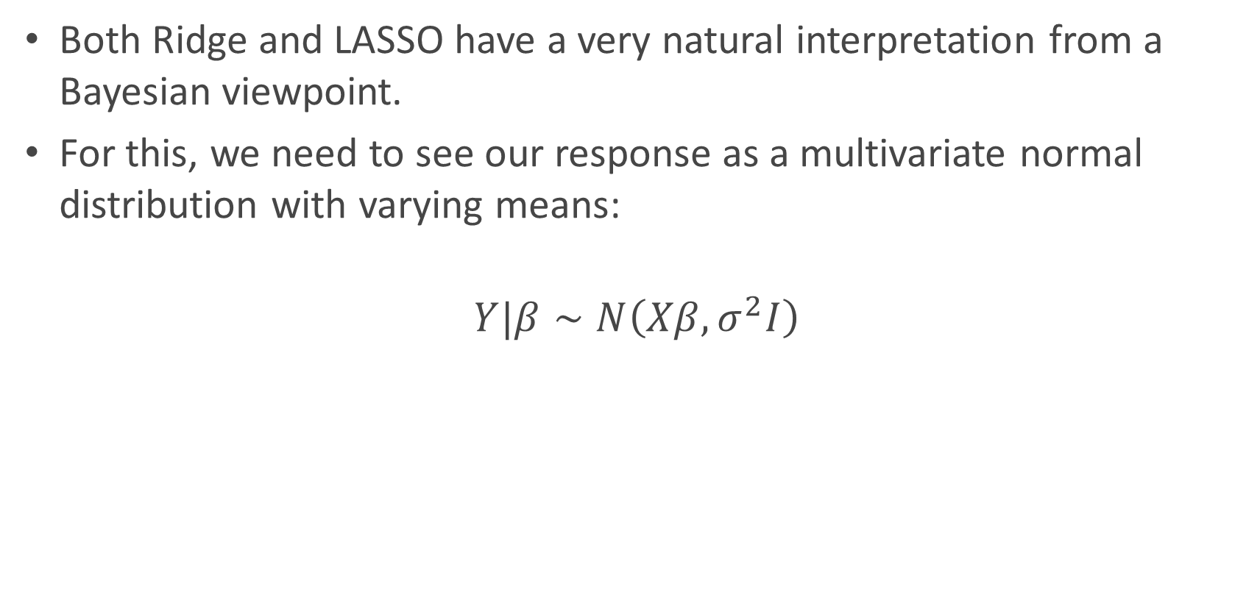
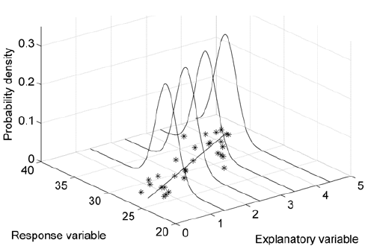
A different but useful perspective

Slide 48
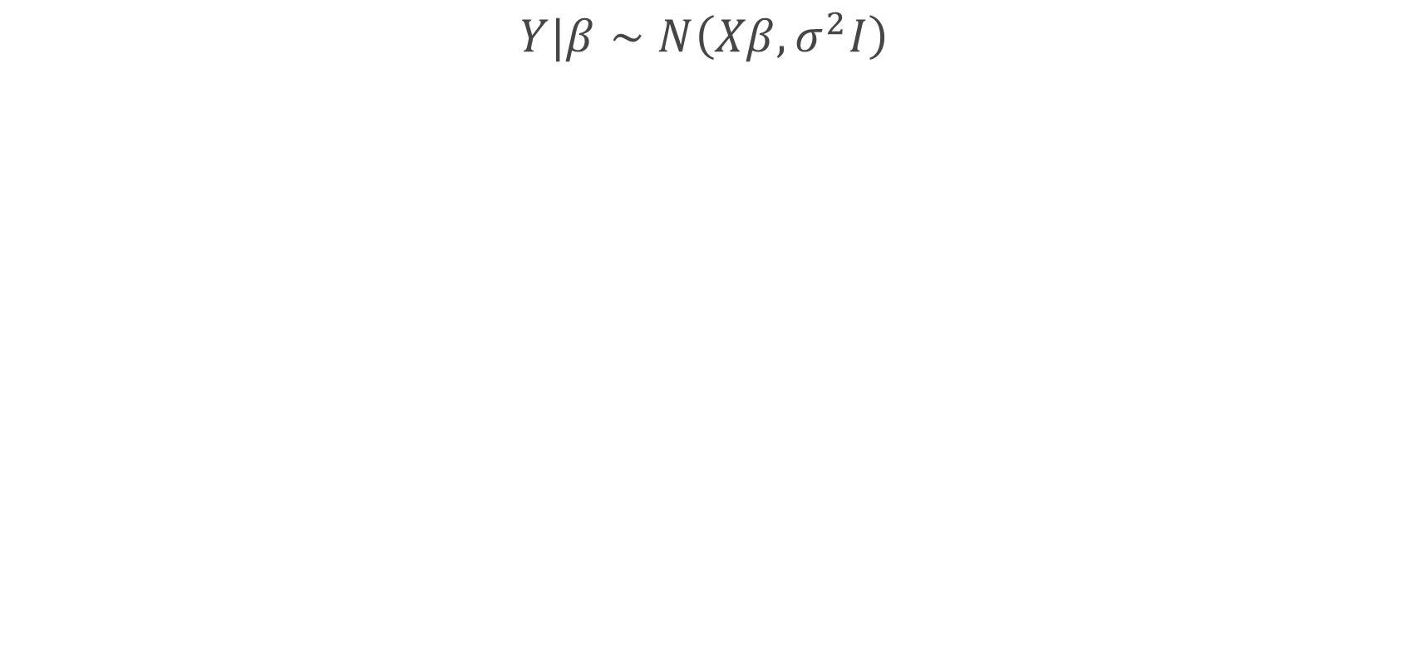
A different but useful perspective

Slide 49

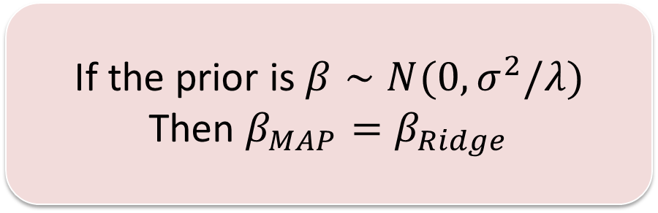
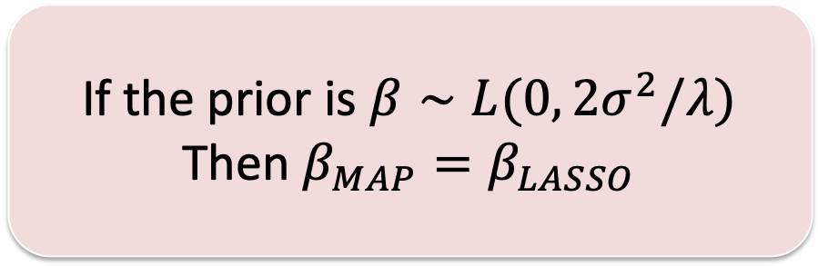
Ridge and LASSO as MAP estimates

Slide 50
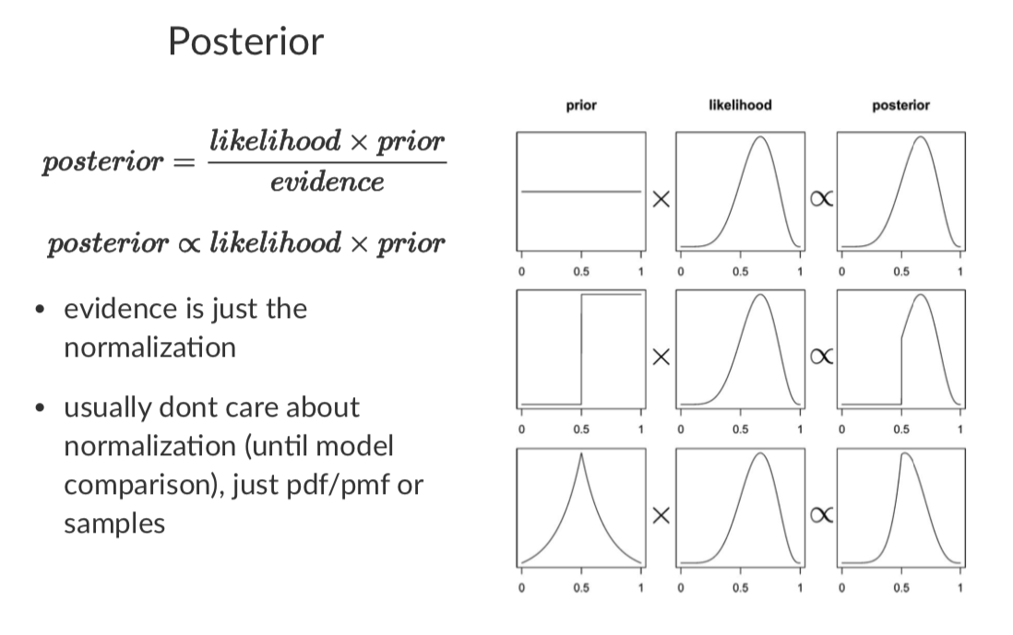
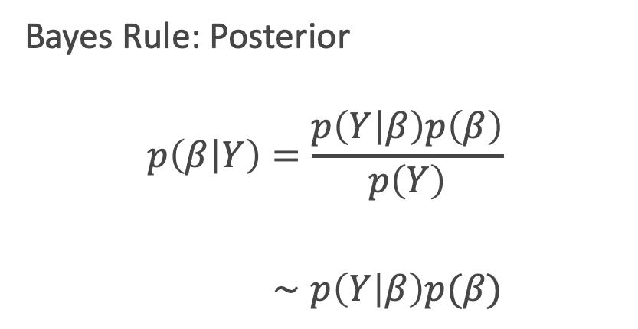
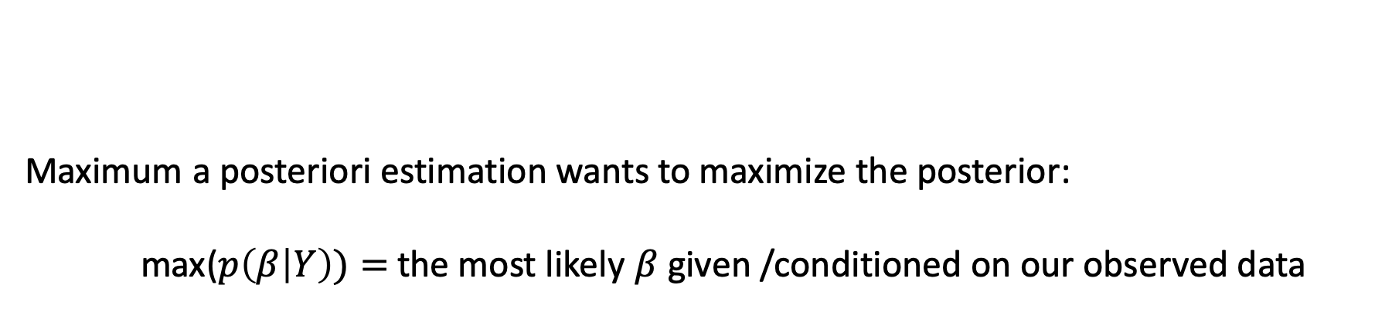
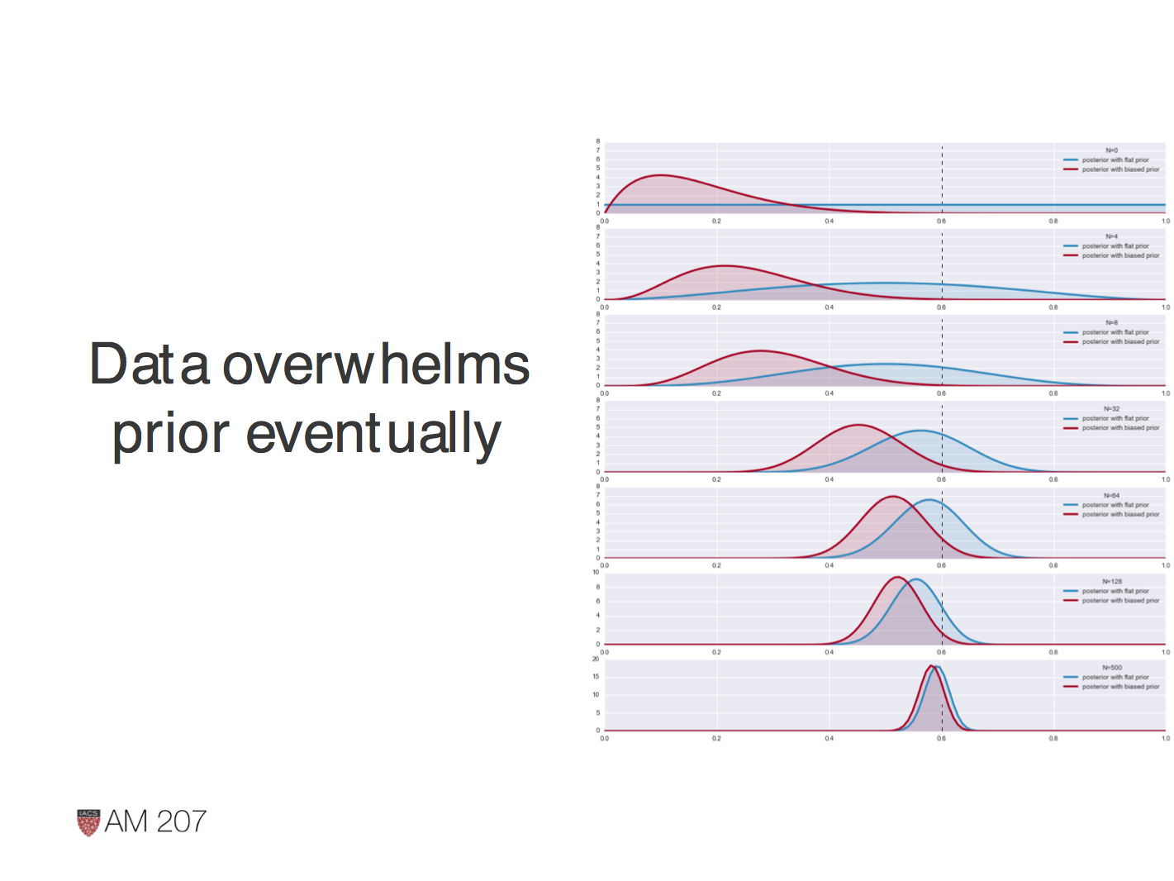
MAP: Maximum a posteriori estimation

Slide 51
Posterior: priors and posteriors as we see more and more data
Blue Player: assumes before seeing any data a uniform distribution = Blue is a non-informative Prior
Red Player: assumes our distribution is close to zero = Red is an informative biased Prior
N=0
N=32
N=500
True beta

Slide 52
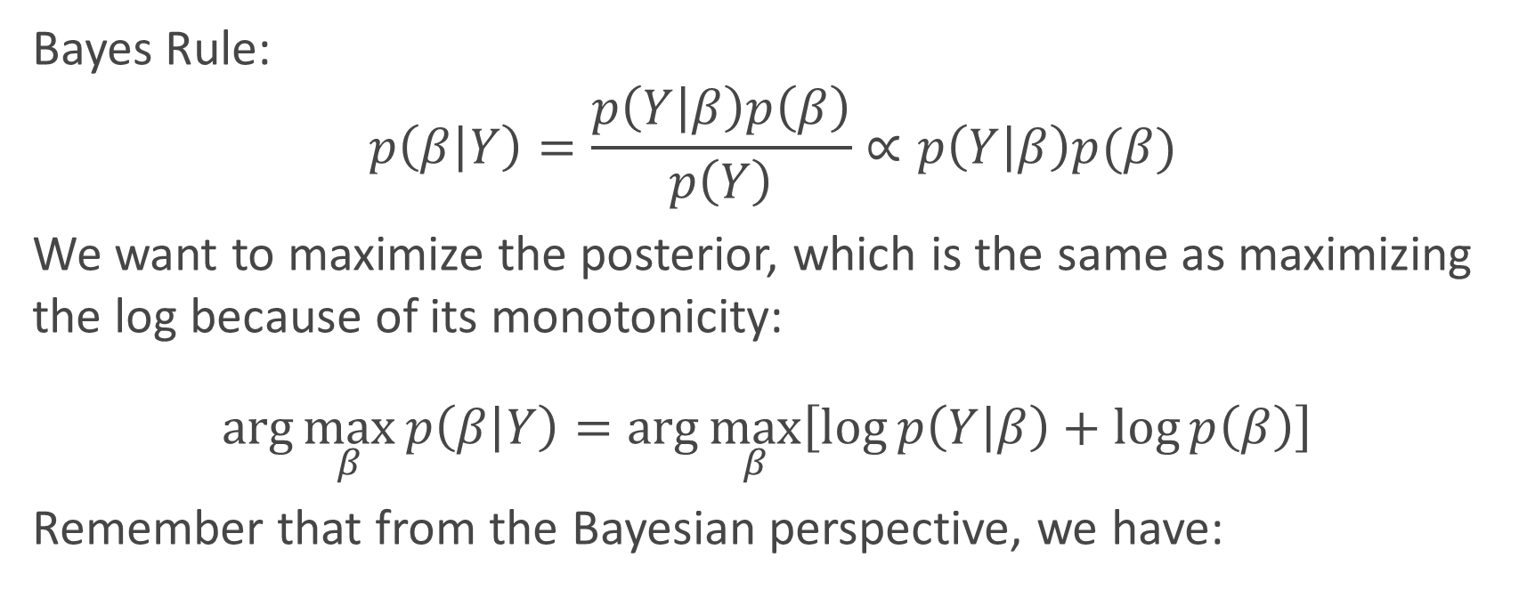



Proof of Bayesian interpretations

Slide 53
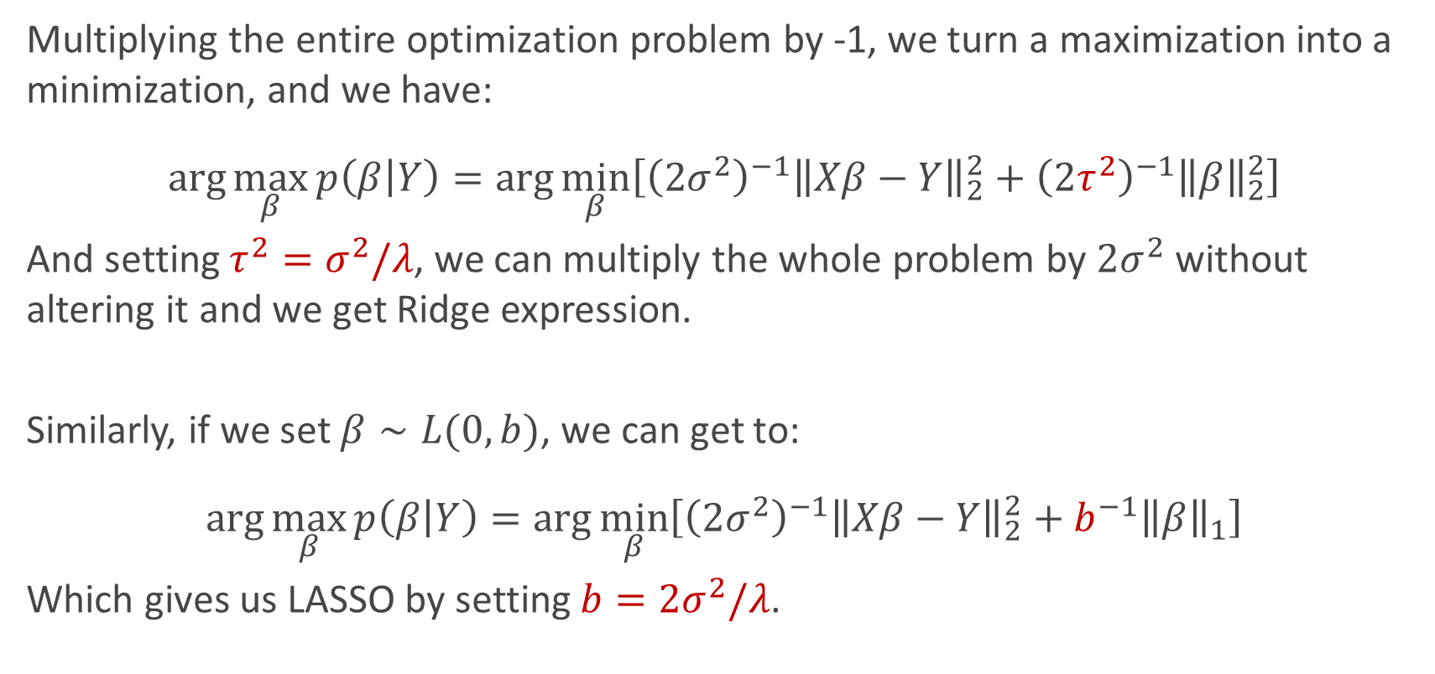
Proof of Bayesian interpretations

Slide 54
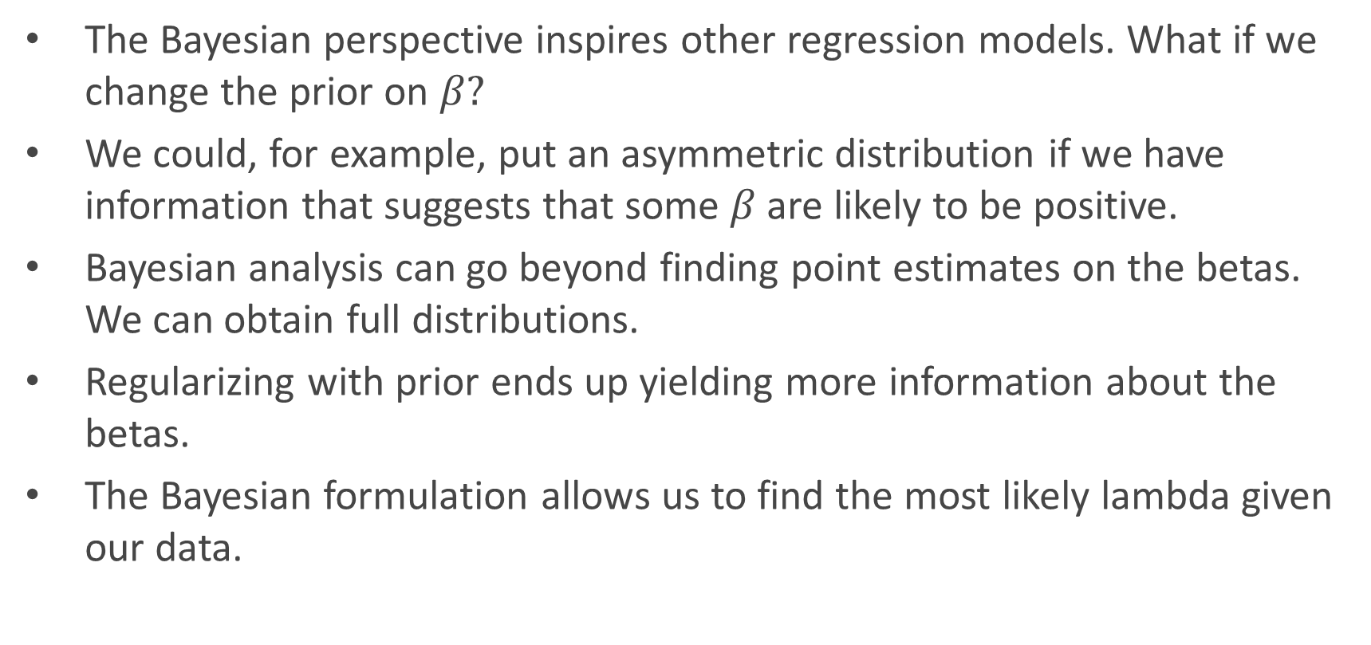
Considerations on Bayesian Linear Regression

Slide 55

Bayesian priors instead of cross-validation
cross-validation.

Slide 56






Evidence Procedure: The math in a nutshell
Assume the following model:
The marginal likelihood can be computed as follows:

Slide 57

Evidence Procedure: The math in a nutshell
1 There is an easy formula to automatically obtain the betas as well, available in chapter 13, p. 464 of Murphy’s “Machine Learning – A Probabilistic Perspective”.

Slide 58
Thank you!

Slide 59


Practical side: how to check for multicollinearity?
Notes:
where R²_{i} is the coefficient of determination of the regression equation in step one, with {X_{i}} on the left hand side, and all other predictor variables (all the other X variables) on the right hand side.

Slide 60

Augmented problem – Elastic Net

Slide 61

Augmented problem – Elastic Net
LASSO problem!

