Slide 1
Neural Network Regularization Dropouts & Batch Normalization

Slide 2
Outline
Regularization of NN
Norm Penalties
Early Stopping
Data Augmentation
Dropout

Slide 3
Co-adaptation
Overfitting is when we are very sensitive to the input and therefore the model fits the noise.
L1 and L2 regularizations ‘shrink’ the coefficients to avoid this problem. However in a large network many units can collaborate to respond to the input while the weights can remain relatively small. This is called co-adaptation.

Slide 4
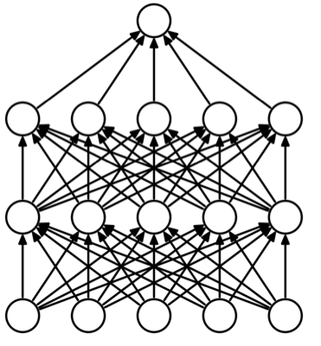
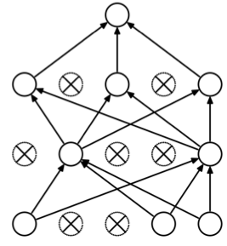
Dropout
Randomly set some neurons and their connections to zero (i.e. “dropped”)
Prevent overfitting by reducing co-adaptation of neurons
Like training many random sub-networks
Standard Neural Network
After applying dropout
https://arxiv.org/pdf/1207.0580.pdf

Slide 5
Dropout: Training
For each new example in a mini-batch (could be for one mini-batch depending on the implementation):
Randomly sample a binary mask μ independently, where μ_{i} indicates if input/hidden node i is included
Multiply output of node i with μ_{i}, and perform gradient update
Typically:
Input nodes are included with prob=0.8 (as per original paper, but rarely used)
Hidden nodes are included with prob=0.5

Slide 6
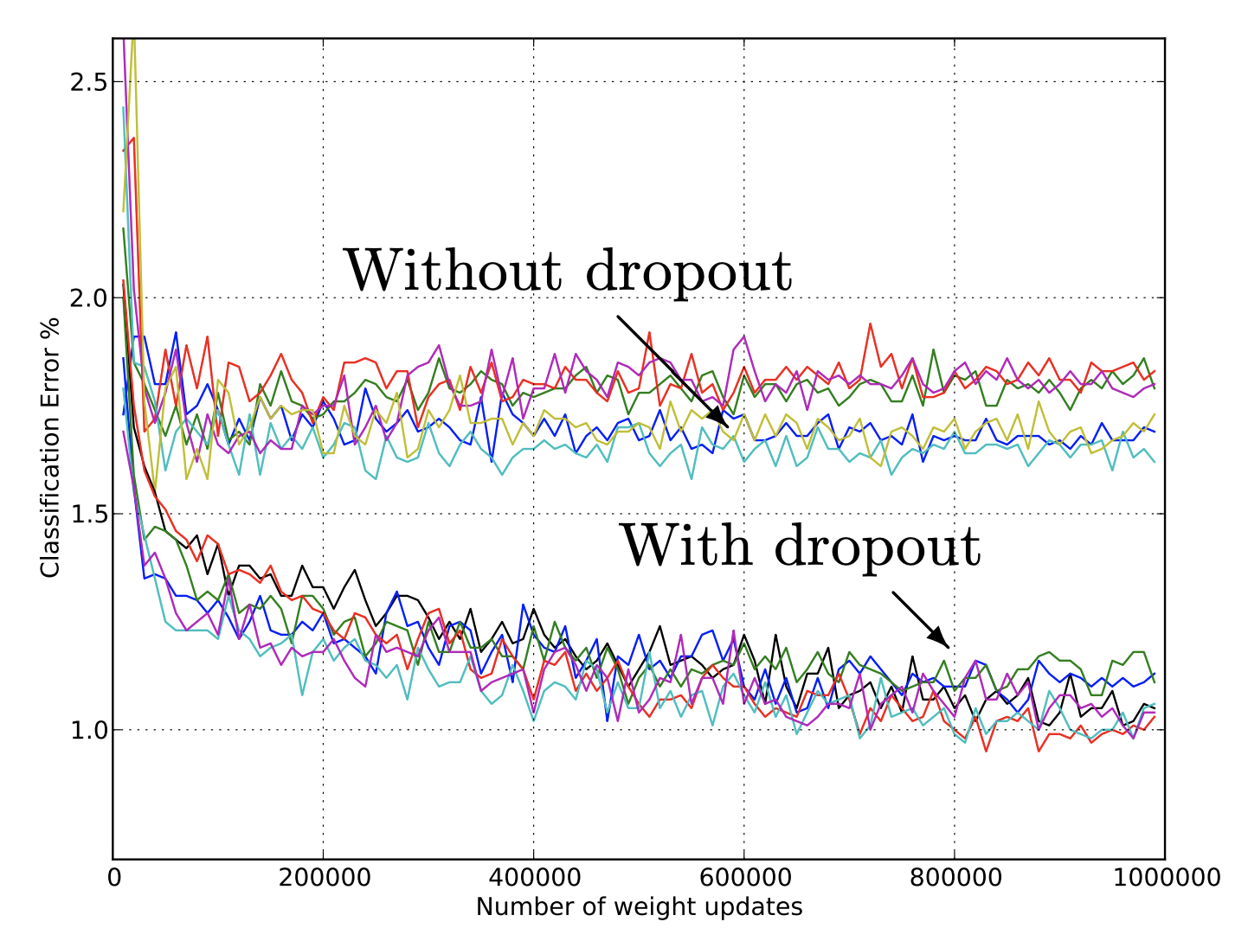
Dropout
Widely used and highly effective
Proposed as an alternative to ensemble methods, which is too expensive for neural nets
Test error for different architectures with and without dropout.
The networks have 2 to 4 hidden layers each with 1024 to 2048 units.
http://jmlr.org/papers/volume15/srivastava14a/srivastava14a.pdf

Slide 7
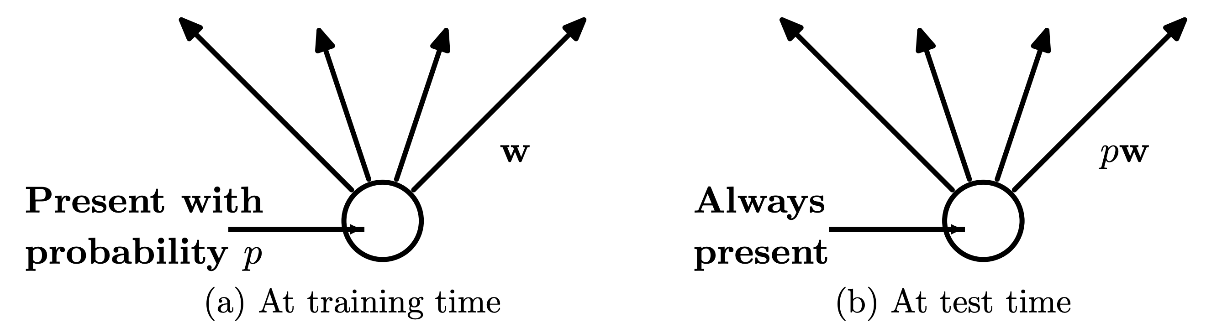
Dropout: Prediction
We can think of dropout as training many of sub-networks
At test time, we can “aggregate” over these sub-networks by reducing connection weights in proportion to dropout probability, p
NOTE: Dropouts can be used for neural network inference by dropping during predictions and predicting multiple times to get a distribution
Notes:
https://chatbotslife.com/regularization-in-deep-learning-f649a45d6e0

Slide 8
Exercise: Dropout

