Slide 1


Lecture 27: Case Study
The process
Harvard IACS
CS109A
Pavlos Protopapas, Kevin Rader, and Chris Tanner

Slide 2
ANNOUNCEMENTS
We realize this is a stressful and chaotic time for everyone, please lean on others for support, don’t be shy to ask for help or to provide such to others, and be kind to yourself. I’m not just referring to 109 coursework.

Slide 3
Learning Objectives
Feel prepared for the project
Gain insights / learn considerations for solving a problem
Feel prepared tackling the remaining course content / gain confidence!

Slide 4
Agenda
Example project

Slide 5
How prepared do you feel for completing your course project?

Slide 6
DISCLAIMER:
This example project concerns predicting customers’ ratings of bourbon (alcoholic drink).
Alcohol is drug. There are state and federal laws that govern the sale, distribution, and consumption of such. In the United States, those who consume alcohol must be at least 21 years of age. In no way am I, or anyone else at IACS or Harvard at large, promoting or encouraging the usage of alcohol. My intention is not to celebrate it. Anyone who chooses to consume alcohol should be of legal age and should do so responsibly. Abusing alcohol has serious, grave effects.
The point of this exercise is purely pedagogical, and it illustrates the wide range of tasks to which one can apply data science and machine learning. That is, I am focusing on a particular interest and demonstrating how it can be used to answer questions that one may be interested in for one's own personal life. You could easily imagine this being used in professional settings, too.

Slide 7
Step 1: formulate questions
1. Are there certain attributes of bourbons that are predictive of good bourbons? (i.e., highly rated by customers)
Find hidden gems (i.e., should be good but current reviews are absent or unsupportive of such)
Find over-hyped bourbons (i.e., the reviews seem high but the attributes aren't indicative)
Are there significant results if we target experts' ratings instead of average customer ratings?

Slide 8
Step 1: formulate questions
2. Are there certain attributes of bourbons that are predictive of expensive bourbons?
Find underpriced ones
Find over-priced ones

Slide 9
Step 1: formulate questions
3. Which bourbons are most similar to each other?
Which attributes are important for determining similarity? (e.g., does price play a role, or does similarity transcend price?)

Slide 10
Step 1: formulate questions
1. Are there certain attributes of bourbons that are predictive of good bourbons? (i.e., highly rated by customers)
Find hidden gems (i.e., should be good but current reviews are absent or unsupportive of such)
Find over-hyped bourbons (i.e., the reviews seem high but the attributes aren't indicative)
Are there significant results if we target experts' ratings instead of average customer ratings?

Slide 11
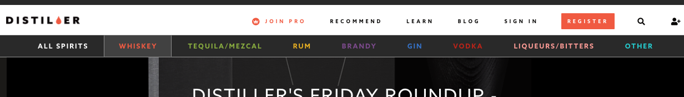
Step 2: get the data
I found distiller.com which seems really comprehensive.
It has a community of reviews, an app, and even tries to make personalized recommendations. Surely we can make a better recommendation engine, though!

Slide 12
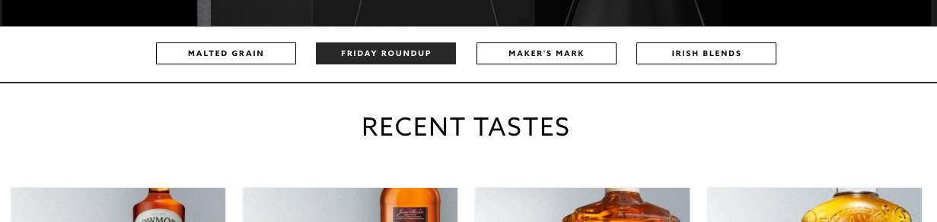
Step 2: get the data
Despite clicking the “whiskey” section, I couldn’t find any listing of whiskeys, only an annoying “recent tastes” (from users) sample. If you click one, it would only show a few other related ones.

Slide 13
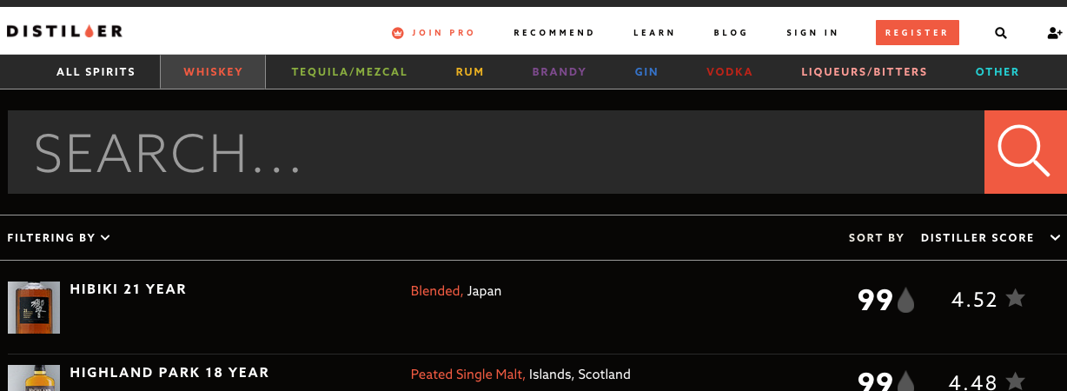
Step 2: get the data
But, there’s a search bar, and if I search for “bourbon”, I got tons of search results!

Slide 14
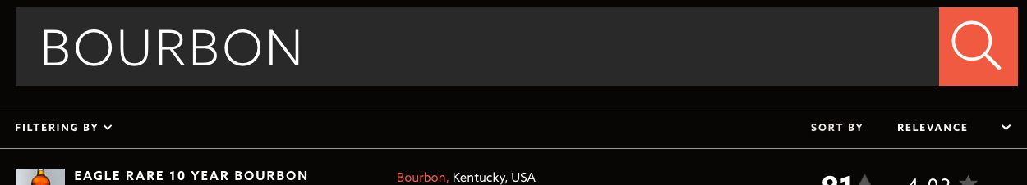
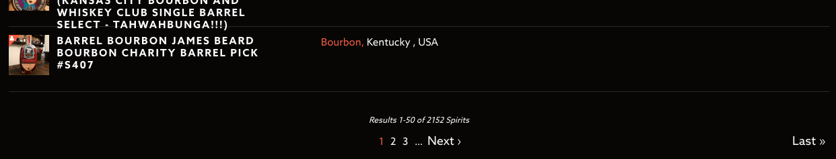
Step 2: get the data
. . .
. . .
. . .

Slide 15
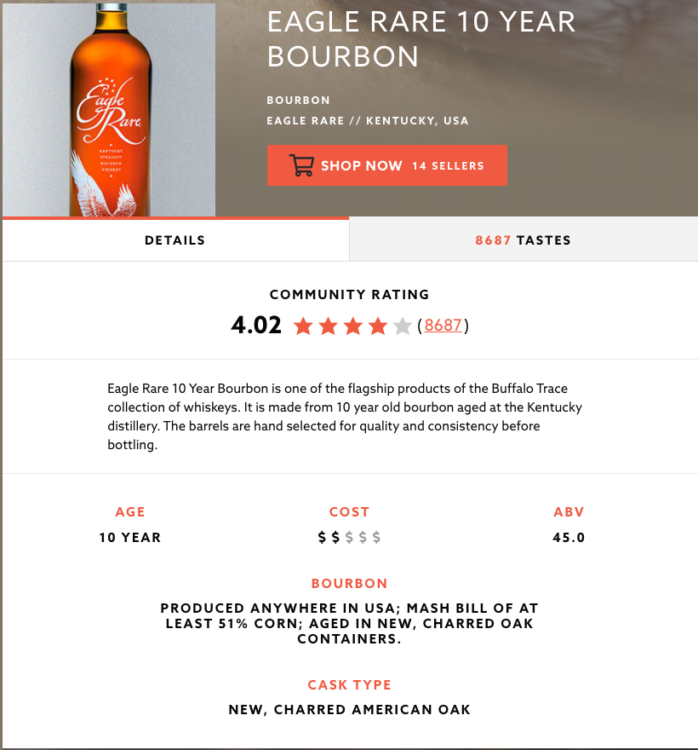
Step 2: get the data
Top part of page

Slide 16
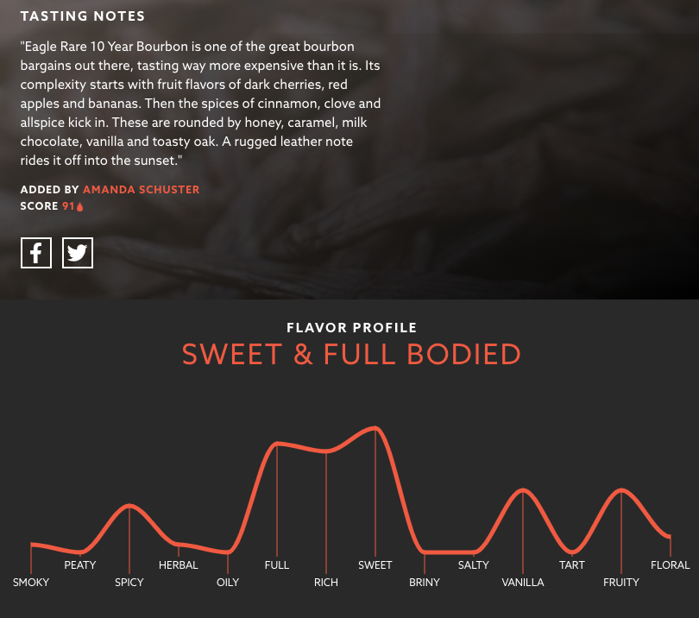
Step 2: get the data
Bottom part of page
What should we try to extract from each webpage?

Slide 17
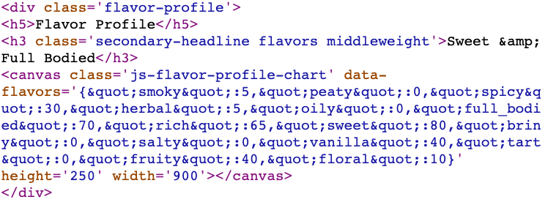
Step 2: get the data

Slide 18
Step 2: get the data
Do all webpages have this info?
Some are missing graphs?
Missing Age statements?
Missing Customer Reviews?
Missing Expert Scores?
Is it possible to scrape the webpages?

Slide 19

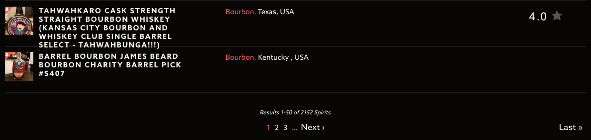
Step 2: get the data
1. Download the contents of each search page, while saving each whiskey’s URL to a set()

Slide 20
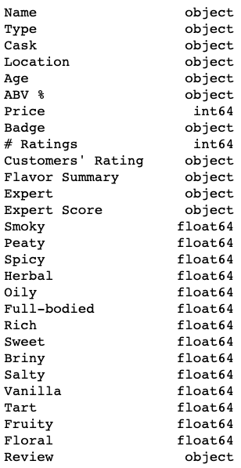
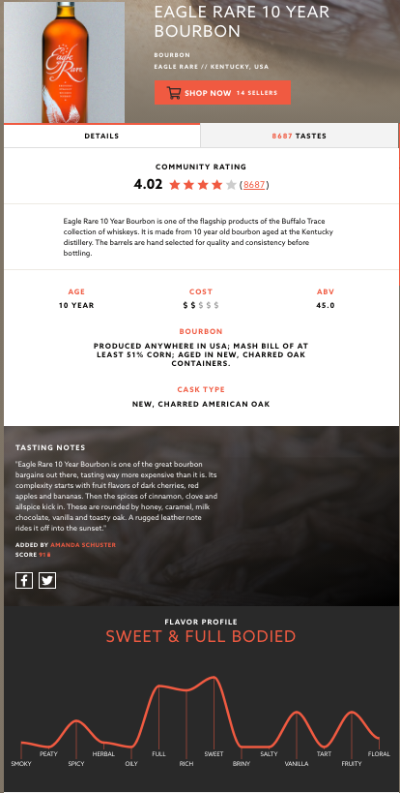
Step 2: get the data
2. Visit each whiskey page, while extracting all the pertinent info that’s available

Slide 21
Step 2: get the data
3. Verify it downloaded correctly and that you don’t need to change how you obtained the data
How much data? 2,139 search result pages on the site
Downloaded 2,205

Slide 22
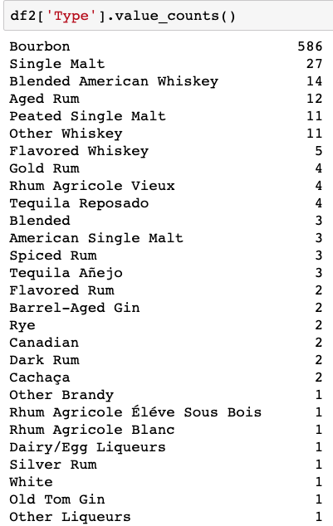
Step 3: explore the data
Filter by those reviewed by an Expert → 701
Filter by those that are bourbons → 586

Slide 23
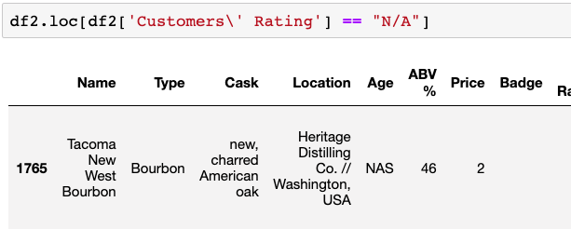
Step 3: explore the data
Filter by those that have Customer Rating → 585

Slide 24
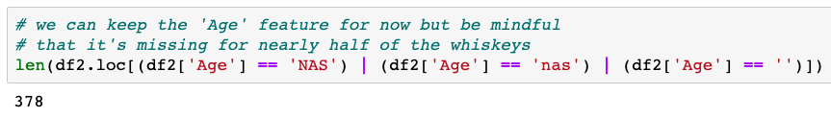

Step 3: explore the data
A lot of missing Age statements

Slide 25
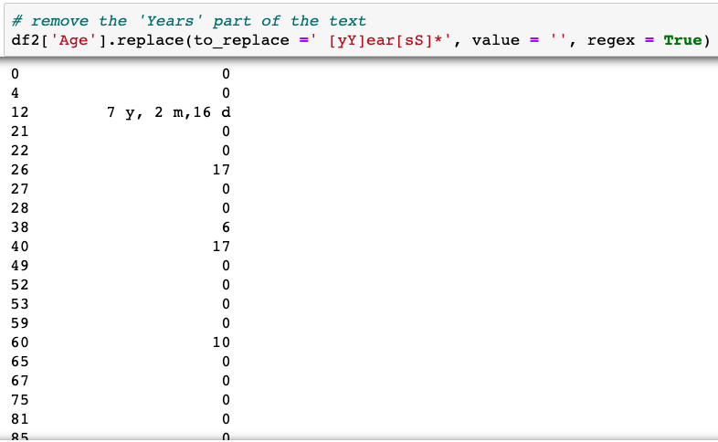
Step 3: explore the data

Slide 26
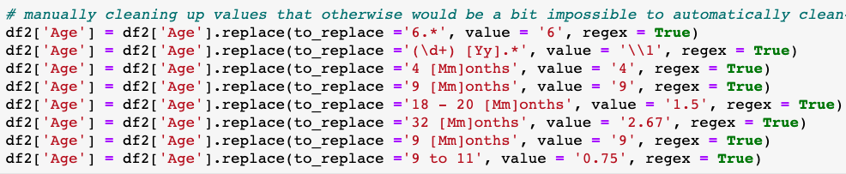
Step 3: explore the data

Slide 27
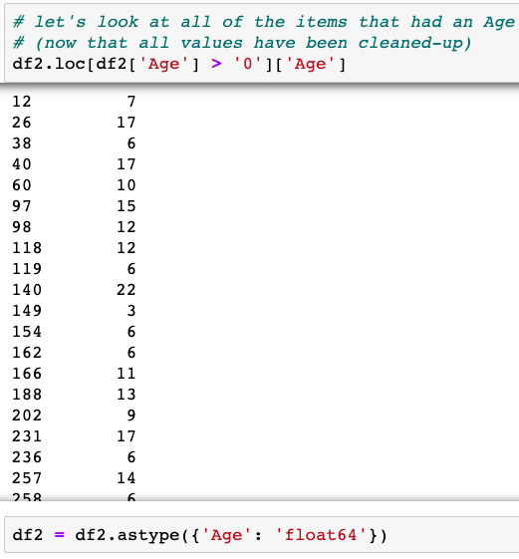
Step 3: explore the data

Slide 28
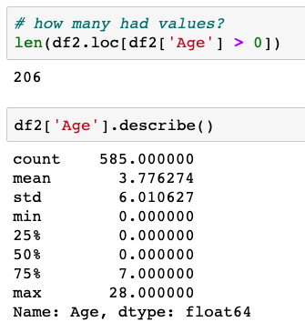
Step 3: explore the data

Slide 29
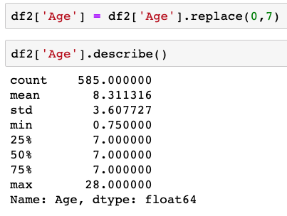
Step 3: explore the data

Slide 30
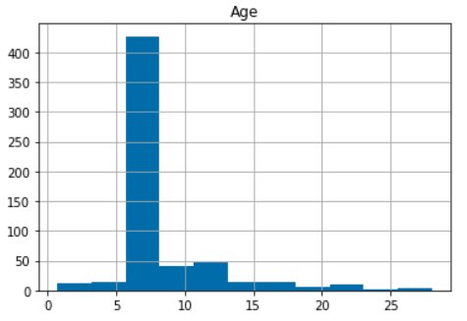
Step 3: explore the data

Slide 31
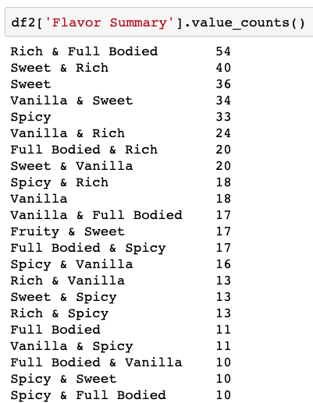
Step 3: explore the data
What’s the distribution of the Flavor Summary?

Slide 32
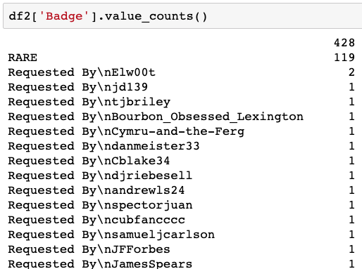
Step 3: explore the data
What’s the Badge feature like?

Slide 33
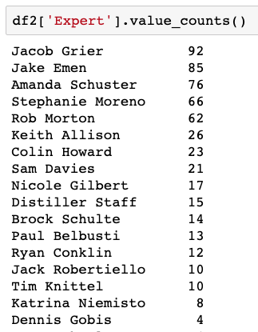
Step 3: explore the data
What’s the Expert feature like?

Slide 34
Step 3: explore the data
Now that our data is clean, let’s explore it. EDA time!
Please see Case_Study_PART_1-4.ipynb, which I will make available after the matinee lecture.

Slide 35
Step 4: model the data
1. Are there certain attributes of bourbons that are predictive of good bourbons? (i.e., highly rated by customers)
Find hidden gems (i.e., should be good but current reviews are absent or unsupportive of such)
Find over-hyped bourbons (i.e., the reviews seem high but the attributes aren't indicative)
Are there significant results if we target experts' ratings instead of average customer ratings?

Slide 36
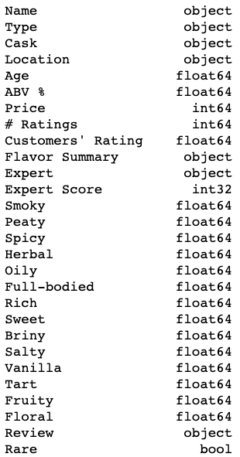
Step 4: model the data
Goal: predict Customers’ Ratings
Data: train/dev/test splits
Features to use: ???
Question: which features should we use? Could we use?

Slide 37
Break-out room time! (Discussion, no coding)

Slide 38
Step 4: model the data
Goal: predict Customers’ Ratings
Data: train/dev/test splits
Features to use:
All 14 flavors
Age
ABV %
Price
Badge
Expert Score
Accuracy Metric: MSE

Slide 39
Step 4: model the data
Model #1: Linear Regression
Question: should we scale our data?
Question: should we use polynomial features?
Please see Case_Study_PART_5.ipynb, which I will make available after the matinee lecture.

Slide 40
Step 1: formulate questions
1. Are there certain attributes of bourbons that are predictive of good bourbons? (i.e., highly rated by customers)
Find hidden gems (i.e., should be good but current reviews are absent or unsupportive of such)
Find over-hyped bourbons (i.e., the reviews seem high but the attributes aren't indicative)
Are there significant results if we target experts' ratings instead of average customer ratings?

Slide 41
Step 4: model the data
Good, important practices:
Heavily inspect your data first
Spend the extra time to clean it
Start with the most simple models
If the model seems sensitive to a particular run, use bootstrapping
Inspect results, and allow that to guide your next choices
Reflect about your modelling choices
Leverage as much of your data as possible (cross-validation)

Slide 42
Step 4: model the data
Good, important practices:
When comparing different models, make everything as fair as possible
Same data splits
Fix all random seeds so your experiments are repeatable
Look at your worst mistakes. Any patterns to these errors?
For classification tasks, look at false positives and false negatives
Do you have any indication that your data is limiting?
Clean up data further or get more data?

Slide 43
Step 5: communicate your results
A long notebooks I provided are only good for exploring and getting work done. By no means is it an attempt to communicate the results
Think of what would be the easiest, most succinct way to discern:
All of your models’ results (e.g., heatmap table?).
The effectiveness and ineffectiveness of your model
Examples of it working / results
It should be clear and compelling which model we should use (instead of the baseline)
Review the Visualization lecture for more inspiration

Slide 44
Step 1: formulate questions
2. Are there certain attributes of bourbons that are predictive of expensive bourbons?
Find underpriced ones
Find over-priced ones

Slide 45
Step 1: formulate questions
3. Which bourbons are most similar to each other?
Which attributes are important for determining similarity? (e.g., does price play a role, or does similarity transcend price?)

Slide 46
Good luck on your projects! You can do it.

