Slide 1
Gradient Descent

Slide 2








Learning the coefficients
Start with single neuron
Classification
Regression
f(X)$=\frac{1}{{1+e}^{−W^{T}X}}$
f$\left(X\right)=W^{T}X$
$$x_{1}$$
$$x_{2}$$
$$W^{T}X$$
$$f$$
$$Y=f(W_{0}+W_{1}x_{1}+W_{2}x_{2}+W_{3}x_{3}+W_{4}x_{4})$$
$$x_{3}$$
$$x_{4}$$
Intercept or Bias
Coefficients or Weights

Slide 3







But what is the idea?
Start with all randomly selected weights. Most likely it will perform horribly.
For example, in our heart data, the model will be giving us the wrong answer.
$$MaxHR=197$$
Correct
$$Age=53$$
$$W^{T}X$$
$$f$$
$$\hat{p}=0.8→Yes$$
y=No
$$Sex=Male$$
$$Chol=152$$
Bad Computer

Slide 4




But what is the idea?
Start with all randomly selected weights. Most likely it will perform horribly.
For example, in our heart data, the model will be giving us the wrong answer.
$$MaxHR=170$$
Correct
$$Age=35$$
$$W^{T}X$$
$$f$$
$$\hat{p}=0.4→No$$
y=Yes
$$Sex=Male$$
$$Chol=352$$
Bad Computer

Slide 5
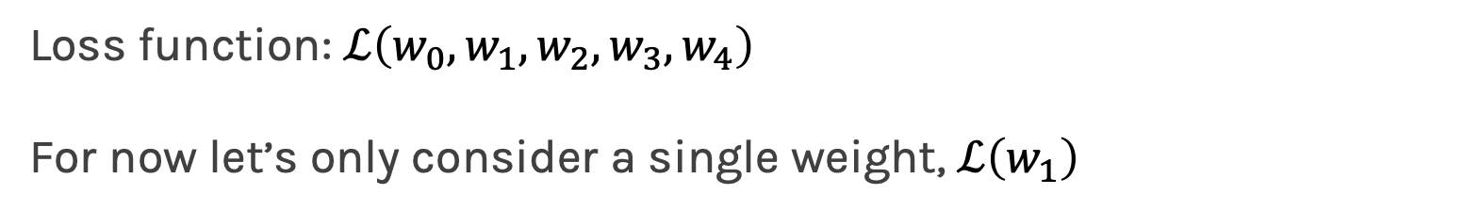
But what is the idea?
Loss Function: Takes all of these results and averages them and tells us how bad or good the computer or those weights are.
Telling the computer how bad or good is, does not help.
You want to tell it how to change those weights so it gets better.
Loss function: $ℒ\left(w_{0},w_{1},w_{2},w_{3},w_{4}\right)$
For now let’s only consider a single weight, $ℒ\left(w_{1}\right)$

Slide 6
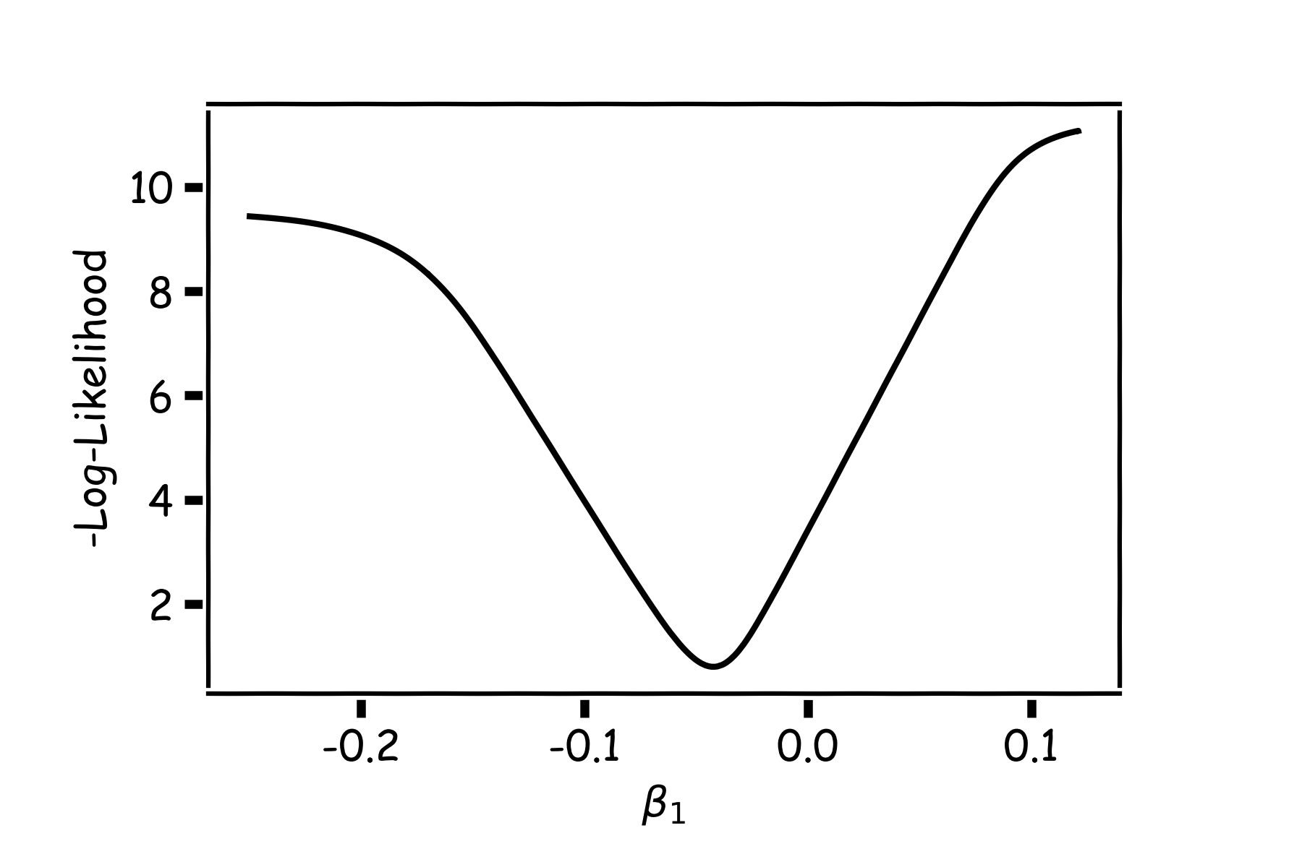
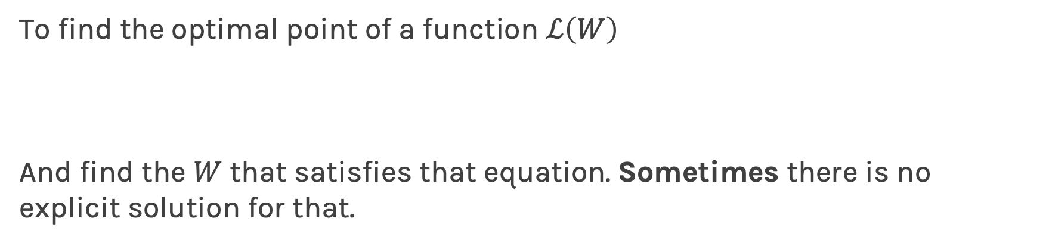
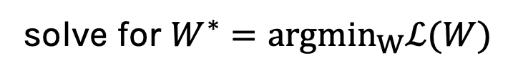
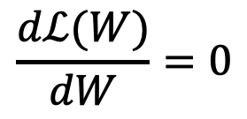
Minimizing the Loss function
Ideally we want to know the value of $w_{1}$ that gives the minimal $ℒ\left(W\right)$
To find the optimal point of a function $ℒ\left(W\right)$
And find the $W$ that satisfies that equation. Sometimes there is no explicit solution for that.
$$\frac{dℒ(W)}{dW}=0$$
solve for $W^{∗}=argmin_{W}ℒ(W)$

Slide 8
Estimate of the regression coefficients: gradient descent
A more flexible method is
Start from a random point
Determine which direction to go to reduce the loss (left or right)
Compute the slope of the function at this point and step to the right if slope is negative or step to the left if slope is positive
Goto to #1

Slide 9
Minimization of the Loss Function
Question: What is the mathematical function that describes the slope?
Derivative
Question: How do we generalize this to more than one predictor?
Take the derivative with respect to each coefficient and do the same sequentially
Question: What do you think is a good approach for telling the model how to change (what is the step size) to become better?

Slide 11
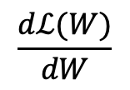
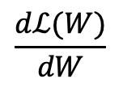
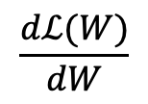
Gradient Descent (cont.)
If the step is proportional to the slope then you avoid overshooting the minimum. How?
$$\frac{dℒ(W)}{dW}$$
$$\frac{dℒ(W)}{dW}$$
$$\frac{dℒ(W)}{dW}$$

Slide 12
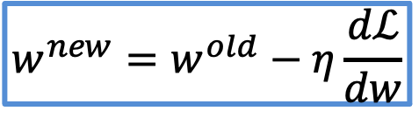


Let’s play the Pavlos game
We know that we want to go in the opposite direction of the derivative and we know we want to be making a step proportional to the derivative.
Making a step means:
Step size is proportional to derivative
$${w^{new}=w}^{old}+step$$
Opposite direction of the derivative means:
$${w^{new}=w}^{old}−η\frac{dℒ}{dw}$$
Learning Rate
Change to more conventional notation:
$${w^{(i+1)}=w}^{(i)}−η\frac{dℒ}{dw}$$

Slide 13
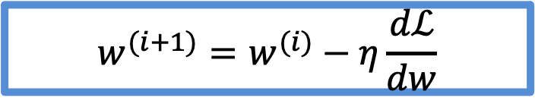
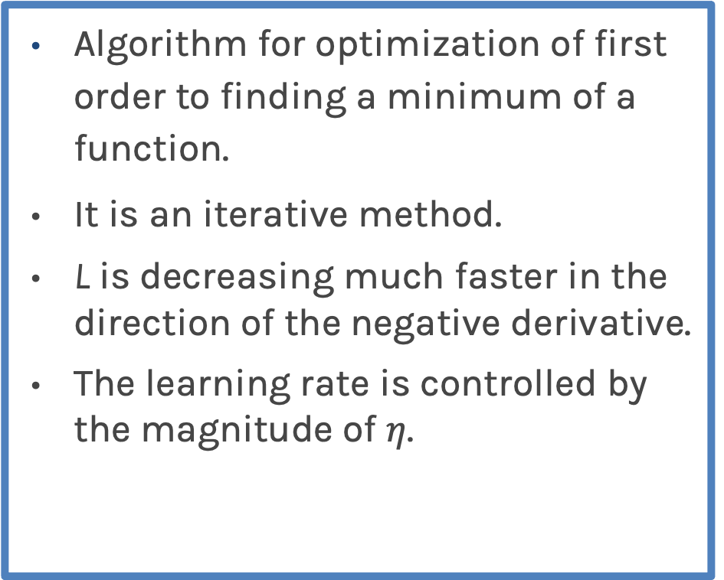
Gradient Descent
Algorithm for optimization of first order to finding a minimum of a function.
It is an iterative method.
L is decreasing much faster in the direction of the negative derivative.
The learning rate is controlled by the magnitude of $η$.
$${w^{(i+1)}=w}^{(i)}−η\frac{dℒ}{dw}$$
L
-
+
w

