Slide 1


Lecture 3: Data II
How to get it, methods to parse it, and ways to explore it.
Harvard IACS
CS109A
Pavlos Protopapas, Kevin Rader, and Chris Tanner

Slide 2
ANNOUNCEMENTS
Homework 0 isn’t graded for accuracy. If your questions were surface-level / clarifying questions, you’re in good shape.
Homework 1 is graded for accuracy
it’ll be released today (due in a week)
Study Break this Thurs @ 8:30pm and Fri @ 10:15am
After lecture, please update your Zoom to the latest version

Slide 3
Background
So far, we’ve learned:
Lecture 1
Lectures 1 & 2
Lecture 2
Lecture 2
This lecture
Future lectures
What is Data Science?
The Data Science Process
Data: types, formats, issues, etc.
Regular Expressions (briefly)
How to get data and parse web data + PANDAS
How to model data

Slide 4
Background
The Data Science Process:
Ask an interesting question
Get the Data
Explore the Data
Model the Data
Communicate/Visualize the Results

Slide 5
Background
The Data Science Process:
Ask an interesting question
Get the Data
This lecture
Explore the Data
Model the Data
Communicate/Visualize the Results

Slide 6
Learning Objectives
Understand different ways to obtain it
Be able to extract any web content of interest
Be able to do basic PANDAS commands to store and explore data
Feel comfortable using online resources to help with these libraries (Requests, BeautifulSoup, and PANDAS)

Slide 7
Agenda
How to get web data?
How to parse basic elements using BeautifulSoup
Getting started with PANDAS

Slide 8
What are common sources for data?
(For Data Science and computation purposes.)

Slide 9
Obtaining Data
Data can come from:
You curate it
Someone else provides it, all pre-packaged for you (e.g., files)
Someone else provides an API
Someone else has available content, and you try to take it (web scraping)

Slide 10
Obtaining Data: Web scraping
Web scraping
Using programs to get data from online
Often much faster than manually copying data!
Transfer the data into a form that is compatible with your code
Legal and moral issues (per Lecture 2)

Slide 11
Obtaining Data: Web scraping
Why scrape the web?
Vast source of information; can combine with multiple datasets
Companies have not provided APIs
Automate tasks
Keep up with sites / real-time data
Fun!

Slide 12
Obtaining Data: Web scraping
Web scraping tips:
Be careful and polite
Give proper credit
Care about media law / obey licenses / privacy
Don’t be evil (no spam, overloading sites, etc)

Slide 13
Obtaining Data: Web scraping
Robots.txt
Specified by web site owner
Gives instructions to web robots (e.g., your code)
Located at the top-level directory of the web server
E.g., http://google.com/robots.txt

Slide 14
Obtaining Data: Web scraping
Web Servers
A server maintains a long-running process (also called a daemon), which listens on a pre-specified port
It responds to requests, which is sent using a protocol called HTTP (HTTPS is secure)
Our browser sends these requests and downloads the content, then displays it
2– request was successful, 4– client error, often `page not found`; 5– server error (often that your request was incorrectly formed)

Slide 15
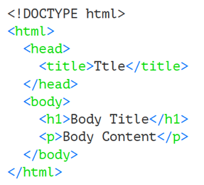
Obtaining Data: Web scraping
HTML
Tags are denoted by angled brackets
Almost all tags are in pairs e.g., <p>Hello</p>
Some tags do not have a closing tag e.g., <br/>
Example

Slide 16
Obtaining Data: Web scraping
HTML
<html>, indicates the start of an html page
<body>, contains the items on the actual webpage (text, links, images, etc)
<p>, the paragraph tag. Can contain text and links
<a>, the link tag. Contains a link url, and possibly a description of the link
<input>, a form input tag. Used for text boxes, and other user input
<form>, a form start tag, to indicate the start of a form
<img>, an image tag containing the link to an image

Slide 17
Obtaining Data: Web scraping
How to Web scrape:
1. Get the webpage content
Requests (Python library) gets a webpage for you
2. Parse the webpage content
(e.g., find all the text or all the links on a page)
BeautifulSoup (Python library) helps you parse the webpage.
Documentation: http://crummy.com/software/BeautifulSoup

Slide 18
The Big Picture Recap
Data Sources
Files, APIs, Webpages (via Requests)
Data Parsing
Regular Expressions, Beautiful Soup
Data Structures/Storage
Traditional lists/dictionaries, PANDAS
Models
Linear Regression, Logistic Regression, kNN, etc
BeautifulSoup only concerns webpage data

Slide 19
Obtaining Data: Web scraping
Get the webpage content
Requests (Python library) gets a webpage for you
page = requests.get(url)
page.status_code
page.text

Slide 20
Obtaining Data: Web scraping
Get the webpage content
Requests (Python library) gets a webpage for you
page = requests.get(url)
page.status_code
page.content
Gets the status from the webpage request.
200 means success.
404 means page not found.

Slide 21
Obtaining Data: Web scraping
Get the webpage content
Requests (Python library) gets a webpage for you
page = requests.get(url)
page.status_code
page.content
Returns the content of the response, in bytes.

Slide 22
Obtaining Data: Web scraping
2. Parse the webpage content
BeautifulSoup (Python library) helps you parse a webpage
soup = BeautifulSoup(page, “html.parser”)
soup.title
page.title.text

Slide 23
Obtaining Data: Web scraping
2. Parse the webpage content
BeautifulSoup (Python library) helps you parse a webpage
soup = BeautifulSoup(page, “html.parser”)
soup.title
page.title.text
Returns the full context, including the title tag. e.g.,
<title data-rh="true">The New York Times – Breaking News</title>

Slide 24
Obtaining Data: Web scraping
2. Parse the webpage content
BeautifulSoup (Python library) helps you parse a webpage
soup = BeautifulSoup(page, “html.parser”)
soup.title
page.title.text
Returns the text part of the title tag. e.g.,
The New York Times – Breaking News

Slide 25
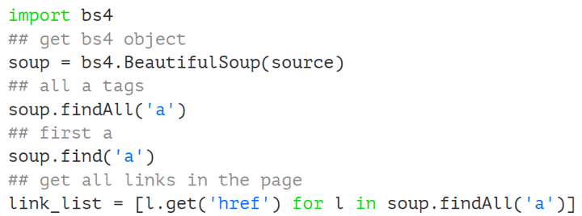
Obtaining Data: Web scraping
BeautifulSoup
Helps make messy HTML digestible
Provides functions for quickly accessing certain sections of HTML content
Example

Slide 26
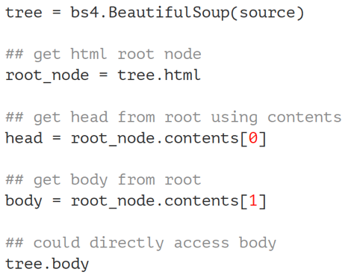
Obtaining Data: Web scraping
HTML is a tree
You don’t have to access the HTML as a tree, though;
Can immediately search for tags/content of interest (a la previous slide)
Example

Slide 27
Exercise 1 time!

Slide 28

PANDAS
Kung Fu Panda is property of DreamWorks and Paramount Pictures

Slide 29
Store and Explore Data: PANDAS
What / Why?
Pandas is an open-source Python library (anyone can contribute)
Allows for high-performance, easy-to-use data structures and data analysis
Unlike NumPy library which provides multi-dimensional arrays, Pandas provides 2D table object called DataFrame (akin to a spreadsheet with column names and row labels).
Used by a lot of people

Slide 30

Store and Explore Data: PANDAS
How
import pandas library (convenient to rename it)
Use read_csv() function

Slide 31
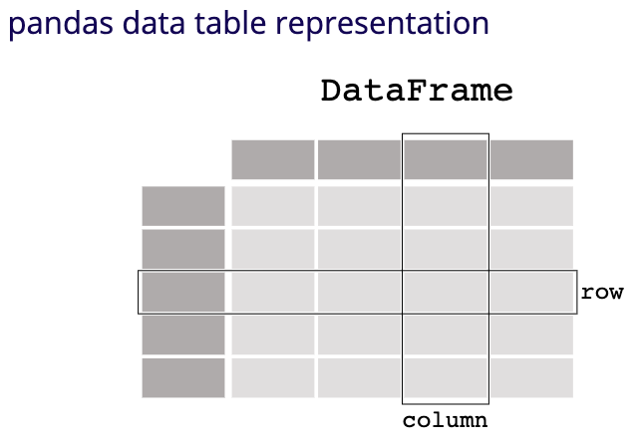
Store and Explore Data: PANDAS
What it looks like
Visit https://pandas.pydata.org/pandas-docs/stable/getting_started/intro_tutorials/01_table_oriented.html for a more in-depth walkthrough

Slide 32

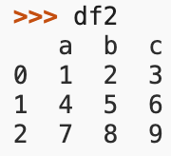
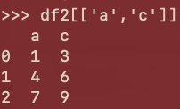
Store and Explore Data: PANDAS
Example
Say we have the following, tiny DataFrame of just 3 rows and 3 columns
df2[‘a’]
selects column a
df2[‘a’] == 4
returns a Boolean list representing which rows of column a equal 4: [False, True, False]
df2[‘a’].min()
returns 1 because that’s the minimum value in the a column
df2[[‘a’, ‘b’]]
selects columns a and c

Slide 33


Store and Explore Data: PANDAS
Example continued
df2[‘a’].unique()
returns all distinct values of the a column once
df2.loc[2]
returns a Series representing the row w/ the label 2
df2.loc[df2[‘a’] == 4]
.loc returns all rows that were passed-in
[False, True, False]

Slide 34
Store and Explore Data: PANDAS
Example continued
df2.iloc[2]
returns a Series representing the row at index 2 (NOT the row labelled 2. Though, they are often the same, as seen here)
df2.sort_values(by=[‘c’])
returns the DataFrame with rows shuffled such that now they are in ascending order according to column c. In this example, df2 would remain the same, as the values were already sorted

Slide 35
Store and Explore Data: PANDAS
Common PANDAS functions
High-level viewing:
head() – first N observations
tail() – last N observations
describe() – statistics of the quantitative data
dtypes – the data types of the columns
columns – names of the columns
shape – the # of (rows, columns)

Slide 36
Store and Explore Data: PANDAS
Common PANDAS functions
Accessing/processing:
df[“column_name”]
df.column_name
.max(), .min(), .idxmax(), .idxmin()
<dataframe> <conditional statement>
.loc[] – label-based accessing
.iloc[] – index-based accessing
.sort_values()
.isnull(), .notnull()

Slide 37
Store and Explore Data: PANDAS
Common Panda functions
Grouping/Splitting/Aggregating:
groupby(), .get_groups()
.merge()
.concat()
.aggegate()
.append()

Slide 38
Exploratory Data Analysis (EDA)
Why?
EDA encompasses the “explore data” part of the data science process
EDA is crucial but often overlooked:
If your data is bad, your results will be bad
Conversely, understanding your data well can help you create smart, appropriate models

Slide 39
Exploratory Data Analysis (EDA)
What?
Store data in data structure(s) that will be convenient for exploring/processing (Memory is fast. Storage is slow)
Clean/format the data so that:
Each row represents a single object/observation/entry
Each column represents an attribute/property/feature of that entry
Values are numeric whenever possible
Columns contain atomic properties that cannot be further decomposed*
* Unlike food waste, which can be composted. Please consider composting food scraps.

Slide 40
Exploratory Data Analysis (EDA)
What? (continued)
Explore global properties: use histograms, scatter plots, and aggregation functions to summarize the data
Explore group properties: group like-items together to compare subsets of the data (are the comparison results reasonable/expected?)
This process transforms your data into a format which is easier to work with, gives you a basic overview of the data's properties, and likely generates several questions for you to follow-up in subsequent analysis.

Slide 41
Up Next
We will address EDA more and dive into Advanced PANDAS operations

Slide 42
Exercise 2 time!

