Slide 1
Optimizers

Slide 2
Outline
Optimization
Challenges in Optimization
Momentum
Adaptive Learning Rate

Slide 3
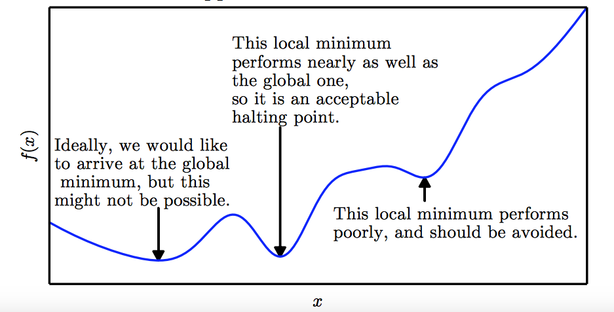
Local Minima
Goodfellow et al. (2016)

Slide 4
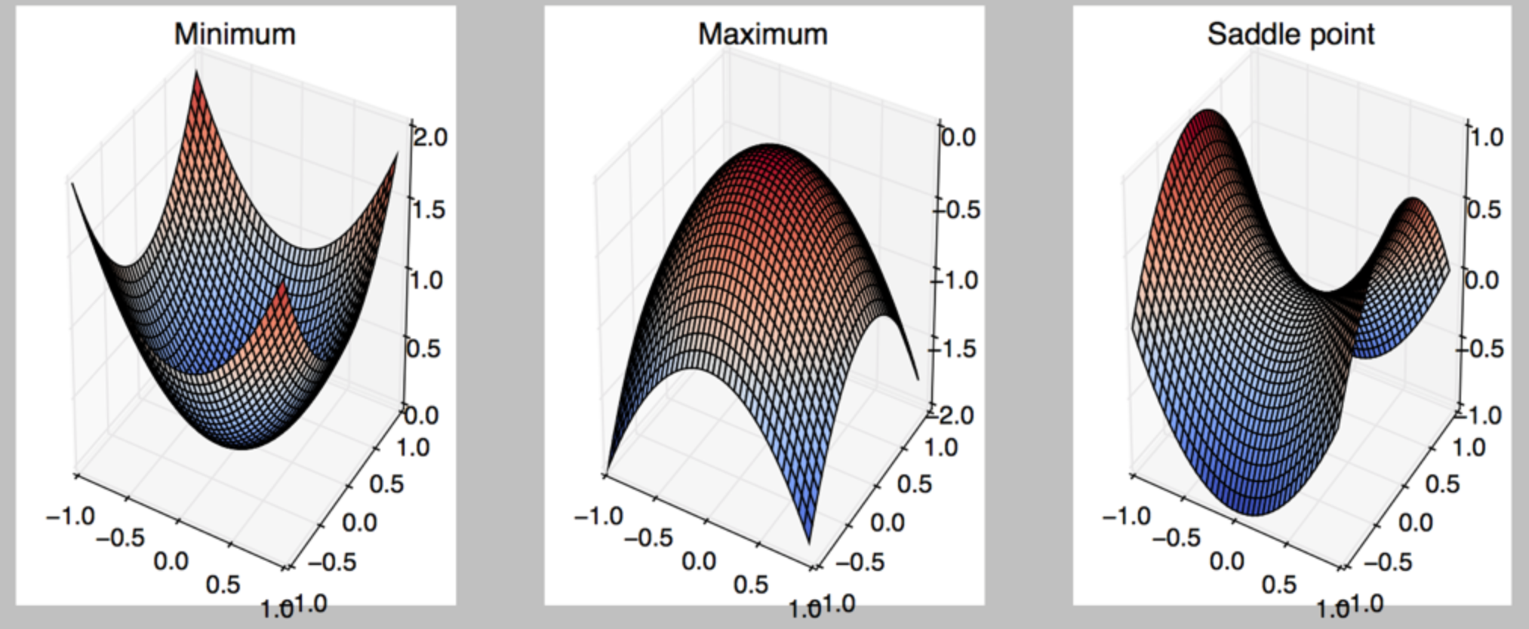
Critical Points
Points with zero gradient
2nd-derivate (Hessian) determines curvature
Goodfellow et al. (2016)

Slide 5
Local Minima
Old view: local minima is major problem in neural network training
Recent view:
For sufficiently large neural networks, most local minima incur low cost
Not important to find true global minimum

Slide 6
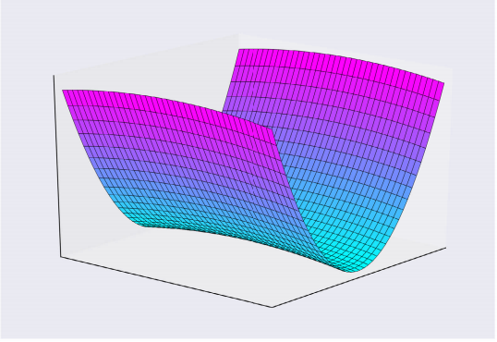
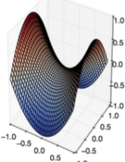
Saddle Points
Both local min and max
Recent studies indicate that in high dim, saddle points are more likely than local min
Gradient can be very small near saddle points
Goodfellow et al. (2016)

Slide 7
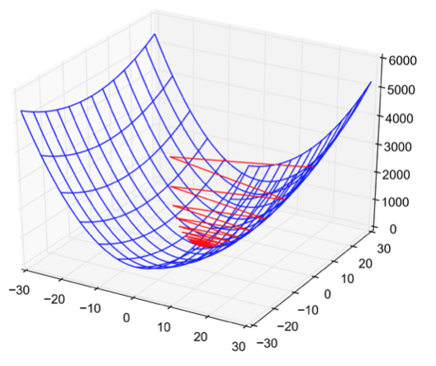
Poor Conditioning
Poorly conditioned Hessian matrix
High curvature: small steps leads to huge increase
Learning is slow despite strong gradients
Oscillations slow down progress

Slide 8
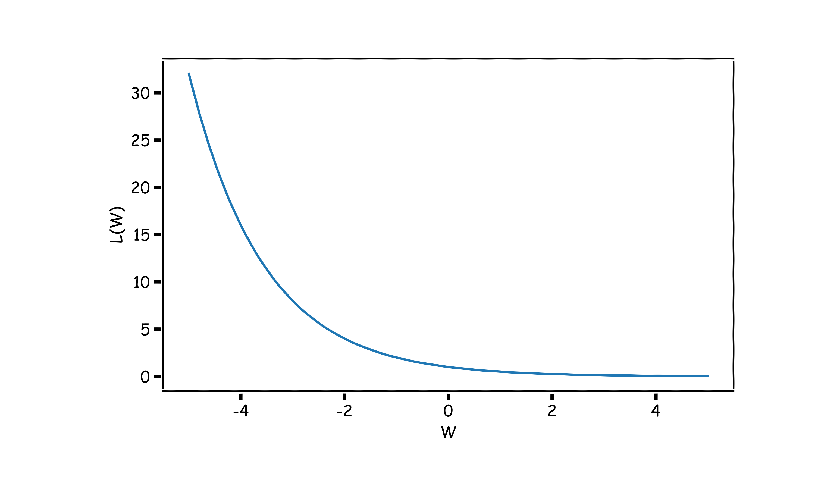
No Critical Points
Some cost functions do not have critical points. In particular classification.
WHY?

Slide 9
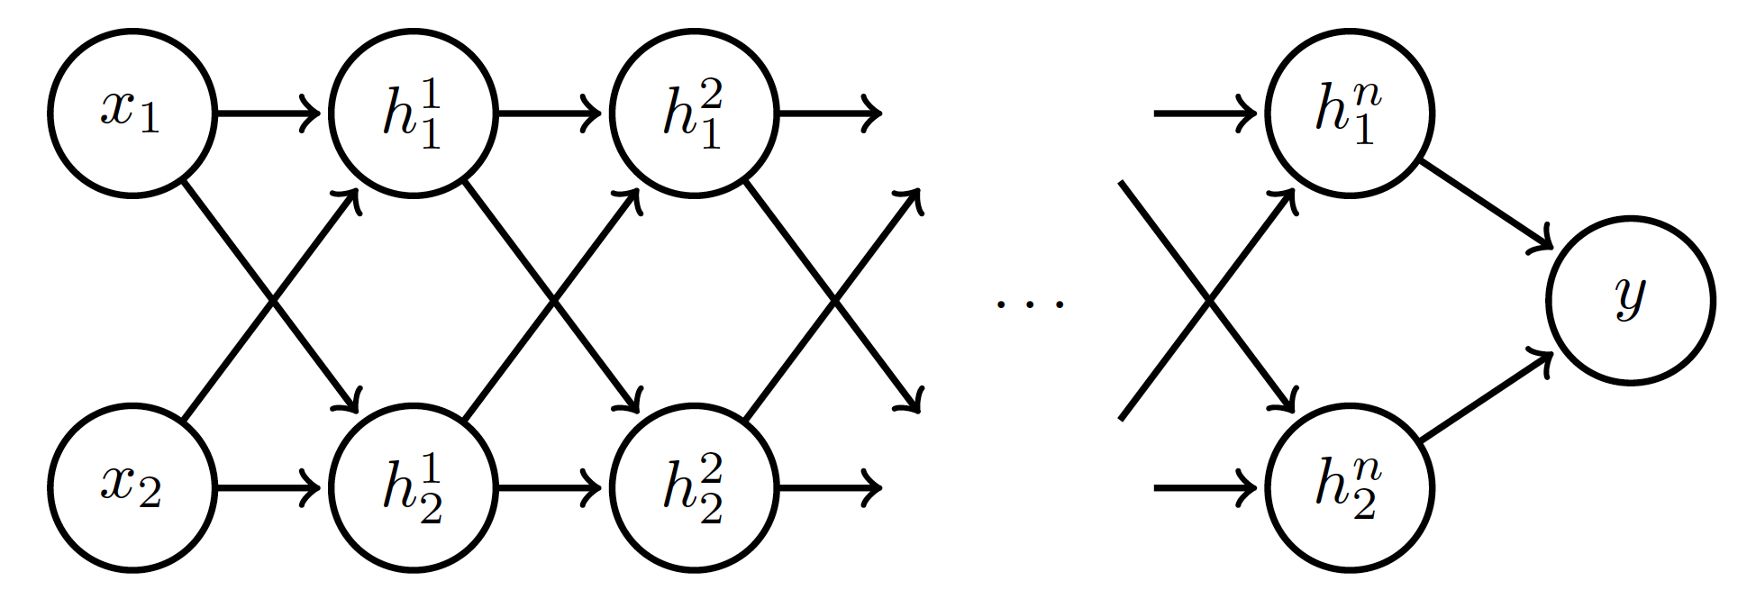
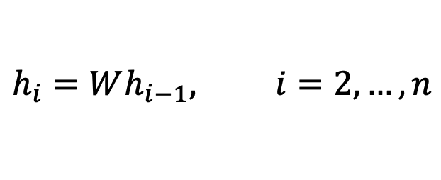

Exploding and Vanishing Gradients
Linear activation
$$h_{i}=Wx$$
$$h_{i}=Wh_{i−1}, i=2,…,n$$
deeplearning.ai

Slide 10
Exploding and Vanishing Gradients

Slide 11
Exploding and Vanishing Gradients
Explodes!
Vanishes!

Slide 12
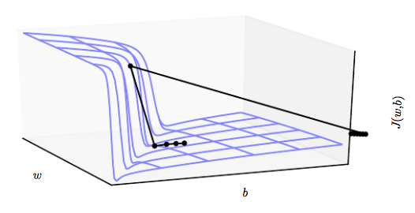


Exploding and Vanishing Gradients
Exploding gradients lead to cliffs
Can be mitigated using gradient clipping
$$if \left\|g\right\|>u$$
$$g⟵\frac{gu}{\left\|g\right\|}$$
Goodfellow et al. (2016)

Slide 13
Momentum
Oscillations because updates do not exploit curvature information
Average gradient presents faster path to optimal: vertical components cancel out
$$L(W)$$
$$W_{2}$$
$$W_{1}$$
Notes:
https://distill.pub/2017/momentum/

Slide 14
Momentum
Question: Why not this?
$$L(W)$$
$$W_{2}$$
$$W_{1}$$
Notes:
https://distill.pub/2017/momentum/

Slide 15
Momentum
Let us figure out an algorithm which will lead us to the minimum faster.
$$L(W)$$
$$W_{2}$$
$$W_{1}$$
Notes:
https://distill.pub/2017/momentum/

Slide 16
Momentum
Look each component at a time
$$L(W)$$
$$W_{2}$$
$$W_{1}$$
Notes:
https://distill.pub/2017/momentum/

Slide 17
Momentum
Let us figure out an algorithm
$$L(W)$$
$$W_{2}$$
$$W_{1}$$
Notes:
https://distill.pub/2017/momentum/

Slide 18
Momentum
Let us figure out an algorithm
$$L(W)$$
$$W_{2}$$
$$W_{1}$$
Notes:
https://distill.pub/2017/momentum/

Slide 19
Momentum
Let us figure out an algorithm
$$L(W)$$
$$W_{2}$$
$$W_{1}$$
Notes:
https://distill.pub/2017/momentum/

Slide 20
Momentum
Let us figure out an algorithm
$$L(W)$$
$$W_{2}$$
$$W_{1}$$
Notes:
https://distill.pub/2017/momentum/

Slide 21
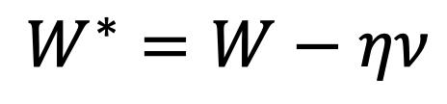
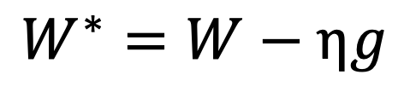
Momentum
$f$is the Neural Network
Old gradient descent:
New gradient descent with momentum:
$$g= \frac{1}{m}\sum_{i}{∇_{W}L(f\left(x_{i};W\right),y_{i})}$$
$$W^{∗}=W−ηg$$
$$ν=αν+(1−α) g$$
$$W^{∗}=W−ην$$
controls how quickly effect of past gradients decay

Slide 22

Nesterov Momentum
Apply an interim update:
Perform a correction based on gradient at the interim point:
$$\tilde{W}=W−η ν$$
$$g= \frac{1}{m}\sum_{i}{∇_{W}L(f\left(x_{i};\tilde{W}\right), y_{i})}$$
Momentum based on look-ahead slope

Slide 23
Outline
Optimization
Challenges in Optimization
Momentum
Adaptive Learning Rate

Slide 24
Adaptive Learning Rates
$$L(W)$$
$$W_{2}$$
Slow
Fast
$$W_{1}$$
Oscillations along vertical direction
Learning must be slower along parameter 2
Use a different learning rate for each parameter?

Slide 25
Adaptive Learning Rates
$$L(W)$$
$$W_{2}$$
Slow
Fast
$$W_{1}$$
Oscillations along vertical direction
Learning must be slower along parameter 2
Use a different learning rate for each parameter?

Slide 26
Adaptive Learning Rates
$$L(W)$$
$$W_{2}$$
Slow
Fast
$$W_{1}$$
Oscillations along vertical direction
Learning must be slower along parameter 2
Use a different learning rate for each parameter?

Slide 27
Adaptive Learning Rates
$$L(W)$$
$$W_{2}$$
Slow
Fast
$$W_{1}$$
Oscillations along vertical direction
Learning must be slower along parameter 2
Use a different learning rate for each parameter?

Slide 28
Adaptive Learning Rates
$$L(W)$$
$$W_{2}$$
Slow
Fast
$$W_{1}$$
Oscillations along vertical direction
Learning must be slower along parameter 2
Use a different learning rate for each parameter?

Slide 29

AdaGrad
Accumulate squared gradients:
Update each parameter:
Greater progress along gently sloped directions
$g$is the gradient
Inversely proportional to cumulative gradient

Slide 30

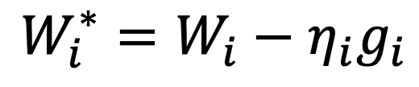
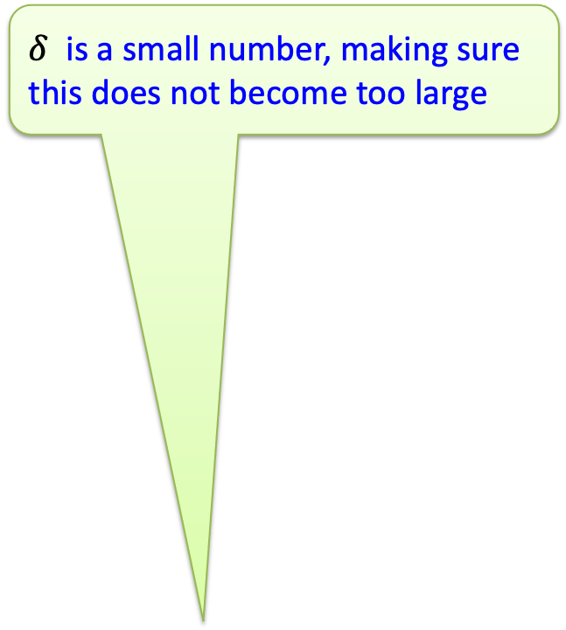
AdaGrad
$δ$ is a small number, making sure this does not become too large
Old gradient descent:
$$g= \frac{1}{m}\sum_{i}{∇_{W}L(f\left(x_{i};W\right),y_{i})}$$
$$W^{∗}=W−λg$$
We would like $λ^{′}s$ not to be the same and inversely proportional to the${|g}_{i}|$
$$W_{i}^{∗}=W_{i}−η_{i}g_{i}$$
$$η_{i}∝\frac{1}{{|g}_{i}|}=\frac{1}{δ+|g_{i}|}$$
New gradient descent with adaptive learning rate:
$$W_{i}^{∗}=W_{i}−\frac{ε}{δ+\sqrt{r_{i}}}g_{i}$$
$$r_{i}^{∗}=r_{i}+g_{i}^{2}$$

Slide 31
RMSProp
For non-convex problems, AdaGrad can prematurely decrease learning rate
Use exponentially weighted average for gradient accumulation

Slide 32

Adam
RMSProp + Momentum
Estimate first moment:
Estimate second moment:
Update parameters:
Also applies bias correction to v and r
Works well in practice, it is fairly robust to hyper-parameters

Slide 33
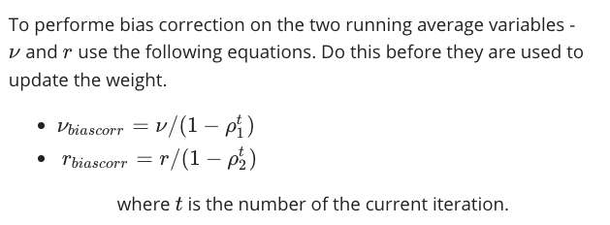
Bias Correction

Slide 34
Momentum Weighting Parameter

