Slide 1
Model Selection Part A: Model Selection

Slide 2
Model Selection
Model selection is the application of a principled method to determine the complexity of the model, e.g. choosing a subset of predictors, choosing the degree of the polynomial model etc.
A strong motivation for performing model selection is to avoid overfitting, which we saw can happen when:
there are too many predictors:
the feature space has high dimensionality
the polynomial degree is too high
too many cross terms are considered
the coefficients values are too extreme (we have not seen this yet)

Slide 3
Generalization Error
We know to evaluate the model on both train and test data, because models that do well on training data may do poorly on new data (overfitting).
The ability of models to do well on new data is called generalization.
The goal of model selection is to choose the model that generalizes the best.

Slide 4
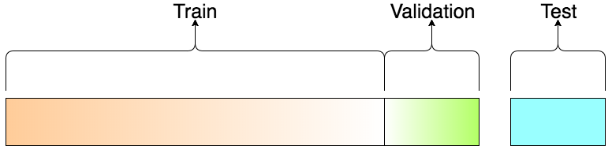
Train-Validation-Test
We use this to train a model
We use this to report model performance
We use this to select model

Slide 5
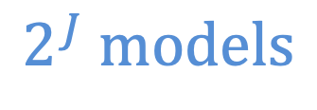
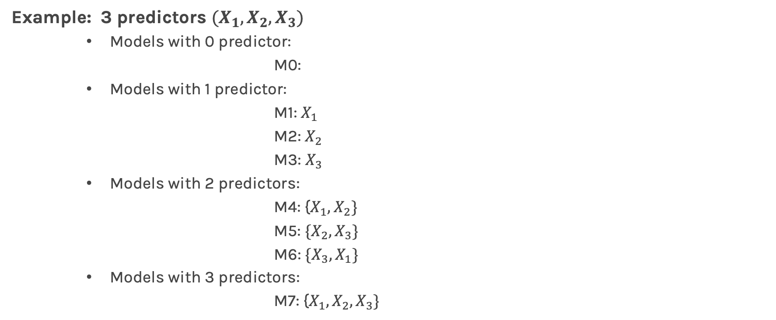
Model Selection
Question:
How many different models when considering J predictors (only linear terms) do we have?
Example: 3 predictors $(X_{1},X_{2},X_{3})$
Models with 0 predictor:
M0:
Models with 1 predictor:
M1: $X_{1}$
M2: $X_{2}$
M3: $X_{3}$
Models with 2 predictors:
M4: {$X_{1},X_{2}\}$
M5: ${\{X}_{2},X_{3}\}$
M6: ${\{X}_{3},X_{1}\}$
Models with 3 predictors:
M7: {$X_{1},X_{2},X_{3}\}$
$$2^{J} models$$

Slide 6
Stepwise Variable Selection and Validation
Selecting optimal subsets of predictors (including choosing the degree of polynomial models) through:
stepwise variable selection - iteratively building an optimal subset of predictors by optimizing a fixed model evaluation metric each time.
validation - selecting an optimal model by evaluating each model on validation set.

Slide 7
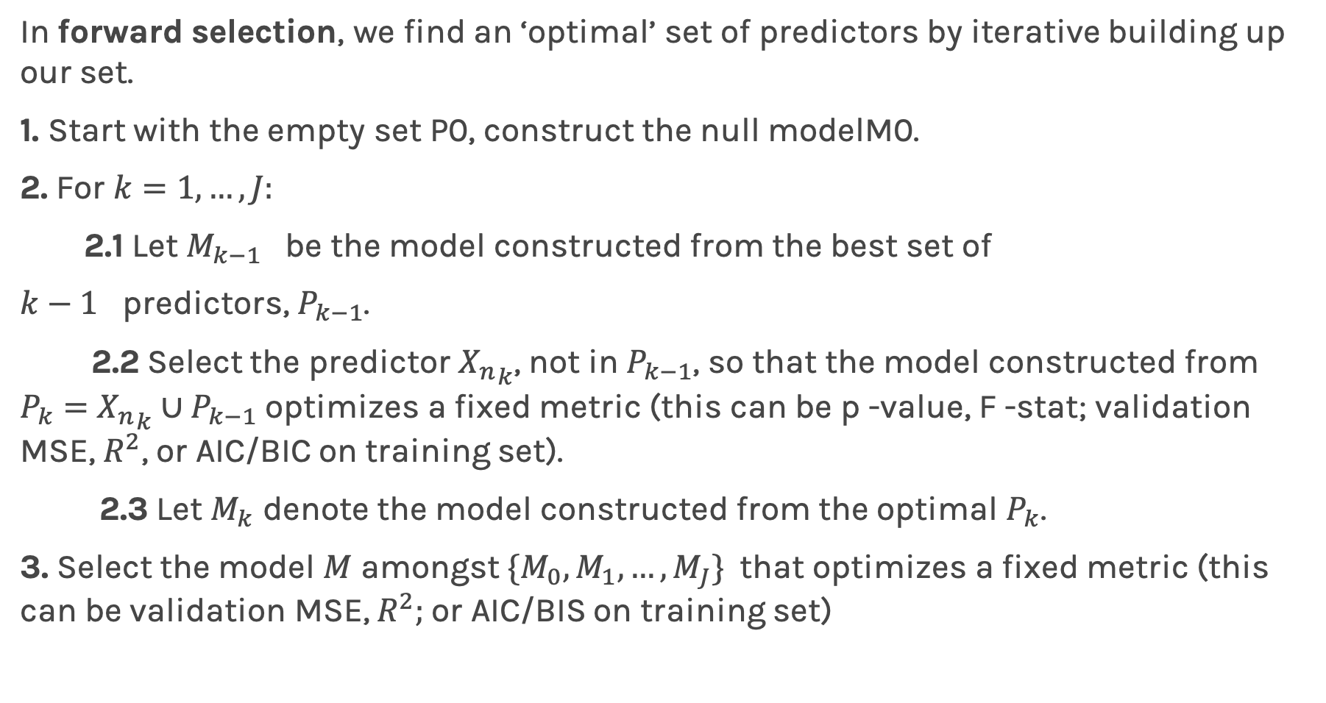
Stepwise Variable Selection: Forward method
In forward selection, we find an ‘optimal’ set of predictors by iterative building up our set.
1. Start with the empty set P0, construct the null modelM0.
2. For $k=1,…, J:$
2.1 Let $M_{k−1}$ be the model constructed from the best set of
$k−1$ predictors, $P_{k−1}$.
2.2 Select the predictor ${X_{n}}_{k}$, not in $P_{k−1}$, so that the model constructed from $P_{k}=$ ${X_{n}}_{k}∪P_{k−1}$ optimizes a fixed metric (this can be p -value, F -stat; validation MSE, $R^{2}$, or AIC/BIC on training set).
2.3 Let $M_{k}$ denote the model constructed from the optimal $P_{k}$.
3. Select the model $M$ amongst $\{M_{0}, M_{1},…, M_{J}\}$that optimizes a fixed metric (this can be validation MSE, $R^{2};$or AIC/BIS on training set)

Slide 8
Stepwise Variable Selection Computational Complexity
How many models did we evaluate?
1st step, J Models
2nd step, J-1 Models (add 1 predictor out of J-1 possible)
3rd step, J-2 Models (add 1 predictor out of J-2 possible)
…

Slide 9
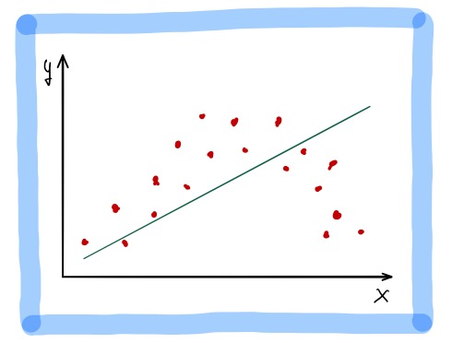
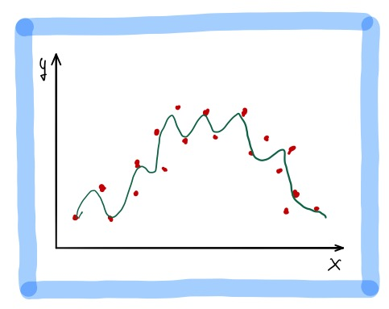
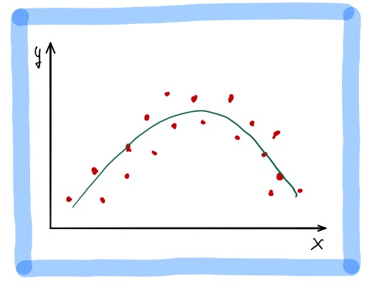
Choosing the degree of the polynomial model
Fitting a polynomial model requires choosing a degree.
Degree 1
Degree 2
Degree 50
Underfitting: when the degree is too low, the model cannot fit the trend.
We want a model that fits the trend and ignores the noise.
Overfitting: when the degree is too high, the model fits all the noisy data points.

Slide 10
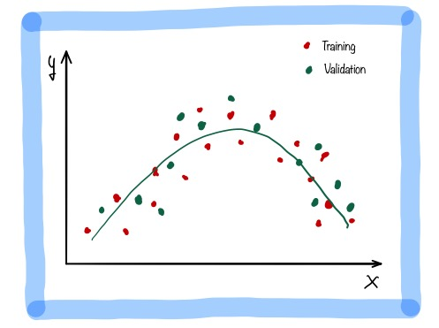
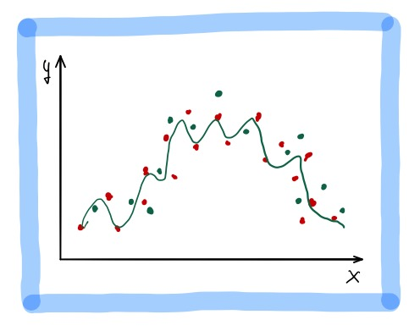
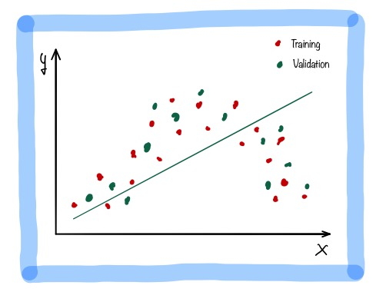
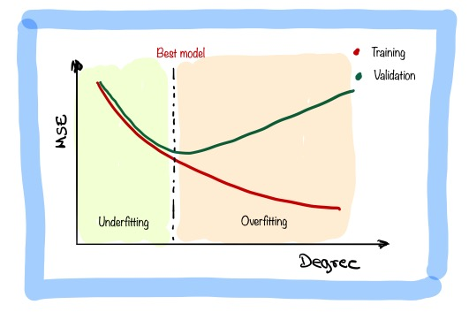
Best model: validation error is minimum.
Overfitting: train error is low, validation error is high.
Underfitting: train and validation error is high.

Slide 11
Exercise C.1

Slide 12
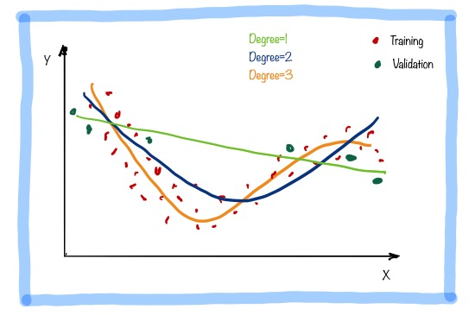
Cross Validation: Motivation
Using a single validation set to select amongst multiple models can be problematic - there is the possibility of overfitting to the validation set.
It is obvious that degree=3 is the correct model but the validation set by chance favors the linear model.

Slide 13
Cross Validation: Motivation
Using a single validation set to select amongst multiple models can be problematic - there is the possibility of overfitting to the validation set.
One solution to the problems raised by using a single validation set is to evaluate each model on multiple validation sets and average the validation performance.
One can randomly split the training set into training and validation multiple times but randomly creating these sets can create the scenario where important features of the data never appear in our random draws.

Slide 14

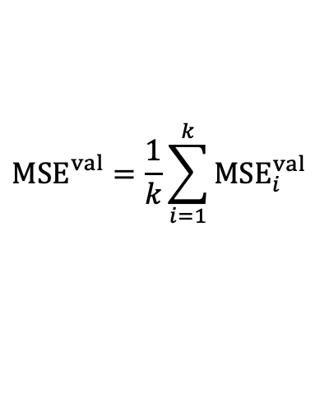



Cross Validation
$$MSE_{1}^{val}$$
$$MSE_{2}^{val}$$
$$MSE_{}^{val}=\frac{1}{k}\sum_{i=1}^{k}{MSE_{i}^{val}}$$
$$MSE_{3}^{val}$$
$$MSE_{k}^{val}$$

Slide 15
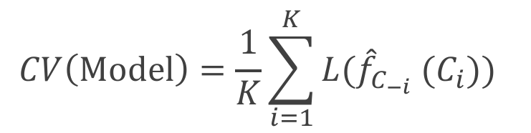
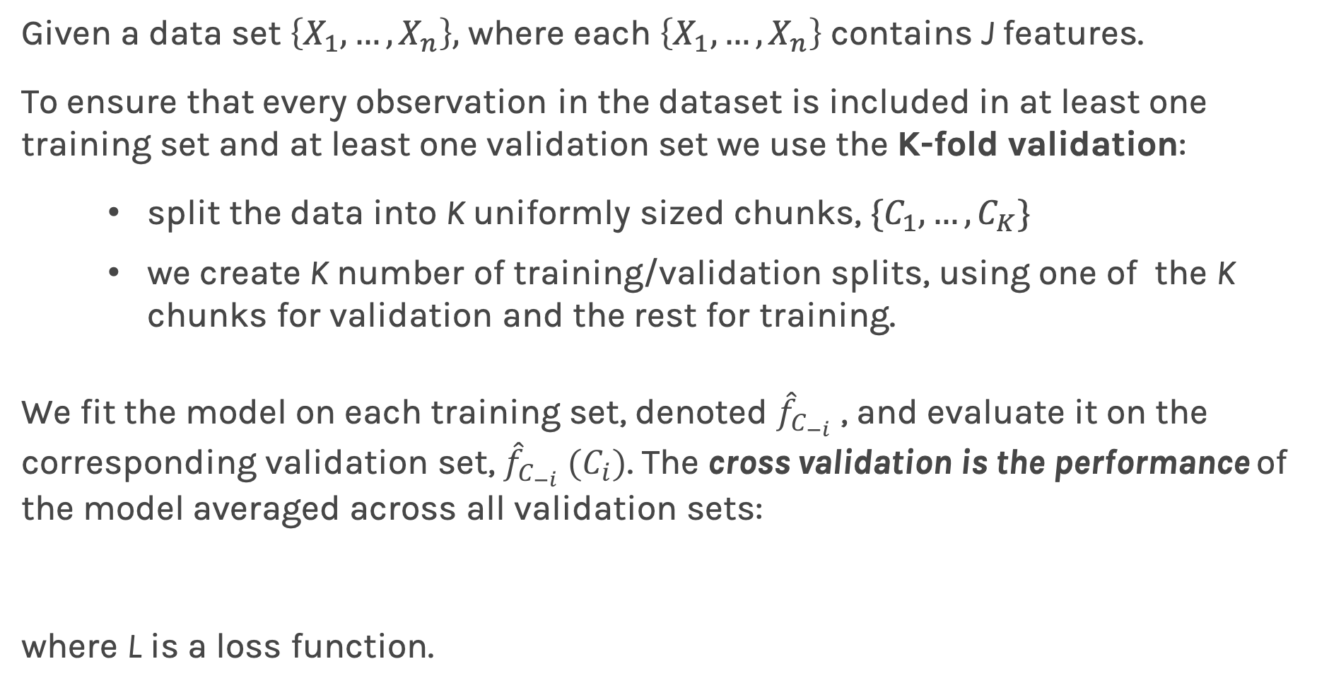
K-Fold Cross Validation
Given a data set $\left\{X_{1},…,X_{n}\right\},$ where each $\left\{X_{1},…,X_{n}\right\}$ contains J features.
To ensure that every observation in the dataset is included in at least one training set and at least one validation set we use the K-fold validation:
split the data into K uniformly sized chunks, $\{C_{1},…,C_{K}\}$
we create K number of training/validation splits, using one of the K chunks for validation and the rest for training.
We fit the model on each training set, denoted ${\hat{f}}_{C_{−i}}$ , and evaluate it on the corresponding validation set, ${\hat{f}}_{C_{−i}} (C_{i})$. The cross validation is the performance of the model averaged across all validation sets:
where L is a loss function.
$$CV\left(Model\right)=\frac{1}{K}\sum_{i=1}^{K}{{L(\hat{f}}_{C_{−i}} (C_{i})\text{)} }$$

Slide 16
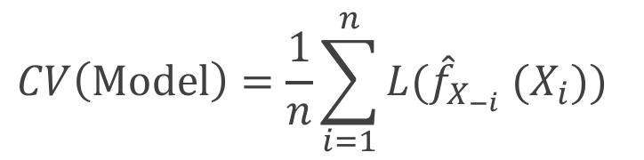
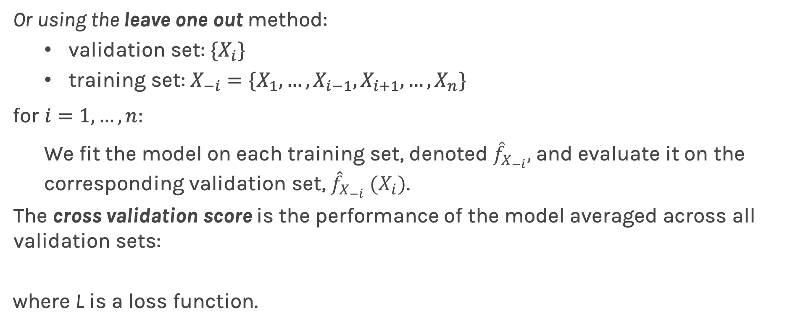
Leave-One-Out
Or using the leave one out method:
validation set: ${\{X}_{i}\}$
training set: $X_{−i}=\{X_{1}, …,X_{i−1},X_{i+1}, …, X_{n}\}$
for ${i=1,…,n: }_{}$
We fit the model on each training set, denoted ${\hat{f}}_{X_{−i}},$and evaluate it on the corresponding validation set, ${\hat{f}}_{X_{−i}} (X_{i})$.
The cross validation score is the performance of the model averaged across all validation sets:
where L is a loss function.
$$CV\left(Model\right)=\frac{1}{n}\sum_{i=1}^{n}{{L(\hat{f}}_{X_{−i}} (X_{i})\text{)} }$$

Slide 17
Exercise C.2

