Slide 1
Third Year Project Charity website “Irish wildlife fund”
‘The nerds with attitude’ (Nwa)
Neil Cronin – Project manager – documentation- testing – HTML – CSS – PHP – SQL
David Broderick – Web development – style – testing – html – css
Shane fitzgerald – database – algorithm design – php - sql

Slide 2
Gantt Chart for the week ahead

Slide 3
Gantt Chart projection for full project

Slide 4
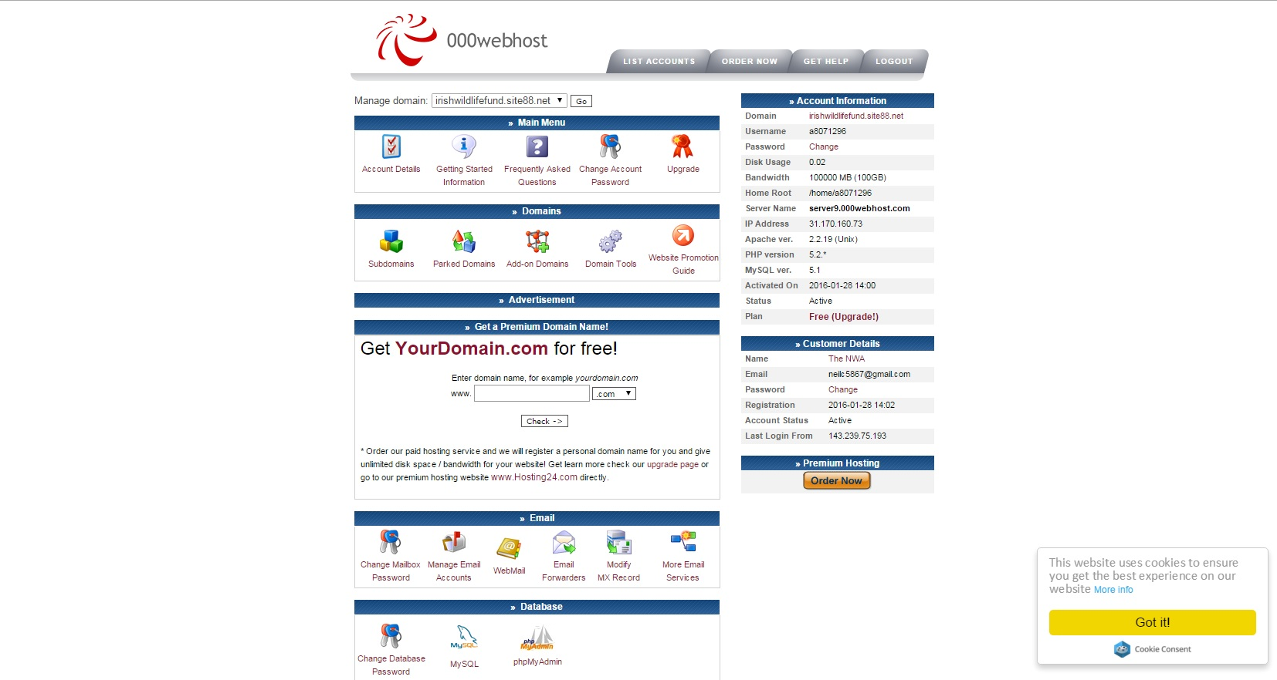
Web hosting - 000webhost.com

Slide 5
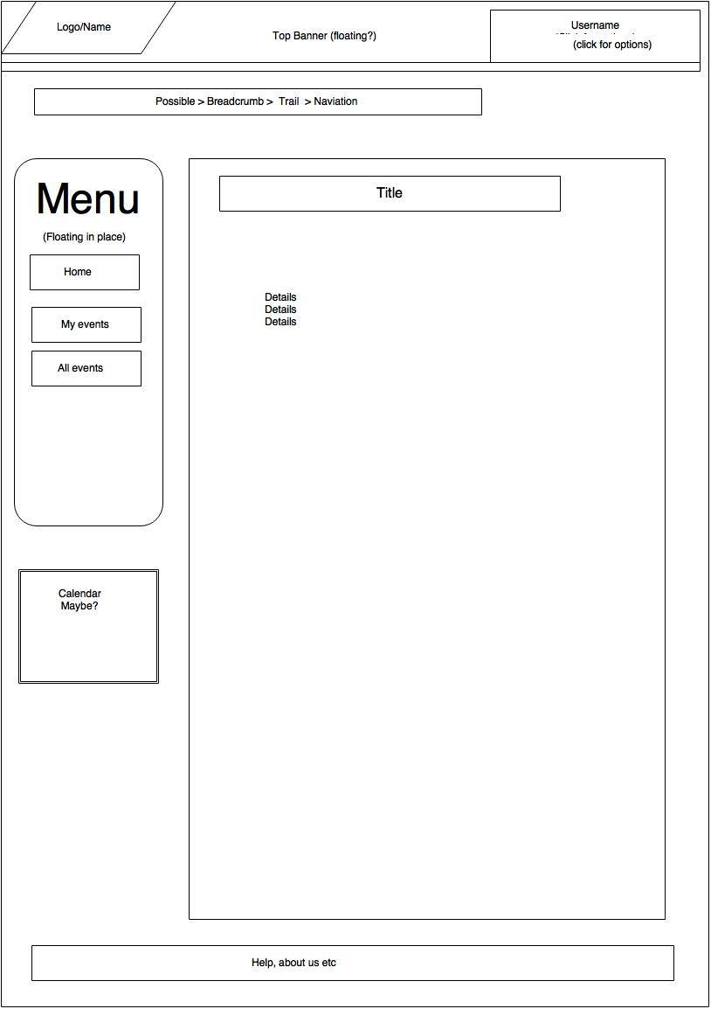

Slide 6
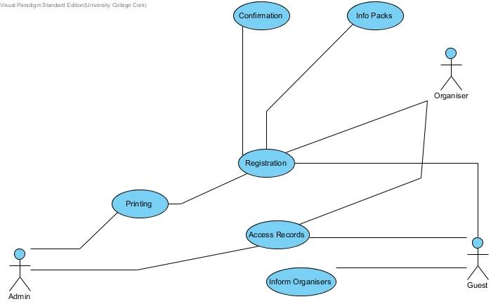
Use Case Diagram

Slide 7
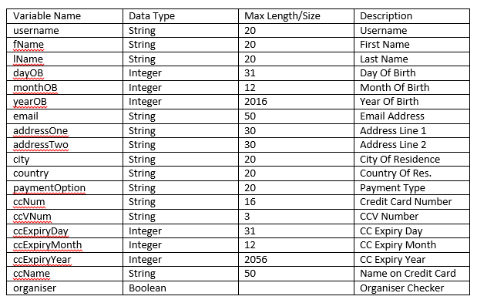
Database Schema/Dictionary

Slide 8
Integrated Developer Environment (IDE) Choice
Eclipse

