Slide 1
Third Year Project Charity website
‘The nerds with attitude’ (Nwa)
Neil Cronin – Project manager – documentation- testing – HTML – CSS – PHP – SQL
David Broderick – Web development – style – testing – html – css
Shane fitzgerald – database – algorithm design – php – sql - JSP

Slide 2
Revised Gantt Chart

Slide 3
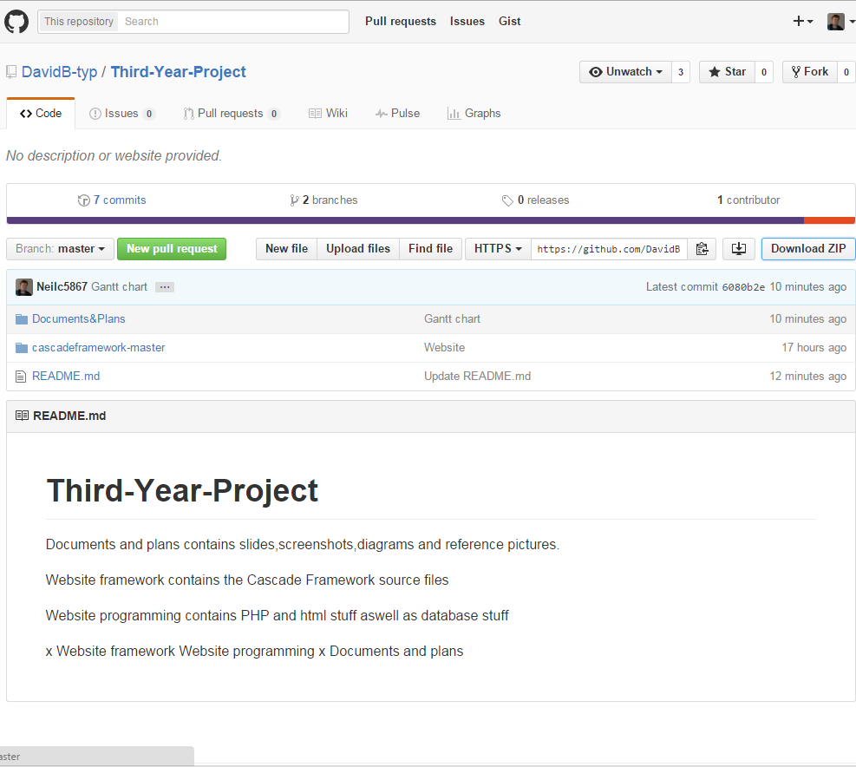

Slide 4
Database Layout OLD

Slide 5
Current Database Layout

Slide 6
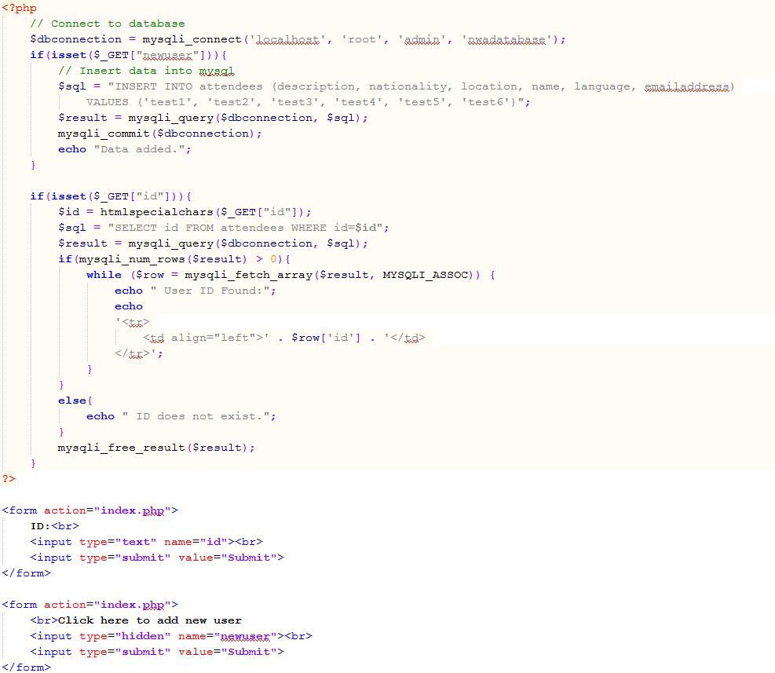

Slide 7
