Slide 1
Lettuces –phenotype investigation
The results based on dataset crafted
from BNEI-ATAROT lettuces greenhouse

Slide 2
RGB dataset
Raw data images source | Raw Reference dataset | Processed images dataset name (hyper parameters) | Processed reference dataset name | Merged (completed) dataset
071225 | 051225 | rgb_imgs_dataset_BneiAtarot_2025-12-28 16 | Anthocyanin_BENI_ATAROT_2025-12-05.csv | complete_ds_of_Anthocyanin_BENI_ATAROT_2025-12-05_1767270034.8005881.csv
121225 | 091225 | rgb_imgs_dataset_BneiAtarot_2026-01-01 10 | Anthocyanin_BENI_ATAROT_2025-12-09.csv | complete_ds_of_Anthocyanin_BENI_ATAROT_2025-12-09_1767256767.5268679.csv
161225 | 171225 | rgb_imgs_dataset_BneiAtarot_2026-01-01 13.csv | Anthocyanin_BENI_ATAROT_2025-12-17.csv | complete_ds_of_Anthocyanin_BENI_ATAROT_2025-12-17_1767268236.1391623.csv
251225 | 251225 | rgb_imgs_dataset_BneiAtarot_2026-01-01 13.csv | Anthocyanin_BENI_ATAROT_2025-12-25.csv | complete_ds_of_Anthocyanin_BENI_ATAROT_2025-12-25_1767268299.6683538.csv
We combine all the completed dataset together to one dataset: complete_ds_of_Anthocyanin_BENI_ATAROT_2025_12.csv

Slide 3
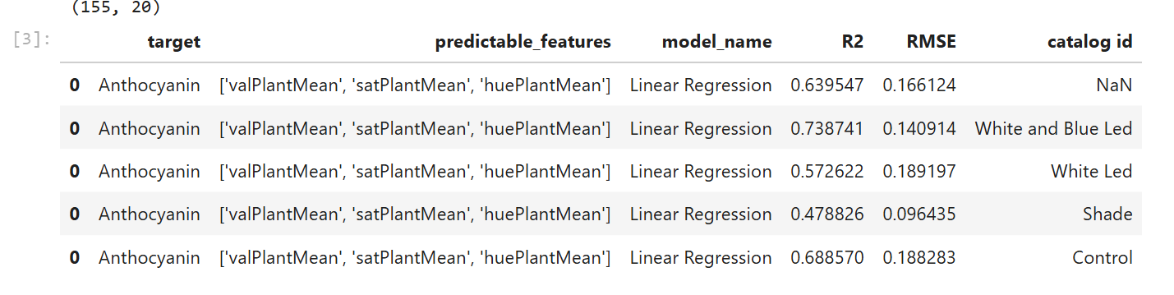
Results (rgb datasets)

Slide 4
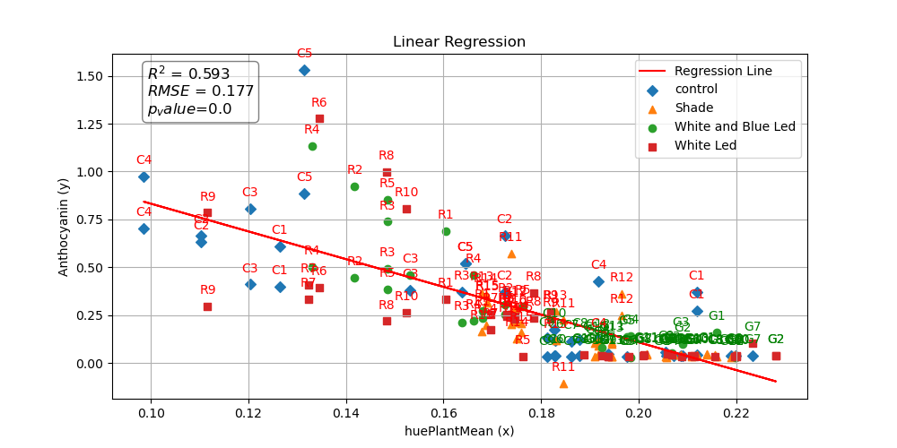

Slide 5
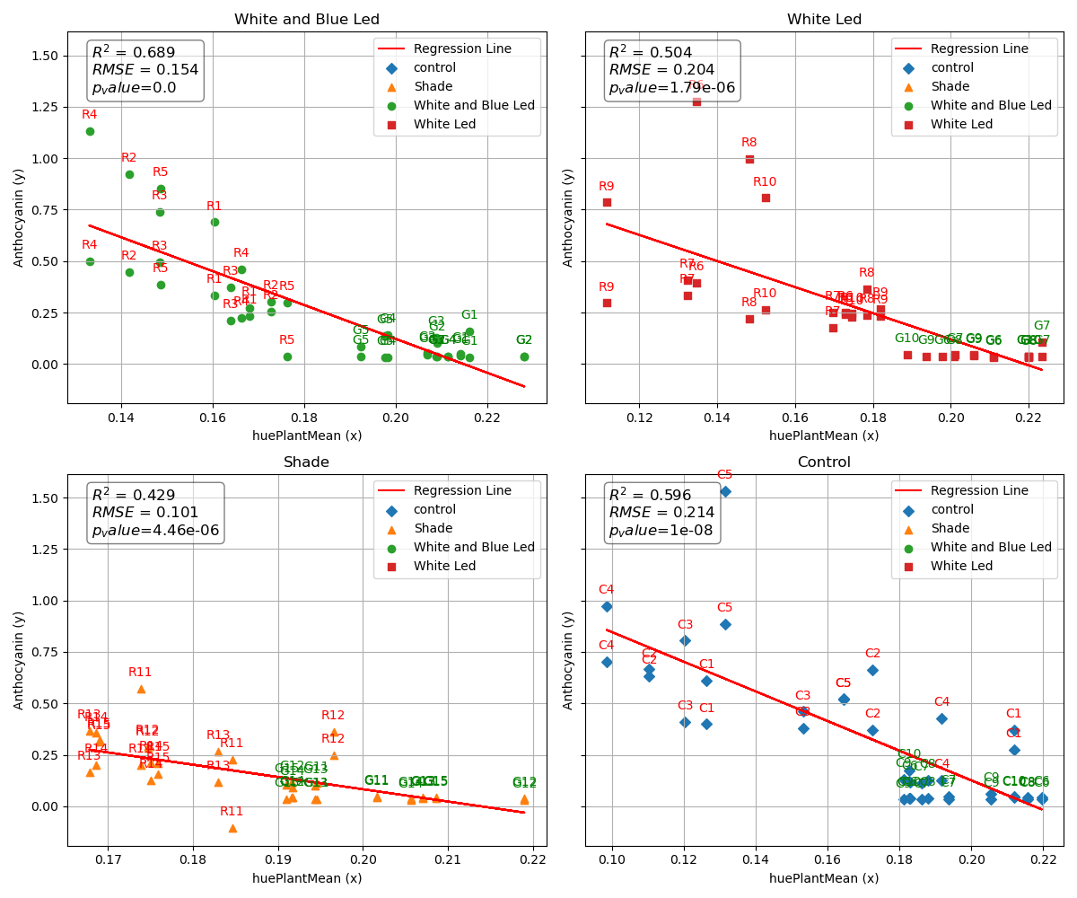

Slide 6
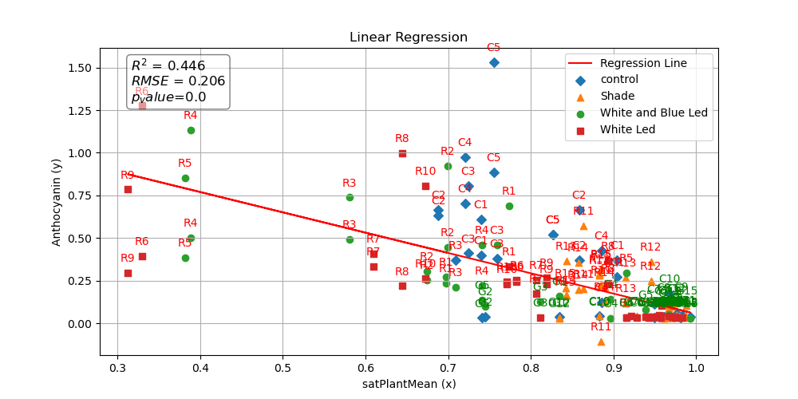

Slide 7
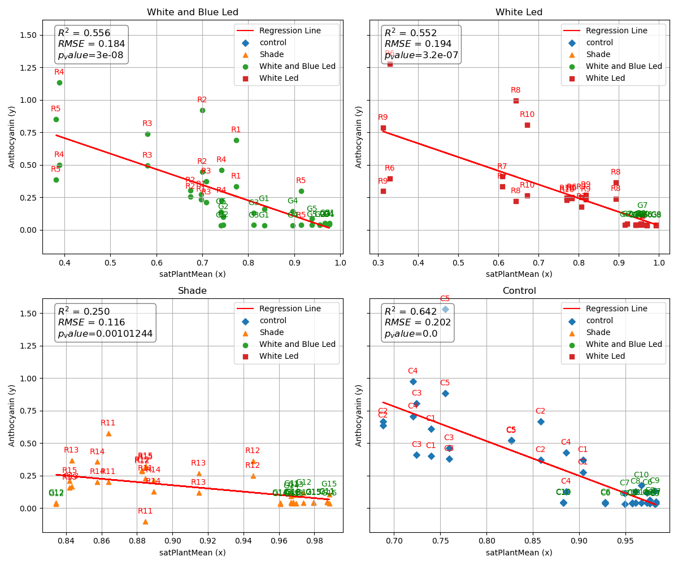

Slide 8
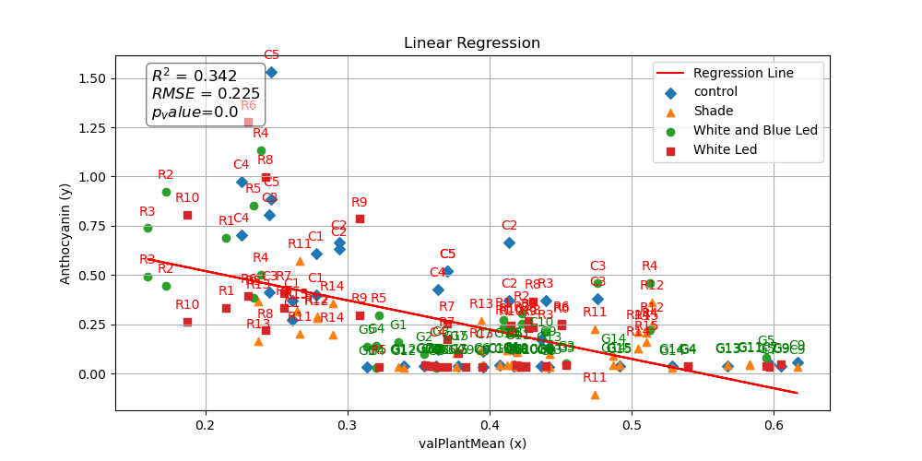

Slide 9
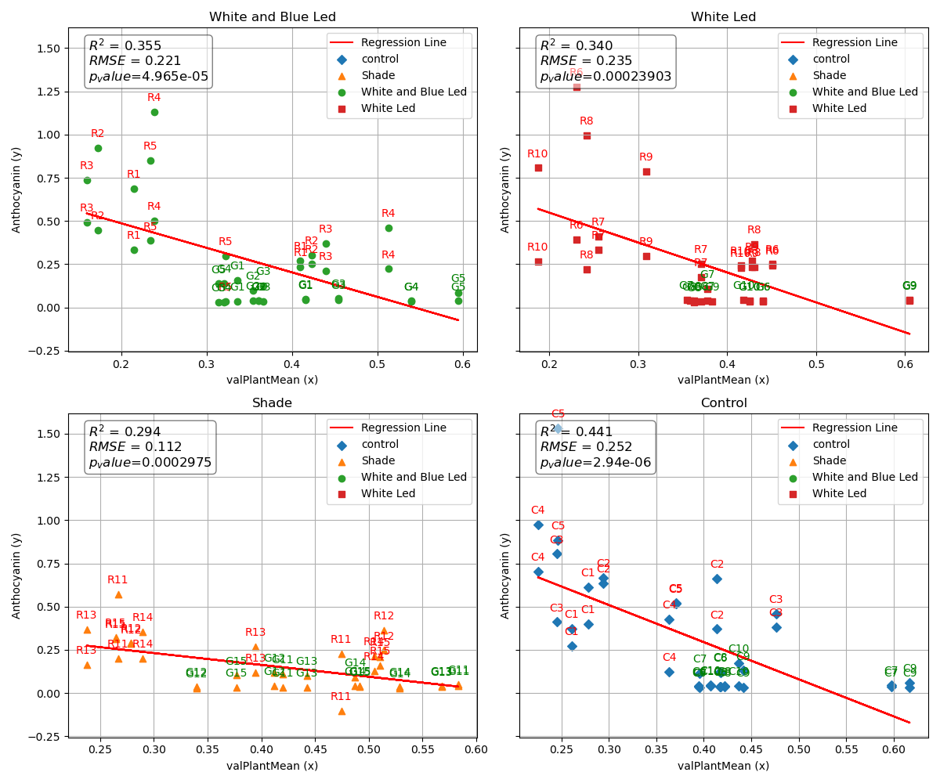

Slide 10
Disclaimer : in contrast of the rgb dataset – here we don’t know the precise number of each plant , only the category it is belong. In thus way we called plant from white and blue led “R1” but the real plant “R1” that from him Anthocyanin values were test – is do not known.

Slide 11
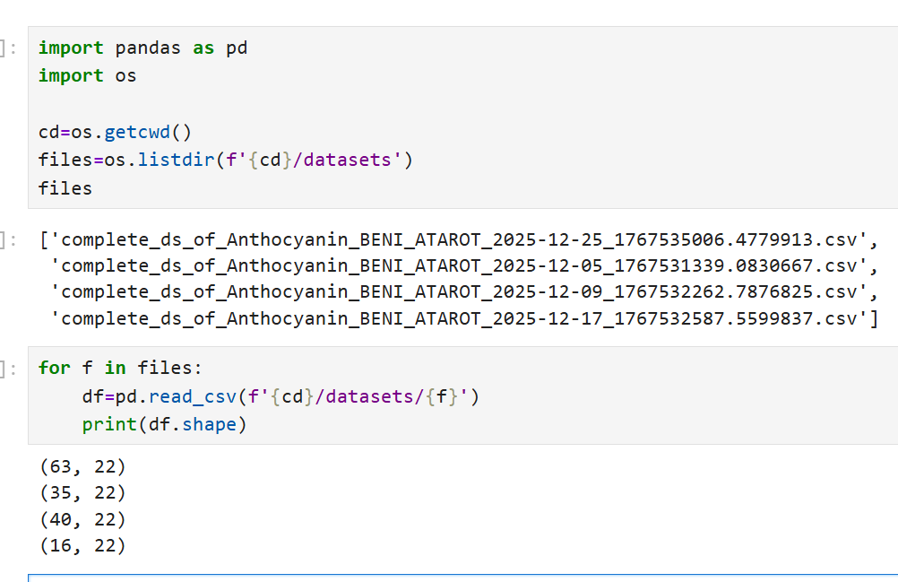
Hyper spectral dataset
20251201 | 051225 | hyper_sp_imgs_dataset_created_at_20251201_from_BneiAtarot_2026-01-04 14.csv | Anthocyanin_BENI_ATAROT_2025-12-05.csv | complete_ds_of_Anthocyanin_BENI_ATAROT_2025-12-05_1767531339.0830667.csv
20251209 | 091225 | hyper_sp_imgs_dataset_created_at_20251209_from_BneiAtarot_2026-01-04 15.csv | Anthocyanin_BENI_ATAROT_2025-12-09.csv | complete_ds_of_Anthocyanin_BENI_ATAROT_2025-12-09_1767532262.7876825.csv
20251223 | 171225 | hyper_sp_imgs_dataset_created_at_20251223_from_BneiAtarot_2026-01-04 15.csv | Anthocyanin_BENI_ATAROT_2025-12-17.csv | complete_ds_of_Anthocyanin_BENI_ATAROT_2025-12-17_1767532587.5599837.csv
20251229 | 251225 | hyper_sp_imgs_dataset_created_at_20251229_from_BneiAtarot_2026-01-04 15.csv | Anthocyanin_BENI_ATAROT_2025-12-25.csv | complete_ds_of_Anthocyanin_BENI_ATAROT_2025-12-25_1767535006.4779913.csv
We concatenate this datasets and created: complete_HS_ds_of_Anthocyanin_BENI_ATAROT_2025_12.csv'
Notes:
Disclaimer : in contrast of the rgb dataset – here we don’t know the precise number of each plant , only the category it is belong. In thus way we called plant from white and blue led “R1” but the real plant “R1” that from him Anthocyanin values were test – is do not known.

Slide 12
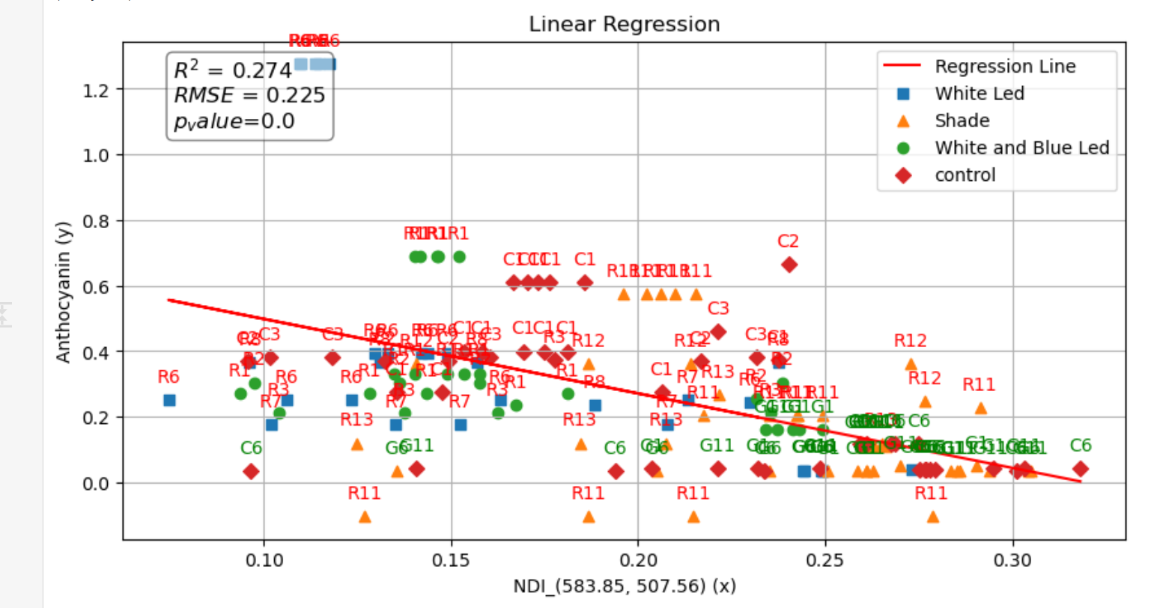

Slide 13
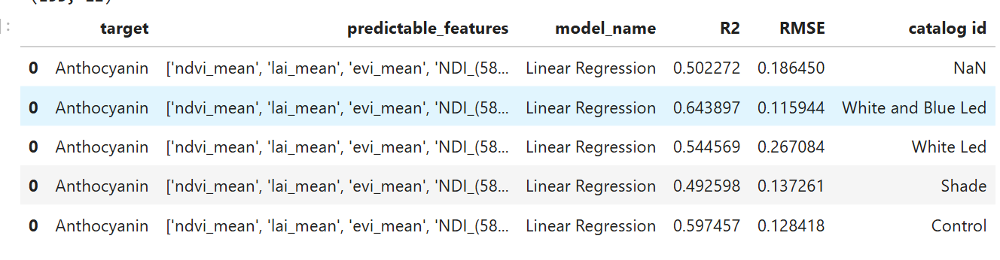

Slide 14
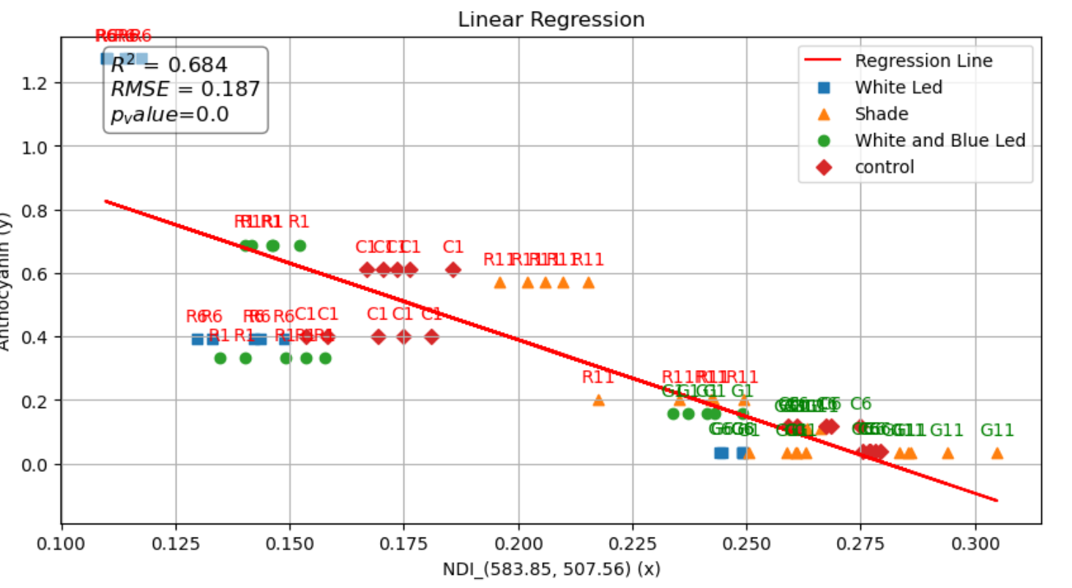
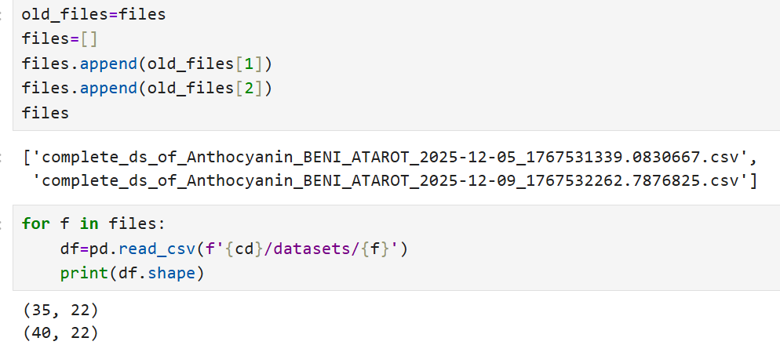
Trial 2 (merge only two dataset)

Slide 15
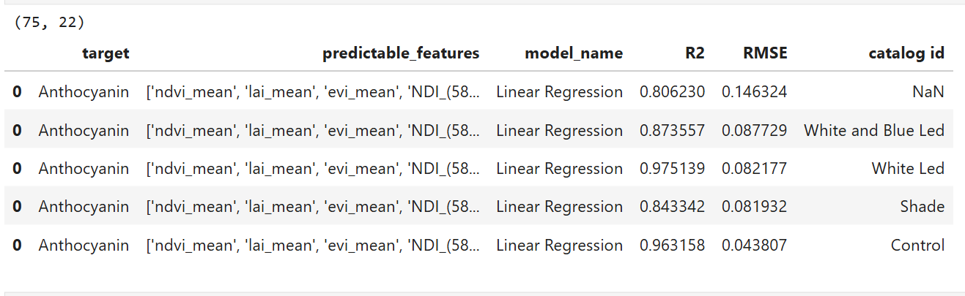

Slide 16
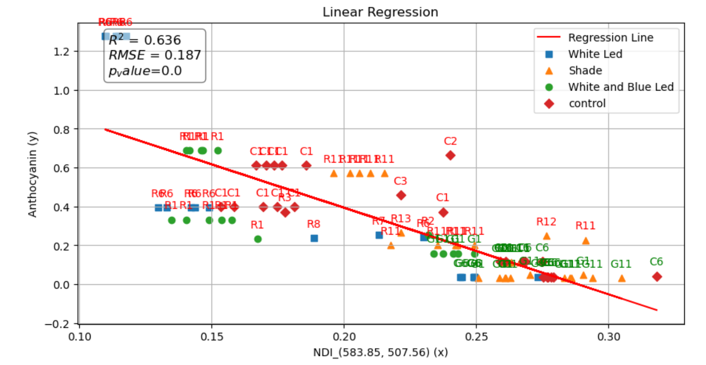
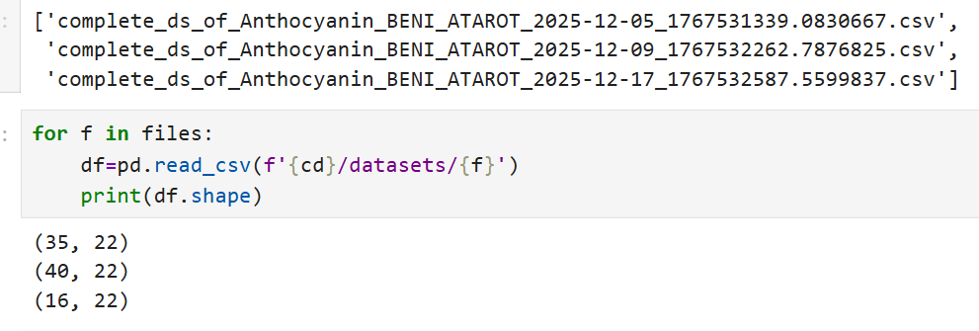
Trial 3 (merge 3 dataset)

Slide 17
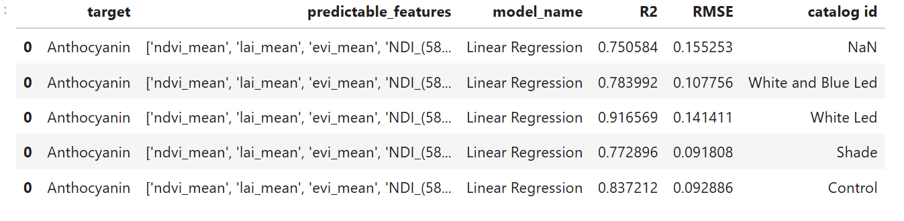

Slide 18
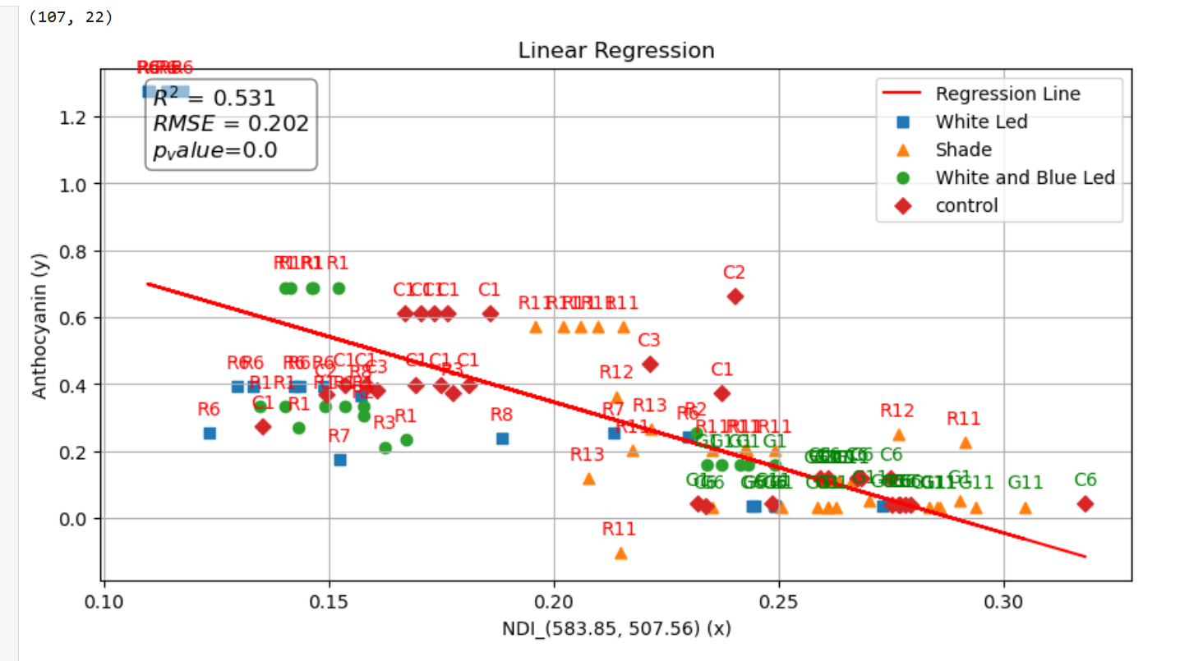
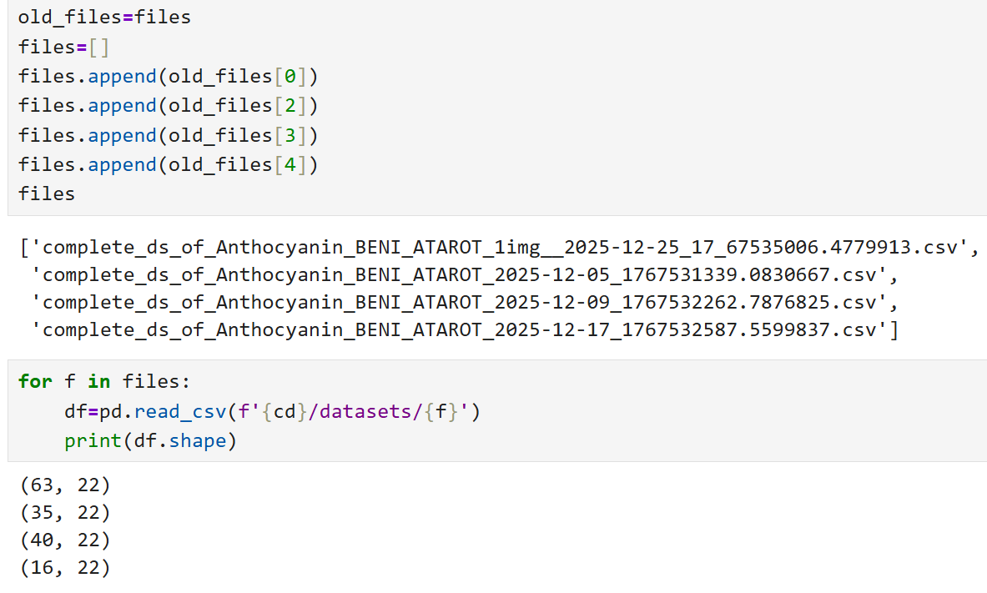
Trial 4 (merge all dataset, but the fourth ds contain only one image)

Slide 19
