Slide 1
Lettuces –phenotype investigation
The results based on dataset crafted
from BNEI-ATAROT lettuces greenhouse

Slide 2
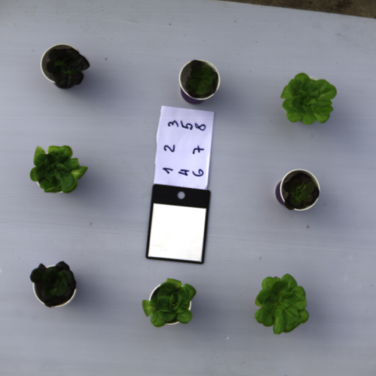
RAW DATA
Scientific explanation on the project can be found here.
Every time we take Hyper Spectral pictures of the lettuces we number them from 1 to 8. The mapping between them is as the follow:
Number 1:6 are correspond to plot : R1,G1,R6,G6,R11,G11
Number 7:8 are control group and correspond to C1,C6
Every time we take 5 different pictures with replacements of the places of the lettuces.

Slide 3
RAW DATA –cont.
R -stand for Red lettuces
G- stand for Green lettuces
C1 belong to the Reds, and C6 belong to the Greens
Light conditions
Be aware that actually there are only four class and for each class there are two samples:
White and blue Led (R1,G1)
White Led (R6,G6)
Shade (R11,G11)
Control (C1,C6)

Slide 4
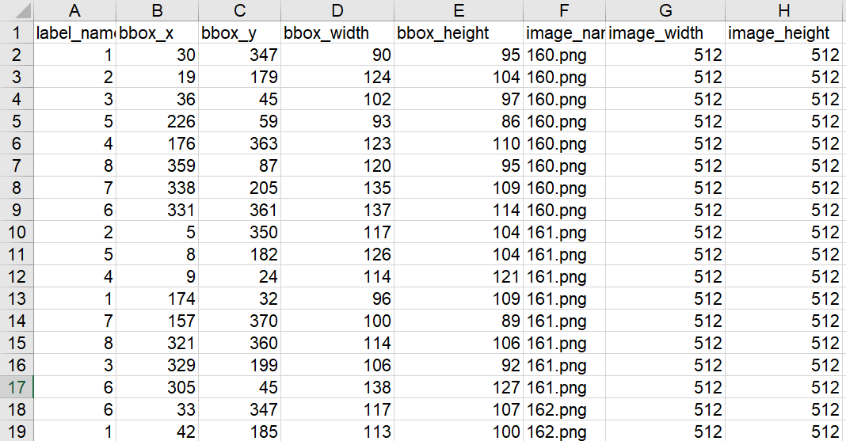
RAW DATA –cont.
For every batch of images we annotated the bounding box of the lettuces.

Slide 5
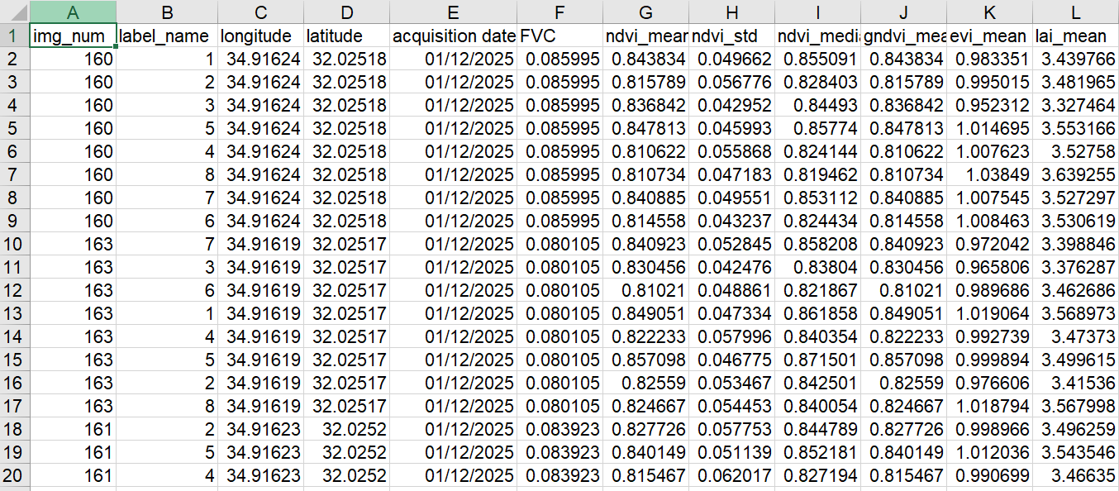
Hyper –parameters Dataset
From the raw dataset we extract the hyper-parameters dataset that contain the vegetation indices for each object

Slide 6
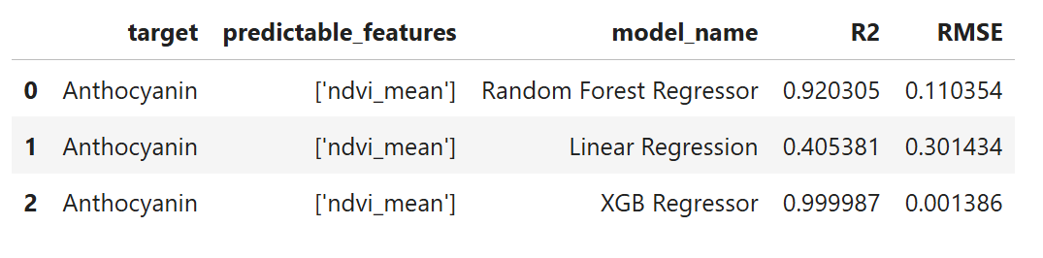
Reference Dataset
We receive the reference dataset with the Anthocyanin test and we merge them together for machine learning classification and regression
color | catalog id | Leaf sample weight (mg) | Sample disc weight (g) | Anthocyanins OD-530 nm | Chlorophyll OD-657 nm | Chlorophyll interference | Anthocyanin
R | R1 | 0.22 | 0.03 | 0.7162 | 0.107 | 0.027 | 0.689
R | R2 | 0.17 | 0.03 | 0.9472 | 0.1053 | 0.026 | 0.921
R | R3 | 0.28 | 0.03 | 0.5231 | 0.1204 | 0.03 | 0.493
R | R4 | 0.39 | 0.03 | 1.1758 | 0.1733 | 0.043 | 1.132
R | R5 | 0.22 | 0.03 | 0.8803 | 0.1148 | 0.029 | 0.852
R | R6 | 0.19 | 0.03 | 1.305 | 0.1175 | 0.029 | 1.276
R | R7 | 0.17 | 0.03 | 0.4376 | 0.1128 | 0.028 | 0.409
R | R8 | 0.19 | 0.03 | 1.021 | 0.0999 | 0.025 | 0.996
R | R9 | 0.22 | 0.03 | 0.8077 | 0.0893 | 0.022 | 0.785
R | R10 | 0.15 | 0.03 | 0.8298 | 0.0927 | 0.023 | 0.807
R | R11 | 0.18 | 0.03 | 0.5975 | 0.0988 | 0.025 | 0.573
R | R12 | 0.23 | 0.03 | 0.3081 | 0.0959 | 0.024 | 0.284
R | R13 | 0.19 | 0.03 | 0.3898 | 0.0959 | 0.024 | 0.366
R | R14 | 0.25 | 0.03 | 0.3802 | 0.1018 | 0.025 | 0.355
R | R15 | 0.18 | 0.03 | 0.3379 | 0.0978 | 0.024 | 0.313
G | G1 | 0.3 | 0.03 | 0.1833 | 0.0969 | 0.024 | 0.159

Slide 7
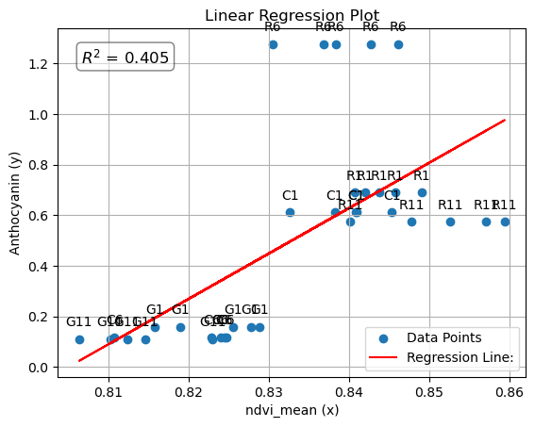
Linear Regression Plot

Slide 8
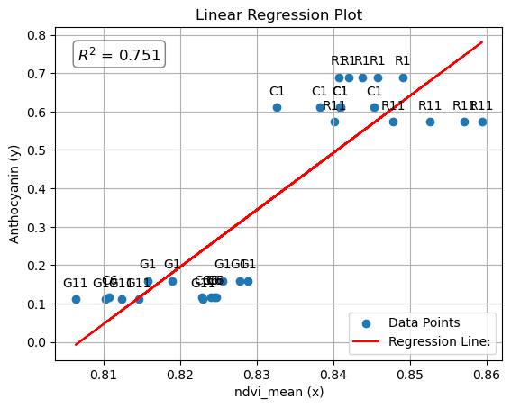
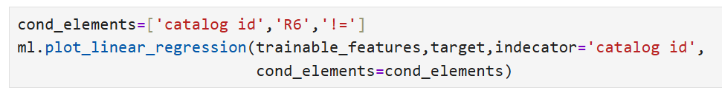
Linear Regression Plot
Excluding R6 from the dataframe
Conclude in better results

Slide 9
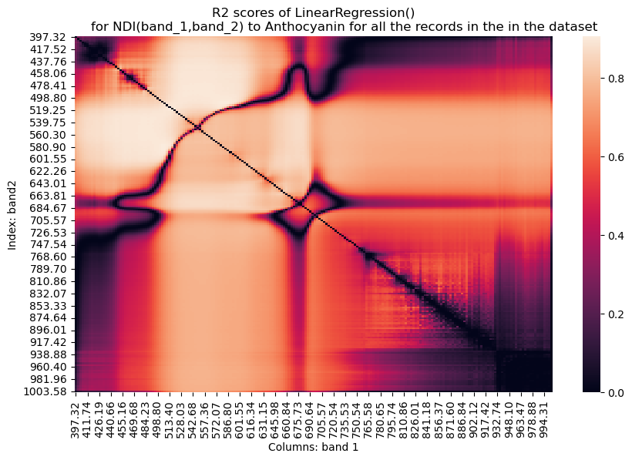
ds_name='complete_ds_of_Anthocyanin_BENI_ATAROT_2025-12-05_1765460817.5458224.csv' ml=training.training(dataset_name=ds_name) print(ml.df.shape) trainable_features=['ndvi_mean','lai_mean','evi_mean','Anthocyanin’]
target='Anthocyanin' ml.evaluate_regression_models(trainable_features,target)
r2_df=ml.compute_r2_for_ndi_tables(target) ml.plot_heatmap_of_r2_score_of_ndi()
print(r2_df.loc[row, col]) #max r2
print(row, col)
0.905844887991963
507.56 583.85
Notes:
band1: 507,
Band2: 583

