Slide 1
Lettuces –phenotype investigation
The results based on dataset crafted
from BNEI-ATAROT lettuces greenhouse

Slide 2
RGB images dataset
We compute the mean of each one of the hsv values of the plant aera for each image in the rgb images pictured at 7/12/25 (rgb_imgs_dataset_BneiAtarot_2025-12-28 16.csv)
Than we merge this dataset with reference dataset contain the Anthocyanin value for each image created in 5/12/25 (Anthocyanin_BENI_ATAROT_2025-12-05.csv)
In the next step we check the correlation to the Anthocyanin in completed dataset (complete_ds_of_Anthocyanin_BENI_ATAROT_2025-12-05_1766935305.461822.csv) with linear regression .

Slide 3

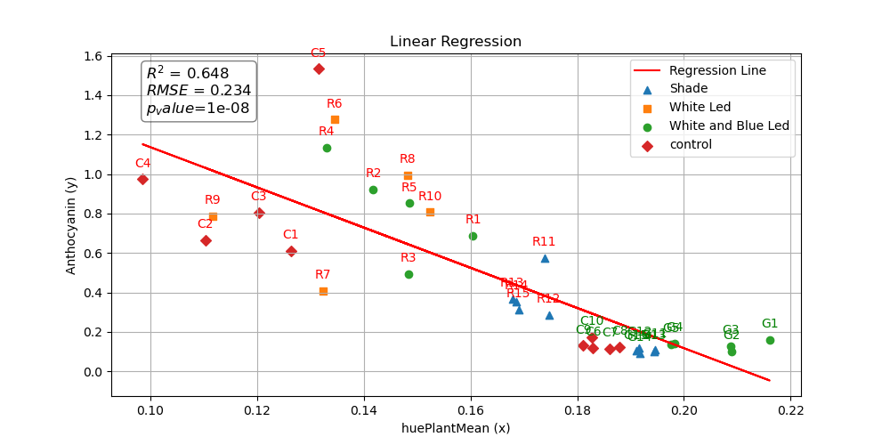
LR of mean of hue values for the plant
ds_name='complete_ds_of_Anthocyanin_BENI_ATAROT_2025-12-05_1766935305.461822.csv' ml=training.training(dataset_name=ds_name) print(ml.df.shape) trainable_features=['huePlantMean','Anthocyanin'] target='Anthocyanin' ml.evaluate_regression_models(trainable_features,target) ml.plot_linear_regression(trainable_features,target,indecator='catalog id')

Slide 4
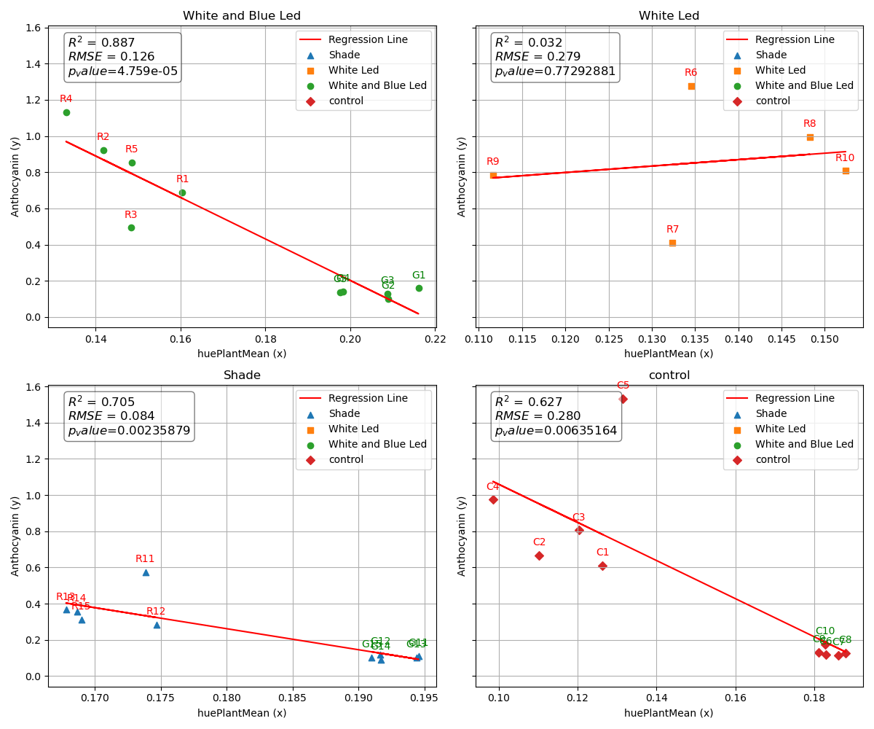

Slide 5
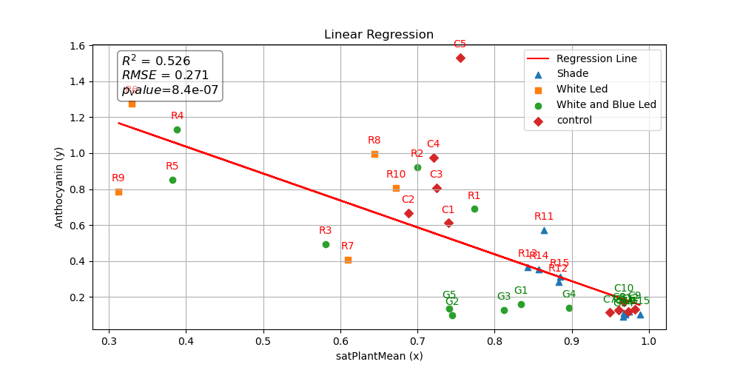
LR of mean of saturation values for the plant

Slide 6
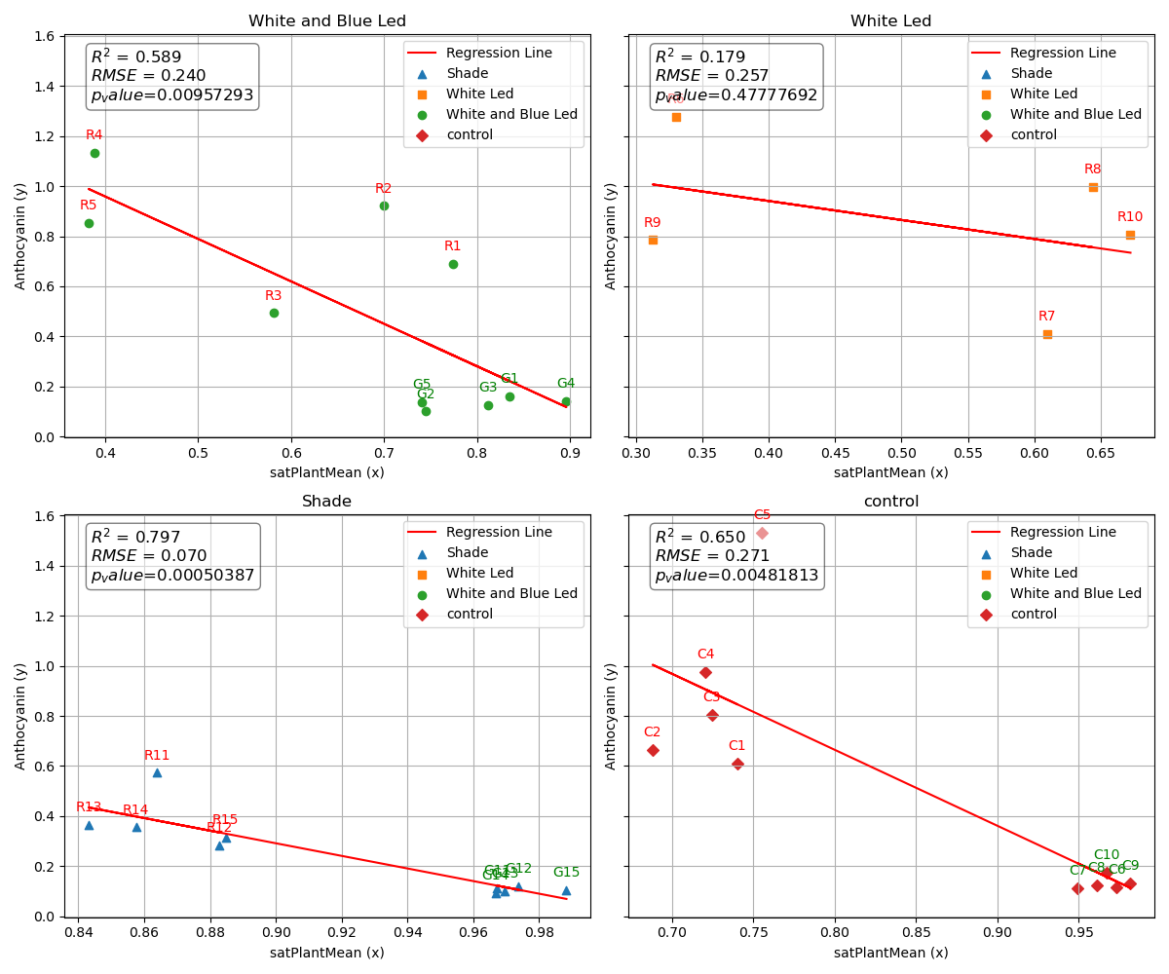

Slide 7
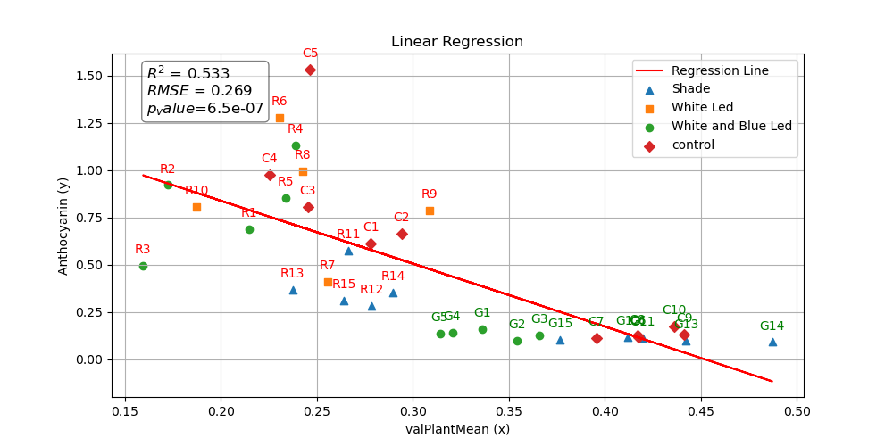
LR of mean of value values for the plant

Slide 8
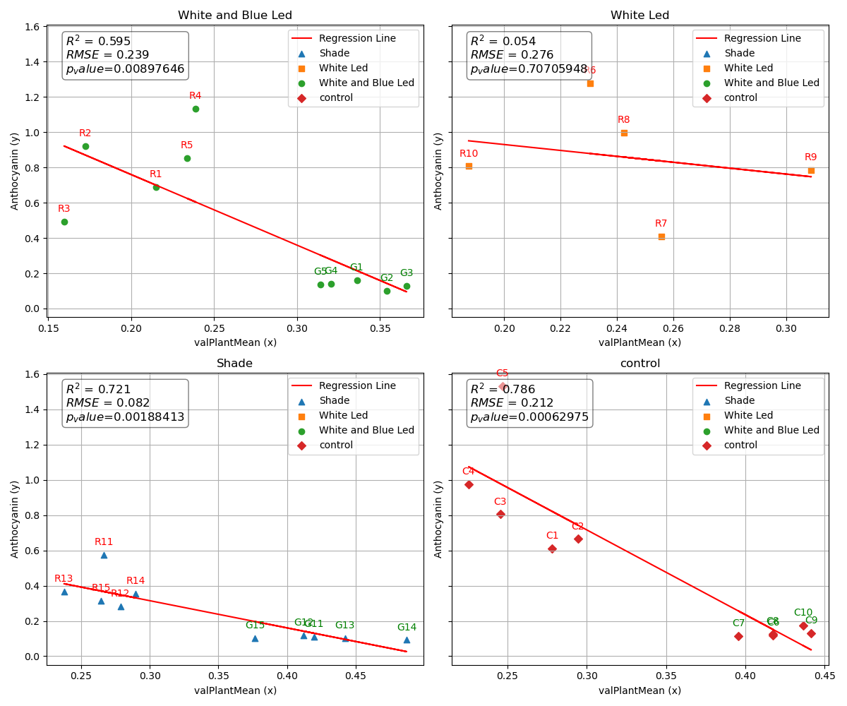

Slide 9
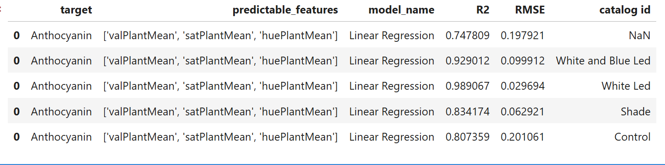
LR of hsv means for the plant

Slide 10
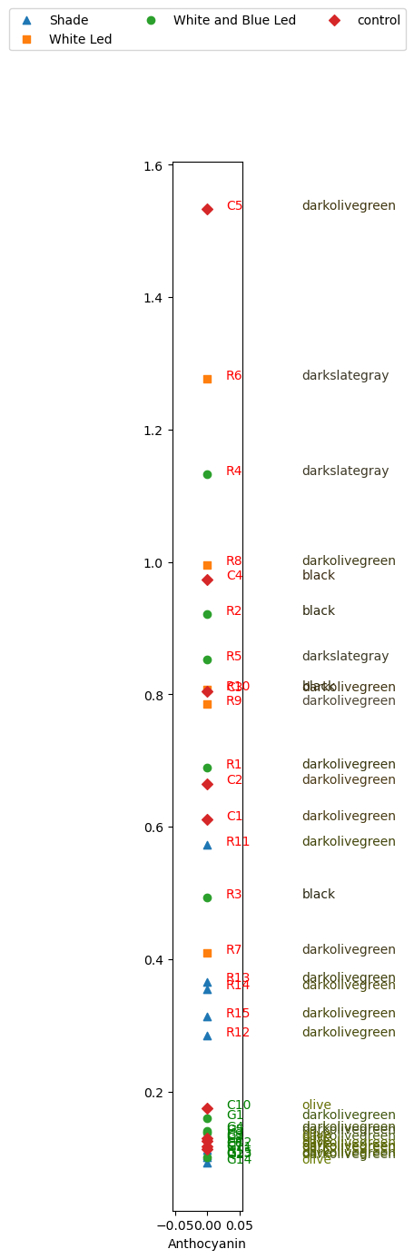
trainable_features=['valPlantMean','satPlantMean','huePlantMean','Anthocyanin’]
target='Anthocyanin'
ml=training.training(dataset_name=ds_name) df=ml.df X,y=ml.split_dataset_to_X_and_y(trainable_features,target,df) y_arr=y.copy()
indecator='catalog id’
# # Create the plot
plt.figure(figsize=(1, 15)) ml.plot_Anthocyanin_values_in_one_line_plot(plt,y_arr,df,target,indecator,trainable_features)

Slide 11
Hyper spectral images dataset
We compute the vegetation indices of the plant area for each image in the hp images pictured at 2025/12/23 (hyper_sp_imgs_dataset_created_at_20251223_from_BneiAtarot_2025-12-24 10.csv)
Than we merge this dataset with reference dataset contain the Anthocyanin value for each image created in 2025/12/17 (Anthocyanin_BENI_ATAROT_2025-17-05.csv)
In the next step we check the correlation to the Anthocyanin in completed dataset (complete_ds_of_Anthocyanin_BENI_ATAROT_2025-12-17_1767192251.7532542.csv) with linear regression .

Slide 12
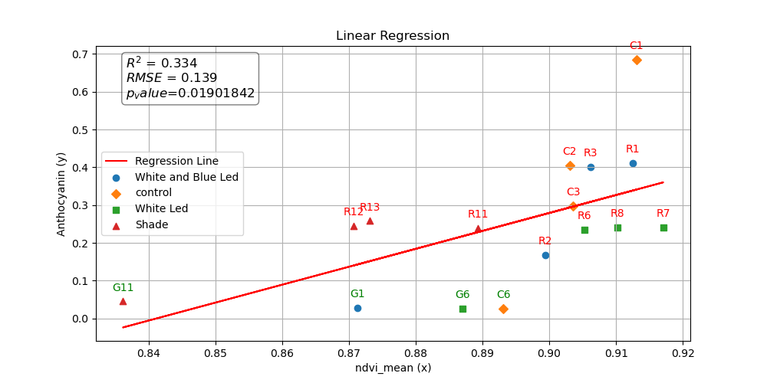

Slide 13
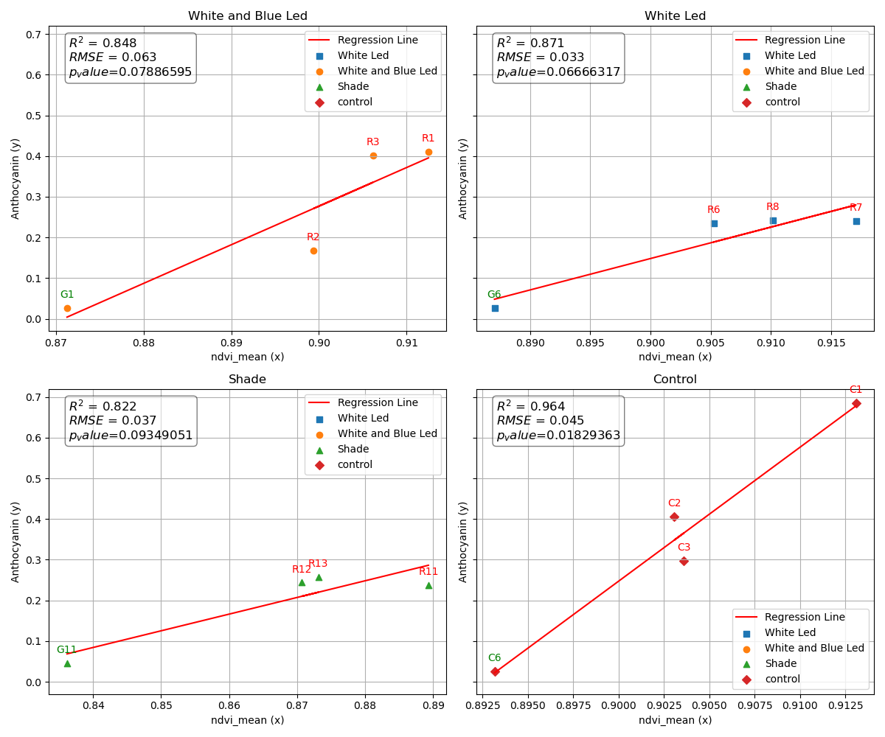

Slide 14
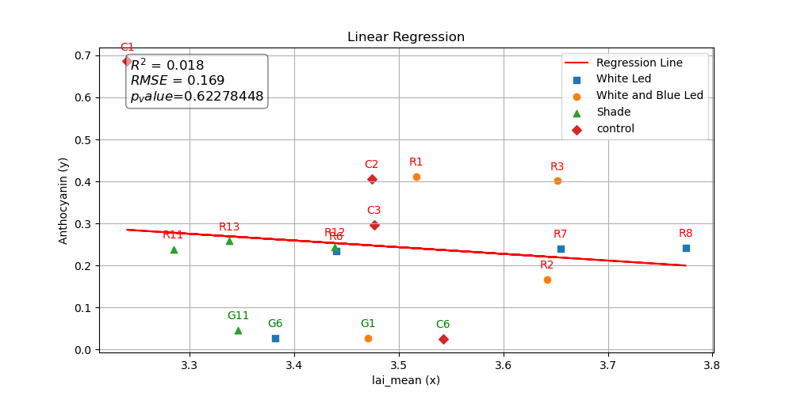

Slide 15
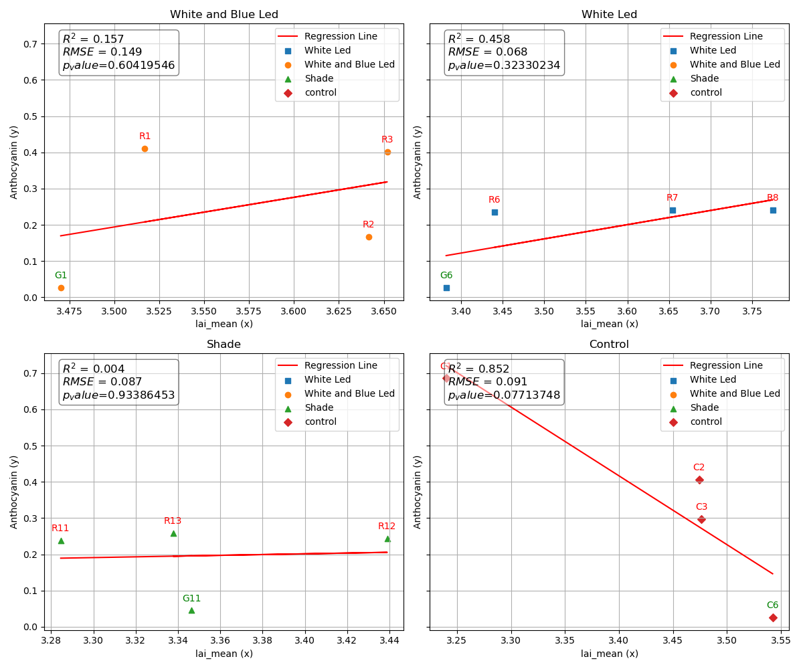

Slide 16
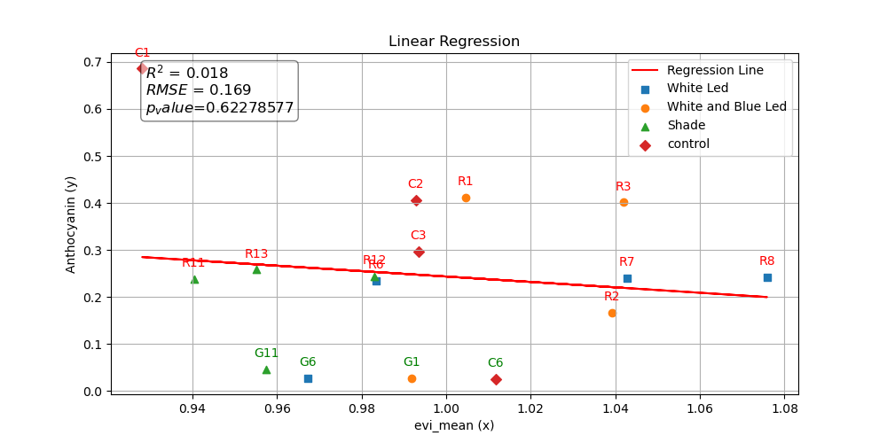

Slide 17
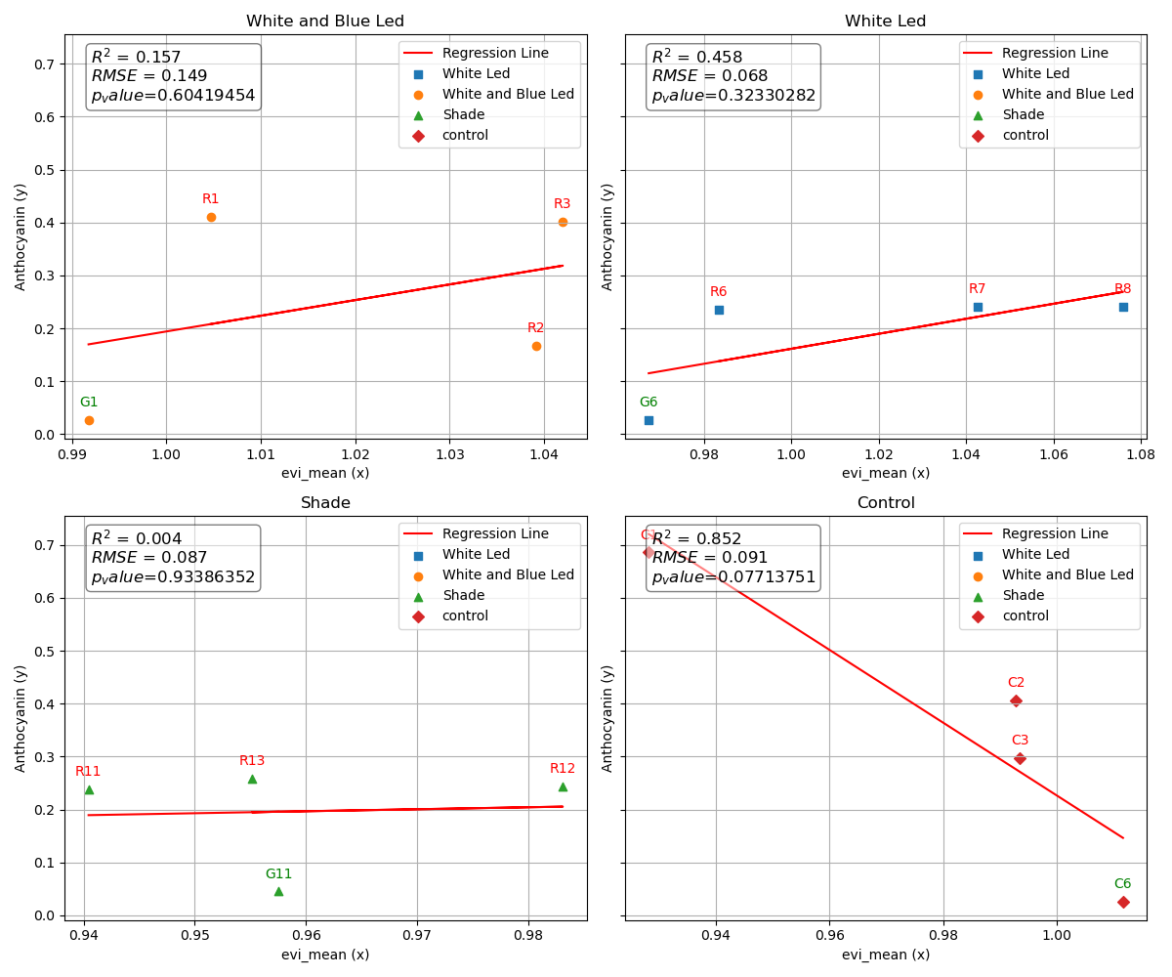

Slide 18
