Slide 1

HACKYEAH 2026 · SPORT & HEALTHCARE
Active City
Kraków pilot
Make the most of a nearby public place, the time you have today, and the small things that help you come back tomorrow.
14 documented public places · private wellbeing diary · review-ready map updates
Fundacja Życie, Razem
KRAKÓW
Notes:
The Active City mark is a project visual generated with AI from the team-owned Foundation tree-and-roots identity; it is not presented as a photograph or official city mark. The slide intentionally avoids an AI-generated scenic illustration.

Slide 2
Getting active should not start with a search puzzle
Public recreation information is scattered across municipal pages, maps and signs on site.
WHAT A RESIDENT HAS TO WORK OUT
Is there somewhere nearby?
THE MISSING CONNECTION
1
A 45-minute window should lead to one realistic public place to move, without handing over health information.
2
What can I actually do there?
3
Will the journey leave time to move?
Active City brings the practical choices together and shows its data limits clearly.
ACTIVE CITY · KRAKÓW PILOT
02
Notes:
Challenge source: Sport & Healthcare details. The brief describes fragmented health, activity and wellbeing information and asks for a clear user journey that makes an achievable next step easier. Local facility sources: Kraków municipal records, documented in the repository data-source file.

Slide 3
The primary user
Kraków residents who want to move more but have limited time, confidence or knowledge of local public facilities.
30–120
< 10
A TYPICAL MOMENT
“I have an hour after work. I want to do something useful, but I do not know whether the place I found is worth the journey.”
minutes available in Today’s Plan
minutes left triggers a closer-place suggestion
A plan has to respect the full return journey, not just the activity itself.
The decision is practical before it becomes motivational.
ACTIVE CITY · KRAKÓW PILOT
03
Notes:
Product assumption for the pilot, based on user testing feedback in the project conversation: distant venues are unrealistic when a person has limited time. The 30–120 minute options and less-than-10-minute threshold are prototype product rules, not a clinical or transport claim.

Slide 4
One clear journey
The app keeps the person moving forward instead of sending them back through disconnected sources.
1
2
3
4
Explore
Plan
Move
Reflect
Choose a nearby documented place
Check time, route and activity
Use a simple venue-aware outline
Keep a private note for next time
The outcome is a realistic next activity and a small, private learning loop for the following week.
ACTIVE CITY · KRAKÓW PILOT
04
Notes:
Challenge source: Sport & Healthcare details. The brief asks for a practical user journey, accessibility, motivation and a next step that is achievable. This slide shows the working pilot flow.

Slide 5
Source-backed public places in Kraków
The pilot shows only places with a public source link and documented activity or equipment detail.
14
5
0
documented profiles shown in the app
activity filters for quick discovery
assumed equipment details
Outdoor gyms and street workout
Courts and pitches
Waterfront recreation
Every profile includes documented activities, access caveats and a source link. If a record does not support a detail, the app leaves it unknown; visitor reports cannot change a map marker.
ACTIVE CITY · KRAKÓW PILOT
05
Notes:
Data sources: Kraków municipal services, Zarząd Zieleni Miejskiej, Zarząd Infrastruktury Sportowej and cited district/public records. See docs/DATA_SOURCES.md. The 14 count reflects the source-backed records currently displayed in the app.

Slide 6
A plan that respects the clock
Today’s Plan reserves travel time before it proposes an activity outline.
1. TIME AVAILABLE
2. JOURNEY CHECK
3. A SENSIBLE CHOICE
60 min
Return travel
Move or swap
Walking, running or public transport. Route estimates stay clearly labelled as guidance.
If less than 10 minutes remain, the app suggests a closer documented place instead.
The person sets their whole window, including the journey.
When a place fits, the person sees a warm-up, main movement, control and ease-out outline for the time left.
ACTIVE CITY · KRAKÓW PILOT
06
Notes:
Prototype behaviour from the working app. Walking and running can request pedestrian routing on demand. Public transport opens an external journey planner. Estimates are planning guidance, not live arrival promises or medical advice.

Slide 7
A private diary, not a health record
After moving, a person can pause, choose how it felt and leave an optional note for themselves.
AFTER AN ACTIVITY
A GENTLE WEEKLY VIEW
“How did that feel?”
Energised · calmer · about the same
Tired · drained
Optional private note
A few check-ins become a simple picture of the week: movement days, a familiar place and one modest next step.
Separate profiles can stay on one device. Saving is optional and local.
No diagnosis, health score, provider sharing or clinical record.
ACTIVE CITY · KRAKÓW PILOT
07
Notes:
Data handling: profiles and diary entries remain in browser memory by default. Device persistence is opt-in. A share link contains only entries selected by the person and creates no Active City server copy. The weekly prompt is a reflection aid, not a health assessment or clinical record.

Slide 8
Keeping the map useful takes a real review process
Visitors can help surface changes, but no report or suggestion becomes a public map update automatically.
Private report
1
Equipment condition, description accuracy, busyness or broad visitor mix.
WHAT HAPPENS IN THIS PROTOTYPE
A report or map suggestion stays in the current browser tab. It does not edit the map, create an account, collect documents or verify anyone.
Place suggestion
2
A public place, approximate area and a public source or map link.
Future review
3
A live service needs a named city, NGO or venue operator and trained reviewers.
A named operator checks evidence, access, privacy and moderation before publishing.
ACTIVE CITY · KRAKÓW PILOT
08
Notes:
Visitor reports and map suggestions are browser-only interaction prototypes. The project does not publish reports, change a marker, create accounts, collect evidence documents or verify a contributor. A live update service would need a named operator, privacy process, public-place/evidence rules, moderation, incident handling and trained reviewers. Volunteer and trainer flows remain separately bounded demos.

Slide 9
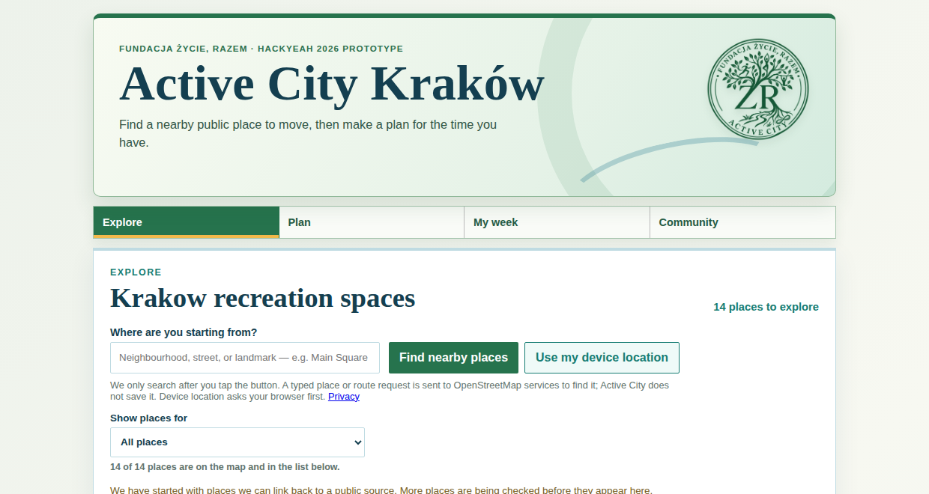
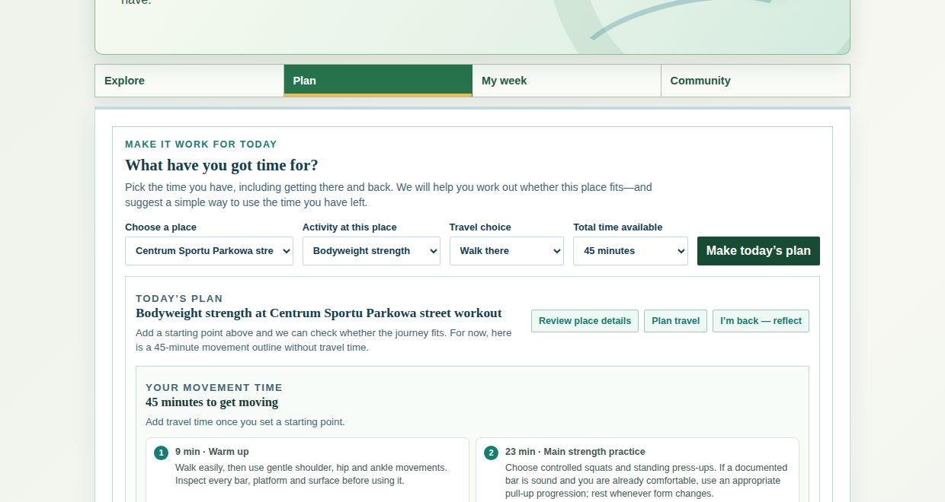
The working journey: find a place, then make it fit today
These are real local screenshots from the Kraków prototype, captured without external map, routing or geocoding requests.
Explore: begin with a neighbourhood, street or landmark
Plan: use the time available for a specific activity
ACTIVE CITY · KRAKÓW PILOT
09
Notes:
Screens are captured from the locally running React prototype. Map tiles are intentionally stubbed for this test capture; no external map, routing or geocoding request was sent. The screens demonstrate the actual interface, not a mock-up.

Slide 10
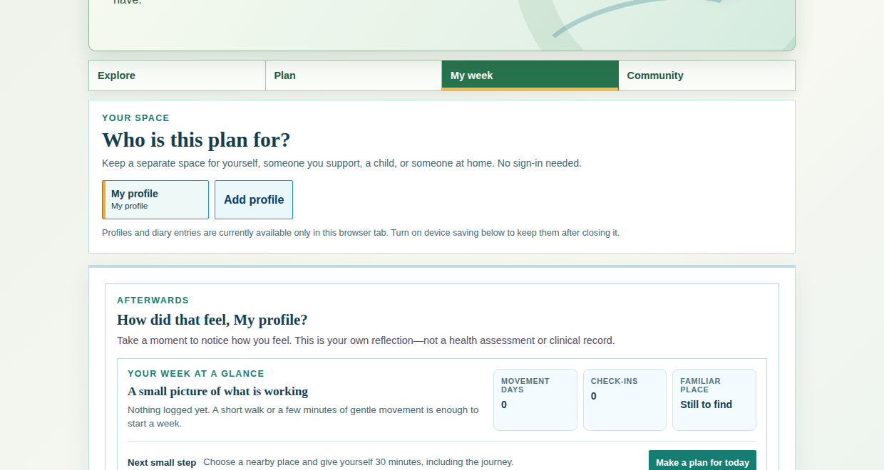
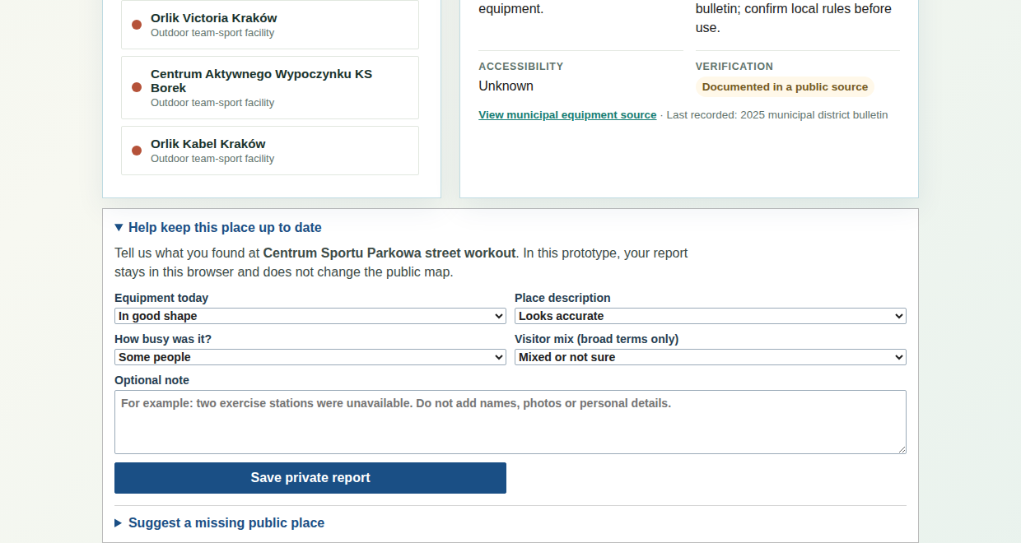
The working boundaries: private reflection and review-ready updates
The app is explicit about what remains private today and what would need a future named review partner.
My week: a personal reflection, not a health record
Place update: a browser-only report that cannot change the public map
ACTIVE CITY · KRAKÓW PILOT
10
Notes:
Screens are captured from the locally running React prototype. The diary and contribution flows stay local to the browser in the current prototype. The contribution screen shows the safety boundary directly in the interface.

Slide 11
Evidence, boundaries and next pilot
The Kraków prototype gives the judging panel something real to inspect while keeping the next stage clear.
WHAT EXISTS NOW
WHAT A CITY PILOT SHOULD TEST
React + TypeScript + Leaflet prototype
14 documented place profiles
Map and text alternative
Distance, route and time-aware plan
Private diary and map-update drafts
Field-check more sites with operators
Test time-aware plans with residents
Check accessibility and language needs
Appoint a named reviewer before public map updates
Sources and disclosure: Kraków municipal facility records, OpenStreetMap and NHS instructional links support the prototype. The Active City mark is an AI-generated project visual based on the team-owned Foundation identity. No health data or personal data is sent by the app.
ACTIVE CITY · KRAKÓW PILOT
11
Notes:
Sources: Sport & Healthcare challenge brief and rules; Kraków municipal records; OpenStreetMap attribution; NHS instructional resources; WHO physical-activity guidance. AI asset disclosure: the Active City project mark is AI-generated from the team-owned Foundation tree-and-roots identity and is not an official city mark. See docs/DATA_SOURCES.md and docs/DEVELOPMENT_LOG.md for full provenance.

