Slide 1
777 CHALLENGE
1 / 9
Seven videos. One story worth finishing.
Live Kickoff | September 7, 2026 | 11:00 AM Mountain Time
Today we stop preparing to begin.

Slide 2
THE ROOM
2 / 9
This is not a performance test.
01
02
03
Stay specific
Stay unfinished
Keep moving
A real moment beats a polished summary.
The story can still be happening while you tell it.
A posted chapter is more useful than a perfect draft.

Slide 3
THE SEVEN DAYS
3 / 9
The arc we are building
1
2
3
4
5
6
7
Begin
Ordinary world
First realization
Road of trials
The fall
The elixir
Return home
Each video carries one job. Together they create the journey.

Slide 4
COMMUNITY
4 / 9
Do the challenge beside people who are also doing it.
Join the community, post the imperfect chapter, and respond to the human being before you respond to the algorithm.
The community link belongs in the live chat and follow-up email.

Slide 5
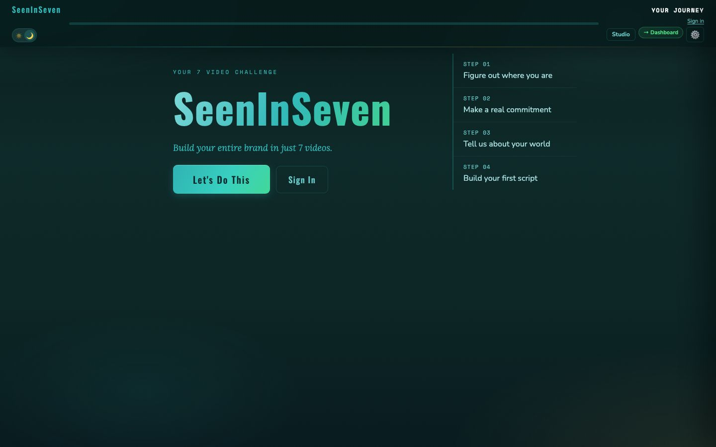
SEENINSEVEN
5 / 9
Build the story. Keep your voice.
SeenInSeven turns rough answers into one connected seven-video journey without asking you to understand story architecture first.
LIVE DEMO
Overview → questions → script → lock

Slide 6
VIDEO 1
6 / 9
Why now?
01
02
03
What must be visible?
Who needs it?
Why today?
Name the knowledge, story, or experience you can no longer keep private.
Picture one person who would recognize their own stalled chapter.
Name what changed, closed, arrived, or became too expensive to postpone.

Slide 7
RECORD
7 / 9
The first recording is allowed to feel like the first recording.
1
Read it once
2
Record one full take
3
Choose the take with life in it
4
Post before editing becomes hiding

Slide 8
POST
8 / 9
Publication completes Day 1.
Use a plain caption, include Video 1 of 7, and let the next chapter create the reason to return.
Do not apologize for the rough edge that proves you actually began.

Slide 9
Q&A
9 / 9
What is still between you and record?
Ask the practical question. Name the emotional one too.
Then make Video 1.

