Slide 1
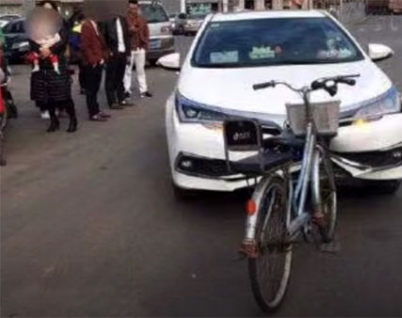
PREDICTING COLLISIONS SEVERITY Seattle David Bertel Capstone project

Slide 2
PREDICTING COLLISIONS SEVERITY
Content:
Background
Interest
Study objectives
Data
Data cleaning
Data initial visualization
Model
Maps

Slide 3
PREDICTING COLLISIONS SEVERITY: Background
The city of Seattle has been gathering information about collisions and their severities
The data set contains attributes that belong to each collision
Collisions are well known to cause traffic delays. The more severe the collision is the more delays may cause
The information in the data set can be analyzed to find correlation or causations that may help to identify the how different attributes affect the severity of collisions

Slide 4
PREDICTING COLLISIONS SEVERITY: Interest
WHO IS INTERESTED?
Useful for the city of Seattle to deploy emergency services or traffic infrastructure
All people using a car are subject of traffic delays
Companies developing autonomous cars can benefit from the outcomes of this study since it would help the to identify high risk situations or areas
This information about risk would be very valuable for insurance companies

Slide 5
PREDICTING COLLISIONS SEVERITY: Objectives
Clean and prepare the data
Investigate correlations between the different attributes
Analyze the data and define a model that will predict the severity of collisions based of certain attributes
Display incidents in a map of the city of Seattle

Slide 6
DATA
Before starting any analysis of the data, the first step is to check the veracity of the data. dataset
The data set includes a description of all the attributes in the data set. https://s3.us.cloud-object-storage.appdomain.cloud/cf-courses-data/CognitiveClass/DP0701EN/version-2/Metadata.pdf

Slide 7
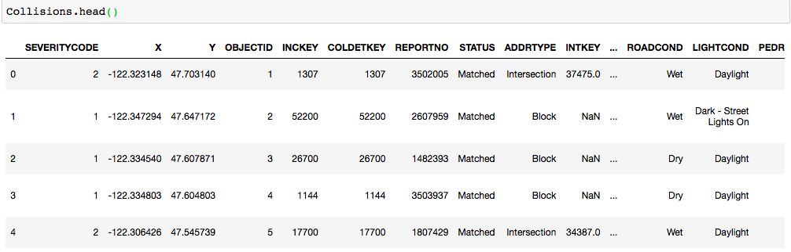
DATA
An initial look at the data set is always important. To check the shape and format used in the attributes

Slide 8
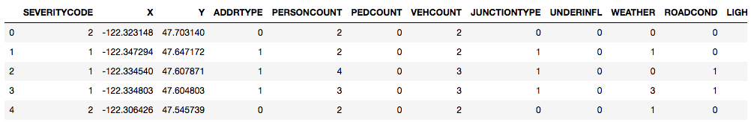
DATA – Cleaning
Rows with NaN/Empty data where removed
The attributes that were described with text where transformed into numerical that can be used for the prediction model afterwards
Several attributes were selected that are relevant in my opinion for the severity of a collision

Slide 9
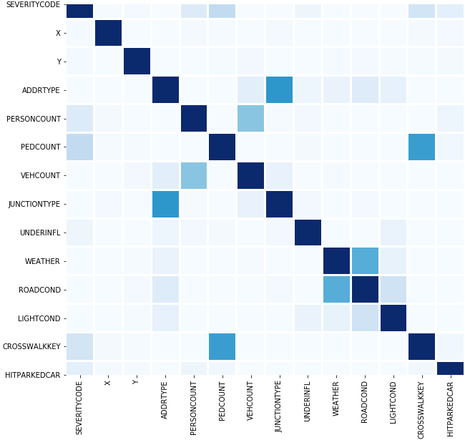
DATA – Correlation matrix
A correlation matrix helps to identify redundant information.
None of the attributes is highly correlated to another therefore all the selected will be used for the model

Slide 10
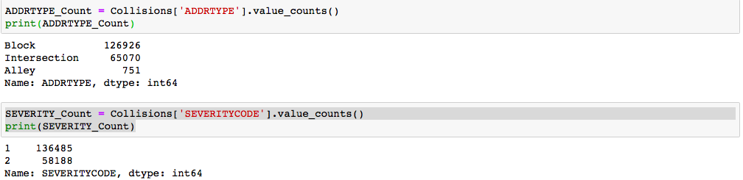
DATA – initial visualization
Short analysis. Most of the document collisions occur in a Block address type

Slide 11
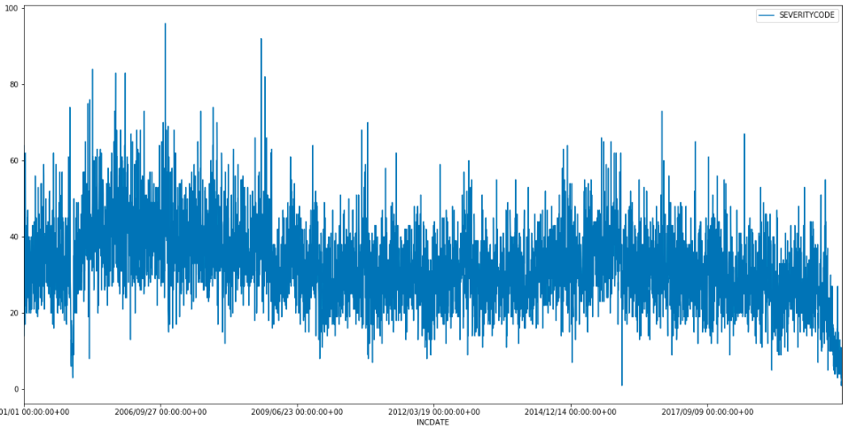
DATA – initial visualization
There is a particular decrease of collisions in 2020 probably due to COVID. Being Seattle a city home of Microsoft and Amazon, it is probable that a lot of the jobs related with these two companies can be done from home. And therefore people are not on the streets

Slide 12
MODEL: KNN
KNN is a supervised algorithm. We have a data set where we have attributes and outcomes. We can use these know incidents to train the model
Since this is a classification problem, KNN is a good option
There is enough data to train and test the model

Slide 13
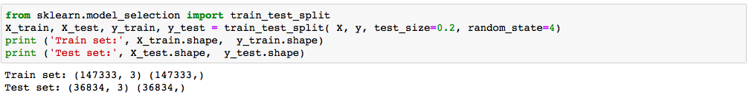
MODEL: training and test set
80% of the data set is used for train and the rest 20% will be used for testing

Slide 14
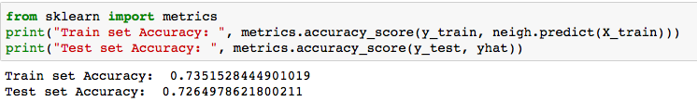
MODEL: training
For training the model I found that the optimal value of k is 4. Giving a good accuracy in the results.
The accuracy of the model is more than 70%. The model does not overfit the training data since the accuracy of the training set and test set is very close.

Slide 15
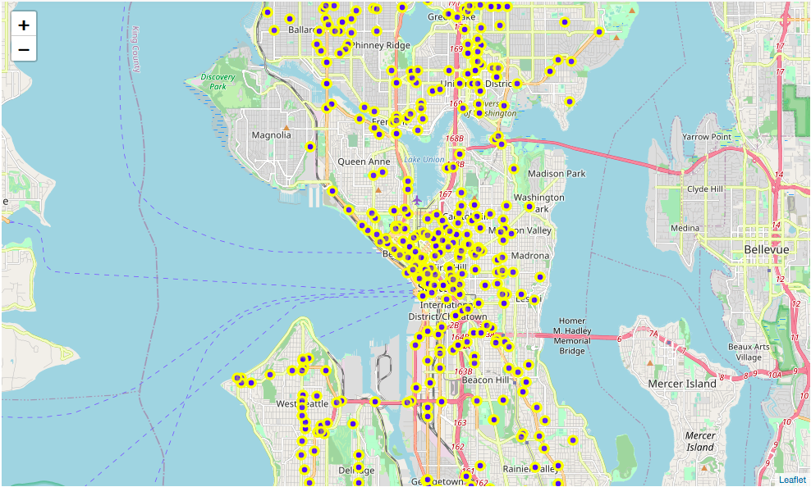
MAPS
In addition to the analyze of the data and visualization of incidents is useful
The map would help to identify problem areas

Slide 16
CONCLUSIONS
A model has been trained and can be used to predict the severity of collisions depending on certain attributes
The visualization of incidents in a map would help authorities to identify problem zones e.g. communities could deploy in advance emergency services
Attributes were identified to have influence in the risk of having a collision. This information can be used by insurance companies of companies developing autonomous mobility systems.

