Slide 1
PREDICTING CAR ACCIDENTS SEVERITY
The city of Seattle has been gathering information about accidents and their severities. It has by now a dataset with these accidents and some features associated to the accidents. These features may be used to identify correlation or causation depending on the features in the dataset, which we are going to investigate in this report.
The worst outcome of an accident is casualties. Even if there are no casualties, normally when an accident occurs the people involved in it have to wait for the police to clarify the facts before being able to remove the cars. This process causes delays in the traffic.

Slide 2
PREDICTING CAR ACCIDENTS SEVERITY
Interest
All people using a car are subject of traffic delays
Companies developing autonomous cars can benefit from the outcomes of this study since it would help the to identify high risk situation or areas.
This information about risk would be very valuable for insurance companies.
Useful for the city of Seattle to deploy emergency services or traffic infrastructure.

Slide 3
DATA
Before starting any analysis of the data, the first step is to check the veracity of the data. In this case I am using the link provided in Cousera which contain the following dataset
The data set includes a description of all the attributes in the data set. Link to the description of the data set: https://s3.us.cloud-object-storage.appdomain.cloud/cf-courses-data/CognitiveClass/DP0701EN/version-2/Metadata.pdf

Slide 4
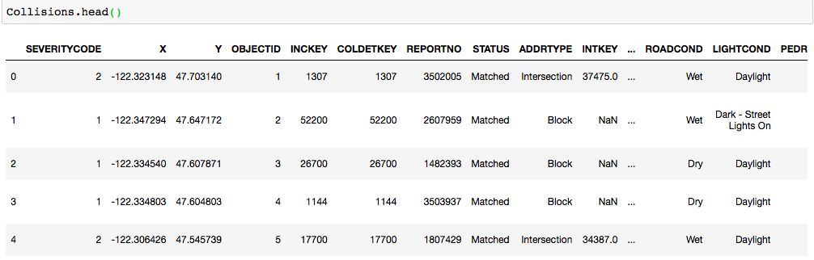
DATA
An initial look at the data set is always important. To check the shape and format used in the attributes

Slide 5
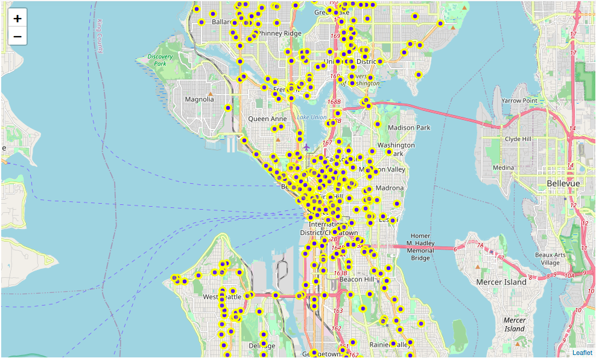
DATA – initial visualization
In the first place may be useful to identify where are these collisions actually happening. With the use the library folium I displayed the collisions in the city of Seattle. As expected, these collisions happen mostly in the city center. This information will help us to draw some conclusions at the end of the report.

Slide 6
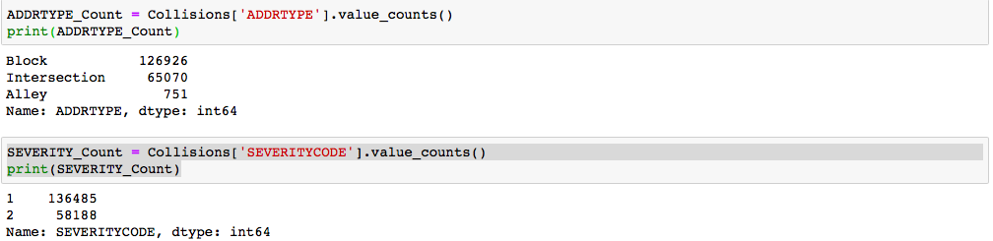
DATA – initial visualization
In the map I displayed a representative number of incidents (500). In the data set there is some more detailed information about the location of these collisions. From the data we can see that only collisions type 1 and 2 are registered (1 = “property damage” and 2 = “injury”) and that most of the collisions do not occur in intersections but in address type Block.

Slide 7
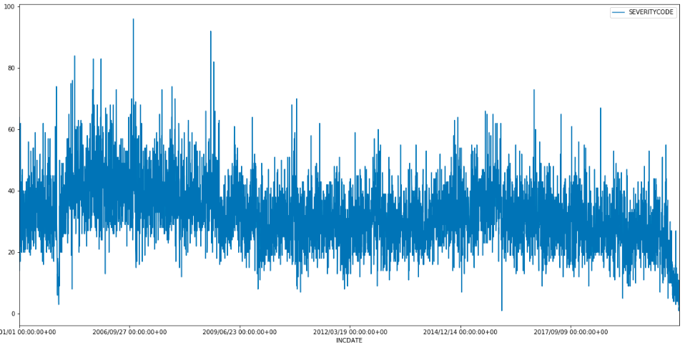
DATA – initial visualization
From the initial visualization another important finding is the fact the number of incidents has being decreasing in the last years. There a particular decrease in 2020 probably due to COVID that has force many people to work from home. Being Seattle a city home of Microsoft and Amazon, it is probable that a lot of the jobs related with these two companies can be done from home.

Slide 8
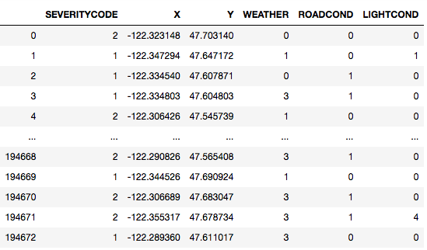
DATA ACQUISITION AND CLEANING
Before starting with any kind of predictions it is important to know the dataset and the format of the information contained in it. Some important features that are going to be used are described in text.
The prediction of the severity of the accident was reduced to three features WEATHER, ROADCOND and LIGHTCOND

Slide 9
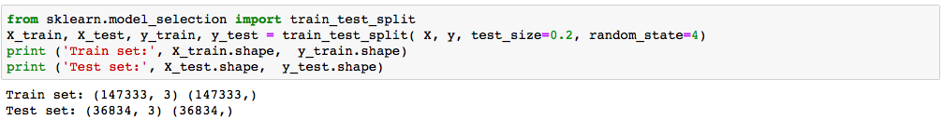
MODEL: training and test set
After normalizing the data the next step is to define training and test data. I have taken 80% of the data set for training and the rest for testing the model:

Slide 10
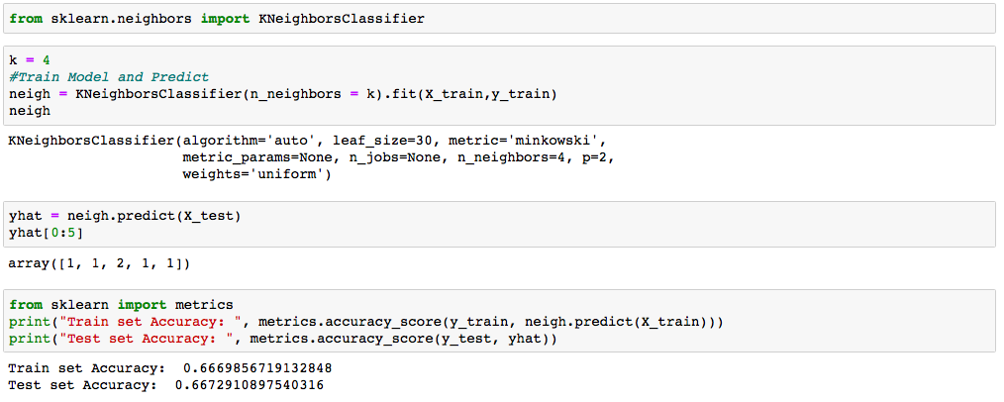
MODEL: prediction
For training the model I found that the optimal value of k is 4. Giving a good accuracy in the results.

Slide 11
MODEL: evaluation
To analyze the data set I used the K- Nearest neighbor method. By reducing the prediction to 3 features I reached an accuracy of the model of around 70%. This information would surely help all the stakeholders interested in the prediction. As mentioned before, 20% of the data set information was used to test the model.

Slide 12
DEPLOYMENT
Having the information about the severity and the location of collisions depending on few parameters may help the communities to deploy in advance emergency services that would help solve fast the situation
For navigation systems and in the future autonomous cars may be deployed to add potential unknown conditions that affect the risk of suffering a collision

