Slide 1
PREDICTING CAR ACCIDENTS SEVERITY
The city of Seattle has been gathering information about accidents and their severities. It has by now a dataset with these accidents and some features associated to the accidents. These features may be used to identify correlation or causation depending on the features in the dataset, which we are going to investigate in this report.
The worst outcome of an accident is casualties. Even if there are no casualties, normally when an accident occurs the people involved in it have to wait for the police to clarify the facts before being able to remove the cars. This process causes delays in the traffic.

Slide 2
PREDICTING CAR ACCIDENTS SEVERITY
Interest
All people using a car are subject of traffic delays
Companies developing autonomous cars can benefit from the outcomes of this study since it would help the to identify high risk situation or areas.
This information about risk would be very valuable for insurance companies.
Useful for the city of Seattle to deploy emergency services or traffic infrastructure.

Slide 3
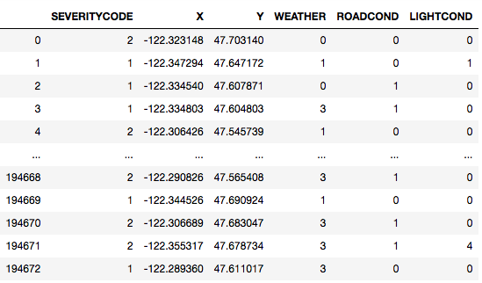
DATA ACQUISITION AND CLEANING
Before starting with any kind of predictions it is important to know the dataset and the format of the information contained in it. Some important features that are going to be used are described in text.
The prediction of the severity of the accident was reduced to three features WEATHER, ROADCOND and LIGHTCOND

Slide 4
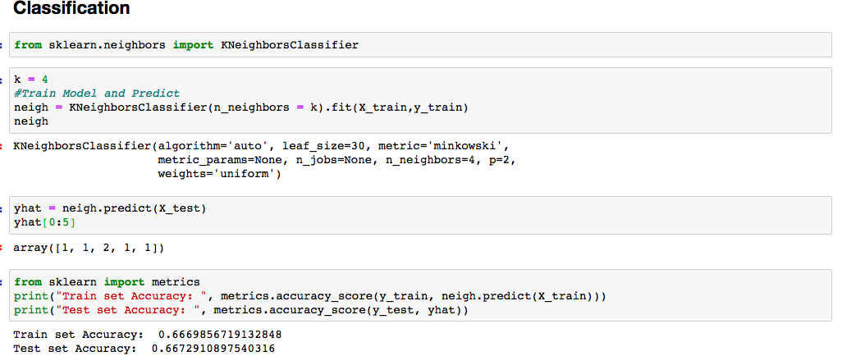
MODEL AND PREDICTION
KNN was used to classify the severity of the accidents.

Slide 5
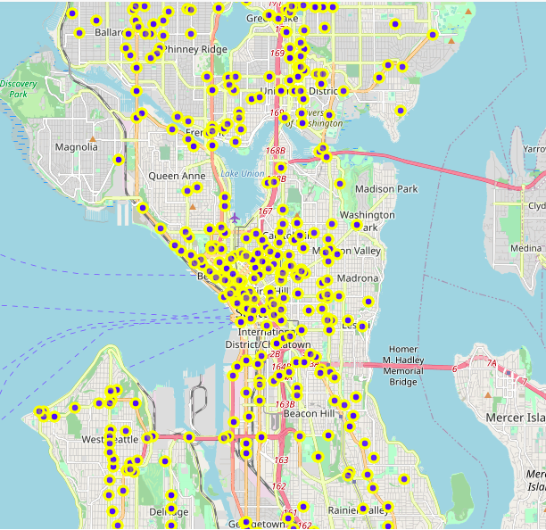
PREDICTION AND VISUALIZATION
70% accuracy in the prediction using just 3 parameters is a good result. Combining this result with the location of the accidents could be a powerful tool for the different stakeholders interested in this informaiton

