Slide 1

“Advent of Code”
Or a guide to how not to prepare for Christmas
David Betteridge @db_betteridge
Notes:
https://www.youtube.com/watch?v=3CWJNqyub3o
Who has done or heard of the advent of code problems?
Similar idea to project Euler.
You get one problem a day. They decide the problem together with a sample input and it’s solution.
They then give the real input, and you have to supply the correct result.
Each day the problem is in two parts, you can only do the second part once you have completed the first part.

Slide 2

Notes:
How to get started
Add second desktop
Windows + Ctrl + Arrow to move desktop.
Sign up – using a new dummy account

Slide 3
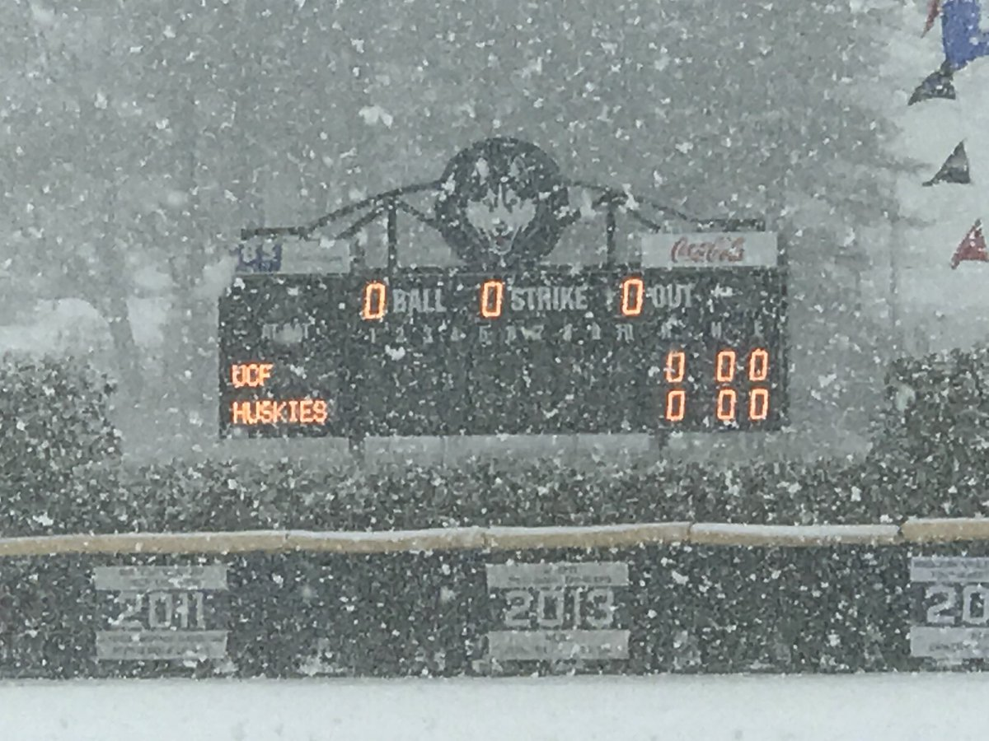
Notes:
Not only do you have to solve the problems but the idea is to solve them as quickly as possible
Show leader board - the problem is that the US get a head start
Instead we can have a private leader board.

Slide 4
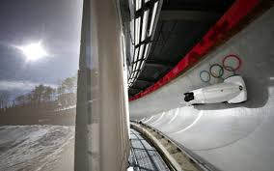
Notes:
So how can we solve these problems faster?
This is a completion, so how can we make solving these problems as quick as possible.
Why do we write unit tests?

Slide 5
Top 8 benefits of unit testing
MAKE THE PROCESS AGILE
QUALITY OF CODE
FIND SOFTWARE BUGS EARLY
FACILITATES CHANGES & SIMPLIFIES INTEGRATION
PROVIDES DOCUMENTATION
DEBUGGING PROCESS
DESIGN
REDUCE THE COSTS
https://apiumhub.com/tech-blog-barcelona/top-benefits-of-unit-testing/
Notes:
A quick google gave these results.
MAKE THE PROCESS AGILE – respond to change – we don’t need to. Our code will only run once.
QUALITY OF CODE – who cares
FIND SOFTWARE BUGS EARLY – maybe if we can cut the solution down into smaller parts
FACILITATES CHANGES & SIMPLIFIES INTEGRATION – e.g upgrade libraries
PROVIDES DOCUMENTATION – who cares
DEBUGGING PROCESS – If a test fails then only latest changes made in code needs to be debugged. N/A
DESIGN – nope
REDUCE THE COSTS - nope
Also, the first sample input doesn’t cover all the cases.

Slide 6
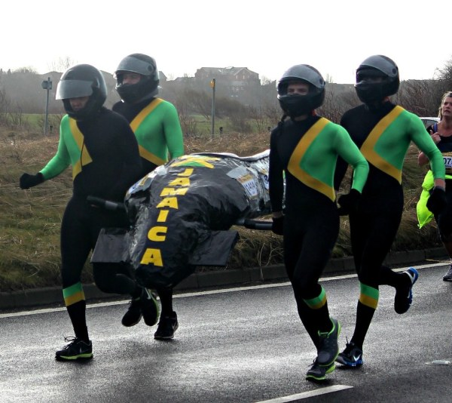
Notes:
Jamaican bob sled team training ☺
But can we go faster?
Show pasting the file into excel

Slide 7

Notes:
But that got me thinking. Perhaps I should try and use an many languages as possible.
I know a few languages, and there were a few I wanted to try out so it seemed like a good idea.
The problems get harder each day, and I still wanted to complete them as quick as possible.
So I decided to solve them quickly in C# fast (the language I know best) and then solve them again in a different language.

Slide 8
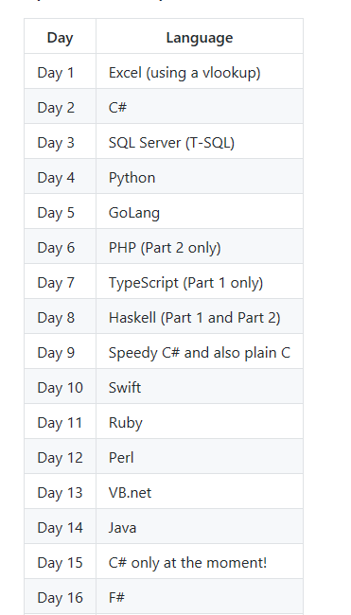
Notes:
This started really well as you can see.
I write a lot of C#, SQL Server and F#
But I hadn’t written any GoLang, TypeScript, Swift or Ruby before.

Slide 9
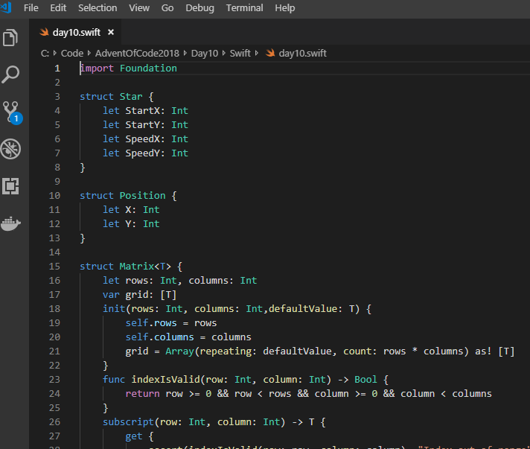
Notes:
The good things
With one exception, I managed to get the solution working in all second languages I tried.
VS Code (using it’s large range of extensions) provides code editors for most languages (swift shown above)
A lot of languages you can run on-line without having to install them locally.
Really enjoyed the Haskell one. Previously I had only completed small exercises.
The bad things
I failed to make any progress with Ada. (Which I hadn’t touched since uni 20+ years ago!)
I found I wasn’t taking full advantage of the language. An hour isn’t really enough time to learn it. I ended up mainly translating the syntax from c# to the other language. For example it would have been nice to have used goroutines.
I was expecting good things from Ruby but I ended up a bit disappointed, in terms of it’s speed.
Every language seems to do arrays differently - and I’m not sure that I like any of them!

Slide 10

Notes:
Until I got to around Day 17
Due to other commitments (work and family) and the fact that so problems were taking a long time to solve, meant that I was running out of time each day.
Some problems take longer to solve because they have a lot of steps to them.
Some are based around algorithms / techniques which are new to me
Some times the problem statement isn’t clear / or you misunderstand it
Some times you just make a mistake.
So then I made the wise decision to stick with C# for the remaining days.

Slide 11

Notes:
The other problem is the run up to Christmas and your family.
In order to not get in the way of family life, you end up starting the problem first thing in the morning. Spend the day with the family and then complete the problems in the evening after they have gone to bed.
However. (I’m sure it’s not just me!) When I have a coding problem, I can’t put it out of my mind during the day. I would find myself trying to solve it using pen-and-paper during the middle of the day.

Slide 12
Merry Christmas
https://github.com/DavidBetteridge/AdventOfCode2018
David Betteridge @db_betteridge
Notes:
My solutions are up on GitHub if you are interested
And have a good Christmas
Any questions

