Slide 1
DECISION TREES AND GAMES
Boris Wu, William Köhler, Oscar Moberg, David Björelind

Slide 2
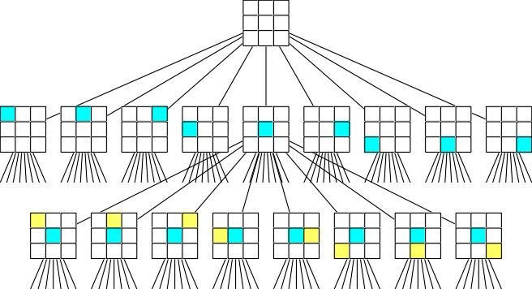
COMPLEXITY
Maps up all combinations of a game
Combinations
3x3: 9! = 9 x 8 x 7 …. 3 x 2 x 1
4x4: 16! = 16 x 15 …. 3 x 2 x 1
nxn: n!
n levels of depth

Slide 3
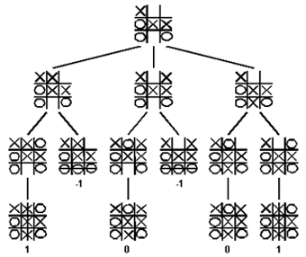
Winning strategy
Procedure to obtain a winning strategy
Determine all games for which you are the winner
Map out all the decisions of the selected games – your strategy
Play the decisions of your strategy according to the decisions of your opponent – maximize your utility

Slide 4
Zero sum game
Win = 1
Draw = 0
Loss = -1
Minimax method: play to minimize your opponents maximum utility
Probability of winning plays a role
If both players play optimal strategies, game will most likely end up in draw

Slide 5
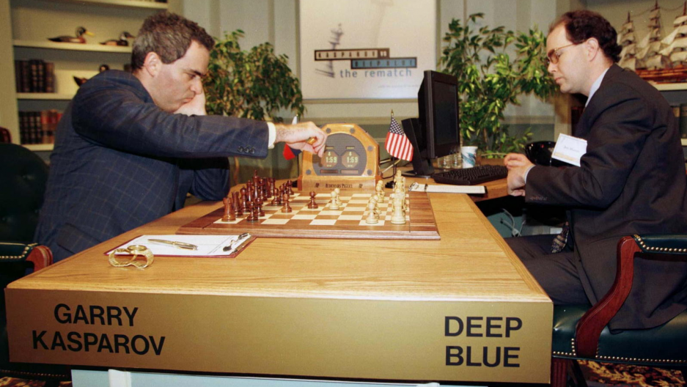
Other games
Chess – impossible? Too complex?
Shannon number: 10^120
Deep Blue – six levels
Alpha beta pruning
If ”sufficiently good” solution is found: stop searching

