Slide 1
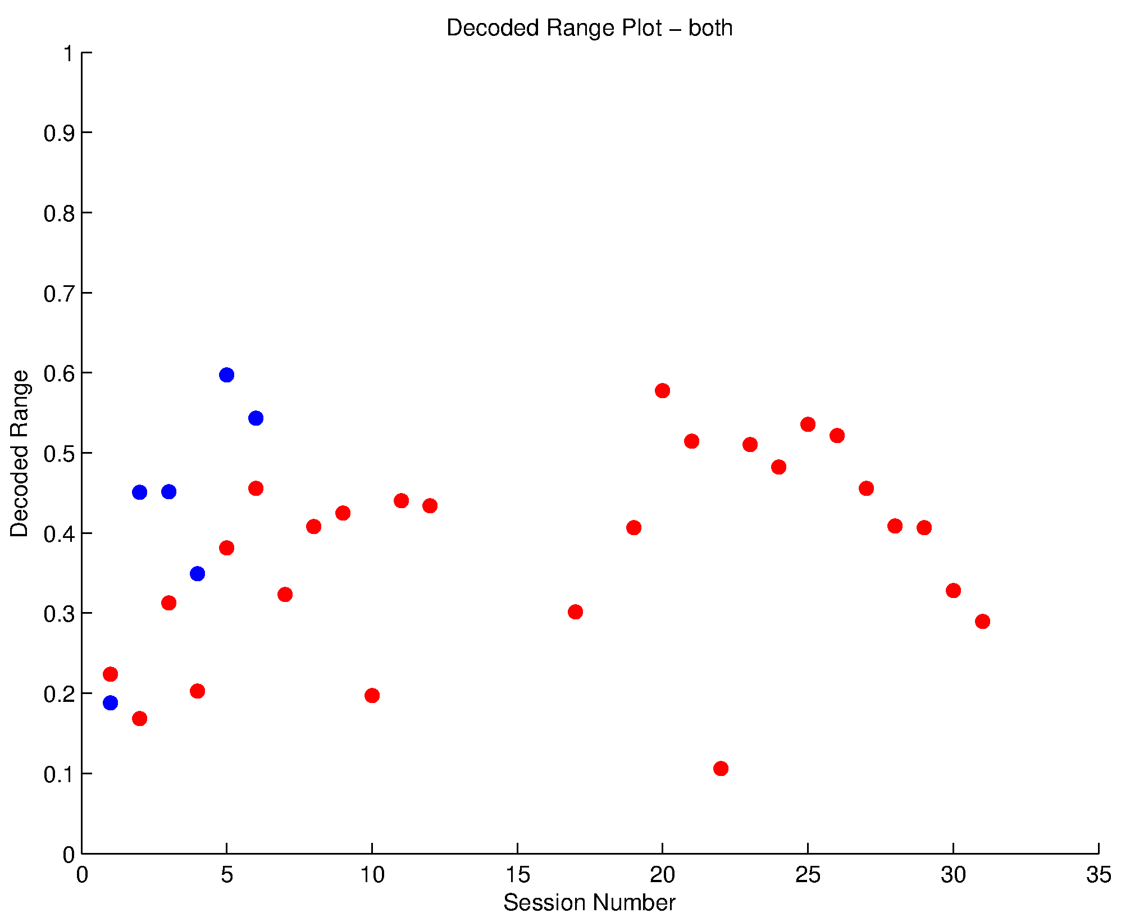
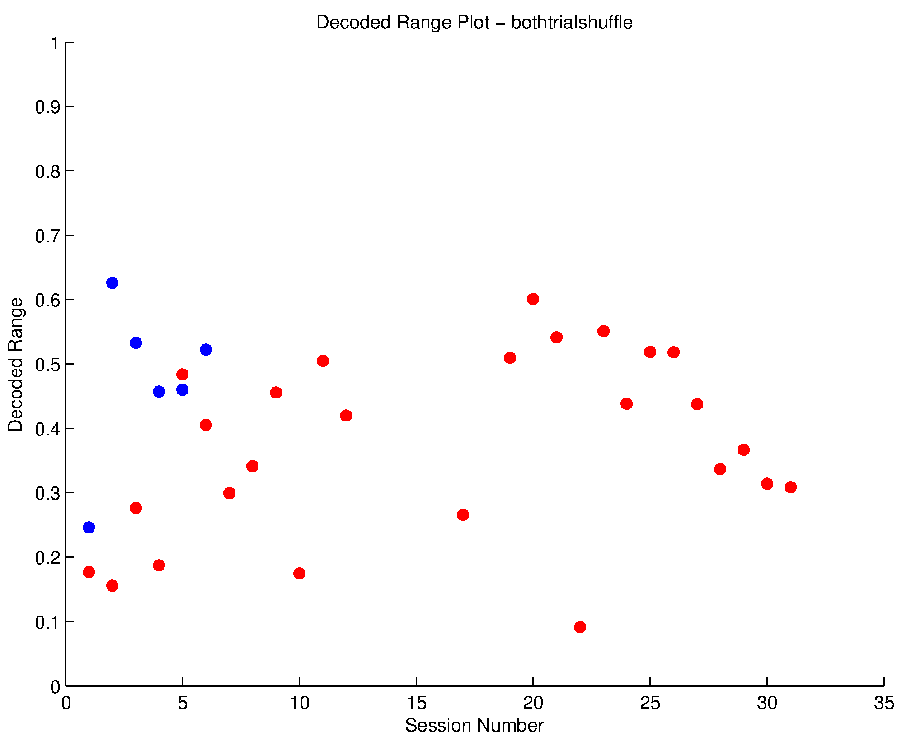
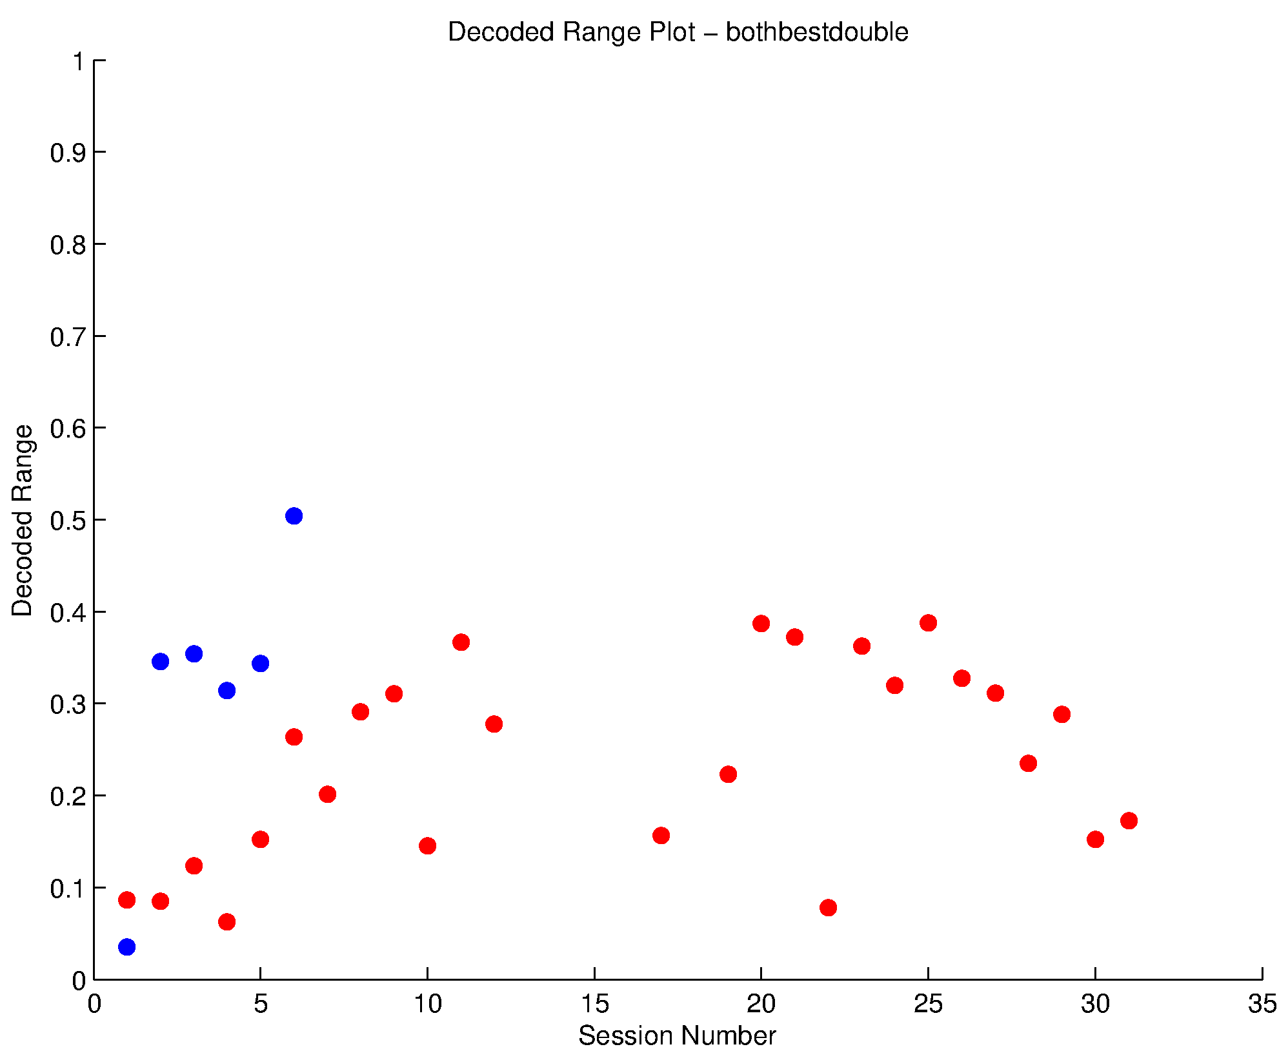
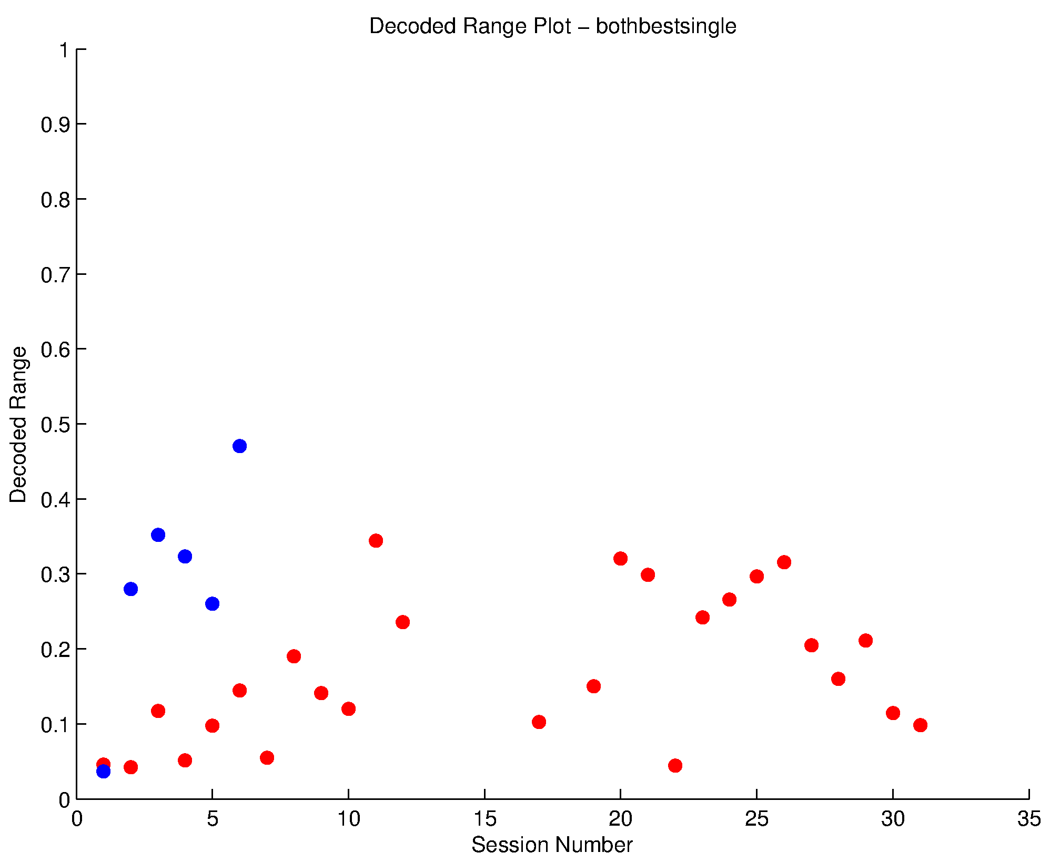

Slide 2
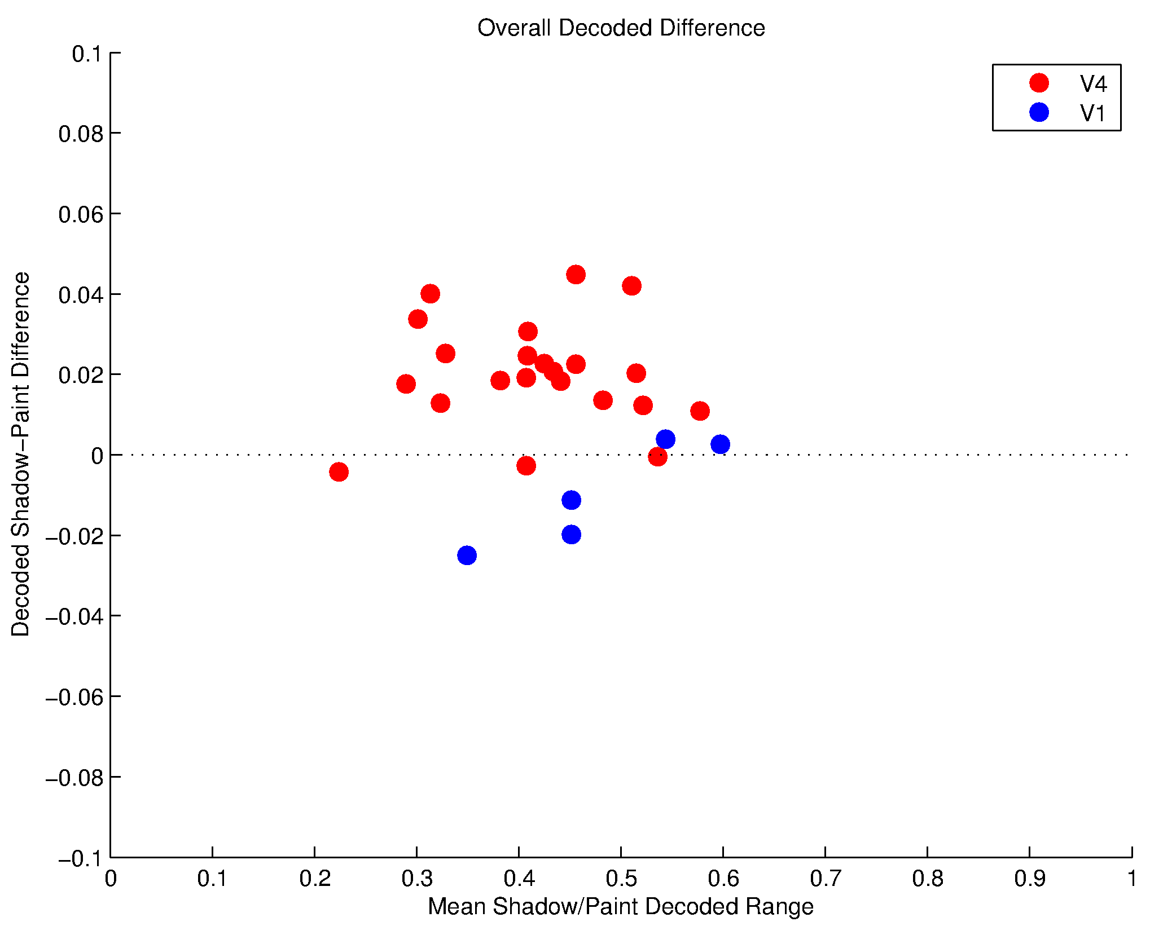
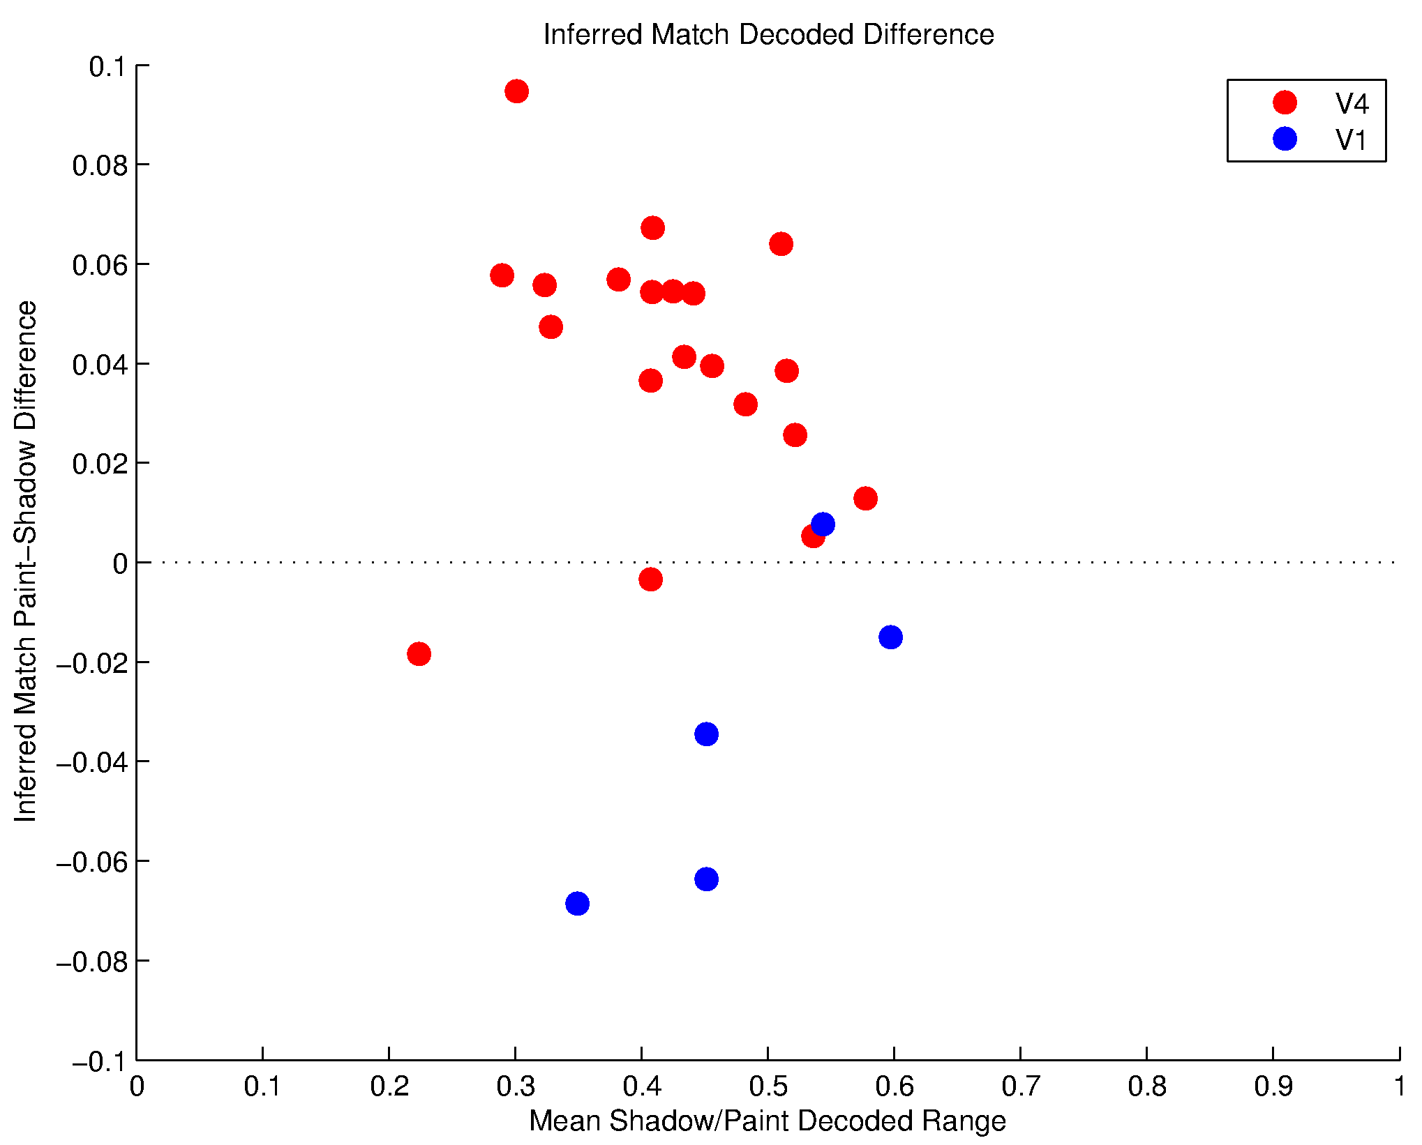
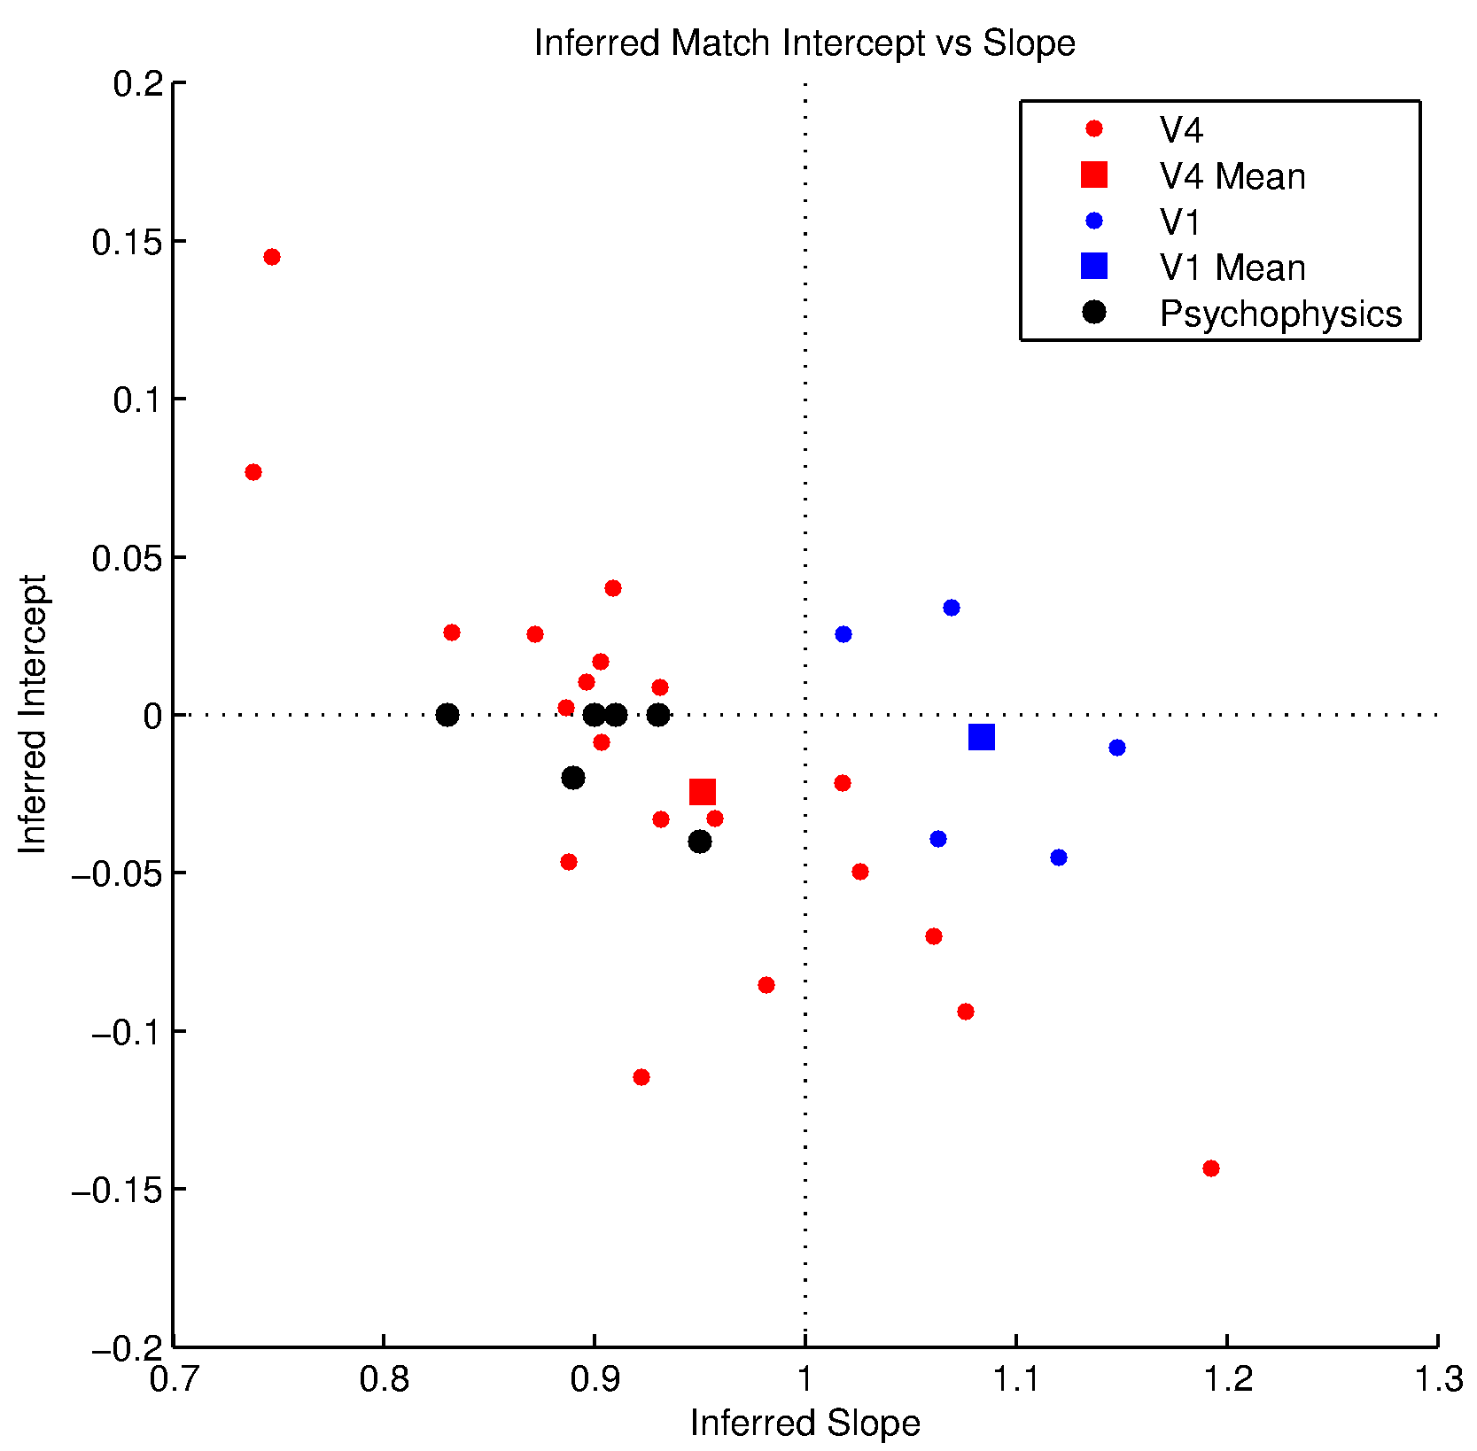
Affine Decoder on Both Paint/Shadow. Original Paint/Shadow. Decode Range > 0.2.

Slide 3
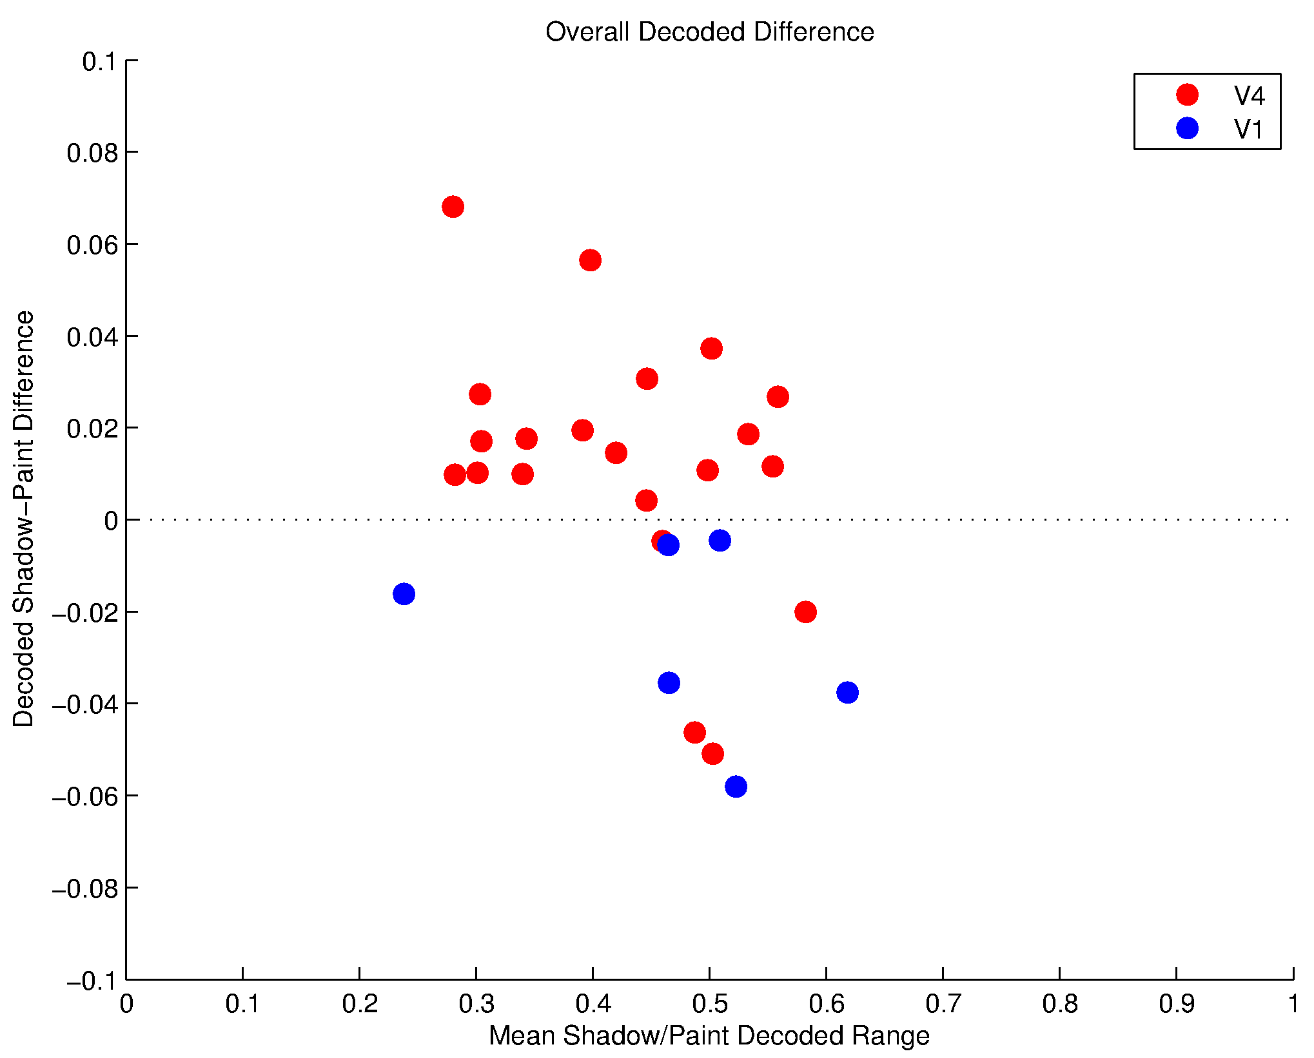
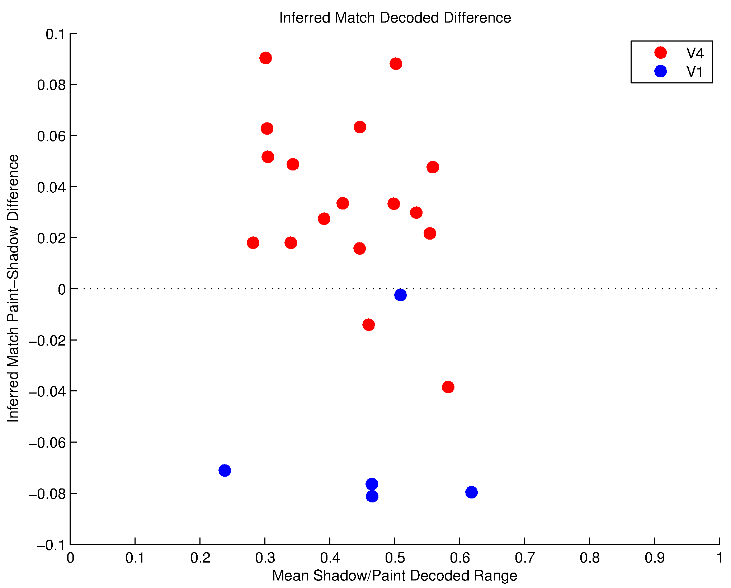
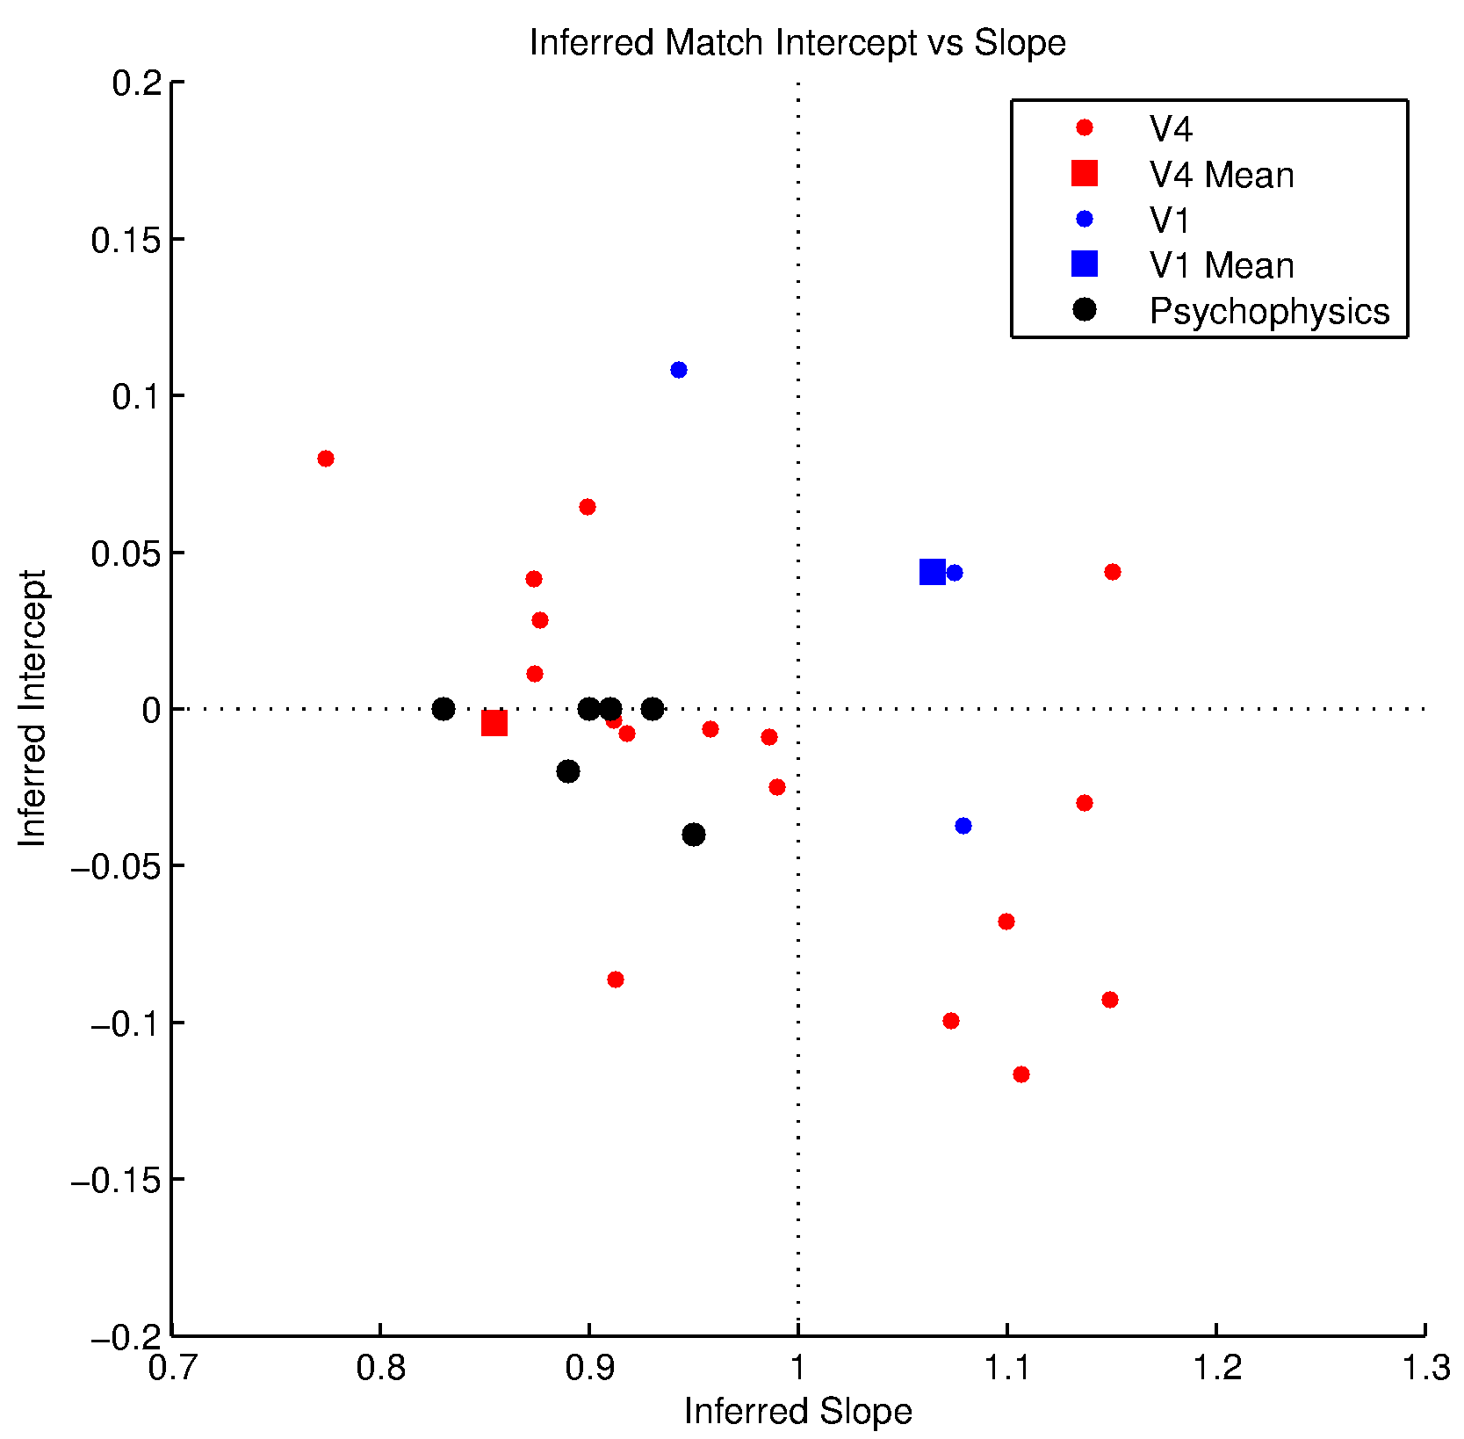
Affine Decoder on Both Paint/Shadow. Electrodes Shuffled. Original Paint/Shadow. Decode Range > 0.2.

Slide 4
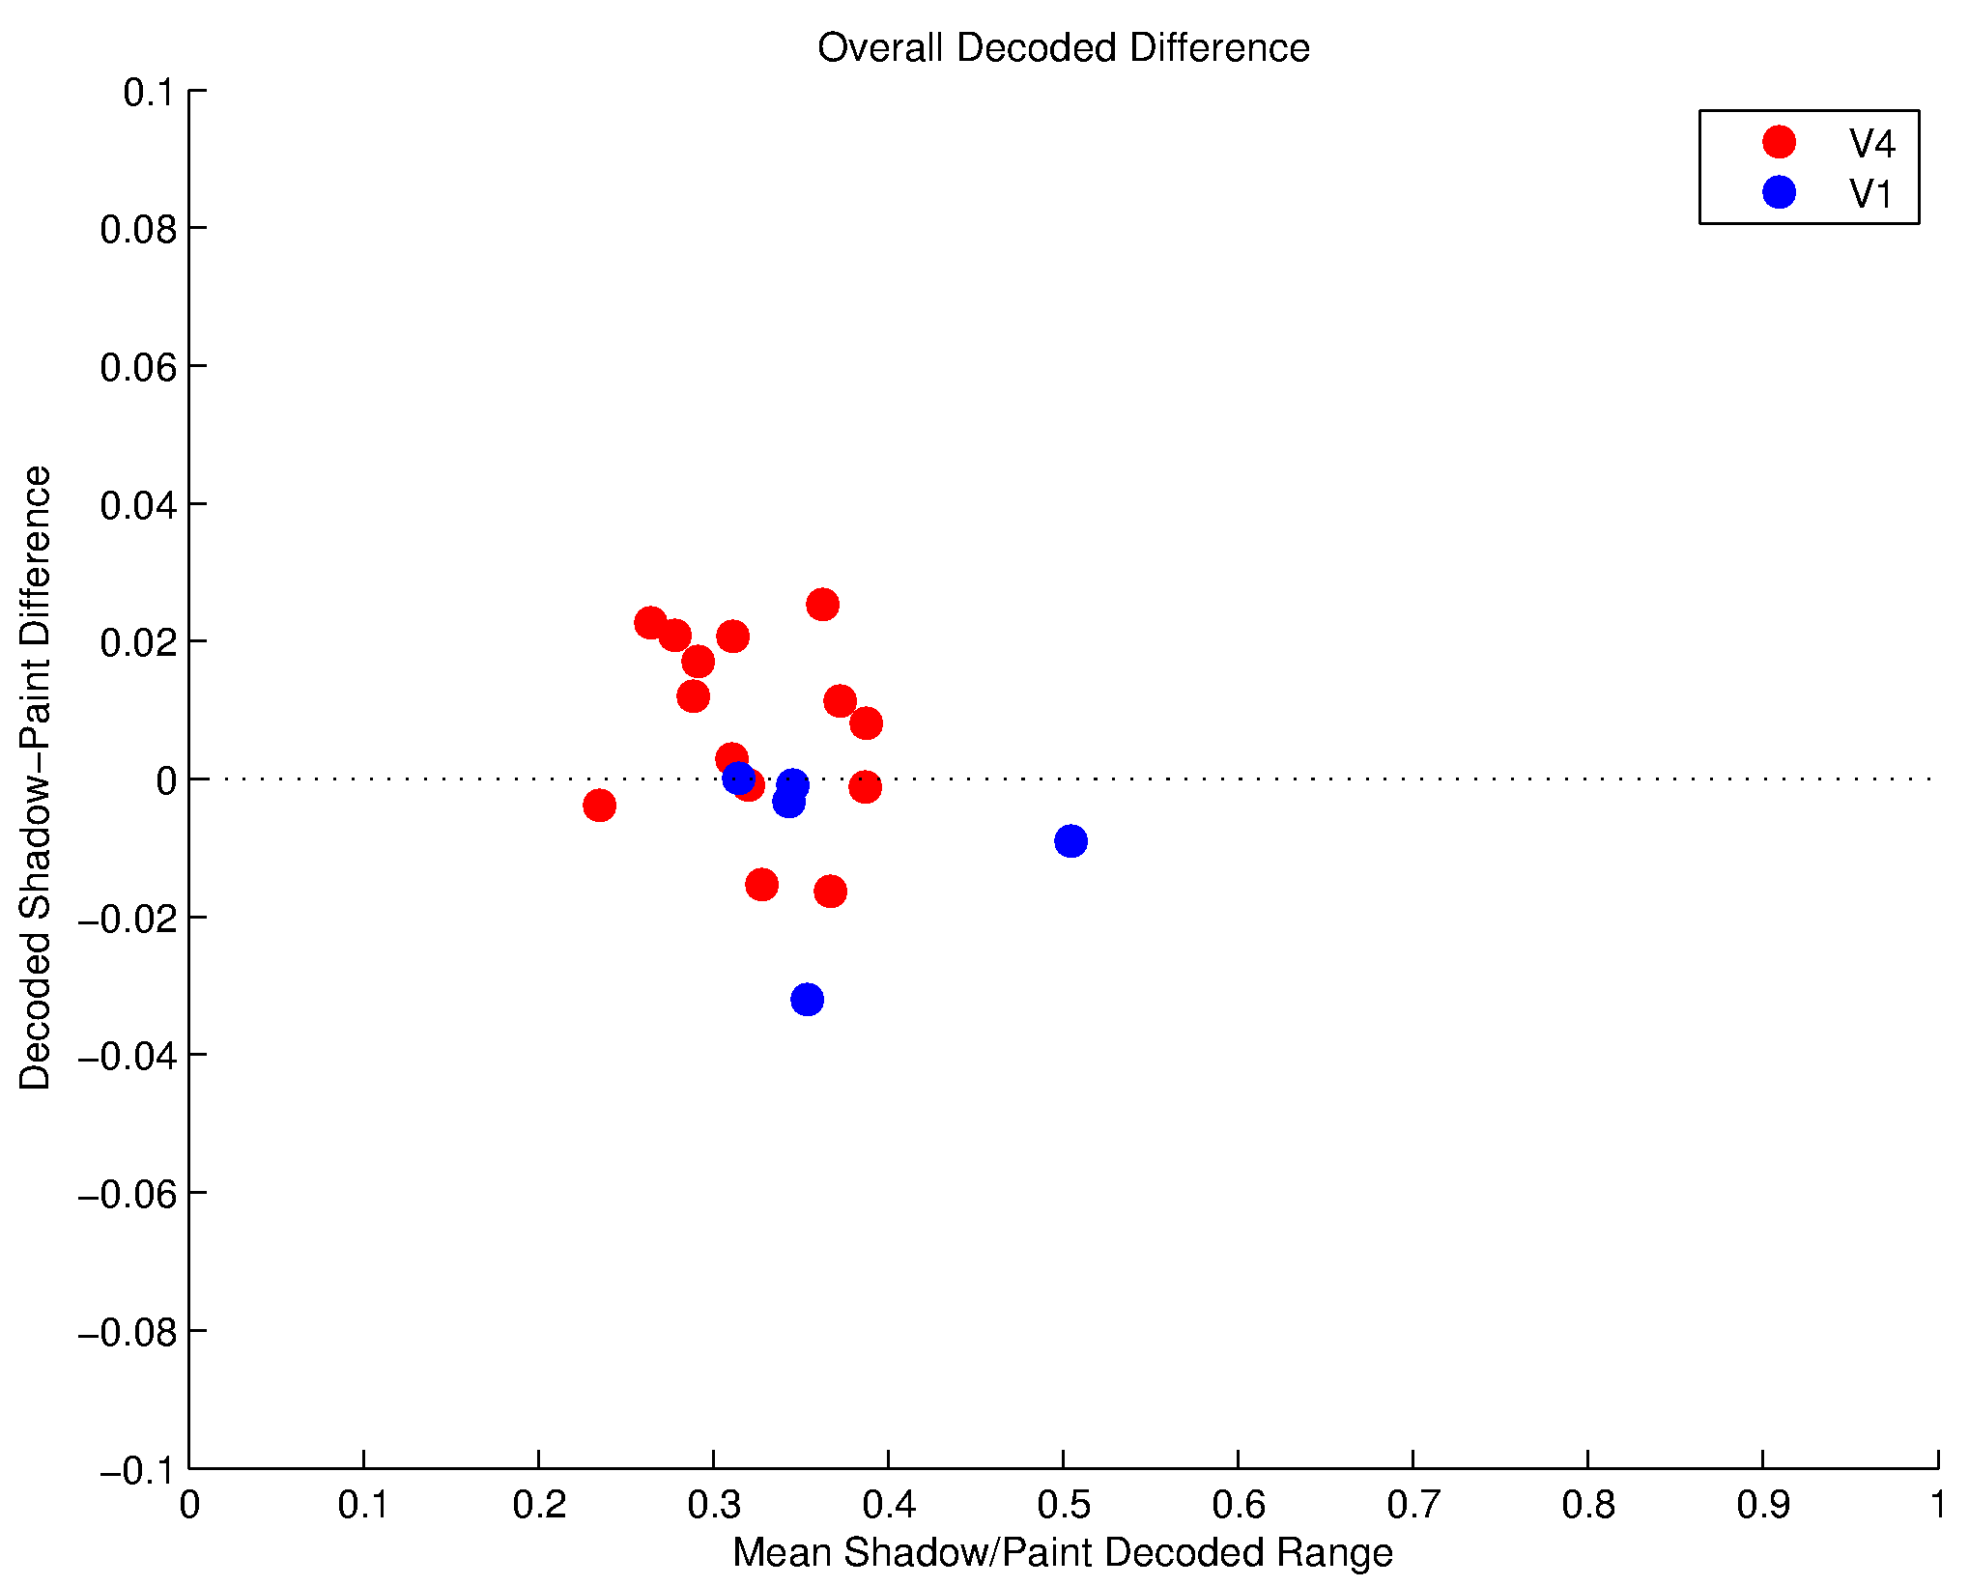
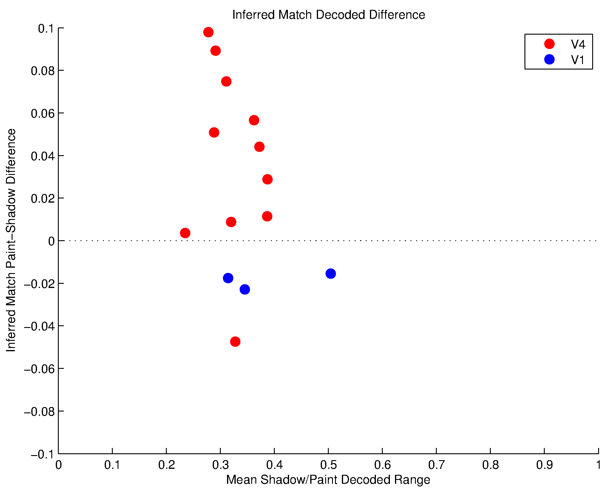
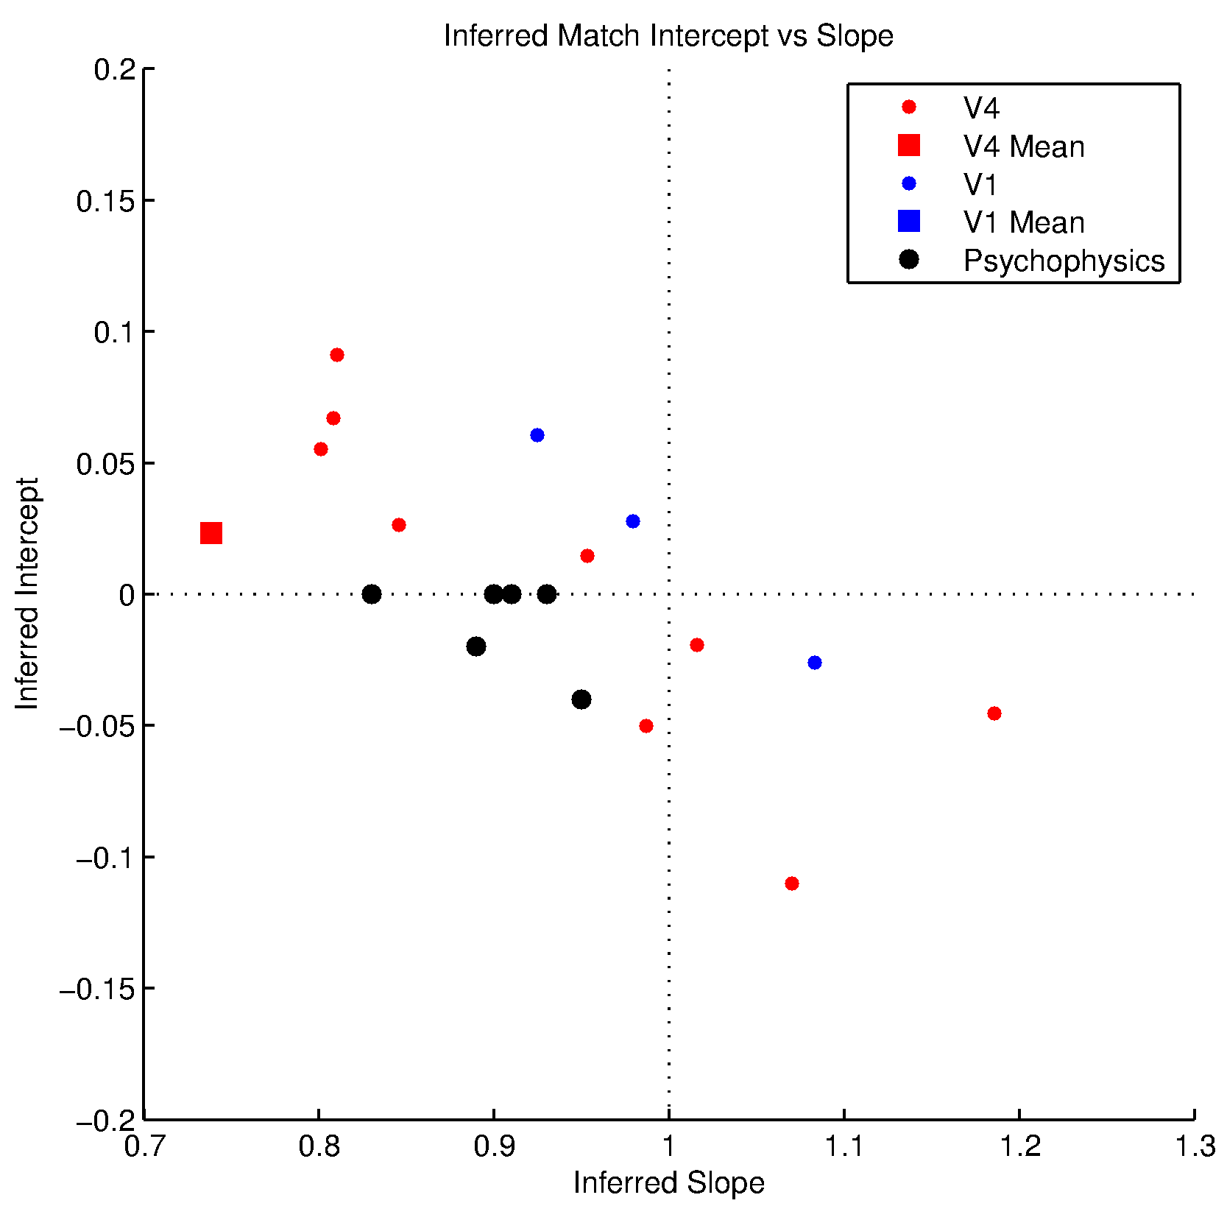
Affine Decoder on Both Paint/Shadow. Best 2 Electrode Decoding. Original Paint/Shadow. Decode Range > 0.2.

Slide 5
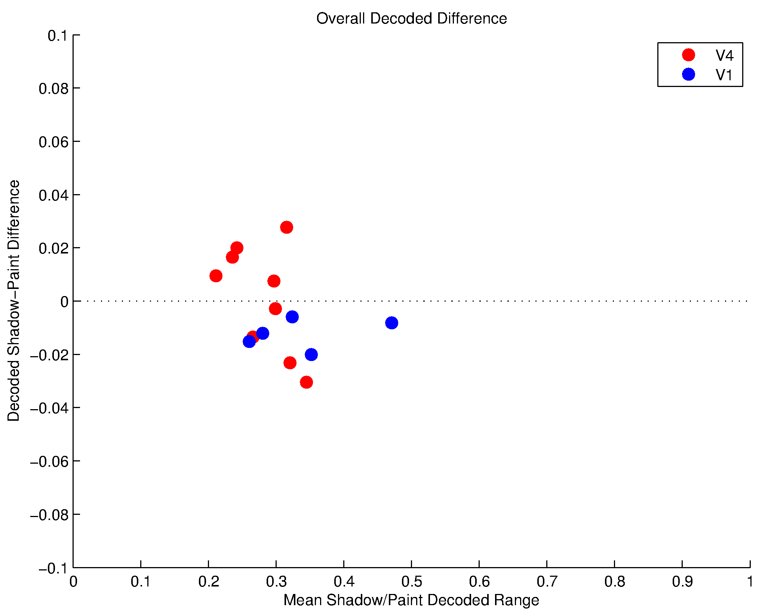
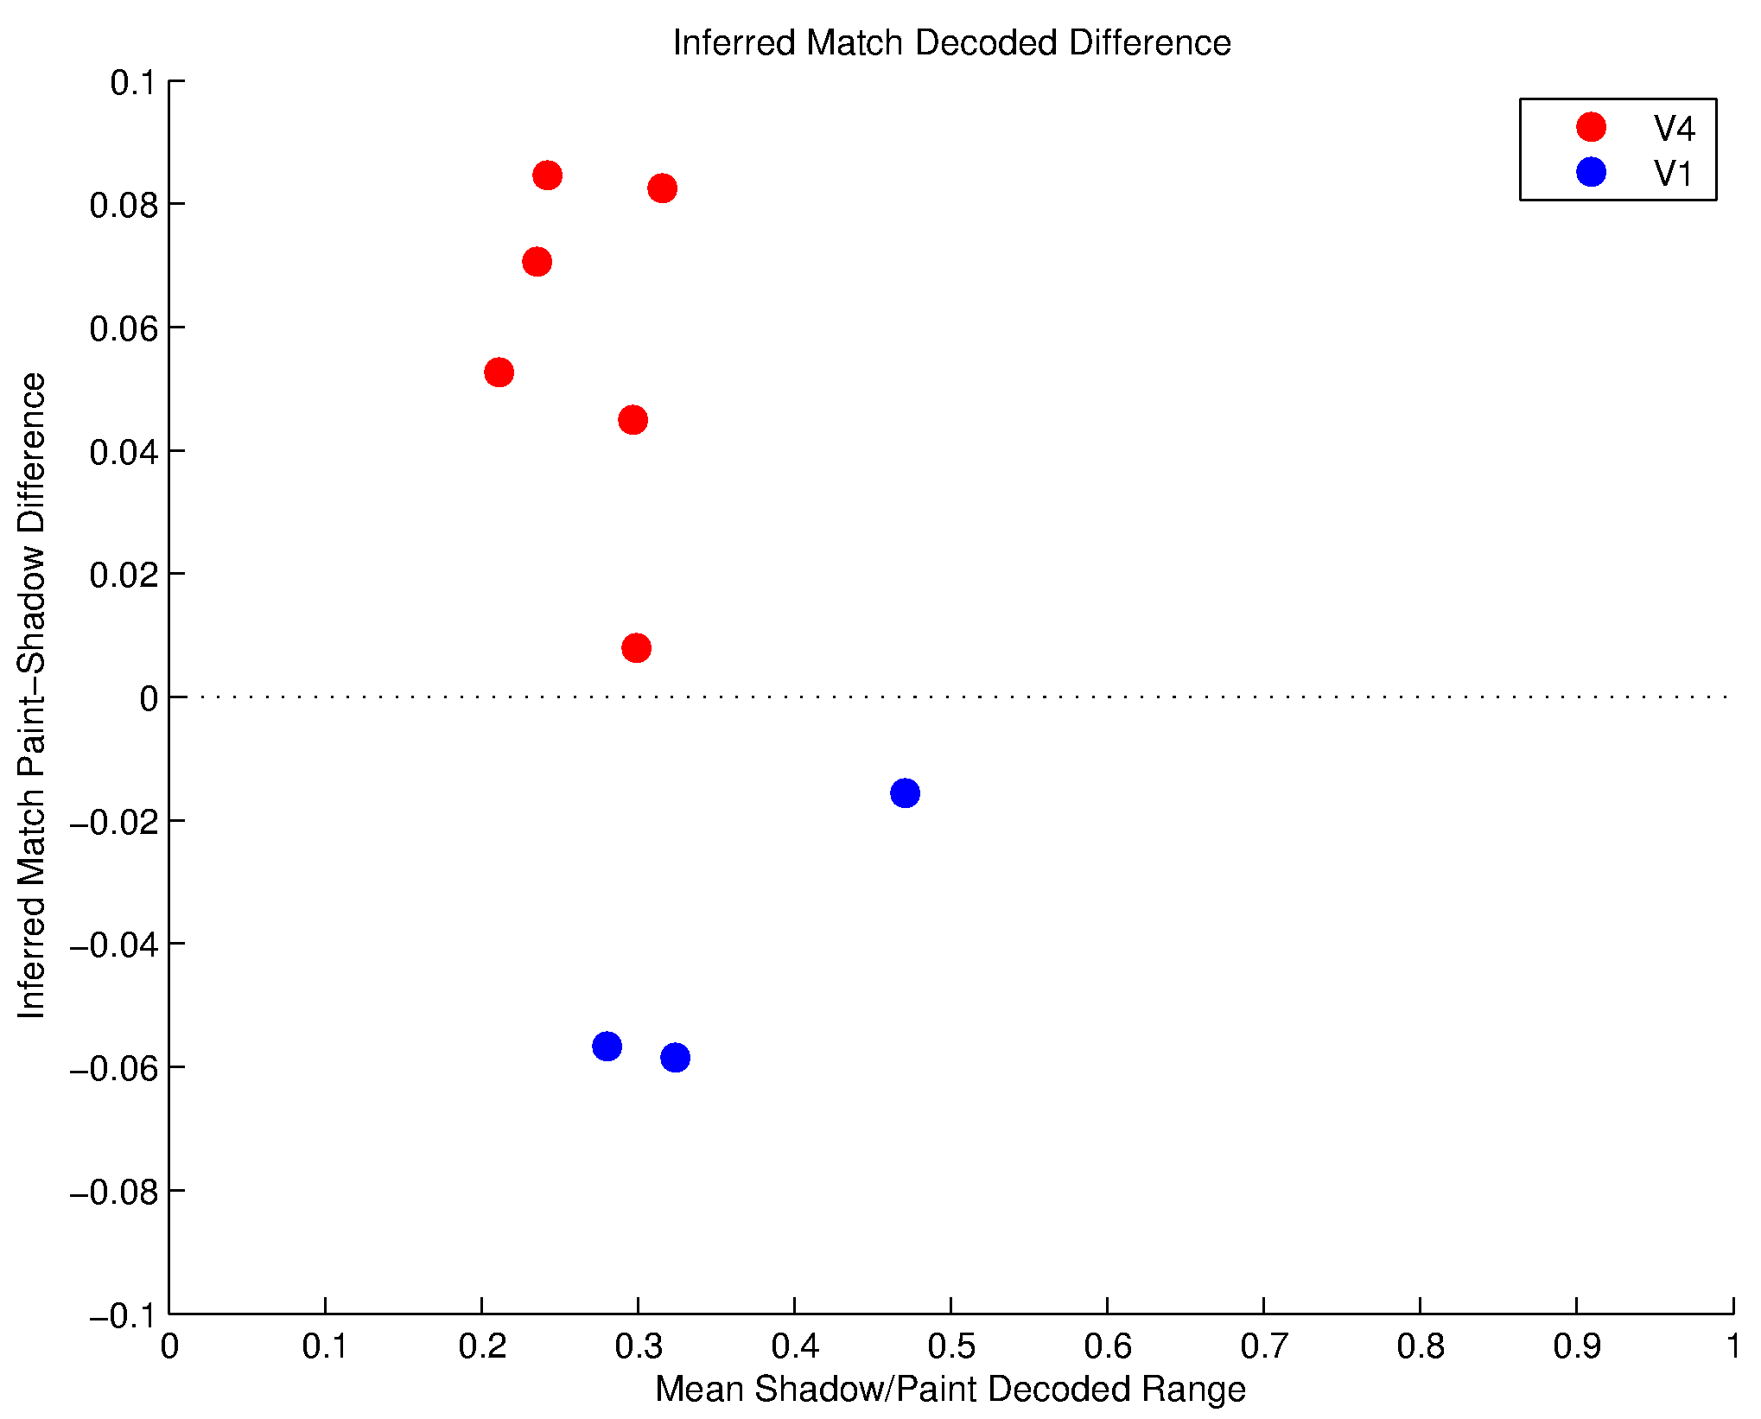
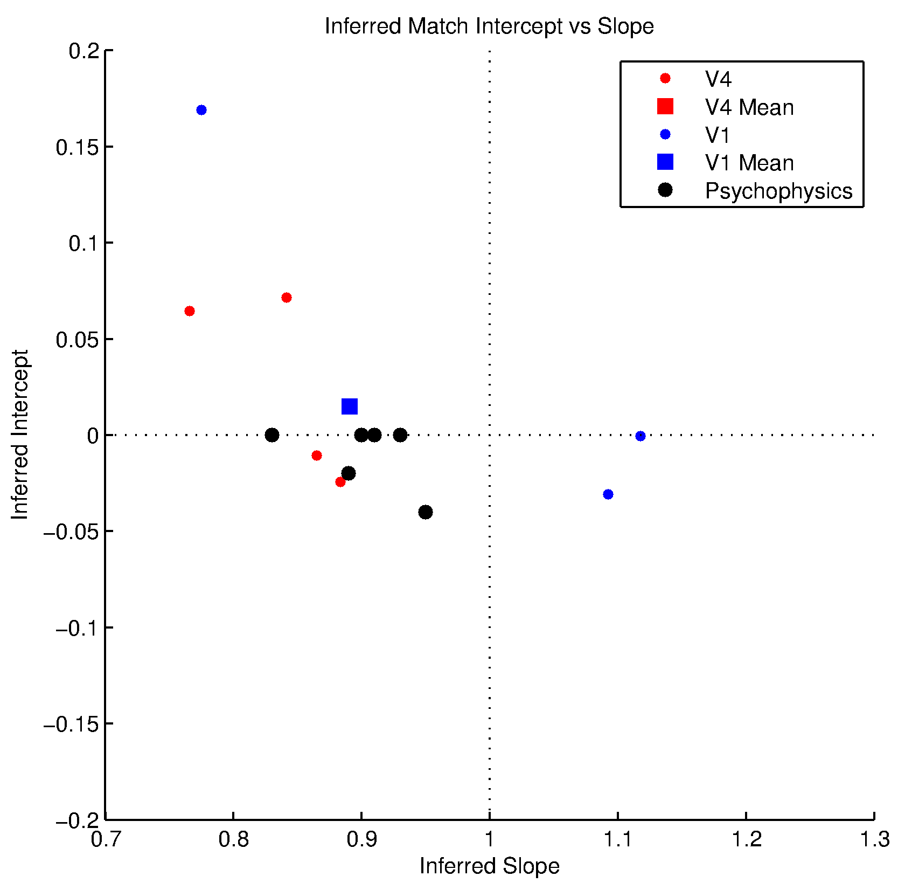
Affine Decoder on Both Paint/Shadow. Best 1 Electrode Decoding. Original Paint/Shadow. Decode Range > 0.2.

Slide 6
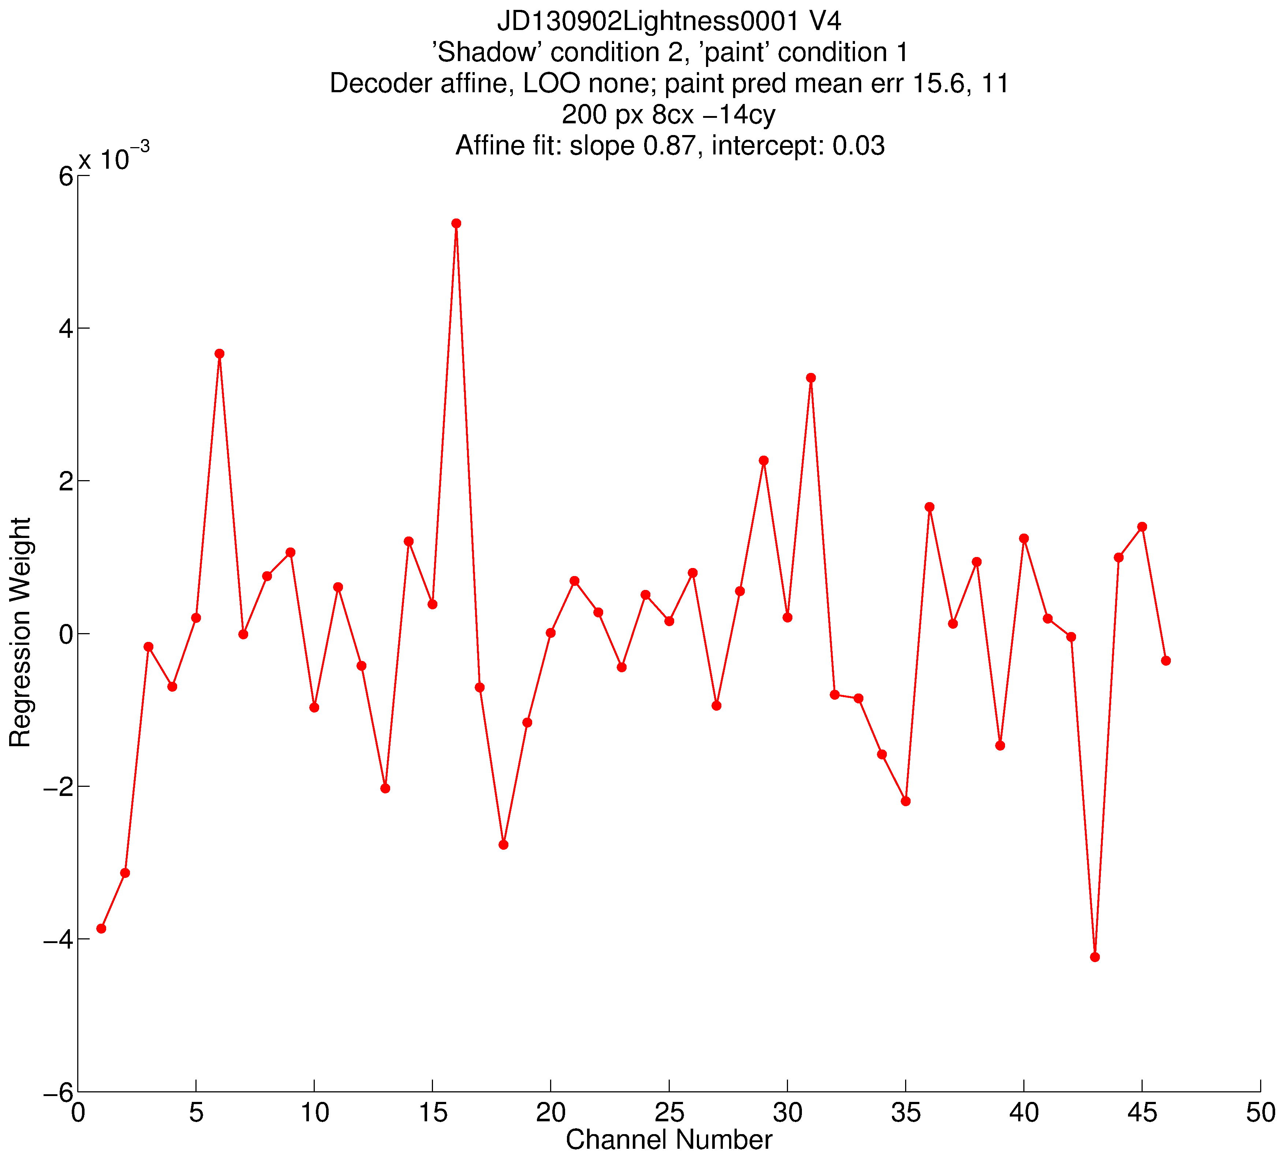
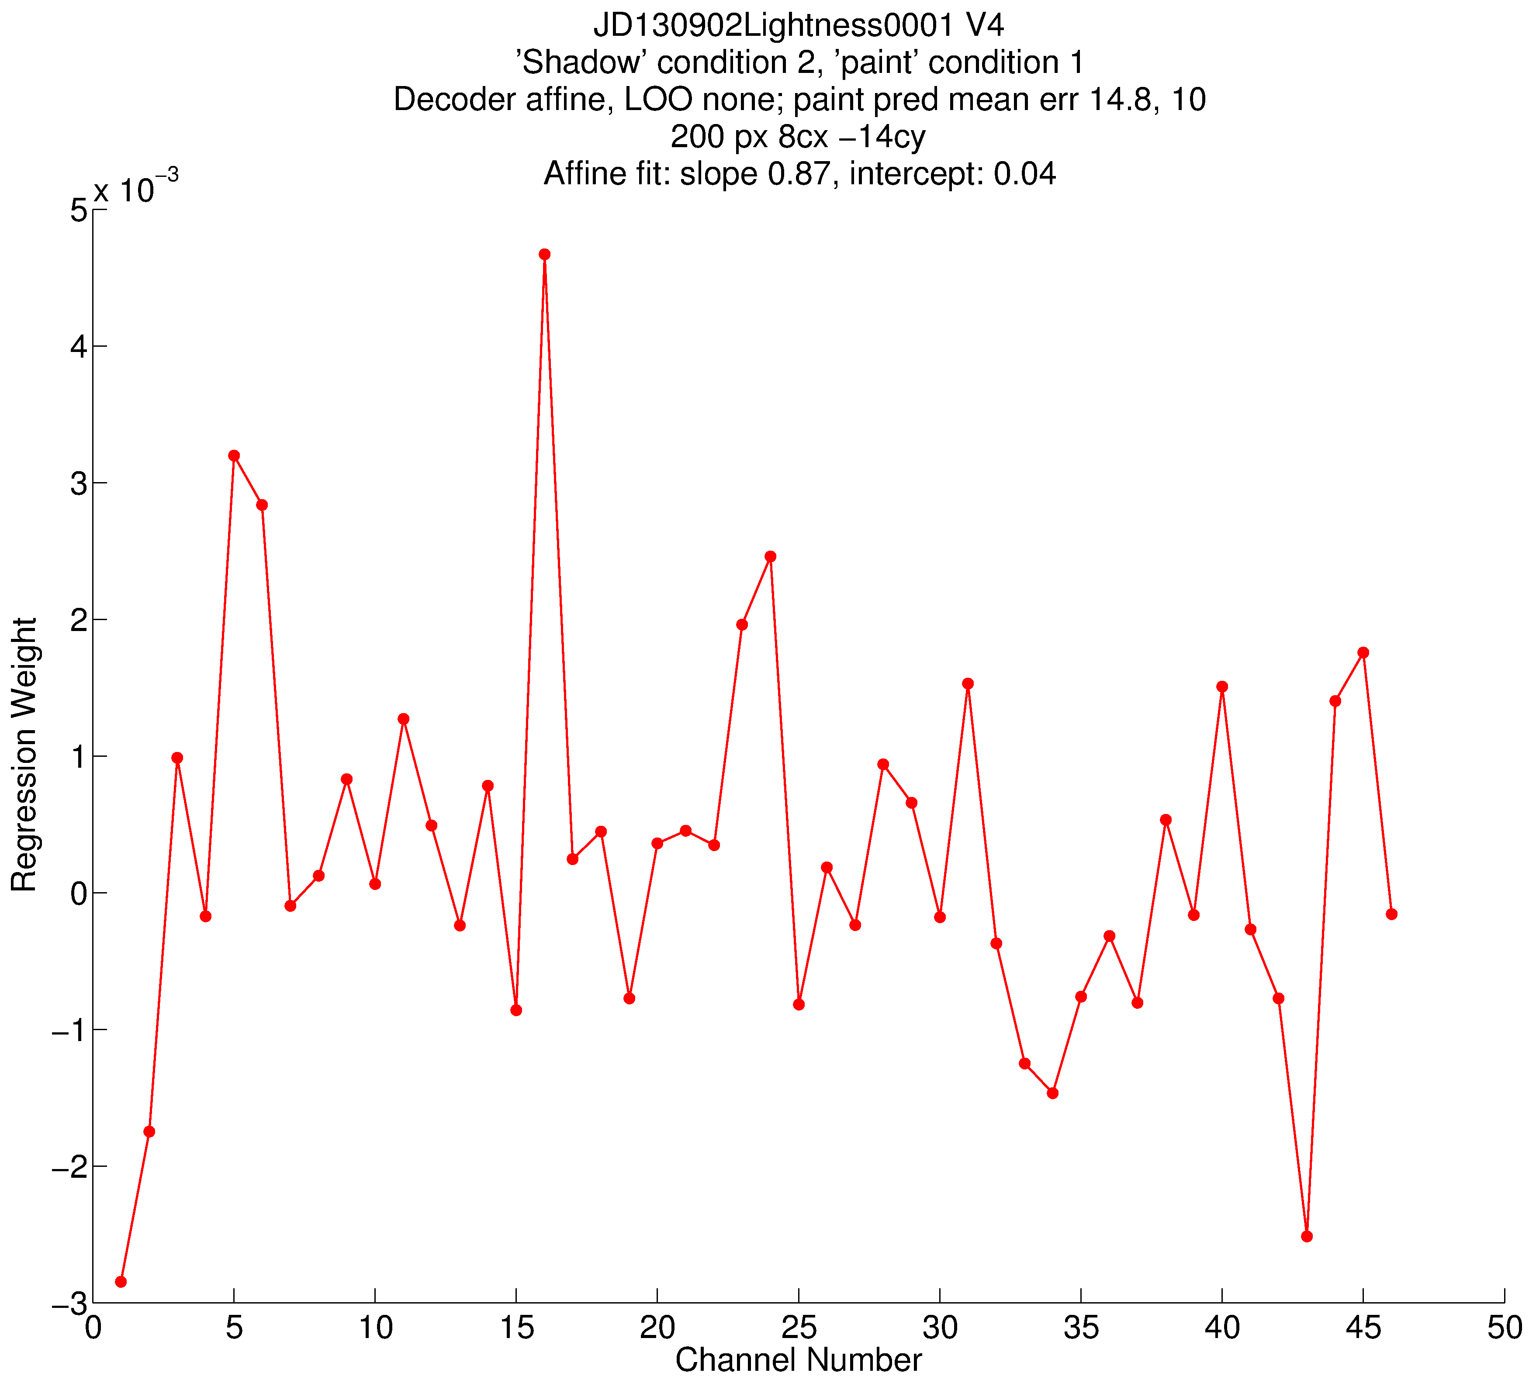
Weights on electrodes. Left, affine decoder. Right, affine decoder with trials shuffled within contrast.

Slide 7
