Slide 1
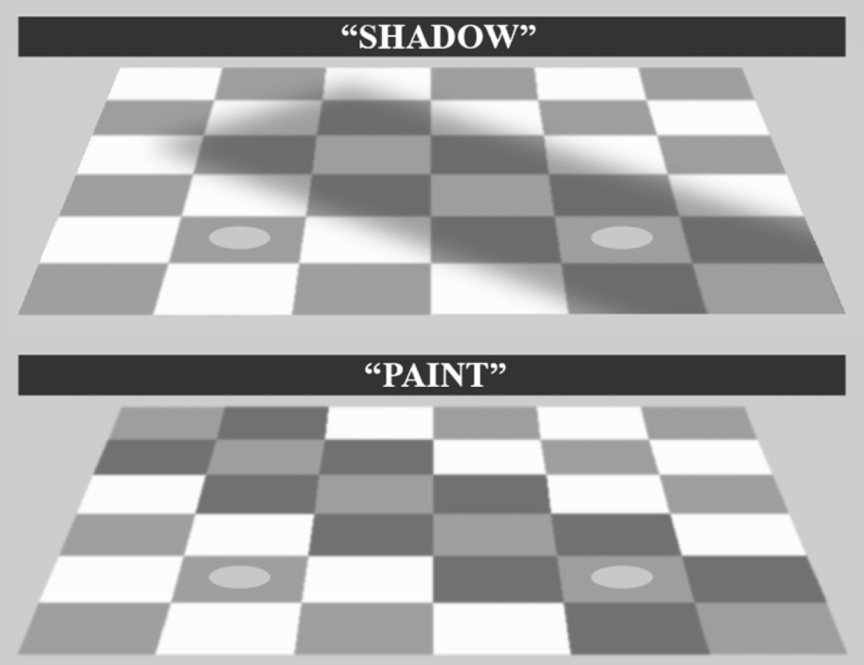
Hillis and Brainard, 2007

Slide 2
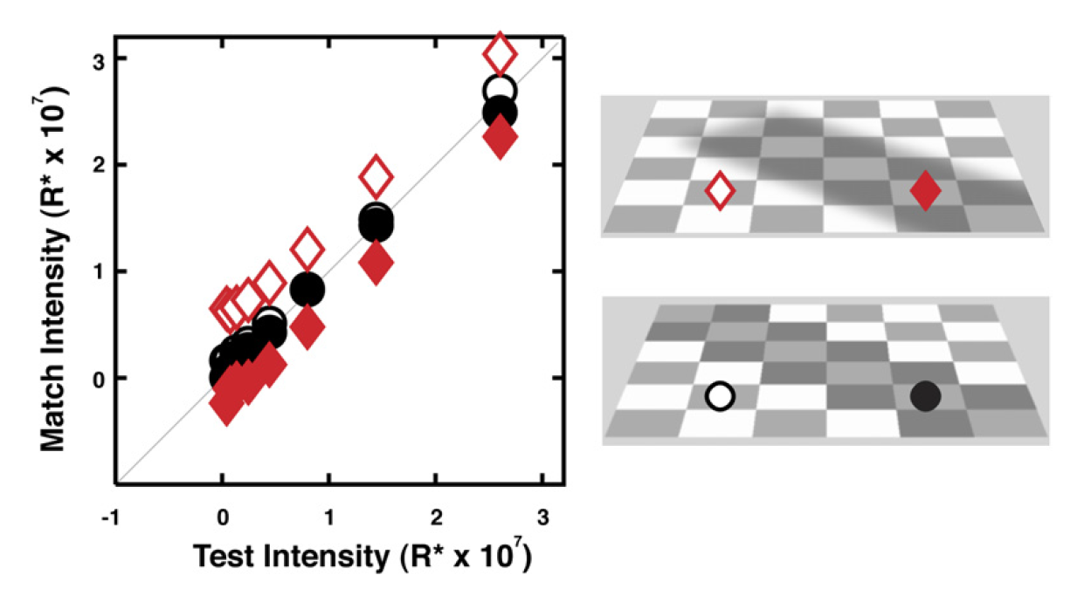
Hillis and Brainard, 2007

Slide 3
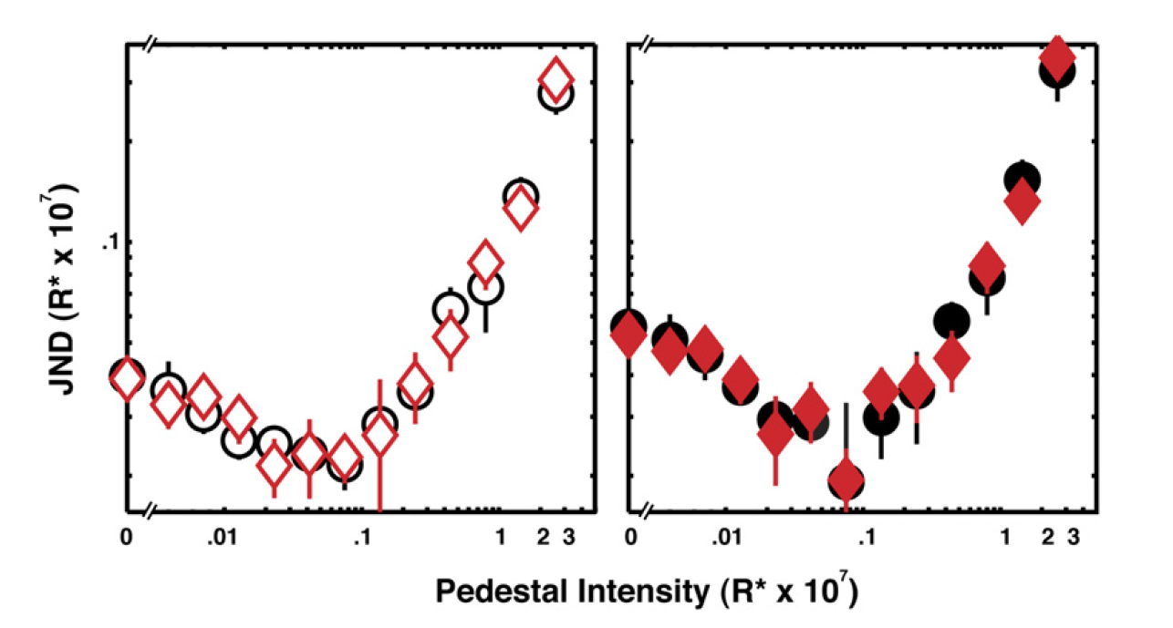
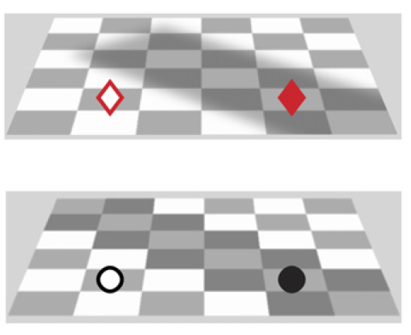
Hillis and Brainard, 2007

Slide 5


Slide 6
Figure 4. Summary Figure, Paint Vs Paint (Control Condition)

Slide 7
A
B

Slide 8

Figure 3. Psychometric Functions, Paint Vs Shadow

Slide 9
Figure 5. Summary Figure, Paint Vs Shadow

Slide 10
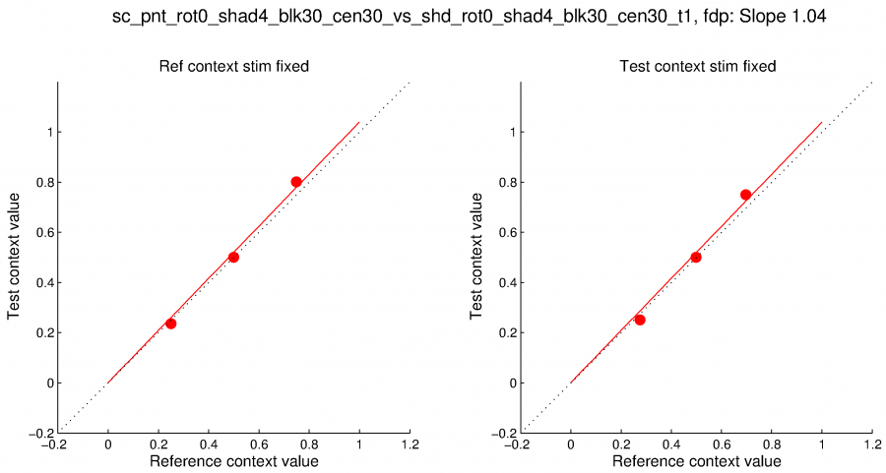
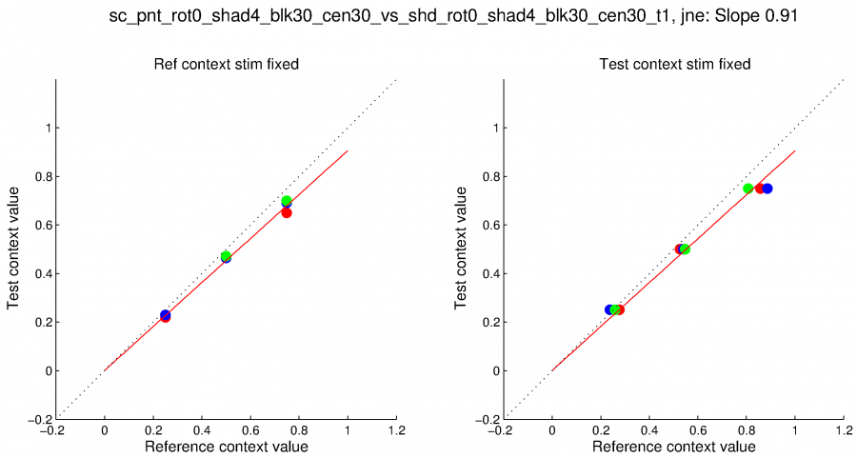

Slide 11
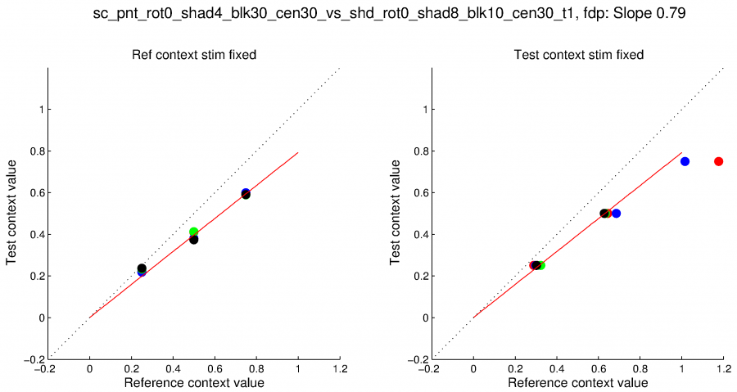

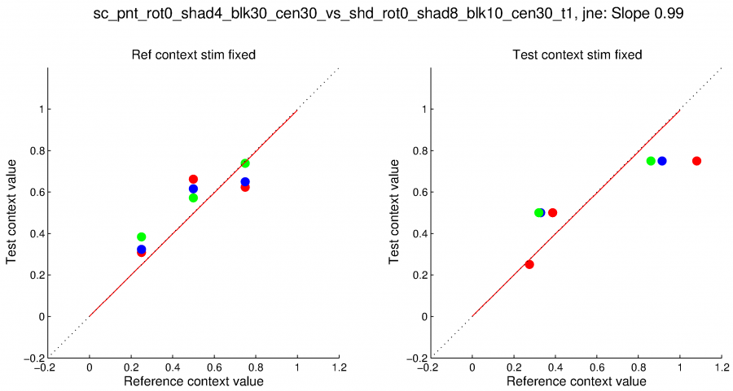

Slide 12
