Slide 1




Eimgs_rot0_shad4_blk40_cen40
“Original Paint”
Eimgs_rot0_shad4_blk40_cen10
“New Paint”
Eimgs_rot0_shad4_blk40_cen40
“Original Shadow”
Eimgs_rot0_shad4_blk40_cen10
“New Shadow”
Probe level 50 illustrated

Slide 2
“Original” paint/shadow psychophysics
Eimgs_rot0_shad4_blk40_cen40, parametricConditions2, paint is ref for both conditions, paint as test in c31, shadow as test in c32)
Probe levels 25, 50, 75 (as illustrated)

Slide 3
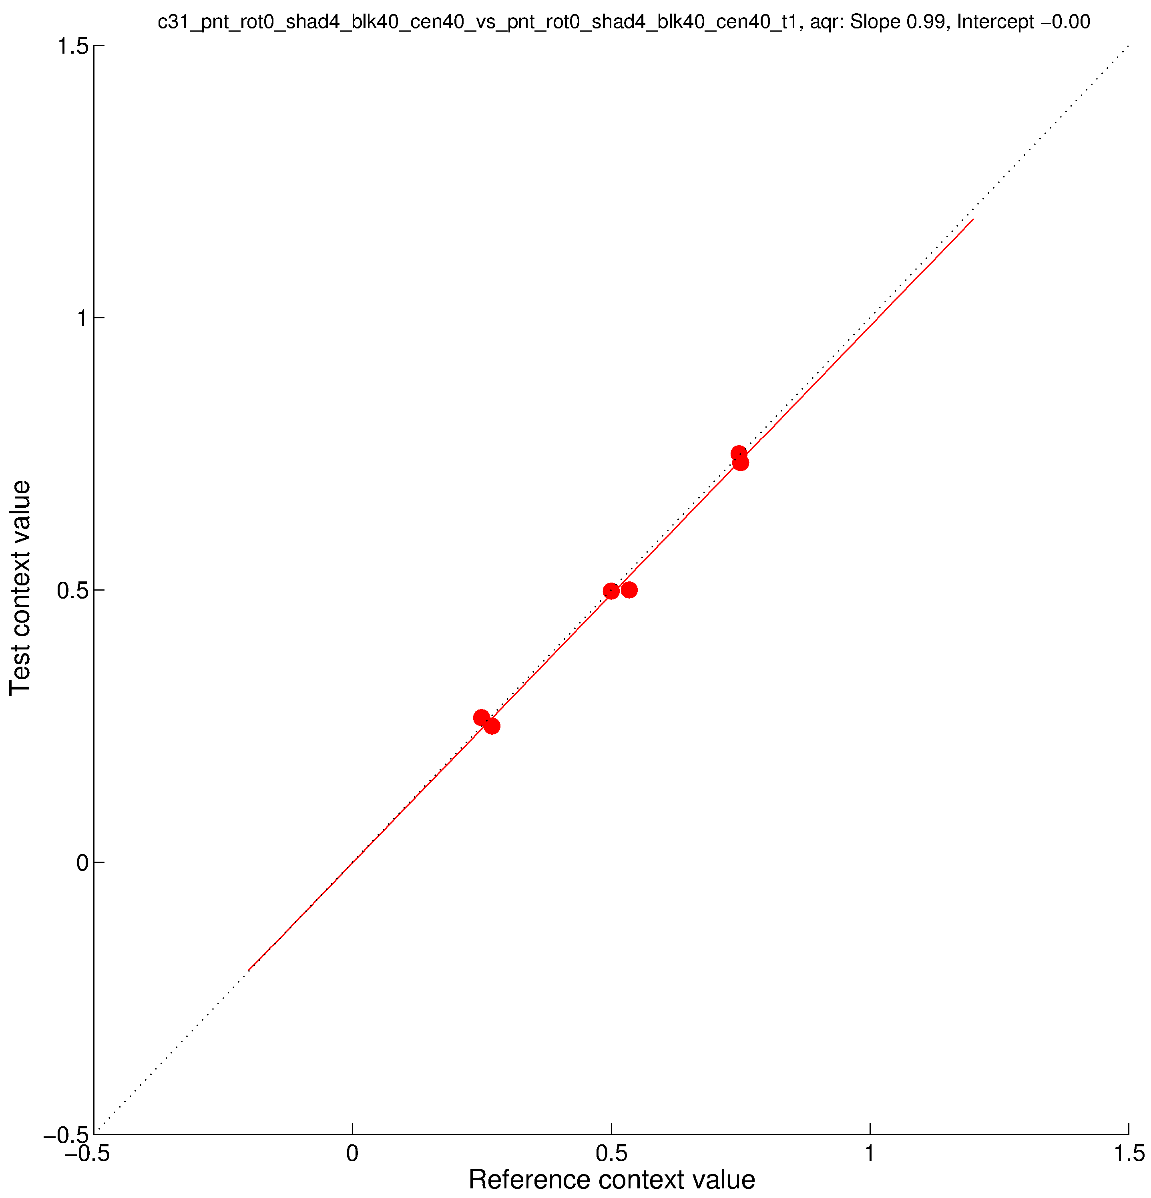
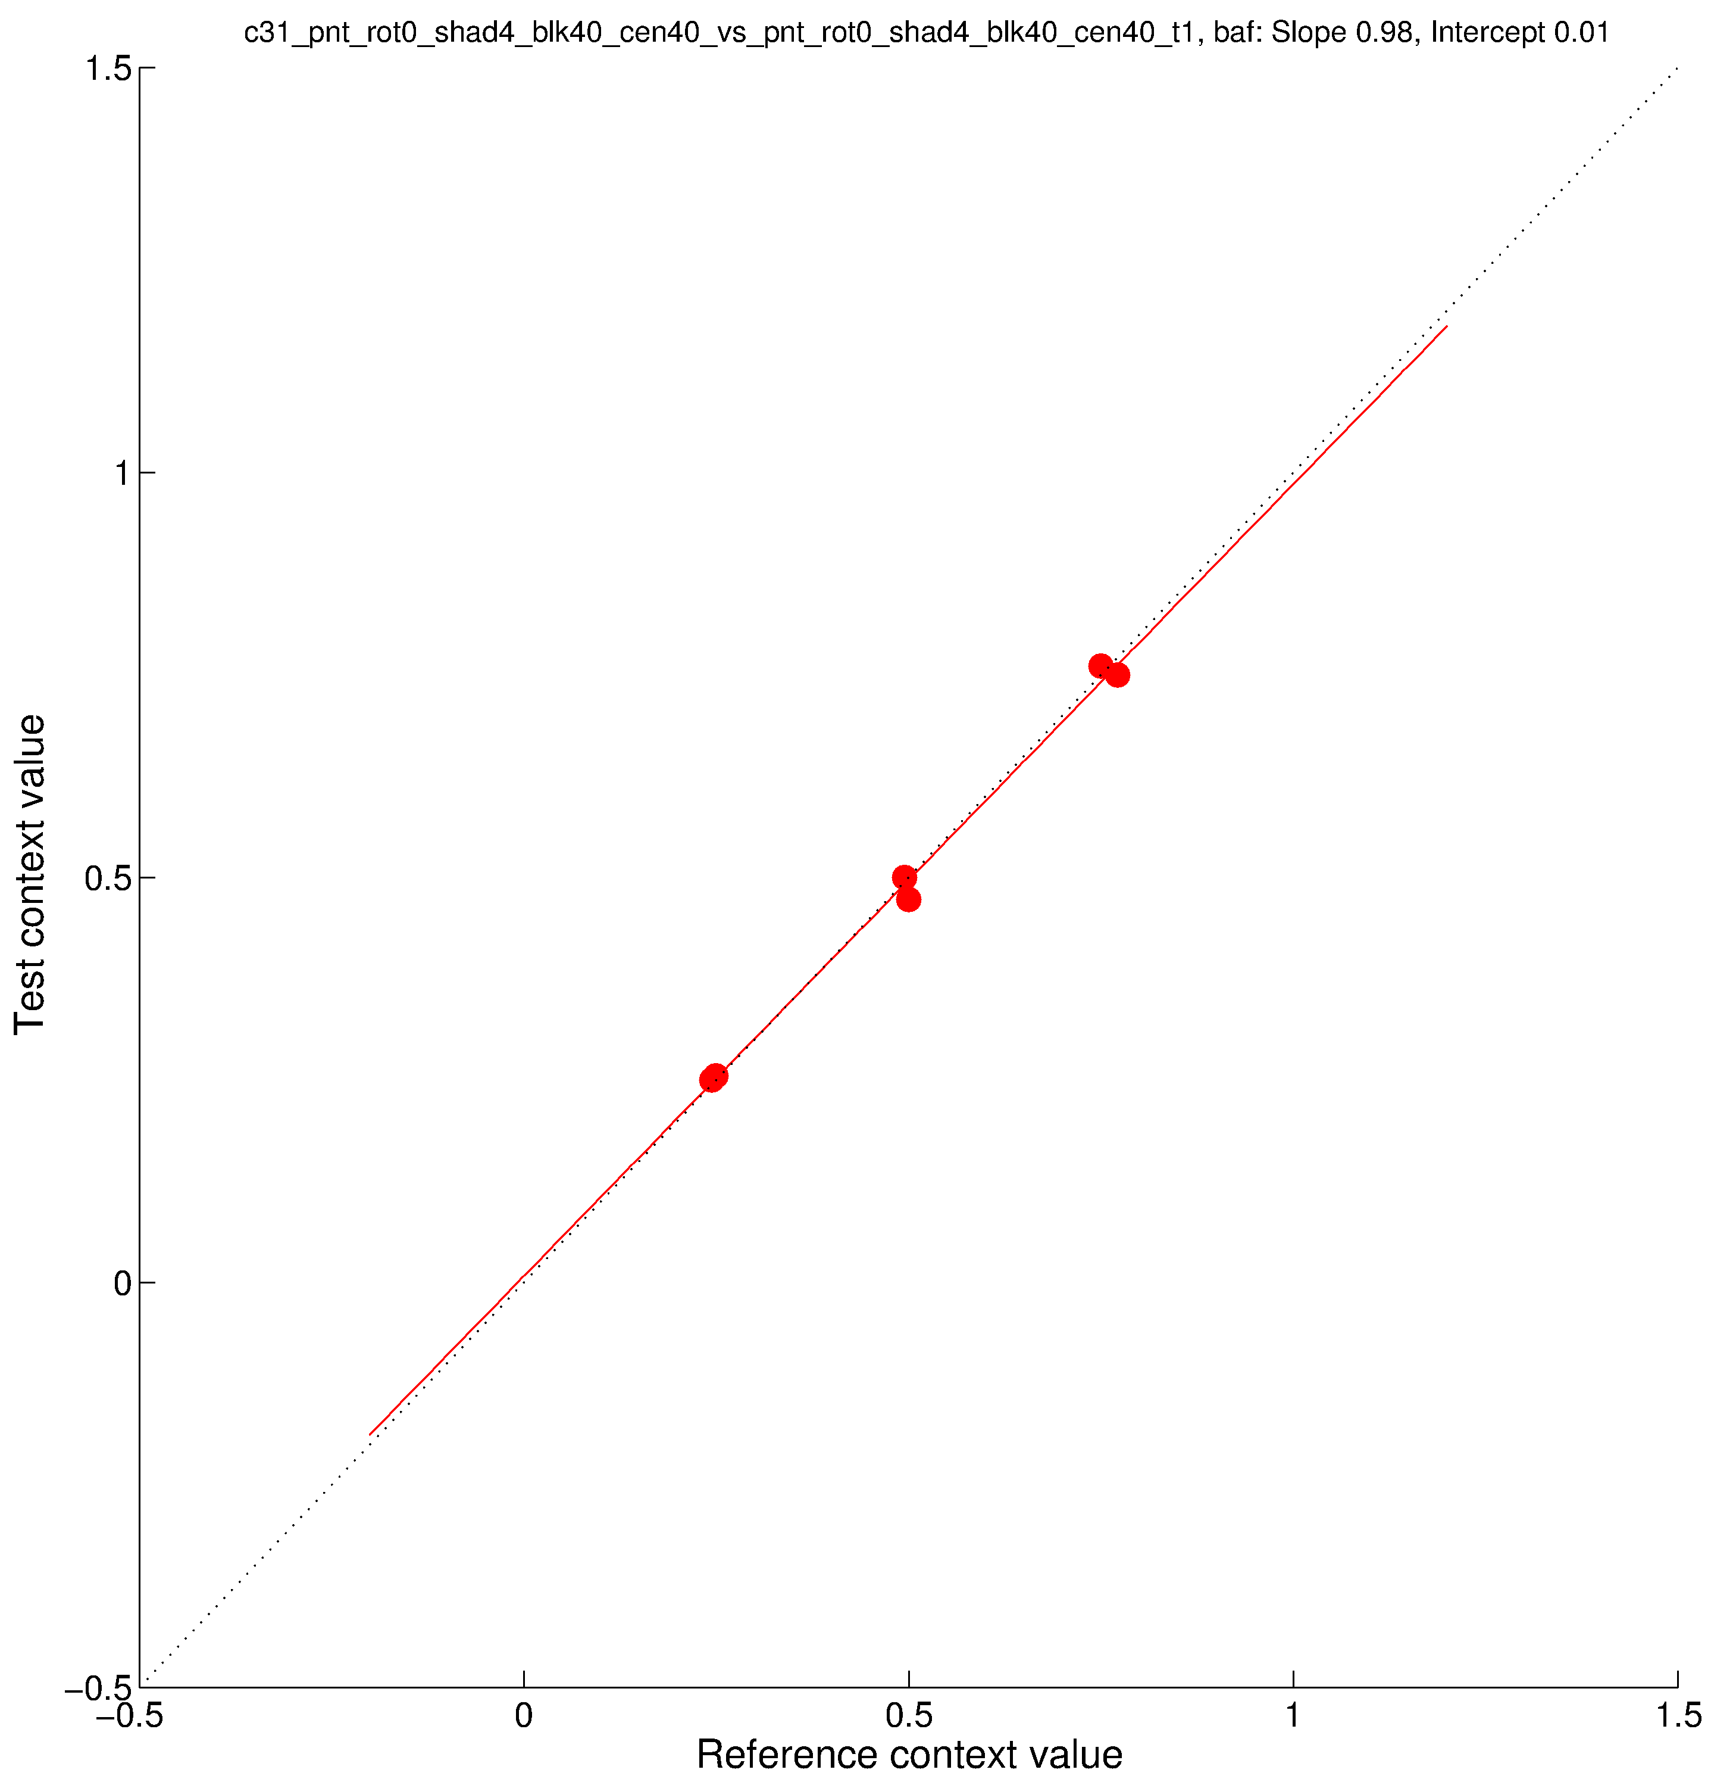
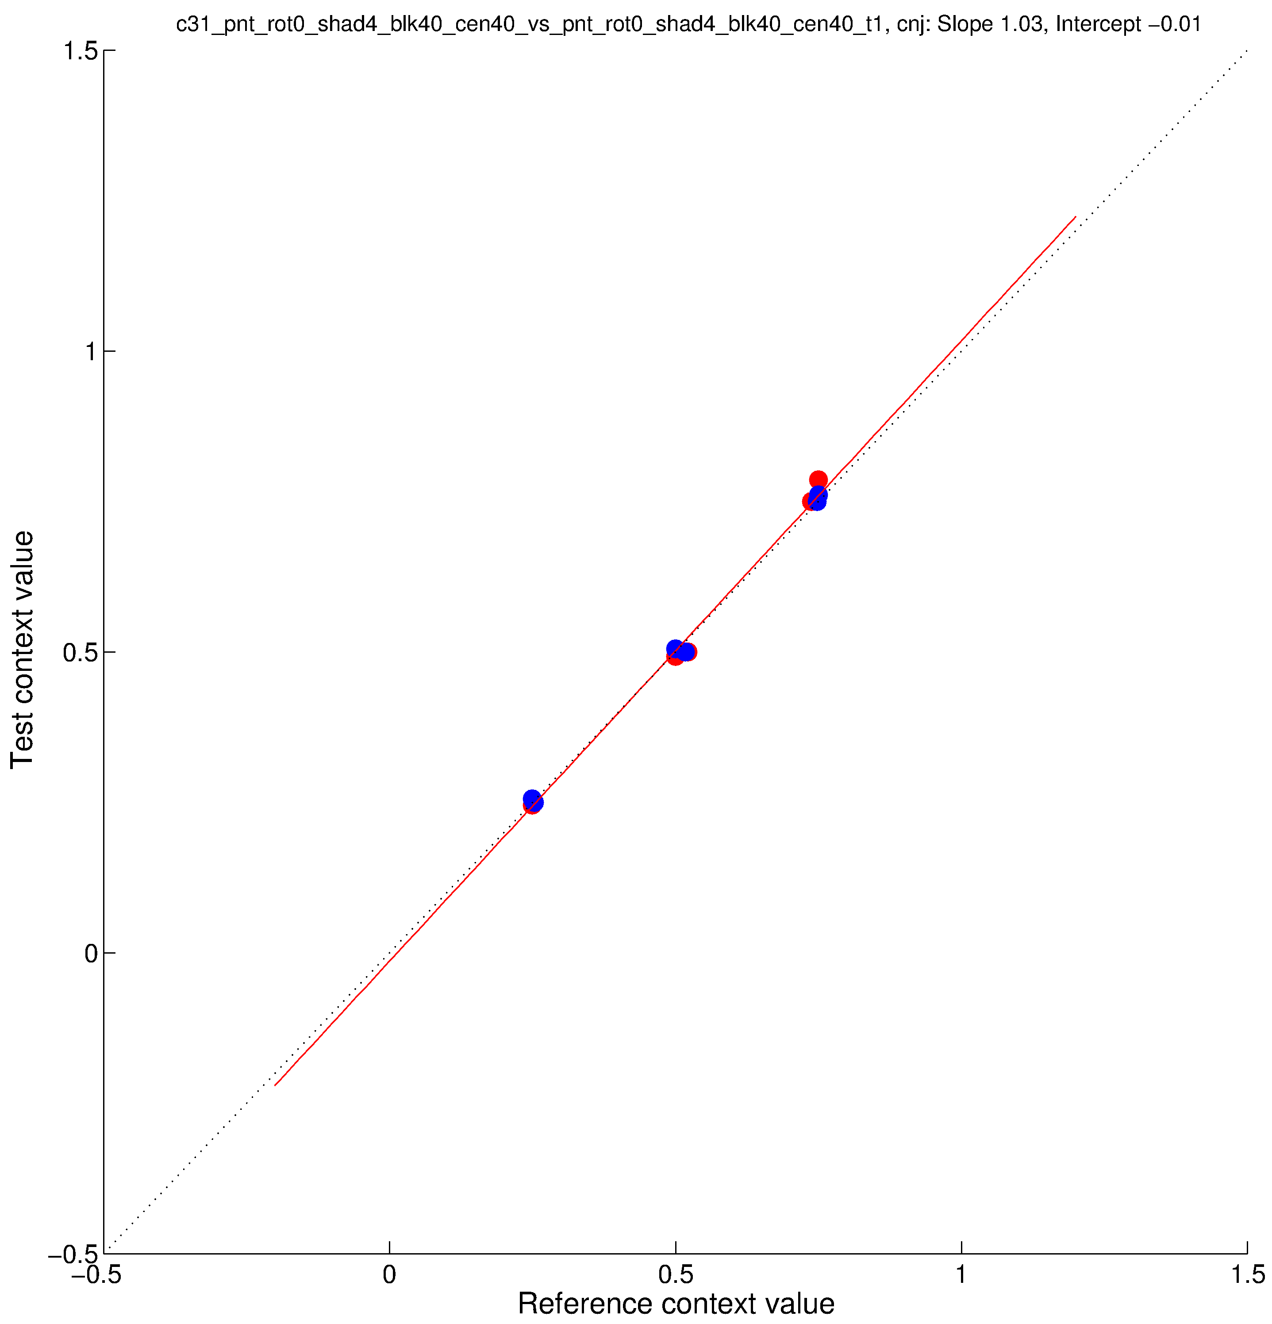
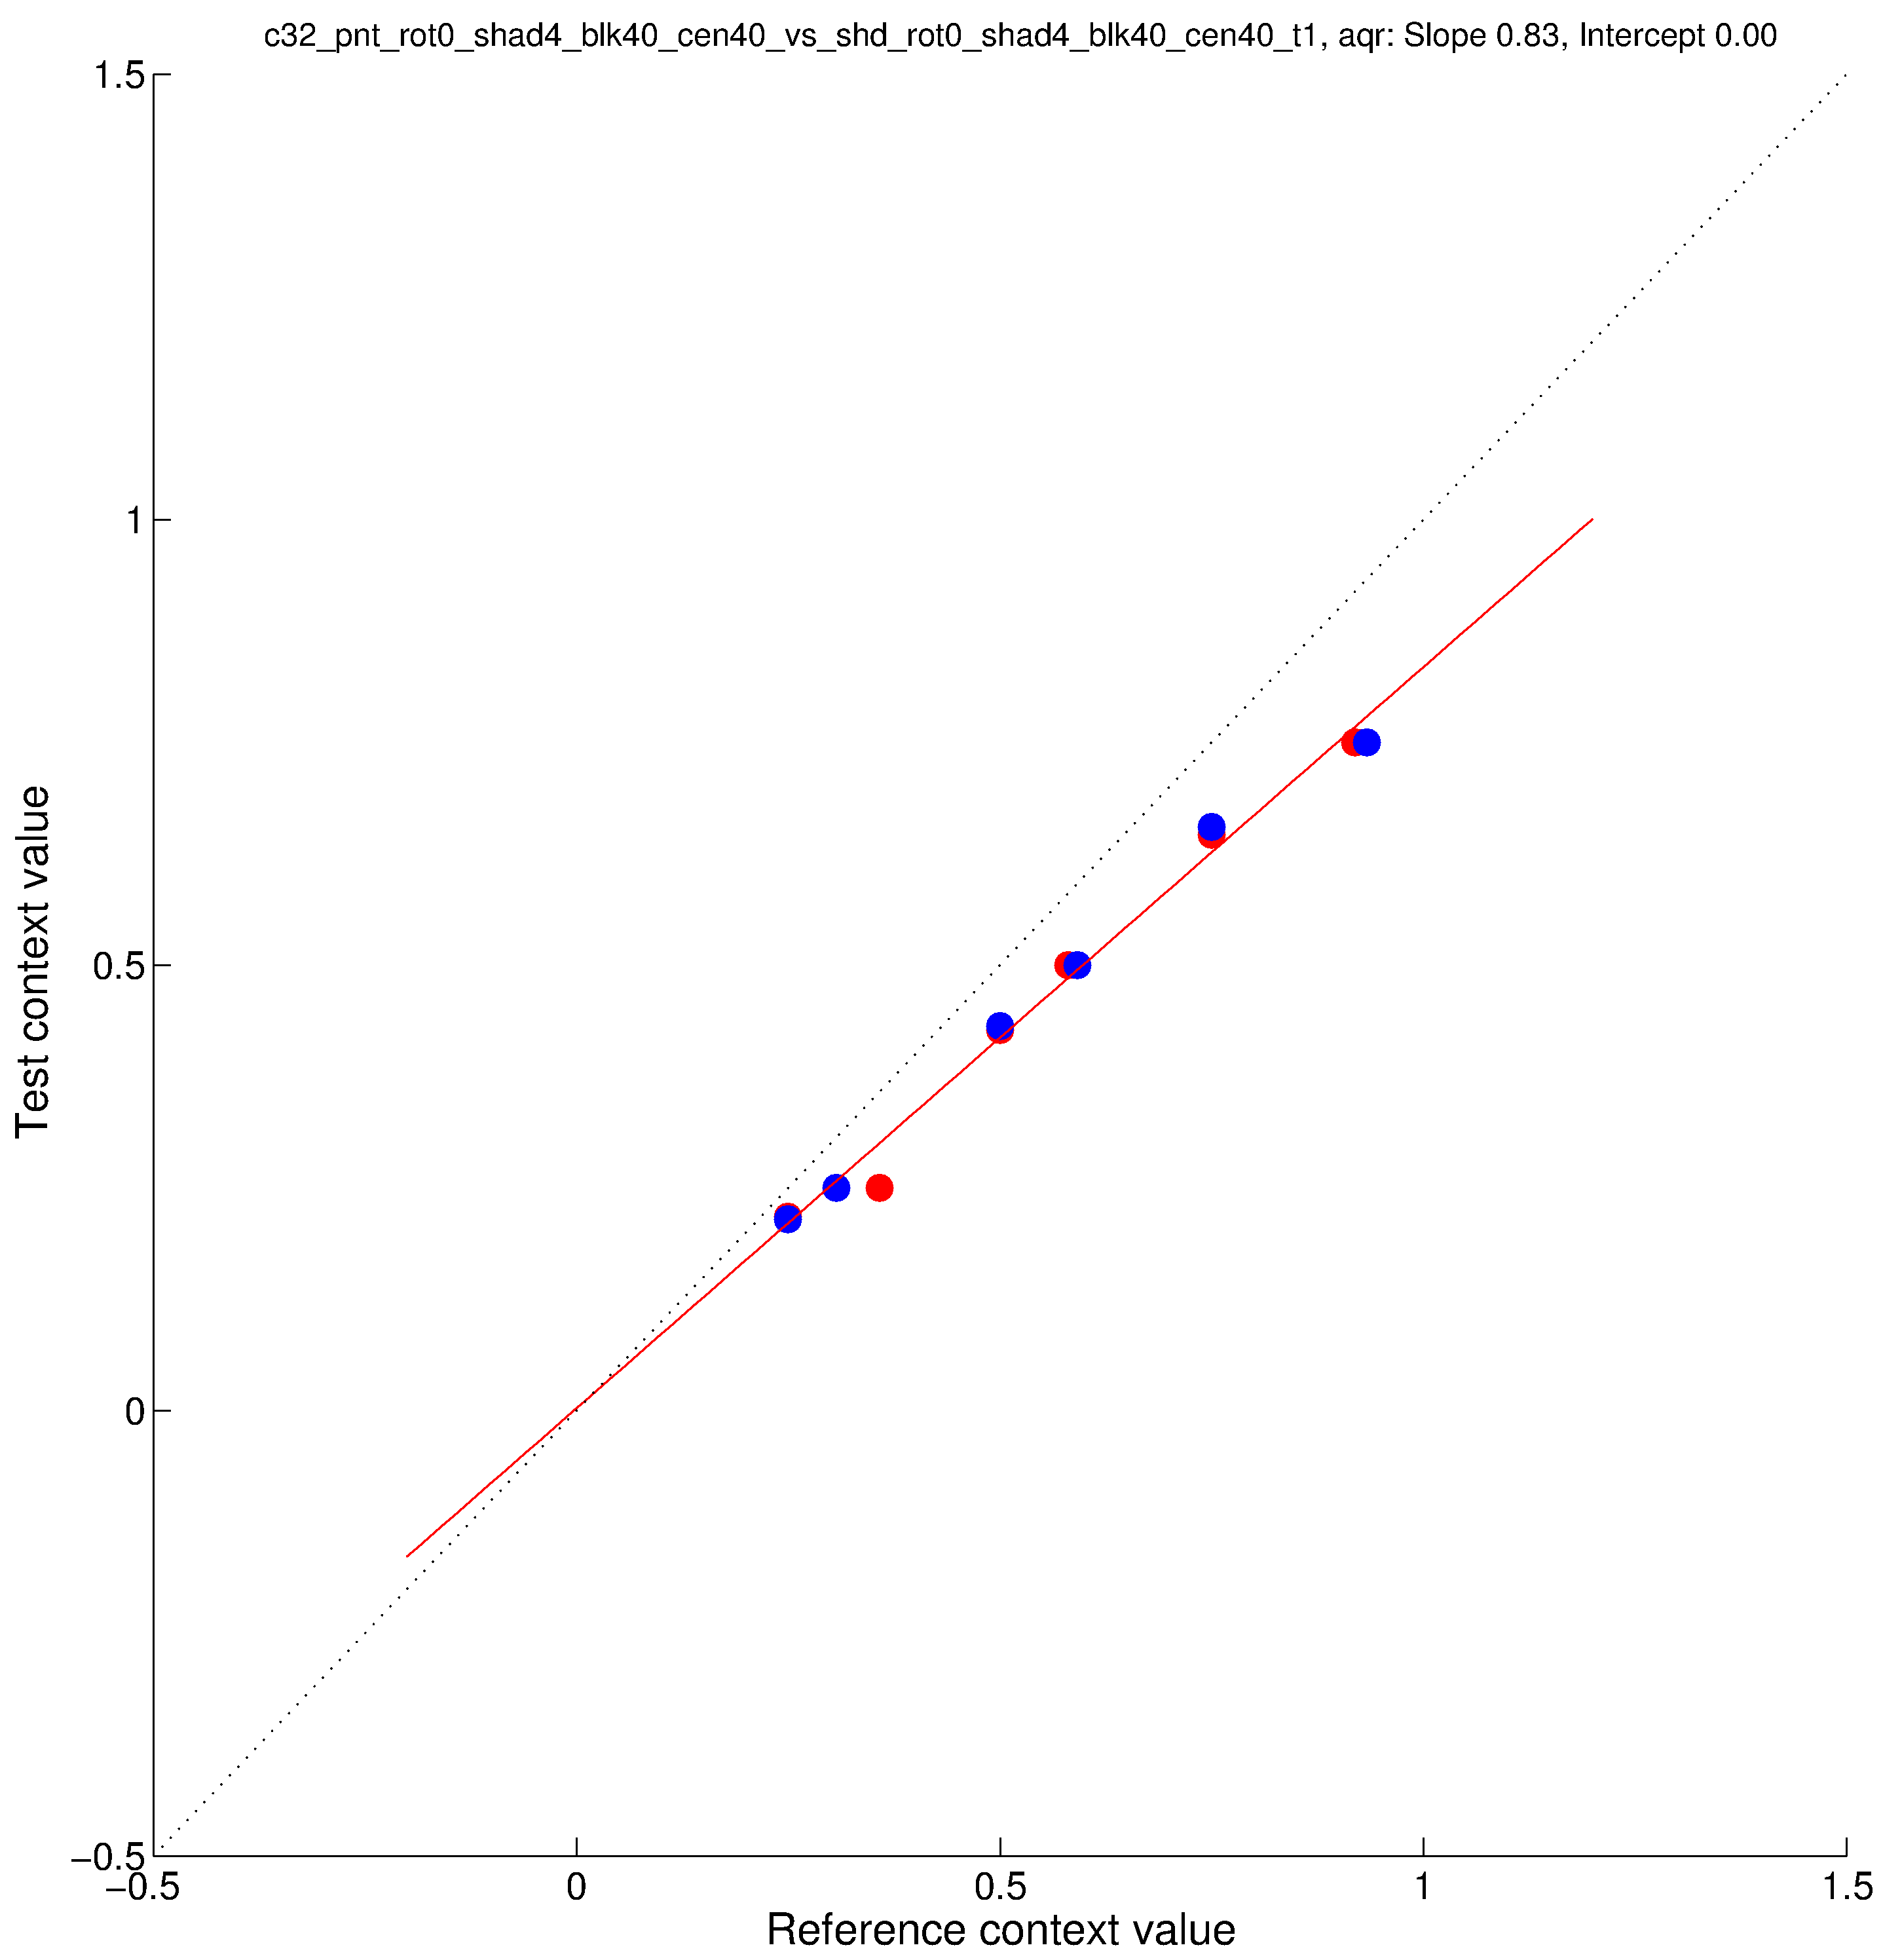
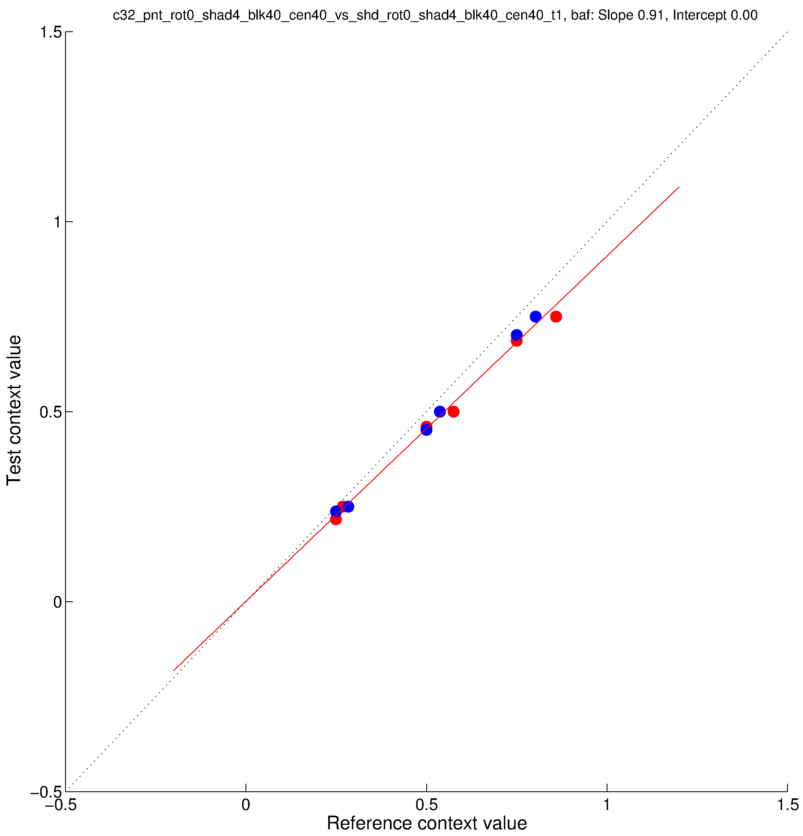
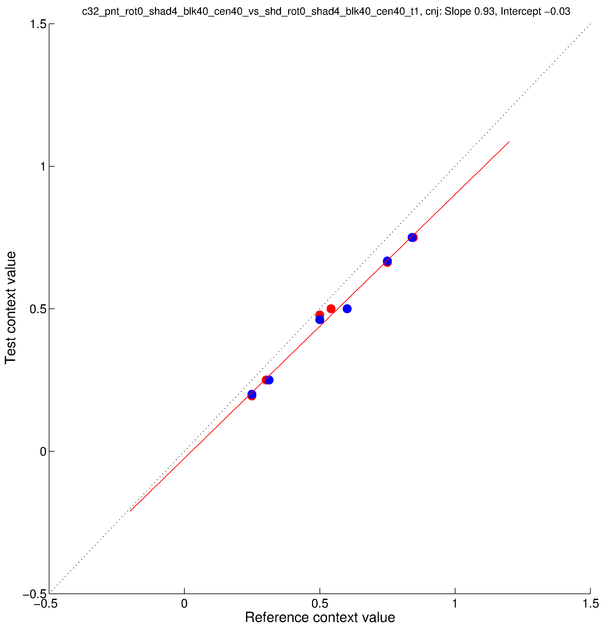
AQR
BAF
CNJ
AQR
BAF
CNJ
parametricConditions2, c31 (top) and c32 (bottom), three subjects

Slide 4
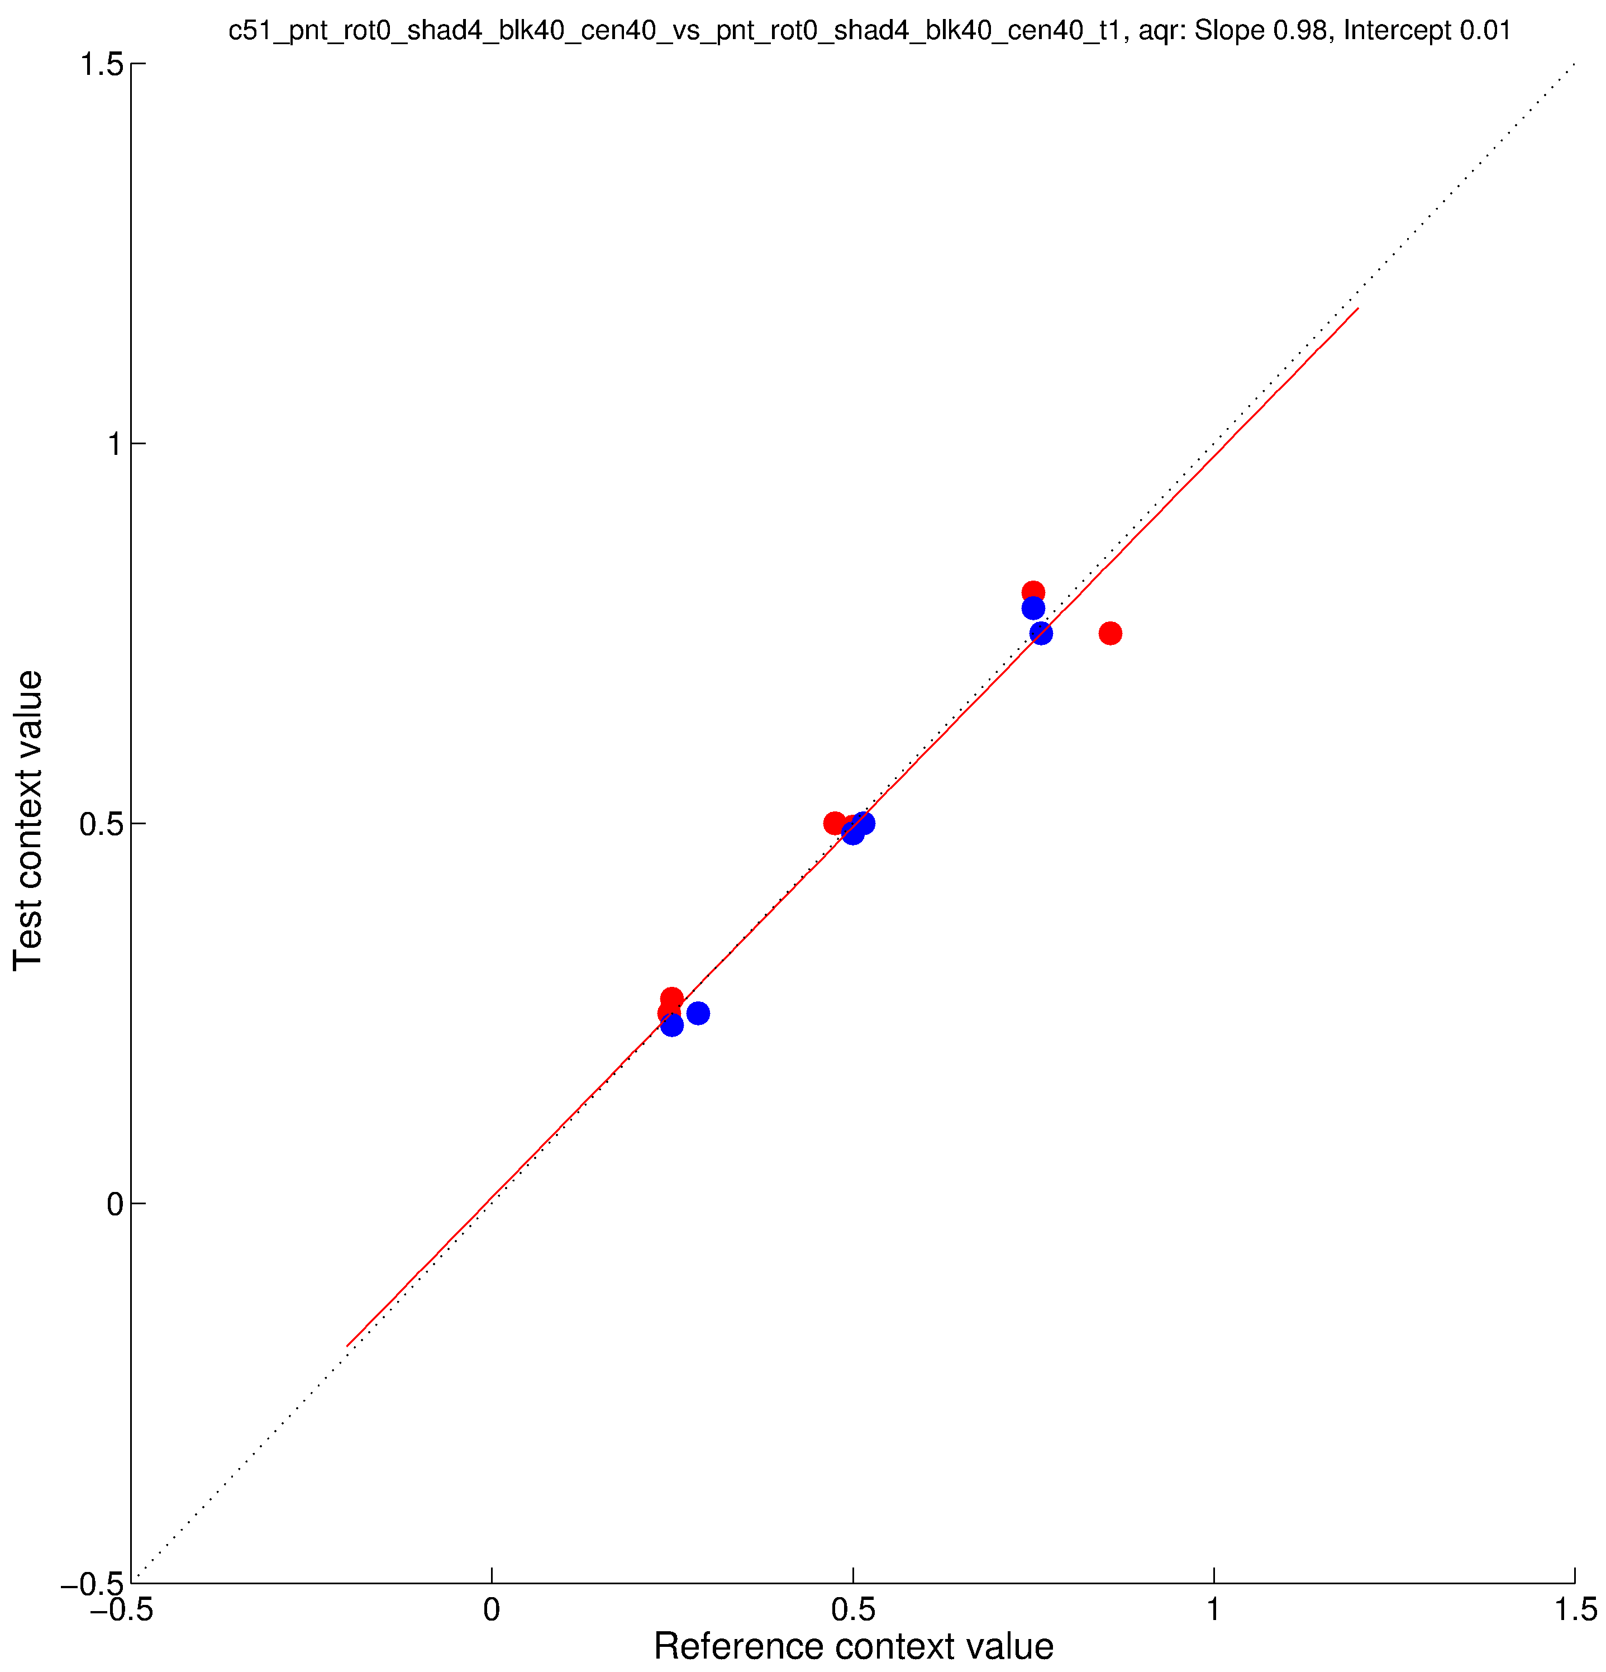
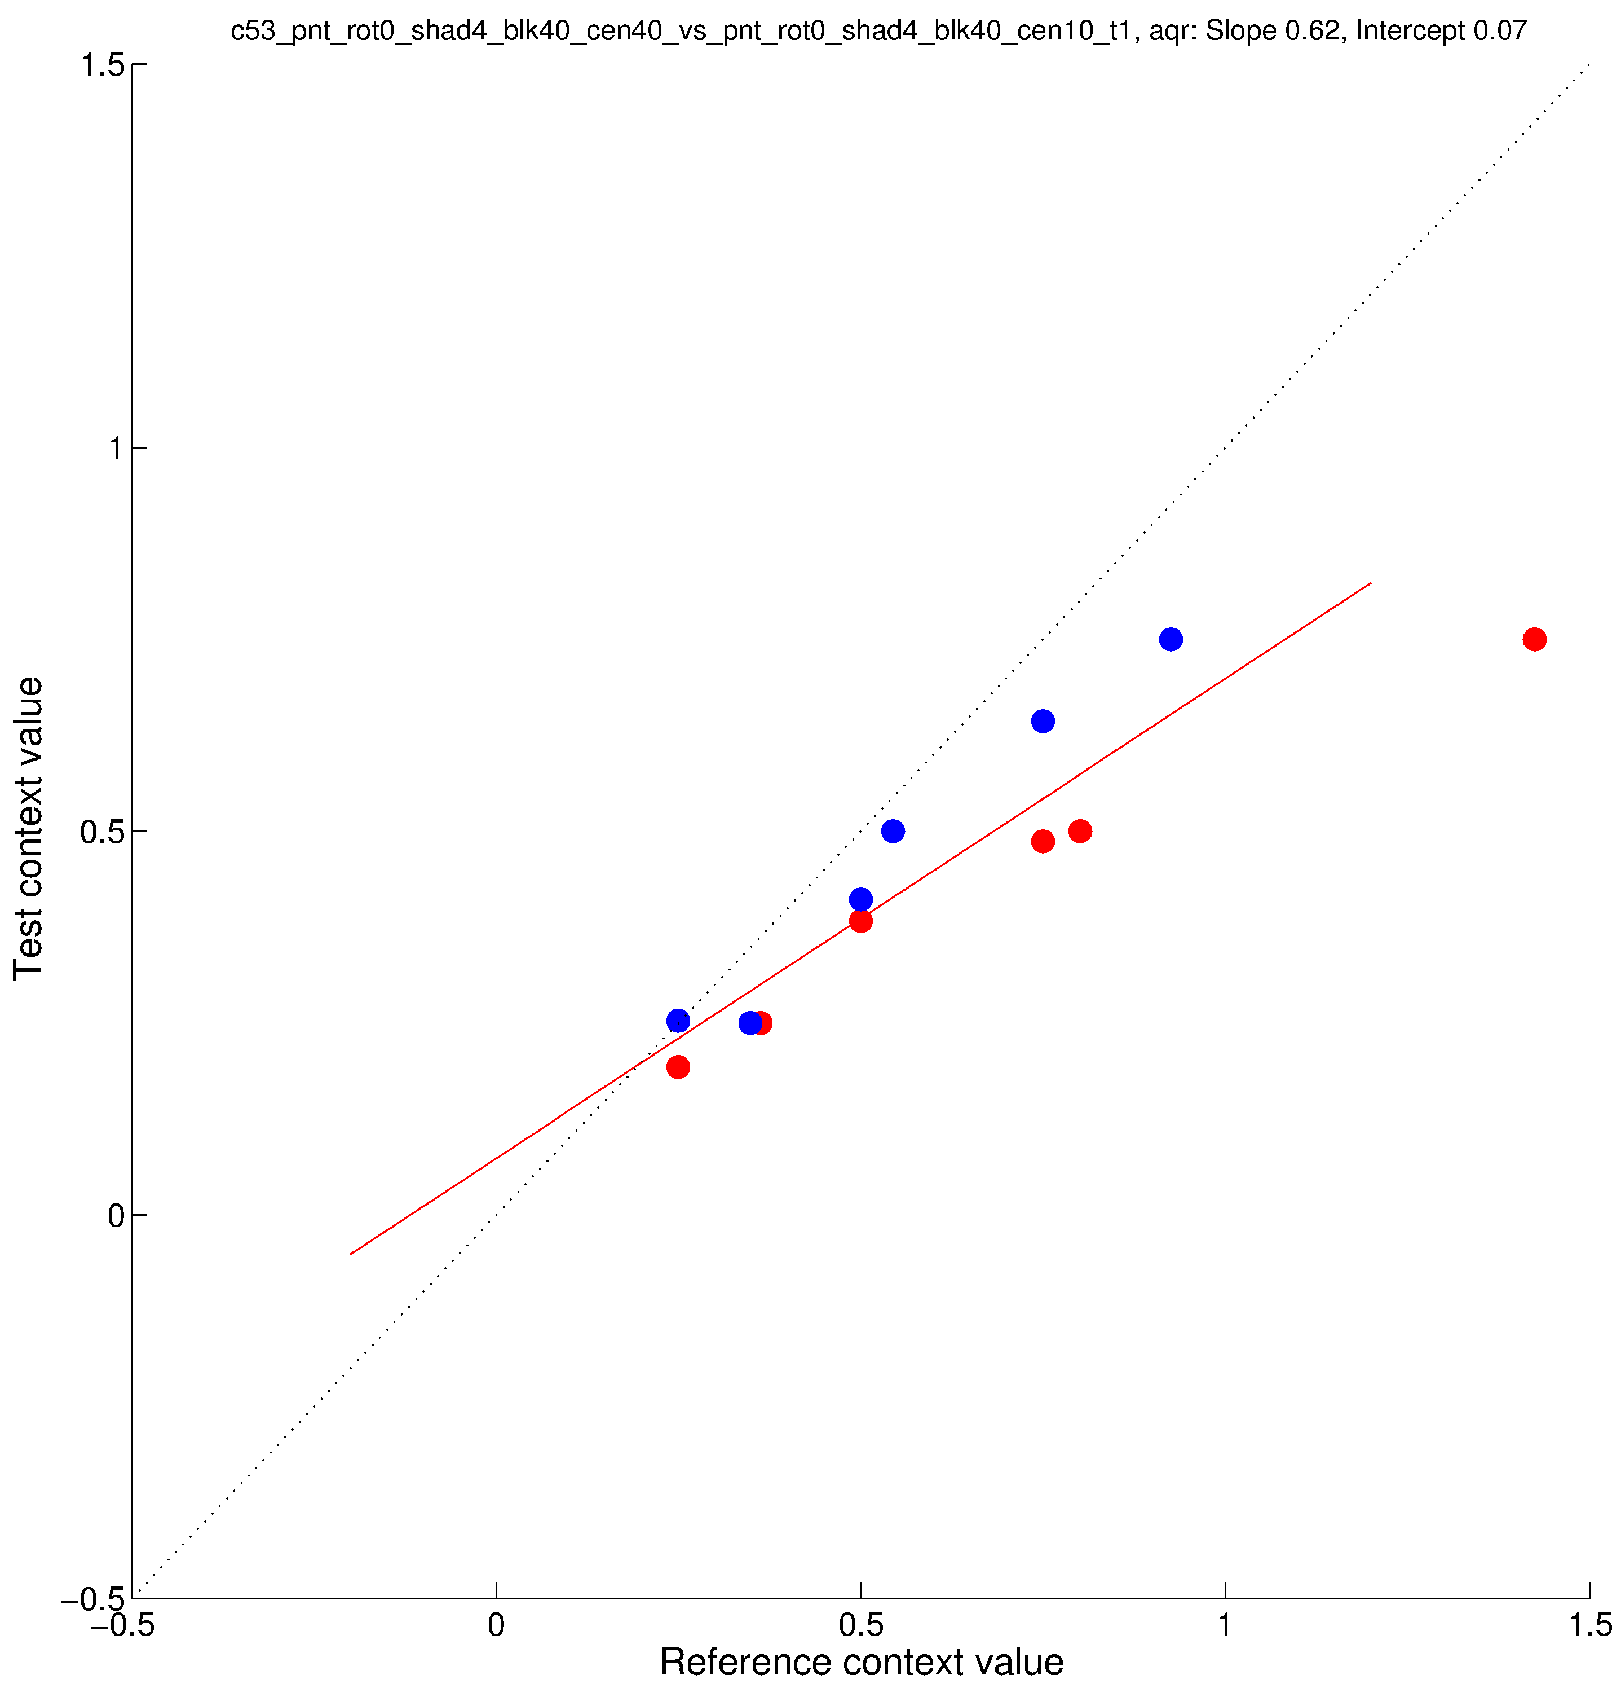
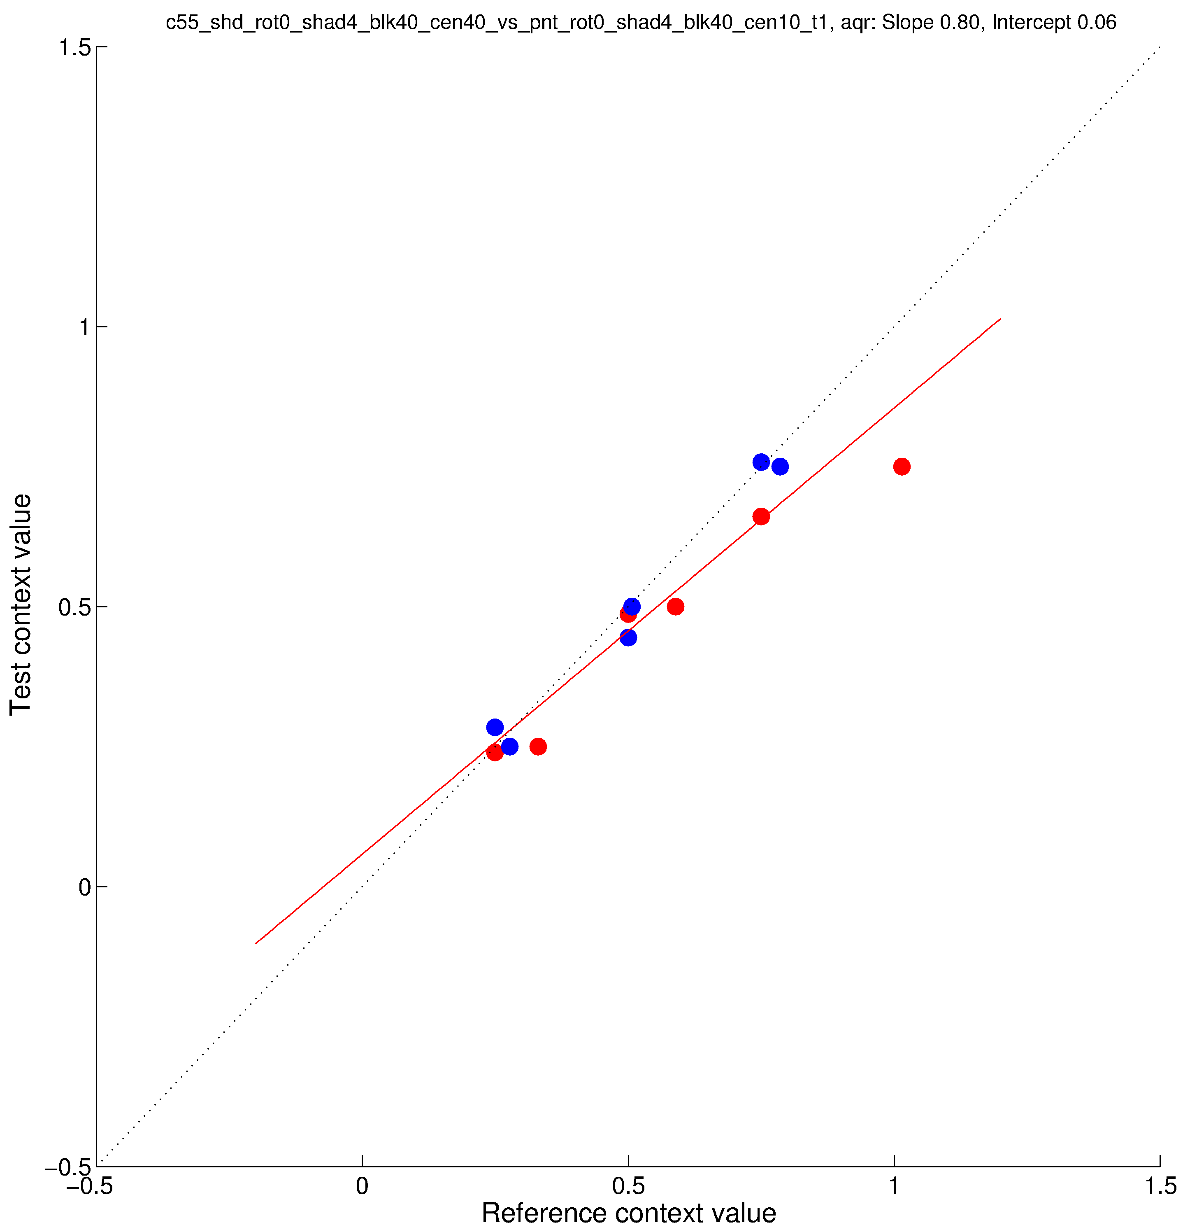
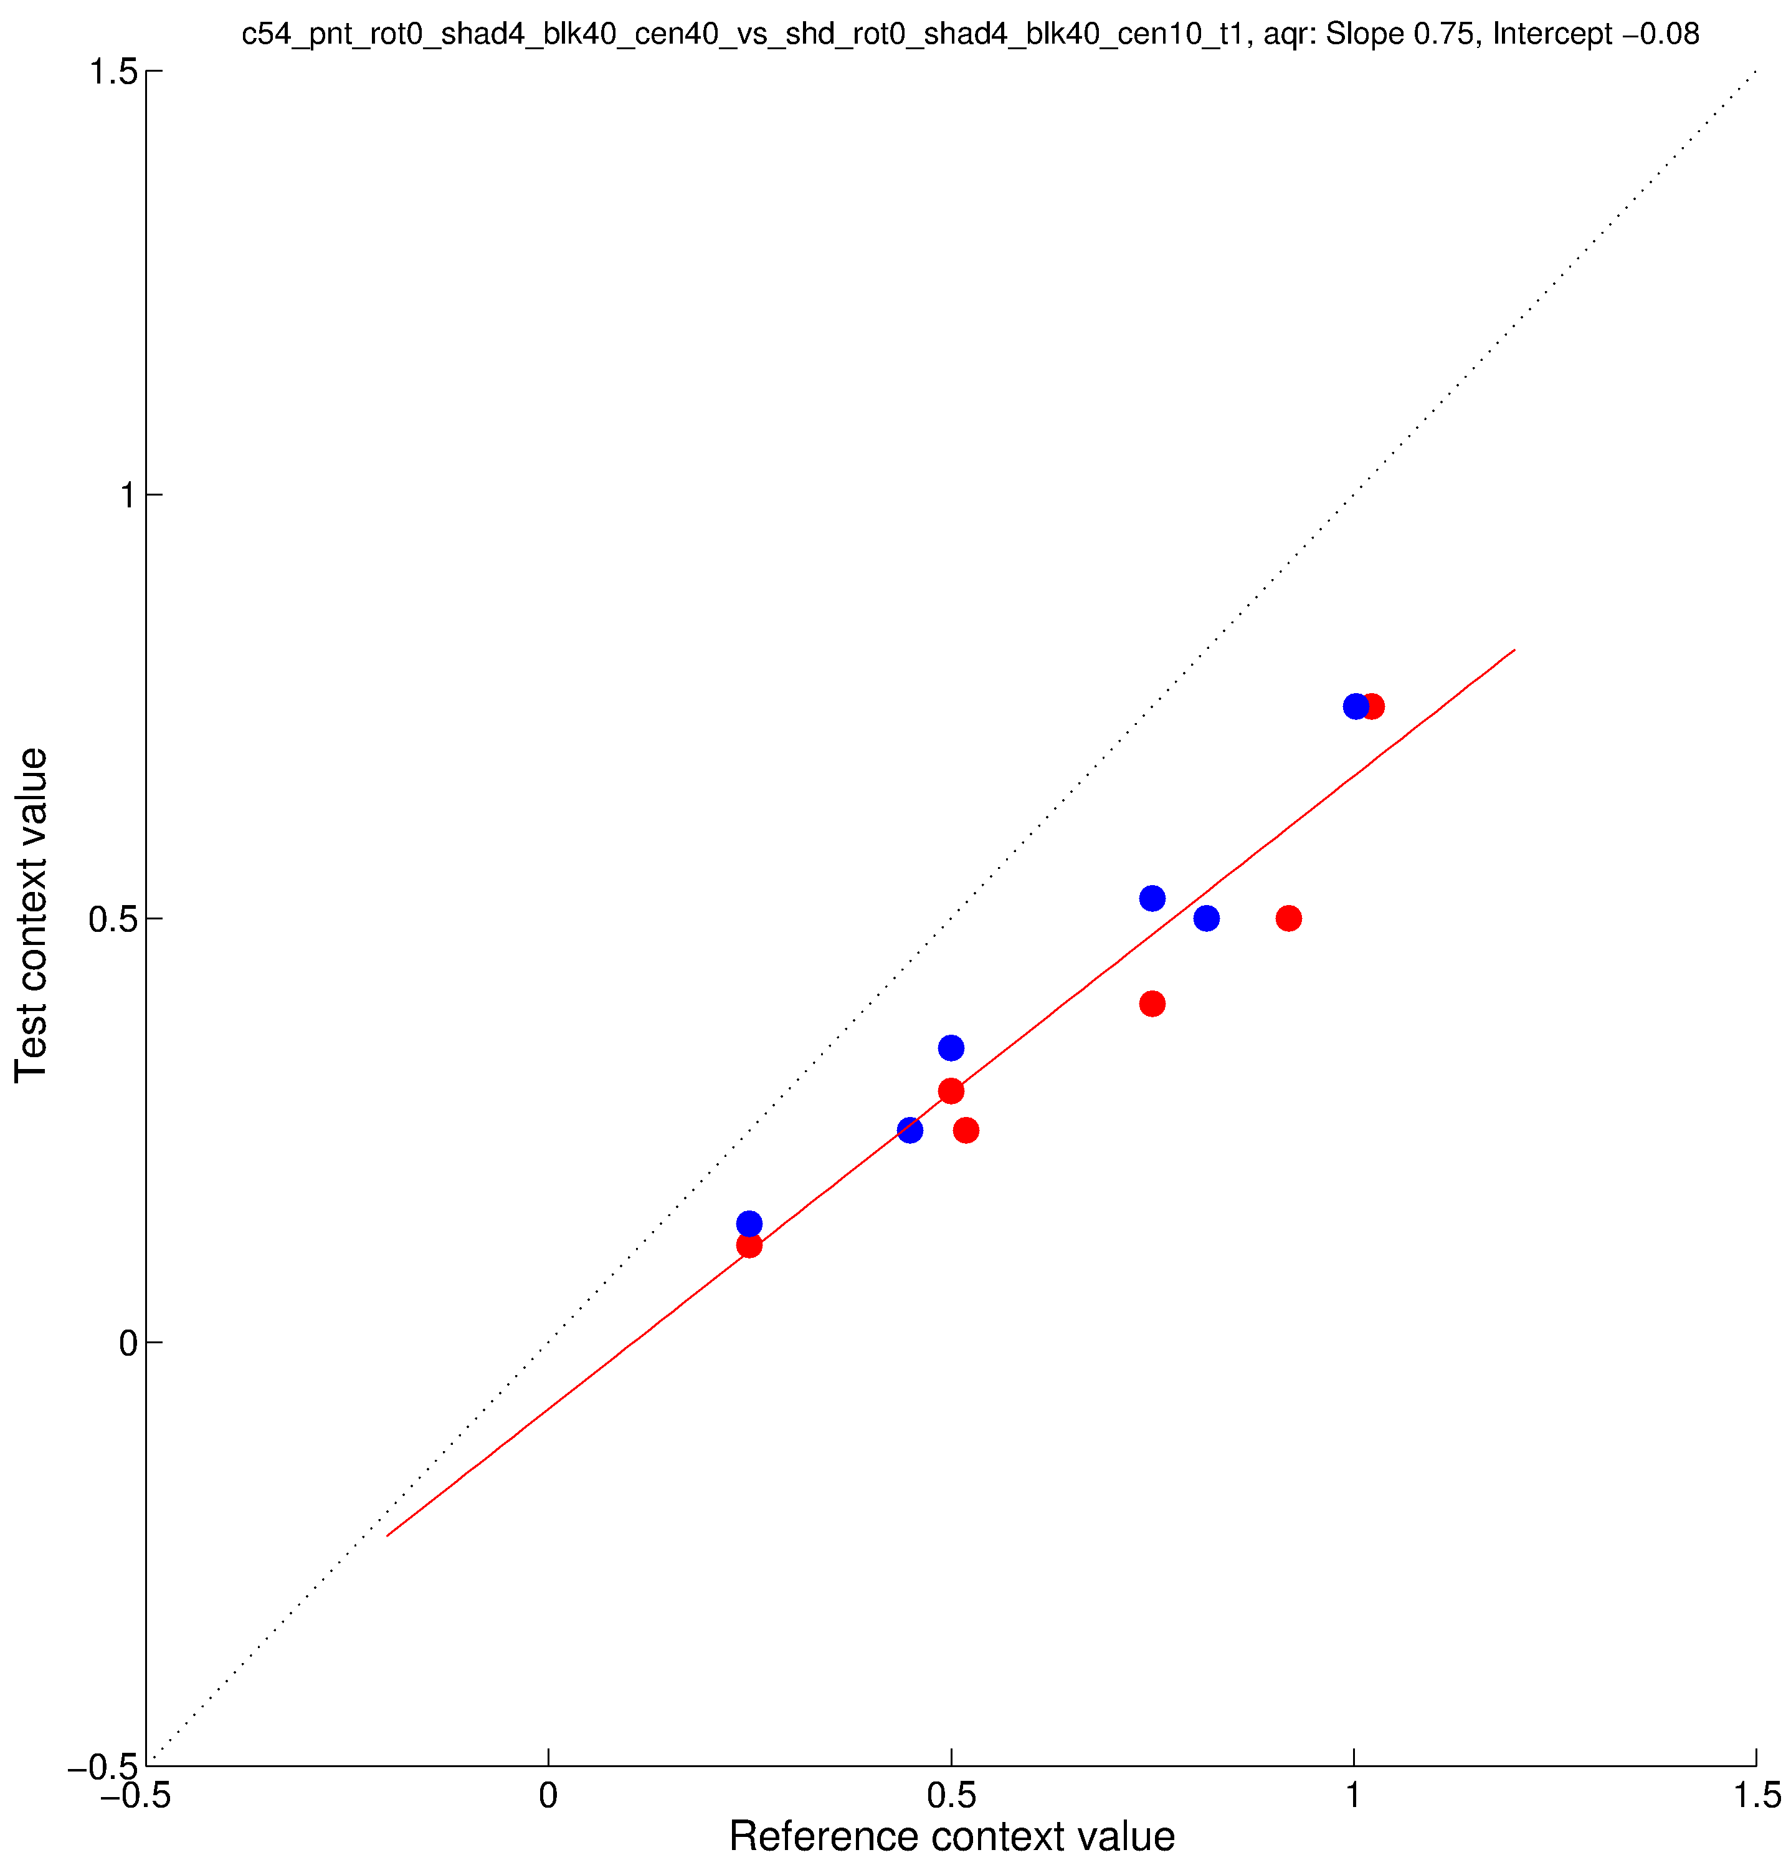
parametricConditions3, AQR
Conditions 51 and 52 are same as parametricConditions2 31 and 32 (“original” paint/shadow).
Conditions 53 and 54 are “new” paint/shadow as test, “original” paint as reference.
Conditon 55 has “new” paint as test, “original” shadow as reference.

Slide 5
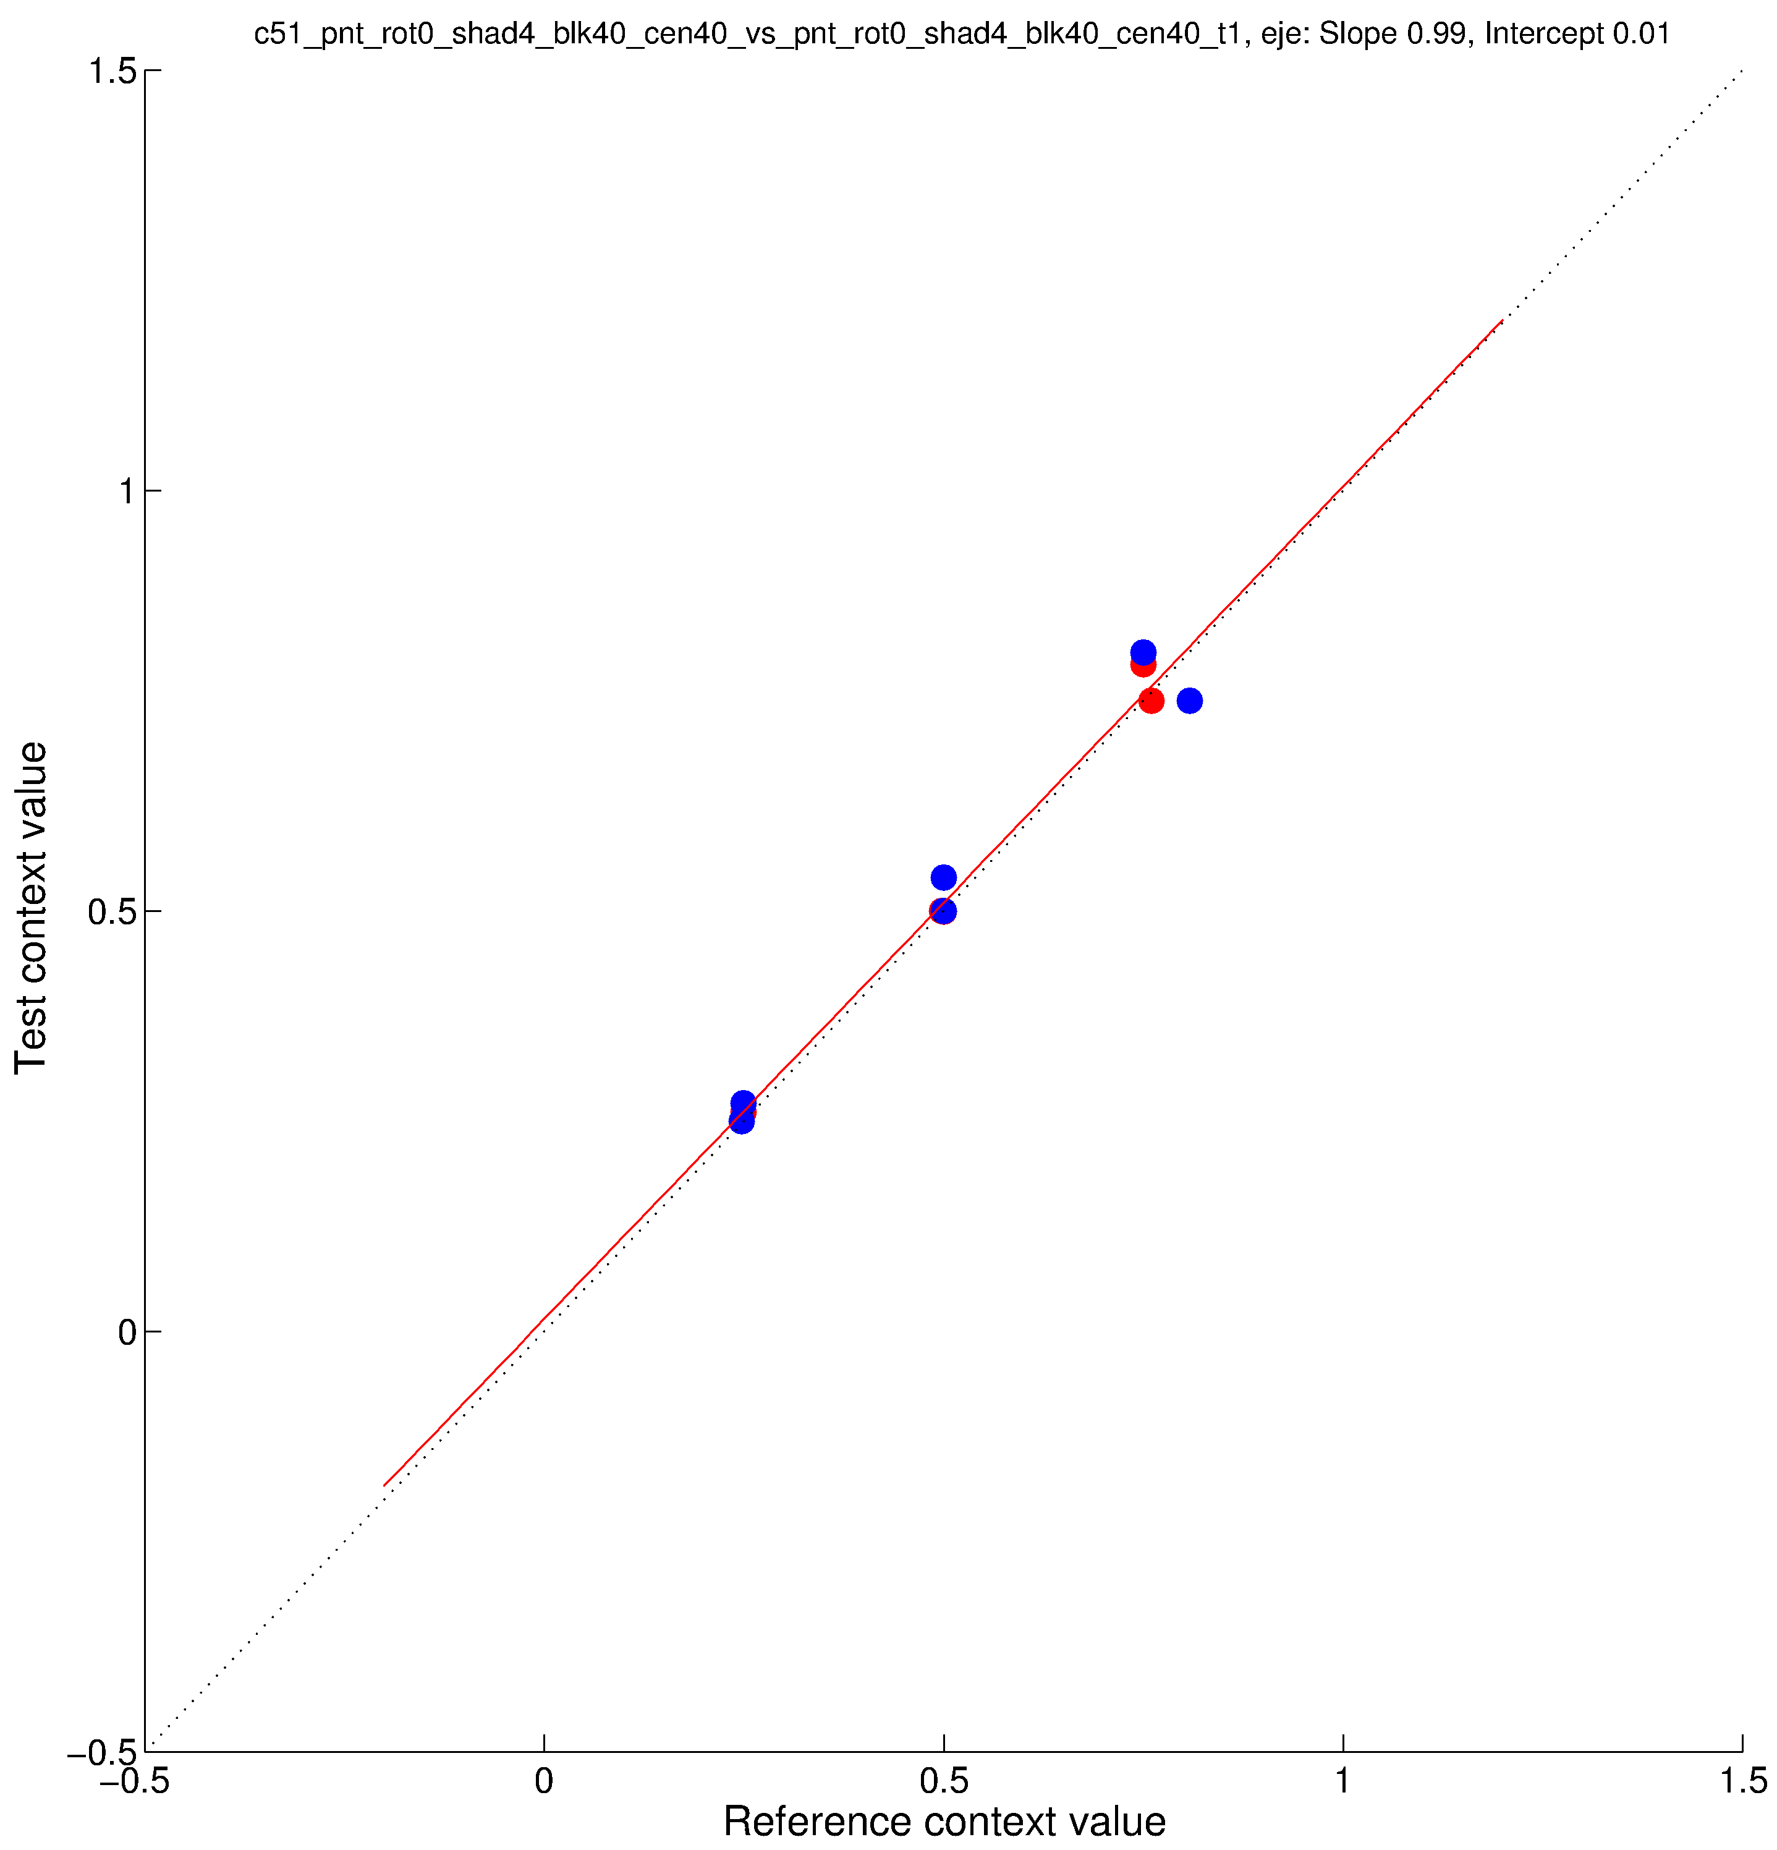
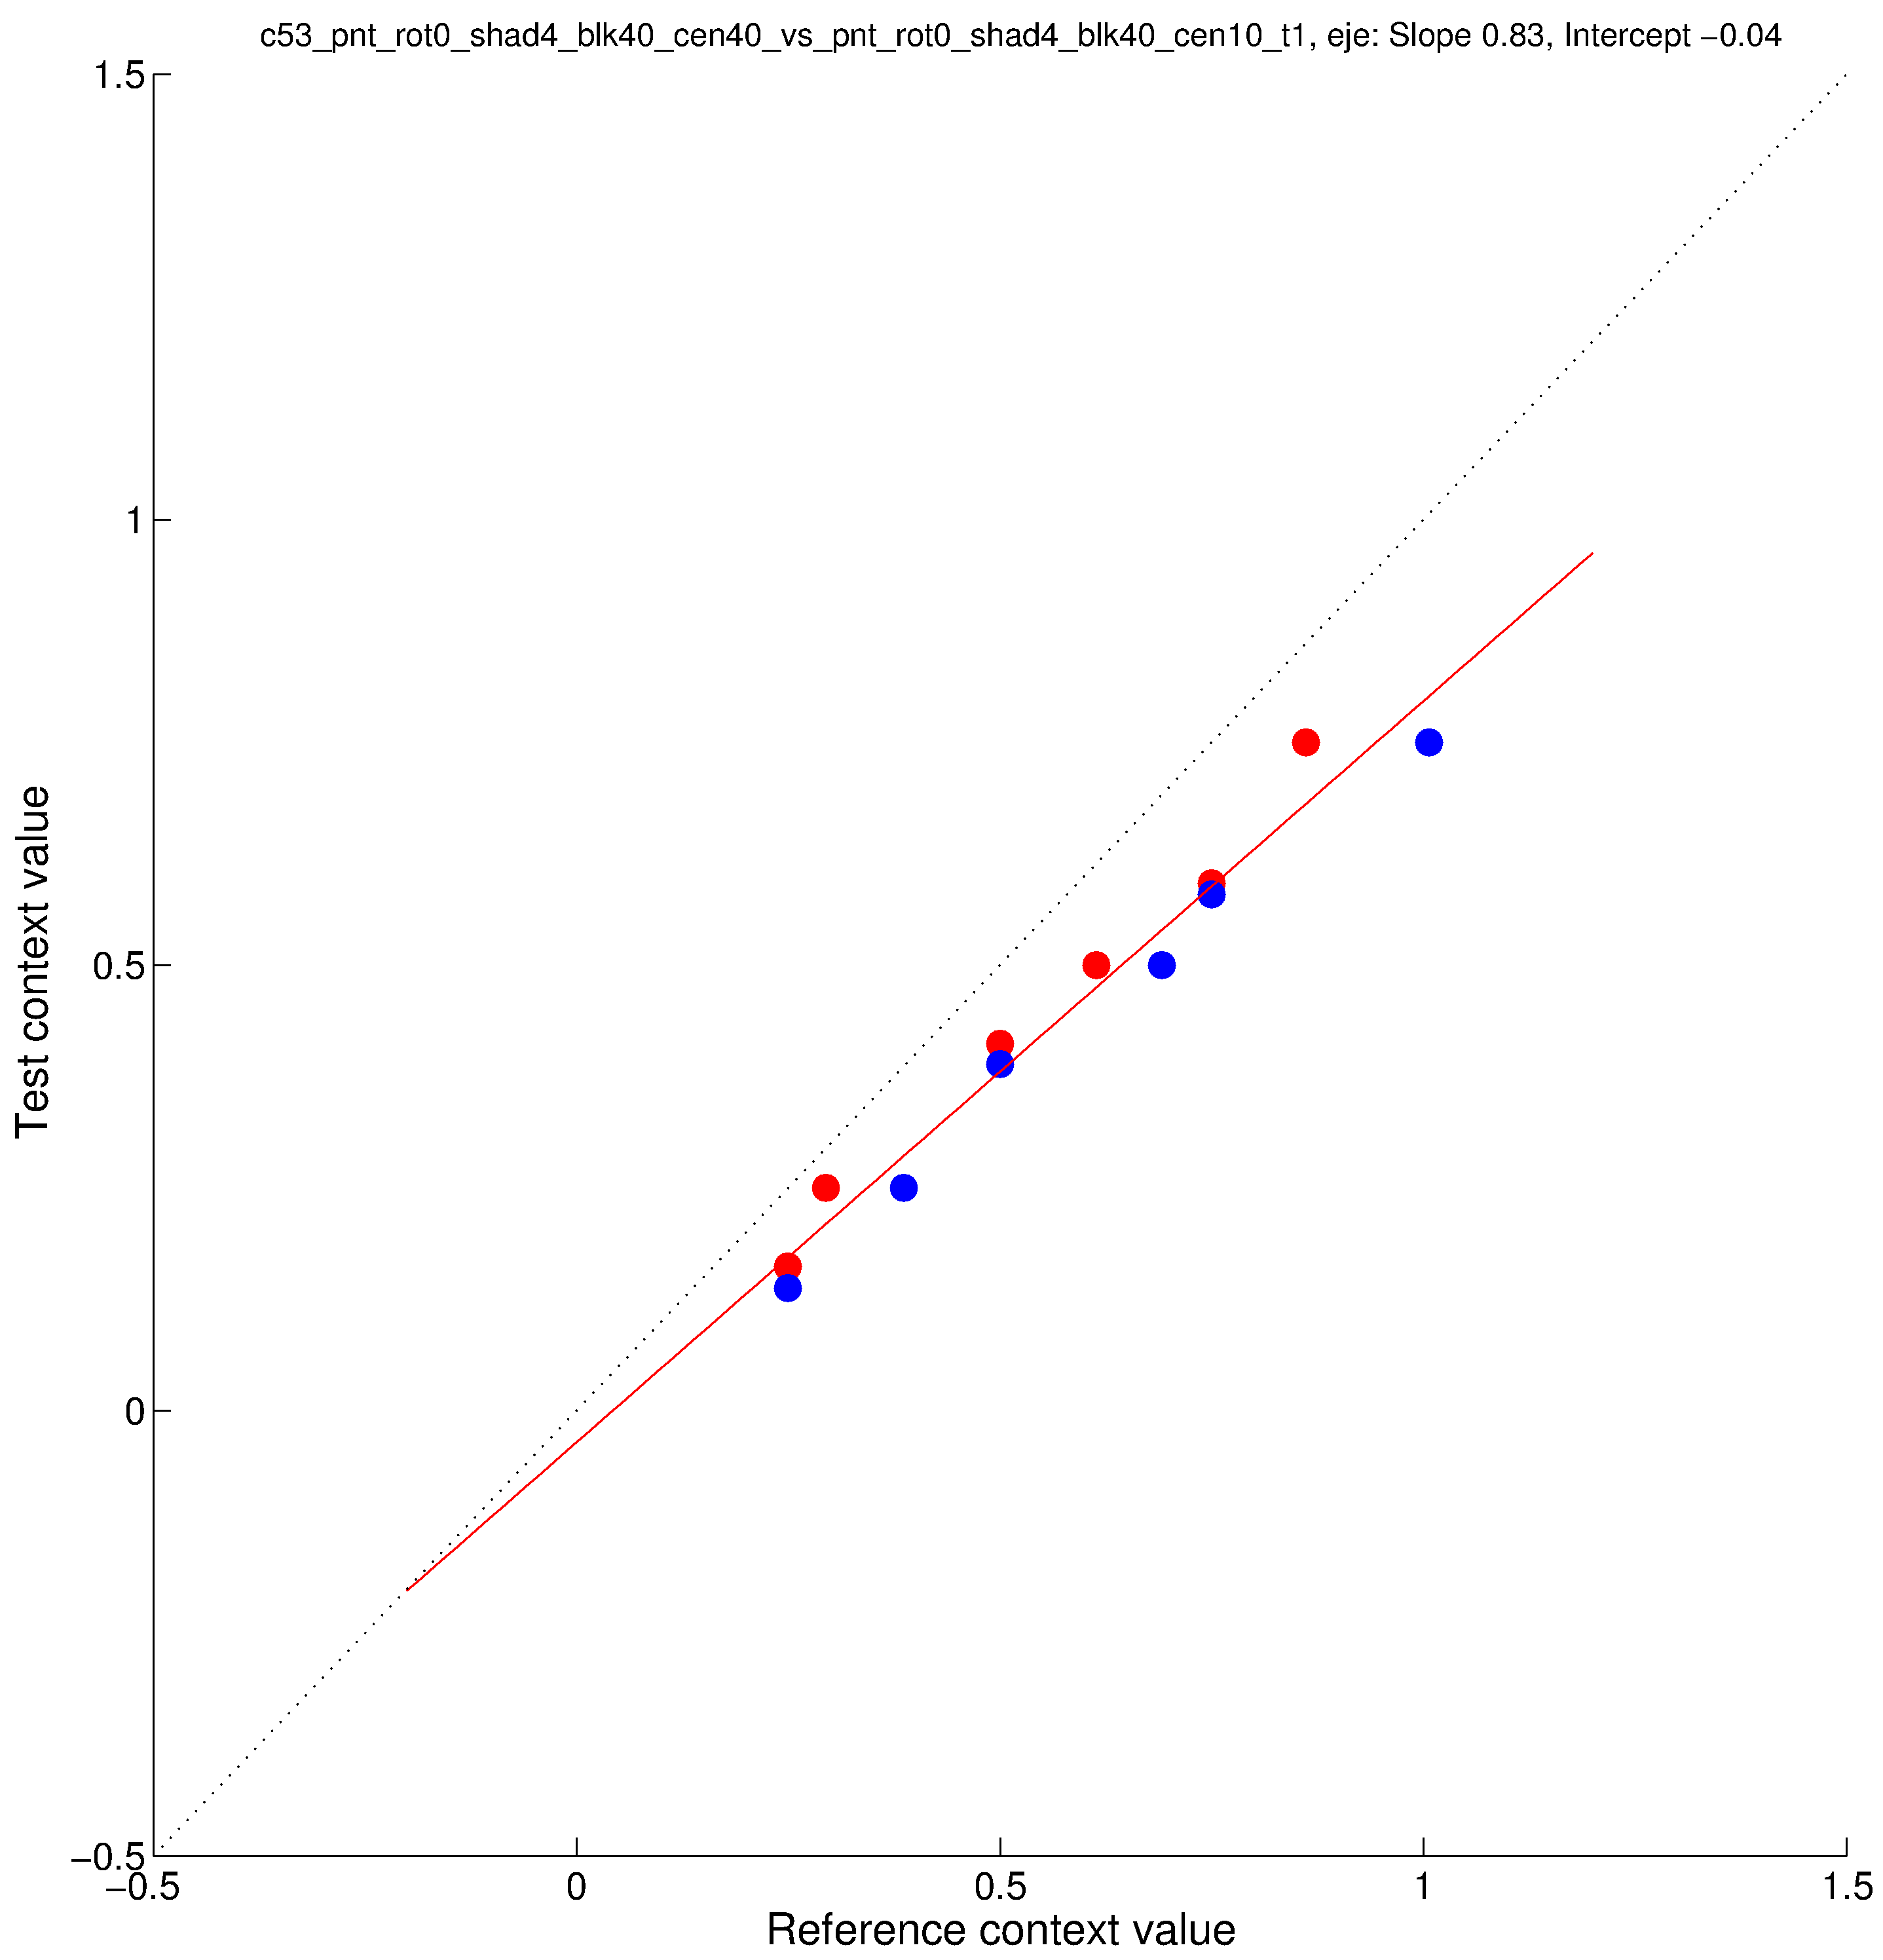
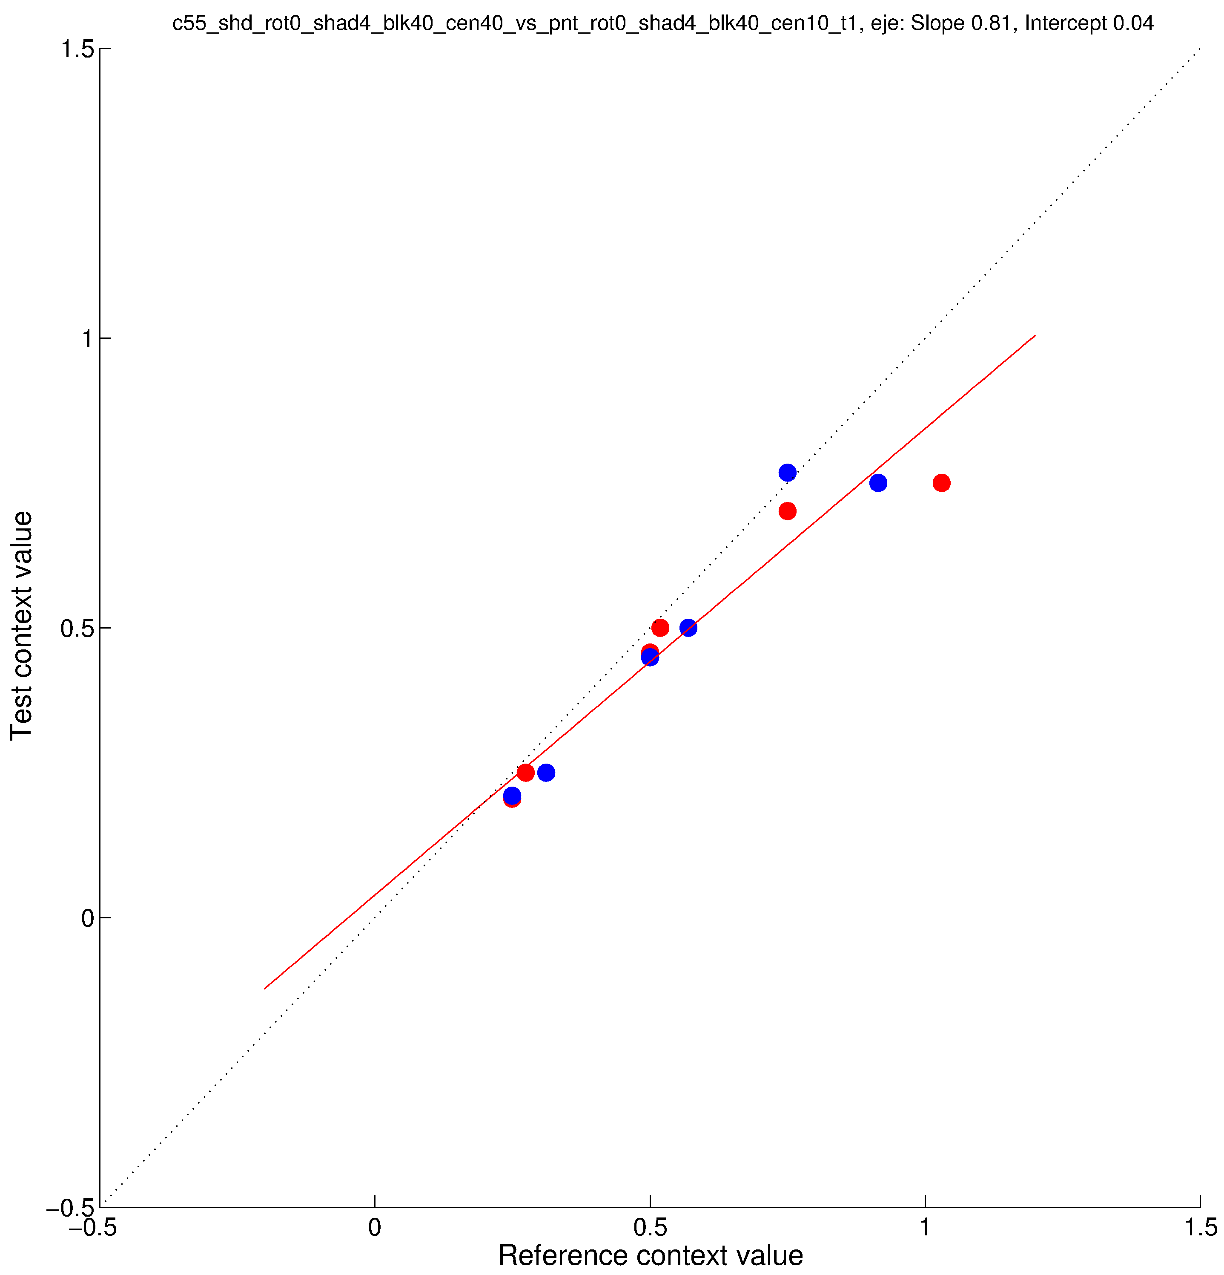
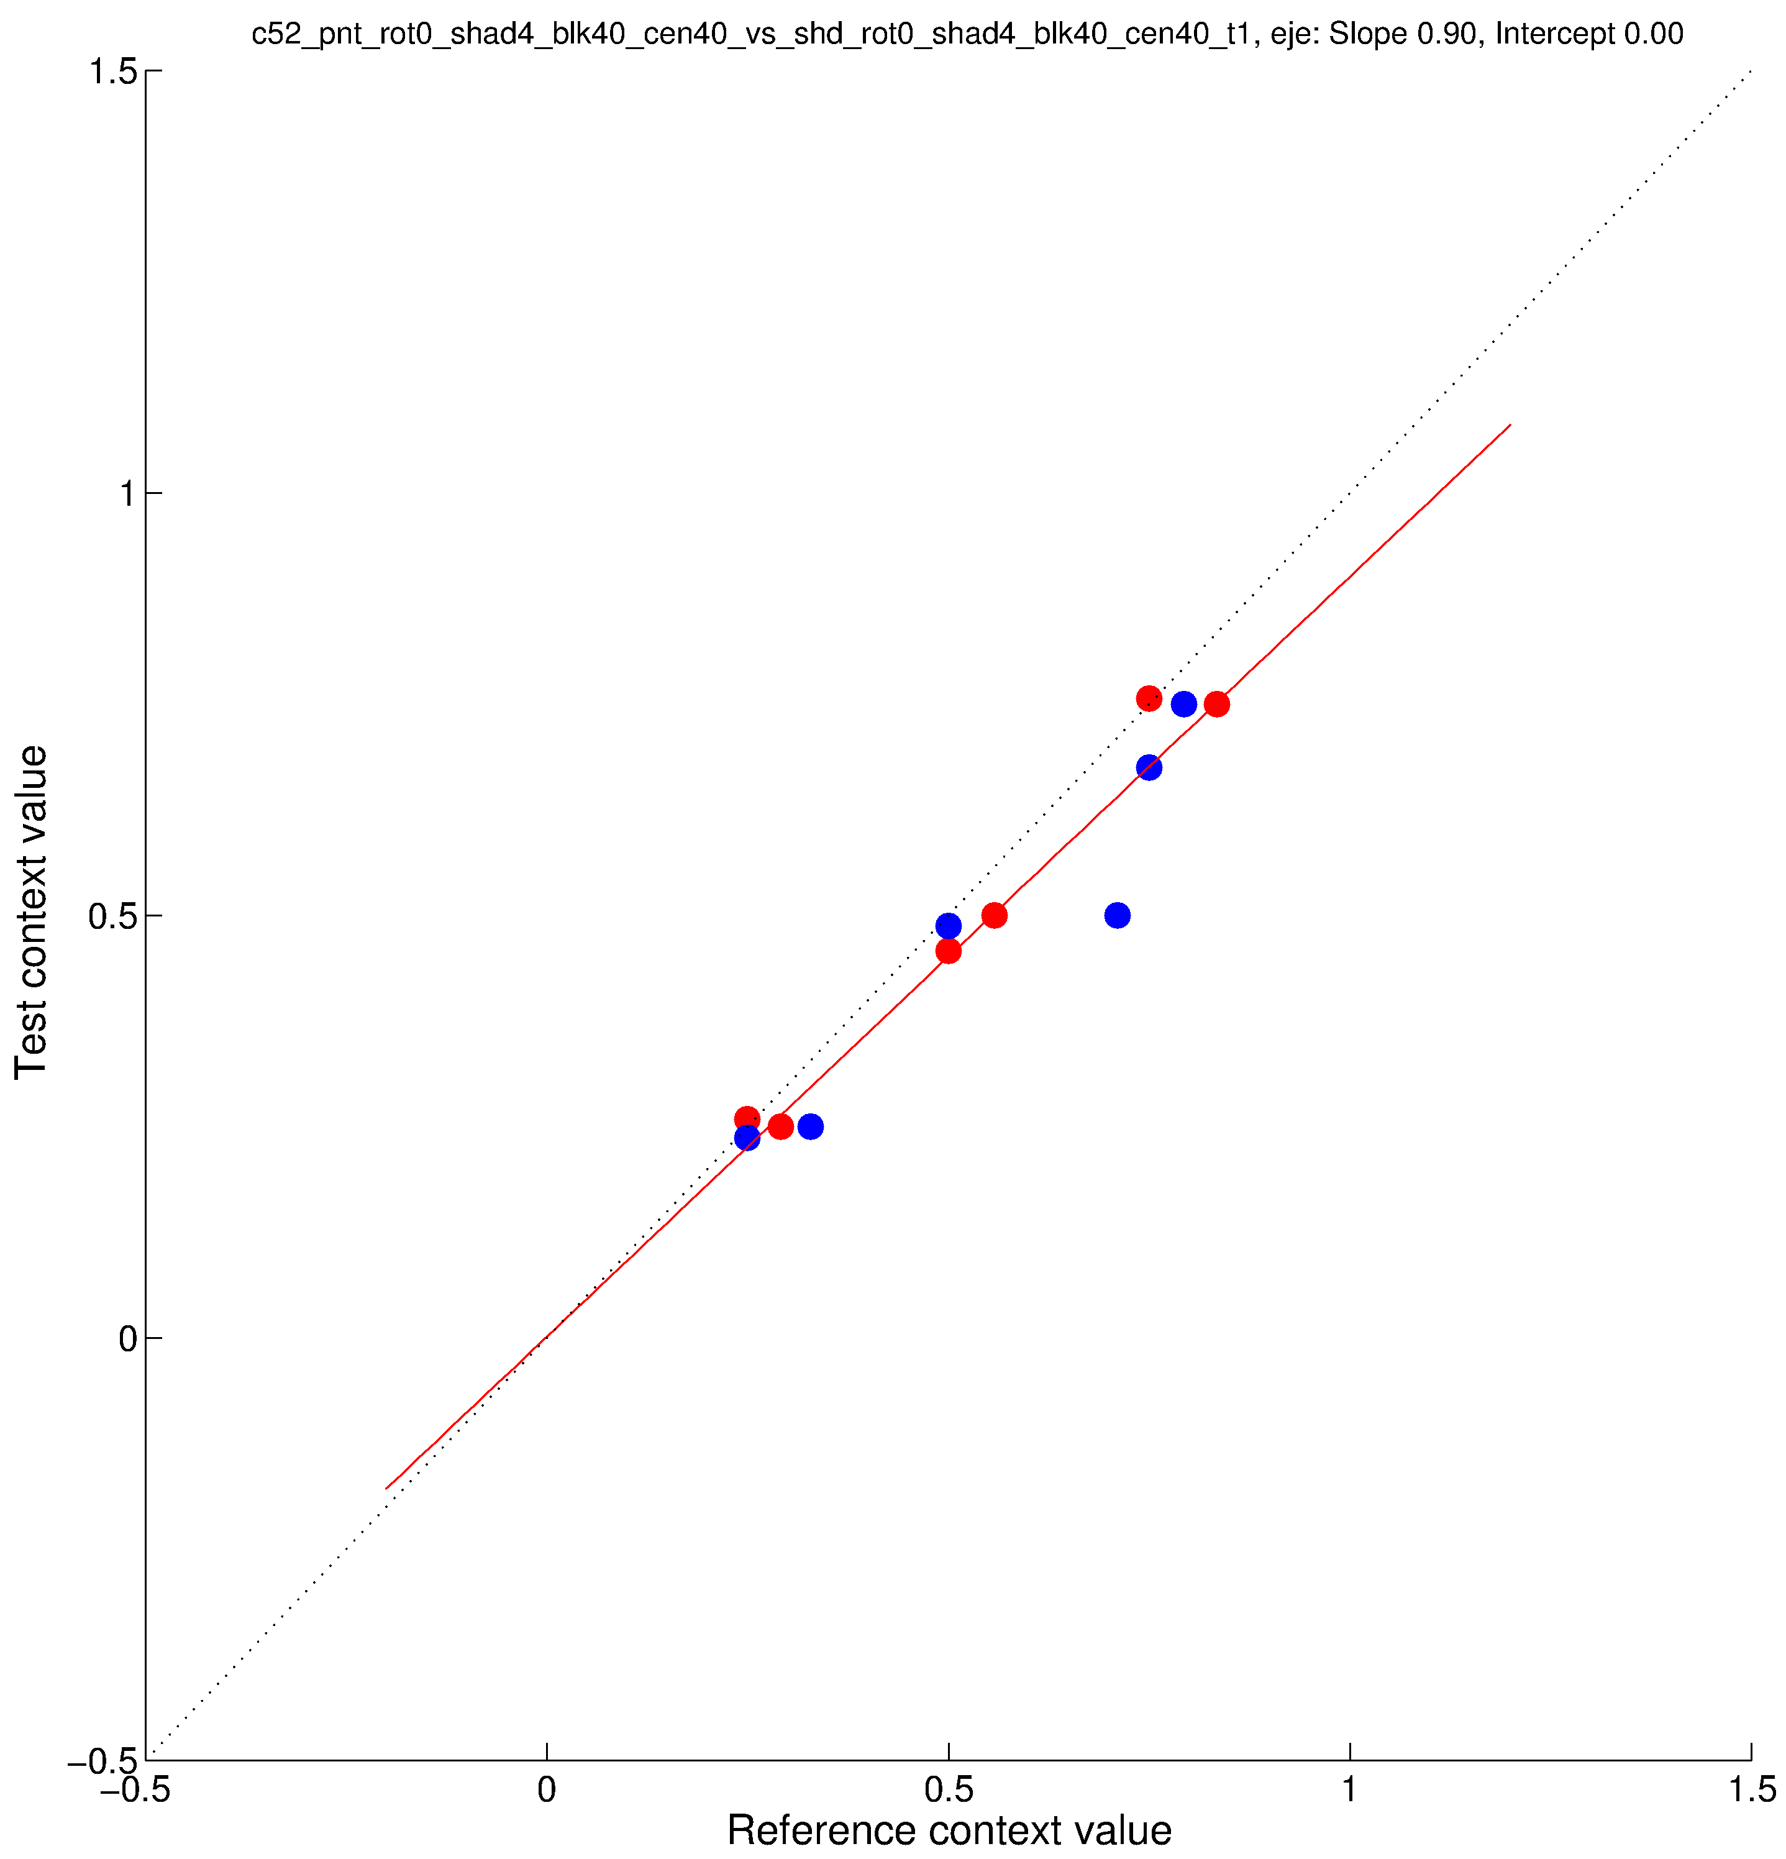
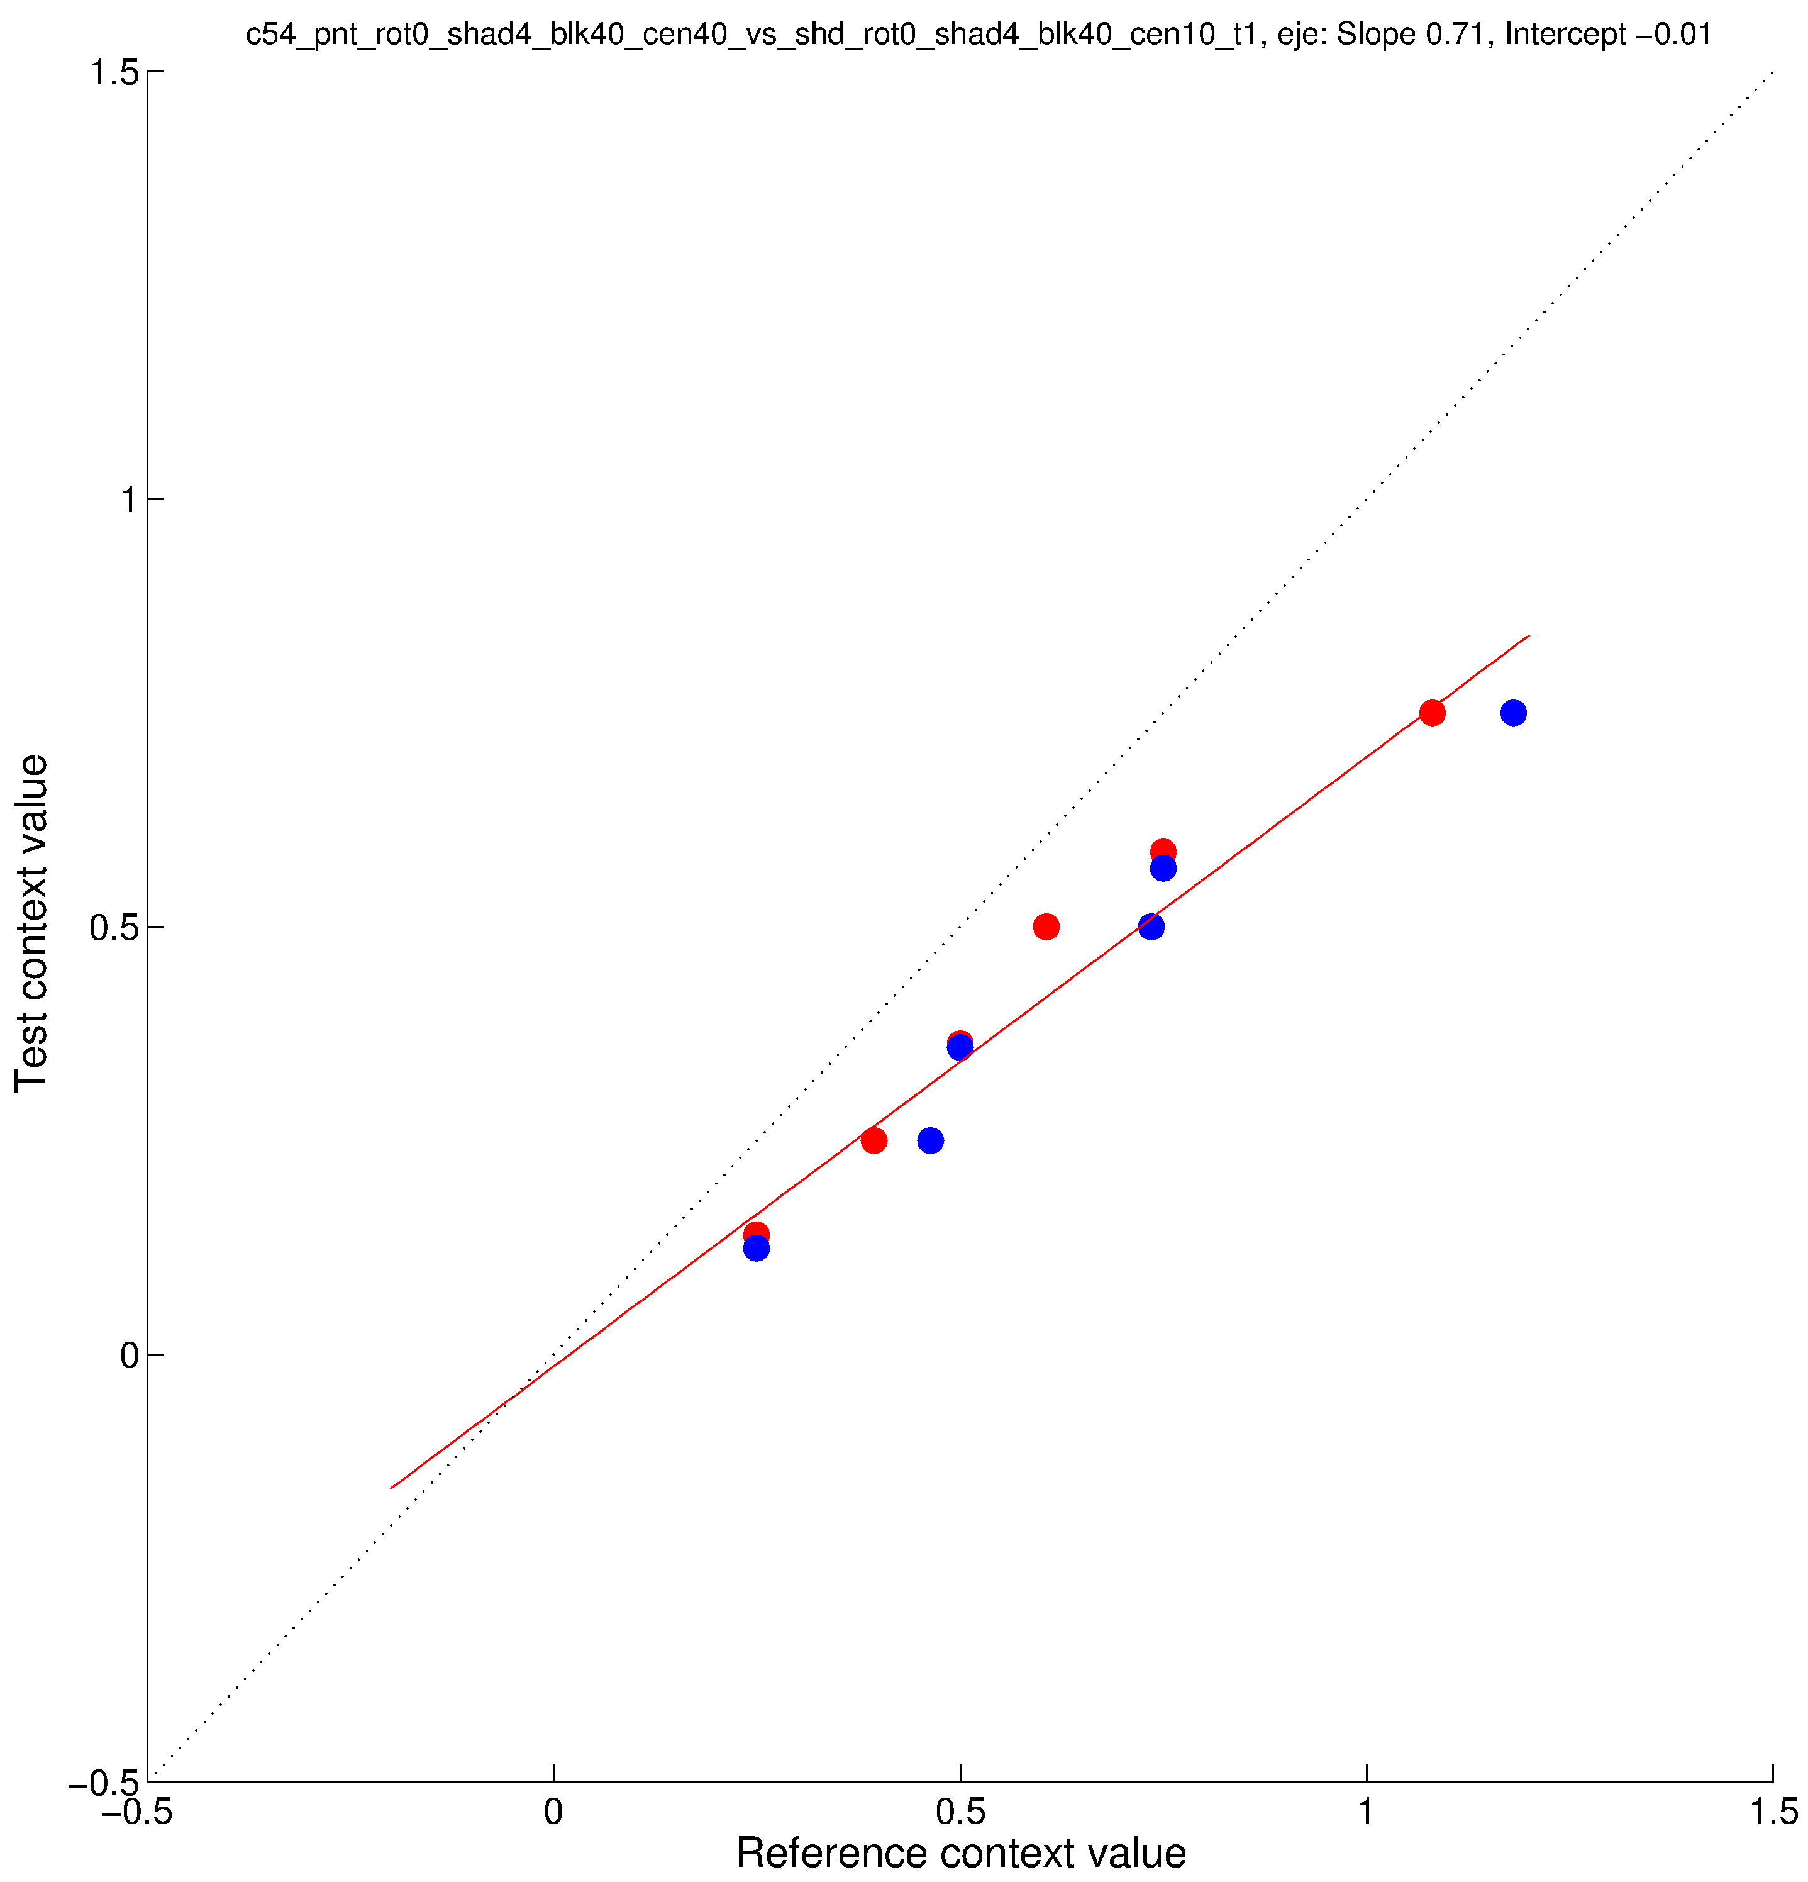
parametricConditions3, EJE
Conditions 51 and 52 are same as parametricConditions2 31 and 32 (“original” paint/shadow).
Conditions 53 and 54 are “new” paint/shadow as test, “original” paint as reference.
Conditon 55 has “new” paint as test, “original” shadow as reference.

Slide 6
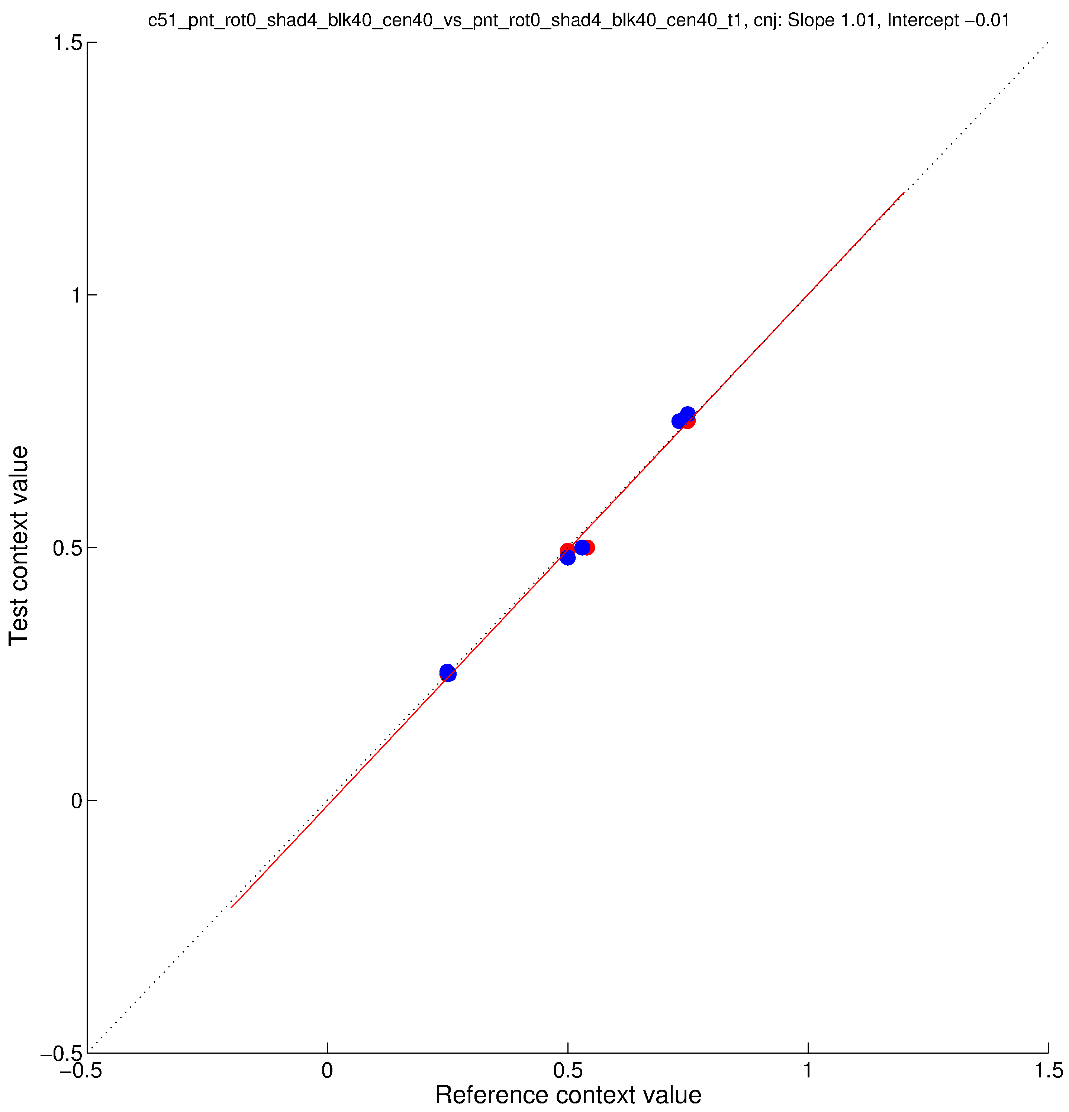
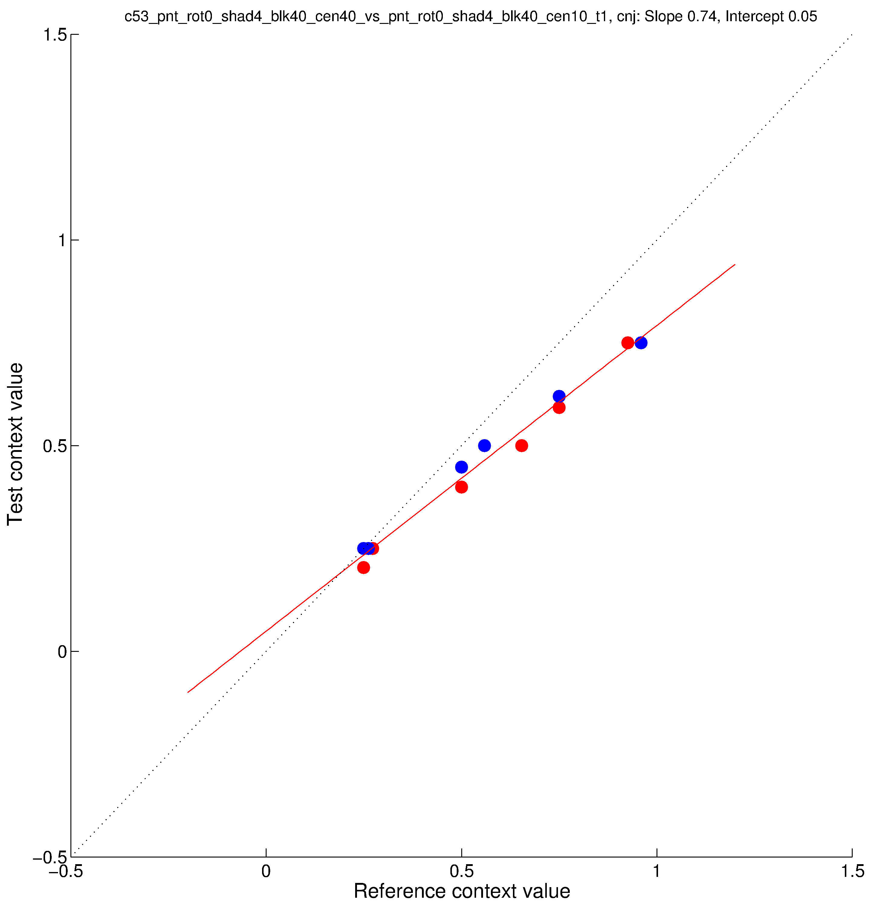
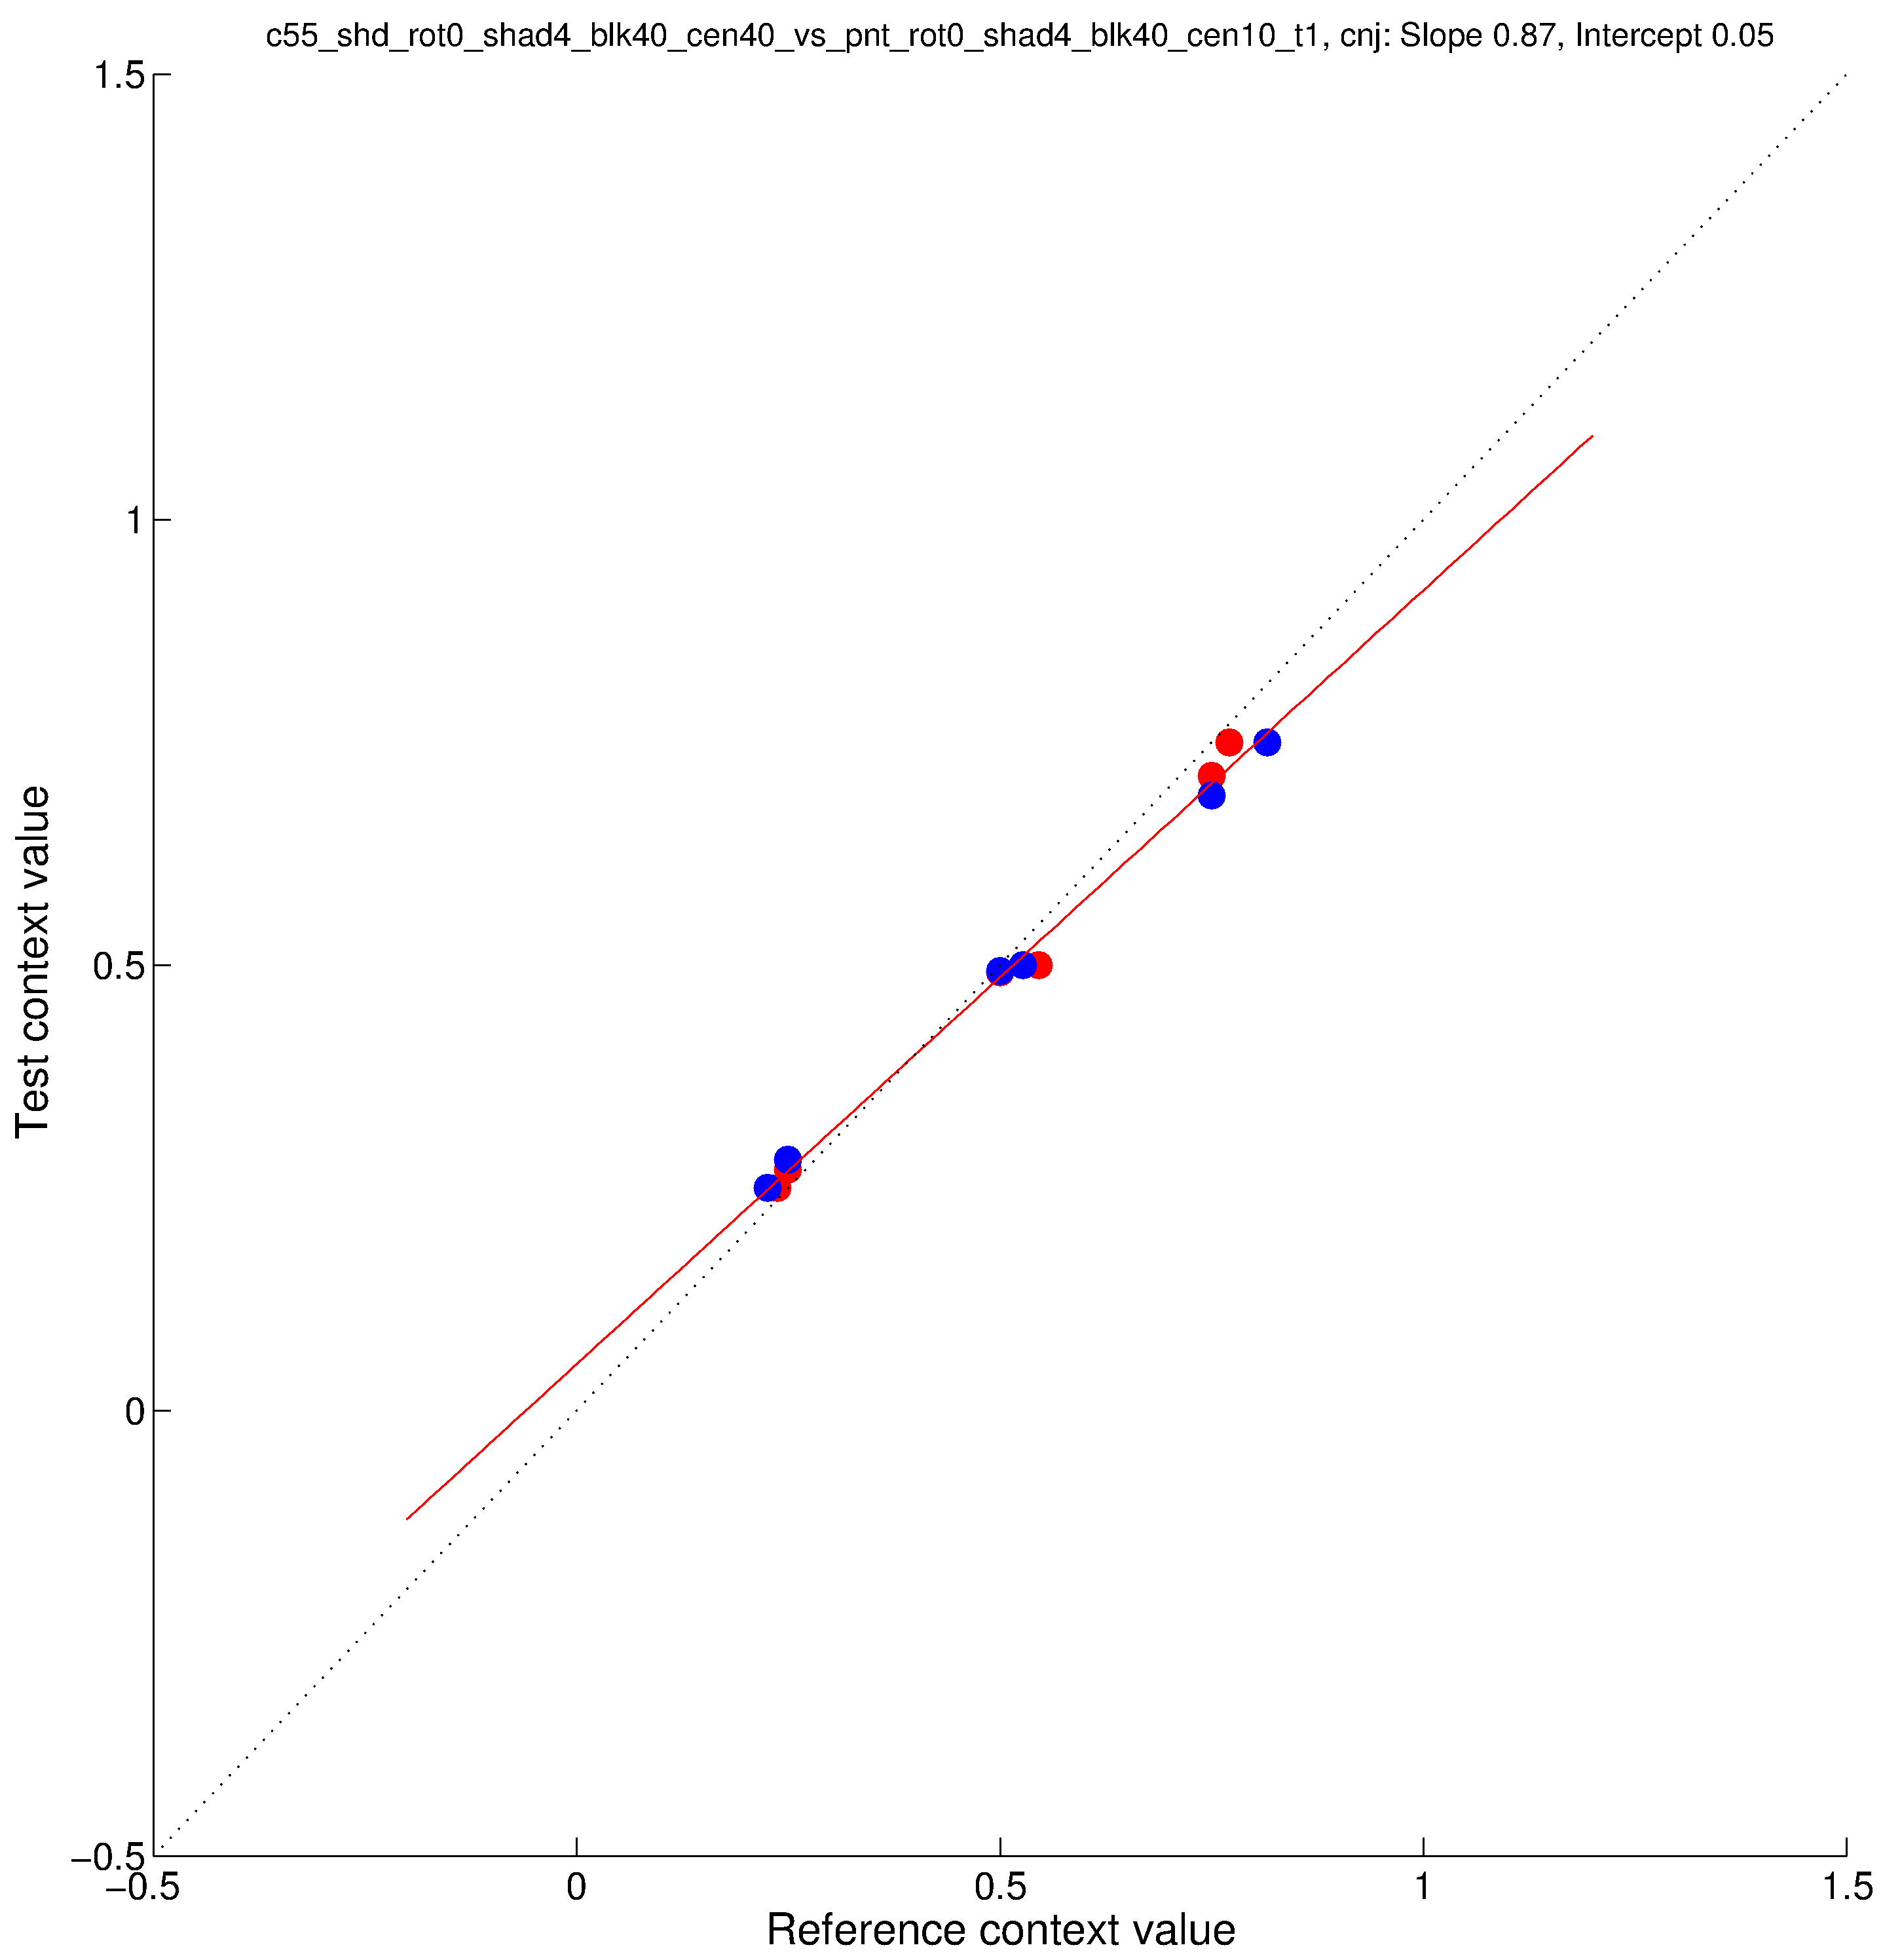
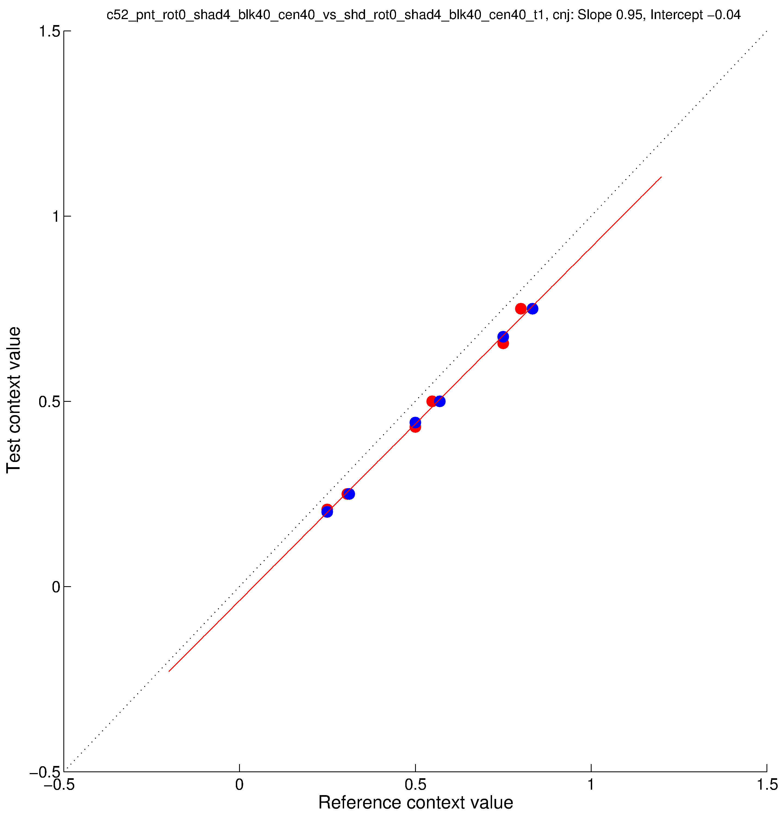
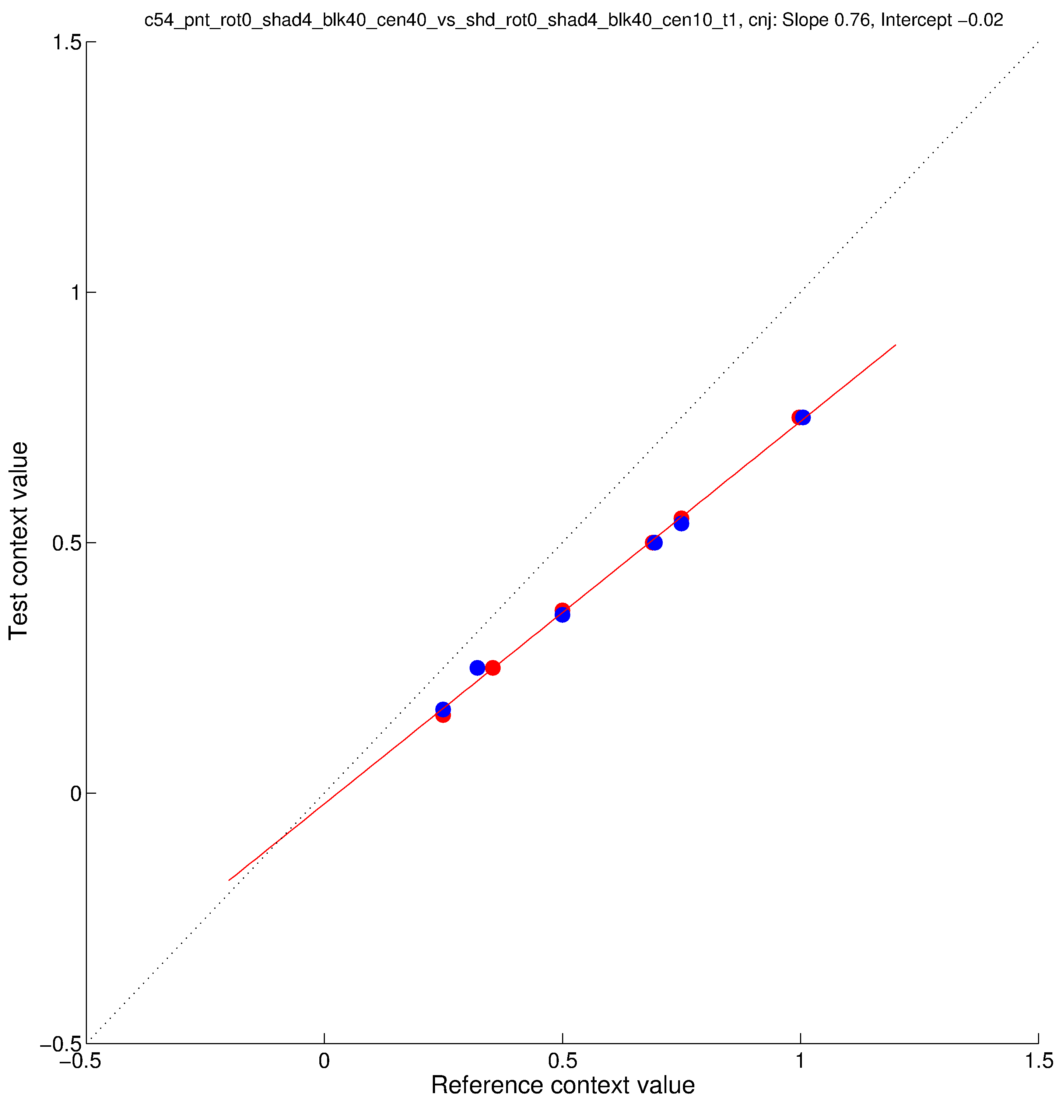
parametricConditions3, CNJ
Conditions 51 and 52 are same as parametricConditions2 31 and 32 (“original” paint/shadow).
Conditions 53 and 54 are “new” paint/shadow as test, “original” paint as reference.
Conditon 55 has “new” paint as test, “original” shadow as reference.

