Slide 1
Eimgs_rot0_shad4_blk40_cen40, parametricConditions2, paint is ref for all conditions, shadow is used in c32)
Gamma corrected, probe levels 25, 50, 75

Slide 2
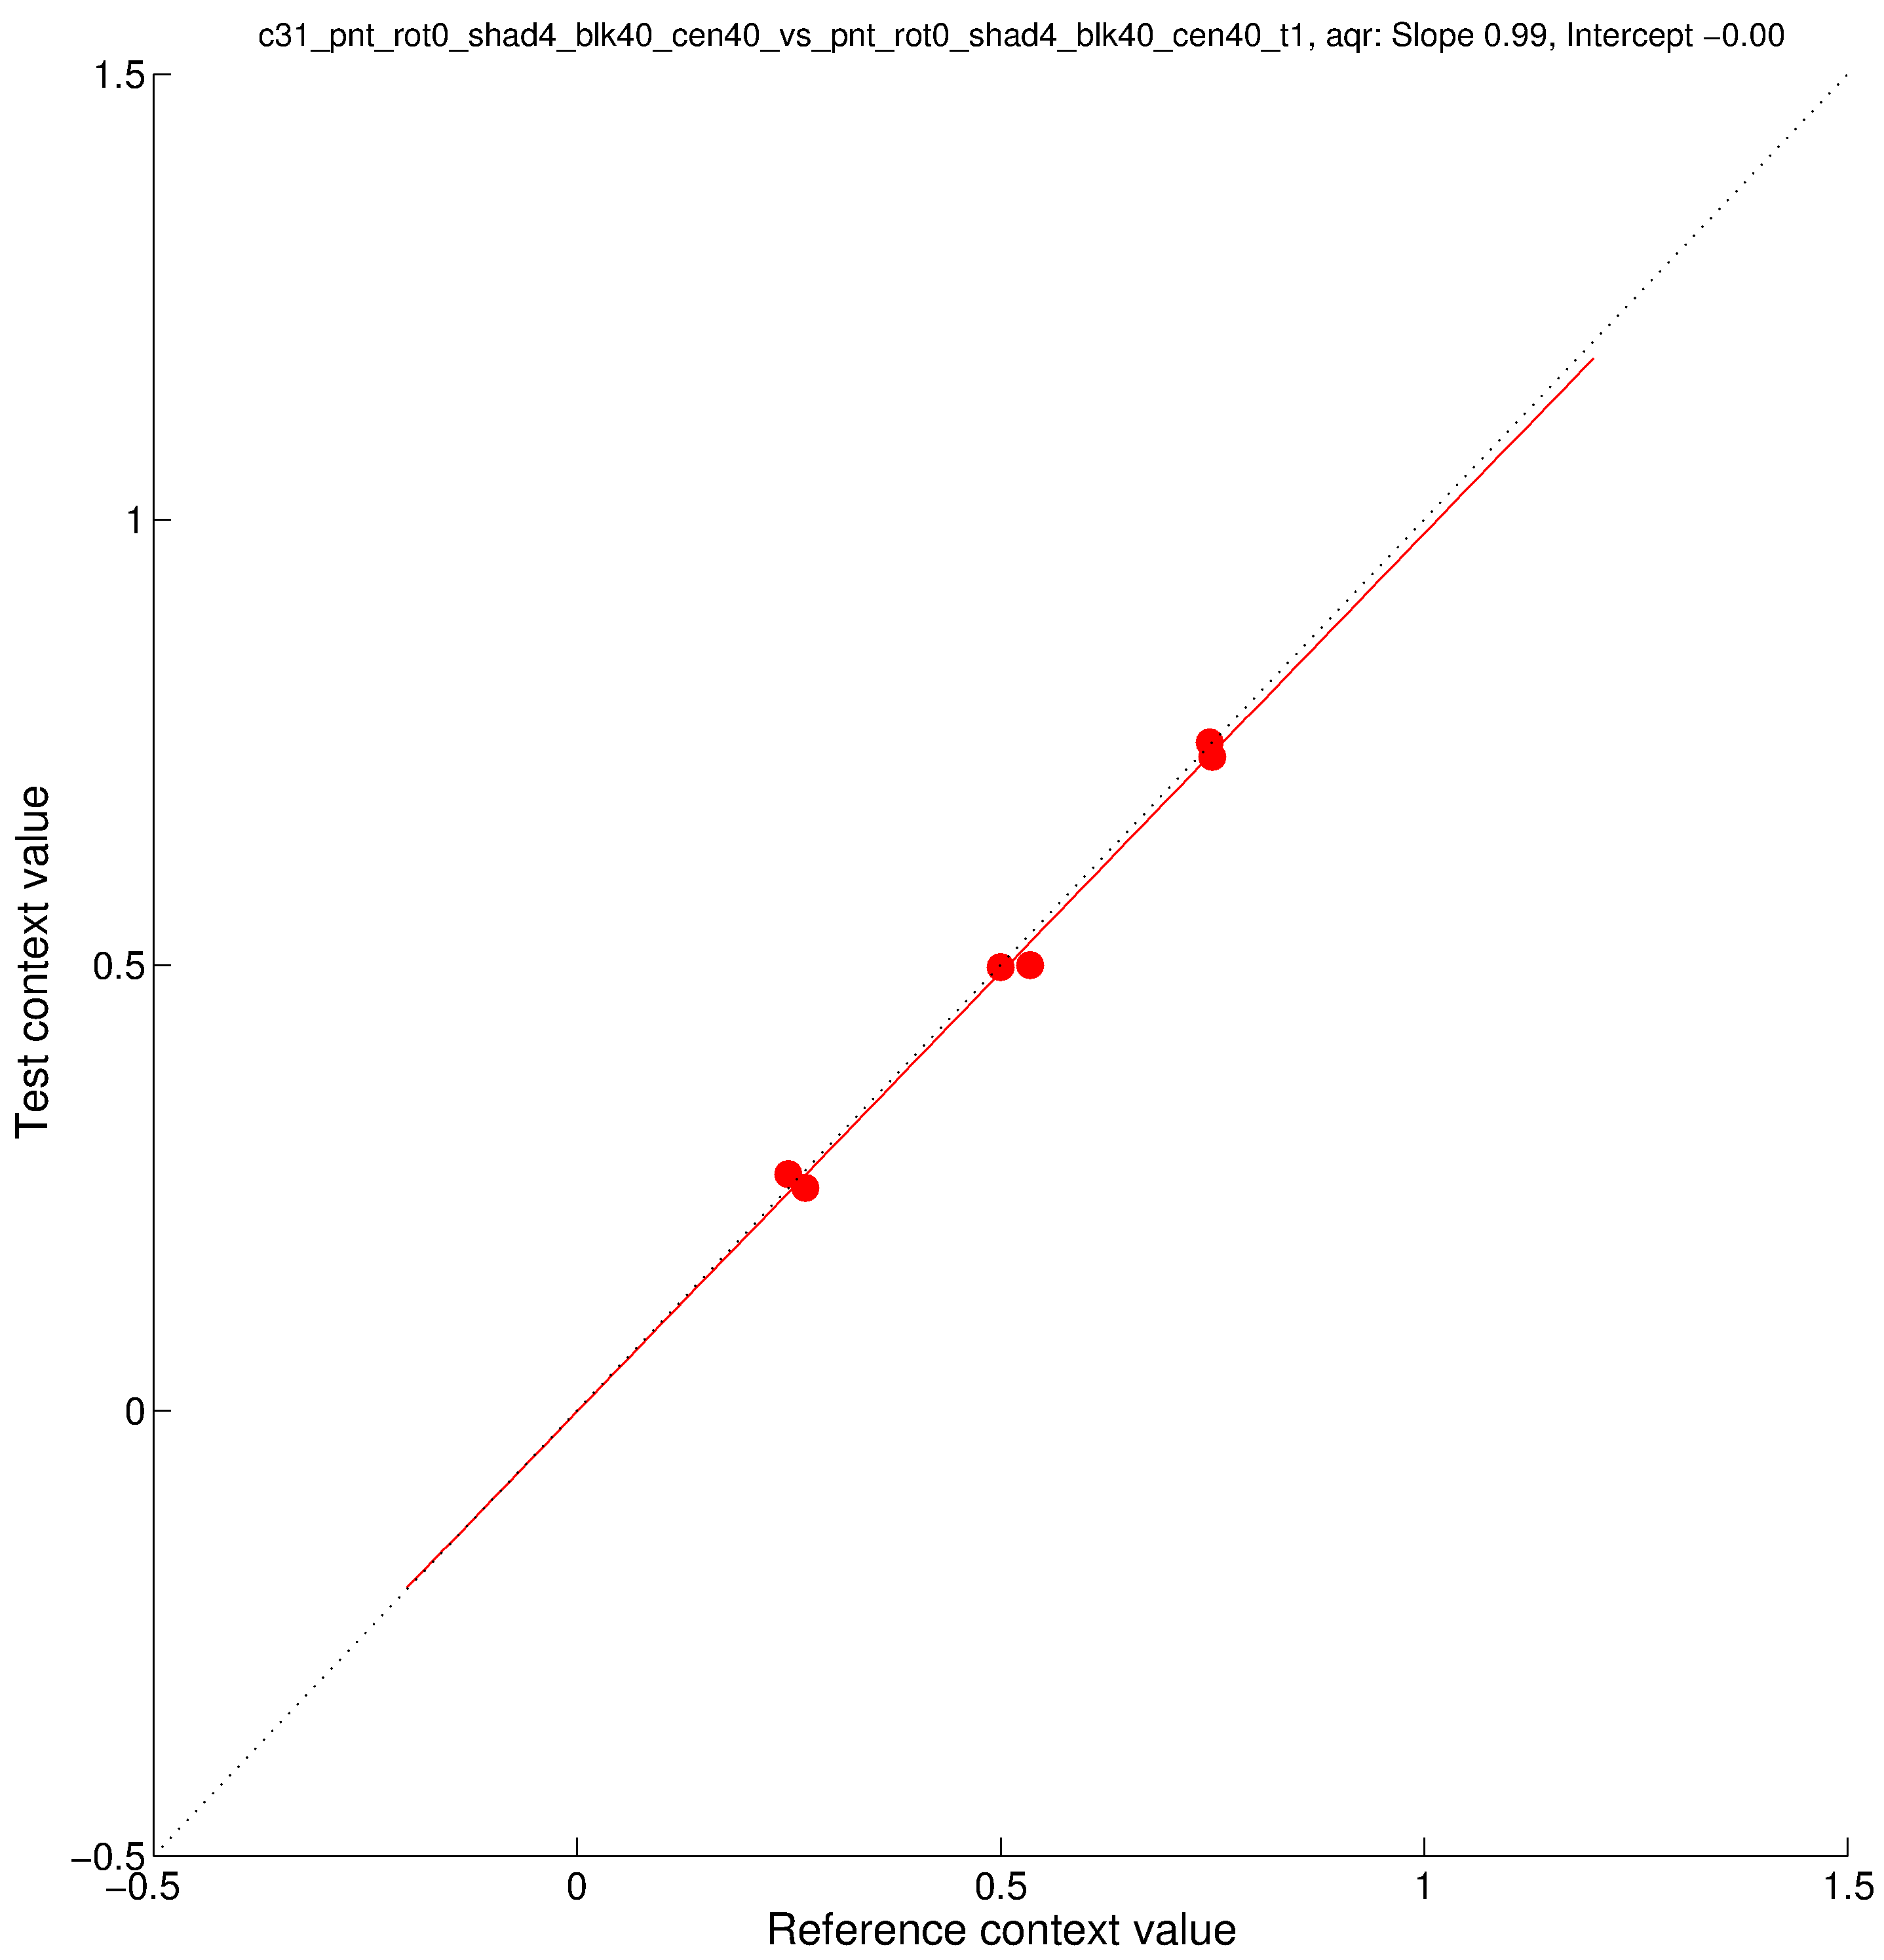
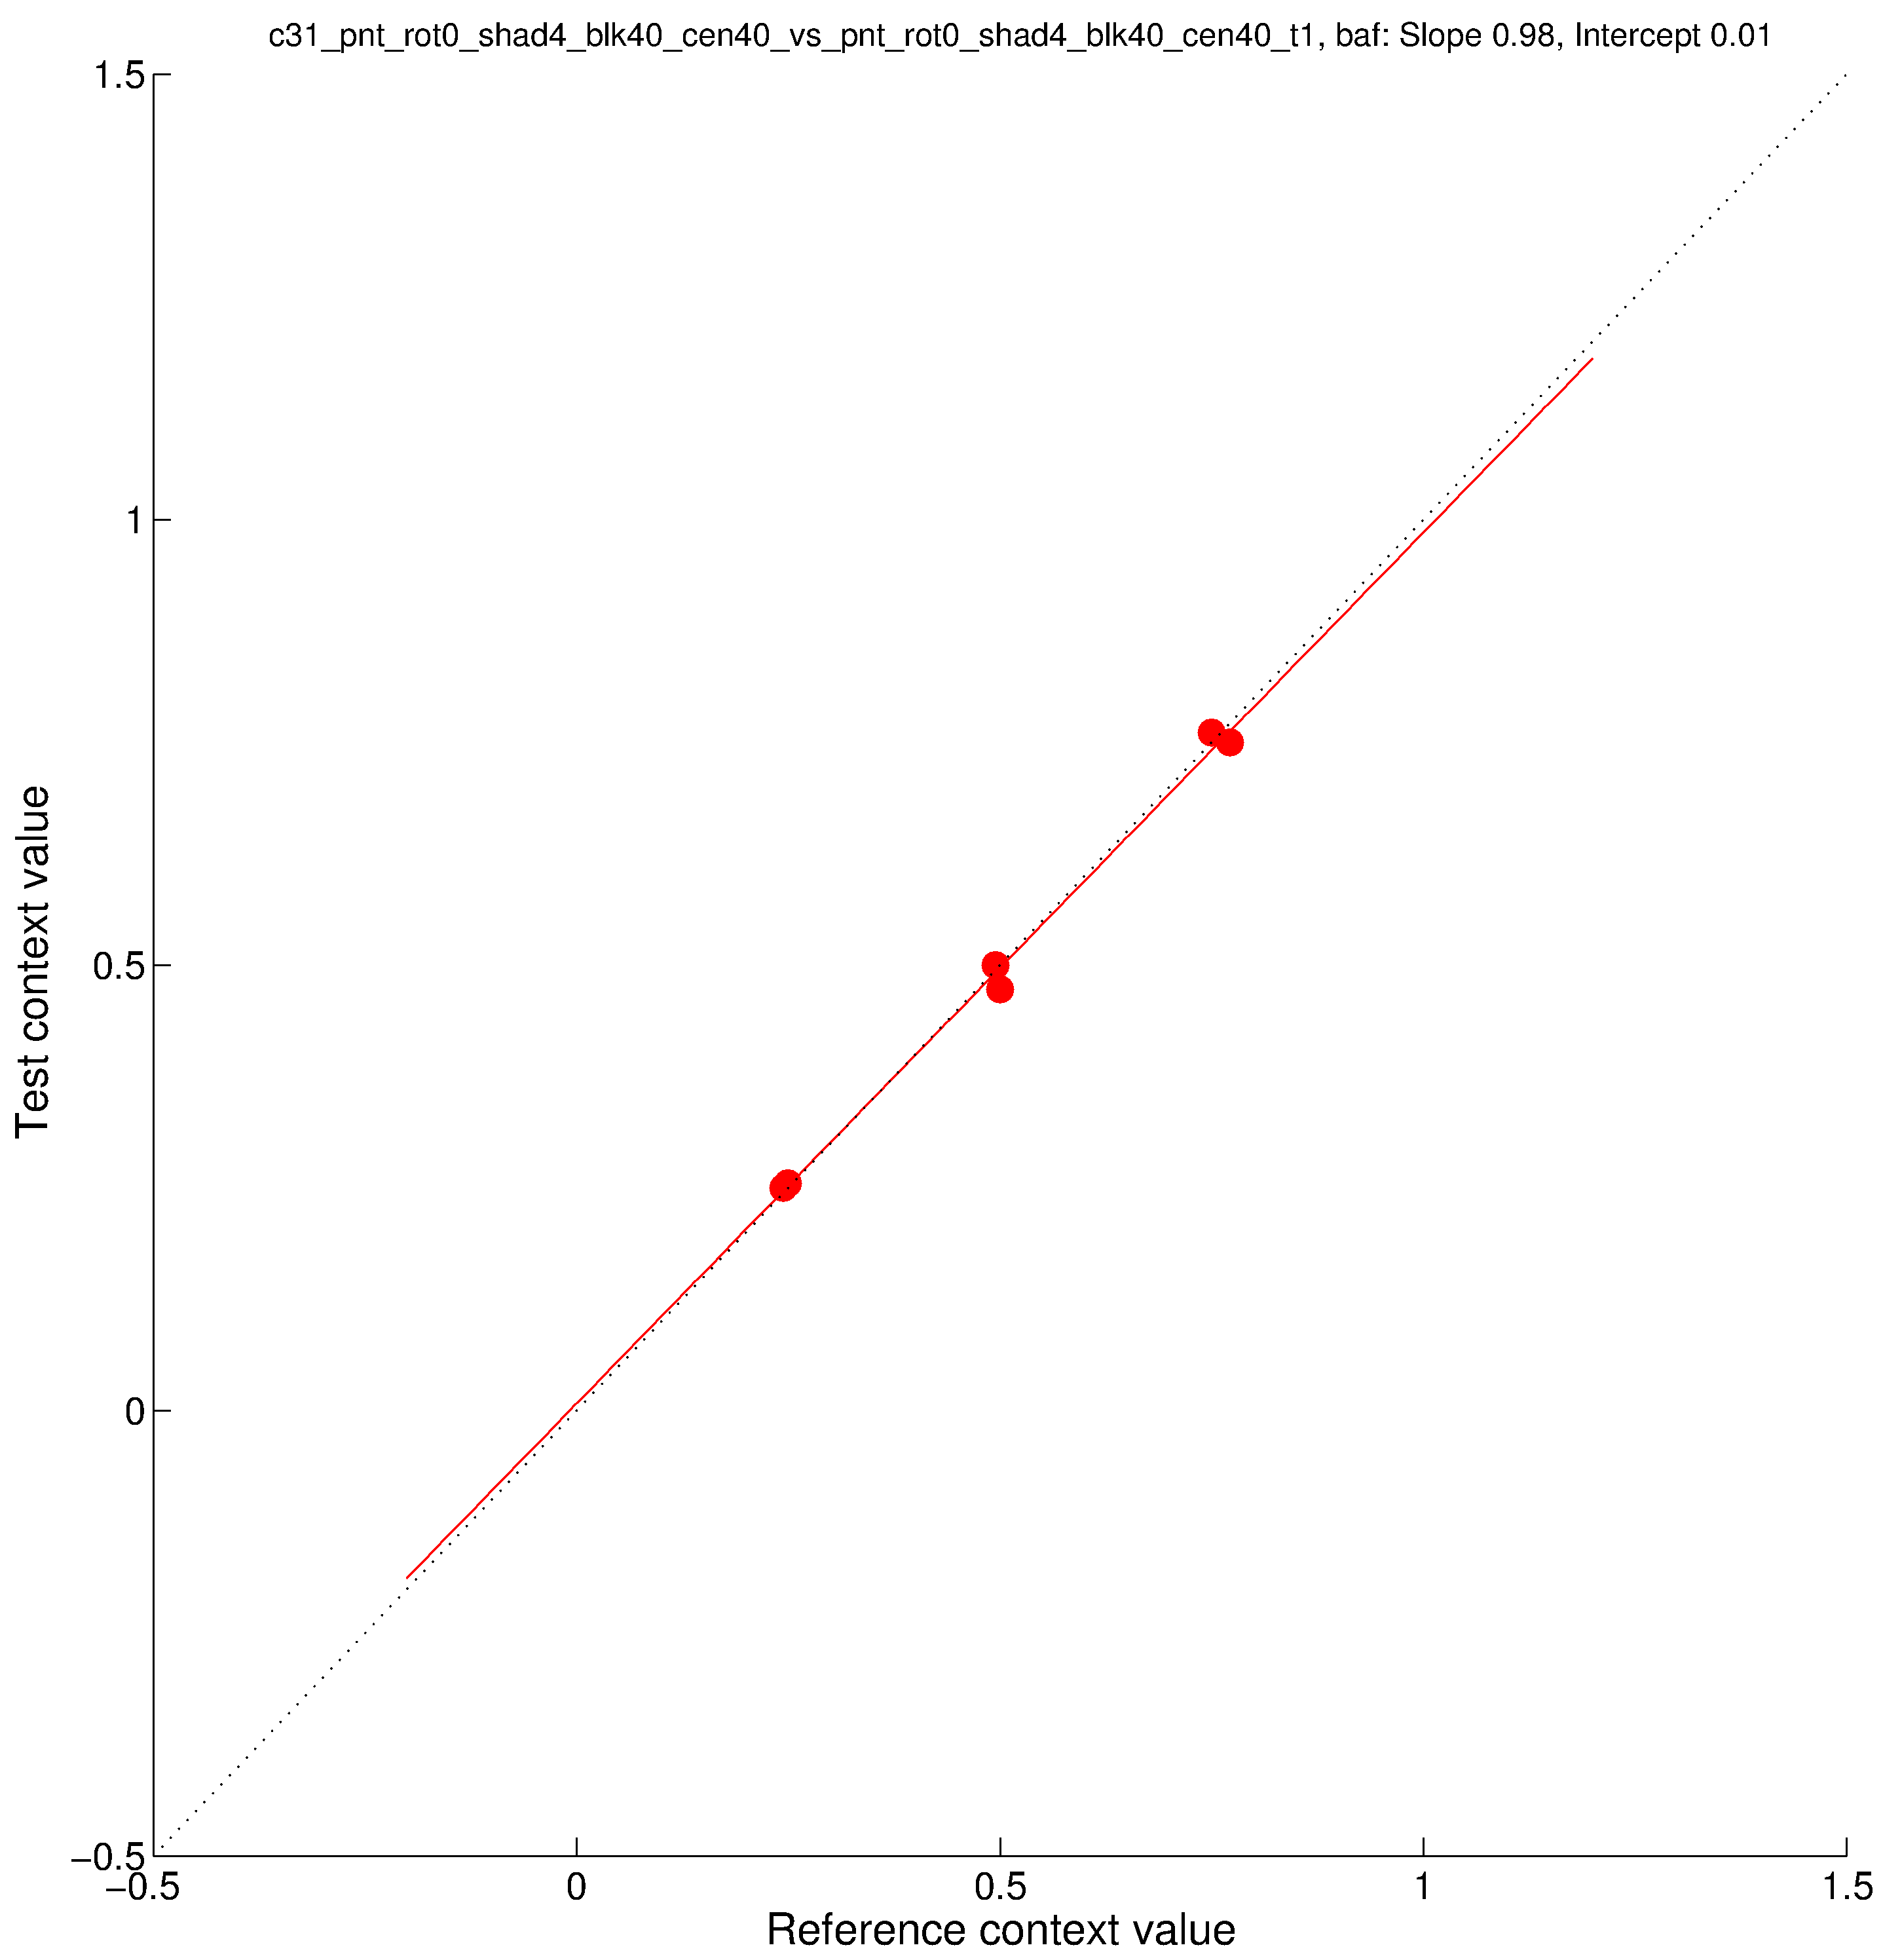
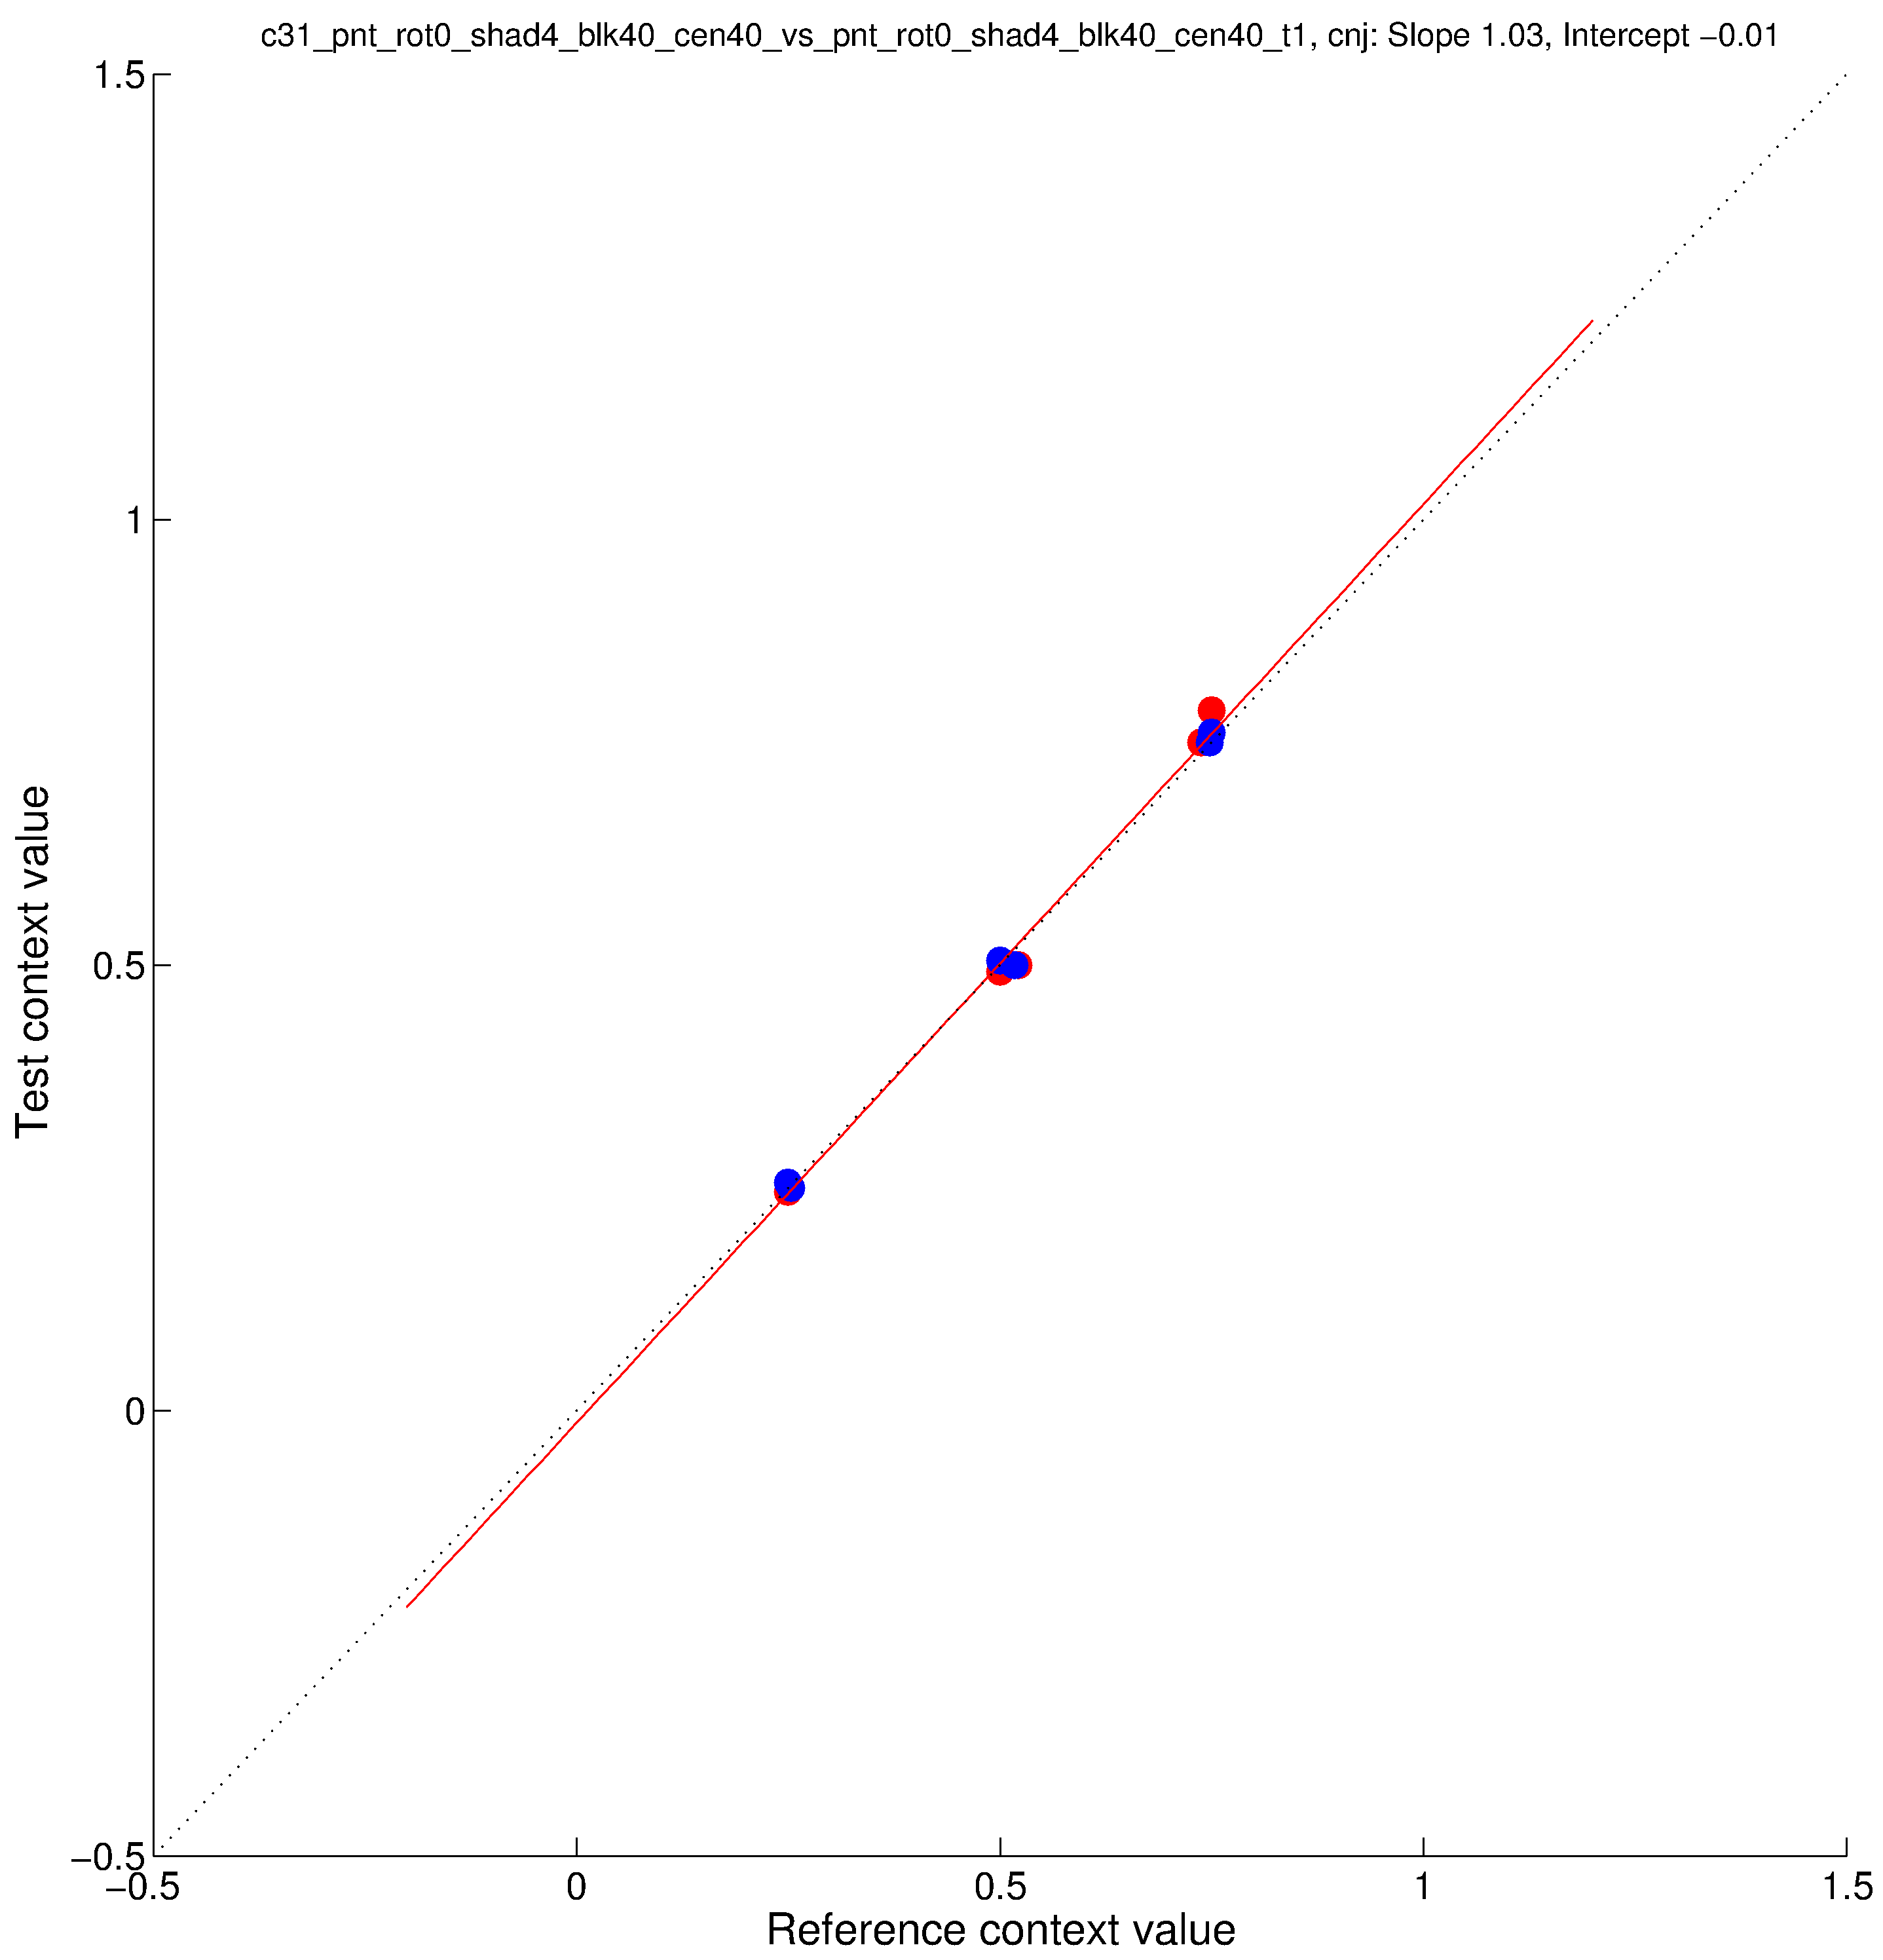
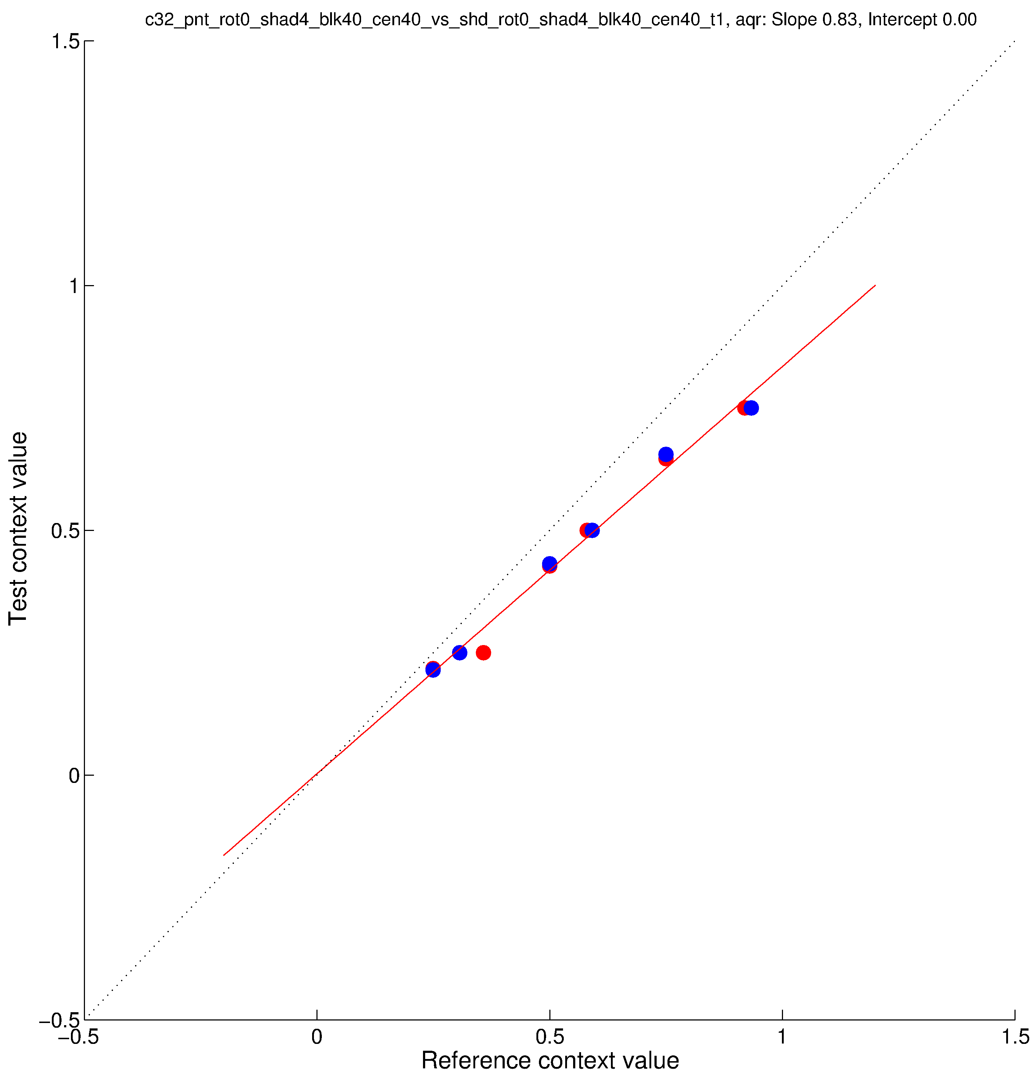
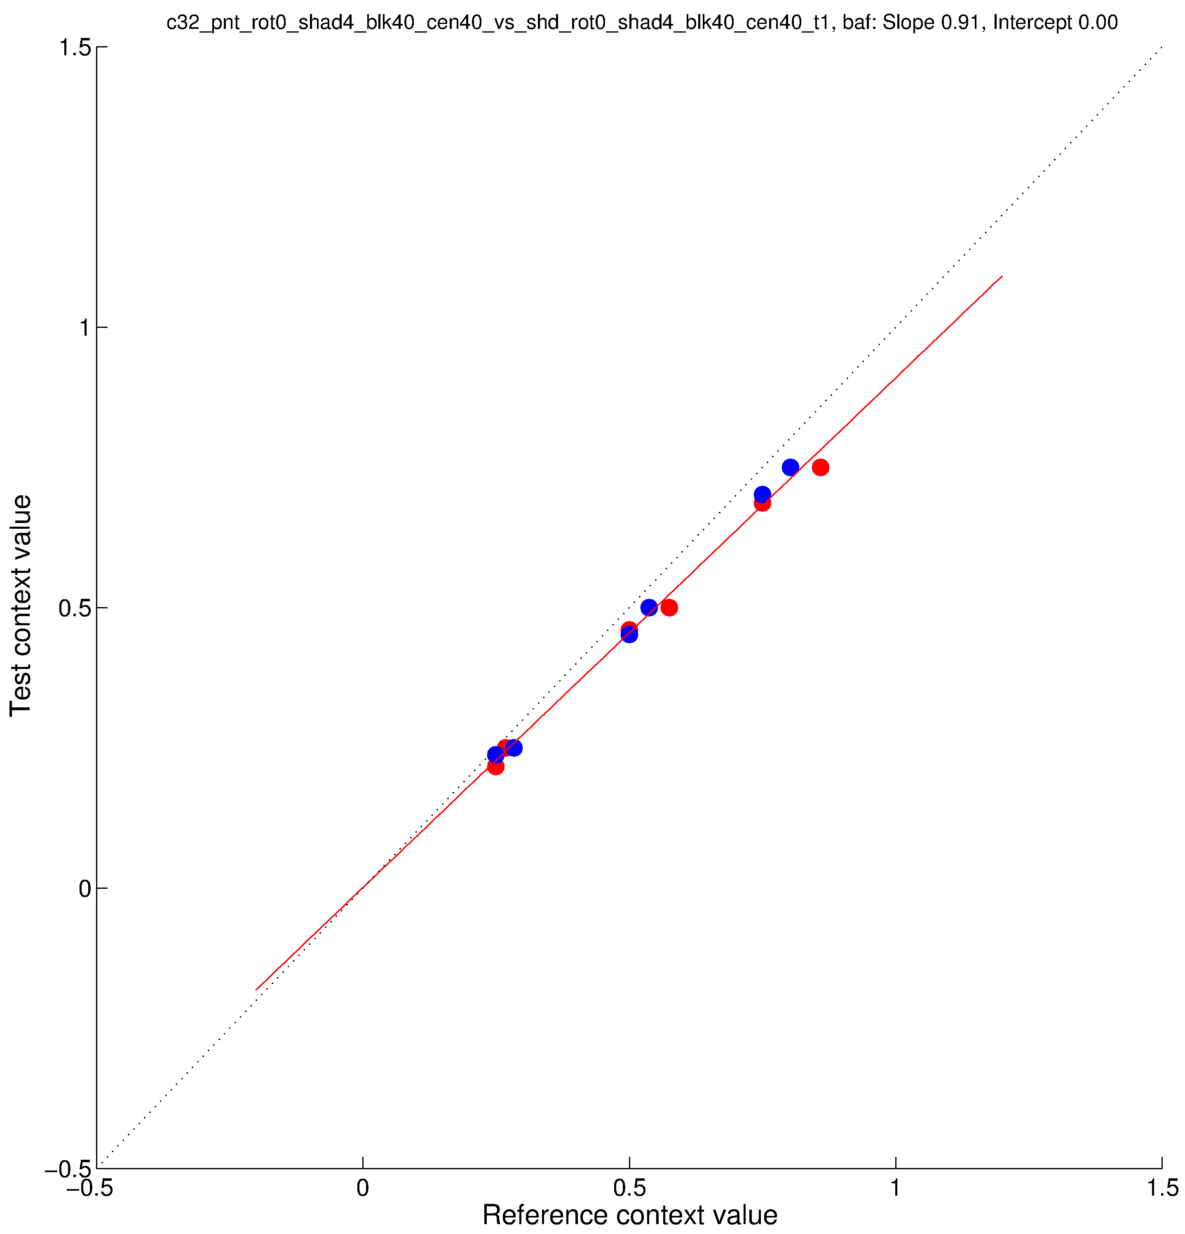
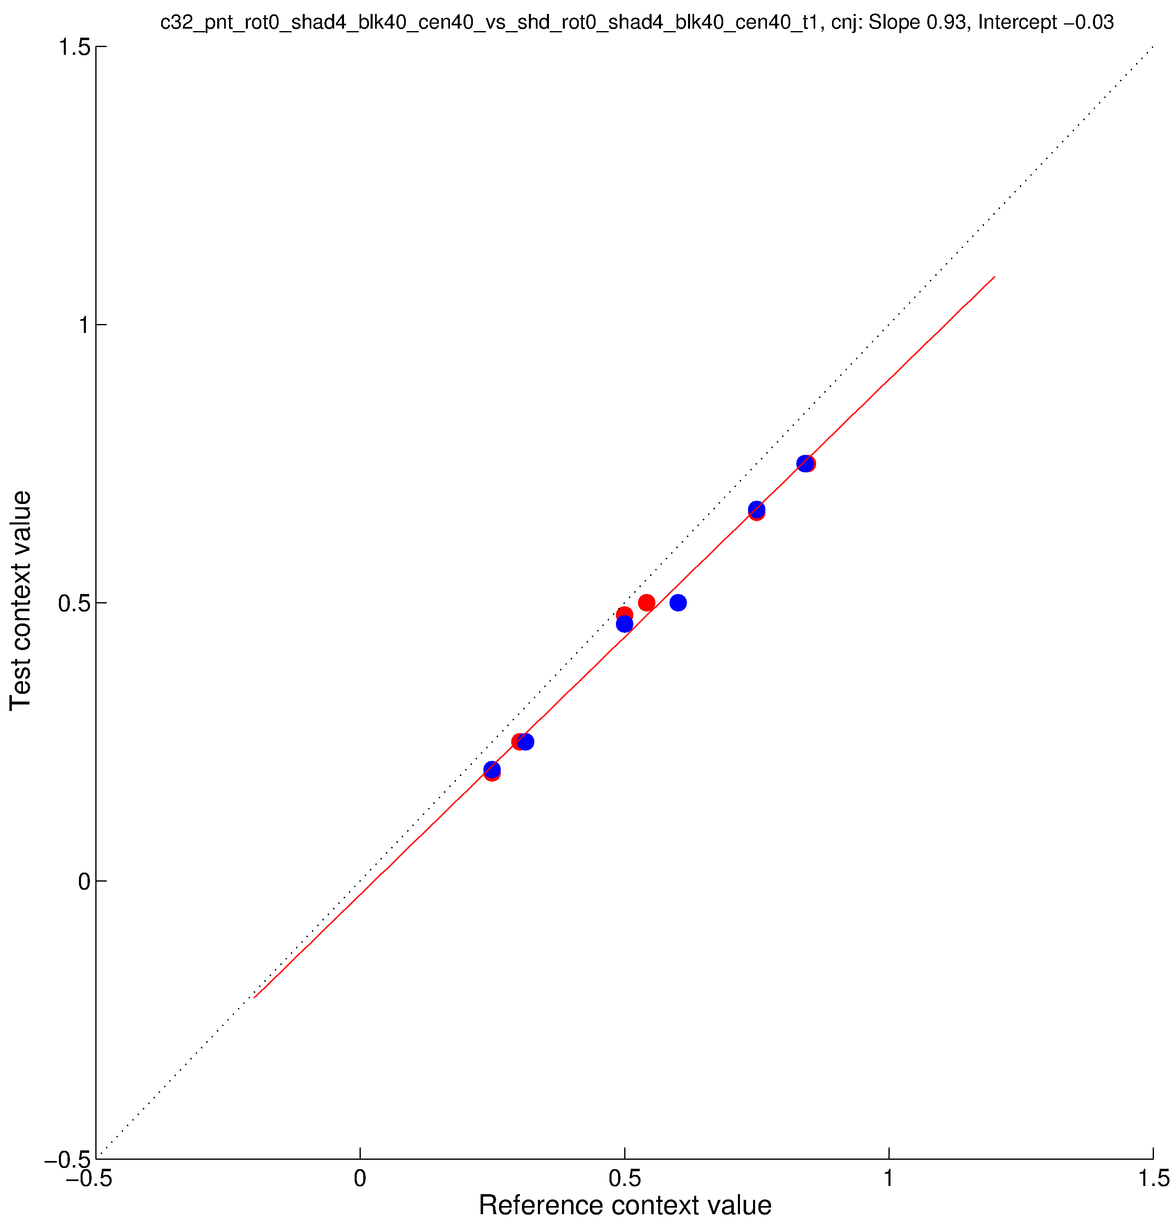
parametricConditions2, c31 (top) and c32 (bottom)

Slide 3
Eimgs_rot0_shad4_blk40_cen40 (paint, parametricConditions2, c31), Eimgs_rot0_shad4_blk20_cen80 (shadow, parametricConditions2, c34)
Gamma corrected, probe levels 25, 50, 75

Slide 4
Eimgs_rot0_shad4_blk40_cen40 (shadow, parametricConditions2, c32), Eimgs_rot0_shad4_blk20_cen80 (shadow, parametricConditions2, c34)
Gamma corrected, probe levels 25, 50, 75

Slide 5
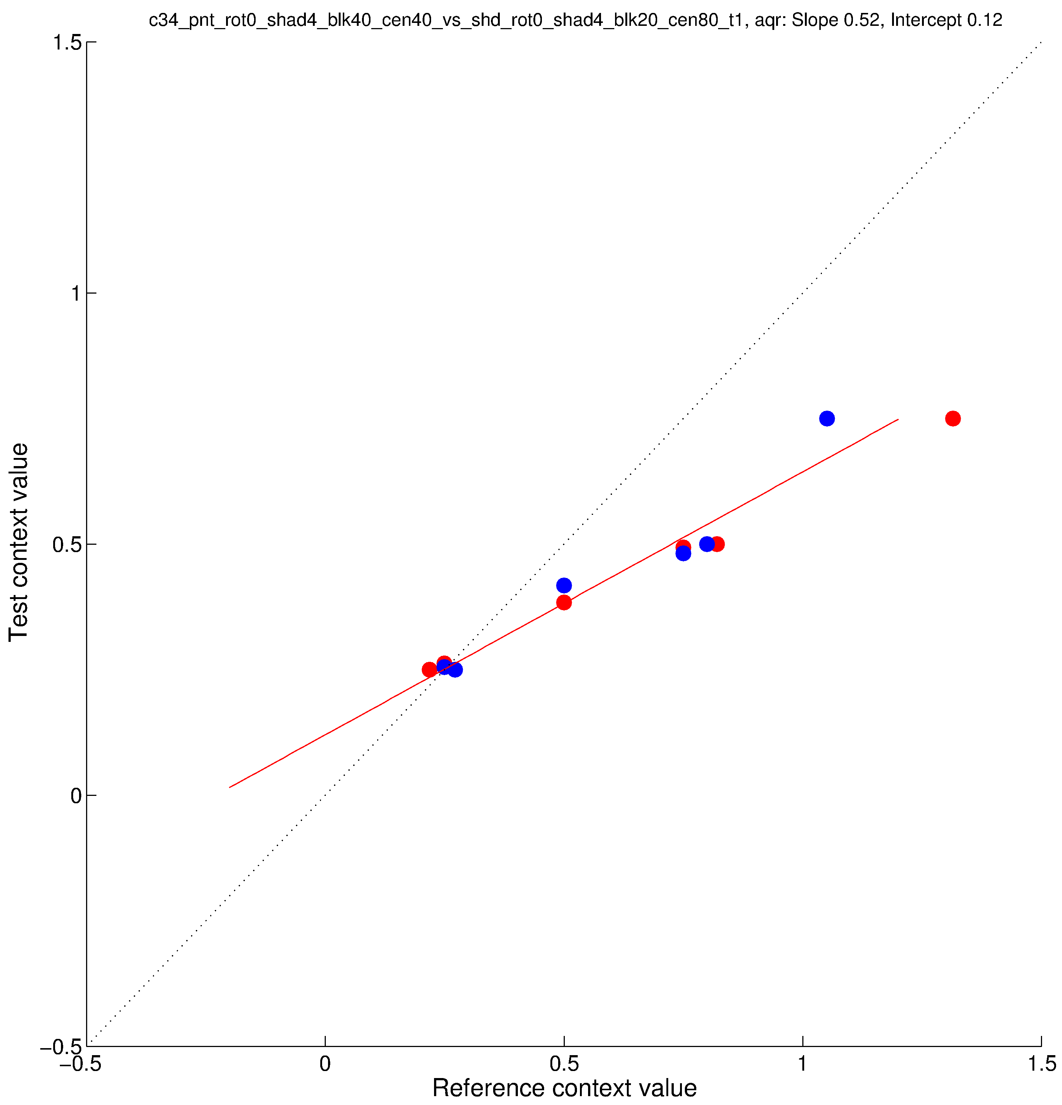
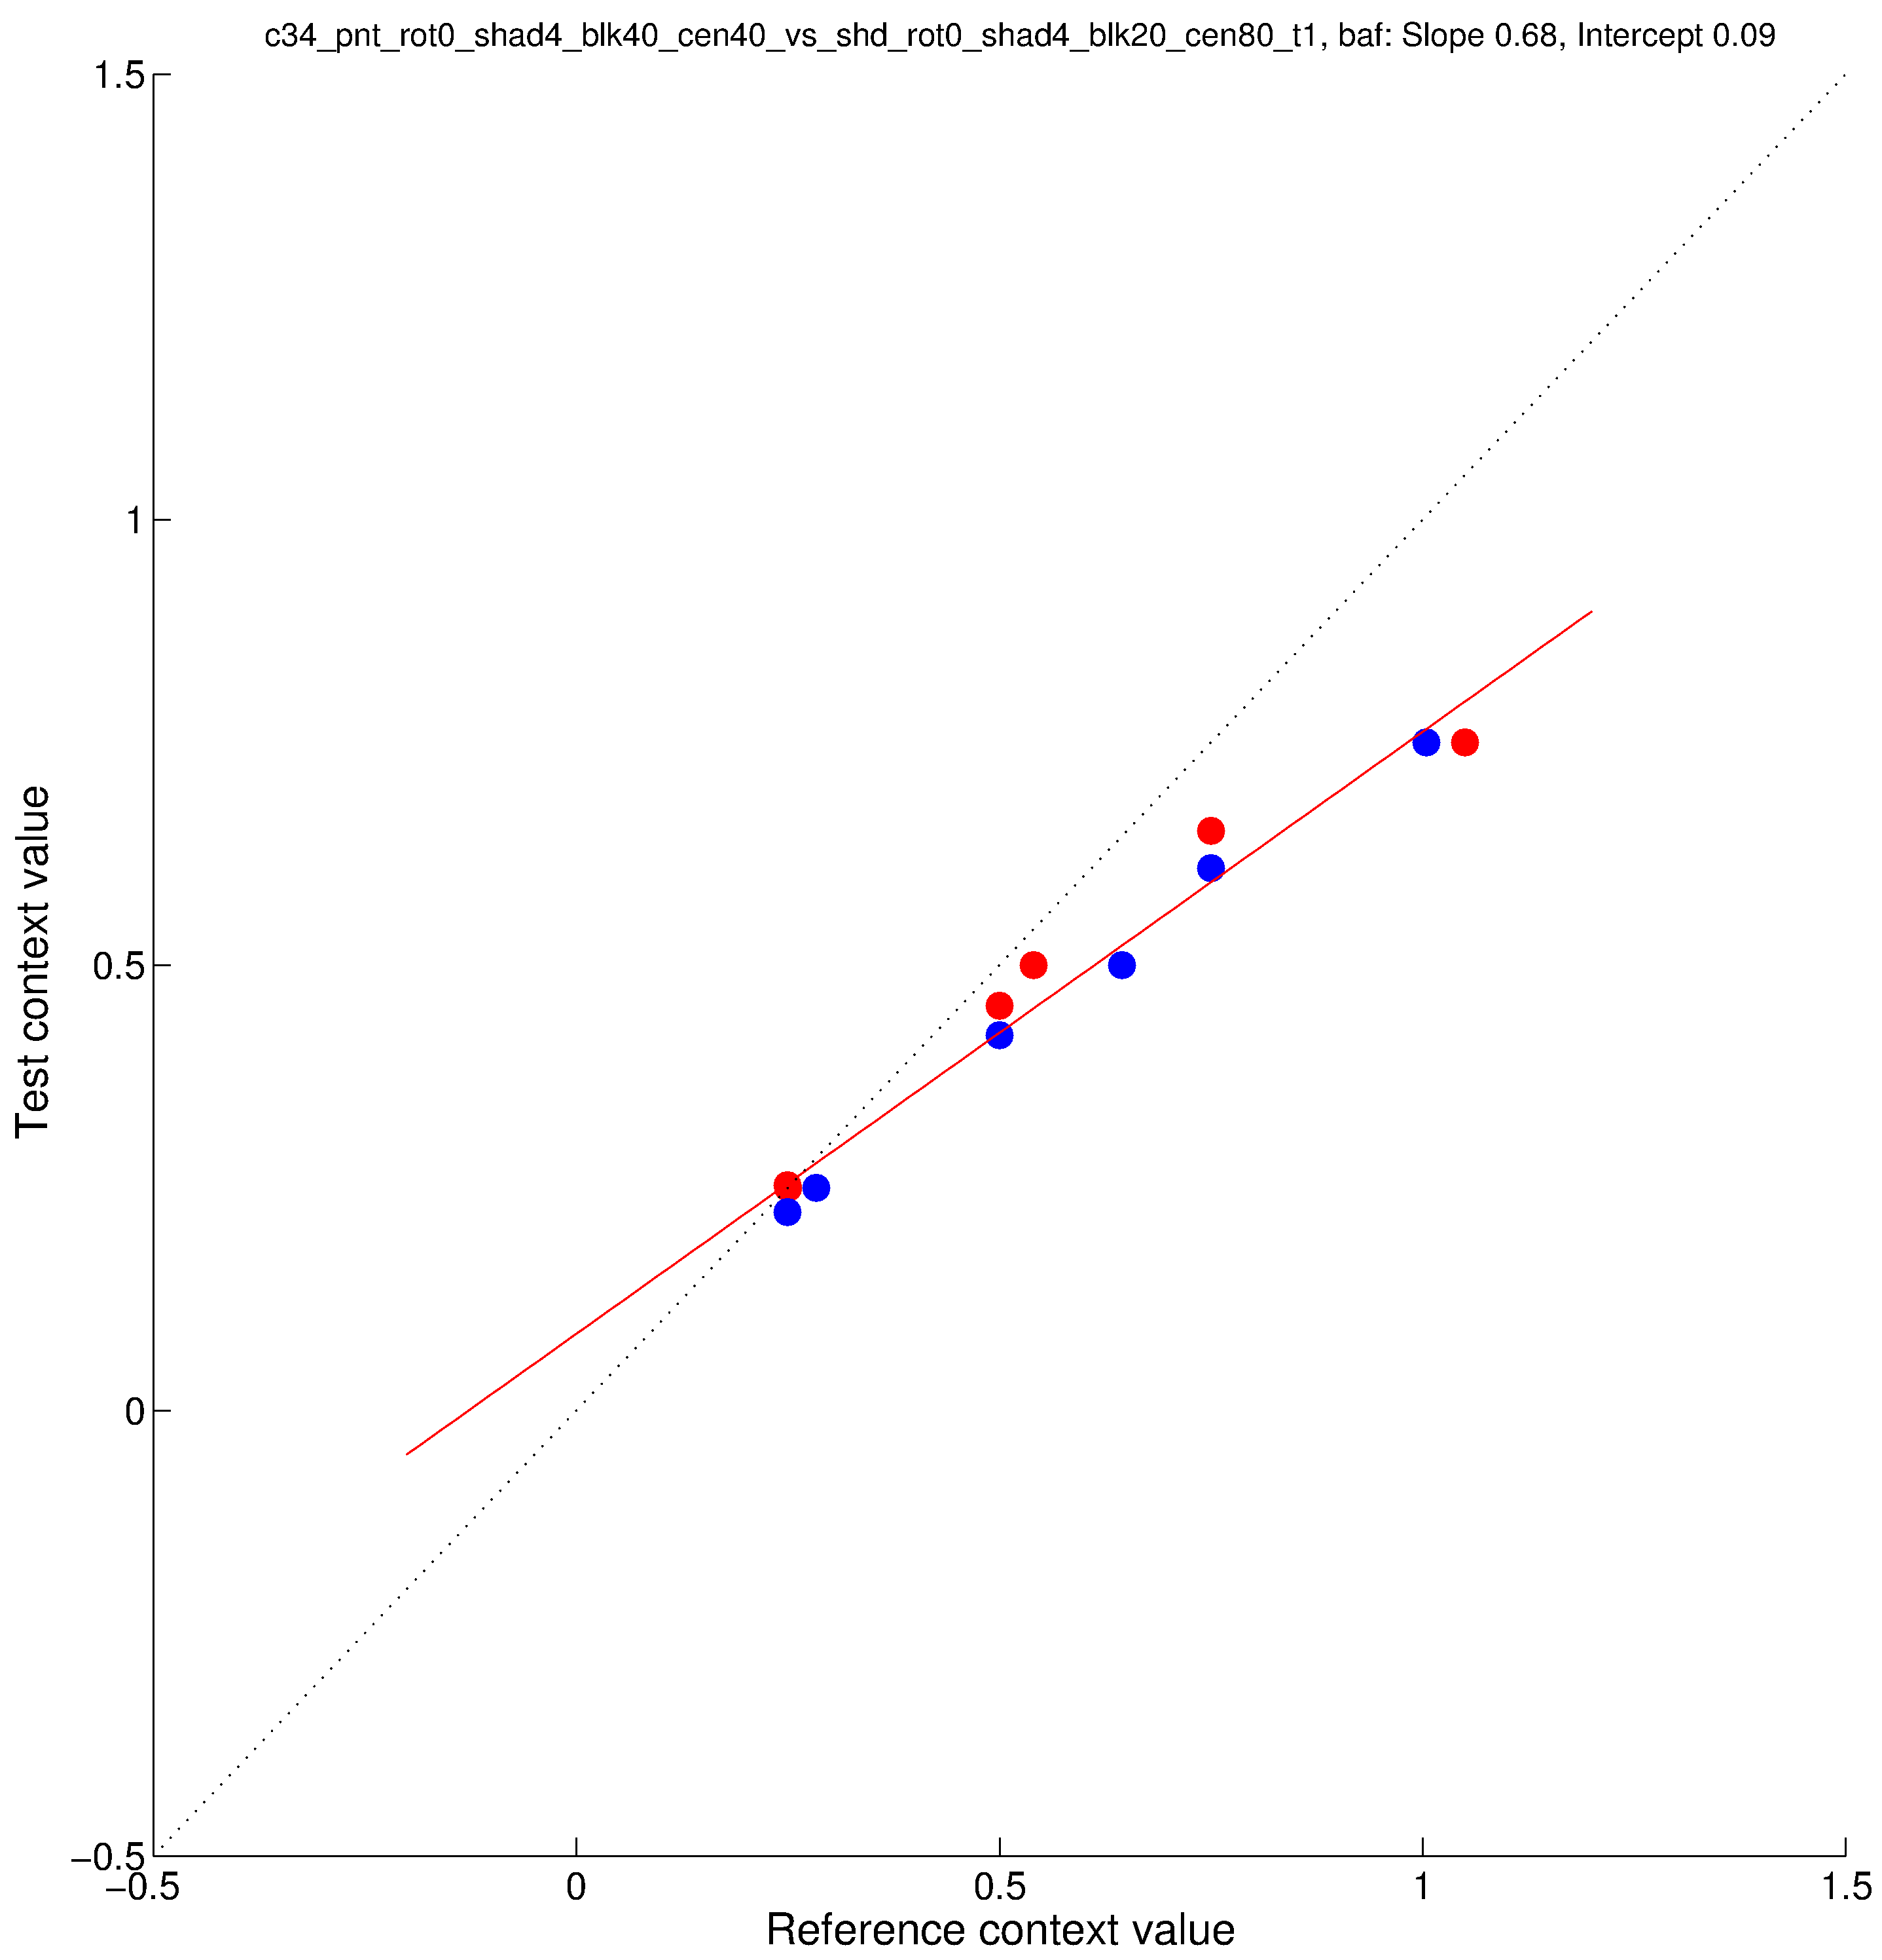
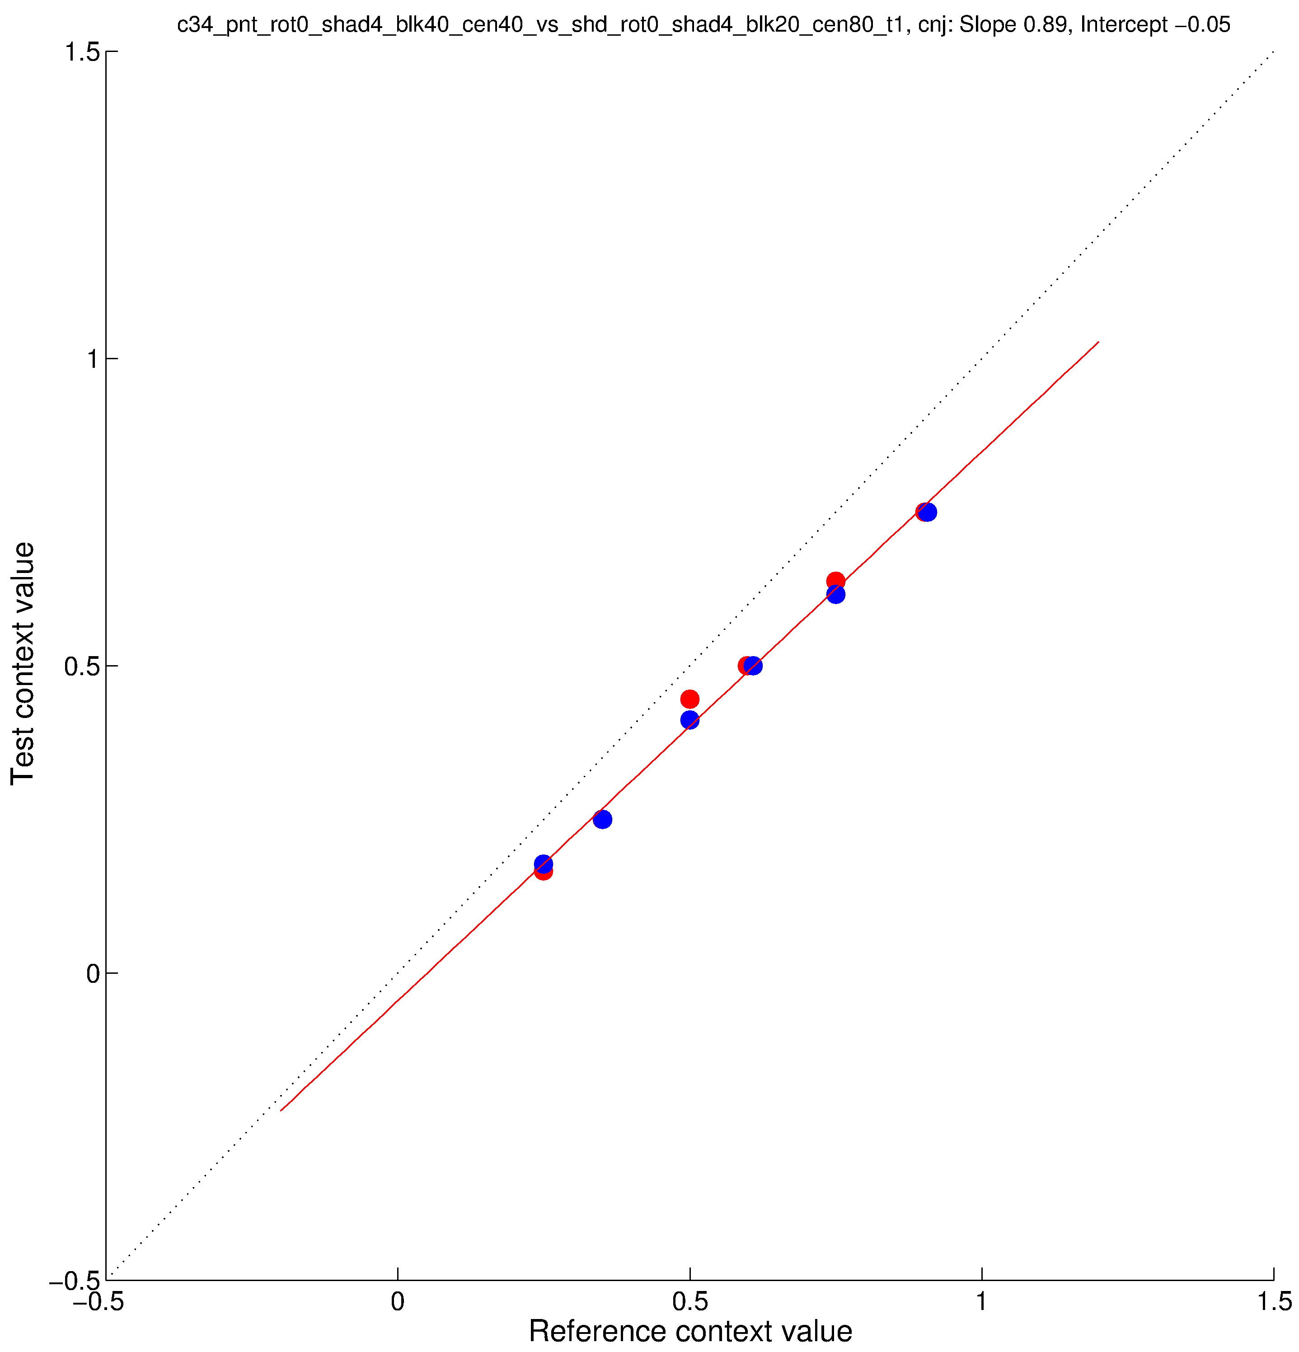
parametricConditions2, c32 (top) and c34 (bottom)

