Slide 1
Top Row: Eimgs_rot0_shad4_blk40_cen40, parametricConditions3, Paint
Bottom Row: Eimgs_rot0_shad4_blk40_cen10, parametricConditions3, Paint
Gamma corrected, probe levels 25, 50, 75

Slide 2
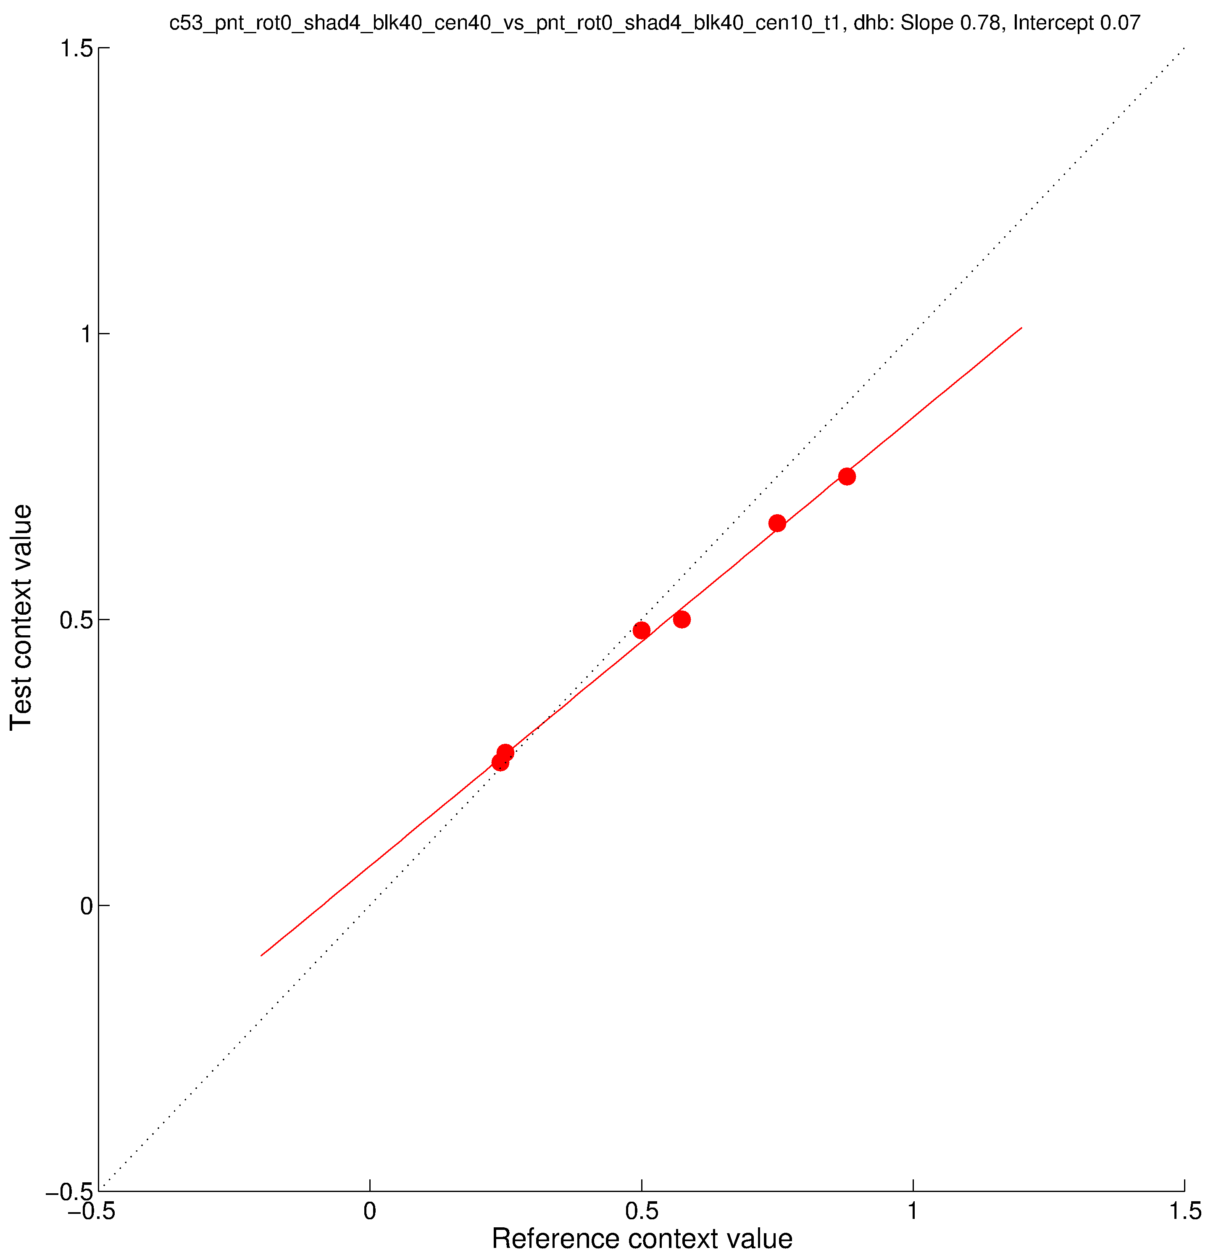
Top Row: Eimgs_rot0_shad4_blk40_cen40, parametricConditions3, Paint
Bottom Row: Eimgs_rot0_shad4_blk40_cen10, parametricConditions3, Paint
Gamma corrected, probe levels 25, 50, 75

Slide 3
Top Row: Eimgs_rot0_shad4_blk40_cen40, parametricConditions3, Shadow
Bottom Row: Eimgs_rot0_shad4_blk40_cen10, parametricConditions3, Paint
Gamma corrected, probe levels 25, 50, 75

Slide 4
Top Row: Eimgs_rot0_shad4_blk40_cen10, parametricConditions3, Shadow
Bottom Row: Eimgs_rot0_shad4_blk40_cen10, parametricConditions3, Paint
Gamma corrected, probe levels 25, 50, 75

Slide 5
Top Row: Eimgs_rot0_shad4_blk40_cen40, parametricConditions3, Paint
Bottom Row: Eimgs_rot0_shad4_blk40_cen40, parametricConditions3, Shadow
Gamma corrected, probe levels 25, 50, 75

