Slide 1
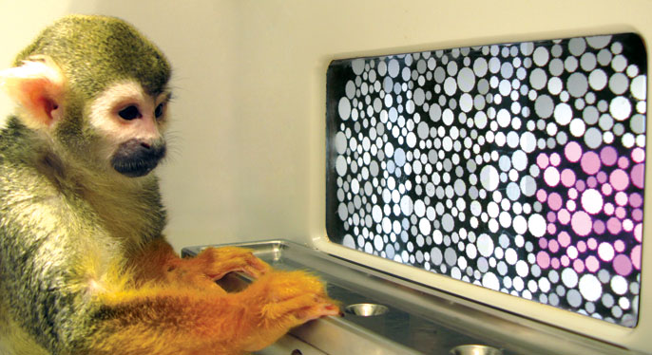
Session Introduction
Neural Signals and Behavior
Photo courtesy Jay Neitz

Slide 2
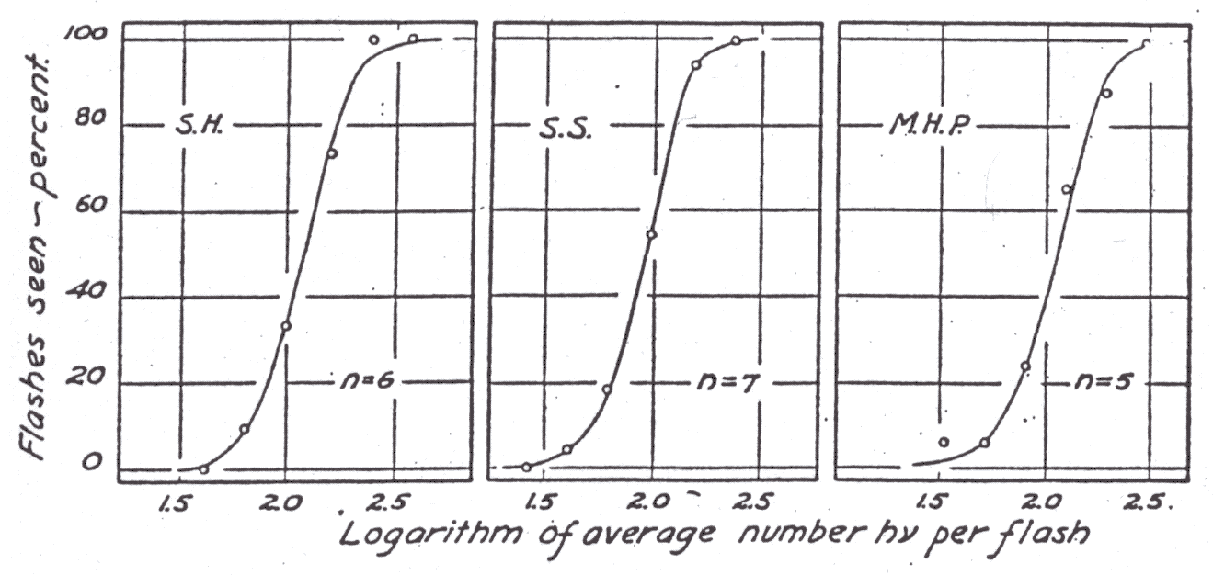
Visual Thresholds (Detection and Discrimination)
Hecht, Schlaer, & Pirenne (1942)

Slide 3
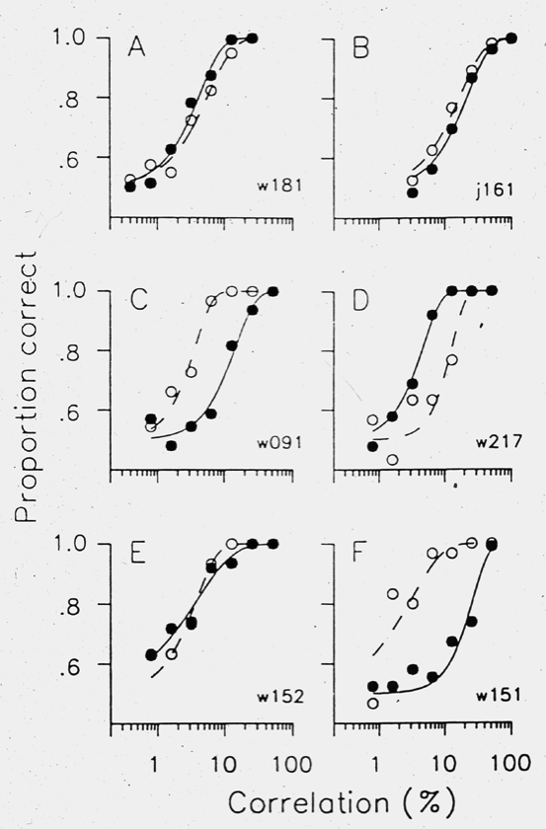
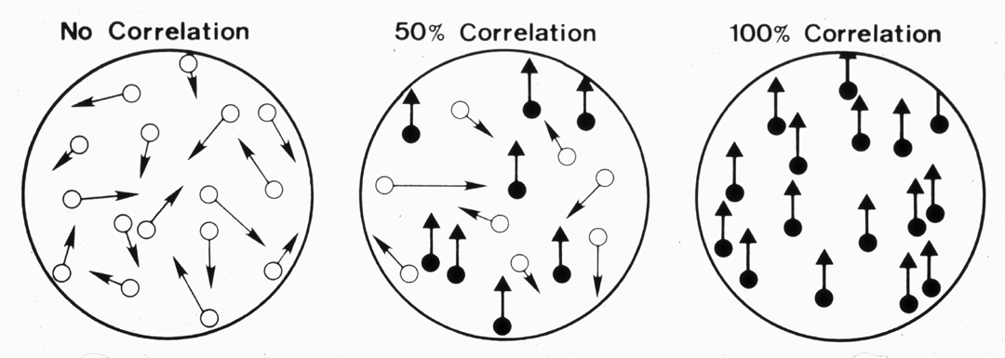
Visual Thresholds (Detection and Discrimination)
• Relatively mature principles for relating neural to behavioral performance
• Theory of signal detection, ideal observer analysis, microstimulation,
selective inactivation, response correlations, …
Britten, Shadlen, Newsome, & Movshon (1992)

Slide 4
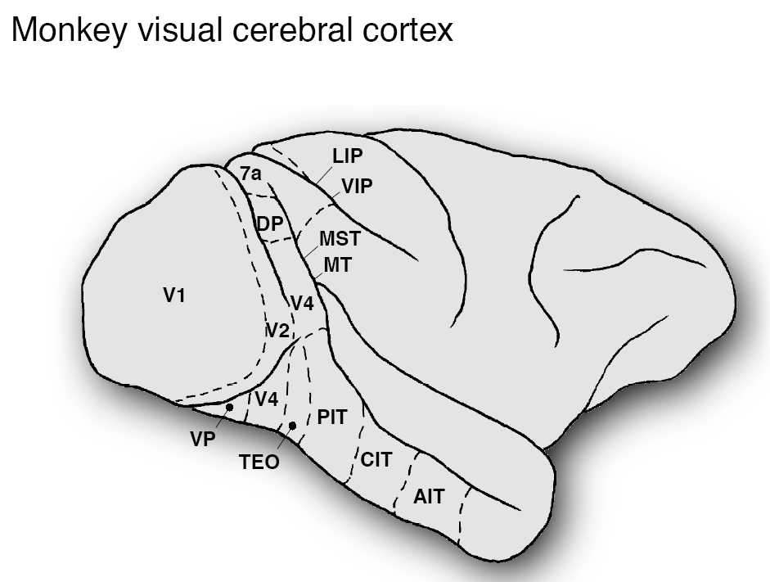
Visual Thresholds (Detection and Discrimination)
• How to generalize from single neuron measurements to populations?
• Which populations (brain areas) to look at for any particular behavior?
• How to scale up predictions from measurements of small #’s neurons
• How do signals from different brain areas interact?
• How do task demands affect both behavior and neural information?
Marlene, Rich

Slide 5
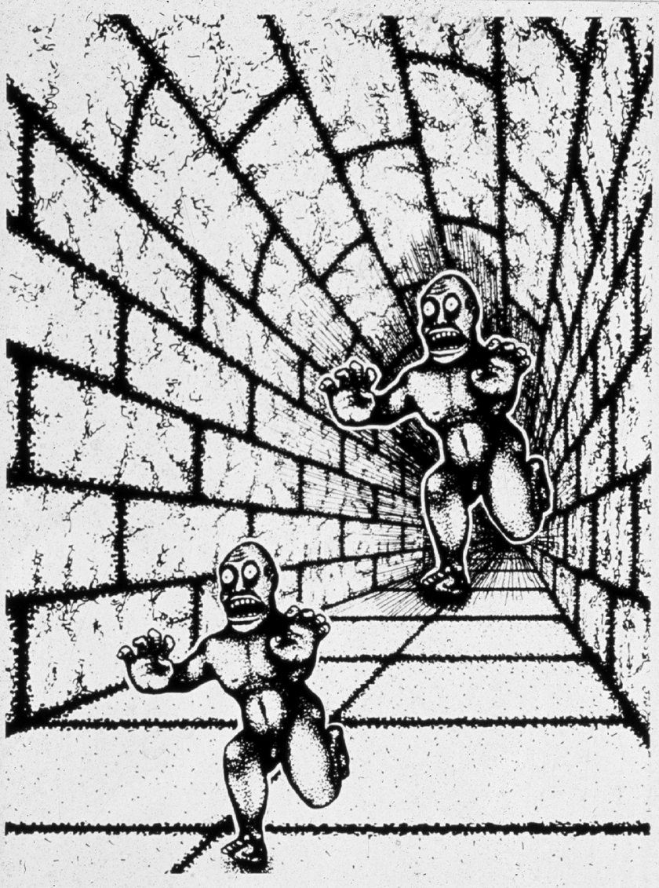
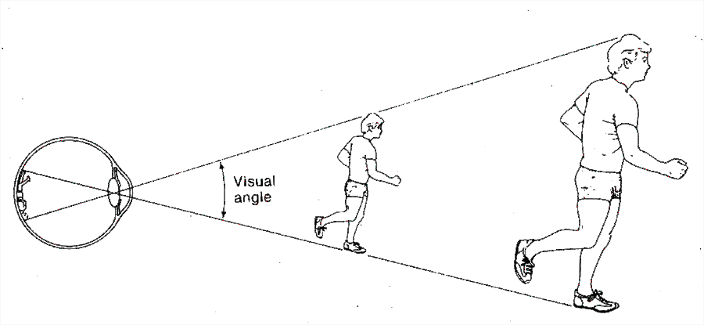
Perceptual Representation (Appearance)
Goldstein, Sensation and Perception
Shepard, Mind Sights

Slide 6
Perceptual Representation (Appearance)
• Information about distal object properties of interest (e.g. size) is tangled up with other variables (e.g. distance) in the retinal image and in early visual representations.
• How do transformations of information as it flows along the visual pathways help provide explicit representations of object properties for guiding thought and action?
Me, Greg
Shepard, Mind Sights

Slide 7

Population Coding of Lightness
in
Primate Visual Cortext
David H. Brainard¹, Douglas A. Ruff², & Marlene R. Cohen²
¹University of Pennsylvania
²University of Pittsburgh

Slide 8
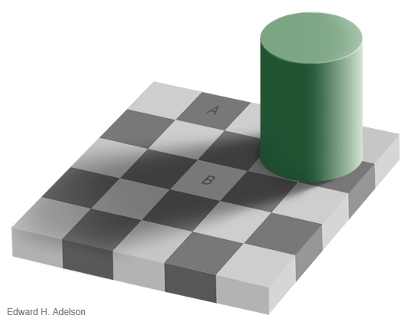

Lightness Is Not Luminance
Adelson’s Checker Shadow Illusion: http://web.mit.edu/persci/people/adelson/checkershadow_illusion.html

Slide 9
Such effects support perception of intrinsic object properties
Lightness appears to be correlated with surface reflectance

Slide 10
Outline
Long term goal
We want to understand how the visual cortex represents lightness.
Work reported today (very much work in progress)
Human psychophysics to quantify a perceptual lightness effect.
Physiological measurements of neural responses in monkey V1 and V4 to same stimuli, using implanted multi-electrode arrays.
Link physiology and psychophysics via population decoding of stimulus luminance.

Slide 11


Paint and Shadow Checkerboards
Paint
Shadow
Disks placed at center of 5 by 5 checkerboards.
The 25 corresponding checks have same average luminance in the paint and shadow checkerboards.
Disks have matched local contrast and global surround luminance.
After Gilchrist, 2006; Hillis & Brainard, 2007; Gilchrist & Radonjić, 2010

Slide 12
Psychophysical Methods
Observer fixates center of display.
On each trial, two checkerboards with disks presented side by side.
Checkerboards are 3.5° by 3.5° and centered at +/- 3.5°.
Observer indicates which disk appears lighter. No feedback given.
.

Slide 13
Basic Psychophysical Data
Reference Disk in Paint
Reference Luminance 0.5

Slide 14
Point of Subjective Equality (PSE)
Reference Disk in Paint
Reference Luminance 0.5

Slide 15
Representing One PSE

Slide 16
Paint/Shadow Effect, One Subject

Slide 17
Psychophysics Summary

Slide 18
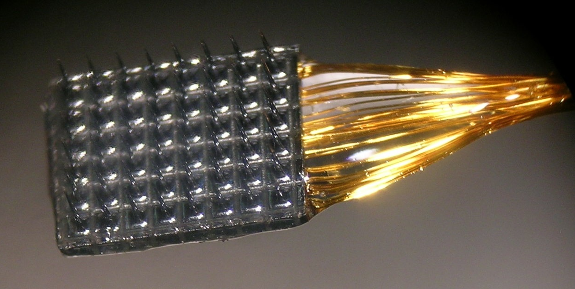
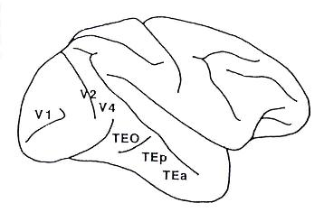
Physiology Methods
Electrode array recordings from V1 and V4 (in different monkeys).
Monkeys performed fixation task while a single checkerboard was presented on each trial; disk luminances between 0.2 and 1.0 (re display max).
Various stimulus sizes (3°-27° mostly 8°-12° checkerboards) and locations (2°-3.5° V1; 0.5°-2° V4) tested; generally stimuli were centered on the coverage of the arrays.
Manual spike sorting.

Slide 19
Population Decoder for Stimulus Luminance
Probe luminances for M trials
(typically 100s of trials per session)
Regression finds weights
N multiunit responses for each
trial (~90 multiunits)

Slide 20
Example Decoding (One V1 Session)
Leave-one-out cross validation used.
Decoder built with both paint and shadow trials.

Slide 21
Example Decoding (One V4 Session)
Leave-one-out cross validation used.
Decoder built with both paint and shadow trials.

Slide 22
Linking Decoding and Psychophysics
Linking hypothesis: Two disks will match in perceived lightness if they decode to the same luminance.
∂∂∂∂
∂∂∂∂
∂∂∂∂
∂∂∂∂

Slide 23
Linking Decoding and Psychophysics

Slide 24
Comparison: V1 Decoding, V4 Decoding, Psychophysics
V1
V4
Psychophysics
Session (nominal)

Slide 25
Conclusions
Can decode stimulus luminance from V1 and V4 population responses.
Quantitative link between decoding and psychophysics.
For our dataset, V4 decoding is consistent with psychophysics, while V1 decoding is not.
Possible reasons for the V1/V4 effect
The V4 representation could be more “lightness-like”
than the V1 representation.
Differences in: stimulus size relative to single unit RF size,
population’s RF coverage of the checkerboard, stimulus size,
stimulus eccentricity, etc.
We think sorting out the reasons will provide insight
into the cortical representation of lightness.

Slide 26
Thanks

Slide 29
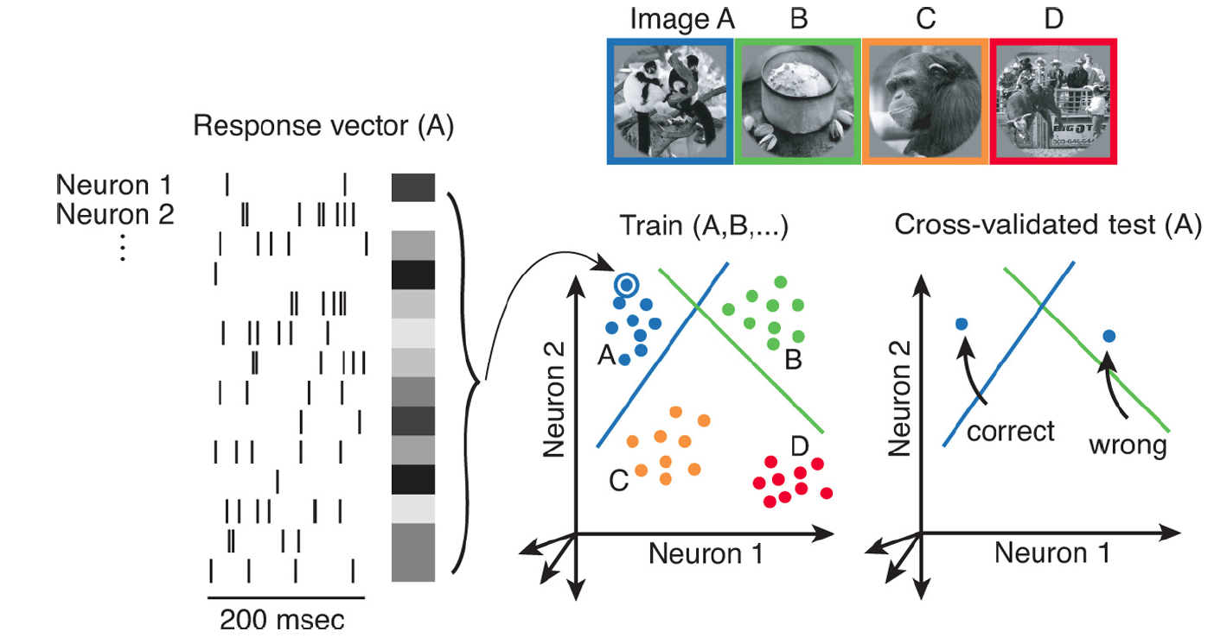
Population Response Analysis
Rust et al. (2010)

