Slide 1
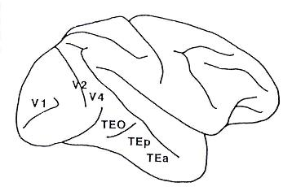
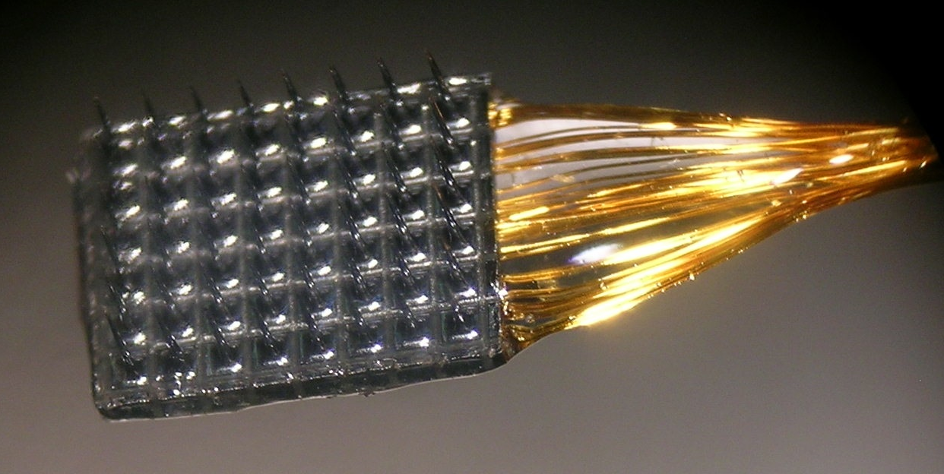
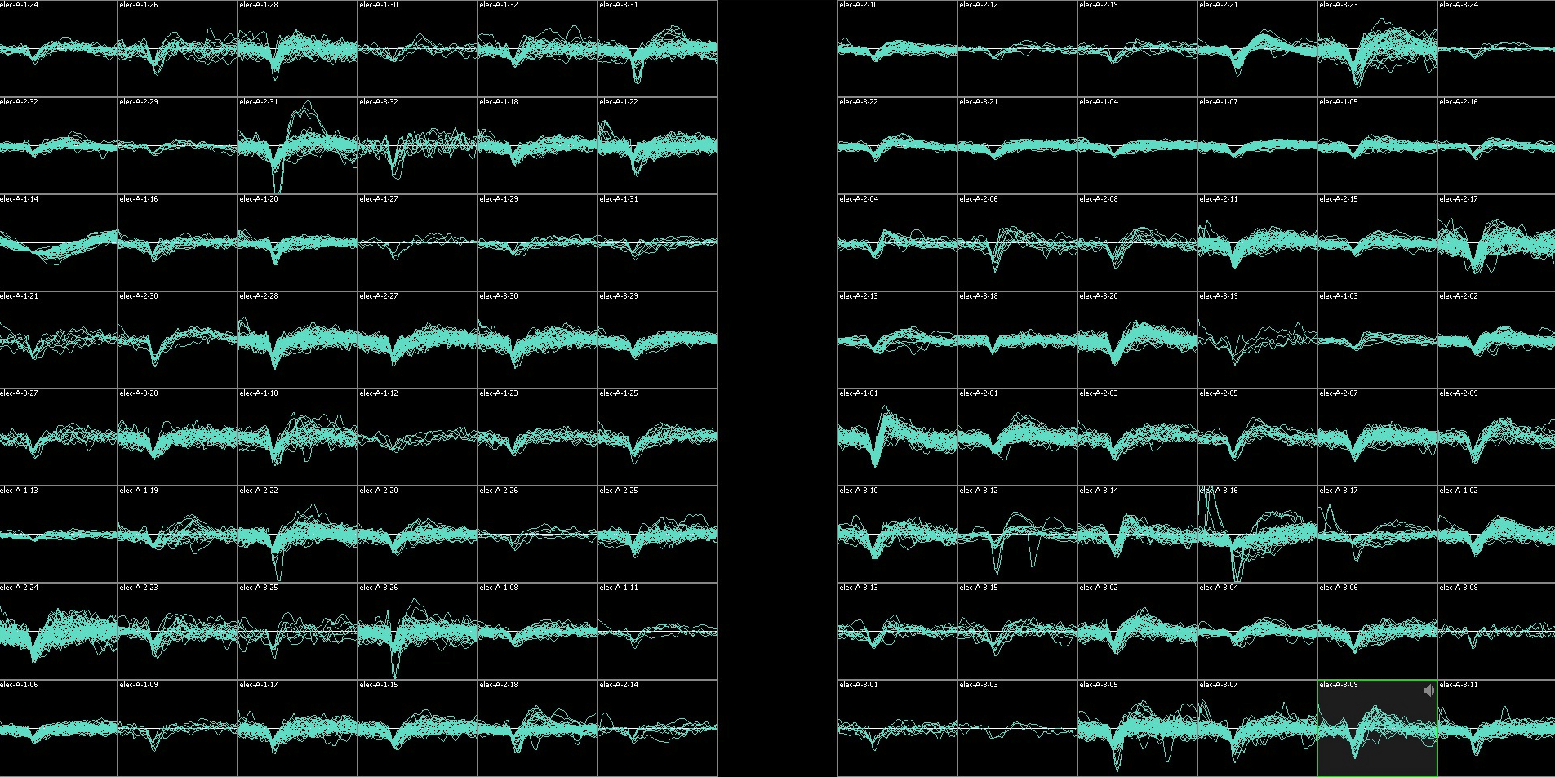
Chronic array recordings
1 mm
Notes:
1
While the monkeys performed that task, we recorded from cortex with chronic array recordings. we implanted two small utah arrays like the one shown here into cortex.
For this project, we placed one array in V4 in both hemispheres of one monkey. V4 is a mid level visual area in the ventral processing stream where previous work has demonstrated that both the rates and correlation structure of neurons is modulated by attention.
Here im showing example RFs centers from the two arrays from a previous study

Slide 2
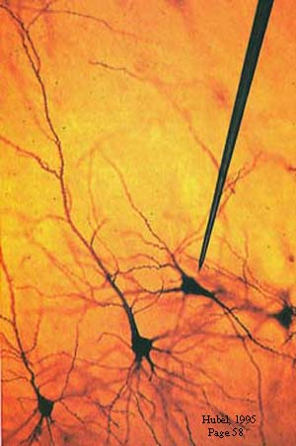
Studying the neural basis of perception

Slide 3
Chronic array recordings
Receptive field centers
Elevation
1 mm
Azimuth
6x8 grid of electrodes in each hemisphere of V4
400 microns between adjacent electrodes

Slide 4
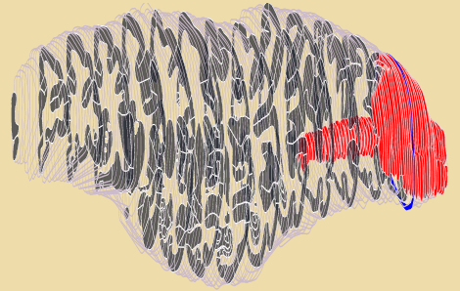

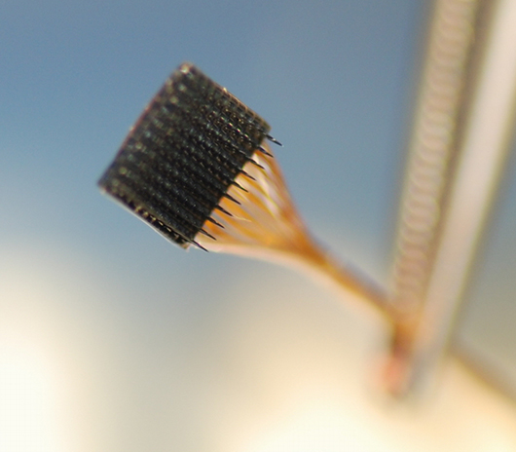

Slide 5
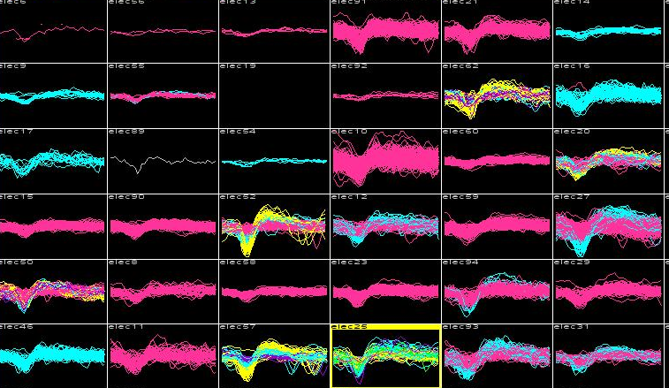

Slide 6
