Slide 1

Neuronal Population Decoding Can Account
for
Perceptual Lightness Illusions
David H. Brainard¹, Douglas A. Ruff², & Marlene R. Cohen²
¹University of Pennsylvania
²University of Pittsburgh

Slide 2
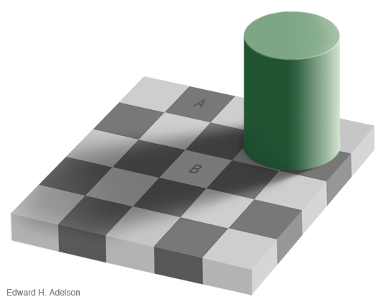

Lightness Is Not Luminance
Adelson’s Checker Shadow Illusion: http://web.mit.edu/persci/people/adelson/checkershadow_illusion.html

Slide 3
Such effects support perception of intrinsic object properties
Lightness appears to be correlated with surface reflectance

Slide 4
Outline
Long term goal
We want to understand how the visual cortex represents lightness.
Work reported today
Human psychophysics to quantify a perceptual lightness effect.
Physiological measurements of neural responses in monkey V1 and V4 to same stimuli, using implanted multi-electrode arrays.
Link physiology and psychophysics via population decoding of stimulus luminance.

Slide 5


Paint and Shadow Checkerboards
Paint
Shadow
Disks placed at center of 5 by 5 checkerboards.
The 25 corresponding checks have same average luminance in the paint and shadow checkerboards.
Disks have matched local contrast and global surround luminance.
After Gilchrist, 2006; Hillis & Brainard, 2007; Gilchrist & Radonjić, 2010

Slide 6
Psychophysical Methods
Observer fixates center of display.
On each trial, two checkerboards with disks presented side by side.
Checkerboards are 3.5° by 3.5° and centered at +/- 3.5°.
Observer indicates which disk appears lighter. No feedback given.
.

Slide 7
Basic Psychophysical Data
Reference Disk in Paint
Reference Luminance 0.5

Slide 8
Point of Subjective Equality (PSE)
Reference Disk in Paint
Reference Luminance 0.5

Slide 9
Representing One PSE

Slide 10
Paint/Shadow Effect, One Subject

Slide 11
Psychophysics Summary

Slide 12
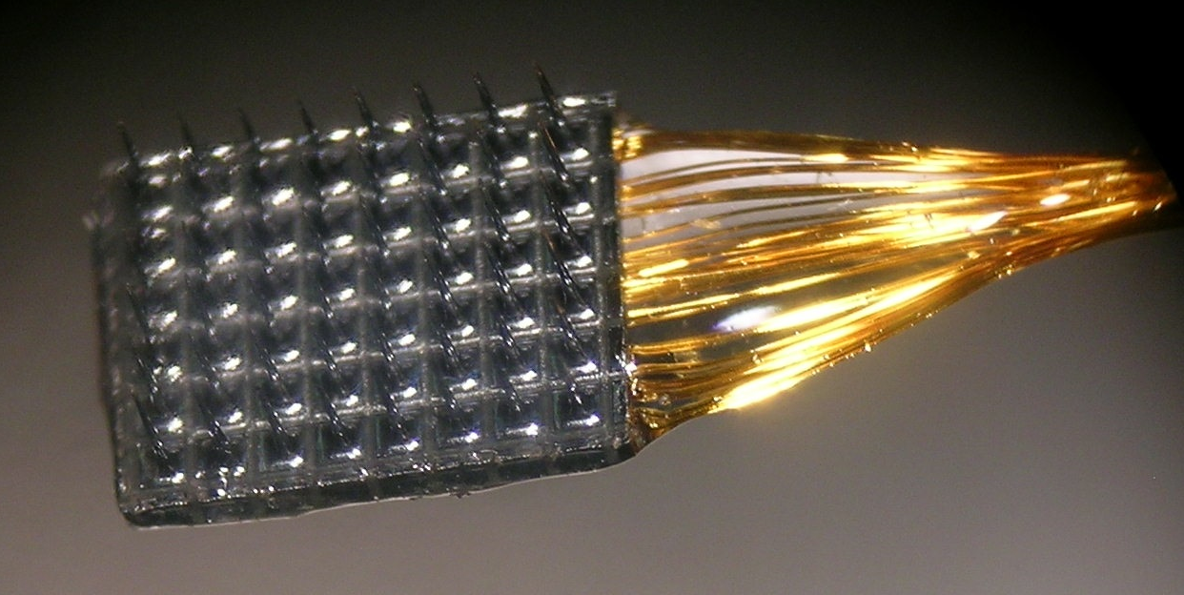
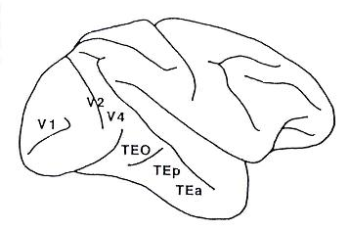
Physiology Methods
Electrode array recordings from V1 and V4 (in different monkeys).
Monkeys performed fixation task while a single checkerboard was presented on each trial; disk luminances between 0.2 and 1.0 (re display max).
Various stimulus sizes (3°-27° mostly 8°-12° checkerboards) and locations (2°-3.5° V1; 0.5°-2° V4) tested; generally stimuli were centered on the coverage of the arrays.
Manual spike sorting.

Slide 13
Population Decoder for Stimulus Luminance
Probe luminances for M trials
(typically 100s of trials per session)
Regression finds weights
N multiunit responses for each
trial (~90 multiunits)

Slide 14
Example Decoding (One V4 Session)
Leave-one-out cross validation used.
Decoder built with both paint and shadow trials.

Slide 15
Linking Decoding and Psychophysics
∂∂∂∂
∂∂∂∂
∂∂∂∂
∂∂∂∂

Slide 16
Linking Decoding and Psychophysics

Slide 17
Comparison: V1 Decoding, V4 Decoding, Psychophysics
V1
V4
Psychophysics
Session (nominal)

Slide 18
Conclusions/Thoughts
Can decode stimulus luminance from either V1 or V4 population responses.
Quantitative link between decoding and psychophysics.
For our dataset, V4 decoding is consistent with psychophysics, while V1 decoding is not.
Possible reasons for the V1/V4 effect
The V4 representation could be more “lightness-like”
than the V1 representation.
Differences in: stimulus size relative to single unit RF size,
population’s RF coverage of the checkerboard, stimulus size,
stimulus eccentricity, etc.
We think sorting out the reasons will provide insight
into the cortical representation of lightness.

Slide 19
Connection to Computational Eye and Brain
Would like to have model of input to V1, to understand better the form of information received there.
Would like eventually to extend models to V1 neurons and compare to measurements as well as psychophysical performance.
Would like computational framework for modeling transformations between V1 and V4 (and beyond).
Several other lab projects would also benefit from the computations (modeling single cone psychophysics, learning cone types, modeling perception in high dynamic range displays, modeling front end contributions to color constancy, understanding visual discrimination for natural scenes, refining ‘silent substitution’ stimulation techniques, ….)

