Slide 1
King County Real Estate: Modeling Sale Prices with Multiple Regression
David Braslow
March 6, 2019

Slide 2
Overview
This analysis includes 21,597 houses sold in King’s County from May 2014 to May 2015.
Our dataset includes many features of these houses, which I will use to predict sale prices. For example:
Zip Code
Square Footage
Number of Bedrooms
This model may be useful for King County residents in a number of ways.
House sellers can better determine their list prices
House buyers can better determine how much to offer
Homeowners can understand the potential value of renovations

Slide 3
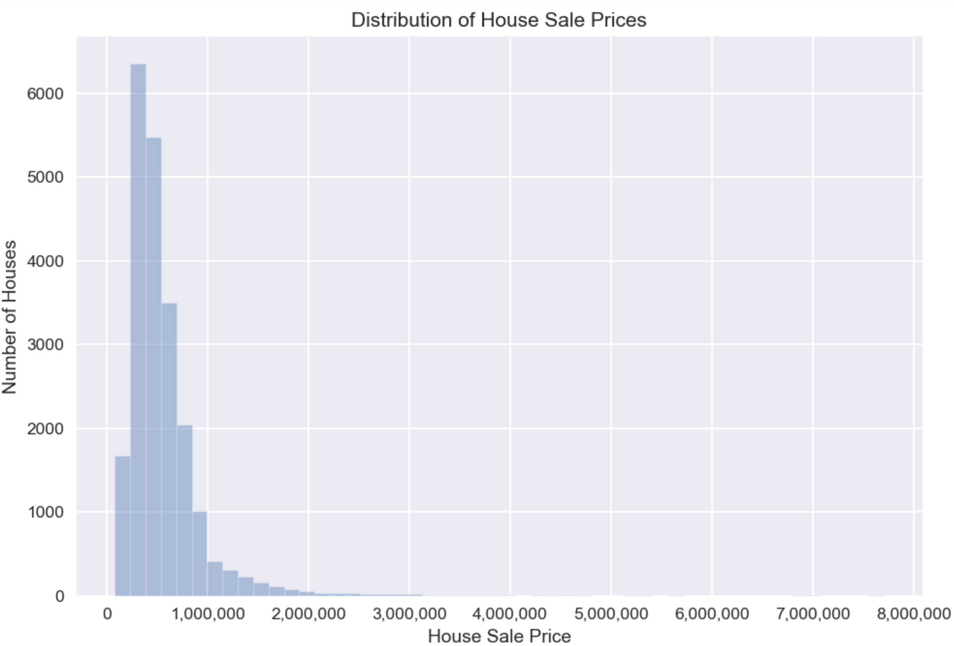
Most Houses Sell for Under $1m, with Some Large Outliers
House sale prices in Kings County range from $78k to $7.7m
Most houses sell for under $1m, with a median sale price of $450k

Slide 4
Regression Model Explains Most Variation
Variation in House Sale Prices
The regression model used for this analysis explains 84% of the variation in house sale prices
Total
84%
Explained

Slide 5
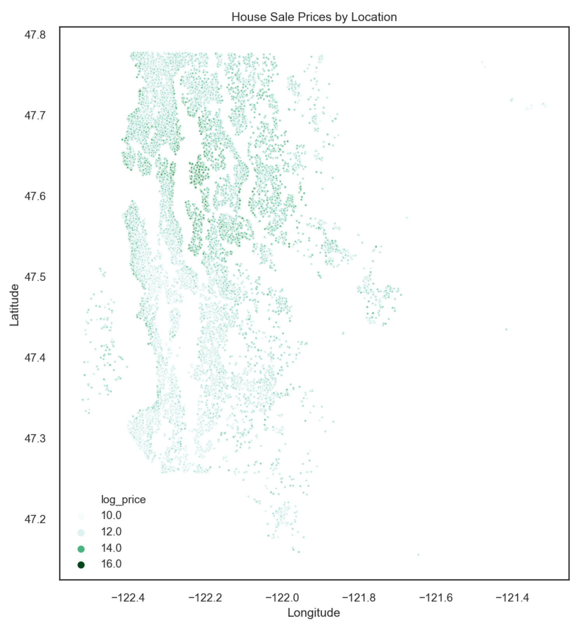
Location, Location, Location
More expensive houses are located toward the middle of King County, or on the waterfront to the west.

Slide 6
Key Features
Waterfront properties are far more valuable than comparable properties not on the water
The King County Grade system is a useful predictor of sales prices
Additional bathrooms increase home values substantially
Renovations can improve house value
* Values are approximate, based on an aggregate of multiple estimates

Slide 7
Summary
Data available from King County about house sales can be used to predict house prices fairly well.
Future analyses using more sophisticated modeling approaches may provide even more predictive power.

