Slide 1
Gene Severity Analysis: Predicting Rater Concurrence
David Braslow
April 23, 2019

Slide 2
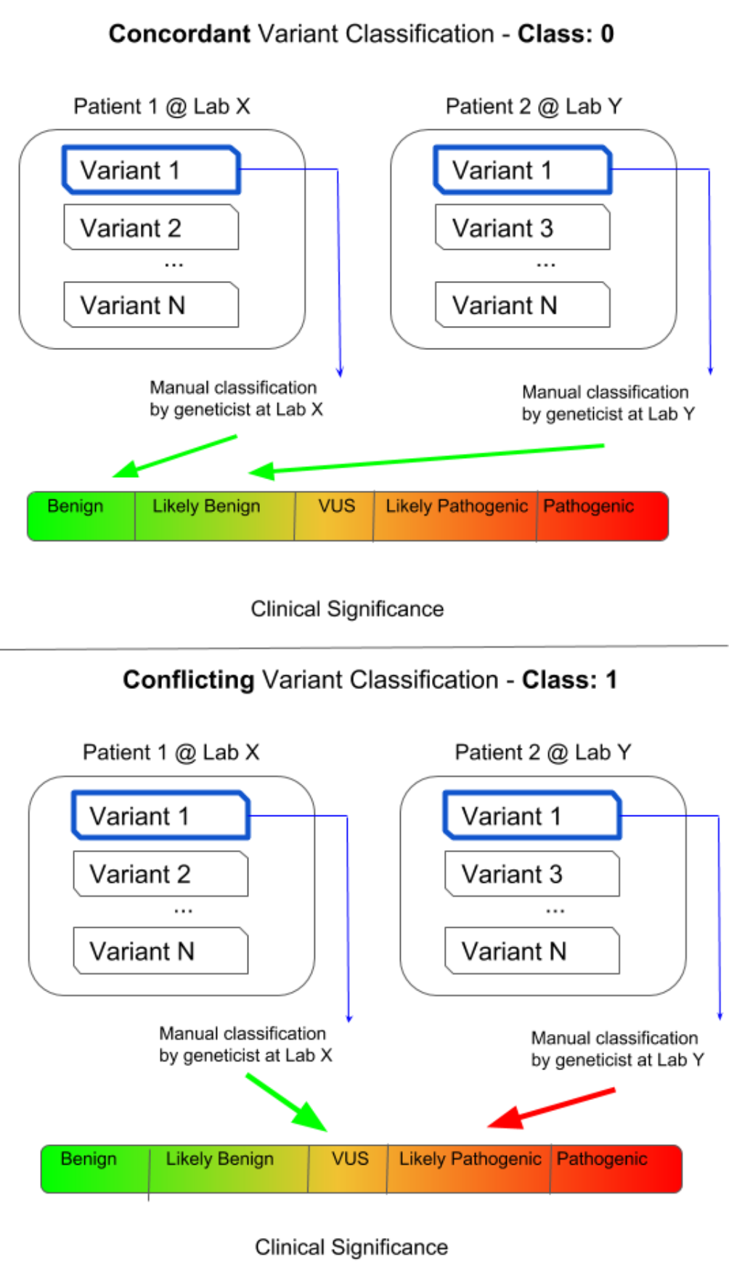
Introduction
Gene variants can have low or high clinical significance.
Can I predict when geneticists will disagree?

Slide 3

Obtaining the Data
https://www.kaggle.com/kevinarvai/clinvar-conflicting/version/3

Slide 4
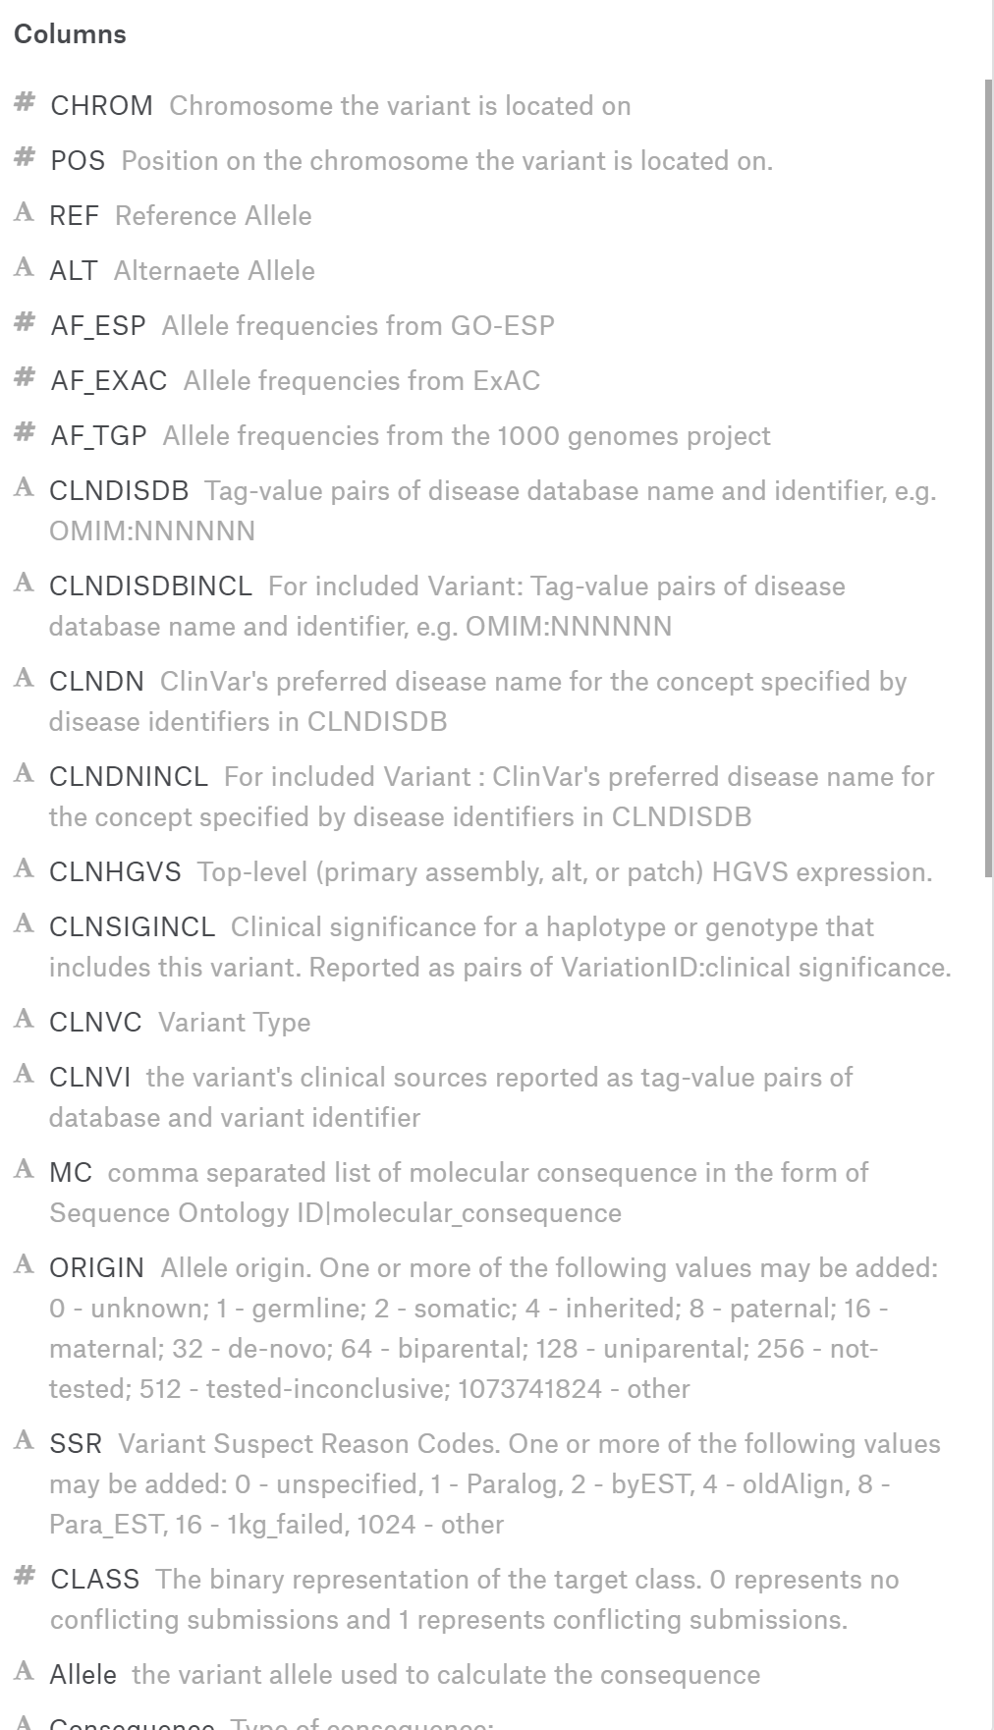
Scrubbing the Data
45 gene properties, most are categorical

Slide 5
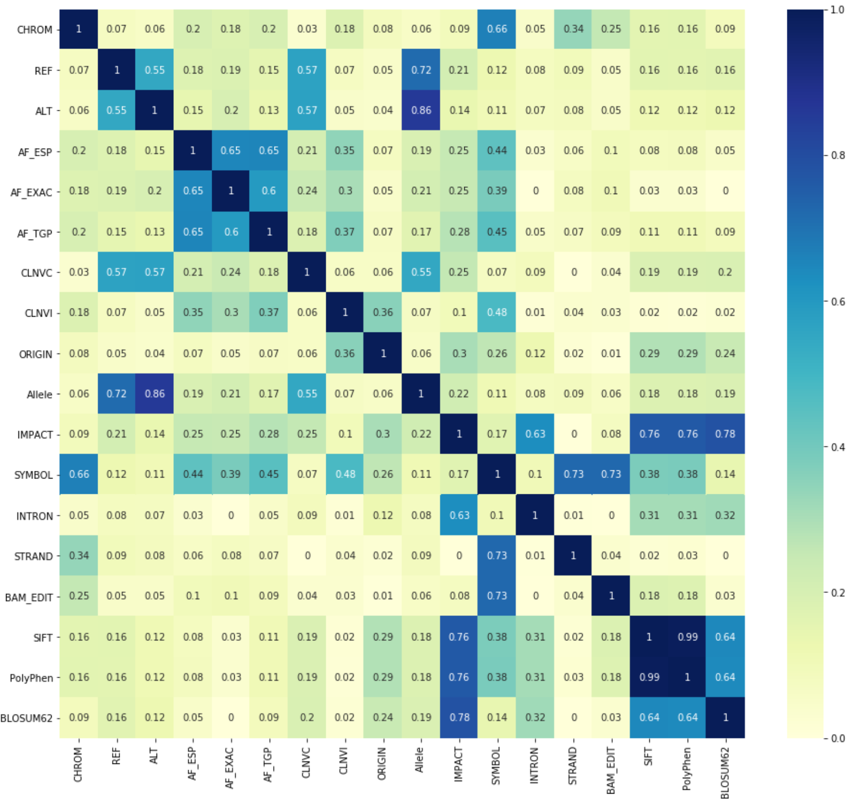
Exploring the Data
Feature Correlations

Slide 6
Modeling the Data

Slide 7
Interpreting the Results
Most Informative Features

Slide 8
Summary
Naïve Bayes modeling can improve prediction of conflicting ratings
This model can help prioritize research
There is still room for improvement with the model

