Slide 1
Toxic Comment Classification
David Braslow
May 8, 2019

Slide 2
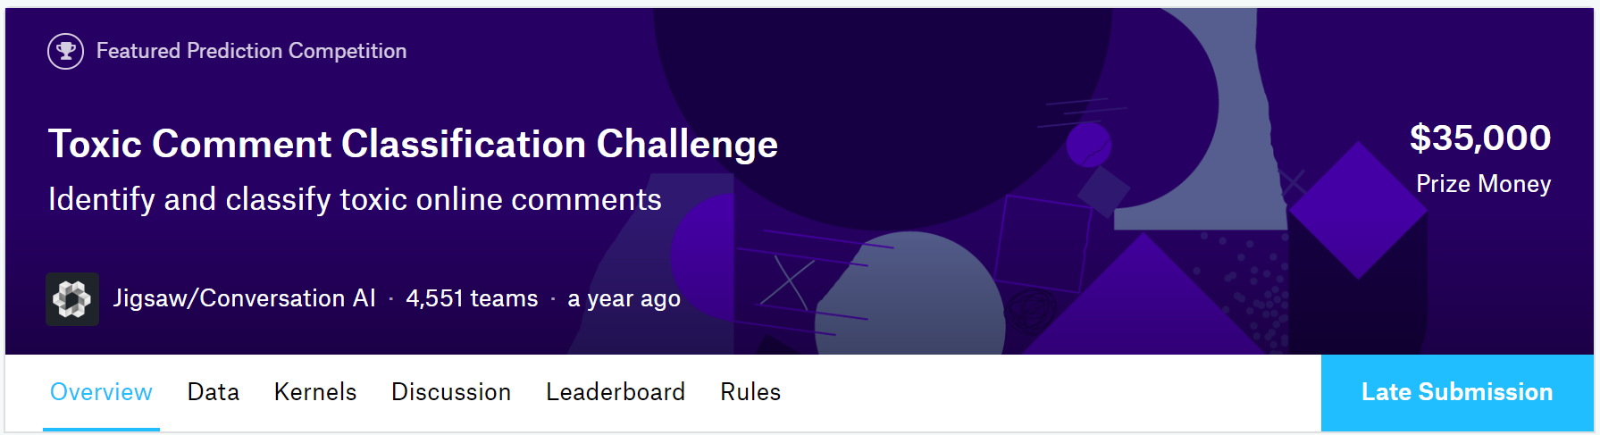
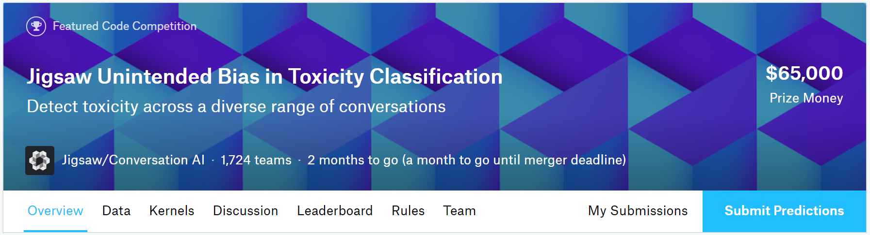
Overview
2018
2019
Detect toxic comments
Detect toxic comments ― and minimize unintended model bias

Slide 3
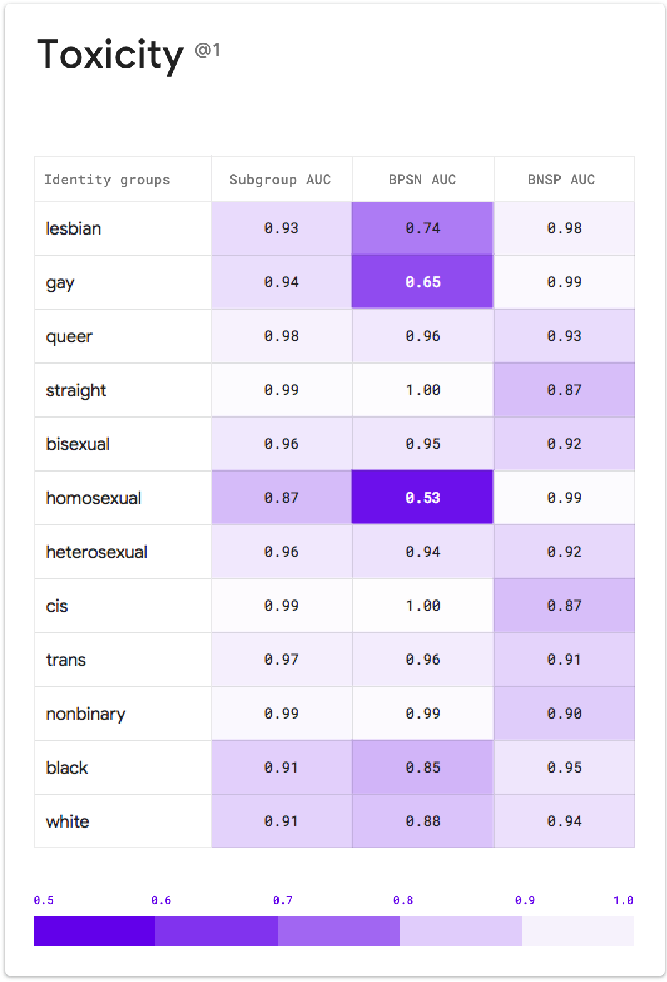
Identity Attributes

Slide 4
Data Exploration

Slide 5
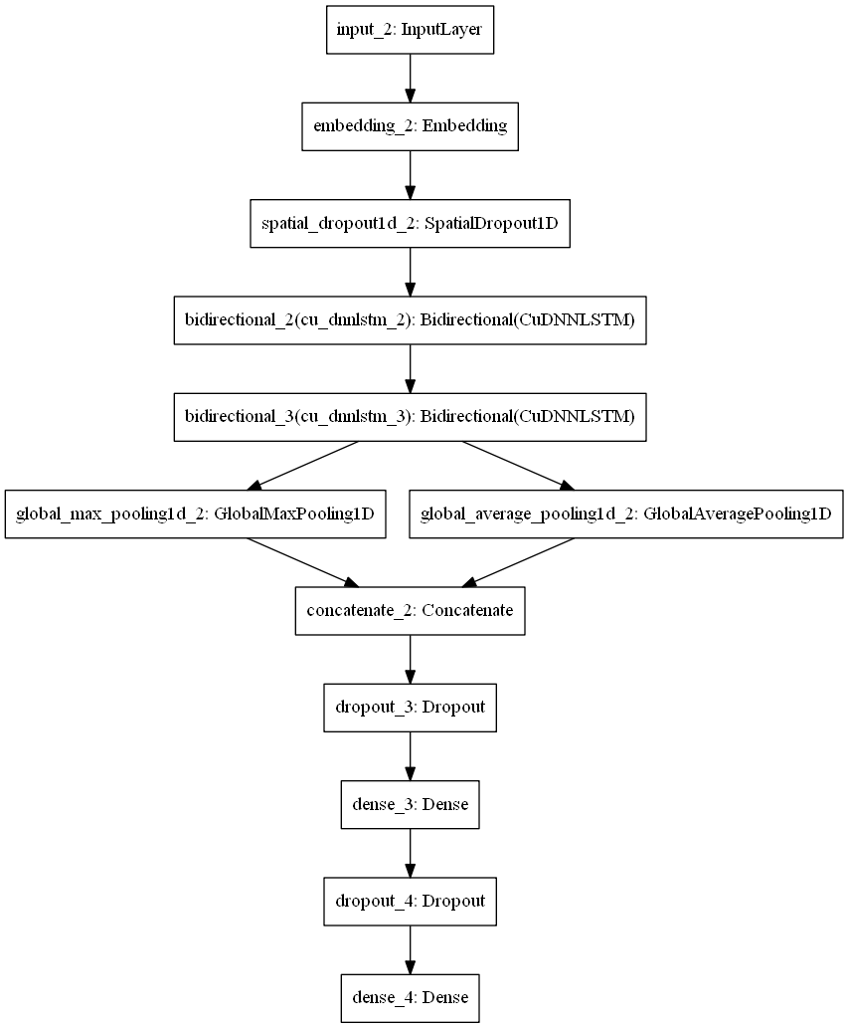
Model Architecture

Slide 6
Results

Slide 7
Subgroup Results
 | Subgroup AUC | BPSN AUC | BNSP AUC
male | 0.88 | 0.92 | 0.93
female | 0.94 | 0.92 | 0.96
homosexual_gay_or_lesbian | 0.84 | 0.78 | 0.98
christian | 0.90 | 0.95 | 0.89
jewish | 0.88 | 0.91 | 0.93
muslim | 0.82 | 0.88 | 0.93
black | 0.83 | 0.77 | 0.97
white | 0.82 | 0.84 | 0.95
psychiatric_or_mental_illness | 0.88 | 0.97 | 0.85

Slide 8
Conclusion
I can predict comment toxicity well using Bidirectional neural networks
This will be useful for flagging comments for removal
Race-based toxicity is particularly challenging to identify
Model improvement is possible with more computing resources

