Slide 1
Flatiron Capstone Project: LANL Earthquake Detection
David Braslow
May 17, 2019

Slide 2
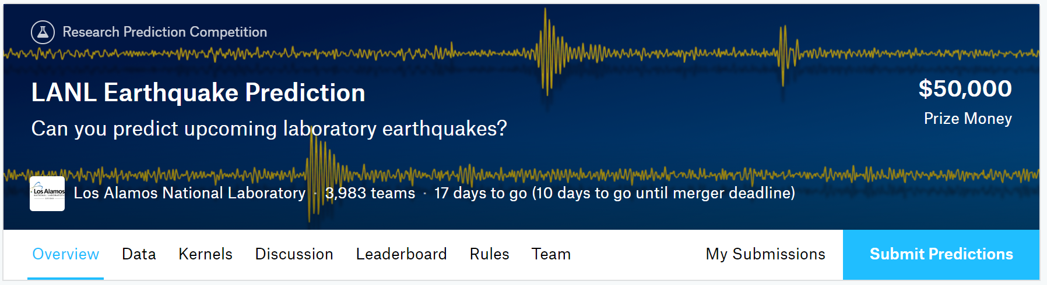
Overview
https://www.kaggle.com/c/LANL-Earthquake-Prediction

Slide 3
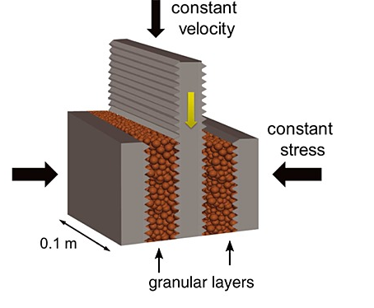
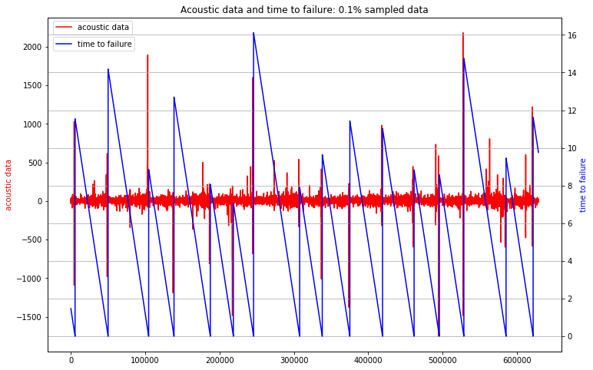
Predicting “Time to Failure”
Notes:
The data are from an experiment conducted on rock in a double direct shear geometry subjected to bi-axial loading, a classic laboratory earthquake model (fig. a)
Two fault gouge layers are sheared simultaneously while subjected to a constant normal load and a prescribed shear velocity. The laboratory faults fail in repetitive cycles of stick and slip that is meant to mimic the cycle of loading and failure on tectonic faults. While the experiment is considerably simpler than a fault in Earth, it shares many physical characteristics. (fig. b)
Los Alamos' initial work showed that the prediction of laboratory earthquakes from continuous seismic data is possible in the case of quasi-periodic laboratory seismic cycles. In this competition, the team has provided a much more challenging dataset with considerably more aperiodic earthquake failures.

Slide 4
Data Processing
Extract and augment acoustic snippets from original acoustic file
Generate over 2000 features for each training and test sample
Select features that are useful for predicting “time to failure”

Slide 5
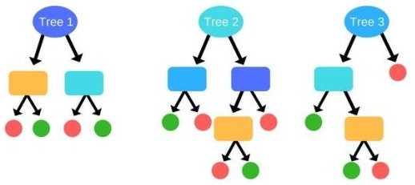
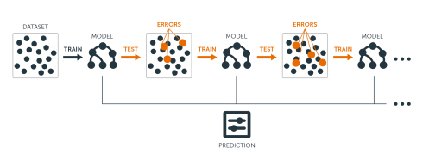
Modeling Approaches
Random Forest
Gradient-Boosting Machine

Slide 6
Results

Slide 7
Conclusion
I can predict the timing of aperiodic earthquakes moderately well using gradient-boosted trees
This can be useful for advancing seismology research and for improving public earthquake warning systems
Model improvement may be possible using continuous acoustic data, rather than relying on acoustic snippets
Additional computing resources could yield further improvements with more feature engineering and model testing

