Slide 1
Flatiron Capstone Project: LANL Earthquake Detection
David Braslow
May 17, 2019

Slide 2
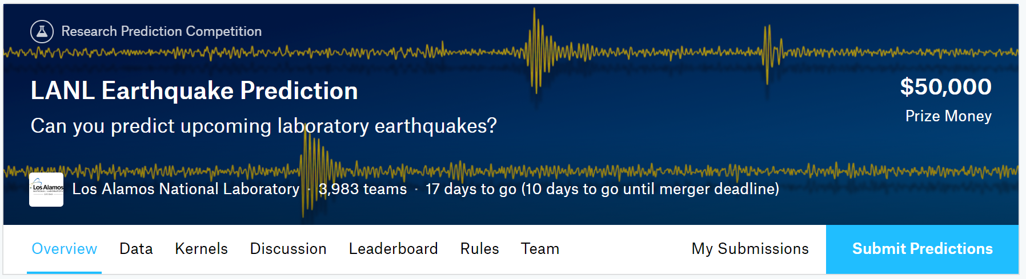
Overview
https://www.kaggle.com/c/LANL-Earthquake-Prediction

Slide 3
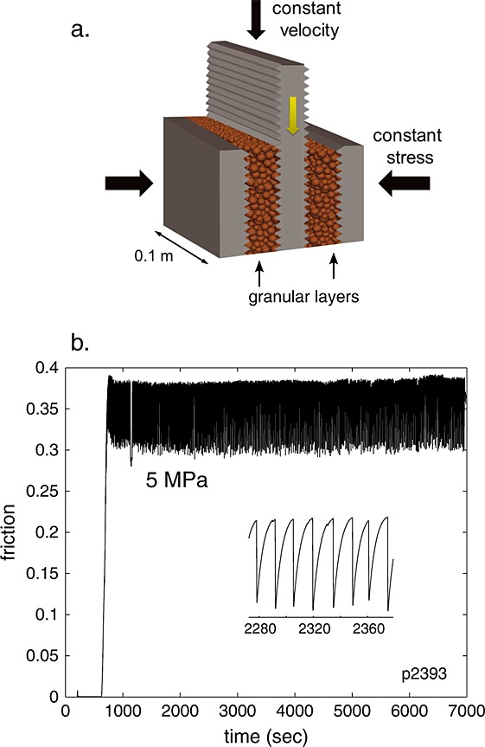
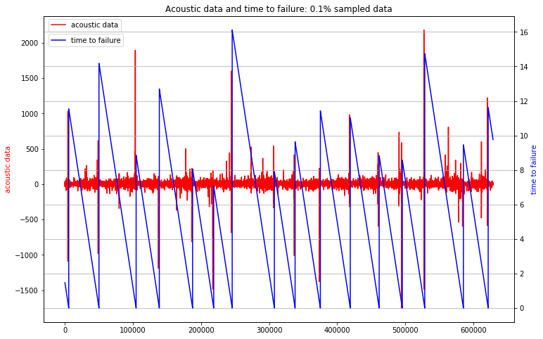
Predicting “Time to Failure”
Notes:
The data are from an experiment conducted on rock in a double direct shear geometry subjected to bi-axial loading, a classic laboratory earthquake model (fig. a)
Two fault gouge layers are sheared simultaneously while subjected to a constant normal load and a prescribed shear velocity. The laboratory faults fail in repetitive cycles of stick and slip that is meant to mimic the cycle of loading and failure on tectonic faults. While the experiment is considerably simpler than a fault in Earth, it shares many physical characteristics. (fig. b)
Los Alamos' initial work showed that the prediction of laboratory earthquakes from continuous seismic data is possible in the case of quasi-periodic laboratory seismic cycles. In this competition, the team has provided a much more challenging dataset with considerably more aperiodic earthquake failures.

Slide 4
Data Exploration

Slide 5
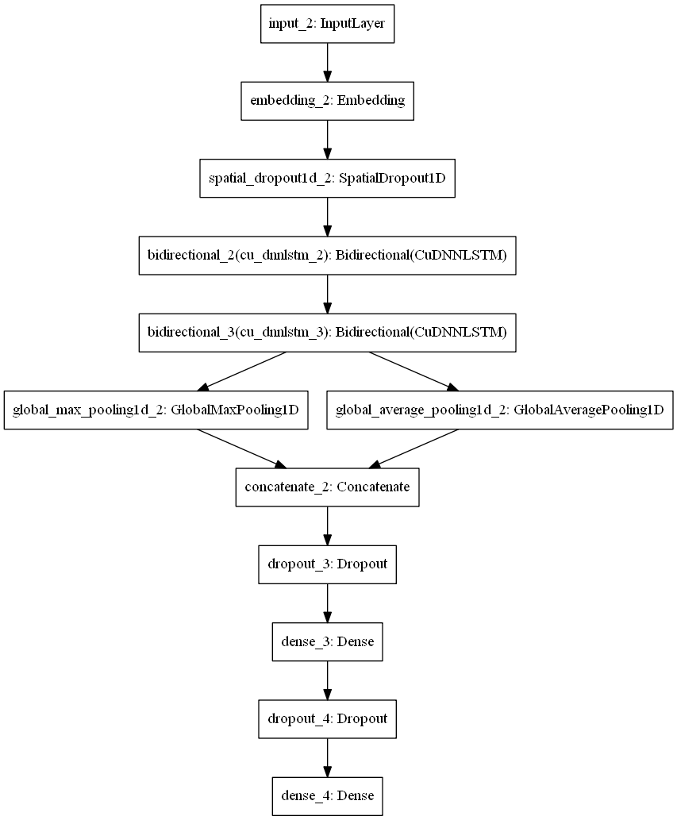
Model Architecture

Slide 6
Results

Slide 7
Subgroup Results
 | Subgroup AUC | BPSN AUC | BNSP AUC
male | 0.88 | 0.92 | 0.93
female | 0.94 | 0.92 | 0.96
homosexual_gay_or_lesbian | 0.84 | 0.78 | 0.98
christian | 0.90 | 0.95 | 0.89
jewish | 0.88 | 0.91 | 0.93
muslim | 0.82 | 0.88 | 0.93
black | 0.83 | 0.77 | 0.97
white | 0.82 | 0.84 | 0.95
psychiatric_or_mental_illness | 0.88 | 0.97 | 0.85

Slide 8
Conclusion
I can predict comment toxicity well using Bidirectional neural networks
This will be useful for flagging comments for removal
Race-based toxicity is particularly challenging to identify
Model improvement is possible with more computing resources

