Slide 1
Linear Regression
Lecture 12:

Slide 2
Correlation
PSY 348
What do you remember about correlations?

Slide 3
Correlation
PSY 348
Assesses how two variables move in relation to one another.

Slide 4
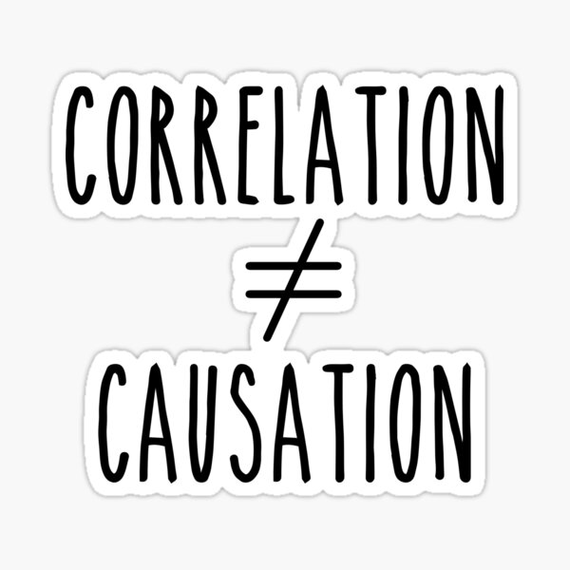
Correlation
PSY 348

Slide 5

Correlation
PSY 348

Slide 6
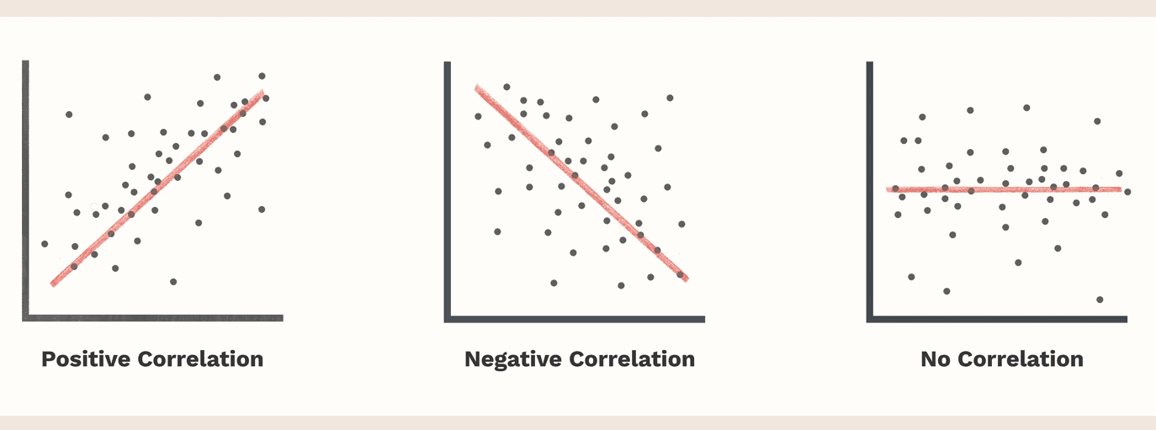
Correlation
PSY 348

Slide 7
Correlation
PSY 348

Slide 8
Correlation
PSY 348
All variables in correlation must be continuous (interval or ratio).

Slide 9
Statistics
PSY 348
Univariate
Bivariate
Multivariate

Slide 10
Statistics
PSY 348
Univariate = one variable
Bivariate = two variables
Multivariate = more than two variables

Slide 11
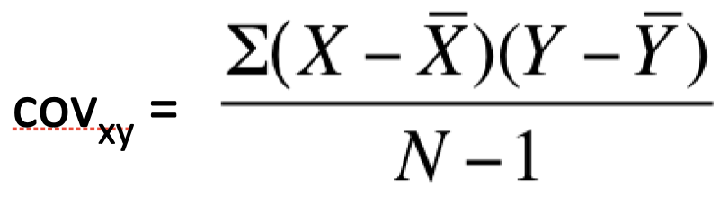
Statistics
PSY 348

Slide 12
Covariance
PSY 348

Slide 13
Covariance
PSY 348

Slide 14

Covariance
PSY 348
Covariance refers to how two continuous variables vary in tandem.

Slide 15
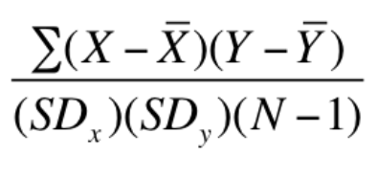
Statistics
PSY 348

Slide 16
Correlation
PSY 348
Covariance is the bivariate version of variance.

Slide 17
Correlation
PSY 348
Covariance is the bivariate version of variance.
Covariance, like variance, is not very useful, because it is inflated.

Slide 18
Correlation
PSY 348
Covariance is the bivariate version of variance.
Covariance, like variance, is not very useful, because it is inflated.
Correlation is the bivariate version of the standard deviation.
Correlation, like standard deviation, is interpretable, because it has been standardized.

Slide 19
Correlation
PSY 348
Correlation is bounded between -1 and +1.
Closer to -1 is a negative correlation.
Closer to +1 is a positive correlation.
Closer to 0 means no correlation.

Slide 20
Correlation size
PSY 348
Number of pirates in the world AND global temperature: - 0.5

Slide 21
Correlation size
PSY 348
Number of pirates in the world AND global temperature: - 0.5
Annual number of Americans who died after falling in a swimming pool AND annual number of films Nicholas cage was in: 0.3

Slide 22
Correlation size
PSY 348
Number of pirates in the world AND global temperature: - 0.5
Annual number of Americans who died after falling in a swimming pool AND annual number of films Nicholas cage was in: 0.3
Number of letters in the winning word in the National Spelling Bee AND number of people who die annually from venomous spider bites: 0.7

Slide 23
Correlation and R^2
PSY 348
Correlation is written as r
If we square r, we get R^2
R^2 is always positive
R^2 refers to:
The amount of x accounted for by y.
The amount of y accounted for by x.

Slide 24
Correlation and R^2
PSY 348
Example: Students grades in MTH 101 and their grades in PSY 348 correlation at r = 0.3
What size is the correlation?

Slide 25
Correlation and R^2
PSY 348
Example: Students grades in MTH 101 and their grades in PSY 348 correlation at r = 0.3
Small correlation
How much of you PSY 348 grade is accounted for by your MTH 101 grade?

Slide 26
Correlation and R^2
PSY 348
Example: Students grades in MTH 101 and their grades in PSY 348 correlation at r = 0.3
Moderate correlation
How much of you PSY 348 grade is accounted for by your MTH 101 grade?
0.3 x 0.3 = 0.09

Slide 27
Correlation and R^2
PSY 348
Example: Students grades in MTH 101 and their grades in PSY 348 correlation at r = 0.3
Moderate correlation
How much of you PSY 348 grade is accounted for by your MTH 101 grade?
0.3 x 0.3 = 0.09
R^2 = 9% of your PSY 348 grade is explained by your MTH 101 grade.

Slide 28
Linear Regression

Slide 29
Types of Analysis
PSY 348
Univariate
Bivariate
Multivariate

Slide 30
Types of Analysis
PSY 348
Univariate: One variable, like the mean
Bivariate: Two variables, like correlation
Multivariate: More than 2 variables

Slide 31
Regression
PSY 348
Regression is the multivariate version of correlation.
Correlation is the bivariate version of regression.

Slide 32
Regression
PSY 348
Regression is the multivariate version of correlation.
Correlation is the bivariate version of regression.
We’re doing the same thing in regression as we do in correlation, BUT there are more than 2 variables.

Slide 33
Regression
PSY 348
Regression is often used to make predictions.
We will call some of the variables “predictors.”

Slide 34
Regression
PSY 348
Regression is often used to make predictions.
We will call some of the variables “predictors.”
BUT remember, this is multivariate correlation, and correlation does NOT mean causation.
These predictions are not causal predictions “X causes Y.”
These predictions say, “Based on the data we have, we estimate that Y will be this based on an X value of that.”

Slide 35
Regression
PSY 348
Regression is often used to make predictions.
We will call some of the variables “predictors.”
BUT remember, this is multivariate correlation, and correlation does NOT mean causation.
We can say “predicts” but not “causes.”

Slide 36
Regression terminology
PSY 348
In regression we will choose one variable to predict.
We call this y.
Y is the outcome variable.
Y is the predicted variable.

Slide 37
Regression terminology
PSY 348
In regression we will choose two or more variables we with believe predict y.
We call these x1, x2, etc.
Some people call these x and z.
X is the predictor variable.

Slide 38
Regression terminology
PSY 348
We we predict Y with X, we say;
we regress y on the x.

Slide 39
Regression Equation
PSY 348
Y_{i} = b₀ + b₁X_{1i} + e_{i}

Slide 40
Regression Equation
PSY 348
Y_{i} = b₀ + b₁X_{1i} + e_{i}
Weight
Error
The predicted value of y for a particular participant
Intercept
The value of a particular participant on the measure of x

Slide 41
Regression Equation
PSY 348
Y_{i} = b₀ + b₁X_{1i} + e_{i}
Random, so we can’t predict what it will be
Weight
Error
The predicted value of y for a particular participant
Intercept
The value of a particular participant on the measure of x

Slide 42
Regression Equation
PSY 348
Y_{i} = b₀ + b₁X_{1i} + e_{i}

Slide 43

Regression Equation
PSY 348
_{i} = b₀ + b₁X_{1i}
Y-hat

Slide 44
Regression Equation
PSY 348
_{i} = b₀ + b₁X_{1i}
_{Y = mx + b}

Slide 45
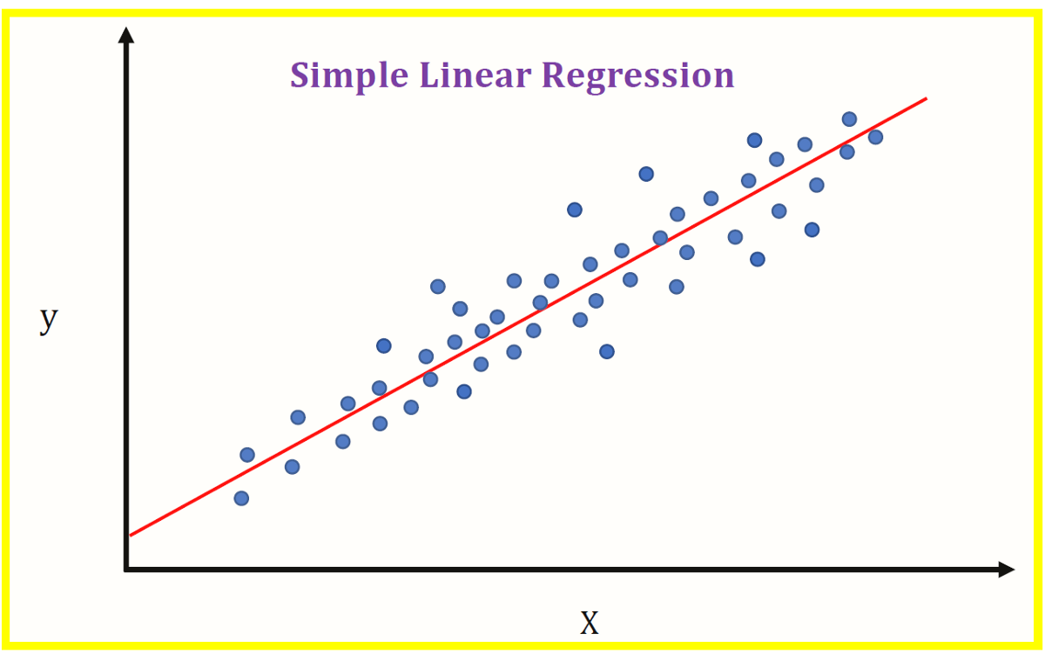
Linear Regression
PSY 348
This form of regression is called linear regression.

Slide 46
Regression
PSY 348
This form of regression is called linear regression.
Curvilinear regression uses a quadratic equation, but we won’t cover that in this course.

Slide 47
Regression: Equation Component Meanings
PSY 348
Y = theoretical prediction of y
= the actual y value for a participant
b₀ = the intercept: the average y value
X₁ = the x value for a participant
b₁ = a weighted value that is multiplied by x and added to b₀ to estimate y.

Slide 48
Regression Equation: Example
PSY 348
_{i} = b₀ + b₁X_{1i}
_{db} = b₀ + b₁X_{1db}

Slide 49
Regression Equation: Example
PSY 348
_{i} = b₀ + b₁X_{1i}
_{db} = b₀ + b₁X_{1db}
_{db} = 120 + 0.44X_{1db}

Slide 50
Regression Equation: Example
PSY 348
_{i} = b₀ + b₁X_{1i}
_{db} = b₀ + b₁X_{1db}
_{db} = 120 + 0.44X_{1db}
_{MaryBeth is 5’8” tall.}

Slide 51
Regression Equation: Example
PSY 348
_{i} = b₀ + b₁X_{1i}
_{db} = b₀ + b₁X_{1mb}
_{db} = 120 + 0.44X_{1db}
Suzie Q is 5’8” tall… 68 inches tall.

Slide 52
Regression Equation: Example
PSY 348
_{mb} = 120 + 0.44(68)
What is Suzie Q’s weight?

Slide 53
Regression Equation: More than one X
PSY 348
_{i} = b₀ + b₁X_{1i} +b₂X_{2i}

Slide 54
Regression: Equation Component Meanings
PSY 348
Y = theoretical prediction of y
= the actual y value for a participant
b₀ = the average y value
X₁ = the x₁ value for a participant
b₁ = a weighted value that is multiplied by x₁
X₂ = the x₂ value for a participant
b₂ = a weighted value that is multiplied by x₂

Slide 55
Regression Equation: More than one X
PSY 348
_{i} = b₀ + b₁X_{1i} +b₂X_{2i}

Slide 56
Interpreting coefficients

Slide 57
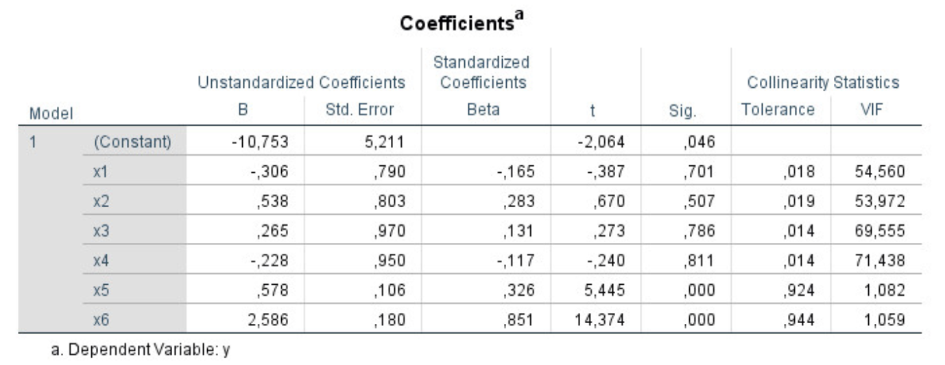
Interpreting coefficients
PSY 348

Slide 58
Interpreting coefficients
PSY 348
Unstandardized b coefficient
Beta coefficient
t-value
p-value

Slide 59
Interpreting coefficients
PSY 348
Unstandardized b coefficient
Beta coefficient
t-value
p-value <— is this a significant predictor of y?

Slide 60
Interpreting coefficients
PSY 348
Unstandardized b coefficient
Beta coefficient <— which predictor of y has the more predictive power?
t-value
p-value

Slide 61
Interpreting coefficients
PSY 348

Slide 62
SPSS

Slide 63
R^2
PSY 348
R^2 is the correlation coefficient (r) squared.
R^2 is always positive

Slide 64
R^2
PSY 348
R^2 is the correlation coefficient (r) squared.
R^2 is always positive
In correlation, the amount of y accounted for by x

Slide 65
R^2
PSY 348
In Regression, R^2 refers to the amount of y accounted for by all of the x’s.

Slide 66
R^2
PSY 348
In Regression, R^2 refers to the amount of y accounted for by all of the x’s.
How much of y did we account for?

Slide 67
R^2
PSY 348
In Regression, R^2 refers to the amount of y accounted for by all of the x’s.
How much of y did we account for?
Did we account for a significant amount of the variance in y?

Slide 68
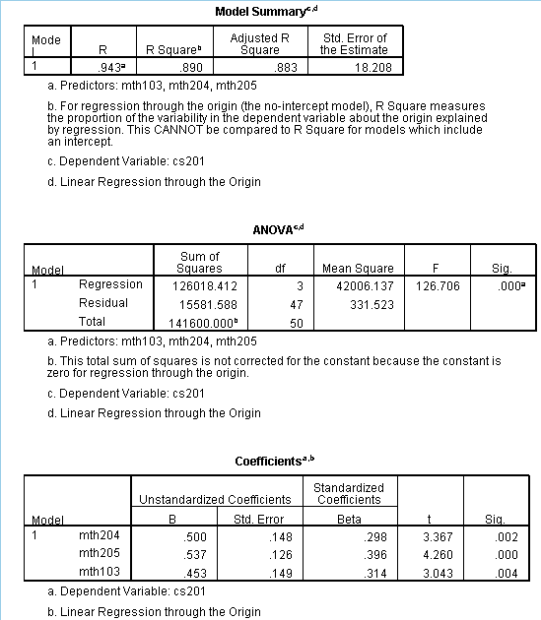
R^2
PSY 348

Slide 69
Interpreting R Squared
PSY 348
R Squared
Adjusted R Squared
F-value
p-value

Slide 70
Interpreting R Squared
PSY 348
R Squared
Adjusted R Squared
F-value
p-value <— is this a significant predictor of y?

Slide 71
Interpreting R Squared
PSY 348
R Squared <— The percentage of y accounted for by the predictors
Adjusted R Squared
F-value
p-value

Slide 72
Interpreting R Squared
PSY 348
R Squared
Adjusted R Squared <— The percentage of y accounted for by the predictors, controlling for using too many predictors
F-value
p-value

Slide 73
Example

Slide 74
Example
PSY 348
Dr. Apriceno wants to predict Halloween cheer.
She measures:
Number of horror movies watched
Number of pieces of Halloween candy consumed
Minutes spent in a Spirit Halloween store

Slide 75
Example
PSY 348
Horror movies
Candy
Spirit Halloween
Halloween cheer

Slide 76
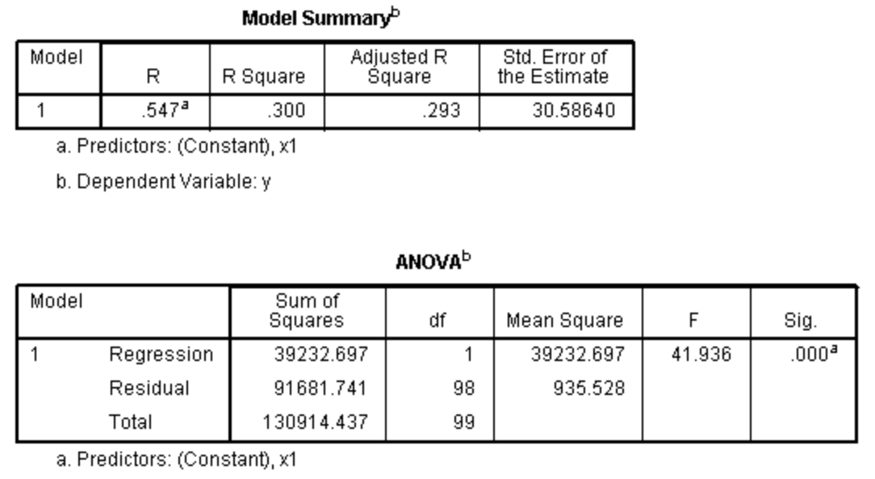
R^2
PSY 348

