Slide 1
Factorial ANOVA
Lecture 17

Slide 2
ANOVA
PSY 348

Slide 3
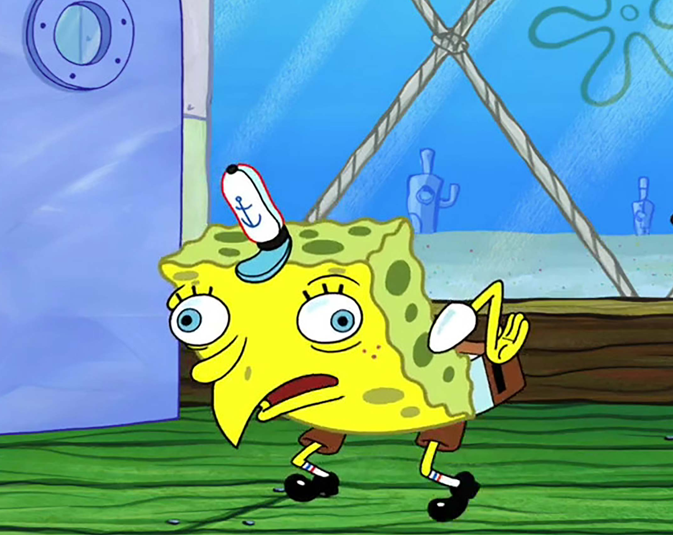
ANOVA
PSY 348
ANalysis
Of
VAriance

Slide 4
AnOVA
PSY 348
What does ANOVA do?

Slide 5
AnOVA
PSY 348
ANOVA compares the means of different groups to determine if they differ significantly from one another.

Slide 6
AnOVA
PSY 348
ANOVA compares the means of different groups to determine if they differ significantly from one another.
ANOVA can examine independent variables with more than 2 groups.

Slide 7
AnOVA
PSY 348
ANOVA compares the means of different groups to determine if they differ significantly from one another.
ANOVA can examine independent variables with more than 2 groups.
ANOVA can also look at multiple independent variables.

Slide 8
2-way AnOVA
PSY 348
Dr. Apriceno believes the key to happiness involves 2 things: coffee and Eric Andre. She wants to see if drinking coffee makes participants significantly happier than not drinking coffee. She also wants to see if watching the Eric Andre show makes them significantly happier than not watching it.
What kind of design is she using?

Slide 9
2-way AnOVA
PSY 348
Dr. Apriceno believes the key to happiness involves 2 things: coffee and Eric Andre. She wants to see if drinking coffee makes participants significantly happier than not drinking coffee. She also wants to see if watching the Eric Andre show makes them significantly happier than not watching it.
What kind of design is she using?
2 x 2

Slide 10
2-way AnOVA
PSY 348
We can write the design of a study analyzed using ANOVA as the number of groups/conditions in the first independent variable “x” the number of groups/conditions in the second independent variable, etc.
2 x 2

Slide 11
2-way AnOVA
PSY 348
Dr. Apriceno believes the key to happiness involves 2 things: coffee and Eric Andre. She wants to see if drinking coffee makes participants significantly happier than not drinking coffee. She also wants to see if watching the Eric Andre show makes them significantly happier than not watching it. This is a 2 x 2 design.
Number of groups in coffee: 2
Number of groups in Eric Andre: 2
DV?

Slide 12
2-way AnOVA
PSY 348
Dr. Apriceno believes the key to happiness involves 2 things: coffee and Eric Andre. She wants to see if drinking coffee makes participants significantly happier than not drinking coffee. She also wants to see if watching the Eric Andre show makes them significantly happier than not watching it. This is a 2 x 2 design.
Number of groups in coffee: 2
Number of groups in Eric Andre: 2
DV = Happiness

Slide 13
2-way AnOVA
PSY 348
Dr. Apriceno believes the key to happiness involves 2 things: coffee and Eric Andre. She wants to see if drinking coffee makes participants significantly happier than not drinking coffee. She also wants to see if watching the Eric Andre show makes them significantly happier than not watching it. This is a 2 x 2 design.
What are Dr. Apriceno’s Alternative Hypotheses?

Slide 14
2-way AnOVA
PSY 348
Dr. Apriceno believes the key to happiness involves 2 things: coffee and Eric Andre. She wants to see if drinking coffee makes participants significantly happier than not drinking coffee. She also wants to see if watching the Eric Andre show makes them significantly happier than not watching it. This is a 2 x 2 design.
What are Dr. Apriceno’s Alternative Hypotheses?
Participants who drink coffee will be significantly happier than those who don’t.
Participants who watch Eric Andre will be significantly happier than those who don’t.

Slide 15
2-way AnOVA
PSY 348
Dr. Apriceno believes the key to happiness involves 2 things: coffee and Eric Andre. She wants to see if drinking coffee makes participants significantly happier than not drinking coffee. She also wants to see if watching the Eric Andre show makes them significantly happier than not watching it. This is a 2 x 2 design.
Participants who drink coffee will be significantly happier than those who don’t.
Participants who watch Eric Andre will be significantly happier than those who don’t.

Slide 16
2-way AnOVA
PSY 348
Dr. Apriceno believes the key to happiness involves 2 things: coffee and Eric Andre. She wants to see if drinking coffee makes participants significantly happier than not drinking coffee. She also wants to see if watching the Eric Andre show makes them significantly happier than not watching it. This is a 2 x 2 design.
Participants who drink coffee will be significantly happier than those who don’t.
Participants who watch Eric Andre will be significantly happier than those who don’t.
Participants who drink coffee while watching the Eric Andre Show will be the happiest.

Slide 17
anova
PSY 348
There are 3 types of ANOVA:
Between subjects One-Way or Factorial
Within subjects (repeated measures ANOVA)
Mixed designs (between and within together)

Slide 18
2-way Between subjects ANOVA
PSY 348
IVs must be nominal/categorical
DV must be continuous

Slide 19
2-way Between subjects ANOVA
PSY 348
IVs must be nominal/categorical
DV must be continuous
Both have to be categorial.

Slide 20
2-way ANOVA
PSY 348
To compare the means, we analyzing two types of variance:
Variance among all of the scores (error variance).
Variance between the groups of the first IV (between group variance 1).
Variance between the groups of the second IV (between group variance 2).
Variance between the combination of the groups (interaction variance).

Slide 21
2-way ANOVA
PSY 348
EA groups
Coffee groups

Slide 22
2-way ANOVA
PSY 348
EA groups
Coffee | Coffee
No coffee | No coffee
Coffee groups

Slide 23
2-way ANOVA
PSY 348
EA groups
Coffee Eric Andre | Coffee No Eric Andre
No coffee Eric Andre | No coffee No Eric Andre
Coffee groups

Slide 24
2-way ANOVA
PSY 348
To compare the means, we analyzing two types of variance:
Variance among all of the scores (within group variance).
Variance between the groups of the first IV (between group variance 1).
Variance between the groups of the second IV (between group variance 2).
Variance between the combination of the groups (interaction variance).

Slide 25
Calculating the Fs

Slide 26
Degrees of freedom
PSY 348
The number of observations (data points) in the data that are free to vary when estimating a statistic.

Slide 27
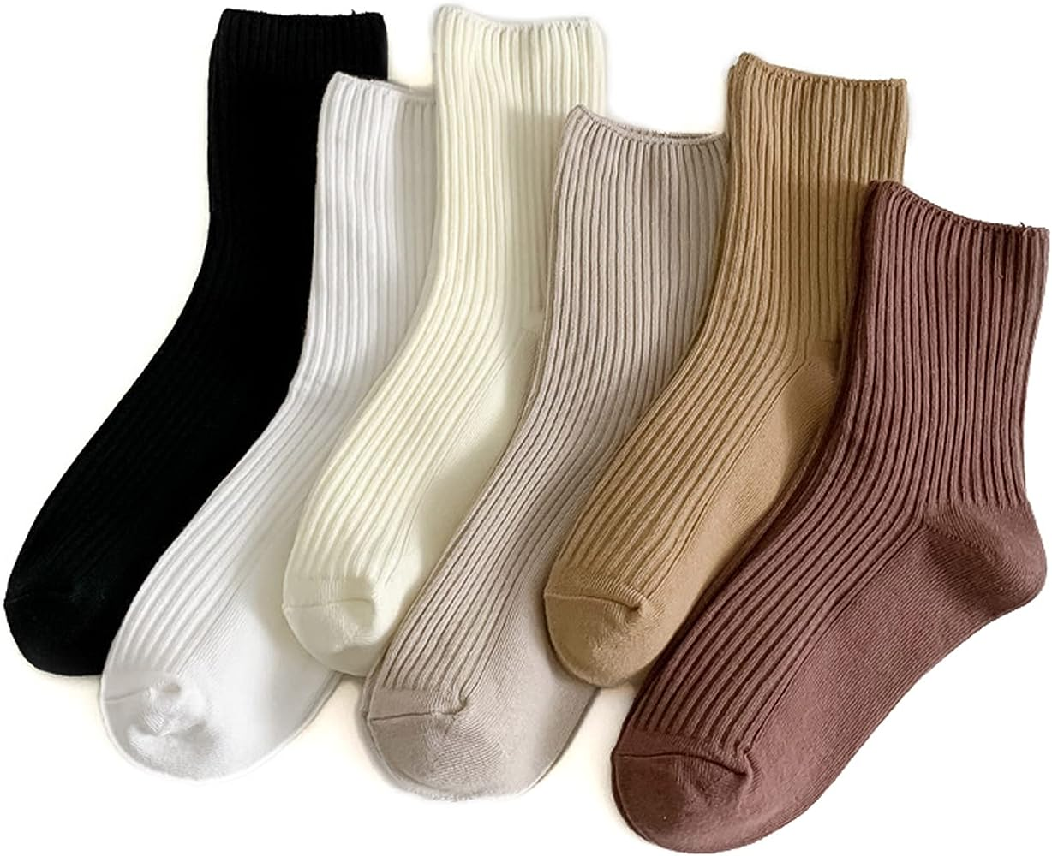
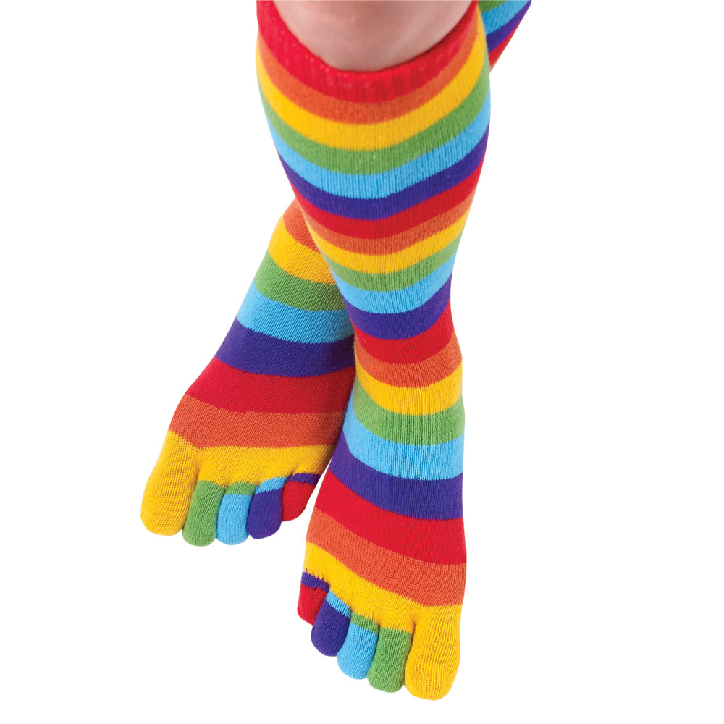
Degrees of freedom
PSY 348
The number of observations (data points) in the data that are free to vary when estimating a statistic.
I own 7 pairs of sock. I want to wear a different pair of socks every day.

Slide 28
Degrees of freedom
PSY 348
The number of observations (data points) in the data that are free to vary when estimating a statistic.
I own 7 pairs of sock. I want to wear a different pair of socks every day.
How many times do I get to pick A pair of socks to wear before I get stuck with what’s left?

Slide 29
Degrees of freedom
PSY 348
The number of observations (data points) in the data that are free to vary when estimating a statistic.
I own 7 pairs of sock. I want to wear a different pair of socks every day.
N - 1
How many times do I get to pick A pair of socks to wear before I get stuck with what’s left?

Slide 30
Degrees of freedom
PSY 348
The number of observations (data points) in the data that are free to vary when estimating a statistic.
The degrees of freedom is how many times things can vary before we are stuck with what’s left over.

Slide 31
Degrees of freedom
PSY 348
Between Groups (MS_{BG} ) = number of groups – 1
Error Groups (MS_{Error}) = number of participants – number of groups
Total = n – 1
*k is the number of groups in the independent variable.

Slide 32
Degrees of freedom
PSY 348
Between Groups 1 (MS_{BG1} ) = k₁ – 1
Between Groups 2 (MS_{BG2} ) = k₂ – 1
Interaction (MS_{Interaction}i) = (k₁ – 1) x (k₂ – 1)
Error (MS_{Error}) = n – (k₁ x k₂)
Total = n – 1
*k is the number of groups in each independent variable.

Slide 33
Calculating the ms in 2-way ANOVA
PSY 348
Between Group 1 Mean Squared: MS_{BG1} = SS_{BG1} / (k₁ – 1)
Between Group 2 Mean Squared: MS_{BG2} = SS_{BG2} / (k₂ – 1)
Interaction Mean Squared: MS_{Interaction} = SS_{Interaction /} (k₁ – 1) x (k₂ – 1)
Error Mean Squared: MS_{Error} = SS_{Error} / n – (k₁ x k₂)

Slide 34
Calculating 2-way ANOVA anova
PSY 348
F = MS_{BG1} / MS_{Error}
F = MS_{BG2} / MS_{Error}
F = MS_{Interaction} / MS_{Error}

Slide 35
Interpreting f

Slide 36
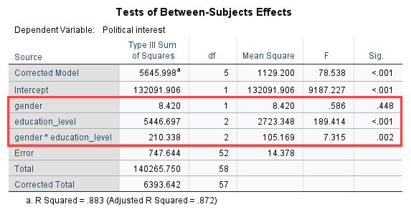
Interpreting the Fs in 2-way ANOVA
PSY 348

Slide 37
Interpreting the Fs in 2-way ANOVA
PSY 348
IV 1 = Gender
IV 2 = Education Level

Slide 38
Interpreting the Fs in 2-way ANOVA
PSY 348
F1 = Gender
F2 = Education Level
F3 = Interaction of Gender x Education Level

Slide 39
Interpreting the Fs in 2-way ANOVA
PSY 348

Slide 40
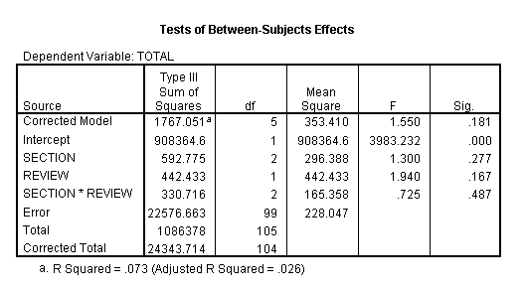
Interpreting the Fs in 2-way ANOVA
PSY 348
F1 =
F2 =
F3 =

Slide 41
Interpreting the Fs in 2-way ANOVA
PSY 348
F1 = Section
F2 = Review
F3 = Section x Review

Slide 42
2-way AnOVA
PSY 348
Dr. Apriceno believes the key to happiness involves 2 things: coffee and Eric Andre. She wants to see if drinking coffee makes participants significantly happier than not drinking coffee. She also wants to see if watching the Eric Andre show makes them significantly happier than not watching it.
She randomly assigns 100 participants to coffee or no coffee x Eric under no Eric Andre.

Slide 43
Calculating the Fs in 2-way ANOVA
PSY 348
Source | SS | df | MS | F
Coffee | 432
Eric Andre | 486
Coffee*EA | 540
Error | 5,184

Slide 44
Calculating the Fs in 2-way ANOVA
PSY 348
Source | SS | df | MS | F
Coffee | 432 | 1 | 432 | 8
Eric Andre | 486 | 1 | 486 | 9
Coffee*EA | 540 | 1 | 540 | 10
Error | 5,184 | 96 | 54

Slide 45
2-way AnOVA
PSY 348
Dr. Apriceno recruit 500 kiddos on Halloween. She assigns half to wear a costume with a mask, and the other half to wear a costume without a mask. She assigns participants to trick-or-treat alone or in groups. Then she measures how much candy each child collects while trick-or-treating.

Slide 46
Text
The results of this study will add to the body of knowledge on this topic and ﻿may assist colleges and universities to improve interactions and relationships between college students and individuals with disabilities by providing an analysis of college﻿ students' societal perceptions (emotions, cognition, behavior) regarding members of ﻿the disabled community. Additional data (e.g., basic demographic information, childhood exposure to disabilities) will be collected and analyzed and may provide further insights into the underling causes of these perceptions.

Slide 47
Calculating the Fs in 2-way ANOVA
PSY 348
Source | SS | df | MS | F
IV 1 | 252
IV 2 | 441
Interaction | 882
Error | 10,416

Slide 48
Calculating the Fs in 2-way ANOVA
PSY 348
Source | SS | df | MS | F
IV 1 | 252 | 1 | 252 | 12
IV 2 | 441 | 1 | 441 | 21
Interaction | 882 | 1 | 882 | 42
Error | 10,416 | 496 | 21

Slide 49
Calculating 2-way ANOVA anova
PSY 348
F = MS_{BG1} / MS_{Error}
F = MS_{BG2} / MS_{Error}
F = MS_{Interaction} / MS_{Error}
**All MS are divided by MS_{Error.}**

Slide 50
Reporting f

Slide 51
Reporting F
PSY 348
If asked to report findings in terms of the Null Hypothesis (H0), you should report findings as:
Reject H0, or
Fail to Reject H0

Slide 52
Reporting F
PSY 348
If asked to report findings in general or for publication, you need EACH F-vale:
F(df for the between group MS, df for the error MS)
= F-value
Corresponding p-value
*For significant results: Means and standard deviations of each group

Slide 53
Reporting F
PSY 348
The group that watched the Eric Andre Show (M=8.43, s=1.02) reported significantly more happiness compared to their peers in the control group who watched Jeopardy (M=6.12, s=0.98), F(1,496) = 7.12, p < 0.05.

Slide 54
Reporting F
PSY 348
Results IV1:
If significant: The group that watched the Eric Andre Show (M=8.43, s=1.02) reported significantly more happiness compared to their peers in the control group who watched Jeopardy (M=6.12, s=0.98), F (1, 496) = 7.12, p < 0.05.
If NOT significant: There was not a significant difference in happiness between the groups, F (1, 498) = 1.02, p = 0.07.

Slide 55
Reporting F
PSY 348
Results IV2:
If significant: The group that drank coffee (M=7.35, s=1.01) reported significantly more happiness compared to their peers in the control group who drank decaf (M=4.21, s=0.99), F (1, 496) = 9.12, p < 0.05.
If NOT significant: There was not a significant difference in happiness between the groups, F (1, 498) = 1.02, p = 0.07.

Slide 56
Reporting F
PSY 348
Results Interaction:
If significant: The group that drank coffee AND watched Eric Andre (M=7.35, s=1.01) reported significantly more happiness compared to the other groups (M=4.21, s=0.99), F (1, 496) = 11.14, p < 0.05.
If NOT significant: There was not a significant difference in happiness between the groups, F (1, 498) = 1.02, p = 0.07.

