Slide 1
Within Subjects ANOVA
Lecture 18

Slide 2
ANOVA
PSY 348
ANalysis
Of
VAriance

Slide 3
AnOVA
PSY 348
ANOVA, like t-tests, compares the means of different groups to determine if they differ significantly from one another:
Independent variable: Categorical / Nominal
Dependent variable: Continuous

Slide 4
2-way AnOVA
PSY 348
Prof. Brocker believes the key to happiness involves 2 things: drinking coffee and watching Dark. He randomly assigns 300 participants to drink coffee or decaf. He also randomly assigns them to watch the Dark or Jeopardy. He then measures their happiness on a scale of 1 (not happy) to 10 (so very happy).

Slide 5
2-way AnOVA
PSY 348
Dr. Apriceno believes the key to happiness involves 2 things: drinking coffee and watching the Eric Andre Show. She randomly assigns 300 participants to drink coffee or decaf. She also randomly assigns them to watch the Eric Andre Show or Jeopardy. She then measures their happiness on a scale of 1 (not happy) to 10 (so very happy).
Independent variable 1:

Slide 6
2-way AnOVA
PSY 348
Dr. Apriceno believes the key to happiness involves 2 things: drinking coffee and watching the Eric Andre Show. She randomly assigns 300 participants to drink coffee or decaf. She also randomly assigns them to watch the Eric Andre Show or Jeopardy. She then measures their happiness on a scale of 1 (not happy) to 10 (so very happy).
Independent variable 1: Coffee vs. Decaf
Independent variable 2:

Slide 7
2-way AnOVA
PSY 348
Dr. Apriceno believes the key to happiness involves 2 things: drinking coffee and watching the Eric Andre Show. She randomly assigns 300 participants to drink coffee or decaf. She also randomly assigns them to watch the Eric Andre Show or Jeopardy. She then measures their happiness on a scale of 1 (not happy) to 10 (so very happy).
Independent variable 1: Coffee vs. Decaf
Independent variable 2: Eric Andre Show vs. Jeopardy
Dependent variable:

Slide 8
2-way AnOVA
PSY 348
Prof. Brocker believes the key to happiness involves 2 things: drinking coffee and watching Dark. He randomly assigns 300 participants to drink coffee or decaf. He also randomly assigns them to watch the Dark or Jeopardy. He then measures their happiness on a scale of 1 (not happy) to 10 (so very happy).
Independent variable 1: Coffee vs. Decaf
Independent variable 2: Dark vs. Jeopardy
Dependent variable: Happiness

Slide 9
2-way AnOVA
PSY 348
Prof. Brocker believes the key to happiness involves 2 things: drinking coffee and watching Dark. He randomly assigns 300 participants to drink coffee or decaf. He also randomly assigns them to watch the Dark or Jeopardy. He then measures their happiness on a scale of 1 (not happy) to 10 (so very happy).

Slide 10
2-way AnOVA
PSY 348
2 x 2
Prof. Brocker believes the key to happiness involves 2 things: drinking coffee and watching Dark. He randomly assigns 300 participants to drink coffee or decaf. He also randomly assigns them to watch the Dark or Jeopardy. He then measures their happiness on a scale of 1 (not happy) to 10 (so very happy).

Slide 11
2-way ANOVA
PSY 348
Eric Andre
Jeopardy
Coffee
Decaf

Slide 12
2-way ANOVA
PSY 348
Eric Andre
Jeopardy
Coffee Eric Andre | Coffee Jeopardy
Decaf Eric Andre | Decaf Jeopardy
Coffee
Decaf

Slide 13
2-way ANOVA
PSY 348
Source |  | SS | df | MS | F
Coffee |  | 432
Eric Andre |  | 480
Coffee*EA |  | 576
Error |  | 14,208

Slide 14
2-way ANOVA
PSY 348
Source |  | SS | df | MS | F | p
Coffee |  | 432 | 1 | 432 | 9 | 0.05
Eric Andre |  | 480 | 1 | 480 | 10 | 0.02
Coffee*EA |  | 576 | 1 | 576 | 12 | 0.001
Error |  | 14,208 | 296 | 48

Slide 15
AnOVA
PSY 348
Dr. Apriceno wants to know if giving lollypops to statistics students improves their opinion of statistics. She asks 100 students to rate how much they enjoy statistics on a scale of 1 (not at all) to 10 (extremely). Then she gives each student a lollypop at the start of statistics class for 2 weeks. After two weeks of conditioning, Dr. Apriceno asks participants to rate how much they enjoy statistics again.

Slide 16
AnOVA
PSY 348
Dr. Apriceno wants to know if giving lollypops to statistics students improves their opinion of statistics. She asks 100 students to rate how much they enjoy statistics on a scale of 1 (not at all) to 10 (extremely). Then she gives each student a lollypop at the start of statistics class for 2 weeks. After two weeks of conditioning, Dr. Apriceno asks participants to rate how much they enjoy statistics again.
Independent variable:

Slide 17
AnOVA
PSY 348
Dr. Apriceno wants to know if giving lollypops to statistics students improves their opinion of statistics. She asks 100 students to rate how much they enjoy statistics on a scale of 1 (not at all) to 10 (extremely). Then she gives each student a lollypop at the start of statistics class for 2 weeks. After two weeks of conditioning, Dr. Apriceno asks participants to rate how much they enjoy statistics again.
Independent variable: Time (before and after)

Slide 18
Within subjects AnOVA
PSY 348
Dr. Apriceno wants to know if giving lollypops to statistics students improves their opinion of statistics. She asks 100 students to rate how much they enjoy statistics on a scale of 1 (not at all) to 10 (extremely). Then she gives each student a lollypop at the start of statistics class for 2 weeks. After two weeks of conditioning, Dr. Apriceno asks participants to rate how much they enjoy statistics again.
Independent variable: Time (before and after)
Dependent variable:

Slide 19
Within subjects AnOVA
PSY 348
Dr. Apriceno wants to know if giving lollypops to statistics students improves their opinion of statistics. She asks 100 students to rate how much they enjoy statistics on a scale of 1 (not at all) to 10 (extremely). Then she gives each student a lollypop at the start of statistics class for 2 weeks. After two weeks of conditioning, Dr. Apriceno asks participants to rate how much they enjoy statistics again.
Independent variable: Time (before and after)
Dependent variable: Enjoyment of statistics

Slide 20
AnOVA
PSY 348
Between subjects ANOVA compares means BETWEEN groups to determine if they differ significantly from one another.
Within subjects ANOVA compares pre-manipulation means to post-manipulation means to determine if there is a difference WITHIN participants over time.

Slide 21
Within subjects AnOVA
PSY 348
Within subjects ANOVA examines differences within participants over time.
Within subjects ANOVA is also known as Repeated Measures ANOVA, because it looks at one measure repeated over time.

Slide 22
Within subjects AnOVA
PSY 348
The independent variable is time.
Before intervention: baseline or pre-test
After intervention: post-test

Slide 23
Within Subjects AnOVA
PSY 348
Within subjects ANOVA can look at 2 or more time points.

Slide 24
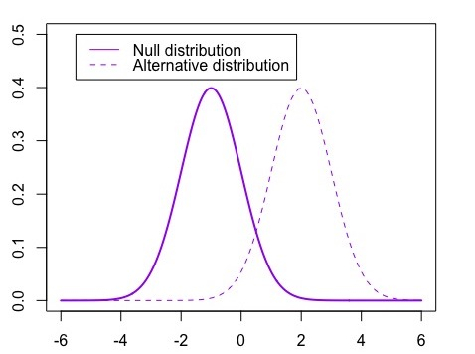
WITHIN subjects ANOVA
PSY 348

Slide 25
Between subjects ANOVA
PSY 348
In between subjects ANOVA, we analyze two types of variance:
Between Group variance: How the data varies between the groups
Error variance: How the data varies across all participants

Slide 26
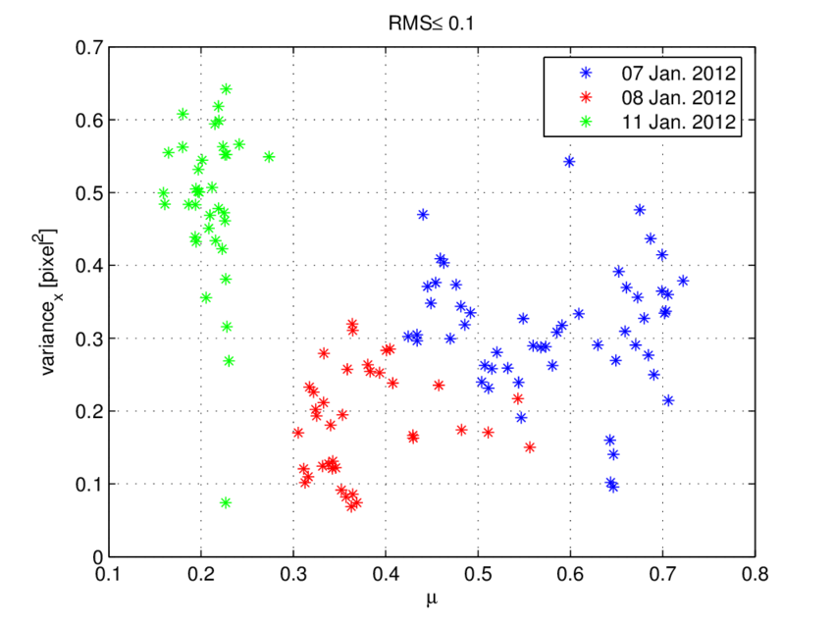
Between subjects ANOVA
PSY 348
Between Group variance: How the data varies between the groups
Error variance: How the data varies across all participants

Slide 27
WITHIN subjects ANOVA
PSY 348
In within subjects ANOVA the variance is more complicated, because data will differ in 3 ways:
Over time: between the time points just like between the groups

Slide 28
WITHIN subjects ANOVA
PSY 348
In within subjects ANOVA the variance is more complicated, because data will differ in 3 ways:
Over time
Error variance: How the data varies across all participants

Slide 29
WITHIN subjects ANOVA
PSY 348
In within subjects ANOVA the variance is more complicated, because data will differ in 3 ways:
Over time
Error variance
Per participant

Slide 30
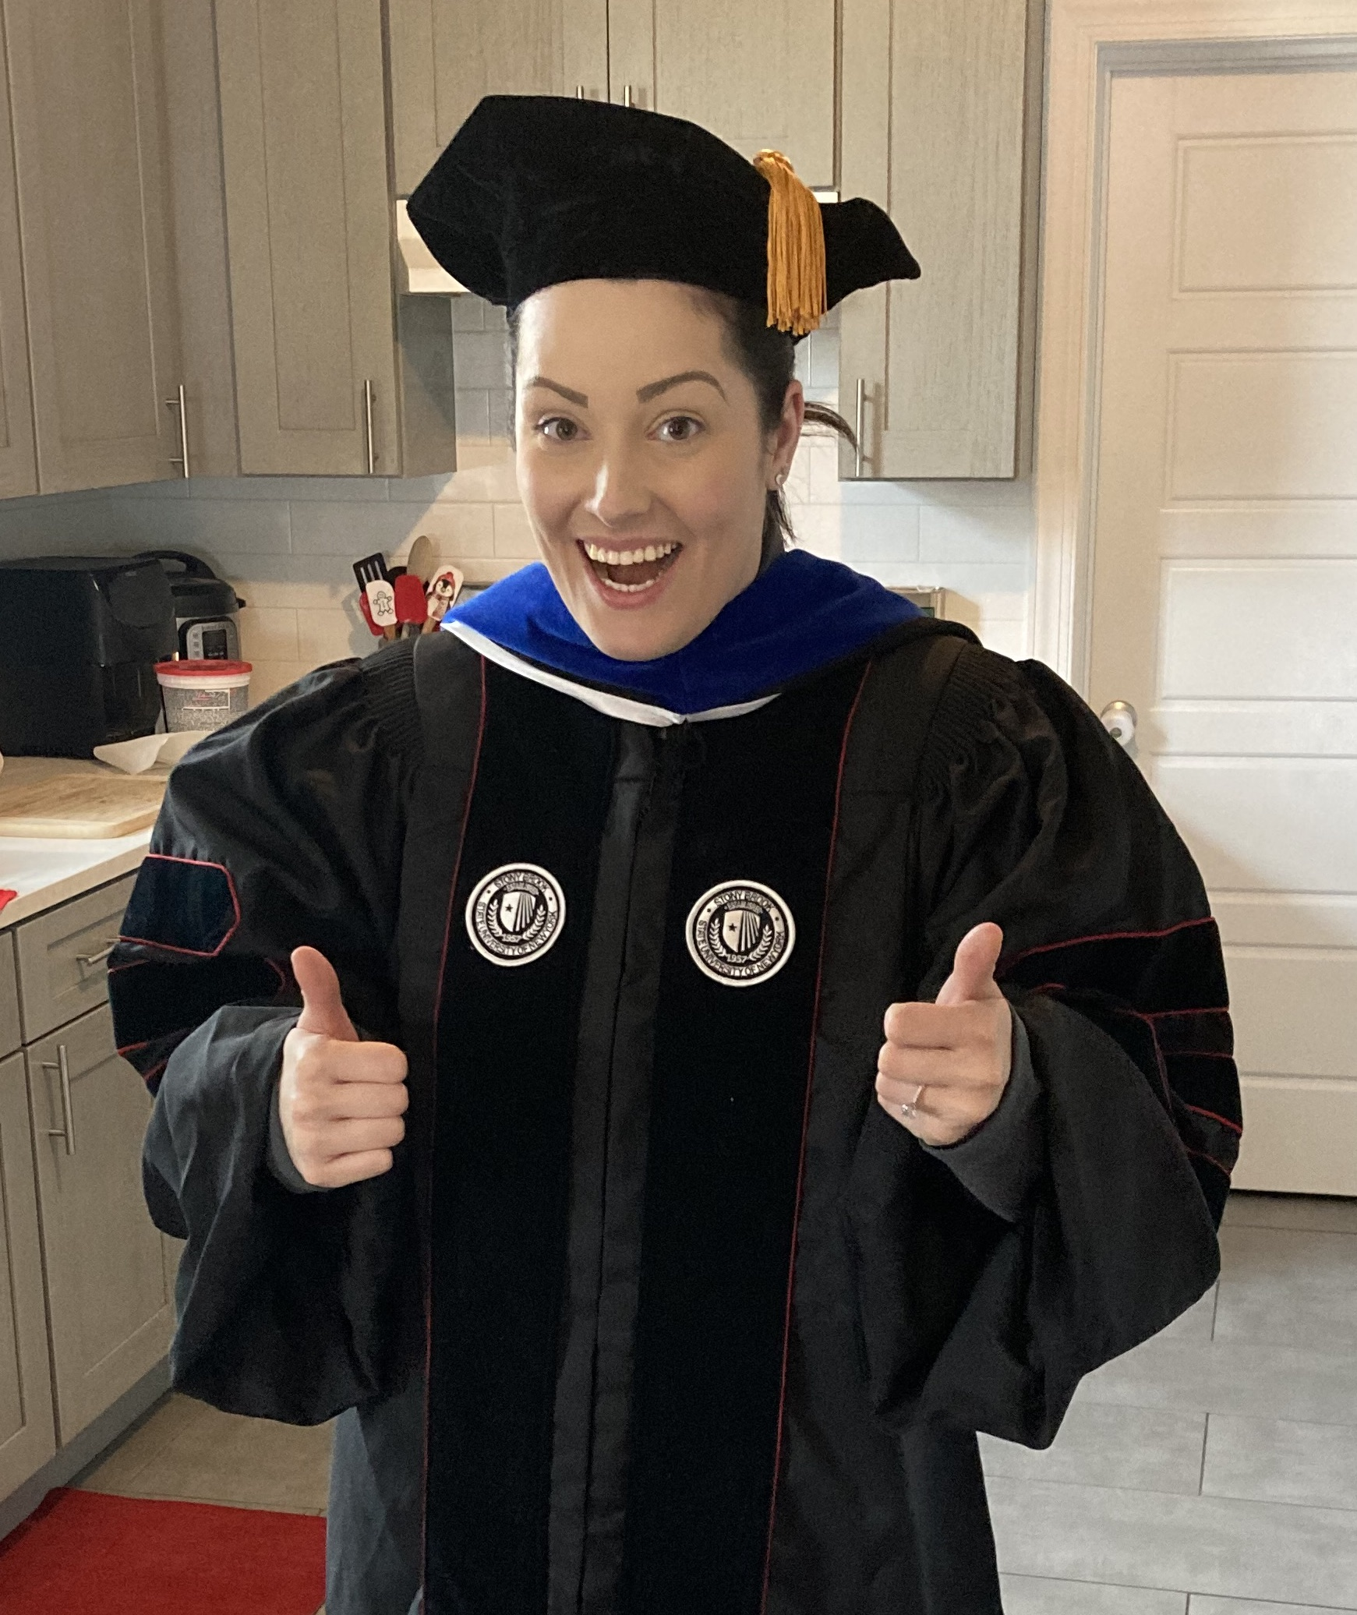
WITHIN subjects ANOVA Example
PSY 348

Slide 31
WITHIN subjects ANOVA Example
PSY 348

Slide 32

WITHIN subjects ANOVA Example
PSY 348

Slide 33
WITHIN subjects ANOVA Example
PSY 348
Pre-test mood

Slide 34
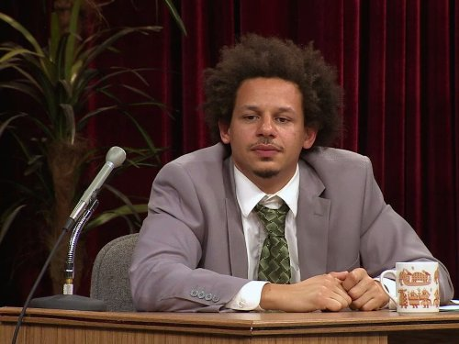
WITHIN subjects ANOVA Example
PSY 348
Pre-test mood
Post-test mood

Slide 35
WITHIN subjects ANOVA Example
PSY 348
In within subjects ANOVA the variance is more complicated, because data will differ in 3 ways:
Over time: Mood before the Eric Andre Show is more similar to mood before the EAS than it is to mood after the EAS.

Slide 36
WITHIN subjects ANOVA
PSY 348

Slide 37
WITHIN subjects ANOVA Example
PSY 348
In within subjects ANOVA the variance is more complicated, because data will differ in 3 ways:
Over time: Mood before the Eric Andre Show is more similar to mood before the EAS than it is to mood after the EAS.
Error Variance: Mood will have natural variance across participants and time.

Slide 38
WITHIN subjects ANOVA Example
PSY 348

Slide 39
WITHIN subjects ANOVA Example
PSY 348
In within subjects ANOVA the variance is more complicated, because data will differ in 3 ways:
Over time: Mood before the Eric Andre Show is more similar to mood before the EAS than it is to mood after the EAS.
Error Variance: Mood will have natural variance across participants.
Per participant: Each participant’s scores will be more like their other scores than they are like the scores of another participant.

Slide 40
WITHIN subjects ANOVA Example
PSY 348
Total sad boi
Always elated
Normal human

Slide 41
WITHIN subjects ANOVA
PSY 348
In within subjects ANOVA the variance is more complicated, because data will differ in 3 ways:
Time
Error
Subjects

Slide 42
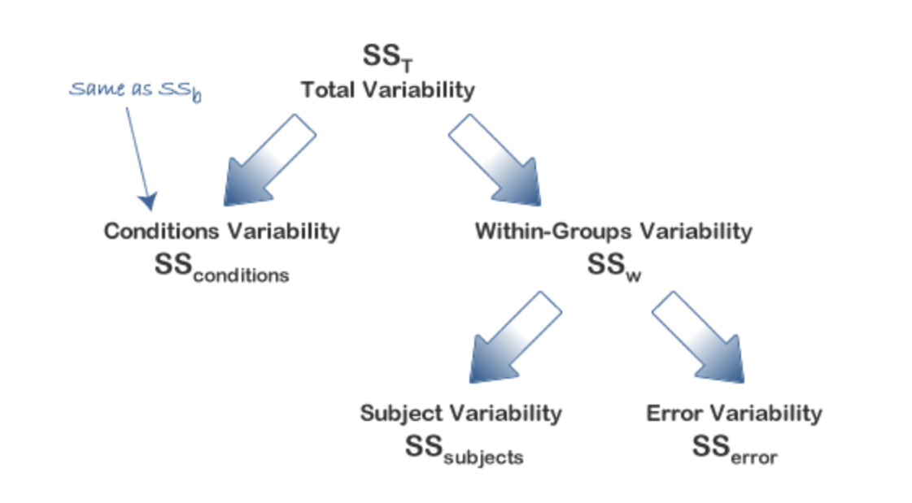
WITHIN subjects ANOVA
PSY 348
Time
Time

Slide 43
Calculating F

Slide 44
WITHIN subjects ANOVA
PSY 348
What is the F ratio in between subjects ANOVA?

Slide 45
WITHIN subjects ANOVA
PSY 348
What is the F ratio in between subjects ANOVA?
F = MSBG / MSError

Slide 46
WITHIN subjects ANOVA
PSY 348
What is the F ratio in between subjects ANOVA?
F = MSBG / MSError
MSBG = SSBG / dfBG

Slide 47
WITHIN subjects ANOVA
PSY 348
What is the F ratio in between subjects ANOVA?
F = MSBG / MSError
MSError = SSError / dferror

Slide 48
WITHIN subjects ANOVA
PSY 348
The F ratio in within subjects ANOVA:
F = MSTime / MSError

Slide 49
WITHIN subjects ANOVA
PSY 348
We want measure 2 sources of variance:
SS_{Time}: this is just like the SS from between subjects ANOVA
SS_{Error}: this is harder to calculate in within subjects ANOVA, because of the subject variance.

Slide 50
WITHIN subjects ANOVA
PSY 348
Time
Time

Slide 51
WITHIN subjects ANOVA
PSY 348
SS_{WG} = SS_{Subjects} + SS_{Error}

Slide 52
WITHIN subjects ANOVA
PSY 348
SS_{WG} = SS_{Subjects} + SS_{Error}
SS_{Error} = SS_{WG} - SS_{Subjects}

Slide 53
Calculating means squared (MS)
PSY 348
We calculate a SS for the variance between the times points (SS_{Time}).
This is just like the SS_{BG} from between subjects ANOVA
We calculate a SS for the within group variance (SS_{WG}).
We calculate a SS for the variance by person (SS_{Subject}).

Slide 54
Calculating means squared (MS)
PSY 348
We calculate a SS for the variance between the times points (SS_{Time}).
To find SS_{Error}, we subtract SS_{Subjects} from SS_{WG}.

Slide 55
Calculating means squared (MS)
PSY 348
MS_{Time} = SS_{Time} / df_{Time}
MS_{Error} = (SS_{WG} - SS_{Subject}) / df_{Error}

Slide 56
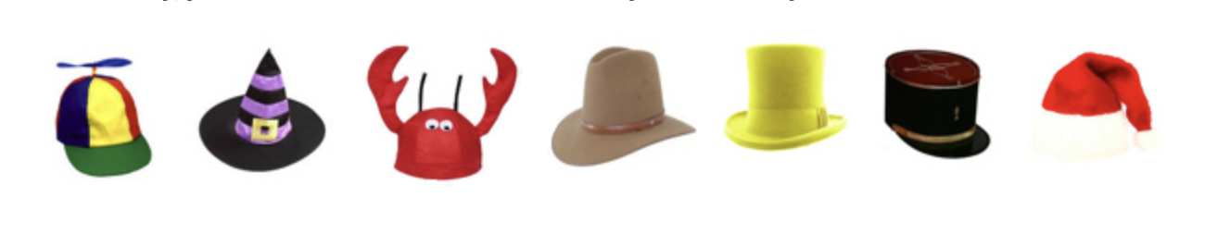
Degrees of freedom
PSY 348
The number of observations (data points) in the data that are free to vary when estimating a statistic.
I own 7 hats. I want to wear a different hat every day of the week.
On Sunday, I don’t get a choice. On Sunday, I have to wear the Santa hat.
The degrees of freedom is how many times I get a choice before I’m stuck with what’s left over.

Slide 57
Degrees of freedom
PSY 348
Time (MS_{Time}) = k – 1
Error (MS_{Error}) = (n – 1) x (k - 1)
*k is the number of time points

Slide 58
Calculating means squared (MS)
PSY 348
MS_{Time} = SS_{Time} / df_{Time} MS_{Time} = SS_{Time} / (k - 1)
MS_{Error} = (SS_{WG} - SS_{Subject}) / df_{Error} MS_{Error} = (SS_{WG} - SS_{Subject}) / (n-1)x(k-1)

Slide 59
WITHIN subjects ANOVA
PSY 348
The F ratio in within subjects ANOVA:
F = MSTime / MSError

Slide 60
AnOVA
PSY 348
Dr. Apriceno wants to know if giving lollypops to statistics students improves their opinion of statistics. She asks 100 students to rate how much they enjoy statistics on a scale of 1 (not at all) to 10 (extremely). Then she gives each student a lollypop at the start of statistics class for 2 weeks. After two weeks of conditioning, Dr. Apriceno asks participants to rate how much they enjoy statistics again.
What’s k?
What’s n?

Slide 61
Practice
PSY 348
Source | SS | df | MS | F
Time | 49
Within Group | 912
Subjects | 219
Error

Slide 62
AnOVA
PSY 348
Dr. Grace believes watching Shameless makes Zoomers happy. She asks 50 Zoomers to rate their happiness on a scale of 1 (no happies) to 10 (all the happies). Then she shows them an episode of Shameless. After each Zoomer watches one episode of Shameless, she asks them to rate their happiness again on the same scale of 1 to 10.
What’s k?
What’s n?

Slide 63
Practice
PSY 348
Source | SS | df | MS | F
Time | 72
Within Group | 3,842
Subjects | 314
Error

Slide 64
AnOVA
PSY 348
Dr. Apriceno measures the aging anxiety of 500 middle-aged women. She then shows them images from anti-aging advertisements featuring young women. After they view the images, participants report their aging anxiety once again. Two weeks later, participants are asked to report their aging anxiety one last time.
What’s k?
What’s n?

Slide 65
Practice
PSY 348
Source | SS | df | MS | F
Time | 672
Within Group | 42,482
Subjects | 566
Error

Slide 66
Interpreting f

Slide 67
Interpreting f
PSY 348
The MS_{Time} is made up of the MS_{Error} + the theoretical difference over time:
MS_{Time} = change over time + MS_{Error}

Slide 68
Interpreting f
PSY 348
The MS_{Time} is made up of the MS_{Error} + the theoretical difference over time:
MS_{Time} = change over time + MS_{Error}
MS_{Time} = 0 + MS_{Error}

Slide 69
Interpreting f
PSY 348
The MS_{Time} is made up of the MS_{Error} + the theoretical difference over time:
MS_{Time} = change over time + MS_{Error}
MS_{Time} = 0 + MS_{Error}
MS_{Time} = MS_{Error}

Slide 70
Interpreting f
PSY 348
The MS_{Time} is made up of the MS_{Error} + the theoretical difference over time:
MS_{Time} = change over time + MS_{Error}
MS_{Time} = 0 + MS_{Error}
MS_{Time} = MS_{Error}
F = 1

Slide 71
Interpreting f
PSY 348
When F =< 1, it’s not likely to be significant.

Slide 72
Interpreting f
PSY 348
The MS_{Time} is made up of the MS_{Error} + the theoretical difference over time:
MS_{Time} = change over time + MS_{Error}
MS_{Time} = effect + MS_{Error}
F > 1

Slide 73
Hypothesis testing: ANOVA
PSY 348
F < = 1 —> Fail to reject the Null Hypothesis
F > 1 —> Refer to p-value —> Reject the Null Hypothesis

Slide 74
How many f’s do Ya Get?
PSY 348
One-way Between Subjects?
Two-way Between Subjects with a 2x2 design?
Within Subjects?

Slide 75
How many f’s do Ya get?
PSY 348
One-way Between Subjects? 1
Two-way Between Subjectswith a 2x2 design? 3 (one for each IV and one for the interaction)
Within Subjects? 1

Slide 76
Reporting F

Slide 77
Reporting F
PSY 348
If asked to report findings in terms of the Null Hypothesis (H0), you should report findings as:
Reject H0, or
Fail to Reject H0

Slide 78
Reporting F
PSY 348
If asked to report findings in general or for publication, you need to report:
F(df time, df error)
= F-value
p-value

Slide 79
Reporting F
PSY 348
Mood after watching the Eric Andre Show was not significantly different from mood before watching the Eric Andre Show, F (1, 499) = 1.02, p = 0.07.

Slide 80
Reporting F
PSY 348
Mood after watching the Eric Andre Show was not significantly difference from mood before watching the Eric Andre Show, F (1, 499) = 1.02, p = 0.07.
There was no significant change in mood over time, F (1, 499) = 1.02, p = 0.07.

Slide 81
Reporting F
PSY 348
Participants’ mood was significantly better after watching the Eric Andre Show compared to before watching it, F(1, 499) = 7.12, p < 0.05.

Slide 82
Reporting F
PSY 348
If asked to report findings in general or for publication, you need to report:
F(df time, df error)
= F-value
p-value
**If the results are significant, we have to also report the means and standard deviations for each time point.**

Slide 83
Reporting F
PSY 348
Participants’ anxiety differed significant across time, F(2, 198) = 3.744, p = 0.25. Anxiety was highest at pre-test (M= 19.58, s = 0.643). Anxiety was lowest at baseline (M , s ). Anxiety at post test was M= , s.

Slide 84
Practice
PSY 348
Open Ihno’s dataset in SPSS

Slide 85
Practice
PSY 348
Open Ihno’s dataset in SPSS
Was anxiety just before the Stats Exam significantly higher than baseline anxiety?

