Slide 1
t-Tests
PSY 348: Lecture 14:

Slide 2
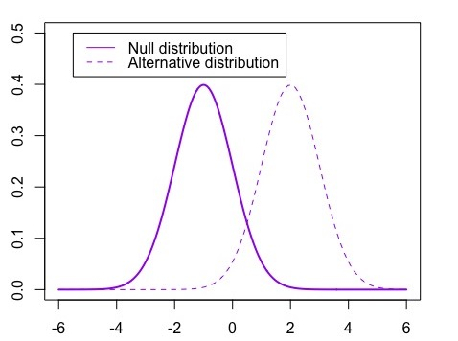
Sampling Theory
PSY 348

Slide 3
Sampling Theory
PSY 348

Slide 4
Sampling Theory
PSY 348

Slide 5
Sampling Theory
PSY 348
Critical value
Setting alpha to 0.05, puts the critical value at a point where 5% of the null distribution’s area is to the right of it.

Slide 6
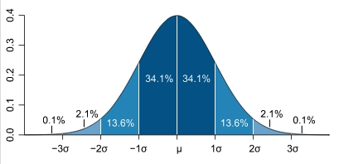
Probability
PSY 348

Slide 7
Sampling Theory
PSY 348
Critical value
Setting alpha to 0.05, puts the critical value at a point where 5% of the null distribution’s area is to the right of it.

Slide 8
Inferential Statistics
PSY 348
Each inferential statistic will give us:
Test statistic
p-value: probability of committing a Type 1 Error < 0.05 or 5%

Slide 9
Inferential Statistics
PSY 348
Each inferential statistic will give us:
Test statistic
p-value
p > 0.05: Fail to reject the H0
p < 0.05: Reject H0

Slide 10
Sampling Theory
PSY 348
Critical value
Setting alpha to 0.05, puts the critical value at a point where 5% of the null distribution’s area is to the right of it.

Slide 11
T-tests
PSY 348

Slide 12
T-tests
PSY 348
IV must be nominal and have only 2 categories
Using experimental versus control
Any two categories (young/old)
DV must be continuous
Scale of 1 to 10
Count

Slide 13
Independent Samples t-test
PSY 348
Example: The experimental group drinks caffeinated coffee. The control group drinks decaf. I ask both groups to complete a survey to measure their happiness on a scale of 1 to 10.
The experimental group has a mean happiness score = 8
The control group mean happiness score = 6
Is the group that drank coffee significantly happier than the control group?

Slide 14
Independent samples t-test
PSY 348
Experimental M = 8
Control M
6

Slide 15
Independent samples t-test
PSY 348
To compare the means we need to know:
Between group variance: how much the answers from the experimental group differ from the control group.
Within group variance: how much the answers of all participants differ from one another.

Slide 16
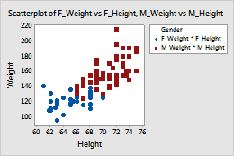
Independent samples t-test
PSY 348
To compare the means we need to know:
Between group variance
Within group variance

Slide 17
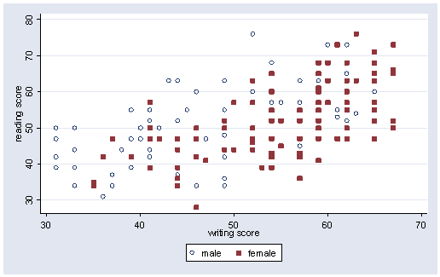
Independent samples t-test
PSY 348
To compare the means we need to know:
Between group variance
Within group variance

Slide 18
Independent samples t-test
PSY 348
To compare the means we need to know:
Between group variance: how much the answers from the experimental group differ from the control group.
Within group variance: how much the answers of all participants differ from one another.

Slide 19
Independent samples t-test
PSY 348
Theoretical Formula:
t = (xbar - μ) / √pooled s

Slide 20
Forumlas
PSY 348
Inferential statistics have both theoretical and computational formulas:
Formula for if we actually knew the population parameters
Formula for estimating the test statistics based solely on sample data

Slide 21
Independent samples t-test
PSY 348
Theoretical Formula:
t = (xbar - μ) / √pooled s

Slide 22
Independent samples t-test
PSY 348
Theoretical Formula:
t = (xbar - μ) / √pooled s

Slide 23
Independent samples t-test
PSY 348
Theoretical Formula:
t = (xbar - μ) / √pooled s

Slide 24
Independent samples t-test
PSY 348
Theoretical Formula:
t = (xbar - μ) / √pooled s

Slide 25
Independent samples t-test
PSY 348
Computational Formula:
(Experimental M — Control M)
√((s1 / n1) + (s2 / n2))
t =

Slide 26
Independent samples t-test
PSY 348
Computational Formula:
(Experimental M — Control M)
√((s1 / n1) + (s2 / n2))
t =
√pooled s

Slide 27
SPSS

Slide 28
The Data
PSY 348
The main window that opens in SPSS
Data view: every row is a participant
Variable view: every row is a variable

Slide 29
The Data
PSY 348
The main window that opens in SPSS
Data view: every row is a participant
Variable view: every row is a variable
Click commands from the data file.

Slide 30
Independent samples t-test: SPSS
PSY 348
Analyze
Compare Means
Independent Samples

Slide 31
INTERPRETTING T

Slide 32
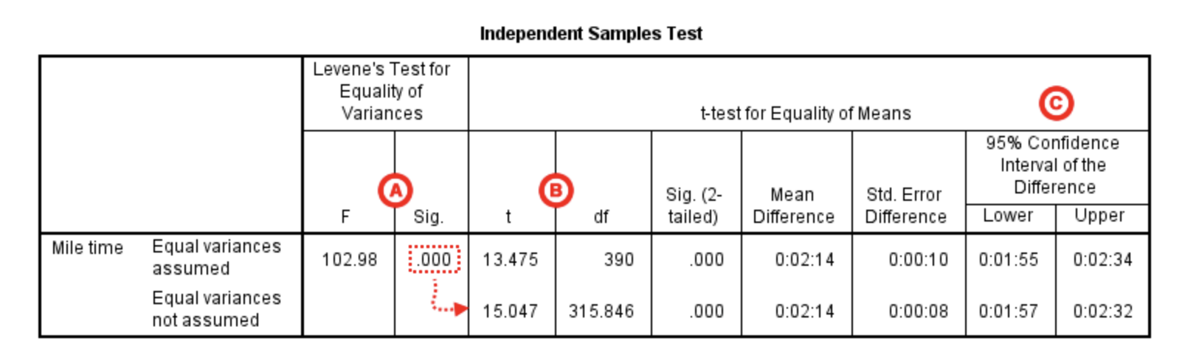
Independent samples t-test: SPSS
PSY 348
*If the Levene’s Test is significant, use the t value from the second row and its corresponding sig.
t is the test statistic.
Sig (2-tailed) is the p-value.

Slide 33
Independent samples t-test
PSY 348
(Experimental M — Control M)
√((s1 / n1) + (s2 / n2))
t =
√pooled s

Slide 34
Independent samples t-test: SPSS
PSY 348
We need the Levene’s Test, because if the variance from the experimental group is not equal to the variance of the control group, we have to use a different formula for the pooled standard deviation.

Slide 35
Independent samples t-test: SPSS
PSY 348
We need the Levene’s Test, because if the variance from the experimental group is not equal to the variance of the control group, we have to use a different formula for the pooled standard deviation.
A significant Levene’s Test means a significant difference in the variances.

Slide 36
Independent samples t-test: SPSS
PSY 348
*If the Levene’s Test is significant, use the t value from the second row and its corresponding sig.
t is the test statistic.
Sig (2-tailed) is the p-value.

Slide 37
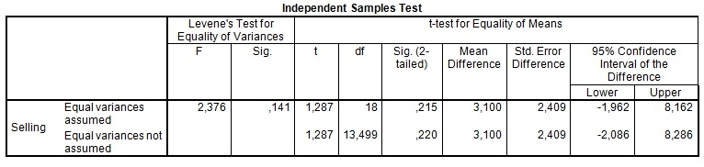
Independent samples t-test: SPSS
PSY 348

Slide 38
Independent samples t-test: Reporting your findings
PSY 348
There was not a significant difference between the groups, t(18) = 1.287, p = 0.215

Slide 39
Independent samples t-test: Reporting your findings
PSY 348
There was not a significant difference between the groups, t(18) = 1.287, p = 0.215

Slide 40
Independent samples t-test: Reporting your findings
PSY 348
There was not a significant difference between the groups, t(18) = 1.287, p = 0.215

Slide 41
Independent samples t-test: Reporting your findings
PSY 348
There was not a significant difference between the groups, t(18) = 1.287, p = 0.215.

Slide 42
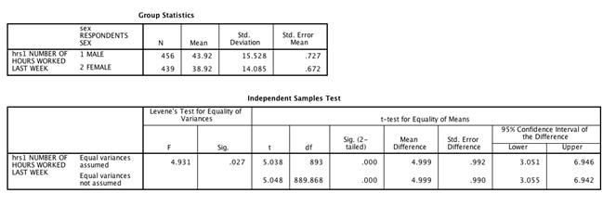
Independent samples t-test: SPSS
PSY 348

Slide 43
Independent samples t-test: SPSS
PSY 348
Step One: Look at Levine’s

Slide 44
Independent samples t-test: SPSS
PSY 348
Step One: Look at Levine’s
Smaller than 0.05 —> bottom
Larger than 0.05 —> top

Slide 45
Independent samples t-test: SPSS
PSY 348
Step two: Look at p (sig)

Slide 46
Independent samples t-test: SPSS
PSY 348
Step two: Look at P
Smaller than 0.05 —> report full findings
Larger than 0.05 —> just report null

Slide 47
Independent samples t-test: SPSS
PSY 348
Reporting the full findings:
t()
t (degrees of freedom) = value, p = value

Slide 48
Independent samples t-test: SPSS
PSY 348
Reporting the full findings:
t()
t (893) = value, p = value

Slide 49
Independent samples t-test: SPSS
PSY 348
Reporting the full findings:
t()
t (893) = 5.048, p = value

Slide 50
Independent samples t-test: SPSS
PSY 348
Reporting the full findings:
t()
t (893) = 5.038, p < 0.001

Slide 51
Independent samples t-test: SPSS
PSY 348
Reporting the full findings:
t()
There was a significant difference in number of hours worked last week between men and women, t (893) = 5.038, p < 0.001.

Slide 52
Independent samples t-test: SPSS
PSY 348
Reporting the full findings:
t()
But who worked more hours???

Slide 53
Independent samples t-test: SPSS
PSY 348
Reporting the full findings:
t()
But who worked more hours???

Slide 54
Independent samples t-test: SPSS
PSY 348
Reporting the full findings:
t()
Men (M = 43.92, s = 15.53) worked significantly more hours last week compared to women (M = 38.92, s = 14.085), t (893) = 5.038, p < 0.001.

