Slide 1
Analysis Of Variance
Lecture 15

Slide 2
ANOVA
PSY 348
ANalysis
Of
VAriance

Slide 3
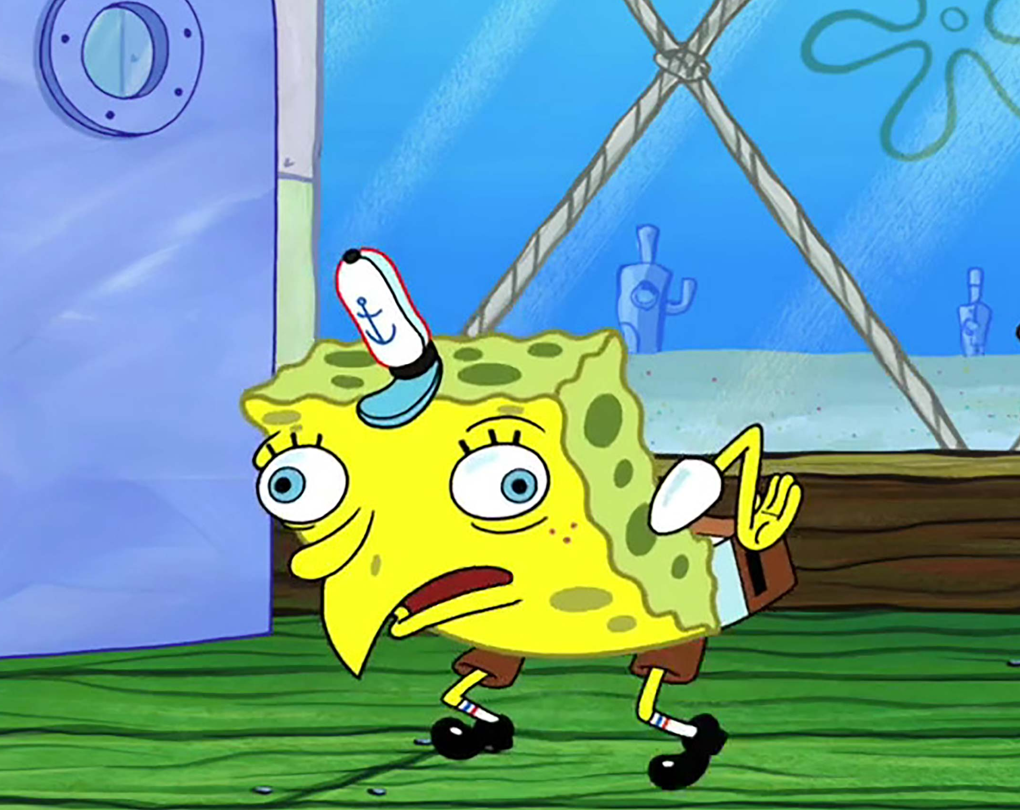
ANOVA
PSY 348
ANalysis
Of
VAriance

Slide 4
AnOVA
PSY 348
ANOVA, like t-tests, compares the means of different groups to determine if they differ significantly from one another.

Slide 5
T-tests
PSY 348
IV must be what two things?
DV must be what one thing?

Slide 6
T-tests
PSY 348
IV must be nominal and have only 2 categories
DV must be continuous

Slide 7
AnOVA
PSY 348
ANOVA, like t-tests, compares the means of different groups to determine if they differ significantly from one another.
ANOVA can examine independent variables with more than 2 groups.

Slide 8
AnOVA
PSY 348
ANOVA, like t-tests, compares the means of different groups to determine if they differ significantly from one another.
ANOVA can examine independent variables with more than 2 groups.
ANOVA can also be used for just 2 groups.
It’s more robust than t-tests.

Slide 9
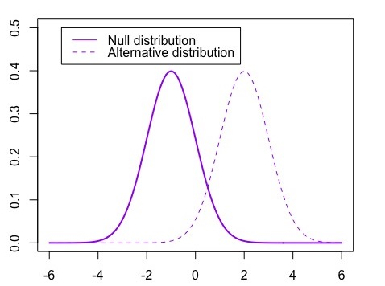
ANOVA
PSY 348

Slide 10
Sampling Theory
PSY 348
Critical value
We set the critical value so that 5% of the null distribution’s area is to the right of it.

Slide 11
anova
PSY 348
There are 3 types of ANOVA:
Between subjects
Within subjects (repeated measures ANOVA)
Mixed designs (between and within together)

Slide 12
Between subjects ANOVA
PSY 348
Example: The experimental group drinks caffeinated coffee. The placebo group drinks decaf. The control group drinks water. I ask all 3 groups to complete a survey to measure their happiness on a scale of 1 to 10.
The experimental group has a mean happiness score = 8
The placebo group mean happiness score = 6
The control group mean happiness score = 5
Is the group that drank coffee significantly happier than the other groups?

Slide 13
Between subjects ANOVA
PSY 348
Placebo & Control
Experimental:
Caffeine

Slide 14
Between subjects ANOVA
PSY 348
If it’s all about the means, why is it called Analysis of Variance?

Slide 15
Between subjects ANOVA
PSY 348
To compare the means, we analyzing two types of variance:
Variance among all of the scores (within group variance)
Variance between the groups (between group variance).

Slide 16
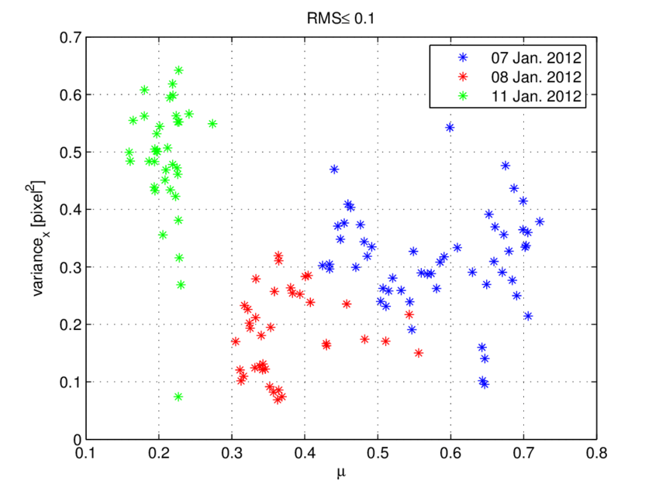
Between subjects ANOVA
PSY 348
Is the variance between the green, red, and blue dots greater than the variance across all of the dots?

Slide 17
The F Statistic
PSY 348
ANOVA produces what we call the F statistic.
Why do we call it F?

Slide 18
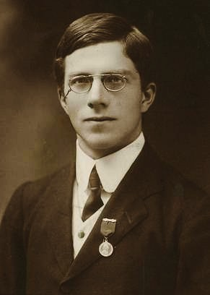
The F Statistic
PSY 348
ANOVA produces what we call the F statistic.
Why do we call it F?

Slide 19
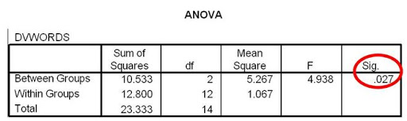
Between subjects anova
PSY 348

Slide 20
Between subjects anova
PSY 348
p

Slide 21
Between subjects anova
PSY 348
p
Reject H0

Slide 22
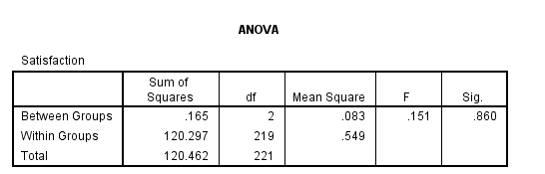
Between subjects anova
PSY 348

Slide 23
Between subjects anova
PSY 348
Fail to Reject H0

Slide 24
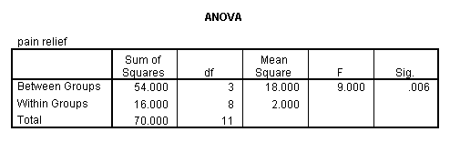
Between subjects anova
PSY 348

Slide 25
Between subjects anova
PSY 348
Reject H0

Slide 26
Calculating F

Slide 27
Calculating the variance
PSY 348
ANOVA looks at variance. How do we calculate the Variance?

Slide 28
Calculating the variance
PSY 348
ANOVA looks at variance. To calculate the Variance:
Calculate the mean.
Subtract the mean from each x-value - what is this called?

Slide 29
Calculating the variance
PSY 348
ANOVA looks at variance. To calculate the Variance:
Calculate the mean.
Subtract the mean from each x-value (deviation score).

Slide 30
Calculating the variance
PSY 348
ANOVA looks at variance. To calculate the Variance:
Calculate the mean.
Subtract the mean from each x-value (deviation score).
Square the deviation scores.
Take the sum of the squared deviations - what is this called?

Slide 31
Calculating the variance
PSY 348
ANOVA looks at variance. To calculate the Variance:
Calculate the mean.
Subtract the mean from each x-value (deviation score).
Square the deviation scores.
Take the sum of the squared deviations (Sum of Squared Deviations).

Slide 32
Calculating the variance
PSY 348
ANOVA looks at variance. To calculate the Variance:
Calculate the mean.
Subtract the mean from each x-value (deviation score).
Square the deviation scores.
Take the sum of the squared deviations (Sum of Squared Deviations).
Divide by (n-1) - what is this called?

Slide 33
Calculating the variance in ANOVA
PSY 348
To calculate the Variance in ANOVA:
Calculate the mean.
Subtract the mean from each x-value (deviation score).
Square the deviation scores.
Take the sum of the squared deviations (Sum of Squared Deviations).
Divide by (degrees of freedom).
** This is the variance, but in ANOVA we also call it a Mean Squared (MS).

Slide 34
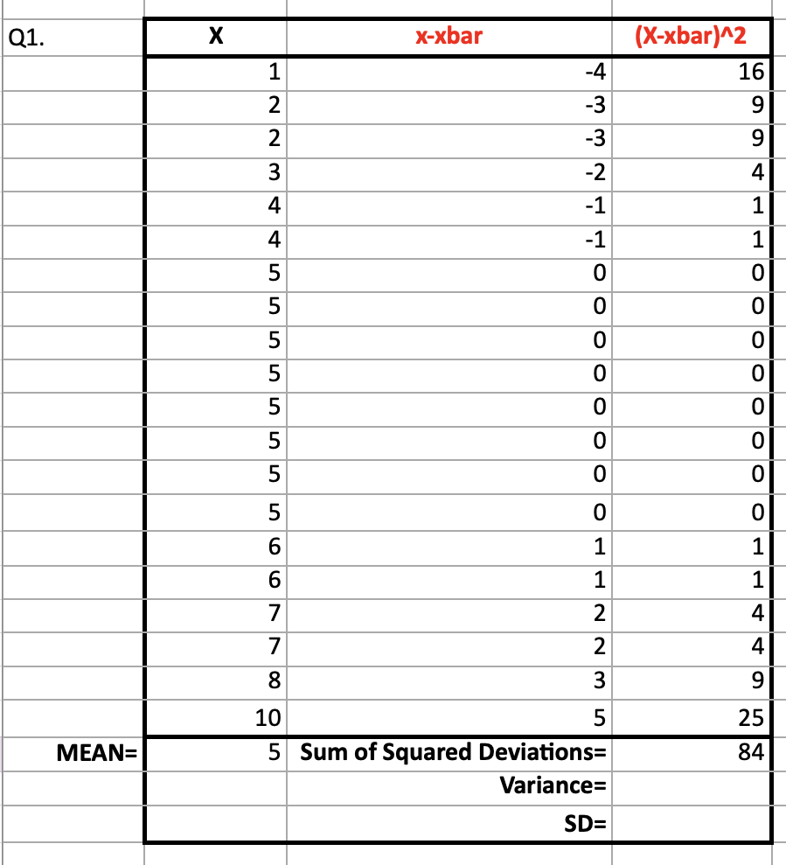
Calculating means squared (MS)
PSY 348
Calculate the SS.
Divide the SS by the degrees of freedom.

Slide 35
Calculating means squared (MS)
PSY 348
We will calculate a SS for the between group variance.
How much variance in the data is from group differences?
We will calculate a SS for all the data.
How much variance in the data is from random error?

Slide 36
Between subjects ANOVA
PSY 348
SS_{BG} = How much variance comes comes from the group differences?
SS_{Error} = How much variance is there in total among all the data points?

Slide 37
Calculating means squared (MS)
PSY 348
Calculate the SS_{BG}.
Calculate the SS_{Error}.
Divide the SS by their degrees of freedom.

Slide 38
Degrees of freedom
PSY 348
The number of observations (data points) in the data that are free to vary when estimating a statistic.

Slide 39
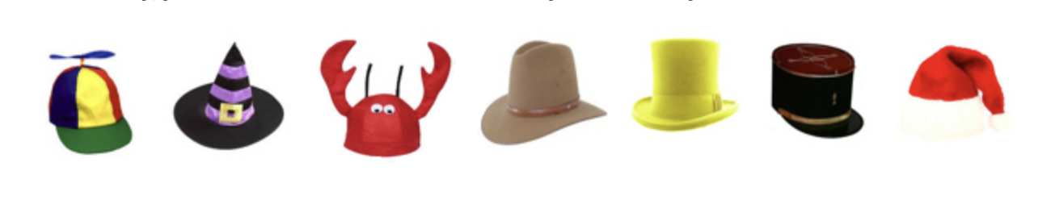
Degrees of freedom
PSY 348
The number of observations (data points) in the data that are free to vary when estimating a statistic.
I own 7 hats. I want to wear a different hat every day of the week.

Slide 40
Degrees of freedom
PSY 348
The number of observations (data points) in the data that are free to vary when estimating a statistic.
I own 7 hats. I want to wear a different hat every day of the week.
On Monday, I have 7 hats to choose from.

Slide 41
Degrees of freedom
PSY 348
The number of observations (data points) in the data that are free to vary when estimating a statistic.
I own 7 hats. I want to wear a different hat every day of the week.
On Tuesday, I have 6 hats to choose from.

Slide 42
Degrees of freedom
PSY 348
The number of observations (data points) in the data that are free to vary when estimating a statistic.
I own 7 hats. I want to wear a different hat every day of the week.
On Wednesday, I have 5 hats to choose from.

Slide 43
Degrees of freedom
PSY 348
The number of observations (data points) in the data that are free to vary when estimating a statistic.
I own 7 hats. I want to wear a different hat every day of the week.
On Thursday, I have 4 hats to choose from.

Slide 44
Degrees of freedom
PSY 348
The number of observations (data points) in the data that are free to vary when estimating a statistic.
I own 7 hats. I want to wear a different hat every day of the week.
On Friday, I have 3 hats to choose from.

Slide 45
Degrees of freedom
PSY 348
The number of observations (data points) in the data that are free to vary when estimating a statistic.
I own 7 hats. I want to wear a different hat every day of the week.
On Saturday, I have 2 hats to choose from.

Slide 46
Degrees of freedom
PSY 348
The number of observations (data points) in the data that are free to vary when estimating a statistic.
I own 7 hats. I want to wear a different hat every day of the week.
On Sunday, I don’t get a choice. On Sunday, I have to wear the Santa hat.

Slide 47
Degrees of freedom
PSY 348
The number of observations (data points) in the data that are free to vary when estimating a statistic.
I own 7 hats. I want to wear a different hat every day of the week.
On Sunday, I don’t get a choice. On Sunday, I have to wear the Santa hat.
The degrees of freedom is how many times I get a choice before I’m stuck with what’s left over.

Slide 48
Degrees of freedom
PSY 348
The number of observations (data points) in the data that are free to vary when estimating a statistic.
The degrees of freedom is how many times things can vary before we are stuck with what’s left over.

Slide 49
Degrees of freedom
PSY 348
Between Groups (MS_{BG} ) = k – 1
Within Groups (MS_{WG}) = n – k
Total = n – 1
*k is the number of groups in the independent variable.

Slide 50
Calculating means squared (MS)
PSY 348
Calculate the SS_{BG}.
Calculate the SS_{Error}.
Divide the SS by their degrees of freedom.

Slide 51
Calculating the ms
PSY 348
Between Group Mean Squared: MS_{BG} = SS_{BG} / (k – 1)
Error Mean Squared: MS_{Error} = SS_{Error} / (n – k)

Slide 52
Calculating Between subjects anova
PSY 348
F = MS_{BG} / MS_{Error}

Slide 53
Calculating Between subjects anova
PSY 348
F = MS_{BG} / MS_{Error}
MS_{BG} = SS_{BG /} df_{BG}
MS_{Error} = SS_{Error /} df_{Error}

Slide 54
Between subjects anova Example
PSY 348
Dr. Apriceno gives one group of 100 participants the Super Secret Limitless Drug. She gives another group of 100 participants a placebo. She gives the third group of 100 participants nothing. All participants then complete an IQ test. She wants to know if those who took the SSLD has significantly higher IQ than the placebo and the control groups.

Slide 55
Between subjects anova Example
PSY 348
Source | SS | df | MS | F
Condition (BG) | 128
Error | 2,376

Slide 56
Between subjects anova Example
PSY 348
Dr. Apriceno recruits 500 participants. She shows half of them the Eric Andre Show and the other half Jeopardy. She then measures their happiness on a scale of 1 to 10. She wants to know if the EAS participants are significantly happier than the Jeopardy participants.

Slide 57
Between subjects anova Example
PSY 348
Source | SS | df | MS | F
Condition (BG) | 72
Error | 1,494

Slide 58
Interpreting f

Slide 59
Interpreting f
PSY 348
The MS_{BG} is made up of the MS_{Error} + the theoretical difference between groups:
MS_{BG} = group difference + MS_{Error}

Slide 60
Interpreting f
PSY 348
The MS_{BG} is made up of the MS_{Error} + the theoretical difference between groups:
MS_{BG} = group difference + MS_{Error}
MS_{BG} = 0 + MS_{Error}

Slide 61
Interpreting f
PSY 348
The MS_{BG} is made up of the MS_{Error} + the theoretical difference between groups:
MS_{BG} = group difference + MS_{Error}
MS_{BG} = 0 + MS_{Error}
MS_{BG} = MS_{Error}

Slide 62
Interpreting f
PSY 348
The MS_{BG} is made up of the MS_{Error} + the theoretical difference between groups:
MS_{BG} = group difference + MS_{Error}
MS_{BG} = 0 + MS_{Error}
MS_{BG} = MS_{Error}
F = MS_{BG} / MS_{Error}

Slide 63
Interpreting f
PSY 348
The MS_{BG} is made up of the MS_{Error} + the theoretical difference between groups:
MS_{BG} = group difference + MS_{Error}
MS_{BG} = 0 + MS_{Error}
MS_{BG} = MS_{Error}
F = MS_{BG} / MS_{Error}
F = 1

Slide 64
Interpreting f
PSY 348
When F =< 1, it’s not likely to be significant.

Slide 65
Interpreting f
PSY 348
The MS_{BG} is made up of the MS_{Error} + the theoretical difference between groups:
MS_{BG} = group difference + MS_{Error}
MS_{BG} = NUMBER GREATER THAN 0 + MS_{Error}
F = DIFFERENCE + MS_{Error} / MS_{Error}
F = DIFFERENCE

Slide 66
Hypothesis testing: ANOVA
PSY 348
F < = 1 —> Fail to reject the Null Hypothesis
F > 1 —> Refer to p-value —> Reject the Null Hypothesis

Slide 67
Reporting f

Slide 68
Reporting F
PSY 348
If asked to report findings in terms of the Null Hypothesis (H0), you should report findings as:
Reject H0, or
Fail to Reject H0

Slide 69
Reporting F
PSY 348
If asked to report findings in general or for publication, you need to report 5 things:
F(df for the between group MS, df for the error MS)
= F-value
p-value
*Mean and standard deviation of each group

Slide 70
Reporting F
PSY 348
The group that watched the Eric Andre Show (M=8.43, s=1.02) reported significantly more happiness compared to their peers in the control group who watched Jeopardy (M=6.12, s=0.98), F(1,498) = 7.12, p < 0.05.

Slide 71
Reporting F
PSY 348
The group that watched the Eric Andre Show (M=8.43, s=1.02) reported significantly more happiness compared to their peers in the control group who watched Jeopardy (M=6.12, s=0.98), F (1, 498) = 7.12, p < 0.05.
There was not a significant difference in happiness between the groups, F (1, 498) = 1.02, p = 0.07.

