Slide 1
Covariance & correlation
Lecture 11:

Slide 2
Correlation
PSY 348
What do you know about correlations?

Slide 3
Correlation
PSY 348
What do you know about correlations?
Correlation ≠ Causation

Slide 4
Correlation
PSY 348
What do you know about correlations?
Correlation ≠ Causation
r

Slide 5
Correlation
PSY 348
What do you know about correlations?
Correlation ≠ Causation
r
Positive correlation: variables move together
As one goes up, the other goes up.
As one goes down, the other goes down.

Slide 6
Correlation
PSY 348
What do you know about correlations?
Correlation ≠ Causation
r
Positive correlation: variables move together
Negative correlation: variables move in opposite directions
As one goes up, the other goes down.

Slide 7
Correlation
PSY 348
Assesses how two variables move in relation to one another.

Slide 8
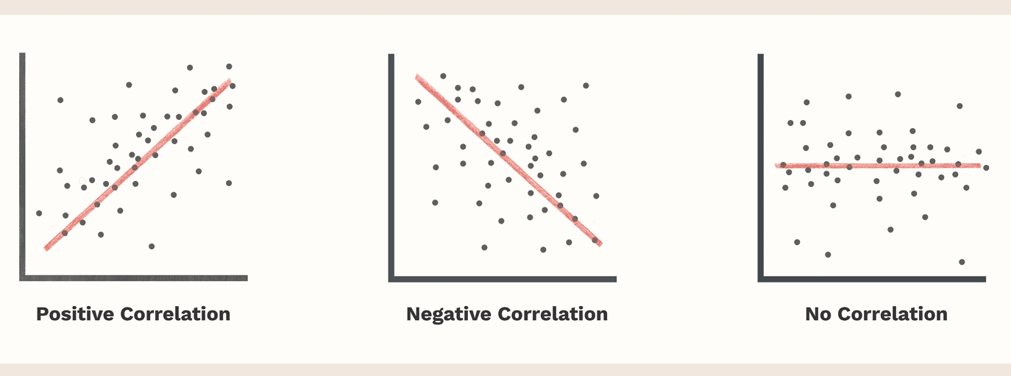
Correlation
PSY 348
Assesses how two variables move in relation to one another:

Slide 9
Correlation
PSY 348
Assesses how two variables move in relation to one another:
HOW??

Slide 10
Measures of Dispersion
PSY 348
What are measures of dispersion?

Slide 11
Measures of Dispersion
PSY 348
Measures of dispersion are measures of how spread out the data are, how much participants differ.

Slide 12
Measures of Dispersion
PSY 348
How do we measure dispersion when we were looking at one variable?

Slide 13
Measures of Dispersion
PSY 348
How do we measure dispersion when we were looking at one variable?
Standard deviation
Variance

Slide 14
Measures of Dispersion
PSY 348
Univariate = one variable
Bivariate = two variables
Multivariate = more than two variables

Slide 15
Measures of Dispersion
PSY 348
Univariate measures of dispersion?
Standard deviation
Variance
Bivariate measures of dispersion:
Covariance

Slide 16
Measures of Dispersion
PSY 348
Univariate measures of dispersion?
Standard deviation: How different are participants from the average?
Bivariate measures of dispersion:
Covariance

Slide 17
Measures of Dispersion
PSY 348
Univariate measures of dispersion?
Standard deviation: How different are participants from the average?
Bivariate measures of dispersion:
Covariance:
How much variation in one variable is the same in another variable?
Do the variables vary in the same way?

Slide 18
Measures of Dispersion
PSY 348
Univariate measures of dispersion?
Standard deviation: Height M = 5’6”, s = 2 inches
Bivariate measures of dispersion:
Covariance: Does the spread-out-ness of height overlap with the spread-out-ness of weight?

Slide 19
Covariance
PSY 348
Dr. Apriceno wants to know if how many lollipops a professor eats daily impacts their happiness. She asks 50 professors how many lollies they eat in a typical day and then has them rate their happiness on a scale of 1 to 10.
Variable 1: # of lollies = continuous
Variable 2: happiness = continuous

Slide 20
Covariance
PSY 348
We could:
Find the variance of each variable
Find the covariance of the two variables together

Slide 21
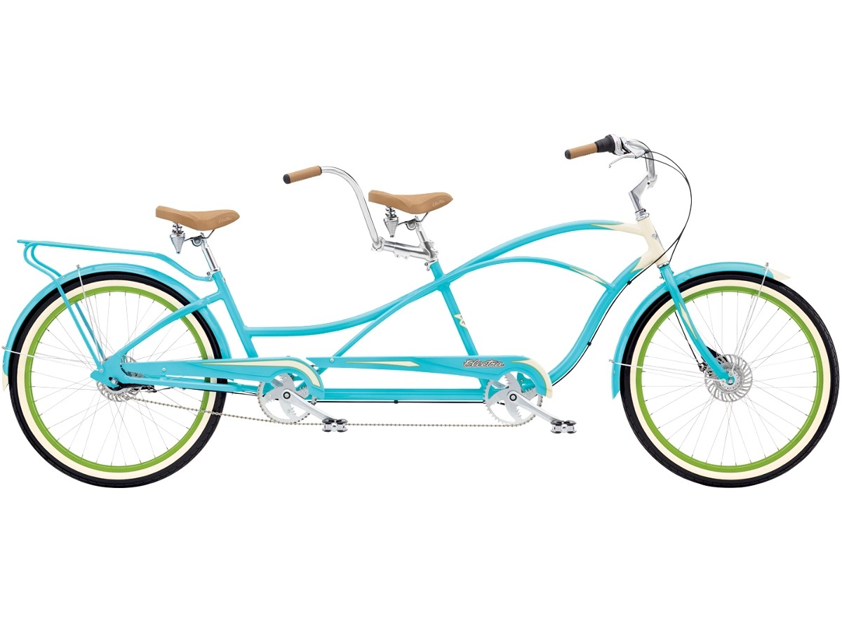
Covariance
PSY 348
Covariance refers to how two continuous variables vary in tandem.

Slide 22
Covariance
PSY 348
Covariance refers to how two variables vary together.

Slide 23
Covariance
PSY 348
Covariance refers to how two variables vary together:
Generally, if # of lollies goes up, what does happiness tend to do?
Generally, if happiness goes up, what does # of lollies tend to do?

Slide 24
Covariance
PSY 348
Dr. Apriceno wants to know if how many lollipops a professor eats daily impacts their happiness. She asks 50 professors how many lollies they eat in a typical day and then has them rate their happiness on a scale of 1 to 10.
X = # of lollies
Y = happiness

Slide 25
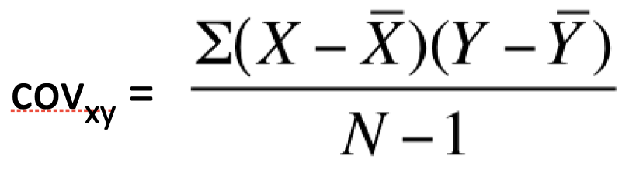
Covariance
PSY 348
Dr. Apriceno wants to know if how many lollipops a professor eats daily impacts their happiness. She asks 50 professors how many lollies they eat in a typical day and then has them rate their happiness on a scale of 1 to 10.
X = # of lollies
Y = happiness

Slide 26
Covariance
PSY 348
Dr. Apriceno wants to know if how many lollipops a professor eats daily impacts their happiness. She asks 50 professors how many lollies they eat in a typical day and then has them rate their happiness on a scale of 1 to 10.
X = # of lollies
Y = happiness

Slide 27
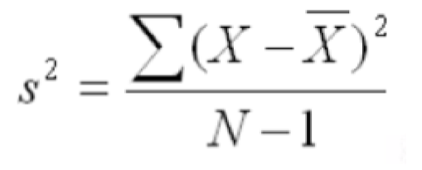
Covariance
PSY 348

Slide 28
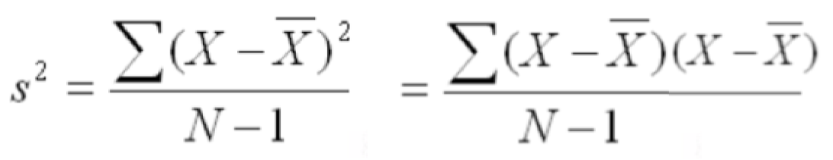
Covariance
PSY 348

Slide 29
Covariance
PSY 348
The variance of a variable is the covariance of that variable with itself.

Slide 30
Covariance
PSY 348
Covariance is the variance of two variables together… how they move together.

Slide 31
Covariance
PSY 348
Let’s break it down.
Find the mean of each variable.

Slide 32
Covariance
PSY 348
Let’s break it down.
Find the mean of each variable.
Subtract the mean of x from each x value.
Subtract the mean of y from each y value.

Slide 33
Covariance
PSY 348
Let’s break it down.
Find the mean of each variable.
Subtract the mean of x from each x value.
Subtract the mean of y from each y value.
Multiple the deviation scores of x with the deviation scores of y.

Slide 34
Covariance
PSY 348
Let’s break it down.
Find the mean of each variable.
Subtract the mean of x from each x value.
Subtract the mean of y from each y value.
Multiple the deviation scores of x with the deviation scores of y.
Sum the products of the deviation scores.

Slide 35
Covariance
PSY 348
Let’s break it down.
Find the mean of each variable.
Subtract the mean of x from each x value.
Subtract the mean of y from each y value.
Multiple the deviation scores of x with the deviation scores of y.
Sum the products of the deviation scores.
Divide by N-1.

Slide 36
Covariance
PSY 348
Covariance is the bivariate equivalent of variance.

Slide 37
Covariance
PSY 348
Covariance is the bivariate equivalent of variance.
What does the covariance tell us?

Slide 38
Covariance
PSY 348
Covariance is the bivariate equivalent of variance.
What does the covariance tell us?
What did the variance tell us?

Slide 39
Covariance
PSY 348
Covariance is the bivariate equivalent of variance.
What does the covariance tell us?
What did the variance tell us —> not much because it was inflated.
For it to be useful, we had to standardize it.

Slide 40
Correlation
PSY 348
Correlation is the standardized covariance.
Correlation is the bivariate version of the standard deviation.

Slide 41
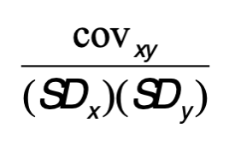
Correlation
PSY 348
Correlation is the standardized covariance.
Correlation is the bivariate version of the standard deviation.
To calculate the correlation, we divide the covariance by the standard deviation of x multipled by the standard deviation of y.

Slide 42
Correlation
PSY 348
Calculating Correlation:

Slide 43
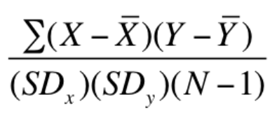
Correlation
PSY 348
Calculating Correlation:

Slide 44
Correlation
PSY 348
Correlation is the bivariate version of the standard deviation.

Slide 45
Correlation
PSY 348
Correlation is bounded between -1 and +1.
Closer to -1 is a negative correlation.
Closer to +1 is a positive correlation.
Closer to 0 means no correlation.

Slide 46
Correlation
PSY 348

Slide 47
Correlation
PSY 348
This is the Pearson Product-Moment Correlation (Pearson, 1895).
The sign indicates the direction.
The number indicates the magnitude/strength of the relationship.
0.1 is a small correlation
0.3 is a moderate correlation
0.5 or higher is a large correlation

Slide 48
Correlation
PSY 348
Correlation is written as r

Slide 49
R^2
PSY 348
If we square r, we get R^2
R^2 is always positive

Slide 50
R^2
PSY 348
If we square r, we get R^2
R^2 is always positive
R^2 refers to:
The amount of x accounted for by y.
The amount of y accounted for by x.

Slide 51
Correlation and R^2
PSY 348
Example: Students grades in MTH 110 and their grades in PSY 348 correlation at r = 0.3
What size is the correlation?

Slide 52
Correlation and R^2
PSY 348
Example: Students grades in MTH 110 and their grades in PSY 348 correlation at r = 0.3
Moderate correlation
How much of you PSY 348 grade is accounted for by your MTH 110 grade?

Slide 53
Correlation and R^2
PSY 348
Example: Students grades in MTH 110 and their grades in PSY 348 correlation at r = 0.3
Moderate correlation
How much of you PSY 348 grade is accounted for by your MTH 110 grade?
0.3 x 0.3 = 0.09

Slide 54
Correlation and R^2
PSY 348
Example: Students grades in MTH 110 and their grades in PSY 348 correlation at r = 0.3
Moderate correlation
How much of you PSY 348 grade is accounted for by your MTH 110 grade?
0.3 x 0.3 = 0.09
R^2 = 9% of your PSY 348 grade is explained by your MTH 110 grade.

Slide 55
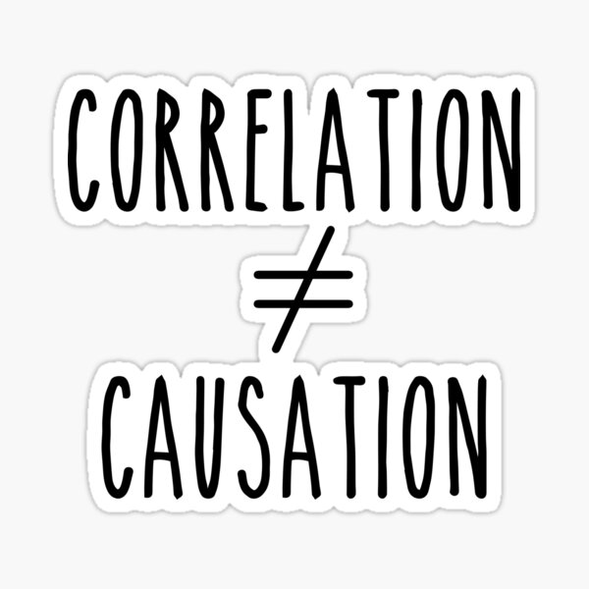
Interpreting Correlation
PSY 348

Slide 56
Interpreting Correlation
PSY 348
We don’t use the words caused/resulting from.
When reporting r: “As x goes up, y tends to go up.”
When reporting R^2: “z% of x is accounted for by y.”

Slide 57
Reporting correlation

Slide 58
Correlation Matrix
PSY 348
In the Method, we report descriptive statistics about our variables (M, s).
It is common to refer readers to a table where they can look at correlations between the variables.

Slide 59
Correlation Matrix
PSY 348
In the Method, we report descriptive statistics about our variables (M, s).
It is common to refer readers to a table where they can look at correlations between the variables.
Why might this be important?

Slide 60
Correlation Matrix
PSY 348
Table 1 in a paper is typically a combination of descriptive stats AND correlation matrix, like this:
 | M | s | 1 | 2 | 3
Age | 20.91 | 1.76 | 1 | -0.03 | 0.65**
Hype Song 1 | 4.21 | 1.2 |  | 1 | -0.34*
Hype Song 2 | 6.42 | 2.18 |  |  | 1
* indicates p < 0.05, ** indicates p < .01

Slide 61
Correlation Matrix
PSY 348
Table 1 in a paper is typically a combination of descriptive stats AND correlation matrix, like this:
 | M | s | 1 | 2 | 3
Age | 20.91 | 1.76 | 1 | -0.03 | 0.65**
Hype Song 1 | 4.21 | 1.2 | -0.03 | 1 | -0.34*
Hype Song 2 | 6.42 | 2.18 | 0.65** | -0.34* | 1
* indicates p < 0.05, ** indicates p < .01

