Slide 1
Regression, Pt 2
Lecture 13:

Slide 2
Types of Analysis
PSY 348
Univariate
Bivariate
Multivariate

Slide 3
Types of Analysis
PSY 348
Univariate: One variable, like the mean
Bivariate: Two variables, like correlation
Multivariate: More than 2 variables

Slide 4
Regression
PSY 348
Regression is the multivariate version of correlation.
Correlation is the bivariate version of regression.

Slide 5
Regression
PSY 348
Regression is the multivariate version of correlation.
Correlation is the bivariate version of regression.
We’re doing the same thing in regression as we do in correlation, BUT there are more than 2 variables.

Slide 6
Regression terminology
PSY 348
In regression we will choose one variable to predict.
We call this y.
Y is the outcome variable.
Y is the predicted variable.

Slide 7
Regression terminology
PSY 348
In regression we will choose two or more variables we with believe predict y.
We call these x1, x2, etc.
Some people call these x and z.
X is the predictor variable.

Slide 8
Regression terminology
PSY 348
We we predict Y with X, we say;
we regress y on the x.

Slide 9
Regression Equation
PSY 348
Y_{i} = b₀ + b₁X_{1i} + e_{i}

Slide 10
Regression Equation
PSY 348
Y_{i} = b₀ + b₁X_{1i} + e_{i}
Weight
Error
The predicted value of y for a particular participant
Intercept
The value of a particular participant on the measure of x

Slide 11
Regression Equation
PSY 348
Y_{i} = b₀ + b₁X_{1i} + e_{i}
Random, so we can’t predict what it will be
Weight
Error
The predicted value of y for a particular participant
Intercept
The value of a particular participant on the measure of x

Slide 12
Regression Equation
PSY 348
Y_{i} = b₀ + b₁X_{1i} + e_{i}

Slide 13

Regression Equation
PSY 348
_{i} = b₀ + b₁X_{1i}
Y-hat

Slide 14
Regression Equation
PSY 348
_{i} = b₀ + b₁X_{1i}
_{Y = mx + b}

Slide 15
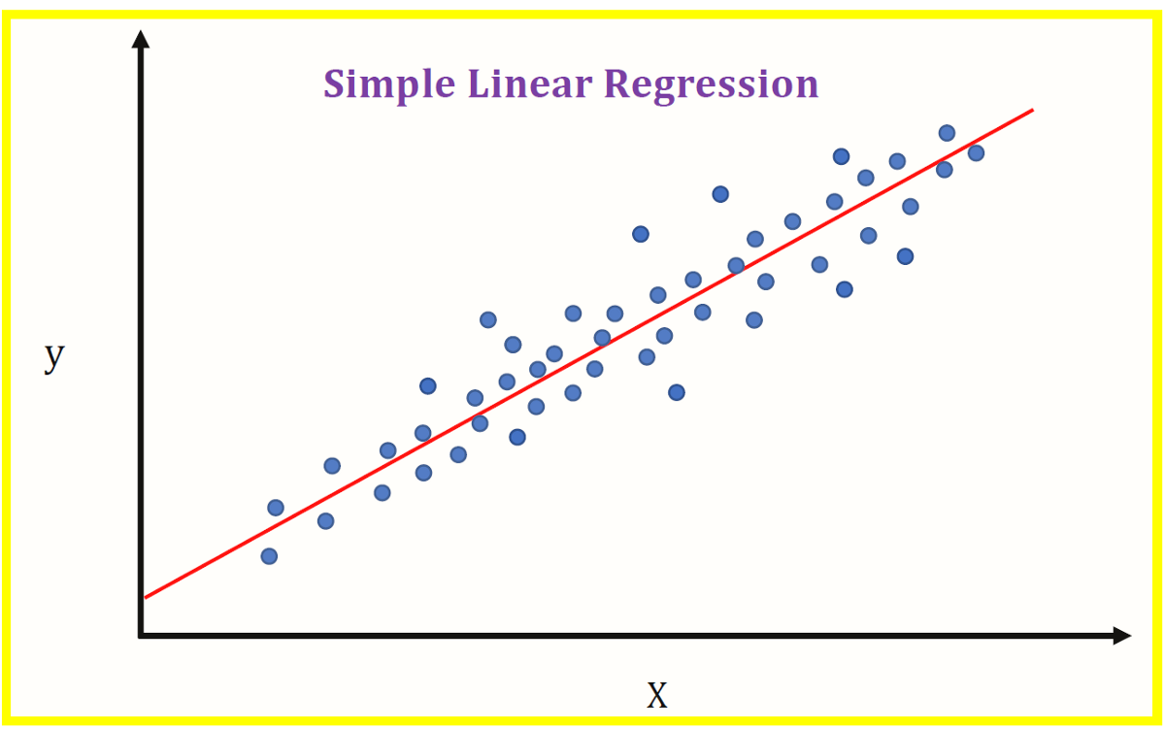
Linear Regression
PSY 348
This form of regression is called linear regression.

Slide 16
Regression: Equation Component Meanings
PSY 348
Y = theoretical prediction of y
= the actual y value for a participant
b₀ = the intercept: the average y value
X₁ = the x value for a participant
b₁ = a weighted value that is multiplied by x and added to b₀ to estimate y.

Slide 17
Regression Equation: More than one X
PSY 348
_{i} = b₀ + b₁X_{1i} +b₂X_{2i}

Slide 18
Regression: Equation Component Meanings
PSY 348
Y = theoretical prediction of y
= the actual y value for a participant
b₀ = the average y value
X₁ = the x₁ value for a participant
b₁ = a weighted value that is multiplied by x₁
X₂ = the x₂ value for a participant
b₂ = a weighted value that is multiplied by x₂

Slide 19
Regression Equation: More than one X
PSY 348
_{i} = b₀ + b₁X_{1i} +b₂X_{2i}

Slide 20
Interpreting coefficients

Slide 21
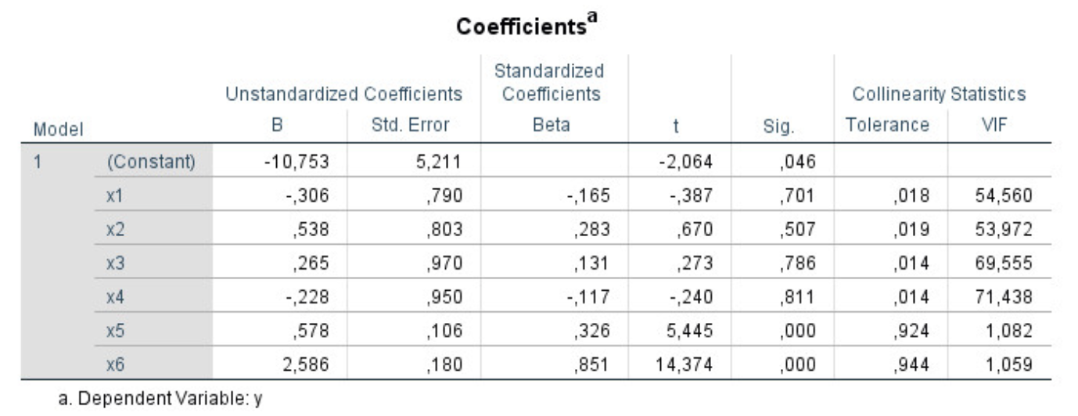
Interpreting coefficients
PSY 348

Slide 22
Interpreting coefficients
PSY 348
Unstandardized b coefficient
Beta coefficient
t-value
p-value

Slide 23
Interpreting coefficients
PSY 348
Unstandardized b coefficient
Beta coefficient
t-value
p-value <— is this a significant predictor of y?

Slide 24
Interpreting coefficients
PSY 348
Unstandardized b coefficient
Beta coefficient <— which predictor of y has the more predictive power?
t-value
p-value

Slide 25
Interpreting coefficients
PSY 348

Slide 26
R^2

Slide 27
R^2
PSY 348
R^2 is the correlation coefficient (r) squared.
R^2 is always positive

Slide 28
R^2
PSY 348
R^2 is the correlation coefficient (r) squared.
R^2 is always positive
In correlation, the amount of y accounted for by x

Slide 29
R^2
PSY 348
In Regression, R^2 refers to the amount of y accounted for by all of the x’s.

Slide 30
R^2
PSY 348
In Regression, R^2 refers to the amount of y accounted for by all of the x’s.
How much of y did we account for?

Slide 31
R^2
PSY 348
In Regression, R^2 refers to the amount of y accounted for by all of the x’s.
How much of y did we account for?
Did we account for a significant amount of the variance in y?

Slide 32
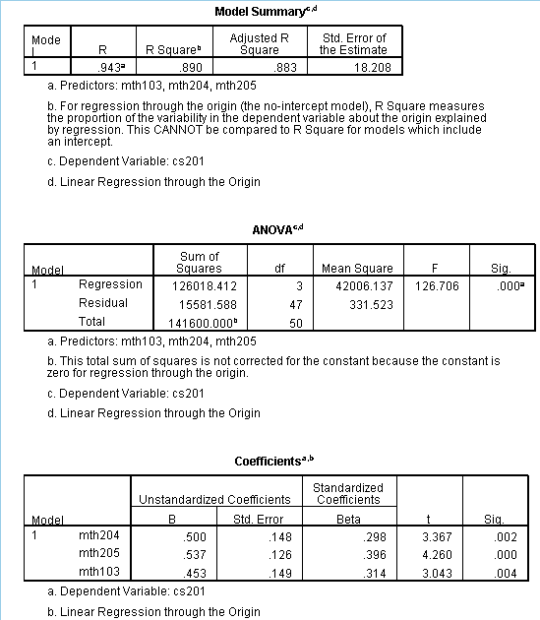
R^2
PSY 348

Slide 33
Interpreting R Squared
PSY 348
R Squared
Adjusted R Squared
F-value
p-value

Slide 34
Interpreting R Squared
PSY 348
R Squared
Adjusted R Squared
F-value
p-value <— is this a significant predictor of y?

Slide 35
Interpreting R Squared
PSY 348
R Squared <— The percentage of y accounted for by the predictors
Adjusted R Squared
F-value
p-value

Slide 36
Interpreting R Squared
PSY 348
R Squared
Adjusted R Squared <— The percentage of y accounted for by the predictors, controlling for using too many predictors
F-value
p-value

Slide 37
Example

Slide 38
Linear Regression
PSY 348
Dr. Apriceno wants to be able to predict high thoughts.

Slide 39
Linear Regression
PSY 348
Dr. Apriceno wants to be able to predict high thoughts.
(High thoughts are ideas that provide a different perspective on the mundane facts and activities of regular life.)

Slide 40
Linear Regression
PSY 348
Dr. Apriceno wants to be able to predict high thoughts.
(High thoughts are ideas that provide a different perspective on the mundane facts and activities of regular life.) - HonestMarijuana.com

Slide 41

Linear Regression
PSY 348
Dr. Apriceno wants to be able to predict high thoughts.
(High thoughts are ideas that provide a different perspective on the mundane facts and activities of regular life.) - HonestMarijuana.com

Slide 42

Linear Regression
PSY 348
Dr. Apriceno wants to be able to predict high thoughts.
(High thoughts are ideas that provide a different perspective on the mundane facts and activities of regular life.) - HonestMarijuana.com

Slide 43
Linear Regression
PSY 348
Dr. Apriceno wants to be able to predict high thoughts.
What are some predictors of high thoughts?

Slide 44
Linear Regression
PSY 348
Dr. Apriceno wants to be able to predict high thoughts.
What are some predictors of high thoughts?
High-making substance consumption

Slide 45
Linear Regression
PSY 348
Dr. Apriceno wants to be able to predict high thoughts.
What are some predictors of high thoughts?
High-making substance consumption
Propensity for high thoughts at baseline

Slide 46

Linear Regression
PSY 348
Dr. Apriceno wants to be able to predict high thoughts.
What are some predictors of high thoughts?
High-making substance consumption
Propensity for high thoughts at baseline
Low propensity for high thoughts

Slide 47

Linear Regression
PSY 348
Dr. Apriceno wants to be able to predict high thoughts.
What are some predictors of high thoughts?
High-making substance consumption
Propensity for high thoughts at baseline
Low propensity for high thoughts
High propensity for high thoughts

Slide 48
Linear Regression
PSY 348
Dr. Apriceno wants to be able to predict high thoughts.
What are some predictors of high thoughts?
High-making substance consumption
Propensity for high thoughts at baseline

Slide 49
Regression Equation
PSY 348
Y_{i} = b₀ + b₁X_{1i} + b₂X_{2i} + e_{i}

Slide 50
Regression Equation
PSY 348
Y_{i} = b₀ + b₁X_{1i} + b₂X_{2i} + e_{i}
The predicted degree of high thoughts for a participant “i”

Slide 51
Regression Equation
PSY 348
Y_{i} = b₀ + b₁X_{1i} + b₂X_{2i} + e_{i}
The predicted degree of high thoughts for a participant “i”
Intercept: Average degree of high thoughts

Slide 52
Regression Equation
PSY 348
Y_{i} = b₀ + b₁X_{1i} + b₂X_{2i} + e_{i}
The predicted degree of high thoughts for a participant “i”
Coefficient for X1
How much substance has been consumed
Intercept: Average degree of high thoughts

Slide 53
Regression Equation
PSY 348
Y_{i} = b₀ + b₁X_{1i} + b₂X_{2i} + e_{i}
The predicted degree of high thoughts for a participant “i”
Coefficient for X1
How much substance has been consumed
One’s baseline high thoughts propensity
Intercept: Average degree of high thoughts
Coefficient for X2

Slide 54
Regression Equation: Theoretical
PSY 348
Y_{i} = b₀ + b₁X_{1i} + b₂X_{2i} + e_{i}
The predicted degree of high thoughts for a participant “i”
Coefficient for X1
How much substance has been consumed
Randomness
One’s baseline high thoughts propensity
Intercept: Average degree of high thoughts
Coefficient for X2

Slide 55
Regression Equation
PSY 348
Y_{i} = b₀ + b₁X_{1i} + b₂X_{2i} + e_{i}

Slide 56

Regression Equation: Computational
PSY 348
Y_{i} = b₀ + b₁X_{1i} + b₂X_{2i} + e_{i}

Slide 57
Regression Equation: Computational
PSY 348
_{i} = b₀ + b₁X_{1i} + b₂X_{2i}

Slide 58
Linear Regression
PSY 348
This form of regression is called linear regression.

Slide 59
Example
PSY 348
Age
0.112
0.06
High Substance
0.912
0.001
High Propensity
0.042
0.04
High thoughts

Slide 60
Example
PSY 348
0.31
0.29
Dependent variable: High thoughts
Predictors: Age
High substance (# of marijuanas)
Propensity for high thoughts

Slide 61
Reporting regression findings

Slide 62
Example
PSY 348
First, report adjusted R^2 and it’s corresponding p:
Our model predicted a significant amount of variance in high thoughts, adjusted R^2 = 0.29, p < 0.001.
Age, consumption of high-making substances, and prosperity for high thoughts predicted a significant amount of variance in high thoughts, adjusted R^2 = 0.29, p < 0.001.

Slide 63
Example
PSY 348
Then report individual betas and their p’s:
High-making substances consumed (beta = 0.912, p = 0.001) and propensity for high thoughts (beta = 0.042, p = 0.04) significantly predicted a higher high thoughts.
Age did not predict likelihood of experiencing high thoughts.
It’s common to report betas and p’s in text as well as in a table.

Slide 64
Categorical variables in regression

Slide 65
Categorical variables
PSY 348

Slide 66
Categorical variables
PSY 348
Categorical variables are variables that are not continuous:
Groups
Categories
Labels

Slide 67
Categorical variables
PSY 348
If your only predictor is a categorical variable, you should run a t-test or ANOVA.

Slide 68
Categorical variables in Regression
PSY 348
Sometimes researchers want to examine how several variables predict one outcome.
We did this with high thoughts:
Age
# of marijuanas
Propensity for high thoughts

Slide 69
Categorical variables in Regression
PSY 348
Sometimes researchers want to examine how several variables predict one outcome.
Sometimes one of these variables is categorical.
Example: How many episodes of a show can Dr. Apriceno watch before she passes out on her couch?

Slide 70
Categorical variables in Regression
PSY 348
Dependent variable: How many episodes of a show can Dr. Apriceno watch before she passes out on her couch?
Predictors:

Slide 71
Categorical variables in Regression
PSY 348
Dependent variable: How many episodes of a show can Dr. Apriceno watch before she passes out on her couch?
Predictors:
Time of night
Cups of coffee consumed
Is Pedro Pascal in the show?

Slide 72
Categorical variables in Regression
PSY 348
Dependent variable: How many episodes of a show can Dr. Apriceno watch before she passes out on her couch?
Predictors:
Time of night
Cups of coffee consumed
Is Pedro Pascal in the show?
Variable Type:

Slide 73
Categorical variables in Regression
PSY 348
Dependent variable: How many episodes of a show can Dr. Apriceno watch before she passes out on her couch?
Predictors:
Time of night
Cups of coffee consumed
Is Pedro Pascal in the show?
Variable Type:
Continuous
Continuous
Categorical

Slide 74
Categorical variables in Regression
PSY 348
Dependent variable: How many episodes of a show can Dr. Apriceno watch before she passes out on her couch?
Predictors:
Time of night: As it gets later, the number of episodes will decrease (negative correlation)
Cups of coffee consumed: As cups of coffee increases, number of eps will increase (positive correlation)
Pedro:

Slide 75
Categorical variables in Regression
PSY 348
Dependent variable: How many episodes of a show can Dr. Apriceno watch before she passes out on her couch?
Predictors:
Time of night: As it gets later, the number of episodes will decrease (negative correlation)
Cups of coffee consumed: As cups of coffee increases, number of eps will increase (positive correlation)
Is Pedro Pascal in the show? If Pedro’s in the show, number of episodes will increase.

Slide 76
Dummy coding
PSY 348
Assign each category a number value.
0 = no
1 = yes

Slide 77
Dummy coding
PSY 348
Assign each category a number value.
0 = no, Pedro is not in the show.
1 = yes, Pedro is in the show.

Slide 78
Interpreting dummy coded variables
PSY 348
Time
-0.112
0.04
Coffee
0.042
0.18
Zaddy
0.912
0.001
Number of episodes of a show MB will watch before passing out

Slide 79
Report the findings
PSY 348
Time significantly predicted the outcome variable in that as the time got later in the evening, number of episodes decreased (beta = -0.412, p = 0.04).

Slide 80
Interpreting dummy coded variables
PSY 348
Time
- 0.412
0.04
Coffee
0.042
0.18
Zaddy
0.912
0.001
Number of episodes of a show MB will watch before passing out

Slide 81
Report the findings
PSY 348
Time significantly predicted the outcome variable in that as the time got later in the evening, number of episodes decreased (beta = -0.412, p = 0.04).
Coffee was not a significant predictor of number of episodes.

Slide 82
Interpreting dummy coded variables
PSY 348
Time
- 0.412
0.04
Coffee
0.042
0.18
Zaddy
0.912
0.001
Number of episodes of a show MB will watch before passing out

Slide 83
Report the findings
PSY 348
Time significantly predicted the outcome variable in that as the time got later in the evening, number of episodes decreased (beta = -0.412, p = 0.04).
Coffee was not a significant predictor of number of episodes.
Pedro Pascal being in the show significantly predicted watching more episodes (beta = 0.912, p < 0.001).

Slide 84
Dummy coding
PSY 348

Slide 85
Dummy coding
PSY 348
Gender:

Slide 86
Dummy coding
PSY 348
Gender:
0 = male
1 = female

Slide 87
Interpreting dummy coded variables
PSY 348
Weirdness
- 0.412
0.04
Age
0.042
0.18
Gender
0.912
0.001
Enjoyment of True Crime

Slide 88
Interpreting dummy coded gender
PSY 348
Beta is positive (beta = 0.912, p < 0.001).
Whatever is coded as 1 is higher on the the dependent variable.

Slide 89
Interpreting dummy coded gender
PSY 348
Beta is positive (beta = 0.912, p < 0.001).
Whatever is coded as 1 is higher on the the dependent variable.
Women reported significantly more enjoyment of True Crime than men.

Slide 90
Categorical variables in regression
PSY 348
Y = How many days would you survive in the zombie apocalypse?

Slide 91
Categorical variables in regression
PSY 348
Y = How many days would you survive in the zombie apocalypse?
X1 = Crossbow skills on a scale of 1 (what’s a crossbow?) to 10 (bullseye)

Slide 92
Categorical variables in regression
PSY 348
Y = How many days would you survive in the zombie apocalypse?
X1 = Crossbow skills on a scale of 1 (what’s a crossbow?) to 10 (bullseye)
X2 = # of episodes of the Walking Dead watched

Slide 93
Categorical variables in regression
PSY 348
Y = How many days would you survive in the zombie apocalypse?
X1 = Crossbow skills on a scale of 1 (what’s a crossbow?) to 10 (bullseye)
X2 = # of episodes of the Walking Dead watched
X3 = Do you have a weapon? Y/N

Slide 94
Categorical variables in regression
PSY 348
Crossbow skills: As crossbow skills go up, days survived will go up.
WD episodes: As episodes goes up, days survived will go up.
Weapon: ?

Slide 95
Categorical variables in regression
PSY 348
Crossbow skills: As crossbow skills go up, days survived will go up.
WD episodes: As episodes goes up, days survived will go up.
Weapon:
0 = No weapon :(
1 = Weapon! :)

Slide 96
Categorical variables in regression
PSY 348
Crossbow skills: As crossbow skills go up, days survived will go up.
WD episodes: As episodes goes up, days survived will go up.
Weapon: Individuals who have weapon will survive more days.
How will we know if this is true?

Slide 97
Categorical variables in regression
PSY 348
Crossbow skills: As crossbow skills go up, days survived will go up.
WD episodes: As episodes goes up, days survived will go up.
Weapon: Individuals who have weapon will survive more days.
How will we know if this is true?
Beta will be positive if having a weapon increases days.
Beta will be negative if having a weapon decreases days.

